Slide 1



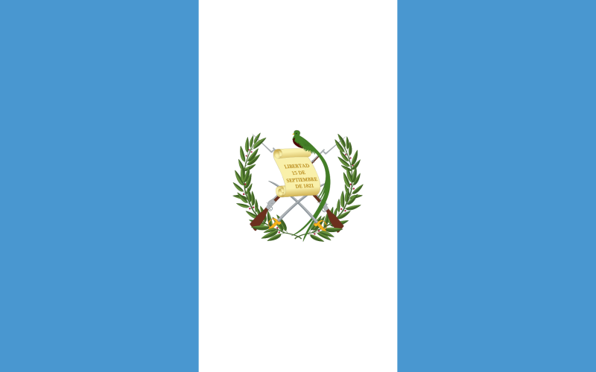
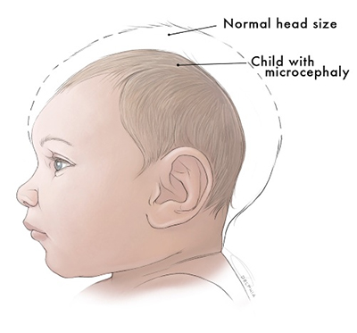
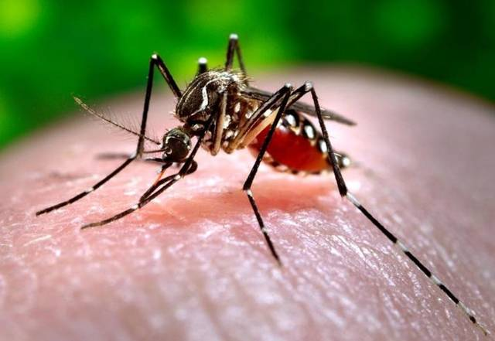
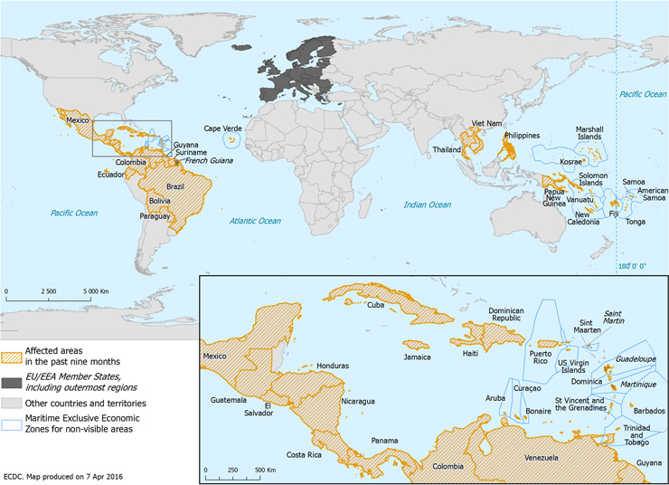
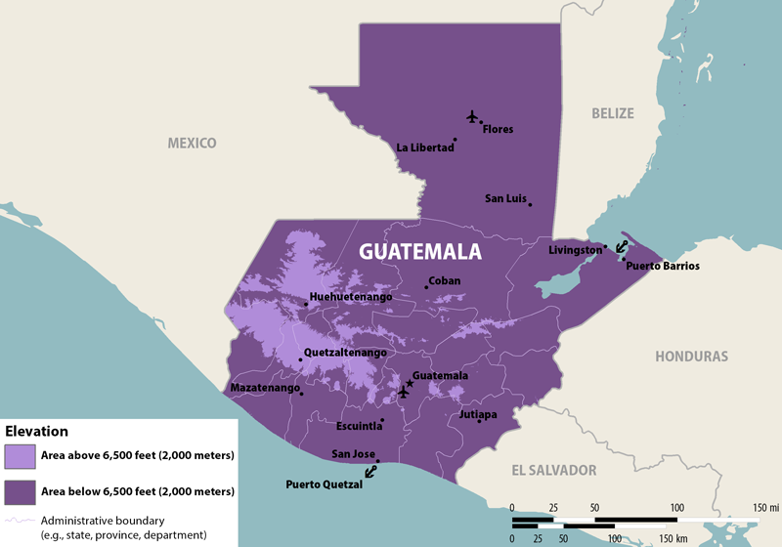
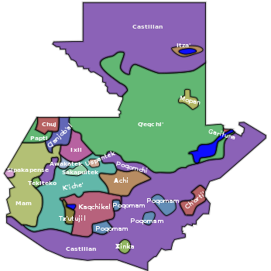
Assessment of a Theoretical Zika Intervention Using SMART Goals
Sarah Olafson
Abstract
As of February 2016, the Zika virus is present in over 20 countries in the Western hemisphere, including many countries housing volunteers from the United States. While initially known to cause physical symptoms similar to those of dengue and chikungunya; Zika has also been associated with a significant rise in the number of babies born with microcephaly, other neurological disorders, and has been declared a global health emergency by the World Health Organization (Peterson et al., 2016). The association and significant increase of microcephaly in areas where Zika is now endemic demands the attention of health authorities (Martinez-Pulgarin et al., 2015 and Rodriguez & Alfonzo, 2016). The virus is known to be transmitted by several Aedes species of mosquitos, although sexual intercourse, perinatal spread and blood transfusions have also been described as additional means of transmission (Martinez-Pulgarin et al., 2015). Health warnings caution pregnant women to avoid travel to countries with Zika due to possible occurrence of infection. In the specific cases of Zika in Brazil, the increase in congenital microcephaly cases observed during the last few months have raised a profound concern for all other countries where this arbovirus has appeared and where conditions for transmission are favorable (Rodrigues-Morales & Alfonzo, 2016). Because of this, the Center for Disease Control (CDC) has developed interim guidelines for health care providers in the United States who care for infants born to mothers who traveled to or resided in an area with Zika virus transmission during pregnancy, (Staples et al., 2016). For volunteers working abroad or individuals in the foreign service, how can the use of SMART Goals (Specific, Measurable, Achievable, Results-focused, and Time- bound) allow these individuals to facilitate Zika crisis interventions? In this poster, the country of Guatemala will be used as a case study. In a 2006 study by Shiftman and Valle, it was found that several factors put pregnant women at risk in Guatemala. A turbulent political history with marginalized indigenous populations in the presence of a conservative Catholic Church milieu, all play a role in marginalizing women's reproductive health. These three factors also account for Guatemala's increased mortality of mothers when compared with neighboring Honduras (Shiftman & Valle,2006). With these risk factors already in place, there seems to be an unmet need for Zika virus screening in the region. Volunteers in the area will need a broad range of culturally sensitive strategies to effectively create an intervention. All of the risk factors described above must be addressed by increasing education and awareness within communities, and the volunteers facilitating this work must avoid infection themselves. This review assesses the use of SMART goals applied within a proposed intervention to theoretically assess the Zika presence and threat within Guatemala.

