Slide 1
Accessibility: Electronic and Information Technologies (EIT)
Wendy Walker (wendy.walker@umontana.edu)
Digital Initiatives Librarian
Mansfield Library, University of Montana
Teressa Keenan (teressa.keenan@umontana.edu)
Head of Bibliographic Management Services and Metadata Librarian
Mansfield Library, University of Montana
Montana Library Association Annual Conference
Significant Tidings
April 7, 2016

Slide 2
EIT Defined
Includes information technology and any equipment or interconnected system or subsystem of equipment that is used in the creation, conversion, or duplication of data or information. The term electronic and information technology includes, but is not limited to, the internet and intranet websites, content delivered in digital form, electronic books and electronic book reading systems, search engines and databases, learning management systems, classroom technology and multimedia, personal response systems (“clickers”), and office equipment such as classroom podiums, copiers and fax machines.
– UM Resolution Agreement, 2014

Slide 3
Accessible EIT: What We Have Learned
Range of disabilities to consider
Redefining library access: availability, not accessibility
Technical accessibility is not always the same as functional accessibility
Some things are hard, some are easy
Some things are beyond our control
Notes:
Physical, cognitive
In libraries, we often talk about access when we really mean available. We’ve found it useful to use the word “available” and to reserve the word “accessible” for accessibility-related issues.
3. When you’re using a tool to check the accessibility of a web page, for example, you might find that something is technically accessible (correct tags, heading structure), but it’s not really functionally accessible. Often, the only way to determine functional accessibility (as well as technical accessibility) is to conduct user testing with patrons who actually use assistive technologies.
4. PDF remediation can be difficult; creating an accessible document is relatively easier (use templates and built-in styles)
5. Vendor decisions, designs, and configurations. Also end user technologies (NVDA, JAWS, etc.), knowledge, skills with those technologies

Slide 4
Accessible EIT: What We Have Learned
Awareness of accessible EIT in libraries and moving forward
“I have to remember that libraries are not just buildings full of books that I can’t read.” – Aaron Page, student
EIT accessibility is iterative
“Accessibility is a design constraint. Treat it like one. I don’t mean that in a negative way, but in the sense that a constraint forces us to push boundaries and think ahead…I need to see accessibility for what it is too. That means, like everything else on the Web, I need to embrace its fluidity. It can’t be perfect, but it can improve incrementally with each release. Better than before is always better than perfect.” http://davidakennedy.com/2014/11/06/accessibility-tunnel-vision/
Notes:
6. We can move forward by promoting what is already accessible, working on what can be made accessible relatively easily, and over time, finding solutions for EIT that is harder to make accessible.

Slide 5
CONTENTdm Assessment: Key Results
The Good
The Bad
Uses some headings for structure
Uses descriptive links in many places
Allows files to be downloaded for viewing/use on user’s machine
Metadata
Navigational issues
Compound objects
Inconsistent use of meaningful alt-text
Conflict between “hyperlink-able” and controlled metadata

Slide 6
CONTENTdm: Key Recommendation
Take the time to create good metadata,
especially for image and text-based items that cannot be OCR’d.
Notes:
Define “good” metadata. Metadata can act like awesome alt-text. Descriptive titles also helpful in the CONTENTdm search-results-list context. (Title: “Abraham Lincoln” versus “Painting of Abraham Lincoln” in search results)

Slide 7
Accessibility and Cataloging
“If it doesn’t say that it’s accessible, I assume that it’s not.” – George Kerscher
Notes:
In case anyone askes who George is: George Kerscher is Senior Officer of Accessible Information at Recording For the Blind & Dyslexic (RFB&D in the USA, Secretary General for the DAISY Consortium, Chairperson of the Board of Directors for the Open eBook Forum (OeBF), and Co-chair of the Steering Council of the Web Accessibility Initiative (WAI).

Slide 8
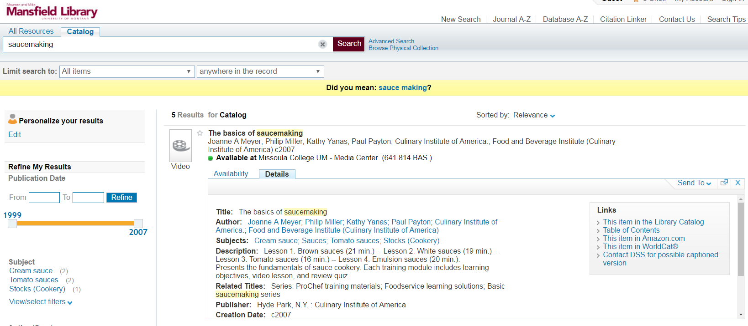
Cataloging and Connecting People with Resources

Slide 9
Resources: Accessible EIT
Accessibility: Electronic and Information Technologies (EIT)
http://scholarworks.umt.edu/ml_pubs/24/
Accessibility: Opening Windows to Digital Collections
http://scholarworks.umt.edu/ml_pubs/16/
Do you hear what I see? Assessing accessibility of Digital Commons and CONTENTdm
http://scholarworks.umt.edu/ml_pubs/20/
Impacts of Metadata on Accessibility of Digital Collections
http://scholarworks.umt.edu/ml_pubs/18/
WebAIM (Web Accessibility in Mind)
http://webaim.org/
World Wide Web Consortium (W3C) Web Accessibility Initiative https://www.w3.org/WAI/

