Slide 1
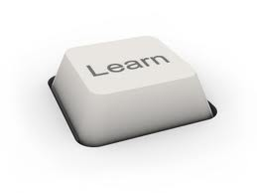
Assessment for Learning: Strategies for Improving Assessments and Curriculum Maps
Nathan Lindsay, UM Associate Provost
OCHE Assessment Workshop
September 22, 2014
Notes:
Image taken from: http://www.everyday-thai.com/learn_thai_online/speak/intermediate_lessons.html

Slide 2
I have a good sense for how my teaching is “making a difference” in my students’ lives and learning.
Strongly agree
Agree
Neither agree nor disagree
Disagree
Strongly disagree
Not applicable

Slide 3
Can dogs talk?

Slide 4
Our Vision for Assessment
To provide sufficient support and guidance to help you achieve the following:
Enhanced learning
Improved programs and degrees
Greater communication about teaching/learning among faculty

Slide 5
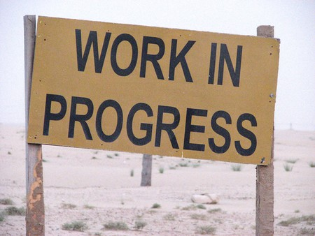
Some Guiding Assumptions…
Teaching and learning can be improved through systematic inquiry
Assessment is always a work in progress, and it’s ok if things don’t go perfectly
Assessment is about lessons learned in the efforts to enhance learning/teaching
Goal of assessment reports=
To demonstrate concerted effort on the part of faculty to examine student outcomes and make appropriate adjustments to improve program

Slide 6
Some Guiding Principles
Assessment Clear and Simple: A Practical Guide for Institutions, Departments, and General Education - by Barbara E. Walvoord
Assessment can be connected to “departmental review, strategic planning, and curriculum revision, or initiatives such as retention, learning communities, distance learning, or enhancing productivity.” (p. 12)
Limit extra work—use embedded assessments!
Notes:
Thomas Angelo (2000) described this as “A vision worth working toward.”

Slide 7
Some Guiding Principles (cont.)
Assessing Student Learning: A Common Sense Guide – by Linda Suskie
“Faculty and staff benefit from constructive feedback on their assessment reports that tells them what they are doing well and how, if at all, they might be even more effective” (p. 311).
“…a culture of assessment is, at its heart, a culture of evidence-based planning and decision making” (p. 312).

Slide 8
I think that the quality of student learning at my institution is excellent.
Strongly agree
Agree
Neither agree nor disagree
Disagree
Strongly disagree
Don’t know/Not applicable

Slide 9
Four “Big Picture” questions to ask about assessment
How do you define a successful student?
What have you learned about your students’ learning?
Are you satisfied with the results?
If not satisfied with the results, what are you going to do about it?
Notes:
Slide taken from Debbie Smith’s 2010 presentation at UMKC, “I Survived Assessment”

Slide 10
Assessing Our University’s (& Your Department’s) Assessment Efforts
Compliance
Commitment
External Questions
Internal Questions
Number & Amount
Quality & Utility
Reporting
Interpreting
Collecting it
Using it
Accreditation
Learning
Notes:
Slide taken from Susan Hatfield’s Presentation on “Coaching Assessment: Student Learning Outcomes”

Slide 11
SWOT Analysis of Student Learning
 | SWOT Analysis Chart
 | Helpful to achieving the objective | Harmful to achieving the objective
Internal origin (attributes of the organization) | Strengths | Weaknesses
External origin (attributes of the environment) | Opportunities | Threats
Provides a forum for faculty to voice their concerns.
Provides potential solutions for challenges and a roadmap for future assessment initiatives.

Slide 12
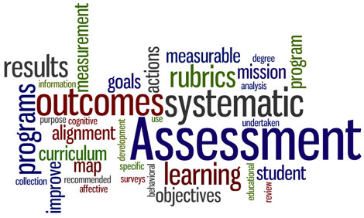
Notes:
Word Cloud image take from http://www.assessment.uconn.edu/

Slide 13
Readings
“What New Faculty Need to Know about Assessment” (http://www.learningoutcomeassessment.org/documents/ABfaculty.pdf )
“Creating a Faculty Culture of Student Success” (http://www.aspeninstitute.org/sites/default/files/content/docs/pubs/Creating%20A%20Faculty%20Culture%20of%20Student%20Success.pdf)

Slide 14
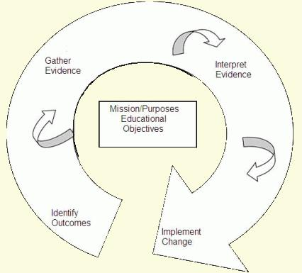
“Closing the Loop” in Assessment
Identify outcomes
Gather evidence
Interpret evidence
Implement change
Gather evidence again
The Assessment Cycle
From Maki, P. L. (2002). Developing an assessment plan to learn about learning. The Journal of Academic Librarianship.

Slide 15
Initial Assessment Components for Each Academic Degree
Mission statement
Department Objectives (usually 2-3)
Student Learning Goals (usually 3-7)
Remember: SMART
Specific
Measurable
Attainable
Relevant/Results-Oriented
Time-bound
Notes:
Specific
-Clear and definite terms describing the abilities, knowledge, values, attitudes, and performance
Measurable
-It is feasible to get data: data are accurate and reliable; it can be assessed in more than one way
Aggressive and Attainable
-The outcome has the potential to move the program or unit forward
Results – oriented
-Describe what standards are expected from students or the functional area being assessed
Time-bound
-Describe a specified time period for accomplishing the outcome

Slide 16
COMPREHENSION
ANALYSIS
EVALUATION
KNOWLEDGE
APPLICATION
SYNTHESIS
Associate
Classify
Compare
Compute
Contrast
Differentiate
Discuss
Distinguish
Estimate
Explain
Express
Extrapolate
Interpolate
Locate
Predict
Report
Restate
Review
Tell
Translate
Analyze
Appraise
Calculate
Categorize
Classify
Compare
Debate
Diagram
Differentiate
Distinguish
Examine
Experiment
Inspect
Inventory
Question
Separate
Su rize
Test
Arrange
Assemble
Collect
Compose
Construct
Create
Design
Formulate
Integrate
Manage
Organize
Plan
Prepare
Prescribe
Produce Propose
Specify
Synthesize
Write
Appraise
Assess
Choose
Compare
Criticize
Determine
Estimate
Evaluate
Grade
Judge
Measure
Rank
Rate
Recommend
Revise
Score
Select
Standardize
Test
Validate
Cite
Count
Define
Draw
Identify
List
Name
Point
Quote
Read
Recite
Record
Repeat
Select
State
Tabulate
Tell
Trace
Underline
Apply
Calculate
Classify
Demonstrate
Determine
Dramatize
Employ
Examine
Illustrate
Interpret
Locate
Operate
Order
Practice
Report
Restructure
Schedule
Sketch
Solve
Translate
Use
Write
Lower level course
outcomes
Notes:
Slide taken from Susan Hatfield’s Presentation on “Coaching Assessment: Student Learning Outcomes”

Slide 17
COMPREHENSION
ANALYSIS
EVALUATION
KNOWLEDGE
APPLICATION
SYNTHESIS
Associate
Classify
Compare
Compute
Contrast
Differentiate
Discuss
Distinguish
Estimate
Explain
Express
Extrapolate
Interpolate
Locate
Predict
Report
Restate
Review
Tell
Translate
Analyze
Appraise
Calculate
Categorize
Classify
Compare
Debate
Diagram
Differentiate
Distinguish
Examine
Experiment
Inspect
Inventory
Question
Separate
Summarize
Test
Arrange
Assemble
Collect
Compose
Construct
Create
Design
Formulate
Integrate
Manage
Organize
Plan
Prepare
Prescribe
Produce Propose
Specify
Synthesize
Write
Appraise
Assess
Choose
Compare
Criticize
Determine
Estimate
Evaluate
Grade
Judge
Measure
Rank
Rate
Recommend
Revise
Score
Select
Standardize
Test
Validate
Cite
Count
Define
Draw
Identify
List
Name
Point
Quote
Read
Recite
Record
Repeat
Select
State
Tabulate
Tell
Trace
Underline
Apply
Calculate
Classify
Demonstrate
Determine
Dramatize
Employ
Examine
Illustrate
Interpret
Locate
Operate
Order
Practice
Report
Restructure
Schedule
Sketch
Solve
Translate
Use
Write
Advanced
Course / Program
outcomes
Notes:
Slide taken from Susan Hatfield’s Presentation on “Coaching Assessment: Student Learning Outcomes”

Slide 18
Measurements
Complete Measurements Process
What instrument? why?
formative or summative assessment?
direct or indirect measure?
if possible, it’s best to use multiple measures
How conduct measurement?
which students? when measured? where?
how administered? by whom?
often good to use smaller samples of students; capstone courses
How collect and store data?
Who analyzes data? how? when?
Who reports?
to faculty: how? when? where?
to administrators?

Slide 19
Achievement Targets
What kind of performance do you expect from your students on your learning outcomes?
What is the desirable level of performance for your students
Rubrics can clarify this (see the next slides)
What percentage of students do you expect to achieve this?

Slide 20
Using Rubrics
A rubric is: “a set of criteria and a scoring scale that is used to assess and evaluate students’ work” (Cambell, Melenyzer, Nettles, & Wyman, 2000).
Addresses performance standards in a clear and concise manner (which students appreciate!)
Clearly articulates to students the areas of improvement needed to meet these standards
To find examples, Google rubrics for your discipline, or see the Rubistar website http://rubistar.4teachers.org/
Notes:
Cambell, D. M., Melenyzer, B. J., Nettles, D. H., & Wyman, R. M. (2000). Portfolio and performance assessment in teacher educations. Boston: Allyn and Bacon.

Slide 21
Example of a Rubric
UMKC Foreign Languages and Literatures
Assessment Tool for Oral Proficiency Interview adapted from “Interpersonal Mode Rubric Pre-Advanced Learner” 2003 ACTFL
Category | Exceeds Expectations | Meets Expectations | Does Not Meet Expectations
Comprehensibility Who can understand this person’s meaning? How sympathetic must the listener be? Does it need to be the teacher or could a native speaker understand the speaker? How independent of teaching situation is the conversation? | Easily understood by native speakers, even those unaccustomed to interacting with language learners. Clear evidence of culturally appropriate language, | Although there may be some confusion about the message, generally understood by those unaccustomed to interacting with language learners. | Generally understood by those accustomed to interacting with language learners.
Language Control Accuracy, form, appropriate vocabulary, degree of fluency | High degree of accuracy in present, past and future time. Accuracy may decrease when attempting to handle abstract topics | Most accurate with connected discourse in present time. Accuracy decreases when narrating and describing in time frames other than present. | Most accurate with connected sentence-level discourse in present time. Accuracy decreases as language becomes complex.

Slide 22
Findings
What do the data tell you?
Part I: specific findings
Compare new data to achievement targets
Did students meet or deviate from expectations?
Important: Include specific numbers/percentages when possible
Do not use course grades or pass rates
Optional: Post anonymous data or files as attachments

Slide 23
Findings (cont.)
Part II: general findings
What lessons did your faculty learn from this evidence about your students?
What broader implications do you draw about your program?
Ex: curriculum, admissions, administration, policies, requirement, pedagogy, assessment procedures, and so on
Conversations
The more people involved, the better!

Slide 24
Action Plans
Concrete Steps for Change
List of specific innovations that you would like to introduce in AY 2014-15 to address lessons learned in AY 2013-14.
Again, in curriculum, admissions, administration, policies, requirement, pedagogy, assessment procedures, and so on
Resources? Time Period? Point Person?

Slide 25
Improving Quality as an Institution
Enhancing the quality of assessment plans, tracking those that need the most work
Developing and refining rubrics
Ensuring that all academic degrees have assessment findings for each reporting cycle
Helping units develop action plans based on their findings
The Assessment Cycle
From Maki, P. L. (2002). Developing an assessment plan to learn about learning. The Journal of Academic Librarianship.

Slide 26
Gauging Effectiveness
When possible, demonstrating how assessment findings have led to higher learning scores.
Working to increase % of faculty who are involved in assessment.
Many departments can depend too much on the assessment coordinator alone.
Assessment reports will continue to help track changes in the “culture of learning.”

Slide 27
Ensuring Sustainability in Assessments
Building upon intact structures
Keeping the reporting format as consistent as possible
Program review
Other opportunities
Some units have developed their own assessment committees
Student representation on assessment committees

Slide 28
Assessing High Impact Practices
Service Learning
Undergraduate Research
Internships
Learning Communities
Study Abroad
Other?

Slide 29
Best Practices from Other Institutions
Salt Lake Community College has online videos highlighting faculty who have used assessment effectively: http://www.slcc.edu/assessment/examples-of-excellence.aspx
University of Kansas has an online teaching portfolio that provides examples of faculty assessment projects: http://www.cte.ku.edu/gallery/index.shtml (see “Evaluating student learning” and “Department analysis of learning”)

Slide 30
Enhancing Curriculum Mapping
Definition
A method for aligning a program’s learning outcomes and courses
A Curriculum Map answers the question:
Where are what learning outcomes taught in your curriculum?
Benefits
Proactive approach to improving learning outcomes
Encourages reflective practice as instructors
Clarifies priorities when there are limited resources
Enhances coherence by revealing gaps in the curriculum
Improves communication among faculty
Supports “major maps” for students
Refines the assessment plan

Slide 31
Program Level
Student Learning
Outcomes
1xx
1xx
2xx
2xx
2xx
3xx
3xx
3xx
4xx
Capstone
1
K
A
A
A
A
S
2
K
A
S
3
K
K
K
K
4
5
K
S
6
K
K
A
A
S
7
S
A
A
S
K= Knowledge/Comprehension; A= Application / Analysis; S= Synthesis /Evaluation
Notes:
Slide taken from Susan Hatfield’s Presentation on “Coaching Assessment: Student Learning Outcomes”

Slide 32
Curriculum Mapping Best Practices
Involve as many faculty as possible in the development and analysis of the curriculum map
Identify learning opportunities within courses that will produce your program’s outcomes
Connect the dots: communicate expectations from course to course
Allow each member of your faculty to teach
to their strengths
Notes:
Everyone in each department should not be required to cover everything

Slide 33
Curriculum Mapping Best Practices (Cont.)
Eliminate outcomes that are not highly
valued, or add those that are missing
Focus on highly valued outcomes by including them in multiple courses – for some there will be room for overlap
Set priorities as a department/program
Communicate: Publish the curriculum map online and distribute to students and faculty (in conjunction with major maps and student learning outcomes)
Notes:
*Important Note: The eliminated outcomes can still be course-level outcomes. They need not disappear completely from the curriculum.
**Working together toward common outcomes can increase the likelihood that students will meet or exceed expectations.
*** For example, at the beginning of the course or unit, a faculty member can remind students what they were introduced to in another course and explain how the current course will have them practice or expand their knowledge. Don’t expect students to be able to make those connections by themselves.

Slide 34
References
Suskie, L. (2009). Assessing student learning: A common sense guide, 2nd Edition. San Francisco: Jossey-Bass.
Walvoord, B. (2004). Assessment clear and simple: A practical guide for institutions, departments, and general education. San Francisco: Jossey-Bass.

Slide 35
Contact Information
For assistance with assessment, please contact
Nathan Lindsay
Associate Provost
University of Montana (406) 243-4689 nathan.lindsay@umontana.edu

