Slide 1
Understanding General Education Learning
Dr. Dave Veazey Sept. 22, 2014
Pacific Lutheran University Missoula, MT
Director: Pacific Northwest Learning Consortium

Slide 2
Outcomes
Comprehend the historical trends in public policy and perceptions around general education student learning over time.
Understand and articulate research of student learning in general education that underpins strategies being utilized by institutions.
Describe key elements to successfully implement initiatives to understand student learning in general education.
Analyze conditions in a higher education environment and develop ideas to improve student learning in general education.

Slide 3
Radical Change
historical
“…although there is considerable number of virtuous and studious youth in the College, yet there has been a practice of several immoralities; particularly stealing, lying, swearing, idleness, picking of locks, and too frequent use of strong drink….”
Report by the Visitation Committee of Harvard College. October 9, 1723

Slide 4
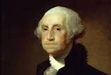
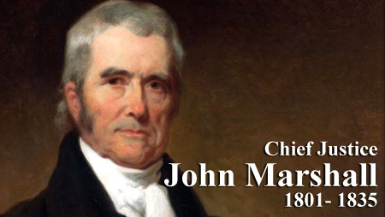
Higher Education & Change
historical
United States Higher Education has always been “Market Driven”
Failed effort to found the
University of the United States
Ruled in favor of Dartmouth (1819) to prevent state interference in operations of the college

Slide 5
Change
historical
Religious doctrine
Moral character
Education for white male elite only
Practical disciplines – Agriculture and the Mechanic Arts
Modern disciplines – Social and Natural Sciences
Racial and gender equality
Research
Mass education since WWII
Convenient education

Slide 6
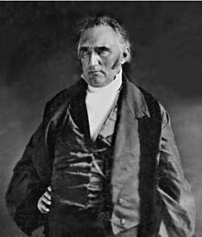
Many new subjects have been added but the length of college remains the same. Colleges must choose contraction in the number of subjects or, extend college education over a longer period of time – which the American public is unwilling to accept.
Francis Wayland – President Brown University 1827 - 1856

Slide 7
General Education
historical
“Present college programs are not contributing adequately to the quality of students’ adult lives either as workers or as citizens. This is true in large part because the unity of liberal education has been splintered by overspecialization.”
Report of the President’s Commission on Higher Education, 1947

Slide 8
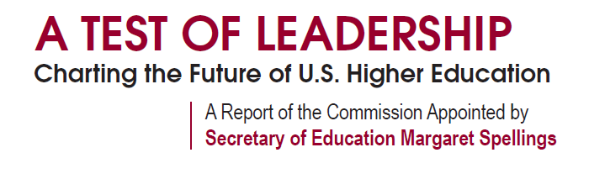
historical
“At a time when we need to be increasing the quality of learning outcomes and the economic value of a college education, there are disturbing signs that suggest we are moving in the opposite direction.”
A Test of Leadership – Charting the Future of Higher Education Sept. 2006

Slide 9
Educational Goals
historical
Survive
Prosper
Find a Life Worth Living
Find a Life Worth Living
Survive
Prosper
“Fit between character of student and institution”
Can we put authentic objective outcome criteria on such subjective outcomes with vastly unique institutions AND variables well out of our control?
Christopher Nelson President, St. John’s College in Annapolis

Slide 10
Iterative & Variable
historical
College Control of Student Experience
Before College
College
After College
Classes
Co-Curricular
?
Studying
?
?

Slide 11

NSPE
National Standardized Parent Exam
historical

Slide 12
Rankings
historical
Peer Reputation
Graduation Rate
Retention of Cohorts
Admit %
Yield %
Pell %
Endowment Size
Student Load Default
Tuition & Fees
Alumni Giving
Research Grants
Faculty Publications
Industry Income
Jobs & Income of Graduates
LEARNING?

Slide 13

research
Longitudinal Study of 49 institutions & 17,000 students
Evaluating Liberal Arts Outcomes

Slide 14
research
Outcome Measures
CAAP Critical Thinking Test | Professional Success
Need for Cognition Scale | Openness to Diversity and Challenge
Mayville-Guzman Universality-Diversity Scale (M-GUDS) | Academic Motivation
Socially Responsible Leadership Scale (SRLS-R2) | Positive Attitude toward Literacy
Defining Issues Test (DIT-2)
Ryff Scales of Psychological Well-Being | Experience Surveys
Contribution to the Arts | NSSE
Contribution to the Sciences | Student Experiences Survey
Political and Social Involvement

Slide 15
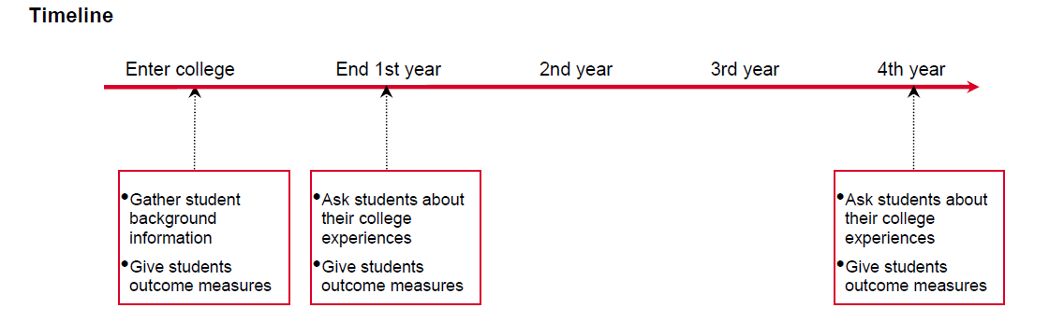
research

Slide 16

Are Student Self Report Data Valid?
research
Pedagogies
Supportive Practices
Assignments

Slide 17

Student Self Report?
research
Longitudinal sample of over 3,000 first-year college students:
“Across several cognitive and non-cognitive outcomes, the correlations between self-reported and longitudinal gains are small or virtually zero”

Slide 18
Liberal Arts Outcomes?
research

Slide 19
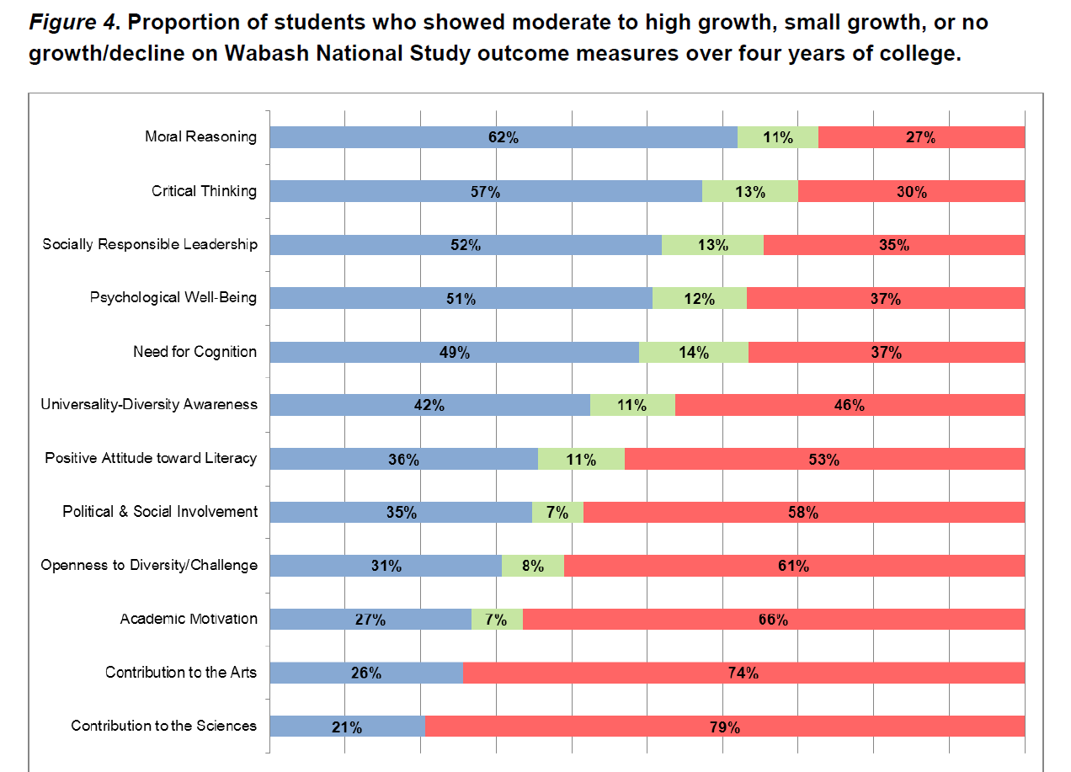
research
Students did not learn in many areas
2. Variability within institutions is greater than between institutions

Slide 20
Use of Data?
research

Slide 21
research
Institutions Often Do Not Use the Data They Have
Very few institutions even utilized actionable data
Even information we already know – anecdotes confirmed by data – frequently do not change practice
MORE data is not always helpful

Slide 22

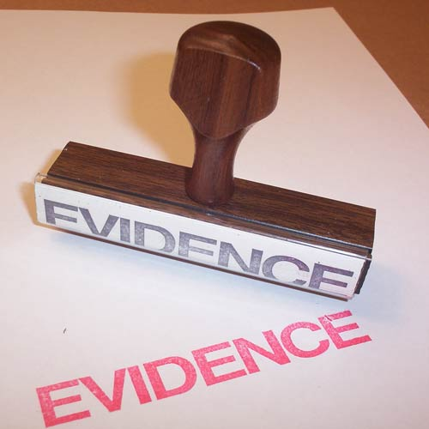
Lessons?
research
Student Self Report Data
Teaching environment and pedagogy
Authentic Student Evidence
Learning
Create Actionable Process
1. Teaching and learning data faculty hunger to know
2. How student learning data speaks to these questions

Slide 23
What Works?
implement

Slide 24
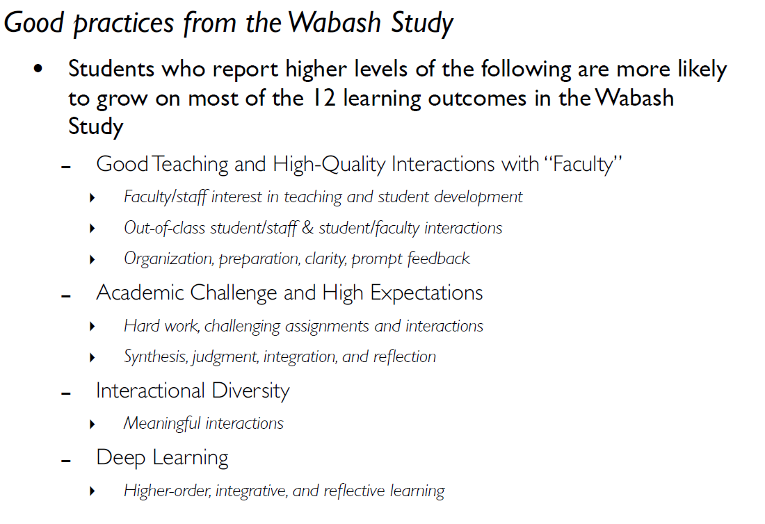
implement

Slide 25
Chickering & Gamson (1987)
Good Teaching Practice
1. Interaction between students and faculty.
2. Interaction and collaboration between students.
3. Active learning techniques.
4. Prompt feedback.
5. Emphasizes time on task.
6. Communicates high expectations.
7. Respects diversity --- talents, experience, and ways of learning.

Slide 26

implement

Slide 27

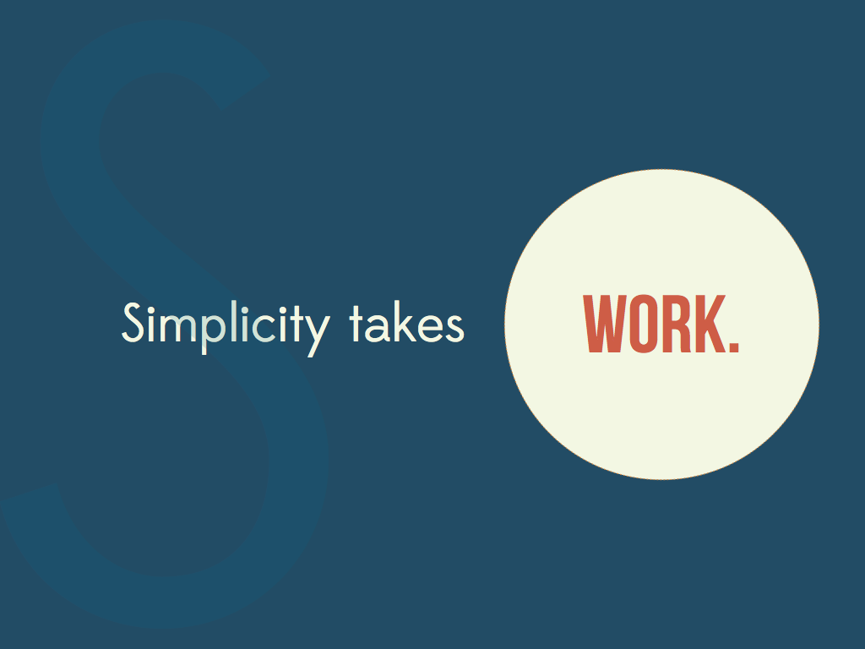
implement

Slide 28

Unique Approach is the
Right Approach
implement

Slide 29
Tips
implement
Be COMMITTED to improvement – Incremental, Long-Term, Sustainable
General Education goals & process MUST stem from mission & culture
Value the notion of openly QUESTIONING long standing institutional practices
EMBRACE the fuzzy world of program level learning – it is not research !
The first “understanding student learning experience” NEEDS to be a good one
Pilot, pilot again, AND again
Be willing to EXPERIMENT before data is “conclusive”
Develop INSTITUTION WIDE rubrics/methods of evaluation – get close enough
Create 4 levels ONLY in the rubric (2 above, 2 below)
Develop the rubric and analyze student evidence TOGETHER with those that teach the courses
Use student evidence to support and drive faculty development, curricular/pedagogical change
Return to a.
QUALITY TEACHING IS WHAT MATTERS !

Slide 30
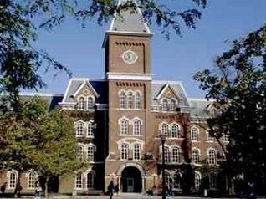
Pacific Northwest University
Private liberal arts institution founded in 1878

Slide 31
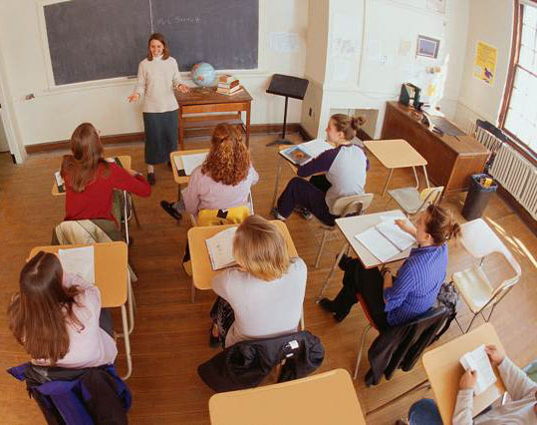

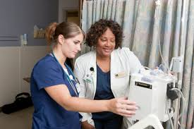
Pacific Northwest University
Professional programs – Business, Health, Education

Slide 32
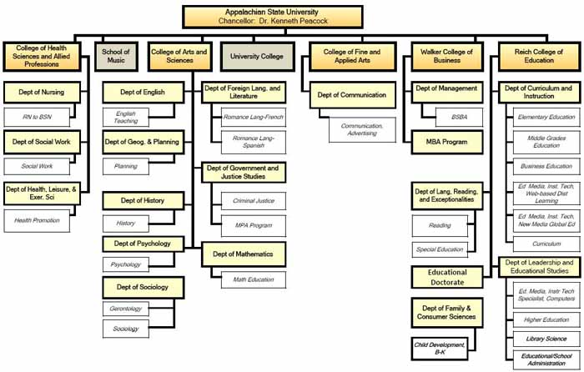
Pacific Northwest University
Assessment is de-centralized and lacks institutional support for faculty
President

Slide 33
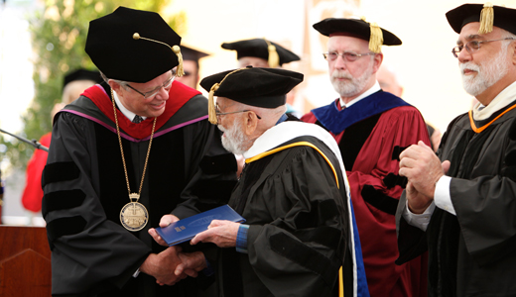
Pacific Northwest University
Provost retired in 2013 – was a faculty member for 15 years before serving as provost for another 15 years

Slide 34
2014 Accreditation Recommendation:
The Evaluation Committee did not find evidence of systematic assessment of student learning outcomes in the general education program that leads to improvements in teaching and learning.
The Evaluation Committee recommends Pacific Northwest University take immediate steps to institute a system of assessment of the general education that utilizes student evidence, demonstrates achievement of learning outcomes and documents curricular and pedagogical changes based on this evidence that is linked to mission fulfillment.
An interim visit in one year is recommended to determine progress.

Slide 35


Case Study
Assessing General Education
At Your Tables
Read “The Gen Ed Curriculum at Pacific Northwest University”

Slide 36
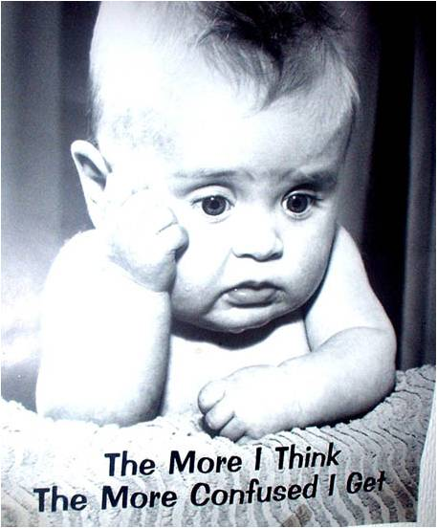


What are the first steps you recommend for Pacific Northwest to develop assessment of the general education program?

Slide 37
“Assessment practices, and data-gathering, vary widely across different disciplines. How can administrators aggregate data from different departments and programs to arrive at meaningful comparisons with regard to student learning outcomes?”
Understanding student learning is engaged community action, not research. Enforcing standardized reporting methods may or may not be the most helpful course of action.
Don’t let methodological imperfection deter incremental improvement.
Think about these questions:
What is most useful ?
What is politically viable ?
What “comparisons” would aid our understanding of student learning ?

Slide 38
“What are the best practices for integrating assessment without it becoming burdensome for faculty?”
Most faculty are already make efforts to understand student learning – however, changes based on what faculty already know are sometimes supported by anecdote and made in an ad-hoc manner…if changes are made at all.
Find out what area of learning people are interested in
If you have a senior experience/capstone, often faculty will describe the deficiencies students bring to this culminating experience – START THERE.
Keep it simple and focused:
Pick one outcome, and one only as a start – let people’s interests guide the focus
Pick one assignment/project in a course to use as evidence as a start
Spend one day agreeing upon a rubric and evaluating student work
Write a few paragraphs about what you learned and what you will do next
You are done until next time !

Slide 39
“Generally, seeing it {general education} as more than just hoops to jump through (both the student and faculty perspective). Why exactly are students required to take these classes? It would be good to better explicate that.”
Be authentic and transparent about reality:
“The current state of affairs in our departments, curricular structures, and programs is usually a compromise carefully negotiated among numerous parties over the course of years. Unless the findings are truly devastating, assessment data has little impact on this tightly constrained arrangement.”
Blaich & Wise, NILOA 2011
Politically – What is the motivation for change?

Slide 40
“Does our current structure of General Education requirements lend itself to assessment, or do we need to better articulate our learning objectives? How can learning objectives be more consistent without imposing undue restraints on faculty regarding course content?”
Start with mission & core educational values where faculty share a passion:
Consider these questions:
Is our current general education system serving students optimally?
How would we know or find out?
What would student behavior/performance look like if the goal is met?
Are we being realistic about what our students learn?

Slide 41
“We don’t have a good way of assessing learning outcomes except in a VERY general way through the CLA. What is the solution to these curricular and assessment issues?”
Realize CLA is for accountability – not understanding student learning
CLA: Critical Thinking, Analytic Reasoning, Problem Solving
Problems:
81% of the variance in institution scores is due to students’ prior learning
“Value Added”, while appealing, is not a valid means to measure changes in student learning (it can work in a laboratory with random sampling and controlling of variables). Reliability score is 0.1 for student learning.
Not tied to what faculty do in the classroom and curriculum

Slide 42
“The challenge in many Gen Ed classes that have mixed populations of students is to teach the non-majors something without boring the majors. In some cases the majors don’t even bother to buy the book since they have already covered much of the material in HS. Kind of sad, in my opinion.”
Down the road – as faculty embrace the idea of change….
Leave Fiefdom Gen Ed and embrace Core Learning tied to mission:
Requires collaborative discussions across departments/units in which faculty wrestle with what general education means at the institution.
Communication Information Literacy Critical Thinking
Global and Civic Leadership Ethical Reasoning
Quantitative and Scientific Reasoning Creative Expression

Slide 43
Thank You !
One Day Student Learning Workshops in October:
October 22 – Spokane, WA Developing and Implementing A-Plans
October 24 – Portland, OR Understanding Student Learning in General Education
www.plu.edu/pnlc

