Slide 1
A Toolkit of Assessment Methods: Multiple Approaches for Collecting Meaningful Data
Nathan Lindsay, Ph.D.
University of Montana September 22, 2014

Slide 2
Our department consistently has the data it needs to “tell a compelling story” of how we are contributing to student success.
Strongly agree
Agree
Neither agree nor disagree
Disagree
Strongly disagree
Not applicable

Slide 3
What are the benefits of assessment?
Making a difference, and measuring that difference
Improvement of services and programs
Documentation of student learning
Demonstration of the value/outcomes of certain offerings
Support for more funding
Preparation for accreditation

Slide 4
Assessment Competencies
ACPA/NASPA Professional Competency Areas for Student Affairs Practitioners: Assessment, Evaluation, and Research (AER)
The AER area “focuses on the ability to use, design, conduct, and critique qualitative and quantitative AER analyses; to manage organizations using AER processes and the results obtained from them; and to shape the political and ethical climate surrounding AER processes and uses on campus.” (p. 8)
See: http://www.naspa.org/regions/regioniii/Professional%20Competency.pdf

Slide 5
Assessment Competencies (cont.)
One should be able to:
Basic: differentiate among assessment, program review, evaluation, planning, and research and the methodologies appropriate to each.
Intermediate: design ongoing and periodic data collection efforts such that they are sustainable, rigorous, as unobtrusive as possible, and technologically current.
Advanced: effectively lead the conceptualization and design of ongoing, systematic, high quality, data-based strategies at the institutional, divisional, and/or unit-wide level to evaluate and assess learning, programs, services, and personnel. (pp. 8-9)
Notes:
See http://www.naspa.org/regions/regioniii/Professional%20Competency.pdf

Slide 6
Competencies (cont.)
ACPA’s Assessment Skills & Knowledge (ASK) Standards:
Assessment Design
Articulating Learning & Development Outcomes
Selection of Data Collection & Management Methods
Assessment Instruments
Surveys Used for Assessment Purposes
Interviews & Focus Groups
Assessment Methods: Analysis
Benchmarking
Program Review & Evaluation
Assessment Ethics
Effective Reporting & Use of Results
Politics of Assessment
Assessment Education
http://www.acpa.nche.edu/ask-standards-booklet

Slide 7
Levels of Student Affairs Assessment
Tracking participation/usage
Satisfaction
Needs Assessment
Benchmarking
Learning Outcomes

Slide 8
Assessment Methods (Schuh, 2009)
Survey
Focus Group/ Interview
Observation
Pre-/Post Tests
Rubrics
Portfolios
Case Studies
Reflective Journals
One-Minute Paper
Tracking Services
Trends
Cost/Benefit Analysis
Document Review
"Not everything that counts can be counted, and not everything that can be counted counts."
Notes:
BUILDING CAPACITY
There are numerous methods to assess a project, program, learning, etc. Use a variety!
Direct vs. Indirect
Direct—People display their knowledge, behavior, or thought processes
Indirect—People reflect on their knowledge, behavior, or thought processes
Varying levels of complexity

Slide 9
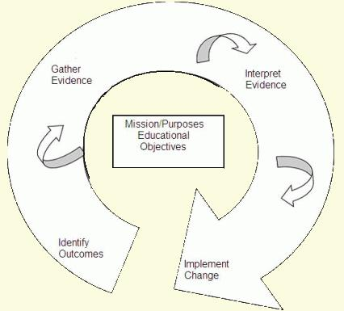
“Closing the Loop” in Assessment
Identify outcomes
Gather evidence
Interpret evidence
Implement change
Gather evidence again
The Assessment Cycle
(Adapted from Bresicani, Zelna, & Anderson, 2004)
Notes:
COMPETING PRIORITIES
Part of improving quality
Program or learning outcomes
Developing a cohesive process, not too complicated or cumbersome

Slide 10
SWOT Analysis of Assessment
 | SWOT Analysis Chart
 | Helpful to achieving the objective | Harmful to achieving the objective
Internal origin (attributes of the organization) | Strengths | Weaknesses
External origin (attributes of the environment) | Opportunities | Threats
Provides a forum for staff to voice their concerns.
Provides potential solutions for challenges and a roadmap for future assessment initiatives.
Notes:
DEALING WITH FEAR
Nathan

Slide 11
Tracking Numbers: Data on Students’ Use of Service Areas (UNCW)
Notes:
Housing is the Fall Occupancy of each year
Career Center is the number of students and other individuals (i.e., alumni) served through individual visits
Counseling Center is the number of clients
Disability Services is the number of students who have registered with Disability Services
Dean of Students is the number of referrals received/adjudicated
University Learning Center is the number of students who used ULC services
Overall Enrollment Housing Disability Services Learning Center Counseling Center Dean of Students Career Center 05 - 06 0.0% 0.0% 0.0% 0.0% 0.0% 0.0% 0.0% 06 - 07 1.1% 26.9% 18.2% 18.1% 12.3% 0.0% 63.1% 07 - 08 1.5% 50.2% 18.2% 37.5% 48.5% 20.3% 105.6% 08 - 09 4.5% 56.2% 9.1% 61.2% 53.7% 28.9% 96.3% 09 - 10 6.4% 72.9% 27.6% 53.7% 63.8% 65.6% 102.4%

Slide 12
Can dogs talk?

Slide 13
What are Learning Outcomes?
Learning outcomes are what students are expected to demonstrate in terms of knowledge, skills, and attitudes upon completion of a program, course, or activity.
** To change the culture, focus on learning!!**
1. How can we help our students learn? 2. What is best for our students?
Notes:
COMPETING PRIORITIES, SUPPORTING INSTITUTION
Even if can’t start with learning, you need to get there fairly quickly in your assessment to demonstrate how you support the learning mission of the institution.
Students is described in a broad sense…it is any participant or learner
Should be meaningful, manageable, and measureable
Example: Texas A&M has learning outcomes for bachelor, master, and doctoral levels, but also have System and State of Texas Outcomes. SA expected to contribute, document, and assess

Slide 14
Learning Outcomes in Student Affairs
Learning outcomes are the knowledge, skills, and values we want our students to have:
Personal Responsibility
Communication Skills
Technology and Information Literacy
Culture and Diversity
Civic and Community Engagement

Slide 15
Personal Responsibility
Students will be able to identify a challenge, formulate solutions, and select an appropriate outcome that meets their needs or resolves a conflict
Students will demonstrate knowledge of the code of conduct
Students will be able to recognize the effects of their behavior on oneself, on others, and on the community
Students will be able to set life goals and identify and use specific campus and community resources to articulate the steps needed to reach these goals
Students can identify methods and resources to maintain their fiscal wellness

Slide 16
Personal Responsibility (cont.)
Students can use their core values to guide decision making when faced with moral, ethical, or other dilemmas
Students demonstrate leadership knowledge, skills, and abilities
Students demonstrate their ability to integrate concepts of honesty and integrity into self-understanding and interactions with others
Students will be able to set life goals and identify and use specific campus and community resources to articulate the steps needed to reach these goals
Students can identify and use appropriate resources for self-advocacy and problem solving

Slide 17
Ways to Measure Personal Responsibility
Report out of data from case management
For students in violation of the code of conduct:
Assess their ability to recognize significant standards or principles
Assess participation and impact
Evaluate data from exit interviews and offices that provide professional development services
Assess student organizations that are founded upon core values

Slide 18
UNCW Learning Outcomes Survey: Personal Responsibility
1,122 UNCW students participated
Random sample stratified by class year, gender, and race/ethnicity
Administered online by Campus Labs
Purpose of the survey:
To assess how participation in student affairs programs and events was related to students’ development of personal responsibility.

Slide 19
Study Research Questions
1) How did the overall sample of UNCW students score on the items measuring personal responsibility?
2) How did participation in student affairs activities predict students’ responses on these items?
The survey had many Likert scale agreement questions, along with a few open-ended questions
Notes:
The analysis of students’ responses was divided into two parts:

Slide 20
Learning Outcomes Results
As a result of their experiences at UNCW,
86.8% of students agreed that they have a better understanding of their personal strengths and weaknesses.
83.5% of students agreed that they are better aware of how their current actions and behaviors impact their future career opportunities.
Notes:
86.75% of students agreed that when compared to when they first started college, their experiences at UNCW helped them better understand their personal strengths and weaknesses.

Slide 21
The Benefits of Involvement Example #1: Housing & Residence Life
“As a result of my experiences at UNCW, I better understand the impact of my behavior on others.”
In response to the above question, the percentages of students who agreed were as follows:
Notes:
Counts:
RA: 31 respondents SA and A
RHA Board: 12 respondents SA and A
RHA Member: 47 respondents SA and A
Area Chapter Board Member: 25 respondents SA and A
Area Chapter Member: 55 respondents SA and A

Slide 22
Questions:
What are a few of the skills, knowledge, and values you want your students to acquire?
What are a few ways in which these “learning outcomes” could be assessed in your department?
What a few ways that “student success” could be assessed in your department?

Slide 23
Needs Assessments and Direct Assessments

Slide 24
What is Needs Assessment?
“Assessing student needs is the process of determining the presence or absence of the factors and conditions, resources, services, and learning opportunities that students need in order to meet their educational goals and objectives within the context of an institution’s mission” (Upcraft & Schuh, 2001, p. 131)
It is important to delineate needs from wants, and to distinguish between national trends and local needs

Slide 25
Common Mistakes in Needs Assessments
Only using one method
Only listening to the majority population
Only studying the users of a service/program
Using needs assessment for a decision that was already made
Lack of coordination
(Upcraft & Schuh, 1996)

Slide 26
Commuter/Non Traditional Student Survey Overview
Purpose: To assess the needs and satisfaction levels of UNCW students related to a wide variety of commuter services.
Collaboratively designed between Office of the Dean of Students and the Office of Student Life Assessment
232 randomly sampled UNCW students completed online survey administered by Student Voice in Spring 2008

Slide 27
Commuter Recommendations
1. Provide more information about commuter services (i.e., by using email announcements, flyers, and Facebook more effectively).
2. Provide opportunities that will allow non-traditional students, student veterans, and graduate students to connect with others from the campus community (e.g., through a lounge space).
3. Allow for online email and workspace access.
4. Community Development Assistants should work harder to make themselves known to the residents in the community, and also to make certain the events they have coordinated are well-publicized.
Notes:
Challenge is to delineate what can be changed and what cannot

Slide 28
Direct Assessments
Indirect assessments often provide a snapshot of students’ perspectives on various programs (e.g., through a survey)
Direct assessments, however, are a means by which students can demonstrate the knowledge they have obtained (e.g., through a quiz)
For example, indirect assessments might ask students whether they think they learned certain principles at a workshop, whereas a direct assessment would test them on these principles.

Slide 29
Direct Assessment: Housing and Residence Life
The Residence Life staff used a series of direct learning outcome assessments (i.e., quizzes) to gauge learning on a variety of training topics including:
Crisis response, programming knowledge, diversity education, and student conduct procedures.
RAs were given a 20 question test—four separate times—before, during, and after their training.
The object of providing multiple post-tests was to gauge the RA’s retention of vital knowledge surrounding the training topics throughout the year.
Notes:
pre-test before training started, a post-test at the end of the one and half week training week, a post-test at mid-year, winter training, and a final post-test at the end of the academic year in May.

Slide 30
Direct Assessment: Housing and Residence Life Results
The following results were observed
RA’s scored an average of 9.8 points higher from pre-test to the initial post test
The second and third post-test results were slightly lower but consistent
Indicating a relatively strong retention of information

Slide 31
Direct Assessment: Housing and Residence Life Results
Results (cont.):
RA’s from various staffs were scoring low from the beginning of the year to end of the year on a consistent group of questions
Returning staff members scored significantly higher on the pre-test (+12.6 on average), but the average difference on all post-tests was very similar between the two groups.

Slide 32
Direct Assessment: Housing and Residence Life Action Steps
Outcomes from the direct assessment:
The Residence Life staff used this information to redesign and strengthen Resident Assistant training by:
Focusing on improving individual training sessions, and providing feedback to returning presenters
Creating more consistent messages between full departmental training sessions and individual staff training sessions
Choosing better methods of instruction in some areas of training.

Slide 33
Questions:
How could needs assessments be used in your department?
How could direct assessments be used in your department?

Slide 34
Mixed Methods Assessments

Slide 35
Mixed Methods: Surveys and Focus Groups
Why Mixed Methods?
Drill Down
Survey =What are the issues/numbers?
Focus Group (Group Interview) = Why are they issues?
Validity of Reports (You’ve gone the extra mile)
Students feel that their voice is heard

Slide 36
Flash Lights vs. Floodlights
The Floodlight = Large Survey (e.g., EBI Benchmarking Survey)
What? Broad issues; not as much
depth in exploration
The Flashlight = Focus Groups
Why? Focused, detailed look;
more depth in exploration

Slide 37
Project Approach

Slide 38
Question:
How could mixed method assessments be used in your department?

Slide 39
Sharing Data and Action Steps with Students:
“We’ve Heard Your Voice”

Slide 40
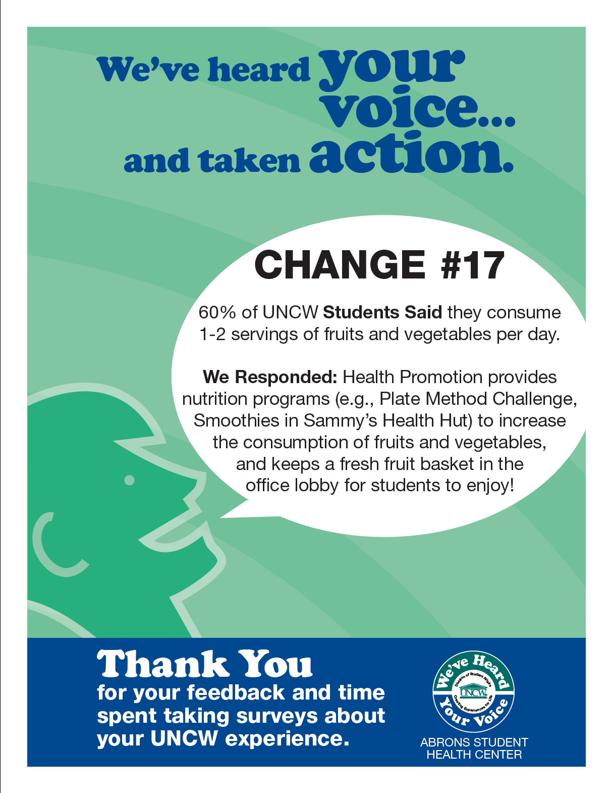
We’ve Heard Your Voice
Initiative developed by the Office of Student Life Assessment, based on similar program in student affairs at the University of Georgia.
Communicates assessment findings back to the student body and other constituents.
Emphasis is placed on demonstrating improvements made due to:
response to surveys
focus groups
other feedback

Slide 41
Distribution of Media
Each department in the Division of Student Affairs was included in this initiative, which was made possible through strong support and encouragement from the Vice Chancellor of Student Affairs
Each area was asked to develop 5-10 talking points
Assessment outcomes were publicized via:
The school newspaper
The school’s parent newsletter
Fliers posted around campus
Email
On-campus Television ads

Slide 42
Quotes from Students
“Some of the things which have changed, I just took for granted, I didn’t know there was any other way. I think that when you tell people what has changed, they will see that they’re helping the future generations of UNCW, and making the University better as a whole.”
“When you take into account things like the national government, you have a lot of people who would say “I don’t vote because my vote doesn’t count”. It was so cool to see—hey, the things that I’m saying are making a difference. It’s great when people see that when I take my time to do this, changes really do happen.”

Slide 43
Question:
How could assessment findings and action steps be shared with students in your department?

Slide 44
Contact Information
Nathan K. Lindsay, Ph.D.
Associate Provost
Associate Professor, Educational Leadership
University of Montana
nathan.lindsay@umontana.edu
Notes:
Image taken from http://www.afghanistan-insurance.com/Contact/contact.htm

