Slide 1
“Learning begins with student engagement, which in turn leads to knowledge and understanding. Once someone understands, he or she becomes capable of performance or action. Critical reflection on one’s practice and understanding leads to higher-order thinking in the form of a capacity to exercise judgment in the face of uncertainty and to create designs in the presence of constraints and unpredictability. Ultimately, the exercise of judgment makes possible the development of commitment. In commitment, we become capable of professing our understandings and our values, our faith and our love, our skepticism and our doubts, internalizing those attributes and making them integral to our identities.”
Schulman, 2002

Slide 2
High Impact Practices
&
Student Learning
Dr. Dave Veazey Sept. 22, 2014
Pacific Lutheran University Missoula, MT
Director: Pacific Northwest Learning Consortium

Slide 3
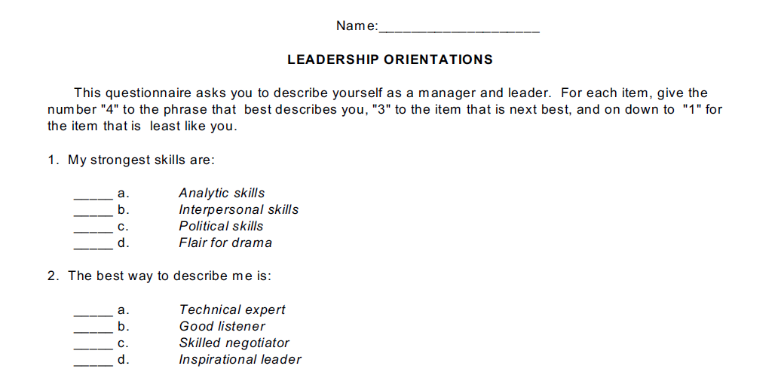
Survey

Slide 4
Outcomes
Describe the changes in the college going student body that demand high quality teaching and pedagogy.
Understand and articulate the research that supports the use of High Impact Practices.
Describe limitations and positive impacts of High Impact Practices in supporting student learning.
Analyze conditions in a higher education environment and develop ideas to improve student learning in High Impact Practices.

Slide 5
Changes
ACCESS HAS BEEN A PRIORITY
Morrill Acts – 1862, 1890
GI Bill
Expansion of Community Colleges
Civil Rights and Federal Financing of Higher Education

Slide 6
Changes
ACCESS HAS BEEN A SUCCESS
Educational Attainment in the U.S.* | 1910 | 2012
25 or older with a High School Diploma | 13% | 87.6%
25 or older with a Bachelor’s Degree | 2.7% | 31%
College Enrollment | 350,000 | 21,000,000
*National Center for Education Statistics

Slide 7
More students
=
Diverse students
Changes
Academic Preparation
Education Self Efficacy
Pressures Outside of Academics

Slide 8
Changes
ACCOUNTABILITY – AFFORDABILITY - QUALITY
Spellings Commission Report - 2006
Public concern about rising costs may ultimately contribute to
the erosion of public confidence in higher education.
In our view, affordability is directly affected by a financing system that provides limited incentives for colleges and universities to take aggressive steps to improve institutional efficiency and productivity.
…we need to be increasing the quality of learning outcomes …the continued ability of American postsecondary institutions to produce informed and skilled citizens who are able to lead and compete in the 21st-century global marketplace may soon be in question.

Slide 9
Changes
ACCESS AFFORDABILITY OUTCOMES
Obama – Higher Education Rankings
Federal Financial Aid Proposed to be tied to Accountability Measures:
Tuition
Graduation Rates
Student Debt
Earnings of Graduates
Percentage of Low Income Students Served

Slide 10
Changes
ACCESS Remains an important goal
AFFORDABILITY Remains a challenge
QUALITY Being defined by others

Slide 11
Changes
Who will define “OUTCOMES”?
1. Federal and State Government – LEGISLATION - simplistic
2. Students & Parents – MEDIA AND PERCEPTIONS – who knows?
3. Employers – ECONOMIC BENEFIT – access to employees
4. Faculty –
“…education that empowers individuals with broad knowledge and transferable skills, and a stronger sense of values, ethics, and civic engagement ... characterized by challenging encounters with important issues, and more a way of studying than a specific course or field of study.”
AAC&U

Slide 12
Current Issues….
Changes
Outcomes are related to retention, graduation rate, jobs and income…not student learning.
Students are coming to higher education that DIDN’T 20 and 30 years ago – less prepared for the college experience
Expectation exists in the public that colleges will successfully graduate students.

Slide 13
Solution?
limitations and positive impacts
HIGH IMPACT PRACTICES
Create research based strategies that:
Engage students in multiple ways to connect to their learning in meaningful ways
Create multiple opportunities for students to experience these pedagogies

Slide 14
HIP’s Bridge
Accountability & Learning
limitations and positive impacts
Critical Thinking
Communication
Lifelong Learning
Civic Responsibility
Problem Solving
Diversity
Information Literacy
Ethics
Teamwork
Quantitative Reasoning
Peer Reputation
Graduation Rate
Retention of Cohorts
Jobs & Income of Graduates
High Impact
Practices

Slide 15


Multiple Opportunities
limitations and positive impacts
Student-Faculty Research
Collaborative Assignment & Projects
Learning Communities
Senior Culminating Experience
First Year Experience
Community Based, Service Learning
Internships
Writing Intensive Courses
Diversity & Global Learning
Common Intellectual Experiences

Slide 16

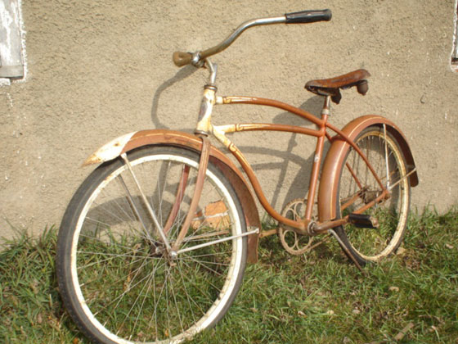
Quality of PROCESS Matters !
limitations and positive impacts

Slide 17
High Impact Practice
limitations and positive impacts
An investment in time and energy over an extended period that has unusually positive effects on student engagement in educationally purposeful behavior
Kuh, 2009

Slide 18
Characteristics of a Quality HIP
limitations and positive impacts
Performance expectations set at appropriate and high level
Significant investment of time and effort over an extended period of time
Interactions with faculty and peers about substantive matters
Experiences with diversity
Frequent, timely and constructive feedback
Periodic, structured opportunities to reflect and integrate learning
Opportunities to discover relevance of learning through real-world applications
Public demonstration of competence

Slide 19
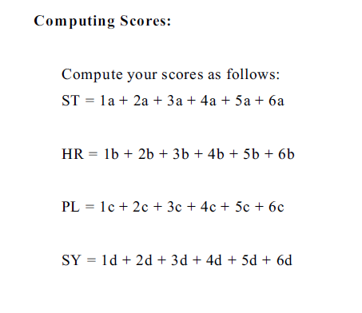
Compile Survey Results

Slide 20
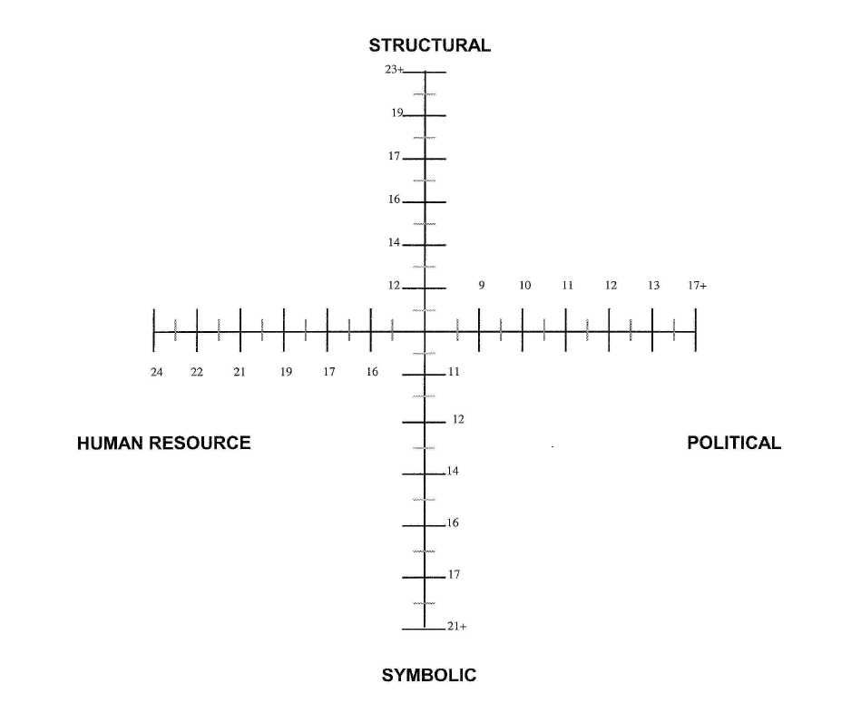

Slide 21
Move to Corners of Room

Slide 22
Change in Higher Education
Many good ideas about change, but change initiatives can be overwhelming
As a result, leaders often rely on one simple approach for all situations
If an approach works once, leaders tend to use it again and do not understand why it does not work
Key – become familiar with many tools (Bolman and Deal, for example)
Kezar, ALA Symposium, 2014

Slide 23
Structural frame
Organization as Factory
Organizations exist primarily to accomplish established goals
A structural form can be designed and implemented to fit any particular set of circumstances
Organizations work effectively when environmental turbulence and personal preferences are constrained by norms of rationality

Slide 24
Structural frame
Specialization permits higher levels of individual expertise and performance
Coordination and control are essential to effectiveness
Problems originate from inappropriate structures or inadequate systems and can be resolved through restructuring or developing new systems

Slide 25
Human Resource frame
Organization at Extended Family
Fit between people and the organization
Key concepts – needs, skills, relationships, interpersonal interactions, fit, satisfaction
Key processes – tailoring the organization to meet individual needs

Slide 26
Human Resource frame
Organizations exist to serve human needs
Organizations and people need each other
When the fit is poor, both will suffer, individuals will be exploited, or seek to exploit organizations, or both
Human beings find meaningful and satisfying work, and organizations get human talents and energy – a good fit between both!

Slide 27
Political frame
Organization as advocacy and activism
Organizations are coalitions of various individuals and interest groups
There are enduring differences among coalition members in values, beliefs, information, interests, and perceptions of reality
Most important decisions involve the allocation of scarce resources through bargaining, negotiation, coalition building, agenda setting

Slide 28
Symbolic frame
Organization as Tribe or Theatre
Key concepts – culture, symbols, ritual, ceremony, stories, heroes/heroines, myths, charisma
Key processes – common vision, attending to meaning, devising rituals, ceremonies and symbols

Slide 29
Symbolic frame
Symbols form a cultural tapestry or secular myths, rituals, ceremonies, and stories that help people find meaning, purpose and passion
Symbols embody and express the organization's culture – the interwoven pattern of beliefs, values, practices and artifacts that define for members who they are and how they are to do things

Slide 30
Which frames to use to create change?
In postsecondary research – political and symbolic proven most important, often least developed in people
How can frames be used to create change?

Slide 31
Return to Seats !

Slide 32
Multiple Opportunities
limitations and positive impacts
Student-Faculty Research
Collaborative Assignment & Projects
Learning Communities
Senior Culminating Experience
First Year Experience
Community Based, Service Learning
Internships
Writing Intensive Courses
Diversity & Global Learning
Common Intellectual Experiences

Slide 33


Are Student Self Report Data Valid?
research
Pedagogies
Supportive Practices
Assignments

Slide 34
research
Institutions Often Do Not Use the Data They Have
Very few institutions even utilized actionable data
Even information we already know – anecdotes confirmed by data – frequently do not change practice
MORE data is not always helpful

Slide 35


Lessons?
research
Student Self Report Data
Teaching environment and pedagogy
Authentic Student Evidence
Learning
Create Actionable Process
1. Teaching and learning data faculty hunger to know
2. How student learning data speaks to these questions

Slide 36


High Impact Practices
research
Student Experiences and Perceptions are valuable data to understand the effectiveness of High Impact Practices

Slide 37
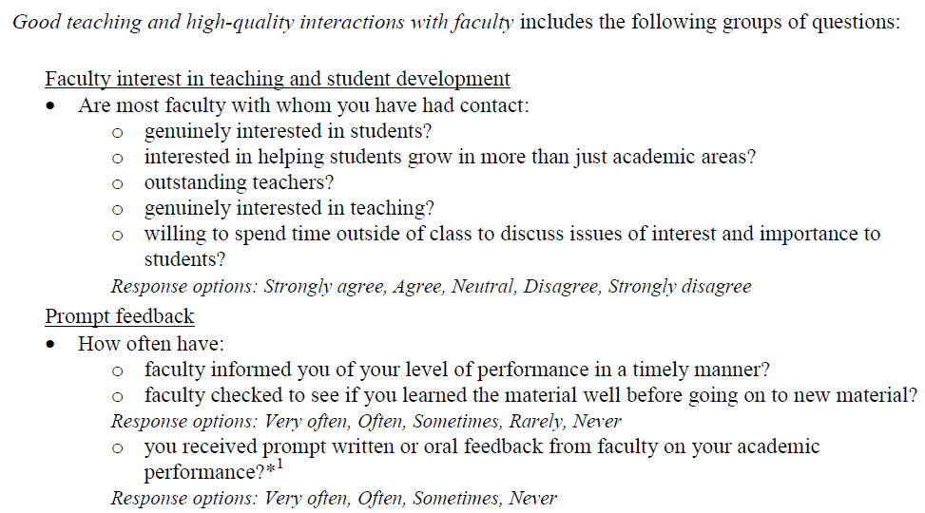
ideas to improve

Slide 38
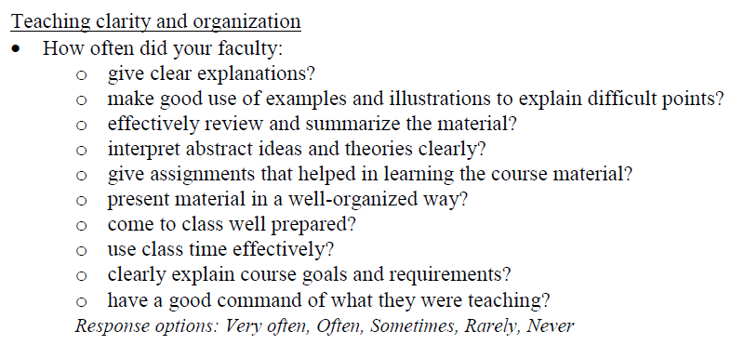
ideas to improve

Slide 39
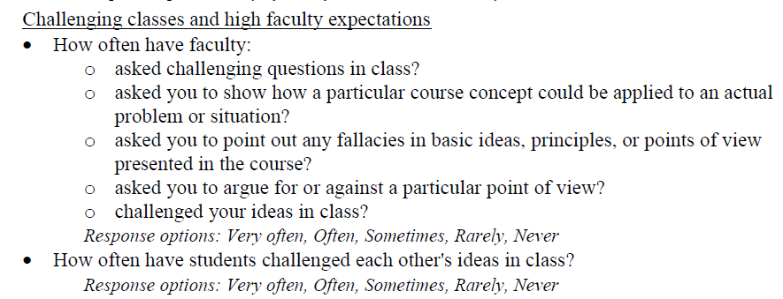
ideas to improve

Slide 40
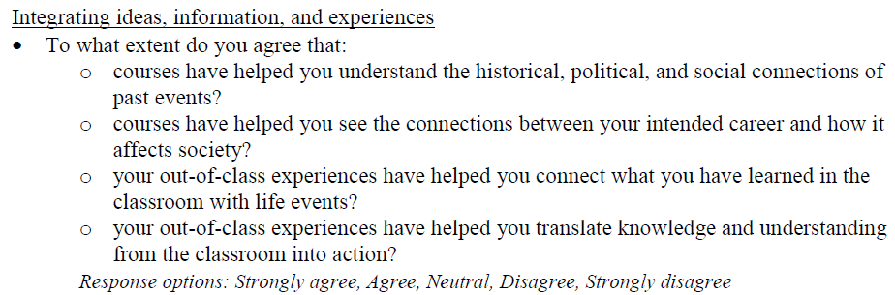
ideas to improve

Slide 41

ideas to improve

Slide 42

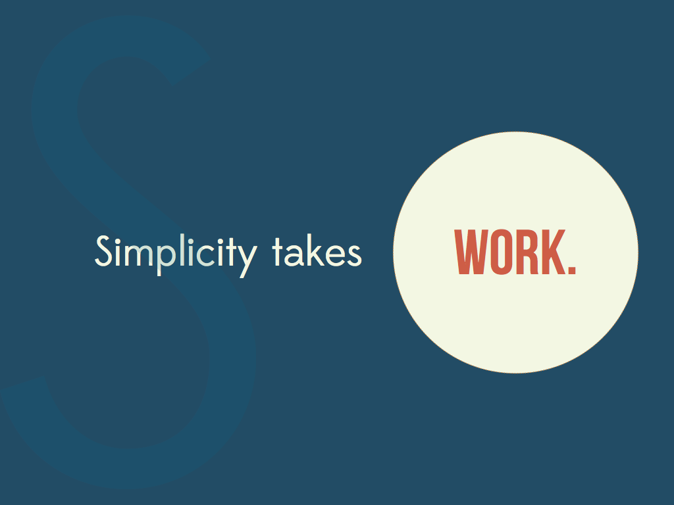
ideas to improve

Slide 43

Unique Approach is the
Right Approach
ideas to improve

Slide 44
Tips
ideas to improve
Be COMMITTED to improvement – Incremental, Long-Term, Sustainable
Education goals & process MUST stem from mission & culture
Value the notion of openly QUESTIONING long standing institutional practices
EMBRACE the fuzzy world of program level learning – it is not research !
The first “understanding student learning” and student experience NEEDS to be a good one
Pilot, pilot again, AND again
1. Be willing to EXPERIMENT before data is “conclusive”
2. Develop INSTITUTION WIDE rubrics/methods of evaluation – get close enough
Create 4 levels ONLY in the rubric (2 above, 2 below)
Develop the rubric and analyze student evidence TOGETHER with those that teach the courses or deliver the program
Use student evidence to support and drive faculty development, curricular/pedagogical change
Return to #1
QUALITY TEACHING IS WHAT MATTERS !

Slide 45
ideas to improve
Case Study
First Year Seminar at Pacific Northwest College

Slide 46
Roles
ideas to improve
Faculty Curriculum Committee Member
FYS Tenured Faculty member
FYS Adjunct Faculty member
Student
Dean of Student Life
Provost
Dean of Arts and Sciences

Slide 47
ideas to improve
Pick a Spokesperson !

Slide 48
Task
ideas to improve
In your role develop a list of key issues
In your role decide on your perception of the most important next step
When you have done this individually…..
Discuss as a group and develop consensus on:
The issue you believe should be addressed.
Should the learning goals be changed in FYS and if so, how?
What are your first steps toward creating a process whereby meaningful evidence can improve the quality, impact and coherence of the First Year Seminar leading to attainment of student learning goals

Slide 49
Tips
ideas to improve
Be COMMITTED to improvement – Incremental, Long-Term, Sustainable
Education goals & process MUST stem from mission & culture
Value the notion of openly QUESTIONING long standing institutional practices
EMBRACE the fuzzy world of program level learning – it is not research !
The first “understanding student learning” and student experience NEEDS to be a good one
Pilot, pilot again, AND again
1. Be willing to EXPERIMENT before data is “conclusive”
2. Develop INSTITUTION WIDE rubrics/methods of evaluation – get close enough
Create 4 levels ONLY in the rubric (2 above, 2 below)
Develop the rubric and analyze student evidence TOGETHER with those that teach the courses or deliver the program
Use student evidence to support and drive faculty development, curricular/pedagogical change
Return to #1
QUALITY TEACHING IS WHAT MATTERS !

Slide 50
Thank You !
One Day Student Learning Workshops in October:
October 22 – Spokane, WA Developing and Implementing A-Plans
October 24 – Portland, OR Understanding Student Learning in General Education
www.plu.edu/pnlc

Slide 51
“Learning begins with student engagement, which in turn leads to knowledge and understanding. Once someone understands, he or she becomes capable of performance or action. Critical reflection on one’s practice and understanding leads to higher-order thinking in the form of a capacity to exercise judgment in the face of uncertainty and to create designs in the presence of constraints and unpredictability. Ultimately, the exercise of judgment makes possible the development of commitment. In commitment, we become capable of professing our understandings and our values, our faith and our love, our skepticism and our doubts, internalizing those attributes and making them integral to our identities.”
Schulman, 2002

Slide 52
Undergrad research Surveys
http://www.grinnell.edu/users/lopatto
Augustana study – July 2012

