Slide 1
Straightening Out Queer Stereotypes through Literature
Paige M. Ferro
April 11th, 2014
The University of Montana Conference for Undergraduate Research

Slide 2
gay
homosexual
dyke
polysexual
androgynous
transgender
bisexual
faggot
homoerotic
butch
pansexual
intersex
lesbian
femme
transsexual

Slide 3
Evolution of a Heteronormative Culture
Sexuality as a “Big Issue”
Deviation from the norm
Heteronormativity
Social Stigmas
Stereotypes of fixed identity

Slide 4
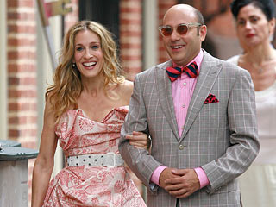
Common Misconceptions and Stereotypes
Archetypal Identities
Gay Men
Overly feminine
Lesbians
Overly masculine
Double fetishism
Bisexual
Stigmatized from both sides

Slide 5
The Beginnings of a Theory
Queer theory- an approach to literary and cultural study that rejects traditional categories of gender and sexuality

Slide 6
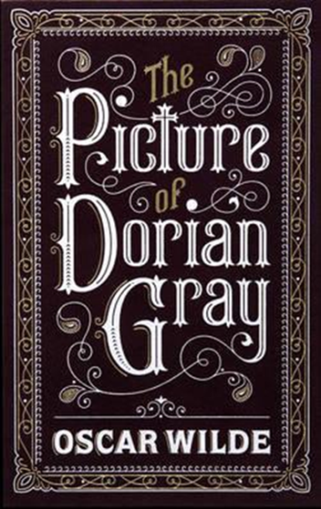
Canonization of the Queer
Merit of canonized queer works
Sappho
William Shakespeare
Walt Whitman
Oscar Wilde

Slide 7
Queer Works for All Orientations
Exposure to queer works
Socially acceptable means of discussion
Reality of lifestyles
Accurate portrayals of truths behind experiences
Accessible for everyone
Works for all audiences
Universality and inclusion

Slide 8
Questions or comments?

Slide 9
A Special Thanks
Dr. David Gilcrest, PhD, Department of English
Dr. Casey Charles, PhD, Department of English
Dean McKusick, Laure Pengelly Drake, Karen Kaley, and everyone at the Davidson Honors College
The UMCUR staff and judges

Slide 10
Works Cited
Beemyn, Genny, and Michele J. Eliason. Queer Studies: A Lesbian, Gay, Bisexual, & Transgender Anthology. New York: New York UP, 1996. Print.
Danforth, Emily M. The Miseducation of Cameron Post. New York: Balzer Bray, 2012. Print.
Hall, Donald E. Queer Theories. Houndsmills, Basinstroke, Hampshire: Palgrave Macmillan, 2003. Print.
Kovacs, Maureen Gallery. The Epic of Gilgamesh. Stanford, CA: Stanford UP, 1989. Print.
"Queer Theory." Merriam-Webster. Merriam-Webster, n.d. Web. 02 Apr. 2014.
Weinberg, Martin S., Colin J. Williams, and Douglas W. Pryor. Dual Attraction: Understanding Bisexuality. New York U.a.: Oxford Univ., 1994. Print.

