Slide 1
Comparing Variations of Mood States in College Students Enrolled in Healthcare Professional Programs
Erika Berens Senior Athletic Training Student
Valerie Moody, PhD, ATC, LAT, CSCS, WEMT-B
The University of Montana, Missoula, Montana, U. S. A.

Slide 2
Disclosure Statement
We do not have a vested interest in the topic/research we are about to present.
We would like to acknowledge the Davidson Honors College at the University of Montana for funding this research project

Slide 3
Overview of Presentation
Objective of presentation
Background
Purpose
Method
Results
Discussion
Conclusion
Limitations
Area of Future Research

Slide 4
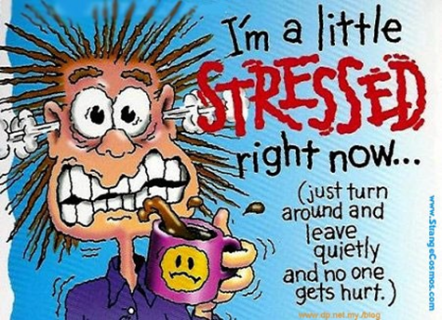
Objective of Presentation
To allow us to better understand the effects of participating in a rigorous professional program on students.
Prevent burnout and promote life balance
With this information, administrators of these programs can find ways to provide necessary support for students.

Slide 5
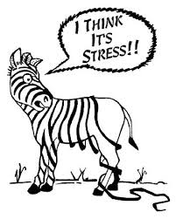
Stress in the College Students
Common sources of stress (Ross, 1999)
Changes in eating habits
Changes in sleeping habits
Increased academic load
Financial difficulties
Other or new responsibilities

Slide 6
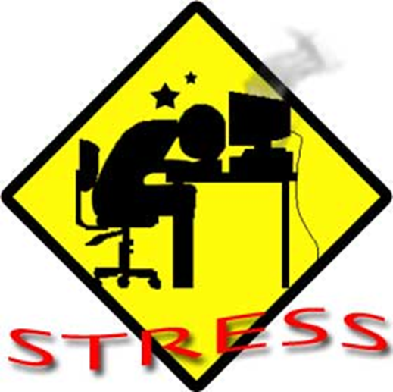
Stress in Healthcare Professional Programs
Very rigorous time Consuming
Students are expected to complete a full course load in addition to 20-30 clinical hours
Money is a common stressor as students aren’t able to work outside of their program
Relationships with friends and family are often strained
(Stilger et al, 2001)

Slide 7
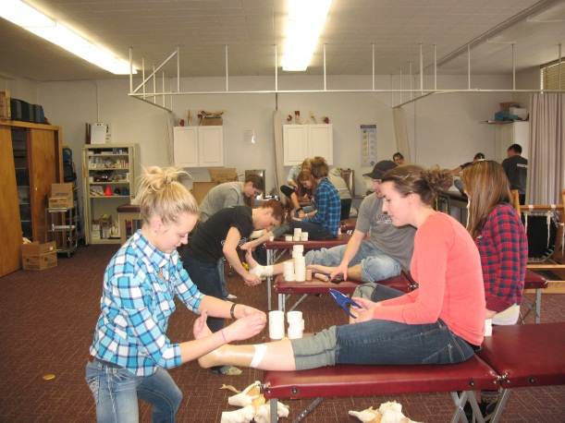
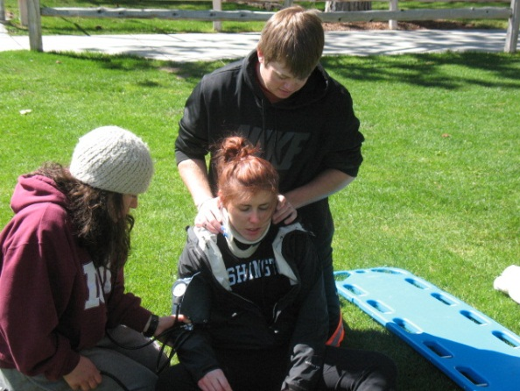
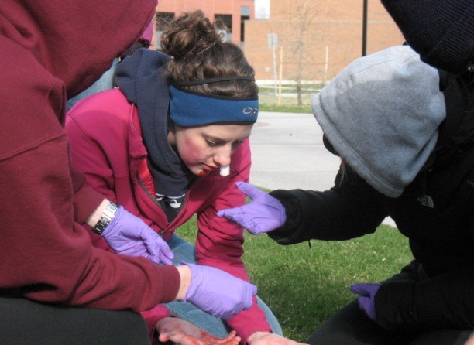
Background
Little research exists about how students in health care professional programs react to stressors while completing their programs
Most of past research is outdated
The literature does not cover the differences in multiple mood state changes during an academic year between students in vigorous healthcare programs and the general student population.

Slide 8
Purpose of Research
The purpose of this study is to examine longitudinal changes in mood patterns among college students completing a healthcare professional program to those students not completing a professional program.

Slide 9
Methods
IRB approval obtained through the University of Montana
Beginning of each month Profile of Mood States (POMS) was administered
September, October, December 2013
Incentive prizes offered for participation

Slide 10
Methods
Participants:
A convenience sampling strategy was used to recruit students currently taking classes in the athletic training program, nursing program, and community health program on campus at UM.
20 Athletic Training Students
5 Nursing Students
26 Community Health Student
Students age ranged from age 18 to 30

Slide 11
What is POMS?
The POMS measures scores along 6 mood states:
Tension-anxiety
Depression-dejection
Anger-hostility
Fatigue-inertia
Confusion-bewilderment
Vigor-activity
Total Mood Disturbance Score calculated
Students answered questions based on how they were feeling at that moment

Slide 12
Mood States
Tension-Anxiety
Depression-Dejection
Tense
On Edge
Shaky
Restlessness
Hopeless
Blue
Lonely
Unworthy
Unhappy
Worthlessness

Slide 13
Mood States
Anger-Hostility
Vigor-Activity
Angry
Mad
Furious
Ready to Fight
Energetic
Cheerful
Alert

Slide 14
Mood States
Fatigue-Inertia
Confusion-Bewilderment
Tired
Fatigued
Lethargic
Very Puzzled
Dumbstruck

Slide 15
Clinical Use of POMS
POMS was first used for
Brief psychotherapy
Controlled outpatient drug trials
Studies of emotion-inducing conditions
POMS has been used in a variety of settings
Validity well established

Slide 16
Data Analysis
Mean scores over the three time points for each factor were calculated

Slide 17
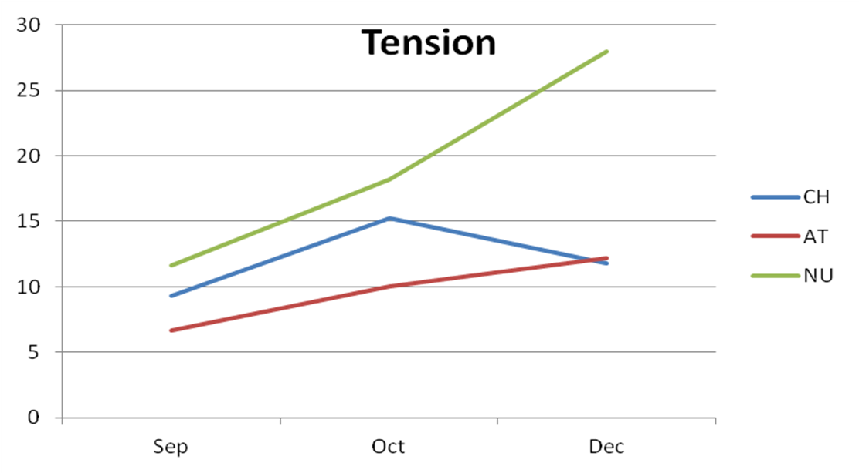
Results

Slide 18
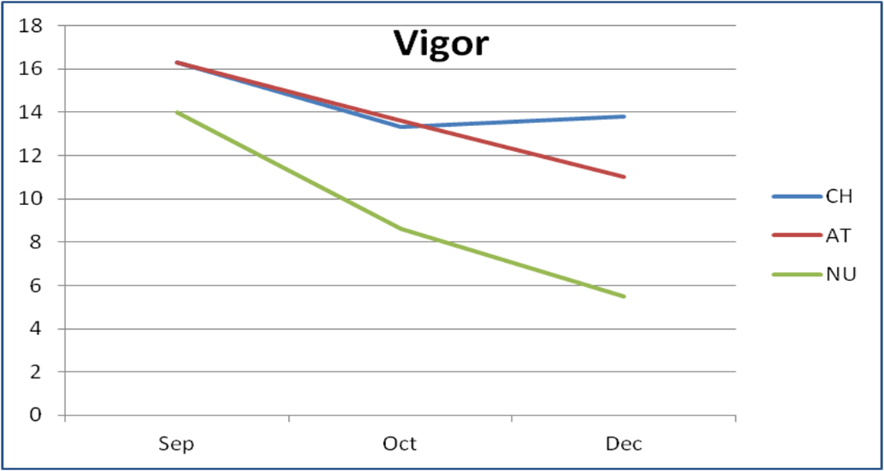
Results

Slide 19
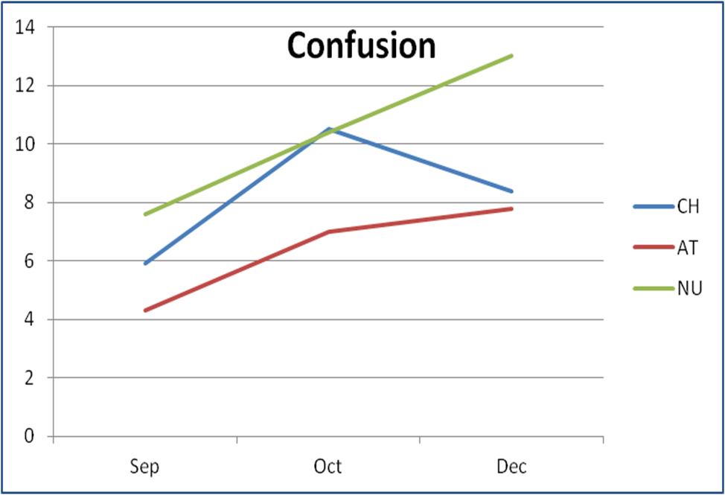
Results

Slide 20
Results

Slide 21
Results
Mean scores over the three time points for each factor reflect an increase in all three subject groups in:
tension-anxiety
depression-dejection
anger-hostility
fatigue-inertia
confusion-bewilderment
total mood disturbance
As the semester progressed, vigor-activity scores decreased for all students regardless of their program.

Slide 22
Discussion
Our findings showed that the type of program does not play a role in the amount of mood disturbance students experience over the course of the semester.
Results indicate that all students, regardless of their program, display a positive trend in total mood disturbance over the course of the semester.
It is reasonable to deduce that balancing school, clinical hours, work and family is a common stressor for all college students.

Slide 23
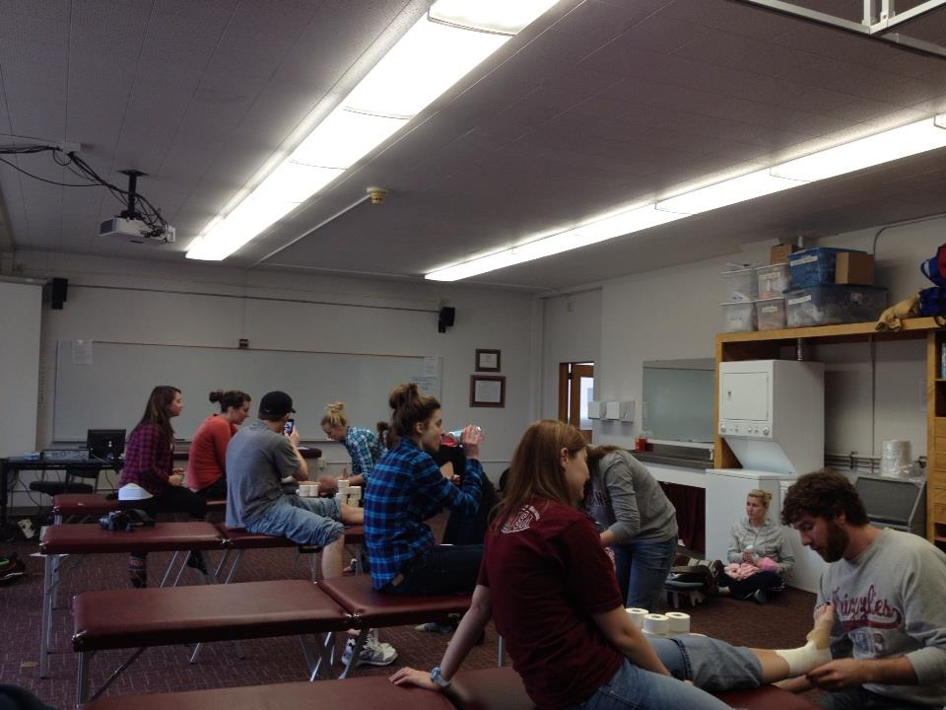
Conclusion
College is a stressful time for all students and levels of stress may vary greatly depending on various factors.
Whether students have jobs, clinical hours or a family outside of a full class load, they must find a balance in order to be successful.

Slide 24
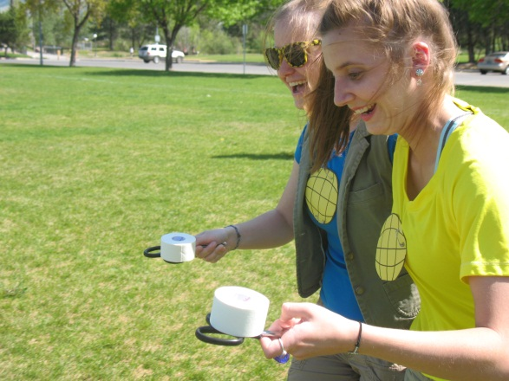
Conclusion
Having the knowledge of when the most stressful times in the semester are can help aid students in taking necessary steps to mitigate stress.
Professors can use this information to help students cope with their mood disturbance by implementing open door policies and open lines of communication

Slide 25
Recommendations
Help students focus on time management and study skills
Plan regular activities within the curriculum
Provide adequate support
Open door policy
Check in with students on a regular basis

Slide 26
Limitations
Small sample size
Outliers present within each sample group
Difficult to recruit students outside the Athletic Training program
Limited generalizability (one school included)

Slide 27
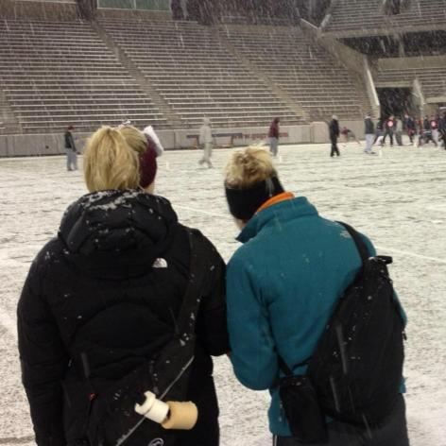
Future Research
Continue to collect more data on a larger sample
Identify and explore sources of change/fluctuation in mood states
Incorporate programs outside of The University of Montana

Slide 28
References
Rich, VJ. Clinical instructors’ and athletic training students’ perceptions of teachable moments in a clinical education setting. J of Athl Train. 2009;44(3):294-303.
Reed, S, Giacobbi, PR. The stress and coping responses of certified graduate athletic training students. J of Athl Train. 2004; 39(3): 193-200.
Bellini, LM, Shea, JA. Mood change and empathy decline persist during three years of internal medicine training. Academic Medicine. 2005; 80(2): 164-167.
Bellini, LM, Baime, M, Shea, JA. Variation of mood and empathy during internship. JAMA. 2002; 287(23): 3143-3146.
Stilger, VC, Etzel, EF, Lantz, CD. Life stress sources and symptoms of collegiate student athletic trainers over the course of an academic year. J Athl Train. 2001; 36(4): 401-407.
Unruh, S, Long, D, Rudy, J. Alcohol comsumption behaviors among athletic training students at accredited athletic training education programs in the mid-america athletic trainers’ association. J Athl Train. 2006; 41(4): 435-440.
Ross SE, Niebling BC, Heckert TM. Sources of Stress Among College Students.College Student Journal.1999;(2):1-6.

Slide 29
Thank You!

