Slide 1

Comparing the Effects of Ultrasound and Stretching on Hip Flexor Flexibility and Postural Control
Britt Dickman
Cali VanValkenburg
Dr. Valerie Moody

Slide 2
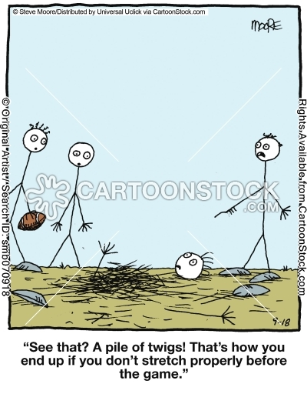
Overview of Presentation
Background
Purpose
Significance
Methods
Results
Discussion
Conclusion
Future Research

Slide 3
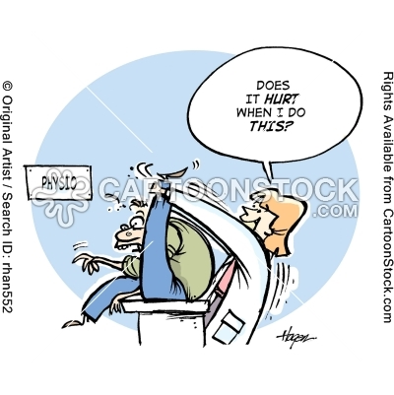
Background
Musculoskeletal injuries plague the physically active population
Significant amount of time invested trying to reduce the rate of injury
Flexibility is often a focus of these injury prevention programs and many people often rely upon heating the muscle prior to activity to facilitate an improvement in flexibility

Slide 4
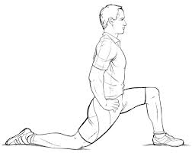
Static Stretching
Warm-Up and Cool-Down Routine
Effects:
  Improve Performance
  Increase Flexibility
  Reduce Muscle Injury
  Reduces Muscle Stiffness
Effects on Postural Control?

Slide 5
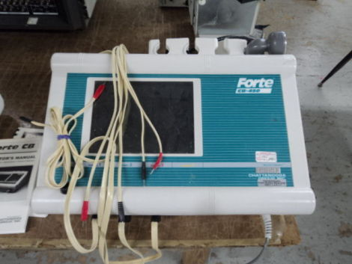
Ultrasound
Vigorous Heating
Tissue depth of 6 cm
Effects:
  Increase Collagen Extensibility
  Reduce Muscle Spasm
  Increase Blood Flow
Effects combined with Stretching?

Slide 6
Purpose
Determining the most effective treatment in improving muscle flexibility prior to performance with the hope of decreasing injury rates and improving performance is critical to injury prevention programs.
The purpose of this study was to assess the effectiveness of ultrasound and static stretching on hip range of motion and postural control

Slide 7
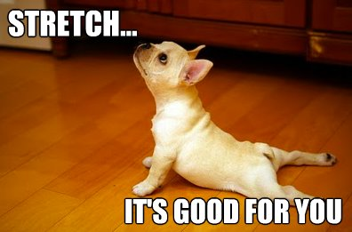
Significance
To our knowledge there are no studies examining the effects of these treatments on the hip flexor muscle group
There is a substantial amount of literature on the hamstrings and calf muscles, but the hip flexor group has yet to be explored

Slide 8
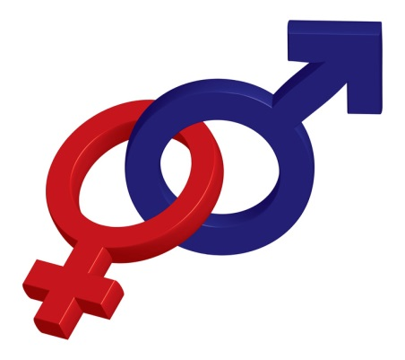
Participants
Six University of Montana Athletic Training Students
  3 Males and 3 Females
Age 18-30
No previous injury to the Lower Extremity within the past 6 months
Participants did not workout 24 hours prior to treatments

Slide 9
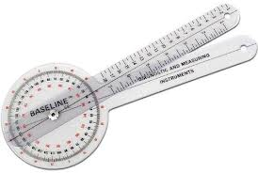
Instruments
Goniometer
12 in goniometer
SEBT
Tape & Tape measure
8 angles:
  Anterior
  Anteromedial
  Anterolateral
  Posterior
  Posteromedial
  Posterolateral
  Medial
  Lateral

Slide 10
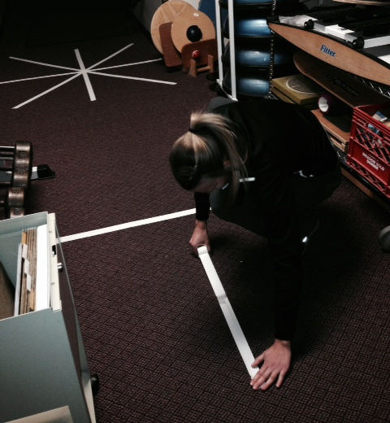
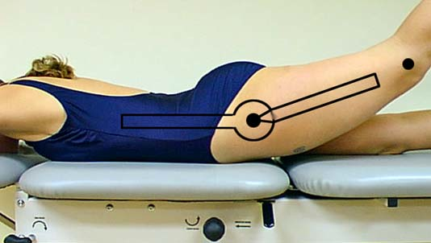
Instruments
Star Excursion Balance Test
Measuring Hip Range of Motion
- Measure of Postural Control
- Active Hip Extension

Slide 11
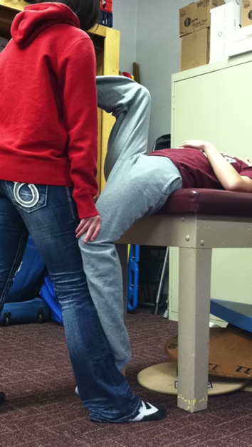
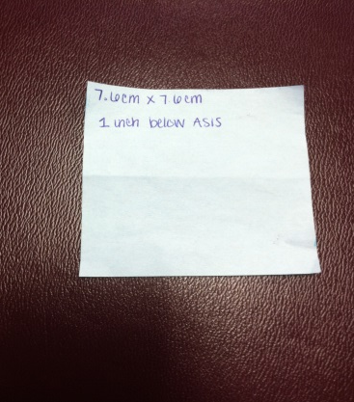
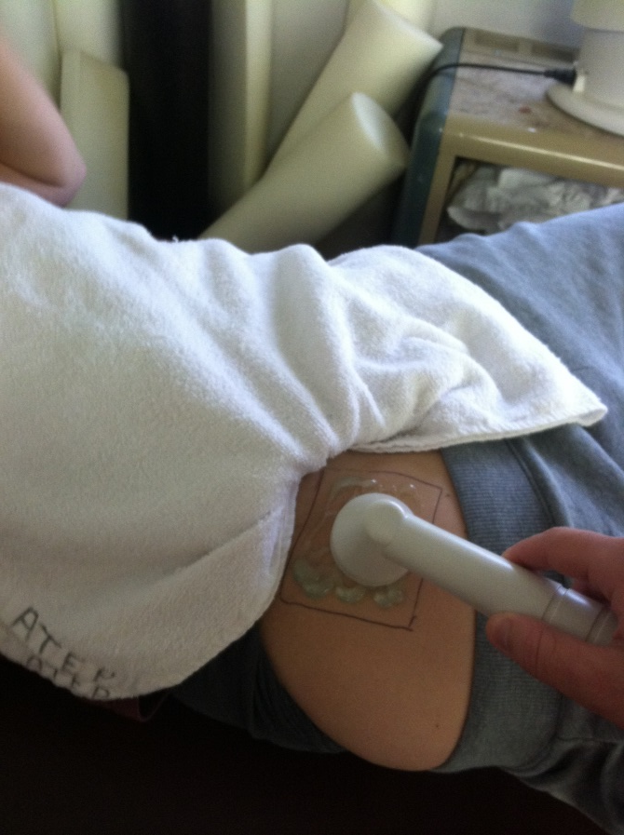
Instruments
Ultrasound
Forte CB- 450
  4 cm sound head
Stretch
Thomas Stretch
Lunge Stretch

Slide 12
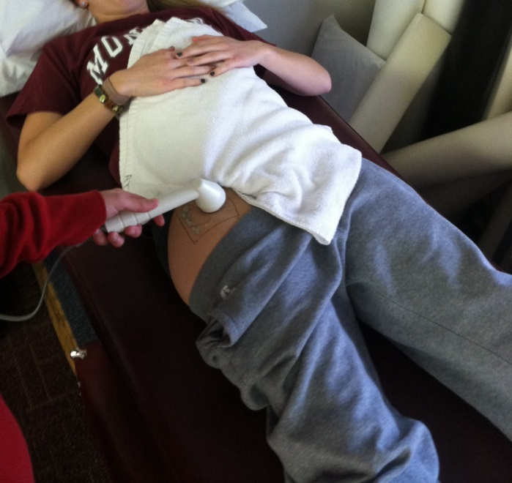
Parameters
Ultrasound
1 mHz
Frequency: 1.0 w/cm²
Duty Cycle: 100%
Time: 15 minutes
Placed 1 inch below ASIS on dominate leg
7.6cm X 7.6cm ultrasound area
Goniometer
Hip extension measured
Lying Prone
Hips remain on table

Slide 13
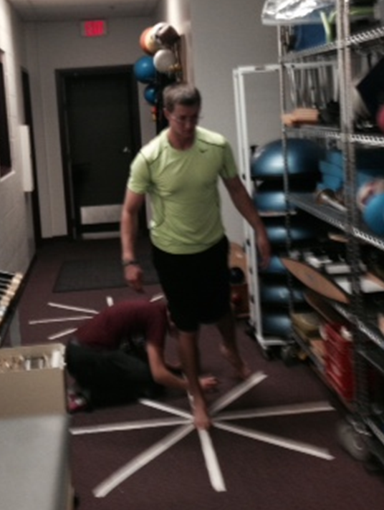
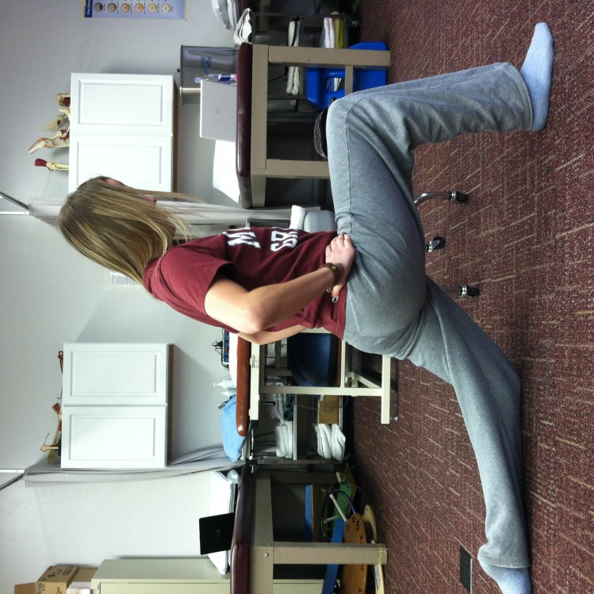
Parameters Cont.
Stretching
30 second hold, 3 times
10 second rest in between sets
SEBT
3 measures in each direction
Rest time was participant driven

Slide 14

Procedures
Pre-Participation Screening Questionnaire
Pre-Trial Measurements
  SEBT and Goniometry
3 Trials
  Stretch
  Ultrasound
  Combination
Post-Trial Measurements
  SEBT and Goniometry

Slide 15
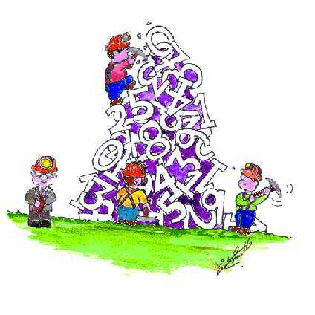
Data Analysis
2 x 3 repeated measures (time x condition) ANOVA was used
If significant interactions were found, pairwise comparisons were run using a Bonferonni adjustment

Slide 16
Results
Hip Extension
  No statistical significance (p=0.791)
  Decrease in ultrasound and combo trials
  Increase in stretch trial
SEBT
  No statistical significance found (p=0.134)
  Increase in stretch and ultrasound trials
    Not enough increase to be clinically relevant
  Decrease in combo trial

Slide 19
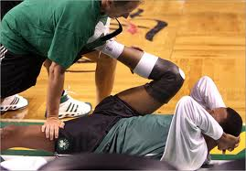
Discussion- Stretching
Increase Flexibility
Decrease Injury
Did not Improve Postural Control
Improve Performance
- Effects of static stretching can take weeks or months before results are seen

Slide 20
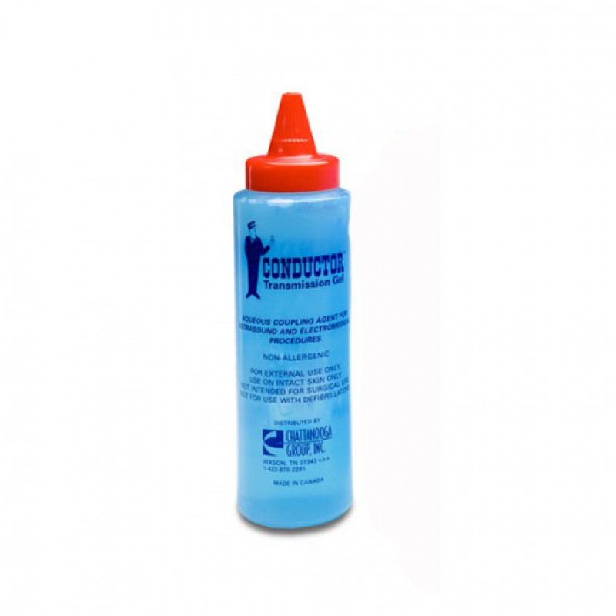
Discussion- Ultrasound
Increases collagen extensibility through deep heating
Muscles put on stretch throughout treatment to increase effectiveness
- Stretching window

Slide 21
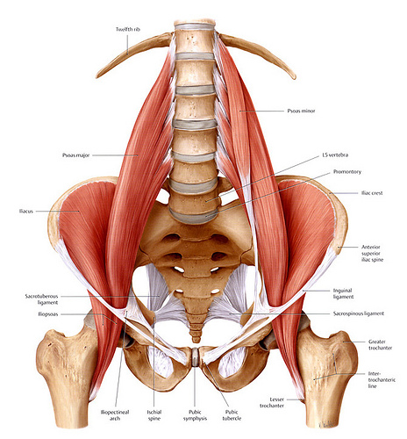
Discussion- Combo
Increase effects of ultrasound with static stretching routine
- Dynamic stretching may have been more beneficial

Slide 22
Limitations
Small sample size
No way to measure temperature rise in tissue
No set time for rest with SEBT
Error measuring hip extension
Exercising 24 hours prior to trials

Slide 23

Future Research
Larger sample size
Competitive athletic population
Dynamic stretch routine
Longer research period (6 weeks)
Different Parameters
Control Group

Slide 24
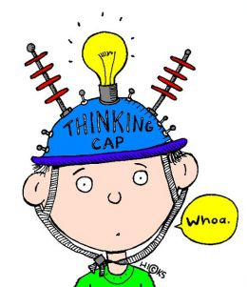
Conclusion
Inconclusive evidence on the effectiveness of ultrasound and stretching in all three trials
Need to further examine the benefits of a more active warm up when the goal is to improve ROM and Postural control of the hip

Slide 25

Acknowledgments
Davidson Honors College
Dr. Valerie Moody

Slide 26
References
1. Thacker SB, Gilchrist J, Stroup DF, Kimsey CD. The Impact of Stretching on Sports Injury Risk: A Systematic Review of the Literature. Med. Sci Sports Exercise. 2004;36(3):371-378.
2. Small K, Mc Naughton L, Matthews M. A Systematic Review into the Efficacy of Static Stretching as Part of a Warm-Up for the Prevention of Exercise-Related Injury. Research in Sports Medicine: An International Journal. 2008;16(3): 213-231. doi:10.1080/15438620802310784.
3. Knight KL, Draper DO. Therapeutic Modalities: The Art and Science. Baltimore, MD: Lippincott Williams & Wilkins; 2013.
4. Speed CA. Therapeutic Ultrasound in Soft Tissue Lesions. Rheumatology. 2001;40:1331-1336.

Slide 27
References
5. Reed BV, Ashikaga T, Fleming BC, Zimny NJ. Effects of ultrasound and Stretch on Knee Ligament. Journal of Orthopaedic & Sports Physical Therapy. 2000;30(6):341-347. doi:10.2519/jospt.2000.30.6.341
6.Starkey C, Brown SD, Ryan J. Examination of Orthopedic and Athletic Injuries. Philadelphia, PA: F.A. Davis Company; 2010.
7. Brumitt J. Assessing Athletic Balance with the Star Excursion Balance Test. NSCA’s Performance Training Journal. 7(3): 6-7.
8. Gribble PA, Kelly SE, Refshauge KM, Hiller CE. Interrater Reliability of the Star Excursion Balance Test. Journal of Athletic Training. 2013; 48(5): 621-626. doi: 10.4085/1062-6050-48.3.03

Slide 28
Questions??

