Slide 1
Layer specific distribution of cholinergic interneurons in the hippocampus
By lizzie catudio-garrett
University of montana
Lawrence lab
Umcur April 11, 2014

Slide 2
The hippocampus
The hippocampus is important for memory, attention, learning, and emotional regulation
Image taken from: http://mgitecetech.wordpress.com/2011/07/26/

Slide 3
Acetylcholine important for hippocampal functioning
Acetylcholine, neurotransmitter of brain and CNS
Decrease in ACh associated with cognitive deficits and is correlated phenomenon in Alzheimer’s Disease
Hippocampal shrinkage and acetylcholine production decrease in Alzheimer’s Disease
Image taken from: http://www.best-alzheimers-products.com/alzheimers-disease.html

Slide 4
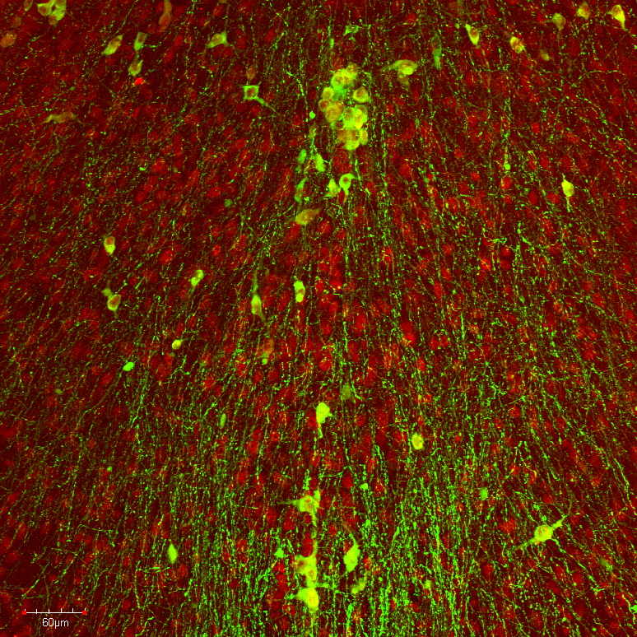
Major Source of Acetylcholine
Flattened Z-projection
20x ChAT-GFP MS-DBB
Green: Anti-GFP
Red: Anti-ChAT
Main source of ACh extrinsic and supplied by MS-DBB
Frotscher, 2000 – cholinergic interneurons/ChAT positive cells
Little is known of cholinergic interneurons

Slide 5
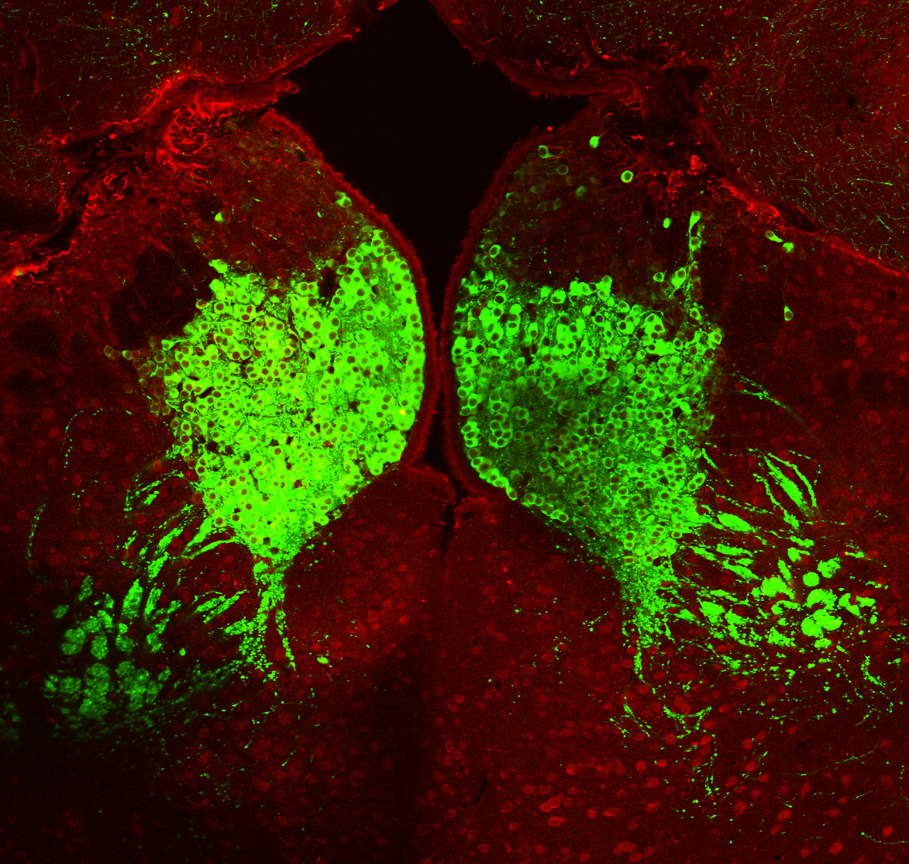
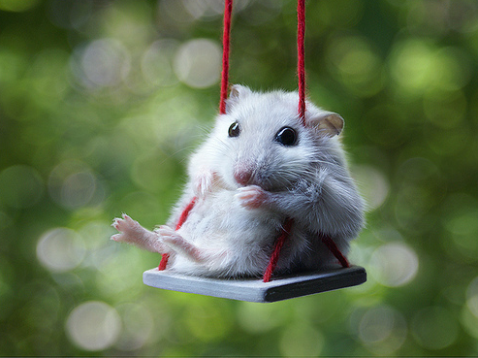
A new mouse
Confocal Z-projection
20x ChATxRosa-YFP
Medial Habenula
Green: Anti-GFP
Red: Anti-ChAT
ChATxRosa-YFP mouse
ChAT expressed through YFP
Choline Acetyltransferase
Visualize and investigate cholinergic interneuron population
Image taken from: http://www.picsgag.com/

Slide 6
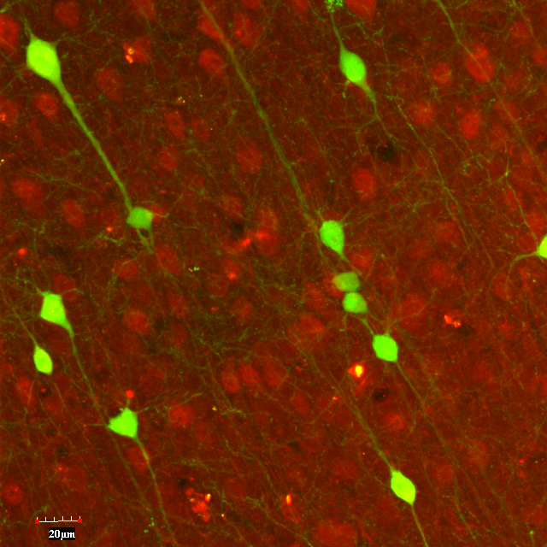
ChAT positive cells
Confocal Z-projection
20x ChATxRosa-YFP
Cortex
Green: Anti-GFP
Red: Anti-ChAT
ChAT stands for choline acetyltransferase
ChAT positive cells are also known as cholinergic neurons
Cholinergic means the cell is associated with acetylcholine.

Slide 7
Specific Aims
I had 2 specific aims in this project:
Specific Aim 1: What does the distribution of cholinergic interneurons look like across all layers and regions of the hippocampus?
Specific Aim 2: Is there lateralization between hippocampal hemispheres?

Slide 8
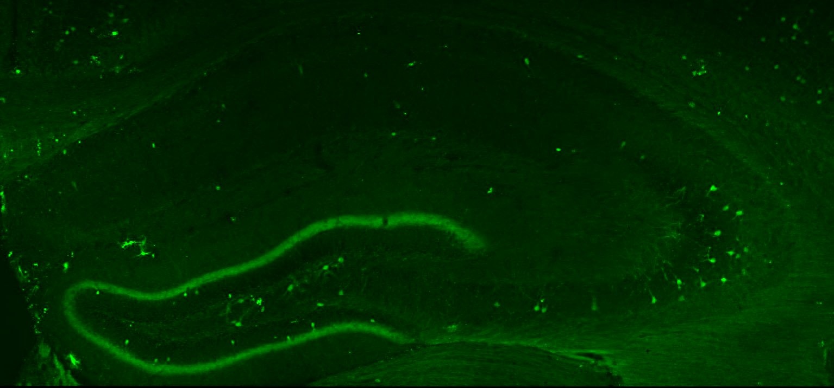
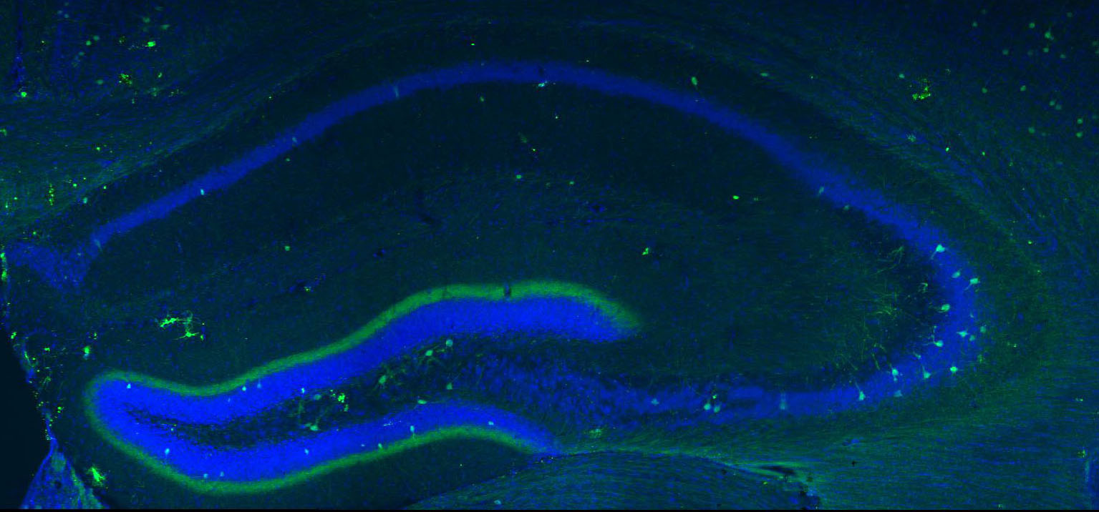
Hippocampus Channels split & areas explored
CA1
SO
SP
SR
SLM
SM
CA3
SG
Hilus
DG

Slide 9
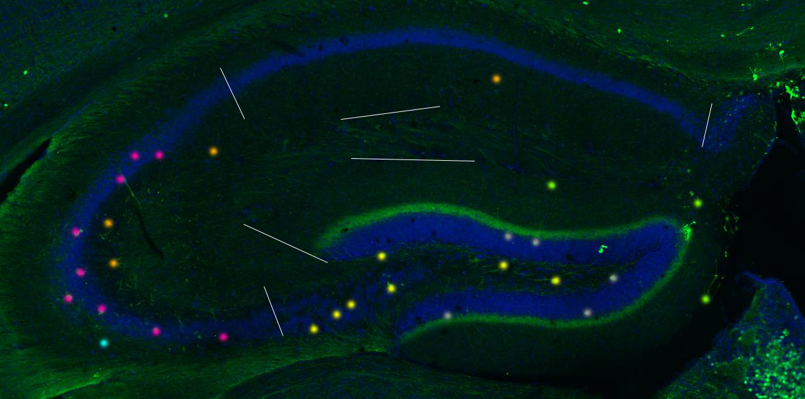
An example of counting procedure

Slide 10
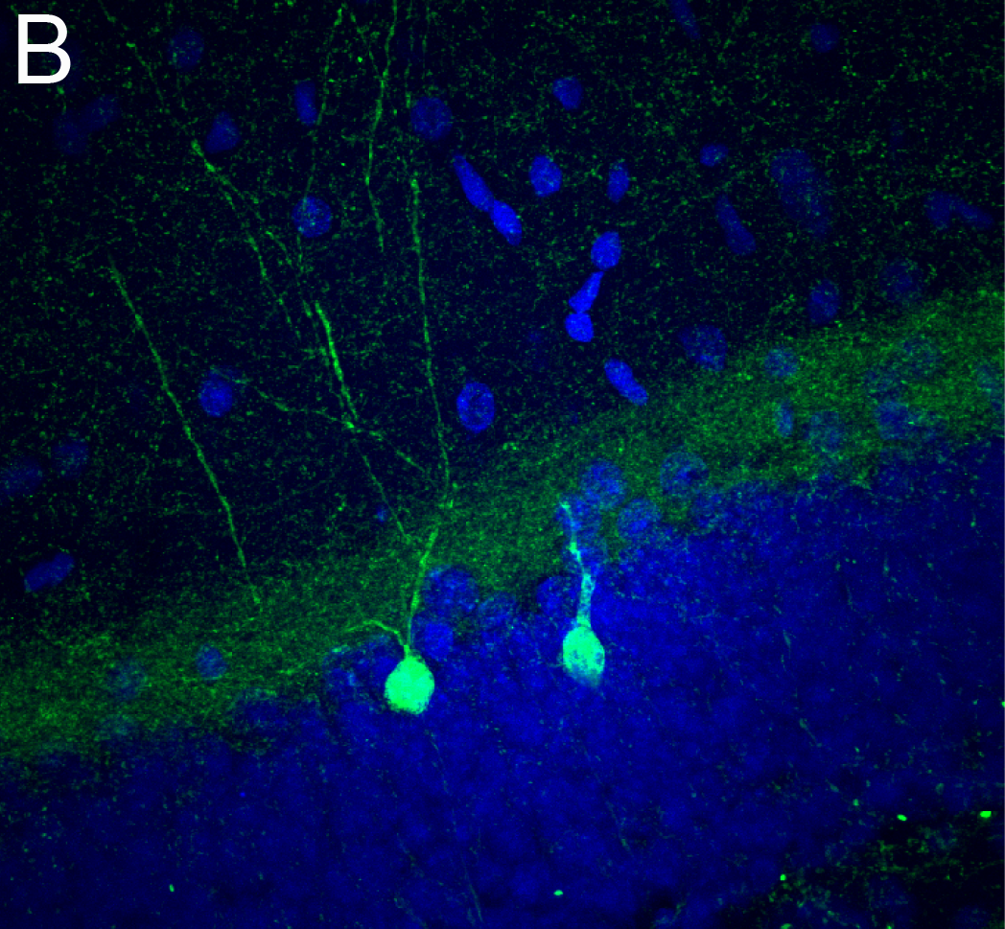
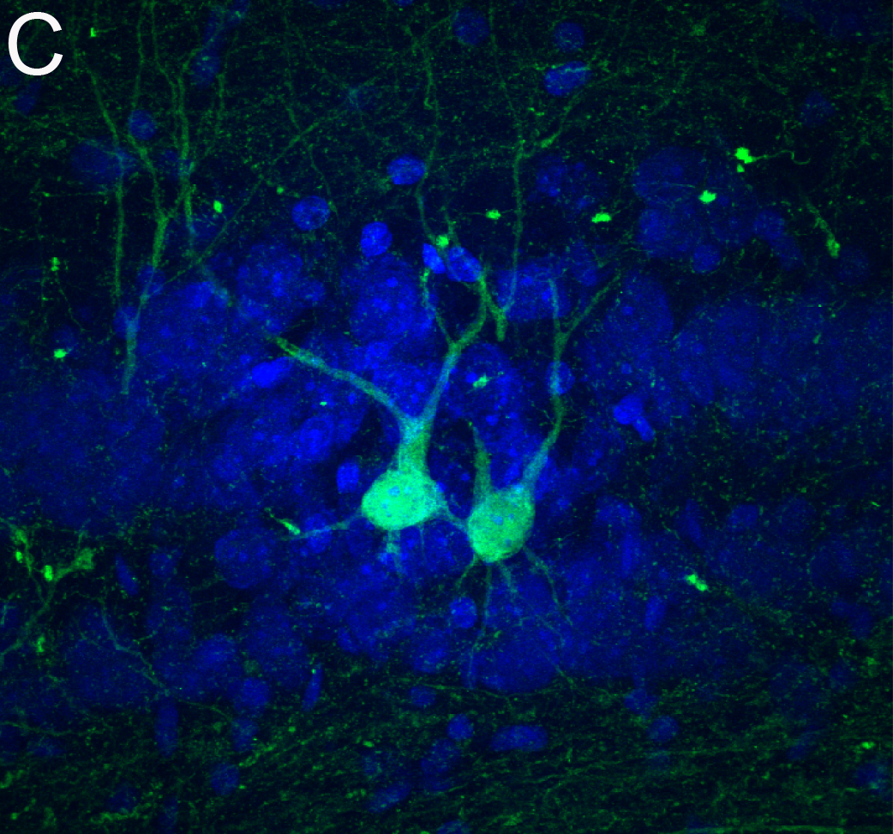
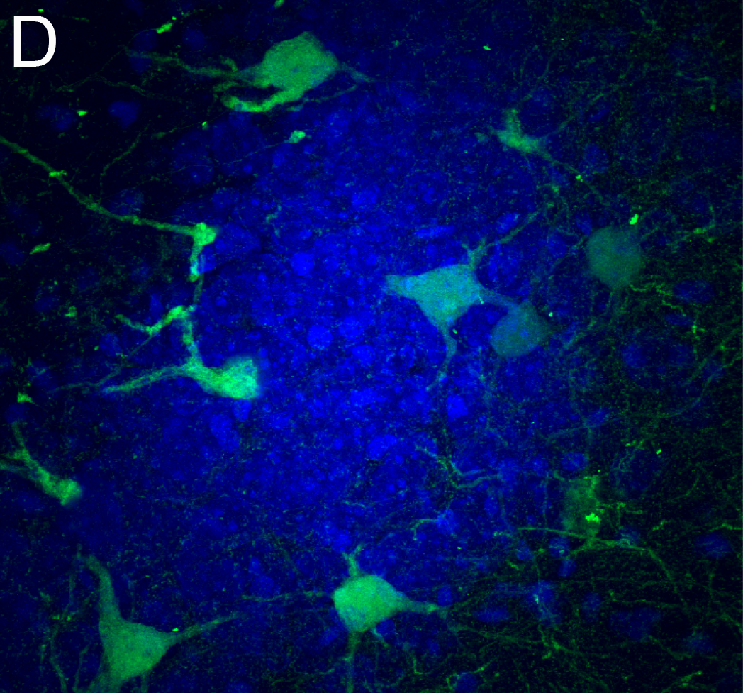
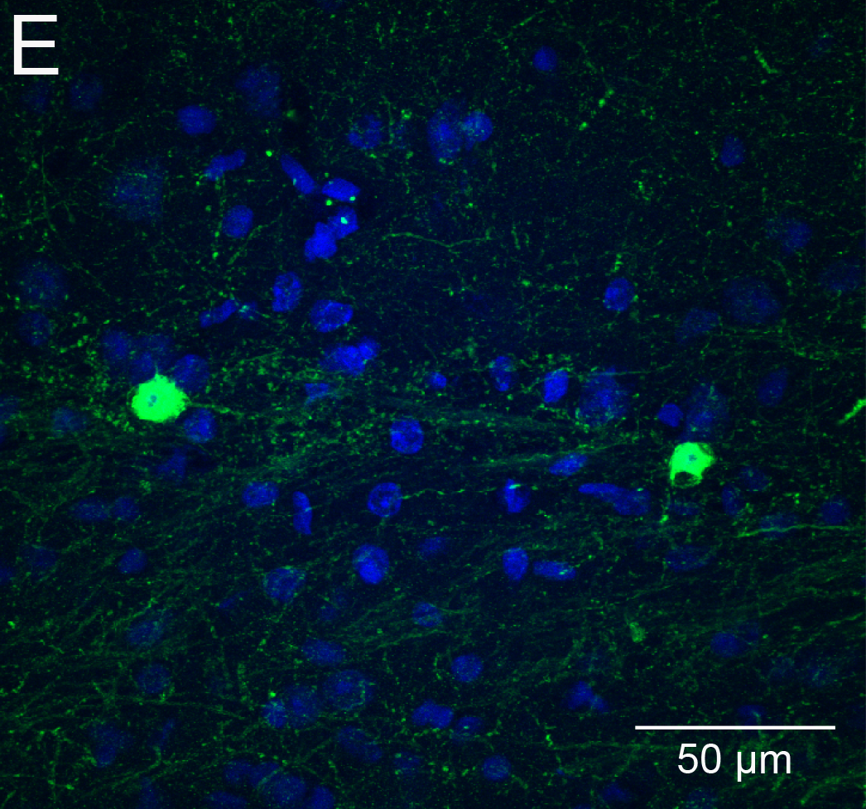
Example of Distribution

Slide 11
Methods
Four 11-12 week old ChATxRosa-YFP mice
Anti-GFP Antibody and Neurotrace Staining
Confocal Imaging

Slide 12
Results of SA1: Distribution
Hippocampal Region

Slide 13
Example of lateralization

Slide 14
Results of SA2: Lateralization
***
***
N=31

Slide 15
What findings mean/contribute
Cholinergic interneurons most densely populated in CA3 SP
Followed by DG layers
Not randomly scattered in hippocampus
Specialized role with layer specificity
Further research question: Do ChAT+ cells possess different roles in hippocampus?

Slide 16
Special thanks to:
The Lawrence Lab:
Feng Yi
Tavita Garrett
Evan DeCan
Jade Bosic
Josh Lawrence (PI)
Other team members & Aids:
Marta Wilhelm
Robert Gabriel
Allen Szalda-Petree
Ben Eisenreich
Katie Lamp
Davidson Honors College

Slide 17
Questions???
Thank you all for coming and listening to my presentation! Best wishes to everyone!
Also, Happy Friday!!!

