Slide 1
The Not-So-Simple Story of International Unity
By: Karla Nettleton

Slide 2
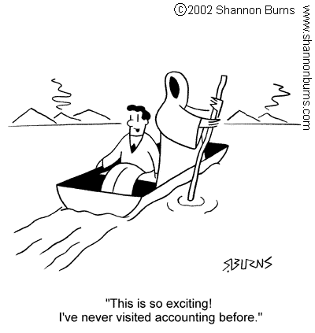
Death
Innocent Sucker

Slide 3
Background
GAAP - Generally Accepted Accounting Principles
US only accounting rules
Written by Financial Accounting Standards Board (FASB)
Enforced by SEC
Rules-based
Over 25,000 pages
Image from: KPMG, “US GAAP” (2014). Retreived from: http://www.kpmg.com/ie/en/services/audit/financial-reporting/us-gaap/pages/default.aspx

Slide 4
Background
IFRS - International Financial Reporting Standards (IFRS)
International
113 countries use IFRS
Written by the International Accounting Standards Board (IASB)
Principles based
About 2,500 pages
Image from: AccountantTown, “IFRS Guide” (2010). Retreived from: http://www.accountanttown.com/site/ifrs-international-financial-reporting-standards

Slide 5
Why should we care?
$$$ MONEY $$$
Financial reporting policy affects businesses
Businesses affect the economy
Businesses have a profound impact on all policy
Image from: 40 ways to get rich, “Fastest Way To Make Money” (2014). Retreived from: http://www.40ishways.com/25-fastest-way-to-make-money-hire-a-small-business-coach

Slide 6
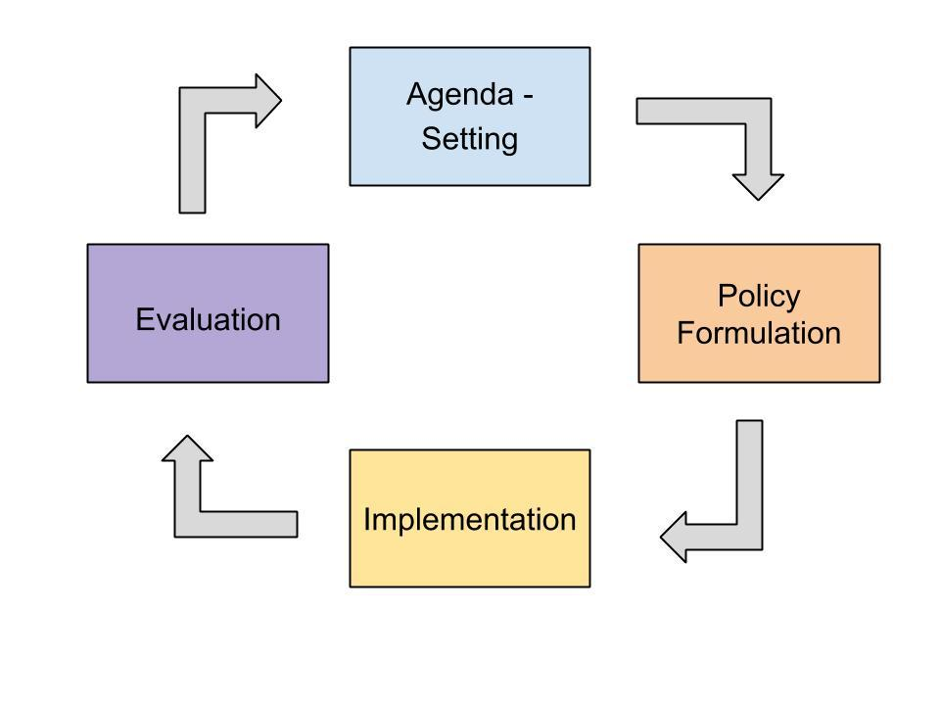
Public Policy Cycle

Slide 7
Agenda - Setting
Definition: stage at which objective societal conditions are recognized as matters of public concern and at which some concerns reach the attention of policy makers and some do not.

Slide 8
Agenda - Setting for IFRS
A Troubling Trend of Greed, Fraud, and Corruption: Enron and WorldCom
Dramatic Event: Sarbanes-Oxley
A Socioeconomic Crisis: Madoff Scandal
A Change in National Mood: Increased Concern for Regulation of Business

Slide 9
The Problem
Financial reporting in the US is weak
Should the US move towards international financial standards to prevent fraud and financial crisis?
Image from: The Nation Network, “Flames Depth Chart Needs Heading into 2013 Free Agency” (2013). Retrieved from: http://flamesnation.ca/2013/7/2/flames-depth-chart-and-needs-heading-into-2013-free-agency

Slide 10
Formulation
The US has not formed a policy to address the call for international standards
There are three approaches
Rational Choice
Institutionalism
Incrementalism

Slide 11
Rational Choice - Convergence
Rational Choice Framework:
Adopt the policy that achieves the maximum social good without the cost outweighing the gains
In context:
US would adopt pure IFRS and stop using GAAP all together
Supported by the American Institue of Certified Public Accountants

Slide 12
Institutionalism - Reform GAAP
Institutionalism Framework:
Choose the option that is run through a government institution because it has legitimacy, domestic universality, and coercion
In context:
The US would keep GAAP because it is run through the SEC, a government institution, but would reform it to help achieve better financial reporting standards
Supported by the National Association of State Boards of Accountancy (NASBA)

Slide 13
Incrementalism - Carve-out
Incrementalism Framework:
Choose to make one or two policy changes at a time to insure quality and completeness
In context:
Because IFRS allows only one or two standards to be adopted by a country, the US would pick key standards to converge with IFRS on and implement them slowly
Supported by the SEC

Slide 14
Barriers and Implications
Before choosing an approach each option must be thoroughly analyzed

Slide 15
Rational Choice - Convergence
Barriers:
- Funding
- Jurisdiction
Implications:
- Comparability
- Costs
- Legal Implications
Image from: AccountancyAge, “Can IFRS 9 Prevent Greek Tragedy?” (2011). Retrieved from: http://www.accountancyage.com/aa/analysis/2099244/ifrs-withstand-greek-effect

Slide 16
Institutionalism - Reform GAAP
Image from: Internet Retailer, “Amazon replaces Netflix at the top of a customer satisfaction survey” (2011). Retrieved from: http://www.internetretailer.com/2011/05/10/amazon-replaces-netflix-top-customer-satisfaction-poll
Implications:
- International perception of the US
- IASB failure

Slide 17
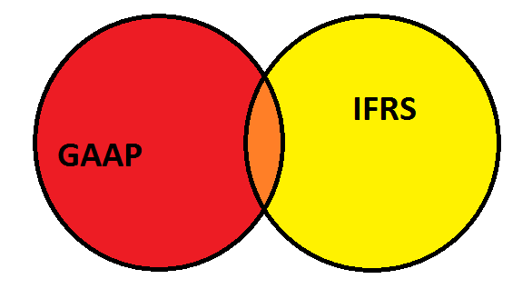
Incremental - Carve-out
Barriers:
- None
Implications:
- Lost comparability
Comparability
Similarities

Slide 18
Discussion
What do you think?

Slide 19
My Conclusion
My analysis lead me to the conclusion that the US should use the incremental approach
Convergence cannot overcome funding or jurisdiction
Reform would be bad for the US and international community
Carve-outs allow for minimal costs but quality standards created by 2 boards

Slide 20
A Special Thanks To:
Dr. Jeffrey Greene
Dr. Casey McNellis
Becky Nettleton
The Writing Center

Slide 21
References
Allen, Noel. “IFRS In Context.” National Association of State Boards of Accountancy. Accessed July 5, 2013.
http://www.nasba.org/files/2011/03/IFRS_In_Context-2009.pdf.
Anderson, Aaron and Nakansah, Ofori. “Should the US Adopt IFRS?.” Financial Executives International. Accessed July 5, 2013.
http://www.financialexecutives.org/KenticoCMS/Financial-Executive-Magazine/2011_09/Should-the-US-Adopt-IFRS-.aspx#axzz2ZWAGSoXw
Beswick, Paul. (remarks, Pasadena, CA, May 30, 2013). Securities and Exchange Commission.
http://www.sec.gov/News/Speech/Detail/Speech/1365171575494#.Ue6yz7HnbIU.
Carozza, Dick, “An Interview with Sen. Paul S. Sarbanes: Sarbanes Oxley Act Revisited,” Fraud Magazine, May/June 2007, retrieved from:
http://www.fraud-magazine.com/article.aspx?id=442
Dharan, Bala and Bufkins, William. “Red Flags in Enron’s Reporting of Revenues and Key financial Measures.” Enron: Corporate Fiascos and Their
Implications (2010): 97 Retrieved from http://www.webcitation.org/5tZ0yCA9i
Dye, Thomas. Understanding Public Policy (San Francisco, Pearson, 2013).
Government and Finance Division. WorldCom: The Accounting Scandal. Senate (2002): 2. Retrieved from:
http://www.law.umaryland.edu/marshall/crsreports/crsdocuments/RS21253_08292002.pdf.
Hail, Luzi, Leuz, Christian, and Wysocki, Peter, “Global Accounting Convergence and the Potential Adoption of IFRS by the US (Part I): Conceptual
Underpinnings and Economic Analysis,” American Accounting Association Journal 24, No. 3 (2010): 344-394, Accessed December 10, 2013,
http://aaajournals.org/doi/pdf/10.2308/acch.2010.24.3.355
Hoogervorst, Hans. Letter to the European Securities and Markets Authority. August 4, 2011.
“IFRS and US GAAP: similarities and differences.” PricewaterhouseCoopers. October 2012. Retrieved from:
http://www.pwc.com/en_US/us/issues/ifrs-reporting/publications/assets/ifrs-and-us-gaap-similarities-and-differences-2012.pdf.
Laux, Bob. Letter to Securities and Commission, April 20, 2009.
Miller, Paul and Bahnson, Paul. “The Spirit of Accounting: It’s Time to Jettison the Idea that
National Association of State Boards of Accountancy, “Is Another Standard Setter Needed?” July 2011. Retrieved from:
http://nasba.org/blog/2011/08/22/is-another-standard-setter-needed/

Slide 22
References
Pavlicek, Bruno. "The new breed of fraudsters: theft and deviance in the modern business world." Risk Management Mar. 2012. Academic OneFile. Web. 10
Dec. 2013. Retrieved from: http://go.galegroup.com/ps/i.do?id=GALE%7CA282580598&v=2.1&u=mtlib_1_1195&it=r&p=AONE&sw=w&asid=96bd93e9c4d5992ed97c9beee907acac
Spiceland, David, Sepe, James, and Nelson, Mark, Intermediate Accounting (New York: McGraw-Hill, 2009).
Stewart, Hedge, and Lester, “The Nature of Public Policy,” Public Policy.
Street, Donna, “IFRS in the United States: If, When and How,” Australian Accounting Review, September 23, 2012, Retrieved from:
http://onlinelibrary.wiley.com.weblib.lib.umt.edu:8080/doi/10.1111/j.1835-2561.2012.00183.x/pdf
Strom, Stephanie. “Elie Wiesel Levels Scorn at Madoff.” New York Times (New York, NY) Feb. 26, 2013, Retrieved from:
http://www.nytimes.com/2009/02/27/business/27madoff.html?_r=0
“The Impact Of Combining the US GAAP and IFRS.” Investopedia. Accessed July 5, 2013.
http://www.investopedia.com/articles/economics/12/impact-gaap-ifrs-convergence.asp.
Thiddeau, Jay and Freier, Deborah. Auditing After Sarbanes-Oxley: Illustrative Cases (New York: Irwin Inc., 2007).
Tompkins, Jonathan. Lecture for “The Agenda-Setting Stage.” University of Montana. January 9, 2012.
Tysiac, Ken. “Still in flux: Future of IFRS in US remains unclear after SEC report.” Journal of Accountancy. (2012): 30. url:
http://www.journalofaccountancy.com/Issues/2012/Sep/20126059.htm
Tysiac, Ken. “Xerox’s Kabureck appointed to IASB, adds to U.S. representation.” Journal of Accountancy. February 22, 2013.
http://www.journalofaccountancy.com/News/20137431.htm (accessed July 5, 2013).
Tysiac, Ken and Vollmer, Sabine. “Half of Canadian business report IFRS, GAAP reporting costs in line.” Journal of Accountancy. July 18, 2013.
http://www.journalofaccountancy.com/News/20138340.htm (accessed July 18, 2013).
US Securities and Exchange Commission Office of Investigations. Investigation of Failure of the SEC to Uncover Bernard Madoff’s Ponzi Scheme. (Report
No. OIG-509) Washington: Government Printing Office. Retrieved from: http://www.sec.gov/news/studies/2009/oig-509.pdf.

