Slide 1

Exploring the Effects of Concealing Versus Disclosing Sexual Minority Identity on Self-Esteem
Parker D. Sanders
Nicholas A. Livingston, BS, and Bryan Cochran, Ph. D.
University of Montana, Department of Psychology

Slide 2
Purpose
My lab group, under Bryan Cochran’s advisement, was conducting a study on LGBT individuals.
Once we had collected our data my graduate lab leader, Nick Livingston, and I conducted exploratory bivariate correlations on our variables.
This lead us to recognize the conundrum that sexual minority individuals experiences when choosing to be open or to conceal their sexual orientation.

Slide 3
Presenter Disclosures
Exploring the Effects of Sexual Identity Disclosure on Self-Esteem
No personal and/or financial relationship with profitable relevance to this presentation have occurred
LGBT - lesbian, gay, bisexual, and transsexual.
Outness/Out – the degree someone is open about their sexual orientation (Mohr & Fassinger, 2000)

Slide 4
Disclosure, Discrimination, and Victimization
Disclosure of Minority Sexual Identity ≈ increased Discrimination and Victimization. (Clausell & Roisman, 2009)
Increased Discrimination and Victimization ≈ Decreases in Self-Esteem (Corrigan & Matthews, 2003)

Slide 5
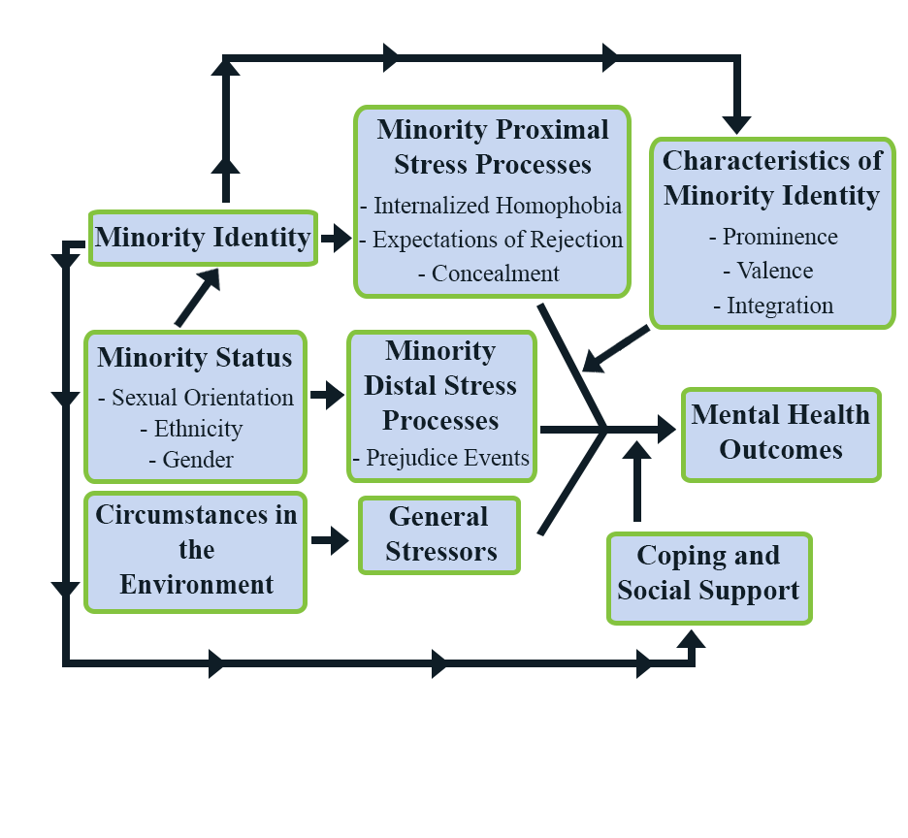
Minority Stress

Slide 6
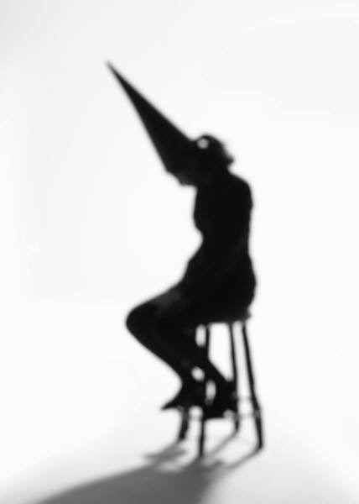
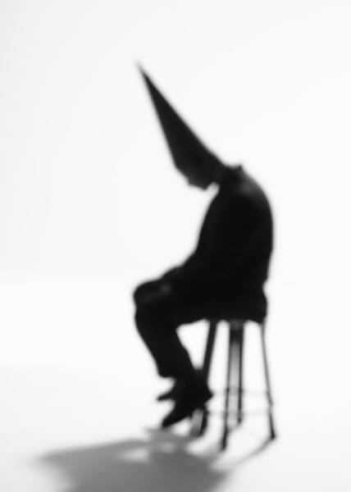
Concealment and Self-Esteem
Concealment of Sexual Minority Identity ≈
Lowered Self-Esteem (Legate, Ryan, and Weinstein, 2012)

Slide 7
Disclosure or Concealment
Do I disclose my sexual identity and risk discrimination and victimization?
Do I hide my sexual identity and continue to allow my self-esteem to decrease?

Slide 8
Exploring the Double Bind: Concealment’s vs Disclosure's Effect on Self-Esteem
This exploratory study investigates whether it is better for an LGBT individuals’ self-esteem to conceal their identity, or disclose it in spite of the increased risk for discrimination and victimization.

Slide 9
Method and Participants
730 sexual minority individuals between 18 and 91 (M= 30.10, SD = 13.83)
  recruited nationally
  from university affiliated LGBT groups, LGBT community organizations, and social networking websites (i.e., Facebook)
Demographics:
  Gender: female (45.7%), male (33.8%), transgender (M to F: 4.4%; F to M: 5.1%), and other/intersex (7.5%)
  Sexual orientation: gay (28.7%), lesbian (21.9%), bisexual (14.3%), straight (4.3%), pansexual (9.3%), queer (14.7%), questioning (1.4%), and other (2.4%)

Slide 10
Participants continued…
Definitions
  Sexual Orientation: Other – includes queer, questioning, heterosexual, or unspecified
  Gender: Other – includes intersex, gender queer, or not-specified
Ethnicity
  Caucasian (85%), Other (4%), Hispanic (3.2%), African American (1.7%), Asian American (1.7%), and Native American (1%)

Slide 11
Instruments
Outness (OI; Mohr & Fassinger, 2000)
Victimization (Herek & Berrill, 1990)
Discrimination (SHE; Selvidge, 2001)
Self-Esteem (RSES; Rosenberg, 1965)
Outcome variables:
  Outness Inventory totals
  Victimization totals
  Rosenberg Self-Esteem Scale totals
  Schedule for Heterosexist Events totals

Slide 12
Bivariate Correlations and Multiple Regressions
Bivariate Correlations – an analysis of the relationship between two separate variables
Multiple Regressions – an analyses that allows for researchers to predict part of the change in a variable based on other variable interactions and their effects.

Slide 13
Analyses
Prior to conducting multiple regression, we performed some bivariate correlations.
  Discrimination
  Victimization
  Outness
  Self-esteem
Multiple regressions were calculated to explore the association between outness and self-esteem
  Block one: age and gender (McMullin, & Cairney ,2004)
  Block two: victimization and discrimination
  Block three: outness
  Before conducting a multiple regression we performed bivariate correlations.

Slide 14
Results
The bivariate correlations were statistically significant.
  Positive associations between outness and self-esteem were observed r(648) = .317, p < .001
  Positive associations between outness and discrimination were observed r(648) = .195, p<.001
  Positive associations between outness and victimization were observed r(648) = .142, p<.001
The hierarchical regression model was significant overall (p<.001) accounted for 21.6% of the variance
  Demographics accounted for 11.8% of the variance overall
  Discrimination and Victimization account for 2.2% (p<.001) of the variance regarding self-esteem in Block Two
  But Outness was still significant beyond discrimination and victimization in Block Three ∆R² = .077, p < .001

Slide 15
Victimization
  We detected a positive bivariate association between victimization and outness. r(648) = .142, p<.001
  Victimization also had a negative effect on Self-Esteem. r(648) = -.142, p<.001
  However, the relationship between victimization and outness disappeared in the regression model, β = -.039, t (672) = -.856, p < .392
  Despite both of those correlational relationships, in the multiple regression analysis on the factors that influence outness and self-esteem, victimization did not have a significant effect. β = -.039, t (672) = -.856, p < .392

Slide 16
Discrimination
  We also detected a positive bivariate association between discrimination and outness. r(648) = .195, p<.001
  Discrimination also had an effect on self-esteem. r(648) = -.183, p <.001
  Unlike victimization, discrimination displayed a significant effect on the interactions between self-esteem and outness.
  β = -.184, t(672) = -4.015, p < .001

Slide 17
Discussion
This exploratory study suggest that after accounting for discrimination and victimization, outness accounted for a larger proportion of variance in a positive direction, β = .294, t (672) = 8.074, p < .001
Despite disclosure putting individuals at risk for victimization and discrimination, which decreases self-esteem, outness appears to have an overall positive effect on self-esteem, which may counter discrimination/victimization effects.
Victimization had less of an influence than was suggested by the bivariate correlations while discrimination had a significant effect.

Slide 18
Future Directions for Research
Investigate the effects of different environments, especially the effects of autonomic support (Legate et. al., 2011)
Investigating the effects of individual sexual identities and individual gender identities
Investigating the effects of occupation on Outness and self-esteem.

Slide 19
Limitations
This study was exploratory in nature there for the data used was collected from another study
Our sample was primarily Caucasian, gay, and lesbian so we missed some of our own minority demographics
Finally our study was primarily focused on age, gender, victimization, and discrimination so we may have missed some of the key factors that influence the choice to be out

Slide 20
Acknowledgement
I’d like to take a moment and acknowledge Professor Bryan Cochran, my graduate lab leader Nick Livingston, and my fellow lab members; Nicole Dusek, Kelly Engen, Adam Gott, Sienna Heinz, Billie Rae McCauley, Brandon Stewart, and Charlotte Siegel for their hard-work and collaboration on this project.

Slide 21
References
Clausell, E., & Roisman, G. I. (2009). Outness, big five personality traits, and same-sex relationship quality. Journal of Social and Personal Relationships, 26(2-3), 211-226.
Corrigan, P. W., & Matthews, A. K. (2003). Stigma and disclosure: Implications for coming out of the closet. Journal of Mental Health, 12(3), 235-248.
Herek, G. M., & Berrill, K. T. (1990). Anti-gay violence and mental health: Setting an agenda for research. Journal of Interpersonal Violence, 5(3), 414-423.
Legate, N., Ryan, R. M., Weinstein, N. (2011). Is Coming Out Always a “Good Thing”? Exploring the relations of Autonomy Support, Outness, and Wellness for Lesbian, Gay, and Bisexual individuals. Social Psychological and Personality Science, 3(2), 145-152.
McMullin, J. A., & Cairney, J. (2004). Self-esteem and the intersection of age, class, and gender. Journal of Aging Studies, 18(1), 75-90.
Meyer, I. H. (1995). Minority stress and mental health in gay men. Journal of Health and Social Behavior, 36(1), 38-56.
Meyer, I. H. (2003). Prejudice, social stress, and mental health in lesbian, gay, and bisexual populations: Conceptual issues and research evidence. Psychological Bulletin, 129(5), 674-697.

Slide 22
References
Mohr, J., & Fassinger, R. (2000). Measuring dimensions of lesbian and gay male experience. Measurement and Evaluation in Counseling and Development, 33(2), 66-90.
Padilla, Y. C., Crisp, C., & Rew, D. L. (2010). Parental acceptance and illegal drug use among gay, lesbian, and bisexual adolescents: Results from a national survey. Social Work, 55(3), 265-275.
Rosenberg, M. (1965) Society and the adolescent self-image. Princeton, NJ: Princeton University Press.
Ryan, C., Russell, S. T., Huebner, D., Diaz, R., & Sanchez, J. (2010). Family acceptance in adolescence and the health of LGBT young adults. Journal of Child and Adolescent Psychiatric Nursing, 23(4), 205-213.
Selvidge, M. M. D. (2001). The relationship of sexist events, heterosexist events, self-concealment and self-monitoring to psychological well-being in lesbian and bisexual women.

