Slide 1
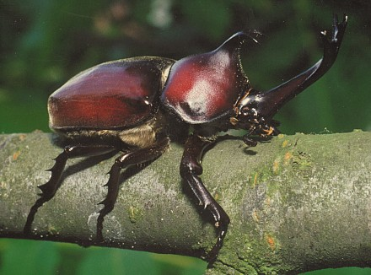
The Origin of Novel Morphologies: A Case Study of a Rhinoceros Beetle (Trypoxylus dichotomus)
Dylan Gomes

Slide 2
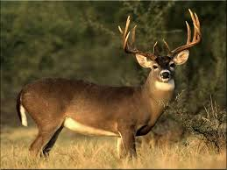
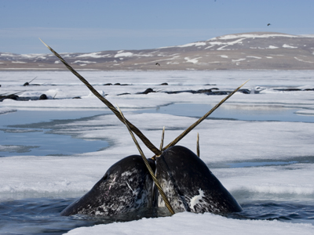
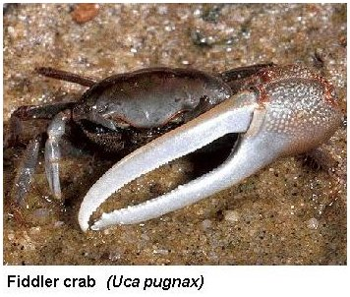
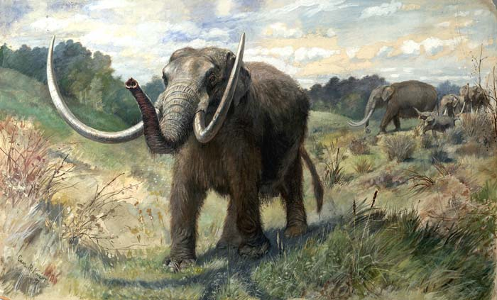
Notes:
Weapons are used throughout the animal kingdom to control access to resources, territories, or females. You are all probably familiar with examples like deer and elk, but there are many more such as narwhals, fiddler crabs, and mastodons, as well as…

Slide 3
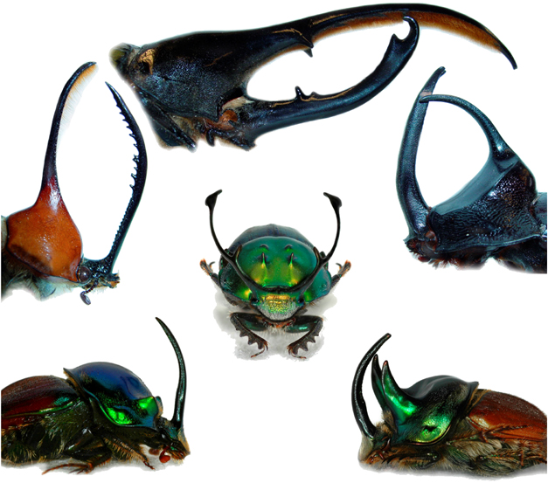
Emlen et al 2006
Notes:
Beetles! These beetle horns can be extremely large and even more impressive per their body size than the antlers of elk.

Slide 4
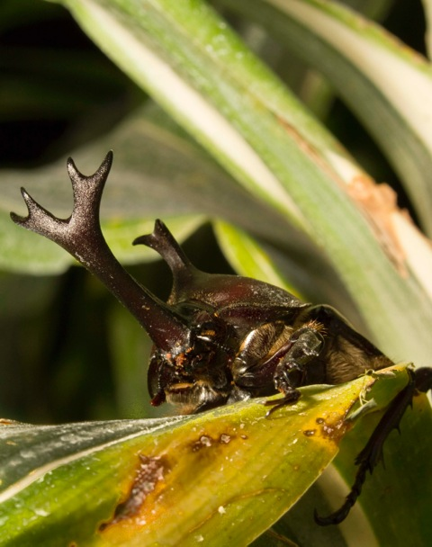
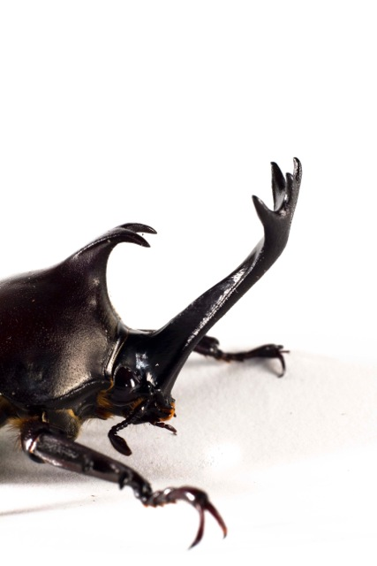
Notes:
The work I have done is with this rhinoceros beetle Trypoxylus dichotomus.

Slide 5
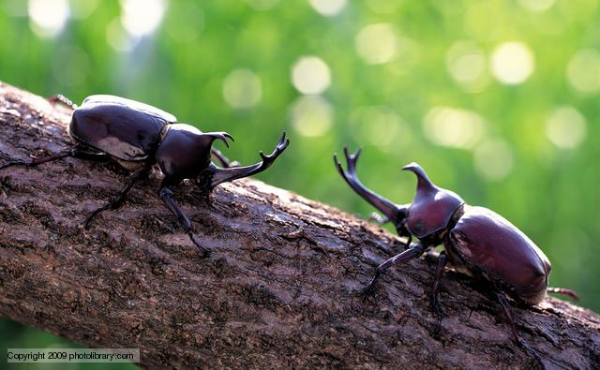
Notes:
Not only do they look extremely cool, but they use their horns in fights over access to females…

Slide 6
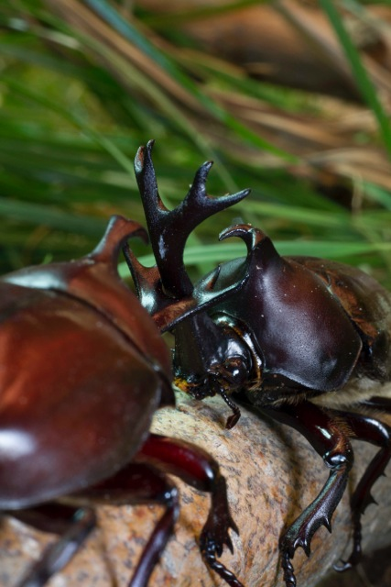
Notes:
…just as deer and elk might.

Slide 7
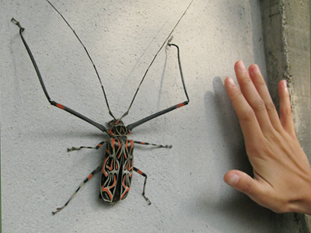
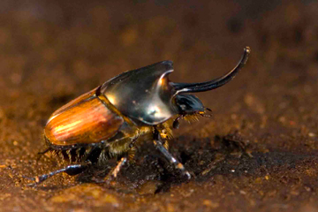
Weapon origins
Modified structure vs. Novel structure
Notes:
There is a fundamental difference between some of these weapons. Some have arisen by the modification of existing structures such as the forelegs of this harlequin beetle or the enlarged claw of a fiddler crab. Others have weapons that do not arise from a pre-existing structures. These weapons are said to arise de novo or of nothing. These novel structures appear to have sprang into existence and protrude from the body proper such as the horns on this dung beetle or the antlers of deer and elk.

Slide 8
“Evolution does not produce novelties from scratch. It works on what already exists…” -- François Jacob (1977)
Jacob, François. 1977. Evolution and Tinkering. Science 196(4295):1161-1166.
Notes:
The longstanding view of evolution, is that it works by slightly modifying or ‘tinkering’ with pre-existing structures.

Slide 9
“Evolution does not produce novelties from scratch. It works on what already exists…” -- François Jacob (1977)
If evolution tinkers, and it can only modify existing structures, how do novel structures arise?
Jacob, François. 1977. Evolution and Tinkering. Science 196(4295):1161-1166.
Notes:
So how is it that these novel structures can arise from nothing?

Slide 10
Emlen et al 2006
Notes:
To understand, we must look a little deeper into the organism. Specifically, we need to look at how these structures develop. For example, during the development of this dung beetle, horn size does not begin to increase until very late in development right before the animal molts from a larva into a pupa (as indicated by the blue line).

Slide 11
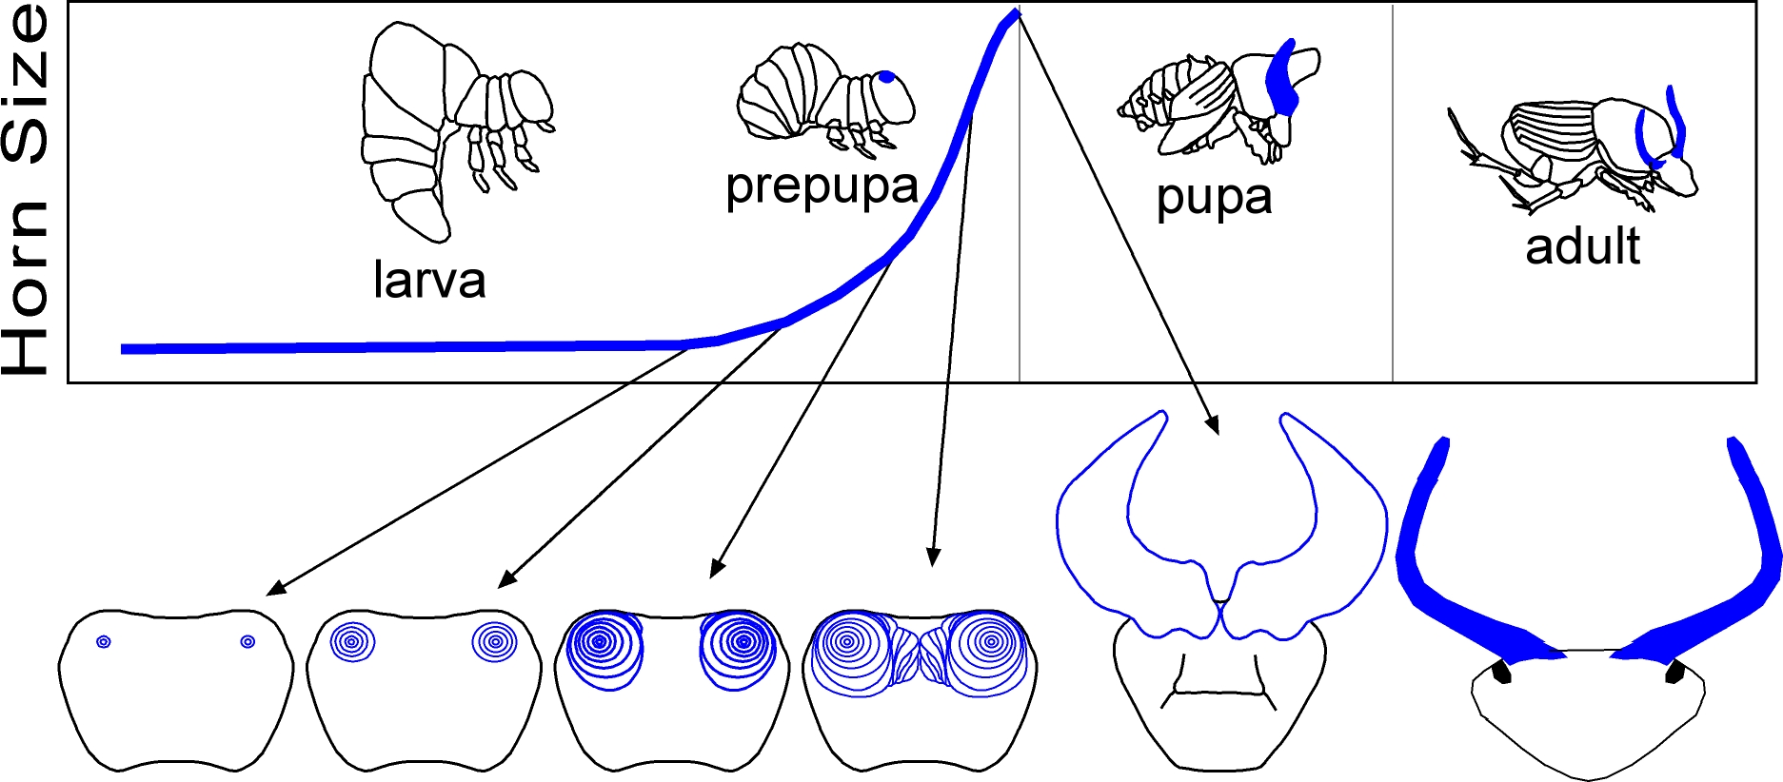
Emlen et al 2006
Notes:
These horns develop from what we call imaginal discs. On the bottom you can see these discs as rings that get larger as the beetle develops.

Slide 12
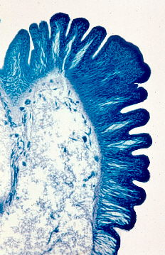
Emlen et al 2006
Notes:
When insects and other arthropods need to get larger they must molt and shed their rigid cuticle (or exoskeleton). As central points of the imaginal discs undergo rapid growth, the soft skin under the cuticle has nowhere to go and the large structures begin to fold up. Once they shed their old exoskeleton, they blow these structures up with fluid pressure and then harden them. At the top you can see the horn in blue folded up in this cross section. Each fold in the cross section corresponds to a ring from the imaginal discs below. Once the beetles reach a certain size they are able to molt and blow these horns up as shown to the bottom right.

Slide 13
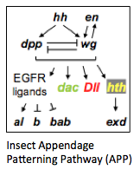
Appendage development
Notes:
In order to understand horn development we must understand what is causing these rings to grow so rapidly. Animal appendages, such as legs, also develop from imaginal discs via a complex suite of interacting genes. This gene network is known as the appendage patterning pathway (or APP for short) shown below. Cells that express these genes develop legs or other appendages, whereas cells that do not express these genes show no outgrowth.

Slide 14
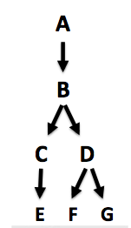
What is a pathway
Notes:
Before continuing, I want to explain what a pathway is. Over evolutionary time, the expression of one gene can begin to influence the expression of another gene if it is beneficial to pair them for a common purpose. For example, here the gene A influences B which can interact with C and D and so forth. These networks can be very complicated, but essentially the expression of a single gene has cascading effects on other genes, which can allow this one starting gene to have substantial downstream consequences.

Slide 15
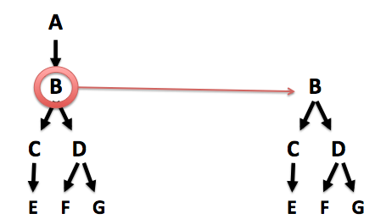
What is a pathway
Notes:
When even part of this pathway is now expressed in a new location the rest of the pathway automatically follows. Here gene B is turned on in a new location via a mutation and the entire cascading pathway has followed. This is what we call co-option of a pathway.

Slide 16
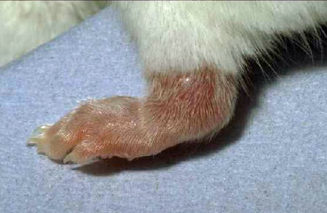
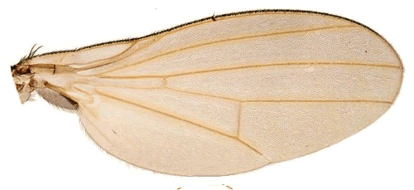
Notes:
Here is our appendage pathway again. I have mentioned that it is deployed in legs, but it is also deployed in insect antennae,

Slide 17
Notes:
Insect wings

Slide 18
Notes:
And even mammalian limbs such as in ourselves. This same pathway is used to develop all of these appendages, which is a pretty amazing phenomenon.

Slide 19
Appendage development
Notes:
To return to co-option, here is our appendage pathway again.

Slide 20
Co-opting pathways
Notes:
It turns out that when this gene cascade is turned on in a new location, it can form an entire new structure. To more fully illustrate this point: suppose we have a pathway that develops a leg (the APP in this case).

Slide 21
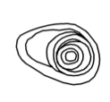
Co-opting pathways
Expressed in new location
Notes:
Then these APP genes are expressed in a new location when they had not been before. After growth in this new location…

Slide 22
Co-opting pathways
Expressed in new location
New structure arises
Notes:
something new develops than would otherwise. It is important to realize that this is not one step from legs to horns. Due to differences in chemical makeup of local cells, and modifications to this pathway over time, the resulting structure may be very different than the one that was originally coded for. In this case, it is the horn of a dung beetle. The take home point here is that the APP was co-opted in a new location which led to a novel outgrowth.

Slide 23
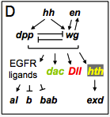
Appendage development
Moczek and Rose 2009
Notes:
To look at the same thing in a little more detail here is work done not too long ago in 2009. Expression of an important appendage patterning gene dll is labeled in red here, which ends up forming the very distal part of the leg. At the top of the slide is the leg developing on the inside of the exoskeleton and only becomes fully elongated in the adult. The colors in the leg are represented below in this diagram of the APP

Slide 24
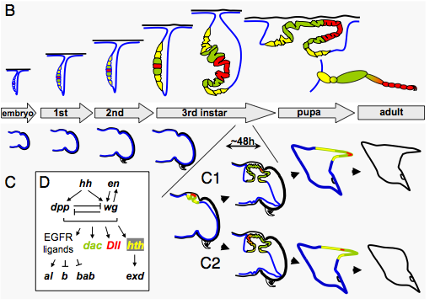
Appendage development
Moczek and Rose 2009
Notes:
Here is the gene expression in a dung beetle horn. Dll again forms the distal most tip of the horn. The gene expression (shown here by color-coding) is suggestive of APP co-option. The two appendages are developing in the exact same way.

Slide 25
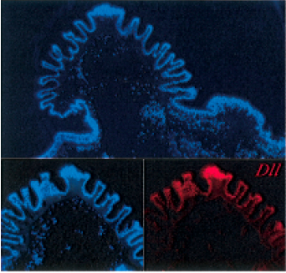
This pathway is involved in dung beetle horn development
Moczek & Nagy (2005)
Notes:
Moczek tagged dll sequences (displayed here in red) and showed that dll is clearly expressed during dung beetle horn development, which suggests that it plays an important role. Keep this in mind as we will later come back to expression of dll.

Slide 26
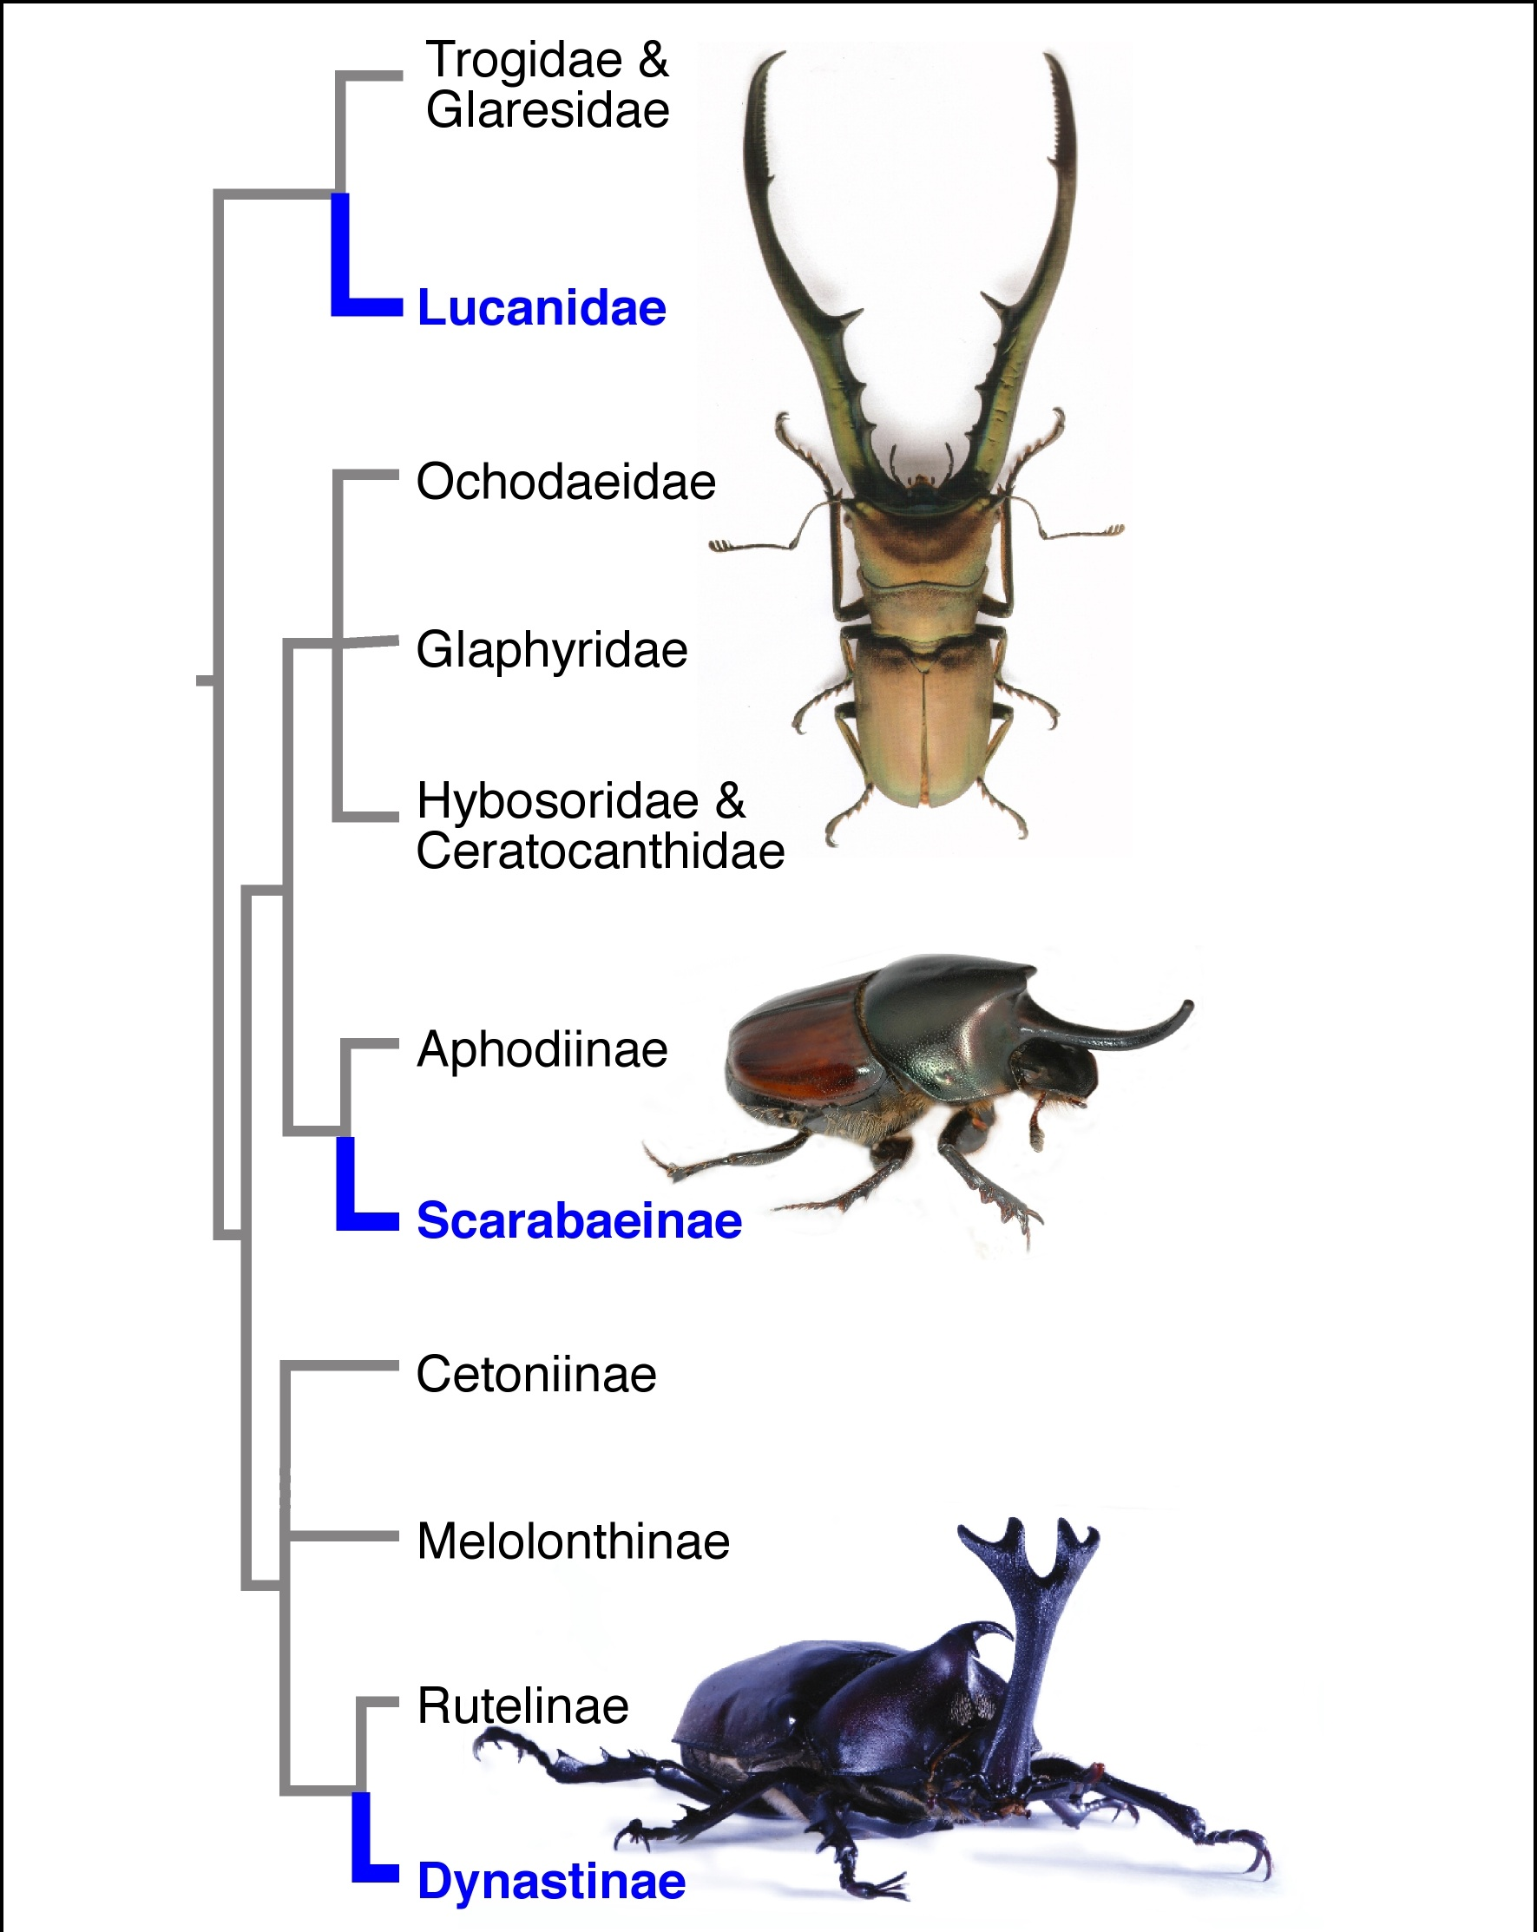
Dung beetles vs. Rhino beetles
Notes:
Everything I have shown you thus far has been on dung beetle horn development. Dung beetles appear to have co-opted the APP in the evolution of their horns. However, the rhinoceros beetles (circled here in yellow) are separated by 150 MY of evolution, and have independently evolved horns. This means that they may not have co-opted the same pathway. However, co-opting the APP is such a widespread phenomenon, that it is a great place to start looking for answers.

Slide 27
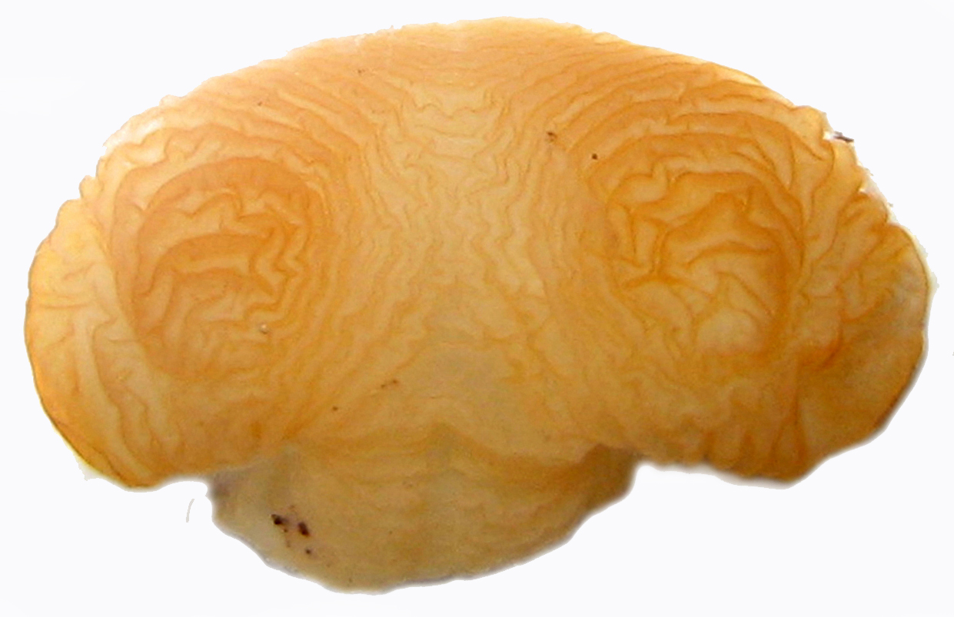
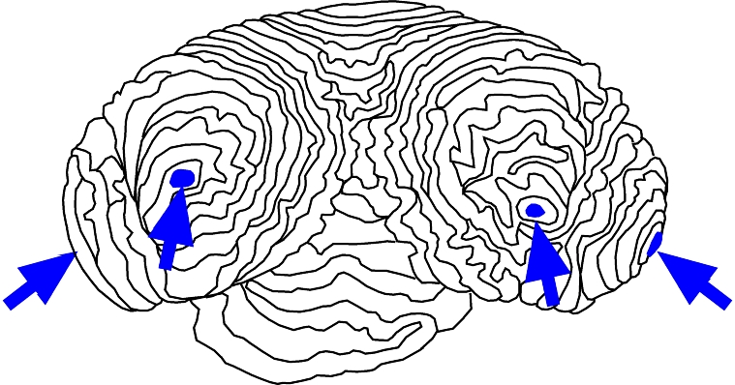
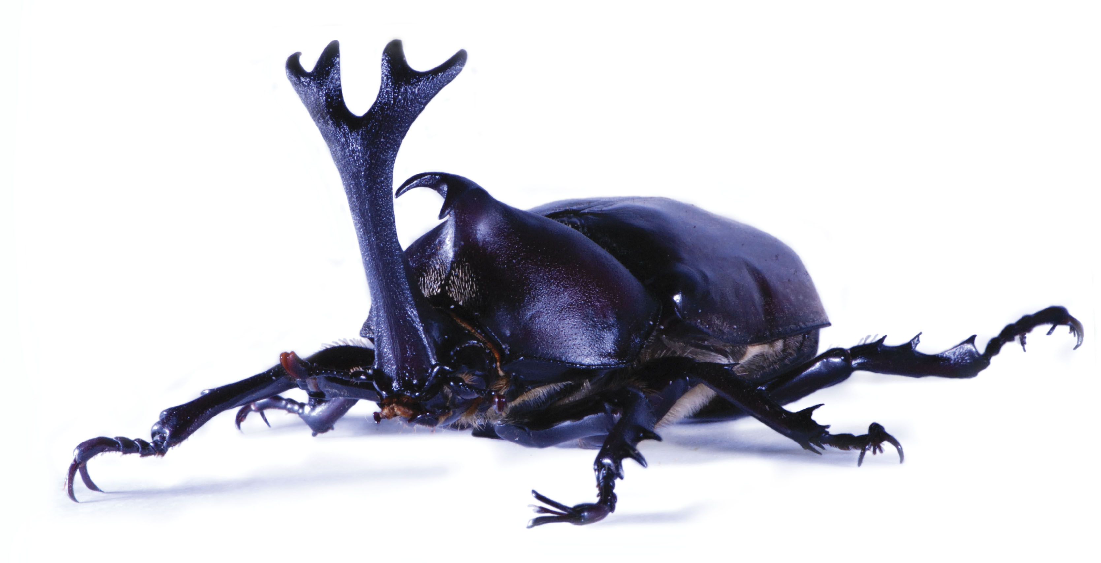
Notes:
When we look at the rhinoceros beetle horn tissues, we see imaginal discs much like those involved in the development of legs and in development of dung beetle horns. This begs the question.

Slide 28
Is the APP involved in rhinoceros beetle horn development?
Notes:
Is the APP involved in the development of rhinoceros beetle horns? How can we tease apart whether or not the APP is involved in the development of these weapons?

Slide 29
Is the APP involved in rhinoceros beetle horn development?
Knock down a gene from the APP
Decide if it effects horn development or not
Notes:
One way is to choose known genes from the APP and disable them to identify their function. If they play a part in the development of the horns, we should see a significant effect after knocking down a selected gene. So, how do we do this?

Slide 30
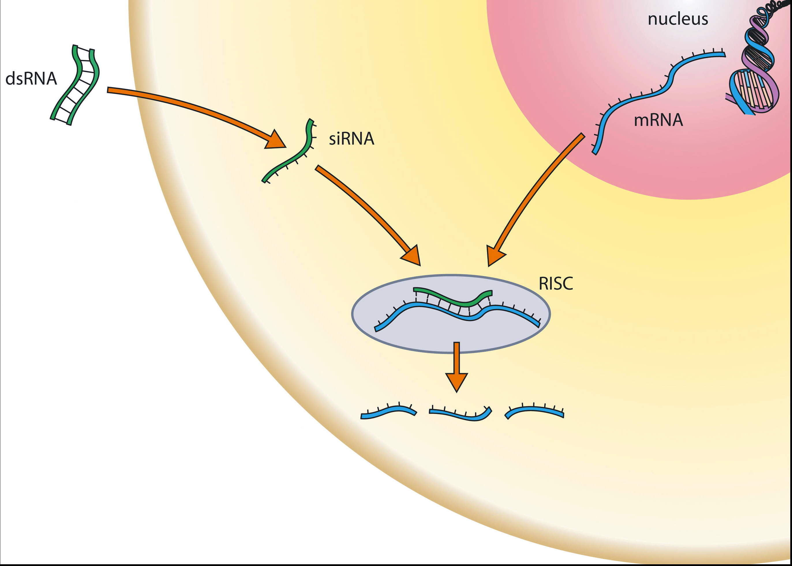
RNAi
Nucleus
Cell
DNA
mRNA
Notes:
We use a new technique called RNA interference or RNAi for short. I am going to take a moment to walk you through this. Generally a cell transcribes DNA into messenger RNA within its nucleus.

Slide 31
RNAi
Nucleus
Cell
DNA
mRNA
mRNA
Notes:
This mRNA then exits the nucleus into the cytoplasm of the cell..

Slide 32
RNAi
Nucleus
Cell
DNA
mRNA
mRNA
Protein
Notes:
Where it binds to a ribosome and is translated into a protein. The protein product is, effectively, the expression of a given DNA sequence (or a given gene).

Slide 33
RNAi
Nucleus
Cell
DNA
dsRNA
mRNA
mRNA
Protein
Notes:
However when a double stranded RNA molecule is introduced into the cell.

Slide 34
RNAi
Nucleus
Cell
DNA
dsRNA
mRNA
siRNA
mRNA
Protein
Notes:
The dsRNA is cut by a cellular enzyme called Dicer into a small interfering RNA (siRNA).

Slide 35
RNAi
Nucleus
Cell
DNA
dsRNA
mRNA
siRNA
RISC
mRNA
Protein
Notes:
A complex of proteins called the RNA-induced silencing complex (AKA RISC) binds to the siRNA molecules.

Slide 36
RNAi
Nucleus
Cell
DNA
dsRNA
mRNA
siRNA
RISC
mRNA
Protein
Notes:
Once they are bound together, RISC and the complementary sequence of siRNA binds to the targeted mRNA strand

Slide 37
RNAi
Nucleus
Cell
DNA
dsRNA
mRNA
siRNA
mRNA
RISC
Protein
Degraded RNA
Notes:
Which is then degraded.

Slide 38
RNAi
Nucleus
Cell
DNA
dsRNA
mRNA
siRNA
mRNA
RISC
Protein
Degraded RNA
Notes:
This blocks that particular mRNA molecule from being translated.

Slide 39
RNAi
Nucleus
Cell
DNA
dsRNA
mRNA
siRNA
mRNA
RISC
Protein
Degraded RNA
Notes:
Thus the protein is not made and the gene is not expressed. Because many different mRNA molecules are floating around in any given cell, we can inject an organism with dsRNA molecules that have complementary sequences to genes that we wish to turn off. If the targeted genes are important to our question, then we expect to see some noticeable difference in the overall appearance of the organism after development.

Slide 40
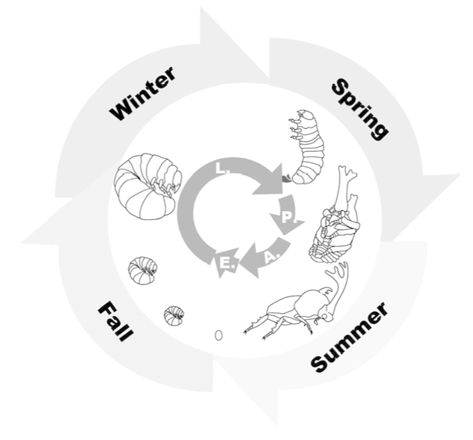
Notes:
So when do we inject dsRNA? Here is the life cycle of my study organism Trypoxylus dichotomus. If you follow the inside arrows in a complete circle each letter represents stages from egg to larva to pupa and finally to adult.

Slide 41
dsRNA injection
Notes:
dsRNA is injected before they begin to grow the horns so that the targeted genes will be silenced before they have a chance to be expressed.

Slide 42
dsRNA injection
?
Measure adult horn characteristics
Notes:
Adult horn characteristics are then measured after development to look for differences between between the RNAi and control groups.

Slide 43
?
Measure adult horn characteristics
Notes:
Here is a very recent example of a dll knockdown that our collaborators in Japan did. This is the same gene that Moczek found to play a role in the dung beetles. Which if you remember are different than these rhinoceros beetles.

Slide 44
RNAi
Control
Dll Knockdown
Notes:
The results of the dll RNA interference are striking! The knockdown severely messed up the forewings (elytra) and the hindwings (which are just underneath the protective elytra as well as removed any traces of legs.

Slide 45
RNAi
Control
Dll Knockdown
Notes:
This is no surprise if you remember that distaless plays an important role in appendage development of legs and wings. The horn, however, appears to be intact. This is the surprise because it is NOT what was found in dung beetles. In the dung beetles dll is important for legs, wings, AND horns! This suggests that rhinoceros beetles may have evolved a different way to build horns.

Slide 46
Candidate genes from APP
1) Empty spiracles (ems)
2) Insulin gene enhancer protein isl-1-like
3) Homeotic protein ultrabithorax-like
Notes:
In order to do this type of RNAi experiment, the researcher needs the gene sequence ahead of time. Luckily for me, our collaborators in Japan have sequenced all of the mRNA expressed in horn tissue. This allowed me to choose three candidate genes that are known to play a role in the APP. I used these sequences to create the dsRNA to induce RNAi, which acts to knock down the targeted genes.

Slide 47
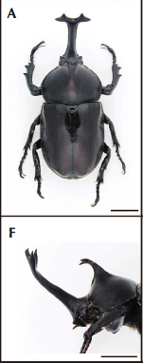
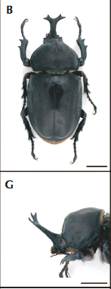
Control
Dsx knockdown
Removal of doublesex gene:
Shortened HH
Removed TH
Ito et al 2013
Notes:
These are results that were just published in 2013 by our collaborators in Japan. They did similar experiments with a gene from different pathway – not the APP. When T.d. was injected with the dsRNA for the gene dsx, the head horn was reduced in size and the thoracic horn completely disappeared.

Slide 48
Expected results!
Control
Dsx knockdown
Removal of doublesex gene:
Shortened HH
Removed TH
Ito et al 2013
Notes:
My project involves measuring these same horn characteristics, and I expect my results to have similar sorts of consequences as we see here (such as reduction and complete deletion of the horns) if they in fact play a role in horn development.

Slide 49
Methods
Came up with candidate genes
Synthesized dsRNA
Injected beetle larvae
Measured adult structures…
Notes:
These beetle larvae are relatively long-lived and take about a year to metamorphose into adults. While the molecular work is complete, the pupae have not begun metamorphosing into adults.

Slide 50
Expecting results soon
Notes:
So stay tuned for a couple weeks as the beetles develop! I want to take a moment to say that this is exciting work that relies on very modern advances to molecular biology. Five or so years ago this type of thing would have been impossible to do. RNA interference has recently exploded as a genetic tool, and it is allowing us to answer questions about the evolutionary history of these beetles that we wouldn’t be able to answer otherwise.

Slide 51
“Evolution does not produce novelties from scratch. It works on what already exists…” -- François Jacob (1977)
Dung Beetle
Rhinoceros Beetle
Jacob, François. 1977. Evolution and Tinkering. Science 196(4295):1161-1166.
Notes:
It is also turning our view of novel morphologies upside-down. Are these beetle horns truly a novel structure? In the case of the dung beetle, the horn arose from no other pre-existing structure, however, It did not arise from nothing at all. There has been a co-option of a pre-existing pathway. So it is really only novel at the morphological level, but not novel at the molecular level. It depends on how you look at it. The first look into rhinoceros beetle development suggests that this same pathway is not co-opted.
This would suggest that rhinoceros beetles have evolved a fundamentally different mechanism of horn growth, which is very exciting considering that every other insect appendage uses the same pathway.

Slide 52
Thank you
Emlen Lab
Jema Rushe!!!!
Doug Emlen
Cerisse Allen
Jen Smith
Erin McCullough
Devin O’Brian
Kim Ledger
Collaborators:
Nagoya University, Japan – Dr. Niimi
WSU – Lavine Lab
Good Lab
Sara Keeble

Slide 53
Questions?

Slide 54
Methods
Extracted DNA from T. dichotomus
Design primers
PCR
Gel electrophoresis (purification)
Transcription reaction
dsRNA injection
Allow development
Measure horn characteristics of adults
Notes:
I began by simultaneously extracting template DNA and designing primers. The primers were designed using computer software and candidate sequences we got from our collaborators. Primer. Polymerase chain reactions (PCR) was run with primers and template DNA to get loads and loads of our targeted sequence amplified. I then ran gels to allow targeted sequences to separate from all other unwanted sequences including primers. Transcription reactions were then performed on these targeted DNA segments to get dsRNA for the injections.

