Slide 1
HOW SHOULD WE TEACH HUMAN SEXUALITY AT THE UNIVERSITY OF MONTANA?
Sandi O’Brien
sandi.obrien@umontana.edu
Anthropology

Slide 2
Voluntary Survey
Anonymous, voluntary survey distributed to ANTY 227 in February 2014
The sample population is demographically representative, drawn from ages 18-60; freshmen to seniors, and numerous majors.
Of 148 students enrolled, 44% volunteered to complete the survey

Slide 3
The Questions

Slide 4
1. What is Title Nine of the Civil Rights Act? Who must comply? What does it require?
45% answered
55% did not answer

Slide 6
2. What is Title Seven of the Civil Rights Act? Who must comply? What does it require?
14% answered
86% did not answer

Slide 8
3. Should UM offer the course, Human Sexuality? What should be included in the syllabus?
100% Yes Responses

Slide 9
Suggestions for Inclusion on Syllabus on Human Sexuality Course

Slide 10
“Absolutely. This course is very important, and I think it should be included as a Gen. Ed. High School sex ed. is very lacking and this course has valuable info everyone should know.”

Slide 11
“Yes the UM should offer this course and it should continue to explore the views of sexuality across the world.”

Slide 12
“Yes . . . Include reproductive anatomy, endocrine system, where we get our sexuality info and what a[re] true facts or myths.”

Slide 13
4. Should the course be offered through Health and Human Performance in the tradition of sexuality education, or as a broader discussion of human sexuality in critical perspectives (evolutionary, cross-cultural and global/international discussion of human rights)?
94 % responded

Slide 14
Course Offerings Comments
“The more facets to the class, the better! Sexuality encompasses so many aspects of life, as should the class.”
“There should be both.” “…there is too much to learn about, not just one or the other.”

Slide 15
“It should include a broader discussion of human sexuality in critical perspectives.”
“Cross-cultural and global/international.”

Slide 16
“a blend of the two is most effective.”
“Offer through other disciplines because its important and if you receive VA benefits they won’t help w/HHP course.”

Slide 17
5. What information and sources should be used?
98% Responded

Slide 18
“King[text book] is good, he is followed in the course too much. Good text but can be biased.”

Slide 19
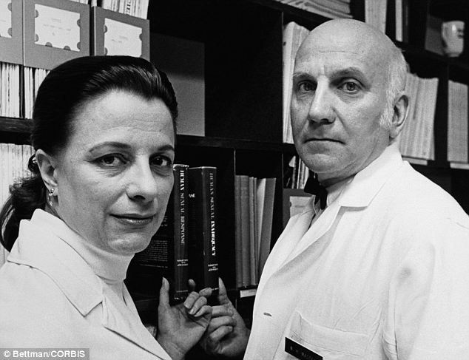
“Textbook, research, asking anonymous opinion.”

Slide 20
“Fun Facts”

Slide 21
“Anything…which is credible & helpful in de-stigmatizing sexuality.”

Slide 22
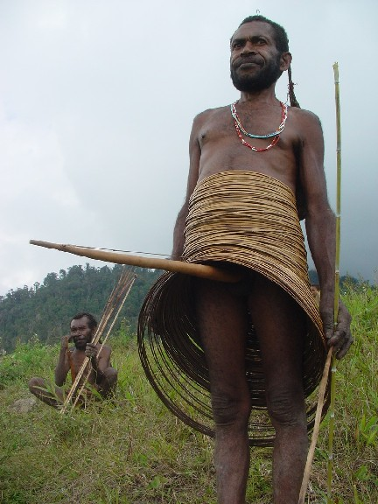
“Info about other cultures…as well as things like transgender, intersex, etc. in our own society”

Slide 23
“Kama Sutra”

Slide 24
6. How should Title Nine and Title Seven requirements be conveyed to students of higher education institutions--through mandatory tutorials, courses for credit, public lecture series, an orientation session or other method?
49% Responded
“PETSA tutorial was not well received”

Slide 26
7. How should Title Nine and Title Seven requirements be conveyed to employees of higher education institutions--through mandatory tutorials, courses for credit, public lecture series, an orientation session or other method?
41% Responded
“(mandatory should be more acceptable for those being paid to take it)”

Slide 28
8. What sexuality education, if any, should be provided beyond K-12 public education?
97% responded

Slide 29
Responses
“Safe sex, STI prevention, prevent pregnancy”
“learning about more than just the gender binary, other cultures and customs…not just straight or gay.”

Slide 30
“A lot more than there is now. You’d be surprised how uneducated most of us are about all things sexual.”

Slide 31
“Voluntary college classes”
“Classes like this should be present in every university”
“Lectures”

Slide 32
“None… go online or talk to someone.”

Slide 33
CONCLUSIONS

Slide 34
RESEARCH IS ONGOING
Will student opinions change when the survey is completed near the end of the course?
Students are receptive to interdisciplinary pedagogy of human sexuality - legal issues, biological, and cross-cultural perspectives

Slide 35
ADDITIONAL THOUGHTS
Create a broader survey of students to allow student involvement in designing the pedagogy of human sexuality.
Student designed PETSA course disseminated to students and staff.

Slide 36
ACKNOWLEDGEMENTS:
Thank you to Professor G.G. Weix, Ph.D., my mentor and advisor who encouraged and guided me.
Thank you to Erin Steuer, TA for ANTY 227 Human Sexuality.
Special thanks to the 65 students enrolled in ANTY 227 Human Sexuality who voluntarily and anonymously provided candid responses to the survey questions presented.

