Slide 1
Wilderness as a Social Movement: Expanding Cultural Relevance in the 21st Century
Dylan Lang
UMCUR 2014

Slide 2
Background
2014 will mark the 50th Anniversary of the Wilderness Act and the Civil Rights Act
The Civil Rights Act guaranteed equal protection under the law for all people, regardless of “race, color, religion, sex, or national origin.”
The Wilderness Act established the National Wilderness Preservation System, a collection of areas protected “unimpaired for future use and enjoyment as wilderness.”

Slide 3
Background
Both acts rose out of large social movements around half a century in the making.
Both acts faced long fights in Congress.
Both acts passed with strong support.
The Civil Rights Act: over 70 percent of the vote in both houses
The Wilderness Act: passed the Senate by over 85 percent, only one dissenting vote in the House of Representatives.
Both acts have had significant effects on the American political and social landscapes.
However, there is little to no formal research examining the overlap between the two acts’ backgrounds and effects.

Slide 4
Some Facts
In 2008, 90% of the supporters and donors to the Nature Conservancy were white and over 50. The Sierra Club and The Wilderness Society are criticized for similar statistics.
By 2050, less than 50% of the US population will be non-Hispanic whites.
Minorities outnumber non-Hispanic whites in over 25% of American cities.
By 2030, 25% of the world’s protected natural areas will be within 9 miles of a city.
So what?

Slide 5
Overview
Recreation Trends
The Importance of Relevance
The Original Wilderness Thinkers: Leopold, MacKaye, and Marshall
The Wilderness Movement in the 21st Century

Slide 6
Recreation Trends
National Park Service (2011)
28% of African Americans surveyed could name an NPS unit they had visited in the prior two years
Of all confirmed park visitors, African Americans made up only 12%.
Why?
Too busy
Parks too far away
Lack of knowledge

Slide 7
3 Constraints on Wildland Use
Skill, Interest, and Knowledge
Proximity
Time

Slide 8
Why does relevance matter?
“On the one hand, one of my own most important environmental ethics is that people should always be conscious that they are part of the natural world, inextricably tied to the ecological systems that sustain their lives….On the other hand, I also think it is no less crucial for us to recognize and honor nonhuman nature as a world we did not create, a world with its own independent, nonhuman reasons for being as it is.”
-William Cronon
“The wildland meaning variable substantially reduced the direct effect of race on visitation. This finding implies that differences in wildland visitation correspond, in part, to differences in how respondents perceived wild areas.”
-Johnson et al. (1997)

Slide 9
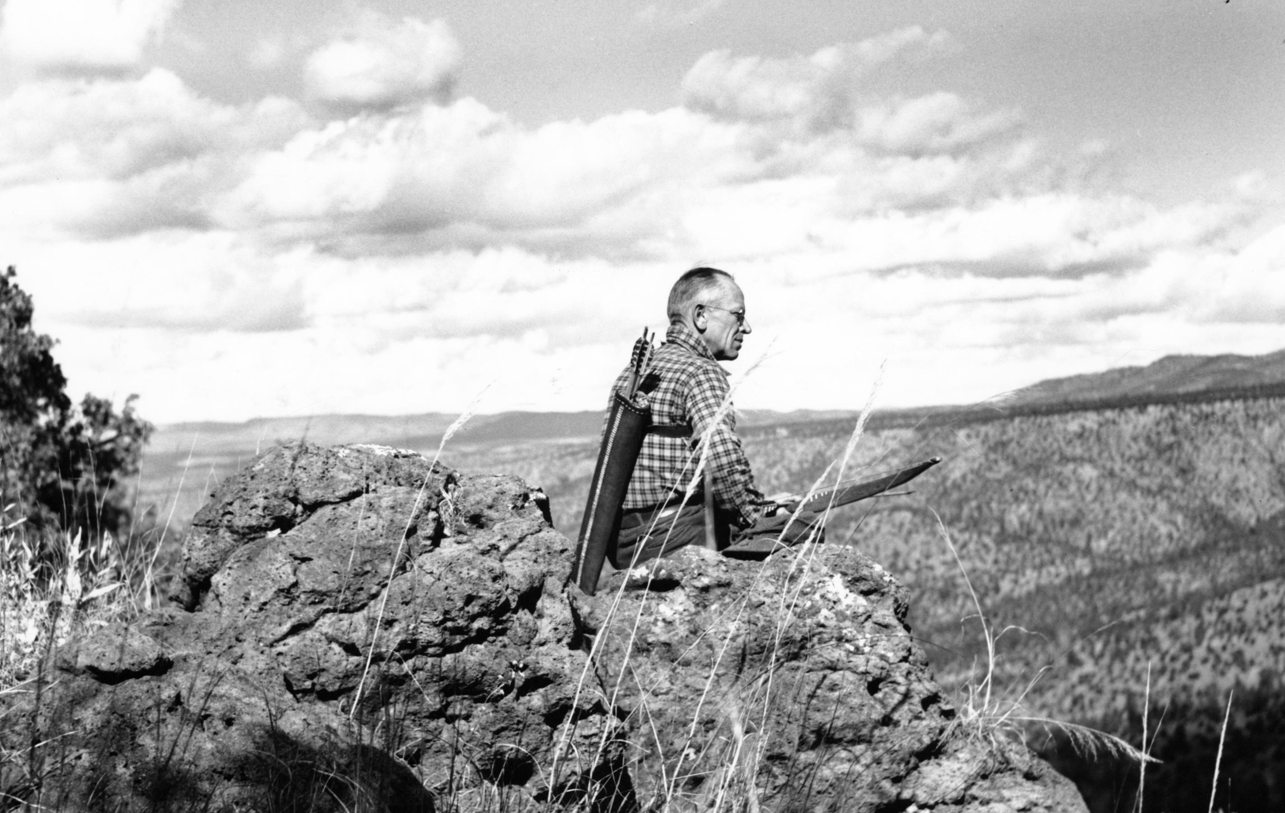
“In short, a land ethic changes the role of Homo sapiens from conqueror of the land-community to plain member and citizen of it. It implies respect for his fellow-members, and also respect for the community as such.”
-Aldo Leopold

Slide 10
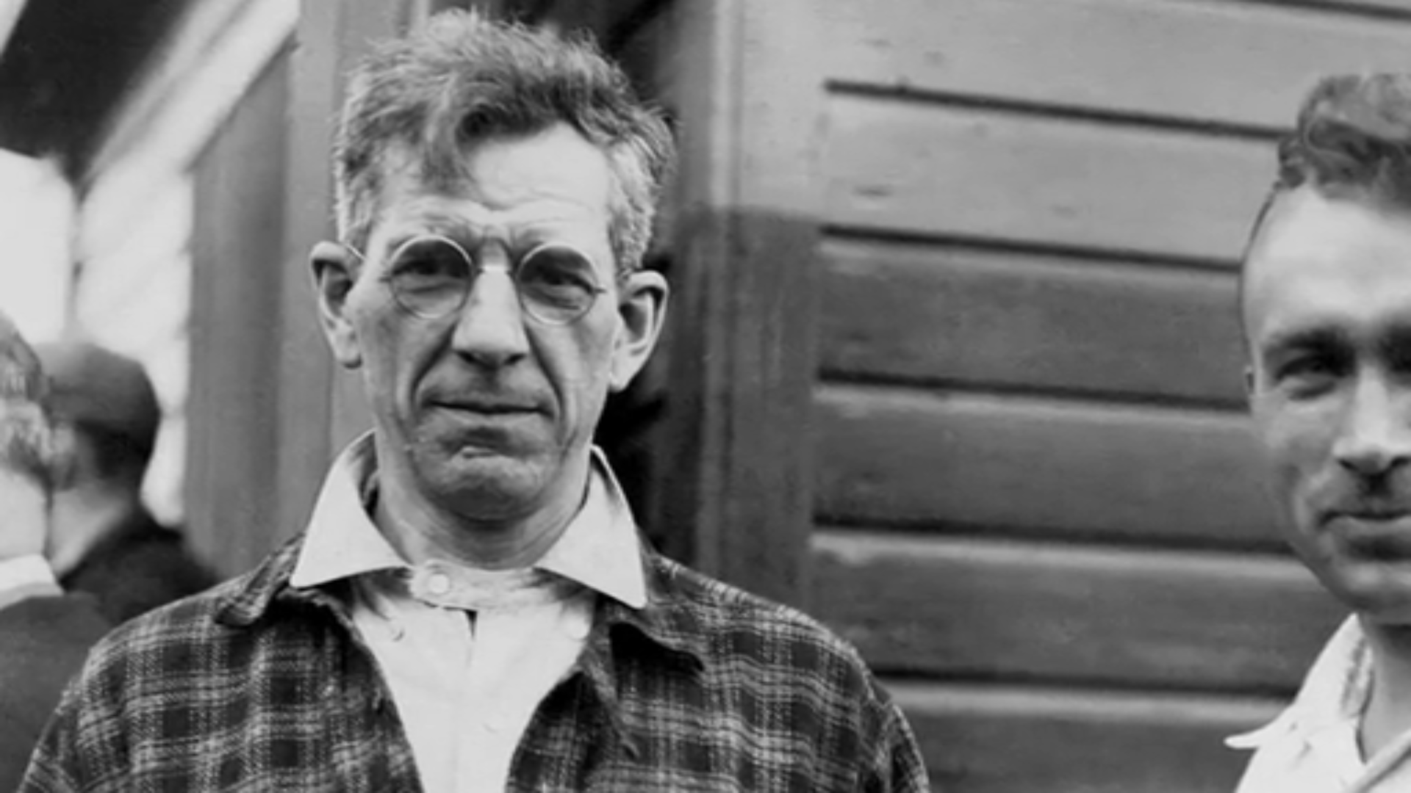
“The effect of an unbalanced industrial life, [the modern metropolis] is the cause of an unbalanced recreational life. For its hectic influence widens the breach between normal work and play by segmenting the worst elements in each. It divorces them into drubbing mechanized toil on the one hand and a species of ‘lollipopedness’ on the other.”
-Benton MacKaye

Slide 11
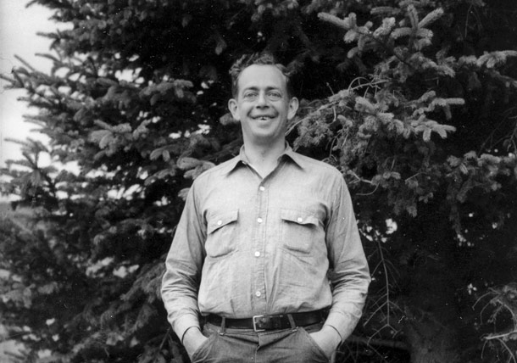
“Why should tolerance extend only to tastes and modes of life which extort acquiescence by the multitude of their adherents?”
-Bob Marshall

Slide 12
The Future
Proximity and Urban Wilderness
Access
Availability of Information
Differing Cultural Knowledge and Worldviews
Creating Relevance
Fostering a Relationship
Stewardship

Slide 13
“By and large, our present problem is one of attitudes and implements. We are remodeling the Alhambra with a steam-shovel, and we are proud of our yardage. We shall hardly relinquish the shovel, which after all has many good points, but we are in need of gentler and more objective criteria for its successful use.”
-Aldo Leopold

