Slide 1
Arctic Climate Change
And the effects on bowhead whales and their environment

Slide 2
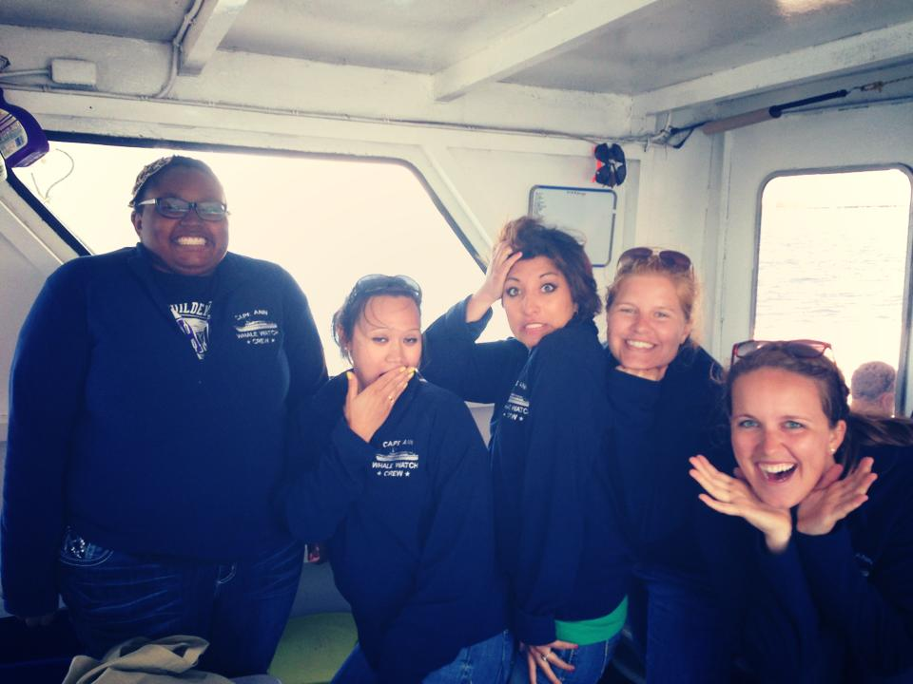
A little about me
Who am I?
How did I develop an interest in whales?
Why is this important to me?

Slide 3
Taking pictures off the bow of the boat
Waiting for a humpback whale to surface

Slide 4
What are bowhead whales
Bowhead are a large whale with a weight of between 75-100 tons and a length of roughly 35-40 ft.
Currently their lifespan is unknown
They tend to eat small organisms,
They are currently located in the waters adjacent to the arctic seas.

Slide 5
Three Major Questions
Guiding Research Questions:
What are the anticipated impacts of arctic climate change, including melting sea ice and warming temperatures on bowhead whales and their environment?
How are human activities currently impacting bowhead whales and what are the potential impacts of an expected expansion of those activities in the arctic?
What are the models conservation science and action that are designed to ensure the health and survival of this unique species?

Slide 6
Impacts of Climate Change

Slide 7
Impacts of Climate Change
Opens water ways for new predation will increase
Changes in the food web
Warmer waters could put a strain on bowhead whales
Could cause a shift in migration putting stress on reproduction and feeding destinations.

Slide 8
Impacts of Climate Change on Bowheads
Direct
Indirect
Loss of sea ice platform
Reduction of suitable habitat for feeding, resting, and breeding
Movement and distribution will be affected
Loss of substrate for prey
Increased incidence of severe weather
Hypothermia, drowning, stranding from exhaustion
Changes in infectious disease transmissions
Increased host density due to reduced habitat, increasing density-dependent diseases
Epidemic disease due to host or vector range expansion
Increased survival of pathogens in the environment
Alterations in the predator-prey relationship
Affected body conditions and potentially, immune functions

Slide 9
Impacts of Climate Change
Warming ocean are expected to affect whales via loss of habitat because each species has a distinct thermal range that it has evolved to exploit. This can cause potential changes in their prey distribution and numbers.
Warming in the ocean including ice cover in the Arctic is projected to lead to increased shipping, oil and gas exploration, and fishing, which is likely to result in additional noise and chemical pollution and increased cetacean bycatch.

Slide 10
Human Impacts

Slide 11
Human Impacts
Marine mammals are known to be very sensitive to sound using it for almost all important aspects of their life, including feeding, reproduction, and navigation.
With melting sea ice, transportation will increase with routes becoming accessible.
Increasing CO2 has lead to the belief that the seawater is becoming more acidic harming small vulnerable organisms.
Open ocean brings out more fishermen bringing in more bycatch.

Slide 12
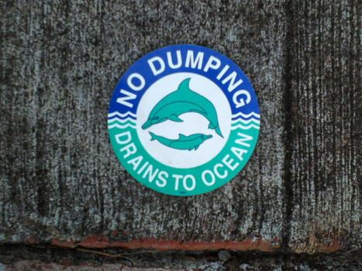
Human Impacts
Pre-1900
Post-1900
Whaling
Transportation
Oil and Gas Drilling
Transportation
Whaling
Contaminants

Slide 13
Oil drilling and Transportation
Whales are sensitive to sounds, they use sounds for all aspects of their life. This includes feeding, reproducing, navigation, and communication.

Slide 14
Conservation Efforts of Past, Present, and Future

Slide 15
Conservation
Before the twentieth century many whales were hunted to the brink of extinction
By the early twentieth century concern over the severe depletion of whale stocks led conservationists and whalers to advocate some form of international regulation
The first attempted took place in 1931- this gave birth to the International Whale Commission (IWC)
Since the 1930’s whale conservation has had a checkered past

Slide 16
Conservation
For future conservation these problems need to be looked at:
Whaling
Trash
Noise and chemical pollution
Transportation routes

Slide 17
Conclusion

Slide 18
Questions, Comments, Concerns
Sir Peter Scott famously said ‘If we can’t save the whales…we have little chance of saving anything else.”
Simmonds and Hutchinson added ‘and to save the whales you need to save the seas’.

Slide 19
References
Allen, Robert C, Ian Keay, and I A N Keay. “Saving the Whales : Lessons from the Extinction of the Eastern Arctic Bowhead.” 64.2 (2014): 400–432. Print.
Barrow, Whaling et al. “Climate Variability , Oceanography , Bowhead Whale Distribution , and Iñupiat Subsistence Climate Variability , Oceanography , Bowhead Whale Distribution , and Inupiat Subsistence Whaling near Barrow , Alaska.” (2014): n. pag. Print.
Bluhm, Bodil A et al. “Regional Variability in Food Availability for Arctic Marine Mammals REGIONAL VARIABILITY IN FOOD AVAILABILITY.” 18.2 (2014): n. pag. Print.
Brakes, Philippa and Mark Simmonds. Whales and Dolphins; Cognition, Culture, Conservation, and Human Perceptions. London: EarthScan, 2011. Print.
Carolyn Symon, Lelani Arris, and Bill Heal, ed. Arctic Climate Impact Assessment. Cambridge: N. p., 2005. Print.
Kovacs, Kit M. et al. “Impacts of Changing Sea-Ice Conditions on Arctic Marine Mammals.” Marine Biodiversity 41.1 (2010): 181–194. Web. 22 Jan. 2014.
Thank you to:
Dr. Sarah Halvorson
Sara Williams
And The University of Montana

