Slide 1
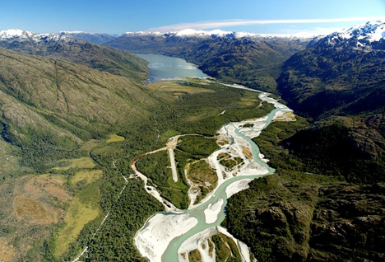
HidroAysén: protest & Environmental Justice in Chilean Patagonia
David Schaad
April 11, 2014
UMCUR
Image Credits: umt.edu; plataformaurbana.cl; thenextweb.com

Slide 2
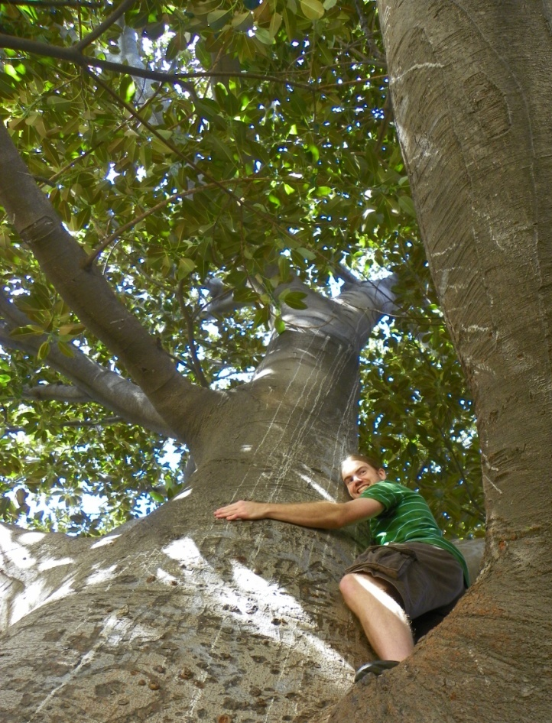
Introduction – Personal Background
M: Environmental Studies & Spanish
m: Latin American Studies, Climate Change, International Development
Spring 2012: academic study abroad in Valparaíso, Chile
The author in a “gomero” tree, Valparaíso, Chile

Slide 3
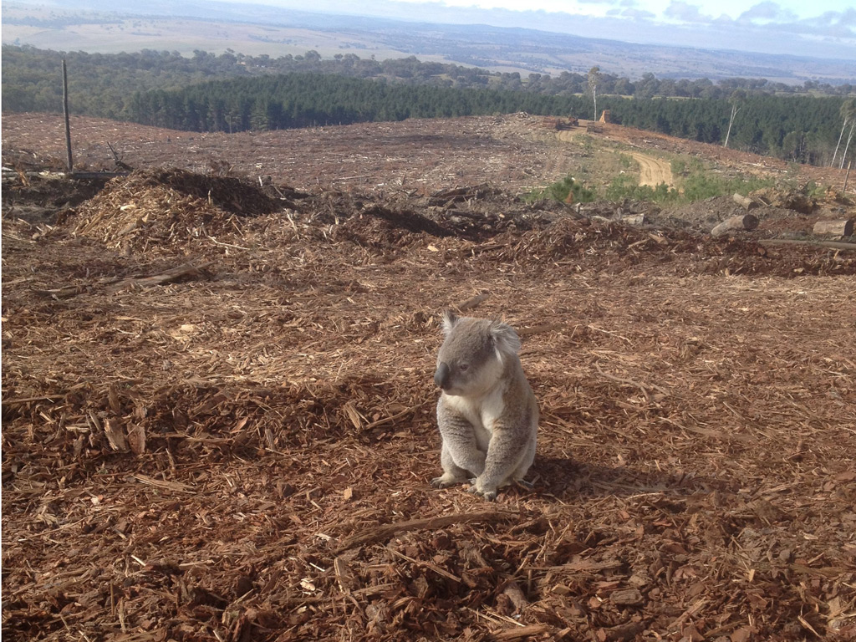
Audience Query: Personal Experience with Ecological Loss
Image Credit: The Guardian (UK)

Slide 4
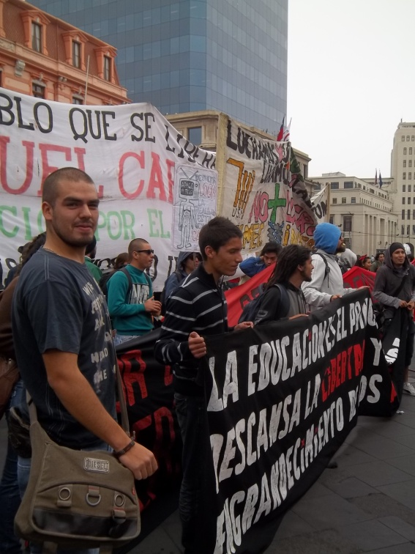
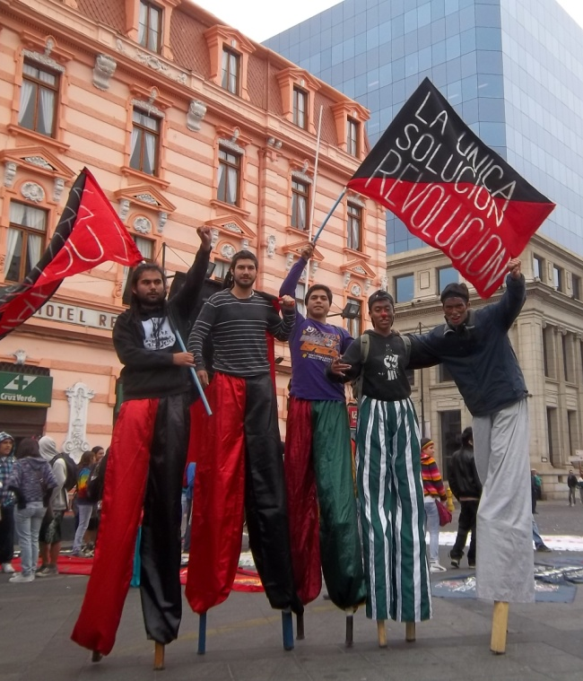
¿Adónde Vamos? (Our Road Map)
HidroAysén – issues & background
Environmental justice issues – what is at stake?
Social context of protest in Chile & HidroAysén

Slide 5
What is Environmental Justice (EJ)?
Social justice in an environmental context
Environmental justice efforts focus on achieving equitable environmental protection
Environment: “Where we live, work, play, pray, and learn”
Image Credit: arb.ca.gov

Slide 6
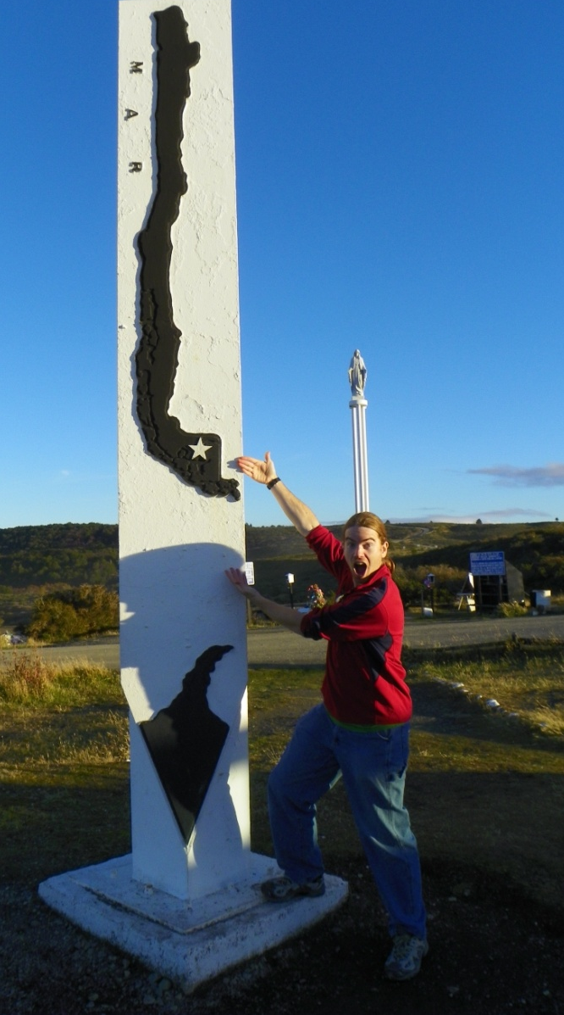
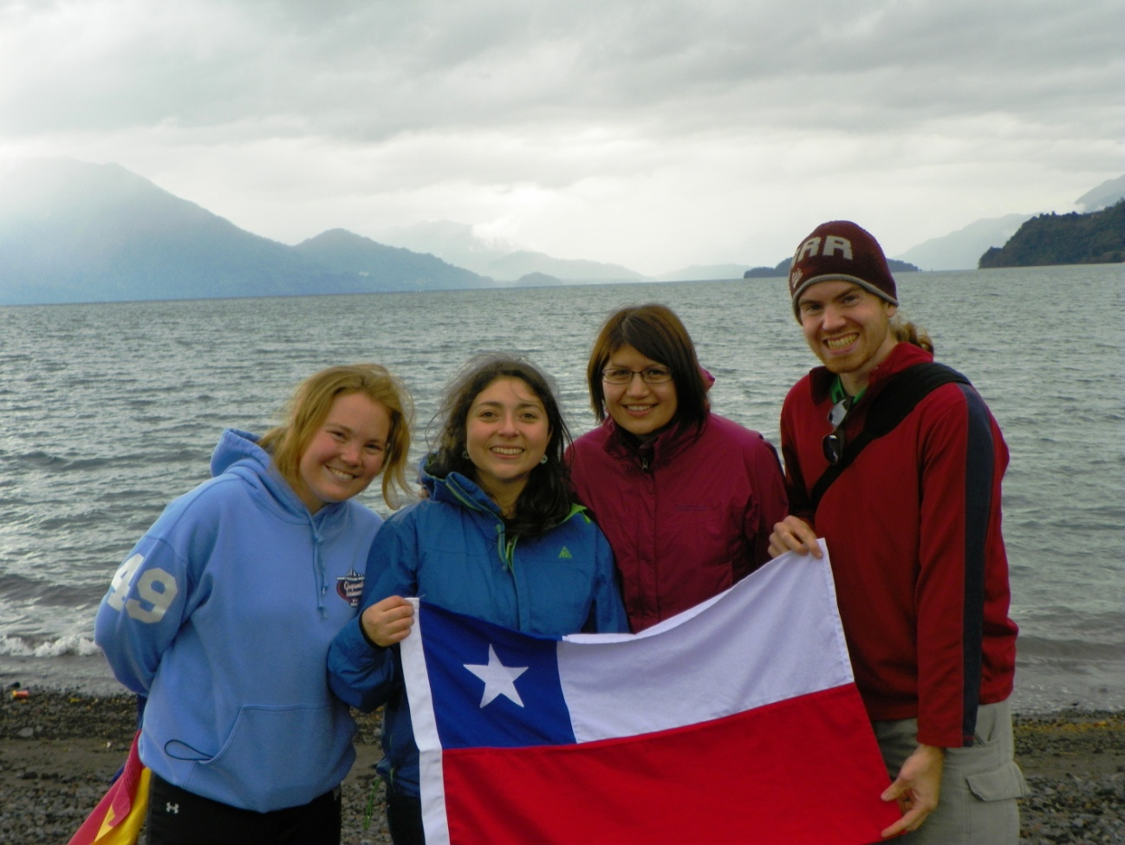
Research Design & Methods
Personal experience in Chile
Secondary source research
Interview(s)

Slide 7
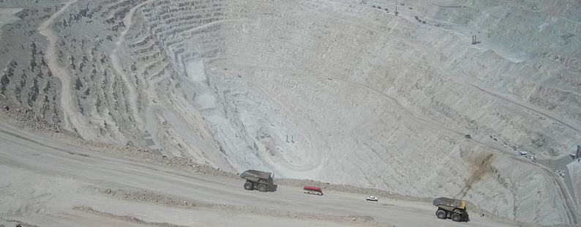
Chile – Energy Demand
Image Credit: Wikipedia
Net importer of electricity
Electricity consumption will double by 2025
Central Chile: electricity demand high
Energy-intensive mining sector: Chuquicamata Mine

Slide 8
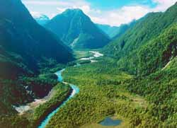
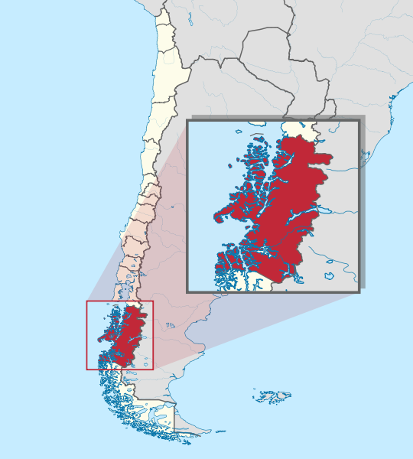
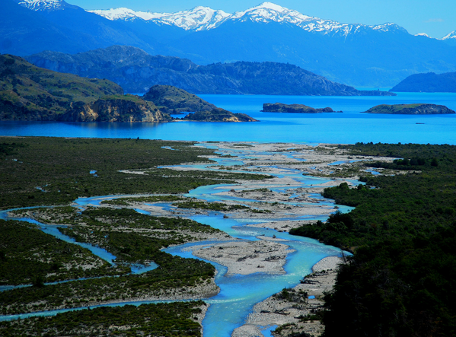
Aysén: Chile´s XI Region
1,640 km (1,019 mi) south of Chile´s capital city, Santiago (Aysén is part of Patagonia)
Image Credits: egoguia.cl; somirasao.tumblr.com; Wikipedia

Slide 9
Project HidroAysén
Approved May 9, 2011
Country´s largest energy project: $4B-$10B US
1600 km transmission line
Consistent energy source; peak load / emergency
Generation: 18,430 GWH annually
Image Credit: hidroaysen.cl

Slide 10
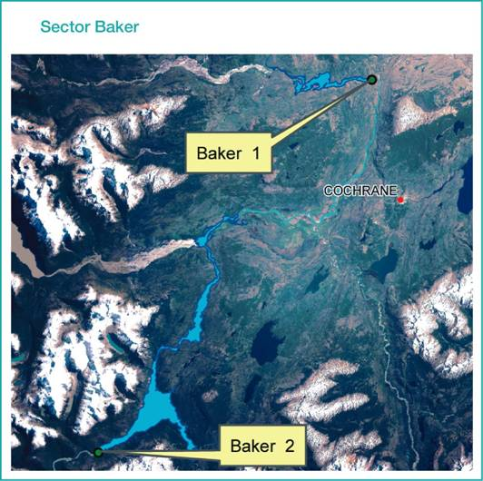
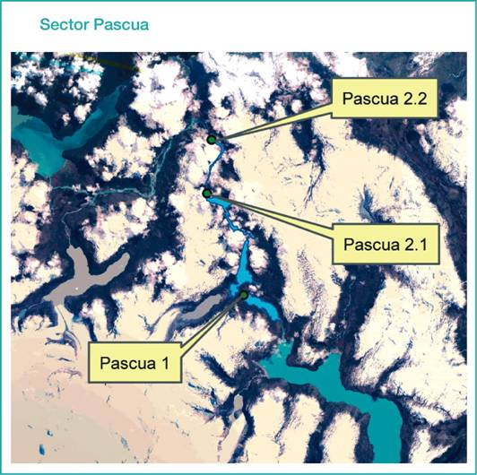
Five Dams Slated for Construction in Aysén
Río Baker (x2) & Río Pascua (x3)
Image Credits: Wikipedia

Slide 11
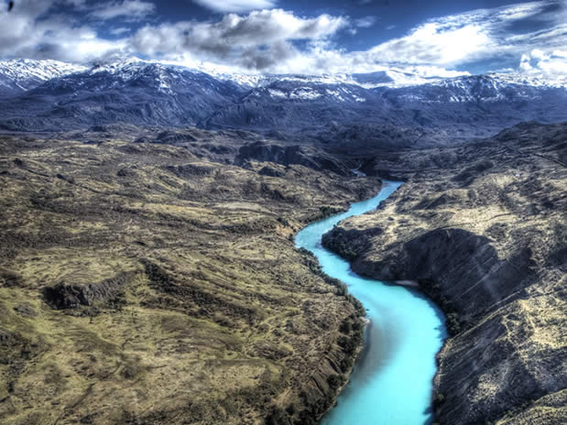
Aysén´s Ecosystems
Unique
Fragile
Intact
Image Credit: economia.tierra.cl

Slide 12
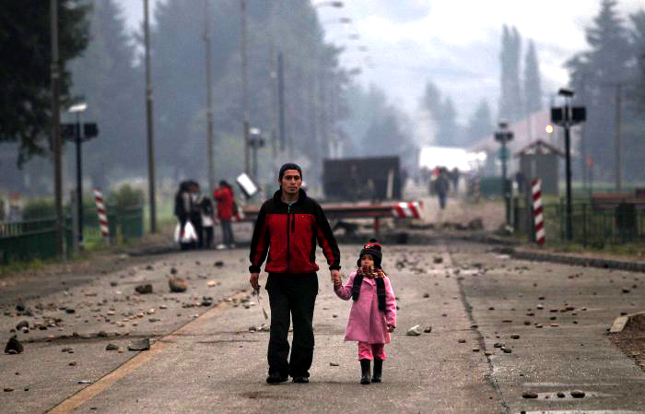
EJ: Social Ramifications of HidroAysén
Displacement of human communities, livelihoods
Marginalized populations: indigenous, working class
Benefit to population center; burden to Aysén
Image Credit: metiendoruido.com

Slide 13
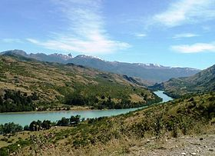
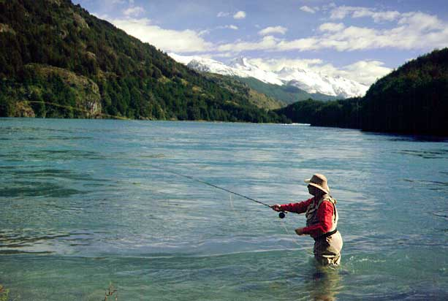
Aysén: River as a Commons
Intrinsic value – intact, wild & scenic rivers
Livelihoods: fishing, ecotourism, recreation
Downstream … issues of equitable sharing
Irreplaceable
Río Baker (Wikipedia; guioteca.com)

Slide 14
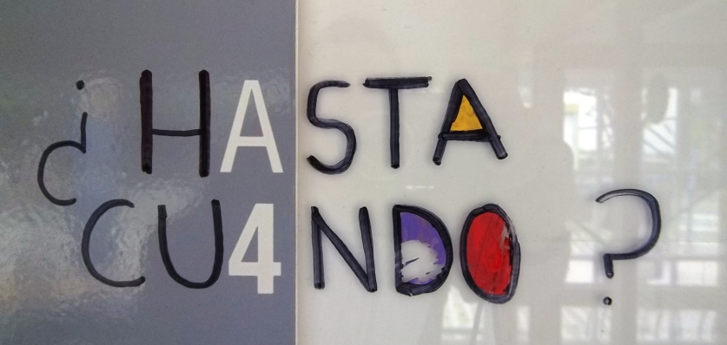
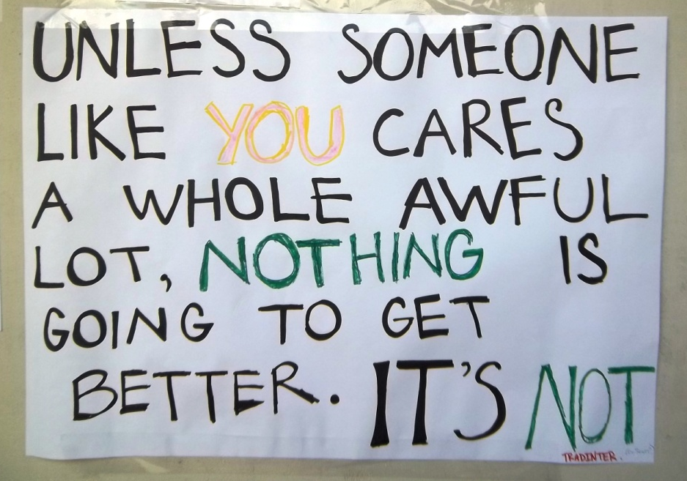
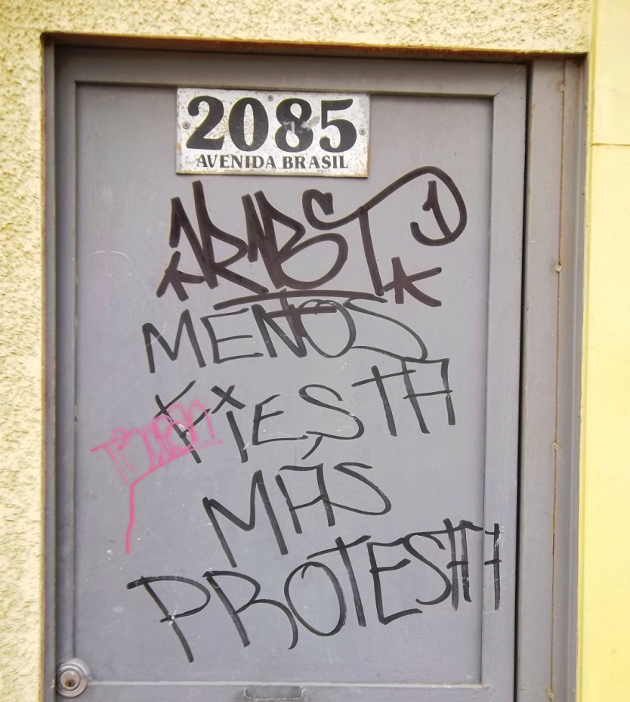
Political Commentary in Public Places

Slide 15
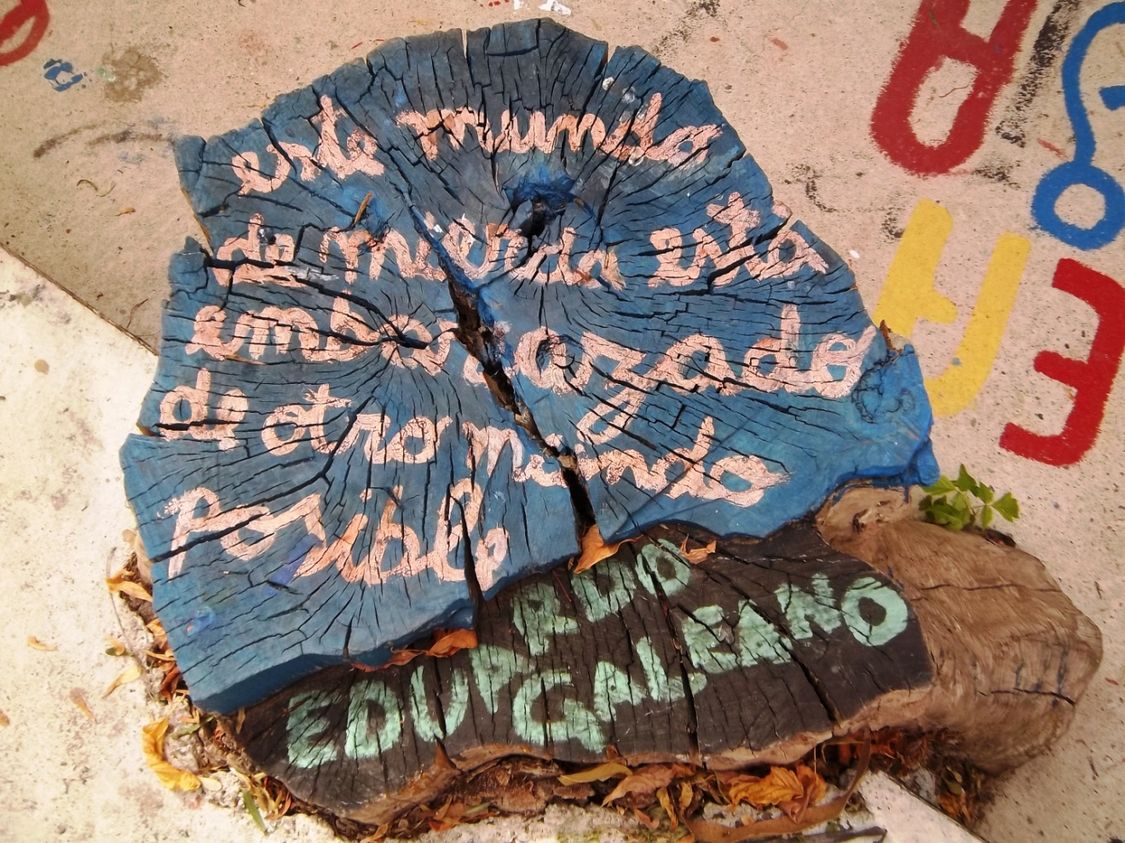
Chile´s Unique Brand of Protest

Slide 16
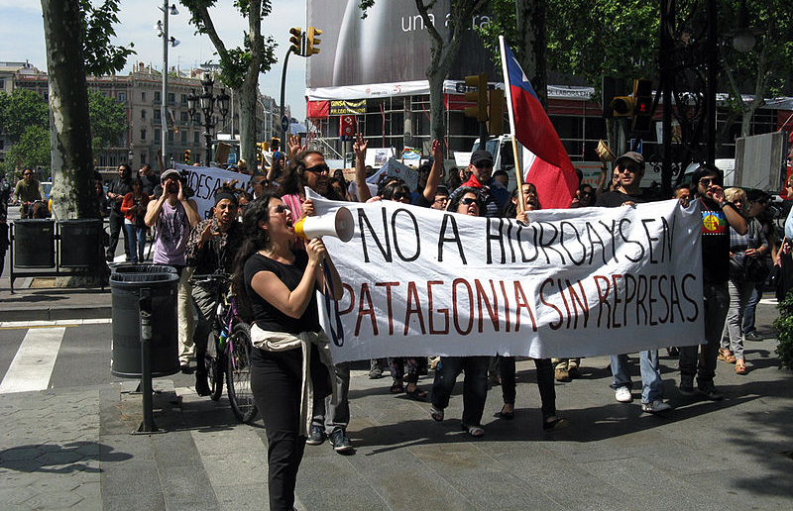
Protest: Relevance to HidroAysén
Project placed on hold June 2012
Cause: widespread demonstrations
Barcelona, Spain
Image Credit: Wikipedia

Slide 17
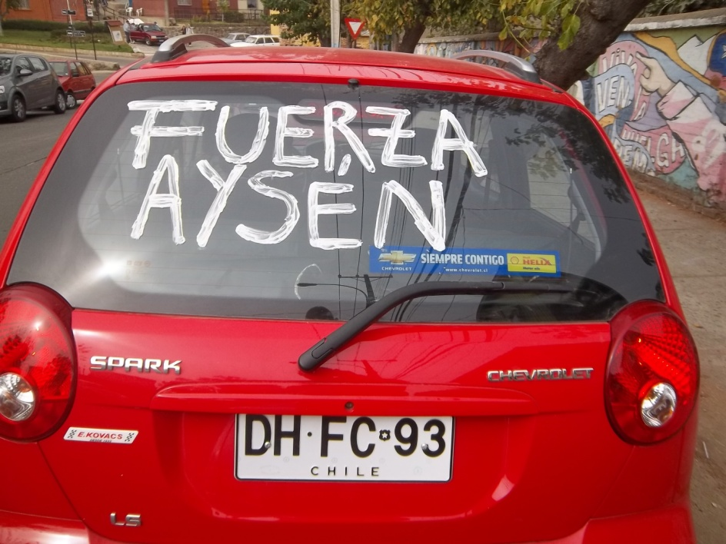
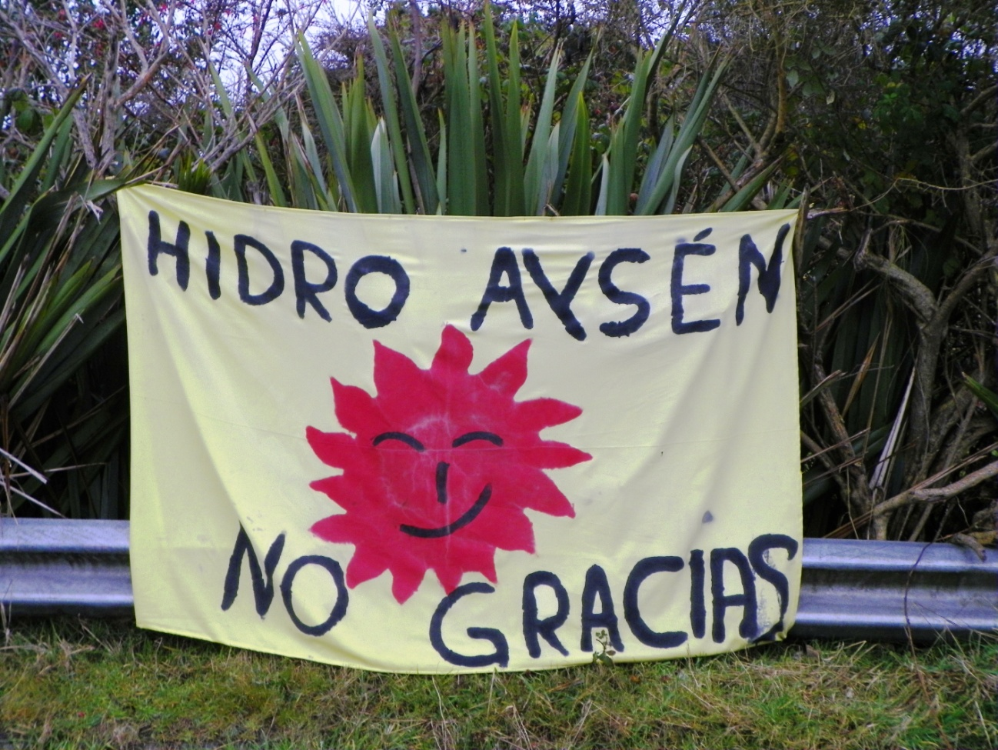
HidroAysén: Public Outcry
Calling for strength / resistance
National park near the Aysén region

Slide 18
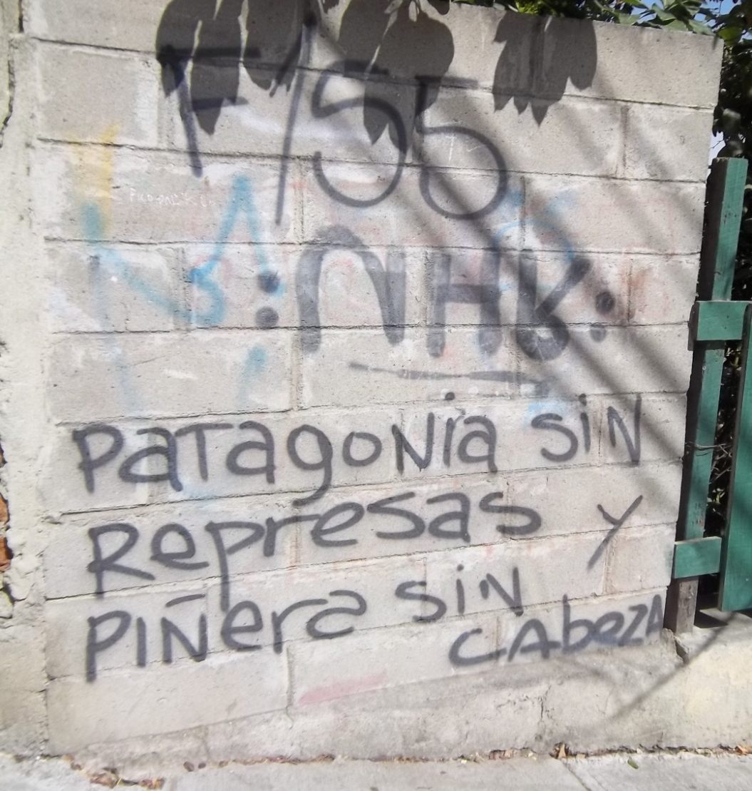
Extreme Discontent with Leadership
President Sebastian Piñera
Image Credit: Wikipedia

Slide 19
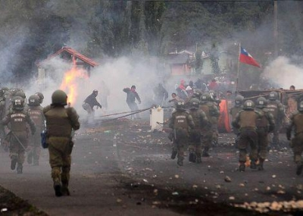
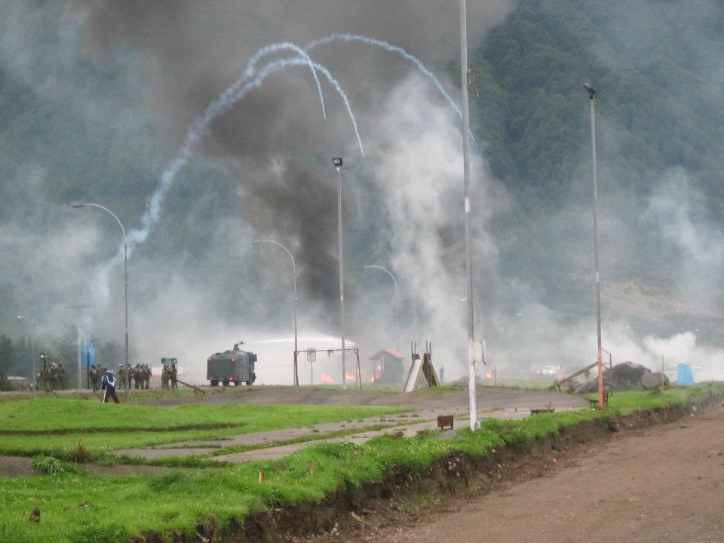
Police Repression (Special Forces)…
Feb-Mar 2012 in Aysén
“We wish the government would back the citizens and not use state funds to send Special Forces. We feel violated by the police and many people are taking to the streets today to protest against the force used.” – Puerto Aysén Mayor Marisol Martinez
Image Credits: elvacanudo.cl; federacionminera.cl

Slide 20
“Patagonia Without Dams!”
International Media Campaign

Slide 21
Benefit Concert –Youth Culture
Image Credit: ecoterritorios.blogspot.com

Slide 22
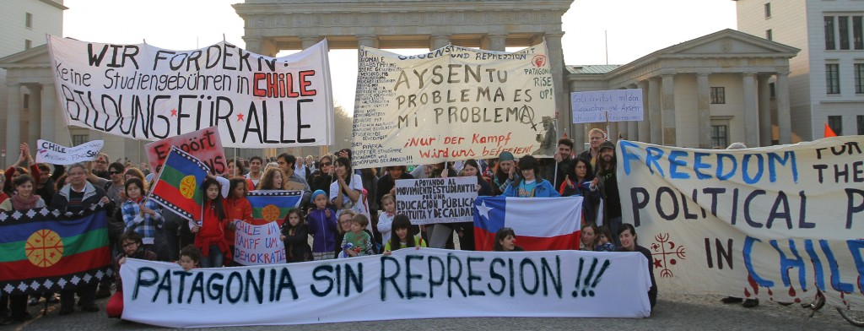
HidroAysén: Solidarity in Protest
Uniquely tied to place, local demographic;
Always united with Aysén: “Tu Lucha es Nuestra”
Let´s look at some examples of forms of protest…
Image Credit: El Ciudadano

Slide 23
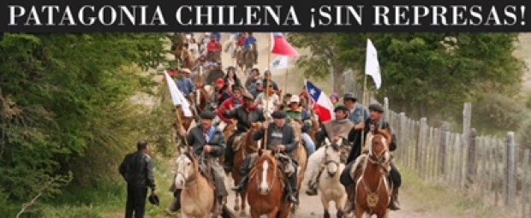
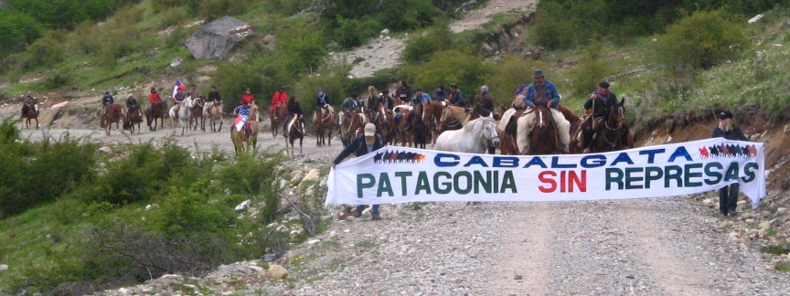
Cabalgata – Protests on Horseback
Communities in Southern Chile
Local / national pride
Image Credits: animalespolíticos.com; jovenestehuelches.blogspot.com

Slide 24
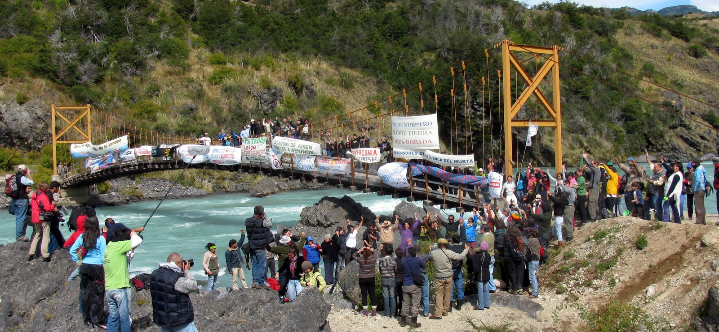
Taking Over a Bridge Within Aysén
Occupying the space at risk of development
Image Credit: SERPAJ Aysén

Slide 25
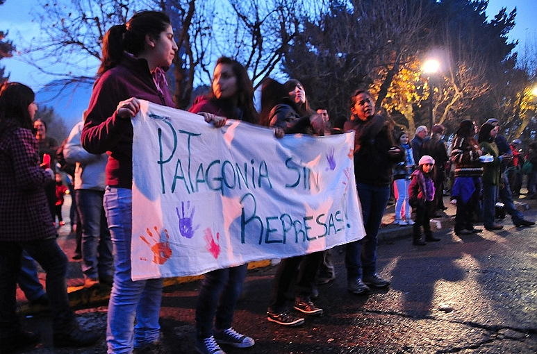
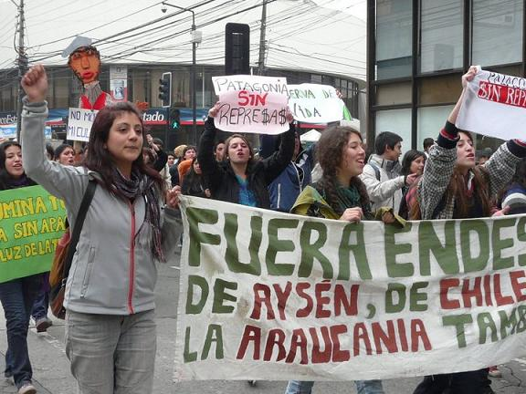
Youth Leadership
Youth in Chile particularly involved in protest
Unique perspective, voice: “Somos el futuro”
Image Credits: aureliennenewenmapuche.blogspot.com; redsocioambientalvalpo.blogspot.com

Slide 26
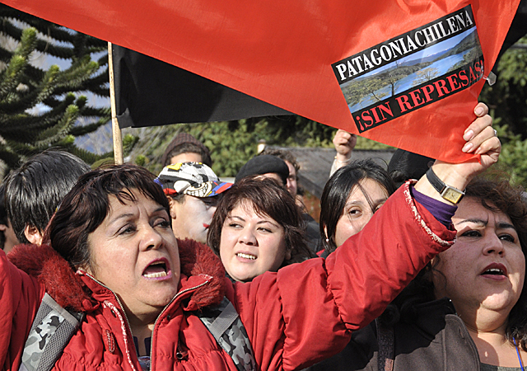
Mapuche & Other Indigenous Communities Protest
Image Credits: Wikipedia; df.cl

Slide 27
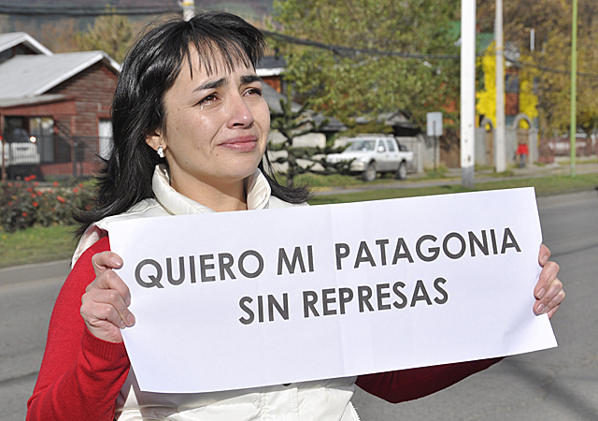
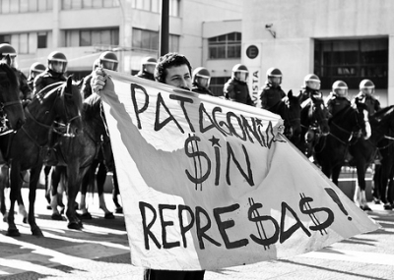
Individual Statements
The power of one
Image Credits: df.cl; elnaveghable.cl

Slide 28
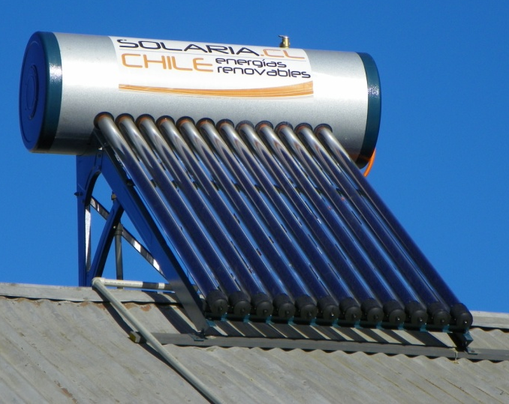
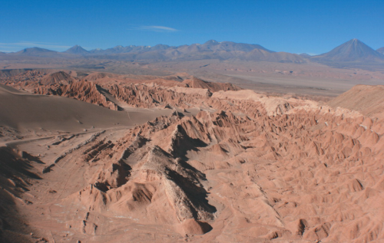
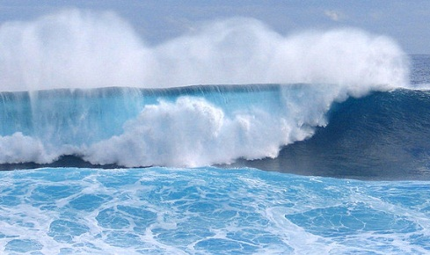
Chile´s Alternatives to HidroAysén
Solar : Atacama Desert
Wave energy (4,000 mi of coastline)
Wind
Geothermal: high volcanic activity
Energy efficiency improvements
Micro hydropower
Image Credits (L to R): renewableenergyfocus.com; thisischile.cl; David Schaad

Slide 29
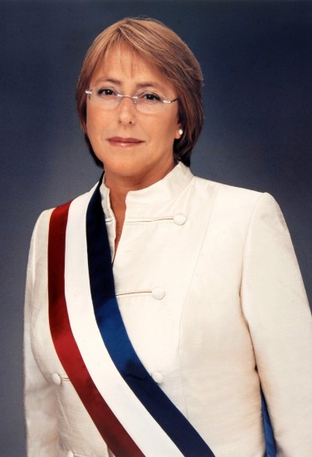
Conclusions & Next Steps
New presidency – Michelle Bachelet – rejects project as “unviable”
Ample [renewable] energy alternatives
Will of the people: 74% oppose
HidroAysén would be an EJ disaster
Unfolding developments – definitive ruling mid-May 2014
Image Credit: betazeta.com

Slide 30
Take-Home Lessons: the Power of Protest in an Environmental Justice Context
Image Credit: imperfectspirituality.com

Slide 31
Acknowledgements / Credits
Dr. Dan Spencer – Faculty Mentor (University of Montana)
Dr. David Terrell - Guest Reader & Editor (Warner Pacific College)
Professor Carlos Cáceres – Topic Introduction (Pontificia Universidad Católica de Valparaíso)
All photographs without credit attached are my own.

Slide 32
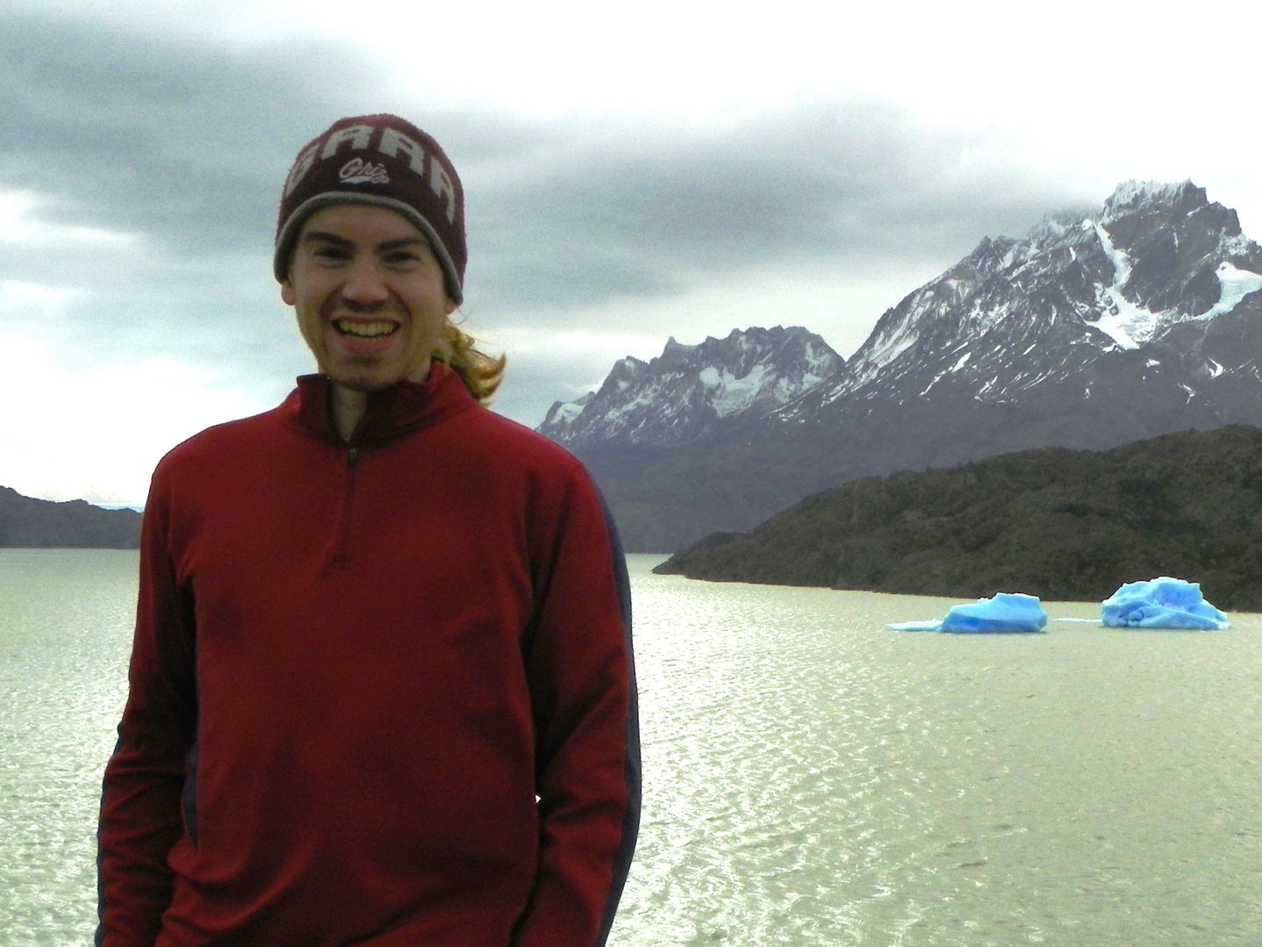
¿Preguntas? (Questions?)
The author near Glacier Gray in Torres Del Paine National Park, Chilean Patagonia

