Slide 1
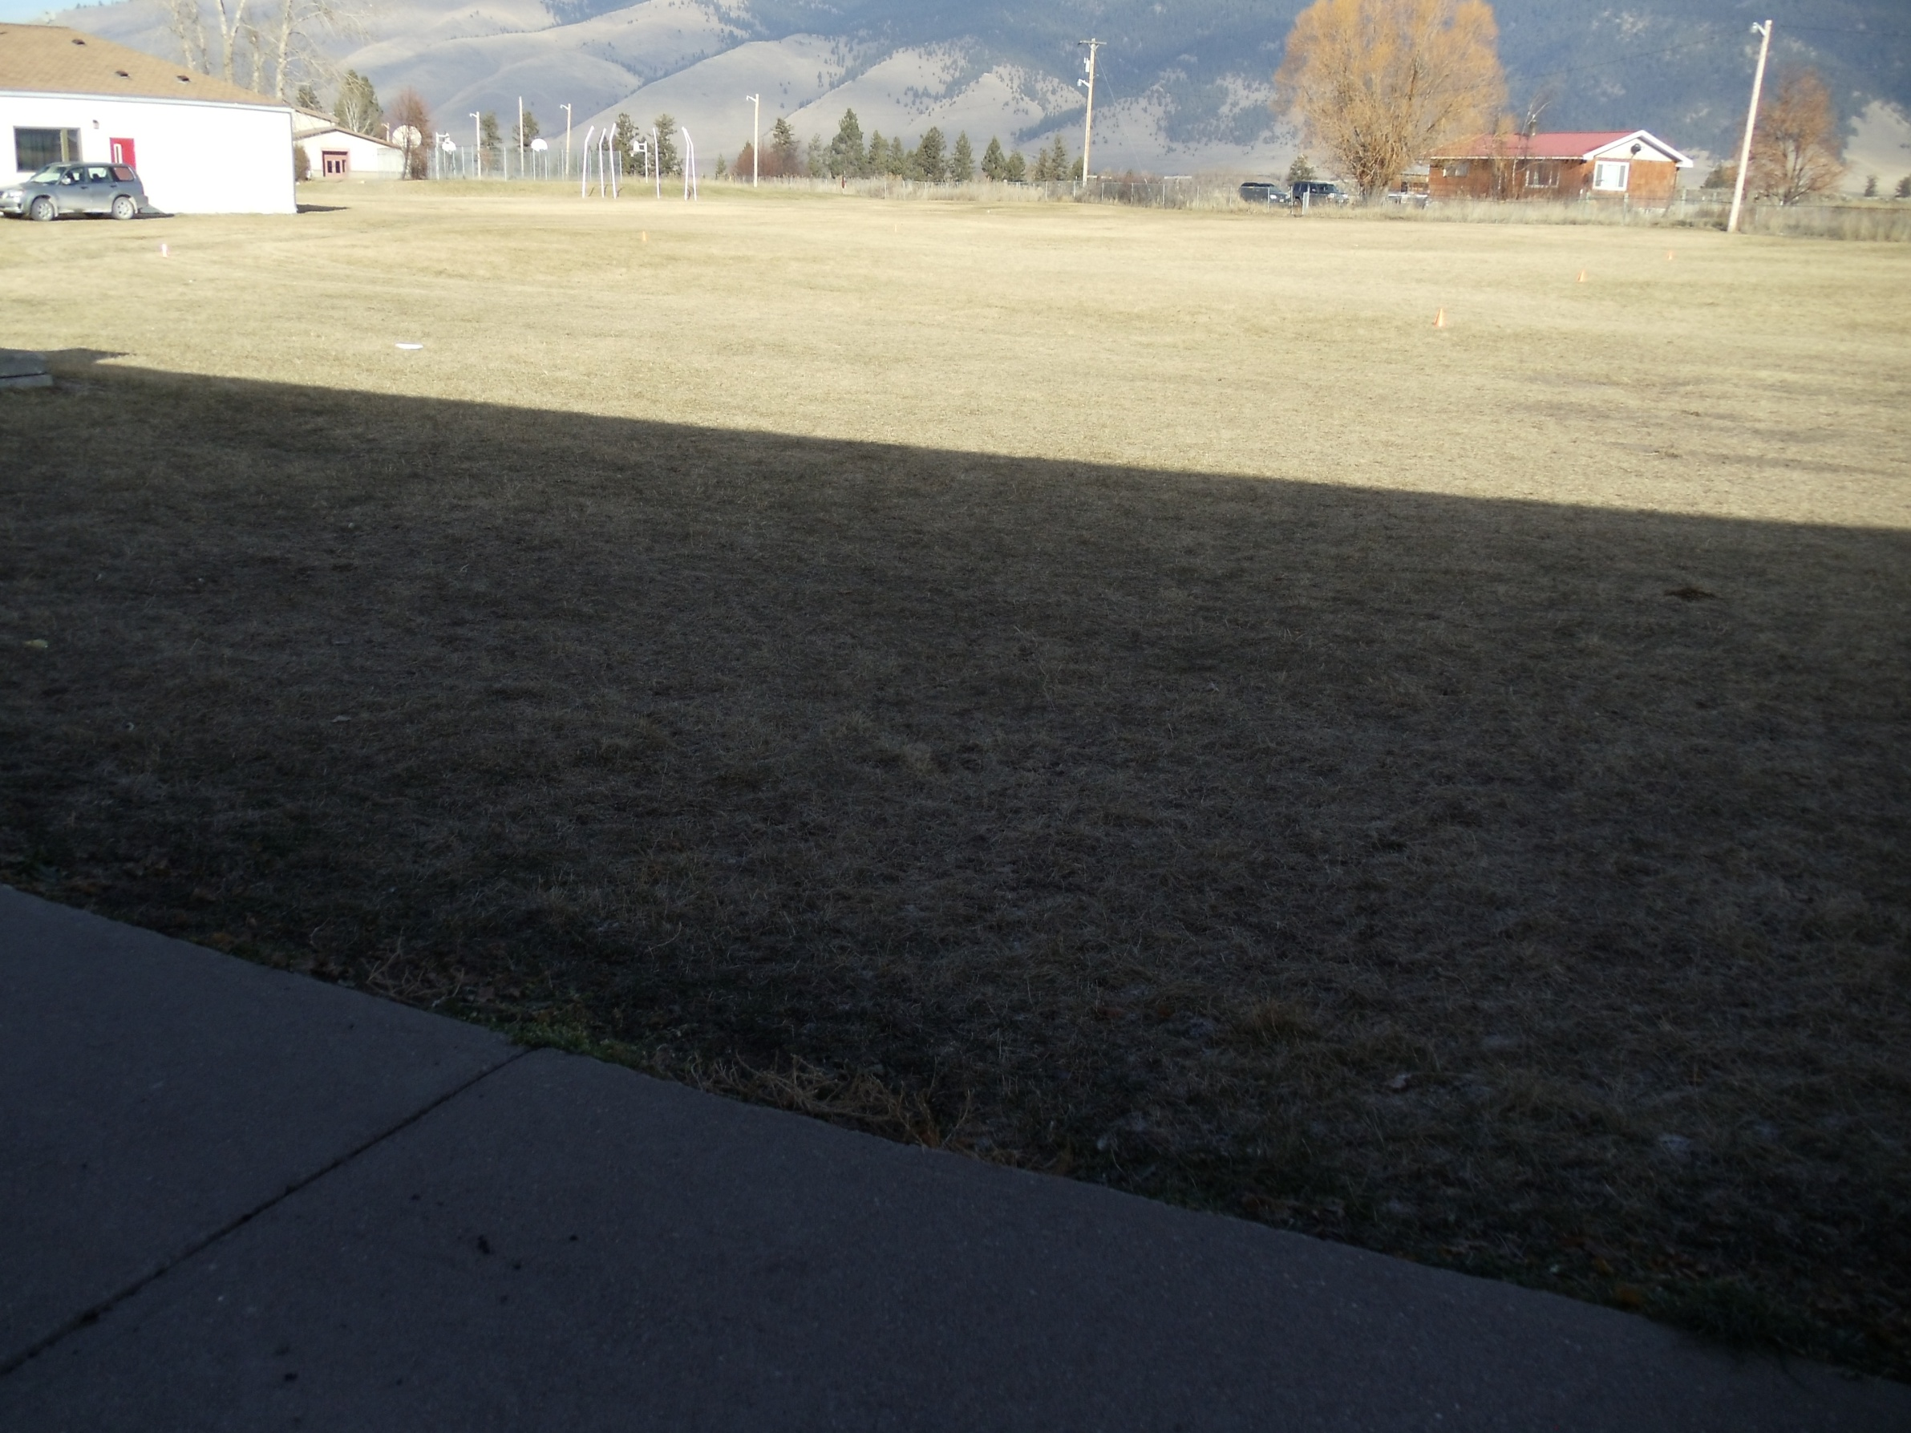
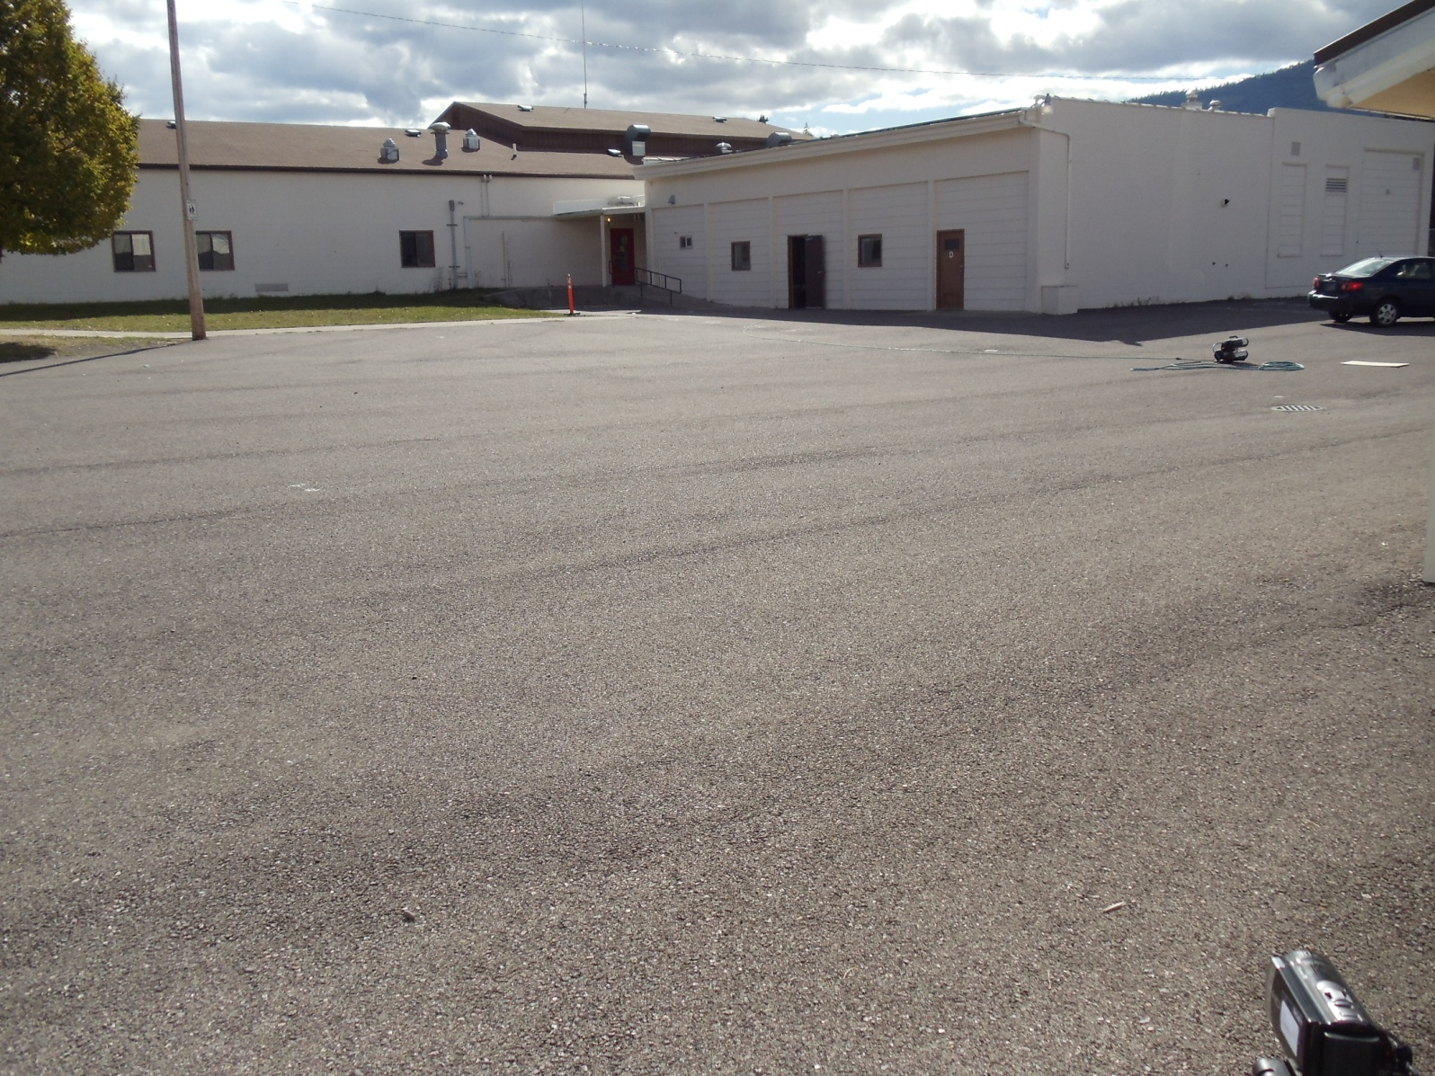
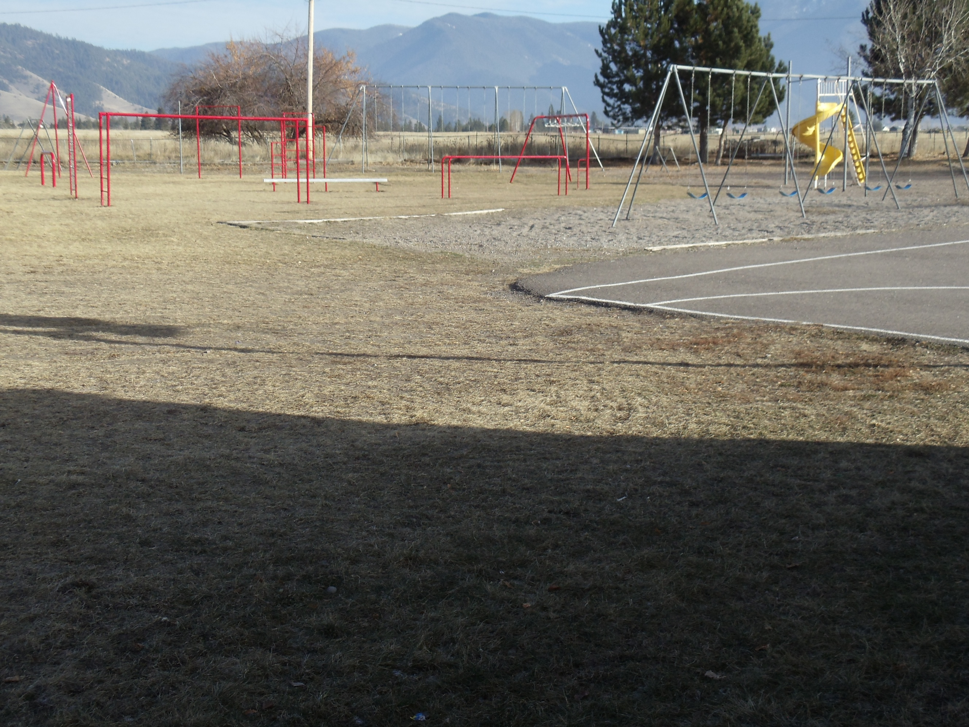
Physical Activity and Body Composition Measures of Elementary-Aged School Children on an American Indian Reservation
¹Kemp, C., ¹Kavanagh, D., ¹Schreiner, A., ¹Yonts, B., ²Grant, V., ³Swaney, G., ¹Brown, B., &¹Gaskill, S.
¹Department of Health and Human Performance, The University of Montana—Missoula
²Individualized Interdisciplinary Doctoral Program, The University of Montana—Missoula
³Department of Psychology, The University of Montana—Missoula
Purpose
The purpose of this study was to collect body composition measures and physical activity (PA) counts for elementary school-age children on an AI reservation.
Figure 5. Zone 3: Open Field
Figure 3. Zone 1: Asphalt Area
Discussion
Overall, boys had more active counts than girls.
Our study agrees with prior research reporting that boys engaged in 7.2% more PA compared to girls during recess.¹¹ Other studies show boys spend significantly more time engaging in moderate physical activity (MPA) than girls (0<0.01)¹² and boys engage in significantly more moderate to vigorous physical activity (MVPA) and vigorous physical activity (VPA) than girls (p<0.05).¹³
Zone 2 had the highest mean number of activity counts—this zone was equipped with play equipment.
Prior research reports that the odds of engaging in MVPA are greater in areas with play equipment—children in playground areas engaged in MVPA about 63% of the time.¹⁴
Zone 3 was an open field where children could not play—thus, this open space was not being utilized. This created an environmental barrier for PA.
Our study is in agreement with prior research that found that barriers for children achieving adequate daily PA is a decrease in opportunities for PA.⁵ Prior research has found that the allocation of playground space had positive effects on children’s PA during recess.¹⁵
Recess was only for 10 minutes and perhaps impacted PA counts.
Longer duration of recess breaks may enable children to organize and to play complete games resulting in higher proportions of active time.¹⁶ One study reported a significant increase in MVPA when accounting for the intervention effect and recess length, suggesting the intervention was more effective when recess was longer.¹¹ Recess duration contributes to increases in PA levels¹⁷ and accounts for about 1/3 of daily recommendations for PA in school children.¹² Ten minutes is not enough time for children to achieve recommended daily levels of PA.
Abstract
Childhood obesity and diabetes are major public health concerns. American Indian (AI) children are at increased risk for these diseases. Physical inactivity and high body mass index (BMI) are risk factors for obesity and diabetes. The purpose of this study was to collect body composition measures and physical activity (PA) counts for elementary school-age children (ages 8-13) on an AI reservation. A total of 61 children (28 males and 33 females) participated in the body composition measures collection. These included weight, height, and waist circumference—BMI was calculated with the equation weight(kg)/height(m)² and converted to BMI-for-age percentiles. Physical activity was measured by direct observation. Three sections of the recess playground were designated as zones: Zone 1 was an asphalt area, Zone 2 contained playground structures, and Zone 3 was an open field. Each zone was video recorded for 10 minutes during a recess period for four school days. PA counts were classified as sedentary, walking, or active. The mean BMI-for-age was at the 67th percentile and mean waist circumference was 72.3cm ± 11.7cm. The PA data showed girls had more sedentary counts (12.2 ± 3.5) and active counts (8.0 ± 2.1) in Zone 2 compared to Zone 1 (sedentary counts = 2.3 ± 1.3; active counts = 2.7 ± 1.6) or Zone 3 (sedentary counts = 0 ± 0; active counts = 0 ± 0). Boys had more sedentary counts (4.7 ± 2.2) and active counts (4.7 ± 2.8) in Zone 2 than either Zone 1 (sedentary counts = 2.4 ± 1.5; active counts = 3.8 ± 2.1) or Zone 3 (sedentary counts = 0.9 ± 1; active counts = 3.8 ± 2.9). These data were the baseline results of a pilot study designed to increase PA during recess in 3rd, 4th, 5th, and 6th grade children in this AI community.
Figure 4. Zone 2: Playground Structures
Methods
The Rocky Mountain Tribal Institutional Review Board approved this study.
Participant recruitment was achieved by doing classroom presentations, sending consent forms
home to parents, and putting an article in the school newspaper. Parental consent for child’s
BMI was collected from signed consent forms that were returned to teachers.
Consent to video tape on the school playground was granted by the school board.
A total of 61 children (28 males and 33 females) participated.
Body Composition Measures were collected:
Weight was recorded to the nearest 0.1kg using a digital scale.
Height was measured to the nearest 0.1cm using a calibrated stadiometer.
Waist circumference was measured to the nearest 0.1cm using a tape measure.
BMI was calculated with the equation weight(kg)/height(m)²
BMI was converted to BMI-for-age percentiles based on the 2000 Centers for Disease Control
and Prevention algorithiums.⁹
Children were given an incentive after measurements were taken (i.e., a free bowling pass).
Three sections of the recess playground were designated as zones: Zone 1 was an asphalt
area, Zone 2 contained playground structures, and Zone 3 was an open field.
Physical activity was measured by direct observation via the System for Observing Play and
Leisure Activity in Youth (SOPLAY).¹⁰
Each zone was video recorded for 10 minutes during a recess period for 4 school days.
PA counts were classified as sedentary, walking, or active.
References
Polhamus B., Dalenius K, Borland, E., Smith, B., & Grummer-Strawn, L. Pediatric Nutrition Surveillance 2006 Report. Atlanta: U.S. Department of Health and Human Services, Centers for Disease Control and Prevention, 2007.
Anderson, S.E. & Whitaker, R.C. Prevalence of Obesity Among U.S. Preschool Children in Different Racial and Ethnic Groups. Archives of Pediatrics and Adolescent Medicine, 2009; 163(4):344-348.
Zephier, E., Himes, J.H., Story, M., & Zhou, X. Increasing Prevalence's of Overweight and Obesity in Northern Plains American Indian Children. Archives of Pediatrics and Adolescent Medicine. 2006;160(1):34-35.
Acton, K.J., Burrows, N.R., & Wang, J. Diagnosed Diabetes Among American Indians and Alaska Natives Aged <35 Years - United States, 1994-2004. Morbidity and Mortality Weekly Report. 2006; 55(44):1201-1203.
Progress in Preventing Childhood Obesity: How do we measure up? Institute of Medicine. 2007; 6:228-252.
Story, M., Evans, M., Fabsitz RR, Clay T.E., Holy Rock B., & Broussard, B. The epidemic of obesity in American Indian communities and the need for childhood obesity prevention programs. The American Journal of Clinical Nutrition. 1999; 69(4):7475-7545.
Ehlers, D.K., Huberty, J.L., & Beseler C.L. Is school community readiness related to physical activity before and after the Ready for Recess intervention? Health Education Research. 2013; 28(2):192-204.
Kids and Exercise. Retrieved from http://kidshealth.org/parent/nurtition_center/staying_fit/exercise.html on November 10, 2013.
Kuczmarski RJ, Ogden CL, Grummer-Strawn LM, et al. CDC growth charts: United States. Advanced Data. 2000; (314):1-27.
McKenzie TL. System for observing play and leisure activity in youth: Description and procedures manual. retrieved from http://www.activelivingresearch.org/node/10642 on November 27, 2012.
Ridgers ND, Stratton, G., Fairclough, S.J. & Twisk, J.W.R. Children's physical activity levels during school recess: a quasi-experimental intervention study. Int J Behav Nutr Phys Act. 2007; 4:1-9.
Ridgers, N. D., & Stratton, G. "Physical activity during school recess: The Liverpool Sporting Playgrounds Project." Pediatr Exerc Sci. 2007; 17:281-290.
Ridgers ND, Fairclough, S.J. & Stratton, G. Twelve-month effects of a playground intervention on children's morning and lunchtime recess physical activity levels. J Phys Act Health. 2010; 7:167-175.
McKenzie, T. L., Crespo, N.C., Baquero, B. & Elder, J.P. Leisure-time physical activity in elementary schools: analysis of contextual conditions. J Sch Health. 2010; 80:470-477.
Loucaides CA, Jago, R. & Charalambous, I. Promoting physical activity during school break times: Piloting a simple, low cost intervention. Prev Med 2009; 48:332-334.
Verstraete SJM, Cardon, G.M., De Clercq, D.L.R. & De Bourdeaudhuij, I.M.M. Increasing children's physical activity levels during recess periods in elementary schools: the effects of providing game equipment. Eur J Public Health. 2006; 16:415-419,.
Ridgers, N. D., Stratton, G., Fairclough, S.J. & Twisk, J.W.R. Long-term effects of a playground markings and physical structures on children's recess physical activity levels. Prev Med. 2007; 44:393-397.
Introduction
Health Problems Among American Indians and Alaska Natives
According to the Pediatric Nutrition Surveillance report,¹ 39.5% of low
income American Indian/Alaska Native (AI/AN) children ages 2-5 are
overweight (OW) or obese (OB).
Anderson et al.² found that 31.2% of AI/AN children 4 years and older
have obesity rates higher than any other racial or ethnic group studied
and almost double the rate among White children the same age.
Zephier et al.³ conducted a study that included children ages 5-17 in
tribes in North Dakota, South Dakota, Nebraska, and Iowa and found that
46.3% of AI girls and 48.1% of AI boys are OW or OB.
Acton et al.⁴ found that between 1994 and 2004, diabetes cases
increased 68% among AI’s.
Barriers to Physical Activity
The Institute of Medicine⁵ reports that 1 of the 5 components in the
environment that create a barrier to children getting adequate daily PA is
a decrease in opportunities for PA.
Importance for Early Intervention
Unhealthy behaviors that are developed early in life and a lack of success
in adult PA programs support the need for interventions in chidren⁶.
The rationale for developing PA interventions in children is habits such as
eating healthy and exercising on a daily basis may be carried into
adulthood if they are formed early in life^{6,7}.
Benefits of Physical Activity
Kids who are active will have stronger muscles and bones, decreased risk
of developing type 2 diabetes mellitus, decreased blood pressure and
cholesterol levels, and a better outlook on life⁸.
Table 1. Ethnicity of all participants
(boys and girls combined; n=61).
Results
Table 2. Body composition measures of all participants (boys and girls combined; n=61).
 | N | Percent
AI¹ | 31 | 51
White | 24 | 39
Other² | 6 | 10
 | Weight (kg) | Height (cm) | WC¹ (cm) | BMI²
Mean | 43.1 | 144.9 | 73.2 | 66.8
SD³ | 13.5 | 8.7 | 11.7 | 29.5
¹AI= American Indian; ²French, German, and/or Irish
¹Waist Circumference; ²BMI-for-age percentiles; ³Standard deviation
Figure 1. Mean physical activity counts for girls
in Zone 1, Zone 2, and Zone 3.
Figure 2. Mean physical activity counts for boys in
Zone 1, Zone 2, and Zone 3.
Acknowledgments
Vernon Grant for all of his guidance while working on this project.
UM Human Health and Performance Department for giving us the opportunity to do this research.
Study Funded in part by: UM Subaward (Harmsen, PI, P20 RR-16455) from National Institutes of Health (NIH) and National Center for Research Resources (NCRR).

