Slide 1
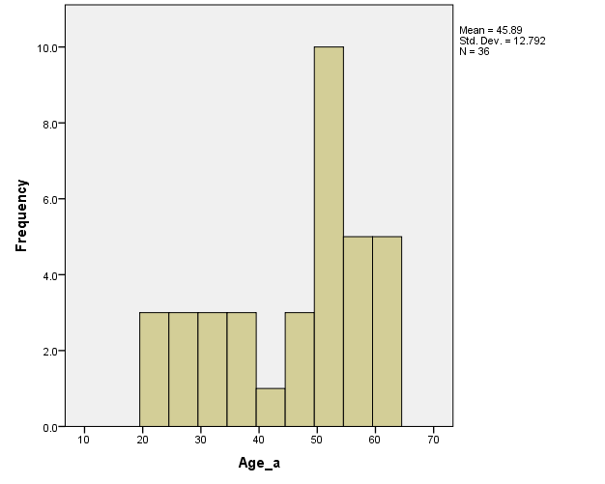
Analysis of Factors that Influence Visits to a Healthcare Professional
Alexandra Schiwal Psychology, University of Montana
Introduction, Materials, and Methods
In this study a survey of 10,000 households led to a postcard response rate of 604 participants. 564 of these participants then returned the Health and Community Survey along with the informed consent. This survey was administered by mail four times. The first three waves of data were used for this particular analysis.
Abstract
The health care system in the United States has changed significantly in recent years. Under the Affordable Care Act, it will continue to change. One of the key factors for improving the healthcare system is an understanding of why people use healthcare services. I examined factors that are predictive of visits to healthcare professionals over time using a longitudinal health and community participation survey. The participants in this study were people in the community, aged 18 to 99, who experienced various impairments (e.g., sensory, physical, etc.). They completed four paper-pencil surveys at four month intervals. The survey respondents reported on barriers, participation, and impairments due to pain or other health conditions. To predict healthcare utilization, I analyzed health insurance coverage, income level, depression, total number of health conditions, education level, and environmental barriers. I conducted my analysis using a multiple regression to build a model showing which factors are predictive of doctor visits. The results of this study will contribute to further understanding of individual characteristics associated with participation in the healthcare system.
Discussion and Conclusions
At Time A, while not yet significant, higher ratings of depression and participant employment status were the two largest predictors of increased visits to a doctor. (See Figure 2).
At Time B the number of health conditions a participant had was predictive of more visits to a doctor. Depression ratings, again were predictive of more doctor visits. (See Figure 2).
At Time C, having no High school education and no health insurance entered as factors predictive of change in doctor visits. No High school was predictive of more visits, while having no insurance was predictive of fewer visits. (See Figure 2).
From Time A to Time 23 participants went from having no insurance to having insurance. Moreover, 25 participants without Medicare coverage at Time A had Medicare coverage by Time C. (See Figures 3,4 and 5).
At Time C having No Insurance entered as a significant factor predictive of doctor visits. Crosstab analysis showing change in insurance status my be indicative of people aging into Medicare over the course of this study. As the group with No Insurance decreased, the group of new Medicare participants increased. To further explore this, I examined the age distribution of those remaining uninsured at Time C. (See Figure 6).
No participants over the age of 65 remained uninsured, and the largest age group remaining were those participants aged 50 to 65. Are these participants waiting to age into Medicare? Continued analysis, including Time D, may support this hypothesis.
Survey Send Dates and Response Rates for all Waves of Data
SURVEY SEND DATE | RESPONSE RATE
OCTOBER 2012 TIME A | 564
FEBRUARY 2013 TIME B | 488
SEPTEMBER 2013 TIME C | 477
JANUARY 2014 TIME D (not included in this analysis) | 457
Figure 1
Demographics
Age: average age is 62, SD 16.3
Ethnicity: 96% White; 4% American Indian
Education:
Less than H.S. = 7.3%
H.S. or GED = 21.4%
Some college/training or Associates = 38.1%
Bachelor’s or higher = 33.2%
Employment: Not employed (Including those who are retired) = 71.8%; Employed = 28.2%
Relationship Status: Married = 47.1; Unmarried (including single, divorced, widowed, member of unmarried couple) = 52.9
Results
Ins__None_a * Ins__None_b Crosstabulation
 |  |  | Ins__None_b |  | Total
 |  |  | 0 | 1.0
Ins__None_a | 0 | Count | 429 | 3 | 432
 |  | % within Ins__None_a | 99.3% | 0.7% | 100.0%
 | 1.0 | Count | 14 | 36 | 50
 |  | % within Ins__None_a | 28.0% | 72.0% | 100.0%
Total |  | Count | 443 | 39 | 482
 |  | % within Ins__None_a | 91.9% | 8.1% | 100.0%
Figure 3: No Insurance at Time A by No Insurance Time B
Ins__None_b * Ins__None_c Crosstabulation
 |  |  | Ins__None_c |  | Total
 |  |  | 0 | 1.0
Ins__None_b | 0 | Count | 415 | 5 | 420
 |  | % within Ins__None_b | 98.8% | 1.2% | 100.0%
 | 1.0 | Count | 10 | 27 | 37
 |  | % within Ins__None_b | 27.0% | 73.0% | 100.0%
Total |  | Count | 425 | 32 | 457
 |  | % within Ins__None_b | 93.0% | 7.0% | 100.0%
Figure 4: No Insurance at Time B by No Insurance at Time C
Figure 6: Age Distribution of those With No Insurance at Time C
Multiple Regression Results Table - Predicting Change in Number of Doctor Visits
Variable | Beta_{Standardized} | p | Change R²
Step 1- Time A
Depression | .191 | < .00
Employed | -.090 | .046
 |  |  | .045
Step 2 – Time B
Number of Conditions | .182 | < .00
Depression | .139 | .007
 |  |  | .075*
Step 3 – Time C
Number of Conditions | .294 | < .00
No High school | .125 | .006
No Insurance | -.099 | .029
 |  |  | .120*
Figure 2 Note: * indicates significance.
Medicare_a * Medicare_c Crosstabulation
 |  |  | Medicare_c |  | Total
 |  |  | 0 | 1.0
Medicare_a | 0 | Count | 196 | 25 | 221
 |  | % within Medicare_a | 88.7% | 11.3% | 100.0%
 | 1.0 | Count | 10 | 240 | 250
 |  | % within Medicare_a | 4.0% | 96.0% | 100.0%
Total |  | Count | 206 | 265 | 471
 |  | % within Medicare_a | 43.7% | 56.3% | 100.0%
Figure 5: Medicare change from Time A to Time C crosstabs.
Acknowledgments: Craig Ravesloot, PhD., Tannis Hargrove, MS, The Rural Institute, University of Montana.

