Slide 1
Comparing the Effects of Static Stretching and Pulsed Short Wave Diathermy on Shoulder Range of Motion
Taylor Baldwin, Erika Stinchcomb
Dr. Valerie Moody
DTM
Notes:
Background info?

Slide 2
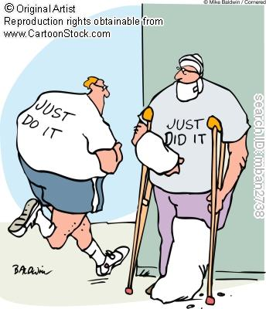
Overview of Presentation
Background
Methods
Results
Discussion
Limitations
Future Research

Slide 3
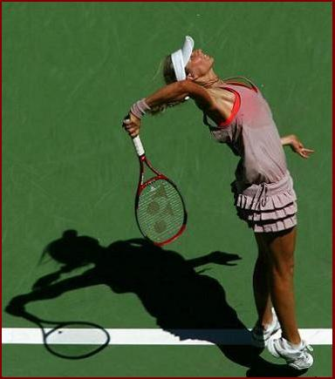
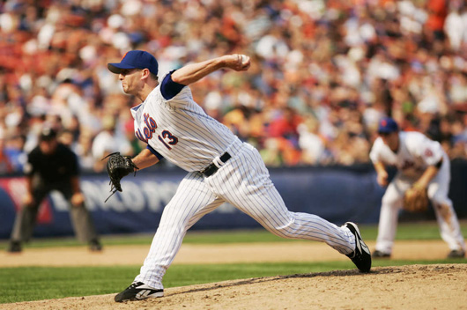
GIRD/ ERG
Baseball, tennis, handball and other overhead sports require repetitive overhead motions that use the posterior rotator cuff musculature to decelerate the arm
Impingement and reduced internal rotation reflect posterior shoulder tightness
Tightening of posterior shoulder capsule leads to approximation of humeral head and the acromion, causing impingement
Mcclure et al. 2007; Borsa et al., 2008
Notes:
Borsa et al- forceful propulsion of an object via maximal external rotation to internal rotation that uses the eccentric contractions of the posterior muscualture as a brake during internal rotation and horizontal adduction in the follow-through phase –
This leads to adaptive shortening and tightness in the post delt, infraspinatus, teres minor, lat dorsi as well as increased humeral head retroversion

Slide 4
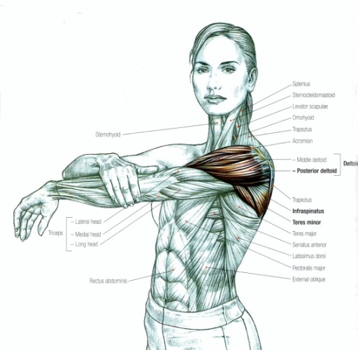
Static Stretch
Static-stretching is traditionally a part of a warm-up to enhance subsequent performance, reduce the risk of injury and alleviate muscle soreness symptoms. (Bacurau et al., 2009 )
Decrease in maximal strength; not good for sports needing high amounts of force
Posterior capsule stretching important for the overhead athlete in particular
(Prentice, 2004; Roberts, Wilson, 1999)
Notes:
Need year bacurau study
Prentice says 3-60 seconds. Erika – look at timing info in static stretching document
Of particular importance is posterior capsule stretching for overhead athletes

Slide 5
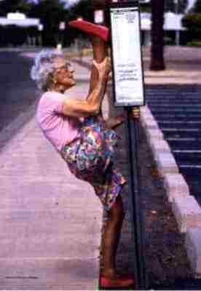
Stretching
Advantages
Disadvantages
Increases in ROM
Easy and safe
Short duration lower intensity static stretching is good for sports that need a high degree of flexibility to minimize impairments
Time consuming
Decrease in performance (strength and power)
Uncomfortable
Notes:
Decrease in performance if done pre exercise

Slide 6
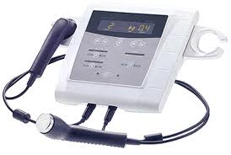
Deep Thermotherapy
Heats deeper tissues (3-5 cm)
Effects:
Circulation
Metabolism
Inflammation
Analgesic
Collagen Extensibility
Muscle Spasm
Joint/Tissue Stiffness

Slide 7
Pulsed Short Wave Diathermy
Advantages
Disadvantages
Provides deepest heating
Larger treatment size than ultrasound
Don’t need to stay with the patient
Longer lasting heating
Expensive
Large machines
Misinformation
Lacks research
Notes:
3-5 cm
$3,000-$25,000
Is price for diathermy trending down?—YES!

Slide 8
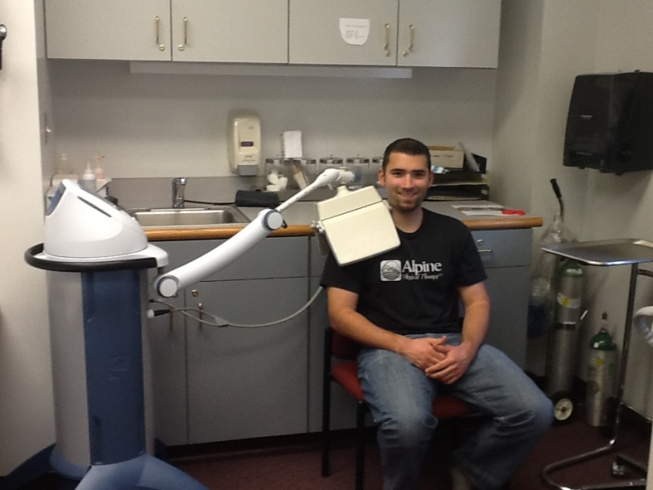
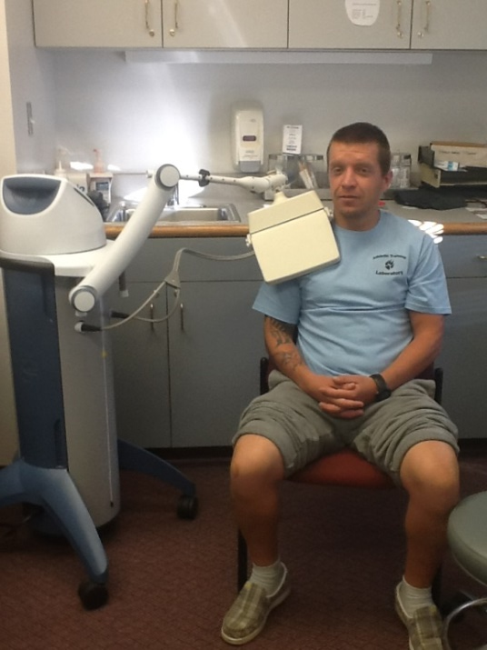
Pulsed Short Wave Diathermy
Vigorous heating is used to increase extensibility of collagen fibers (Knight & Draper, 2013)
Intensity is sufficient to sufficient to cause increases in tissue temperature because of long wavelengths
Better at heating large muscle groups for longer than ultrasound (Garrett et al., 2000)
Notes:
Increasing collagen extensibility to increase ROM
PSWD is more effective than 1 MHz ultrasound in heating a large muscle mass and resulted in the muscles retaining the heat longer – Garret et al

Slide 9
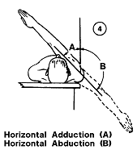
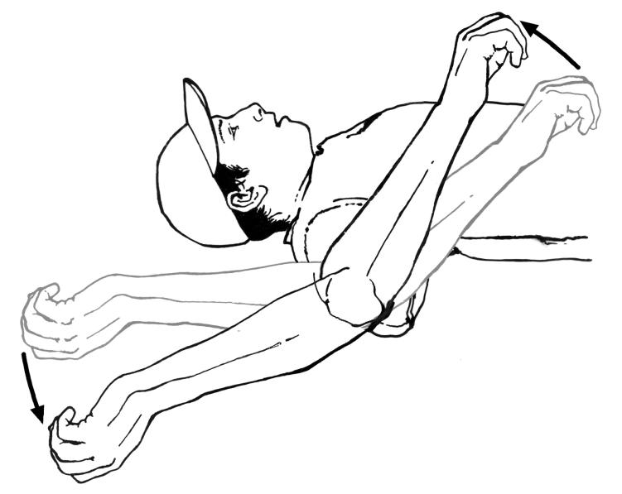
Purpose
To compare the effects of a deep heating modality (PSWD) to static stretching on their ability to improve shoulder ROM

Slide 10
Significance
Most thermotherapy research focuses on improving ROM of the lower extremity
To date, little research exists comparing the different between PSWD and Static Stretching on shoulder ROM
Provide clinical evidence if PSWD increases shoulder ROM as much as or more than Static Stretching

Slide 11
Methods
IRB approval through the University of Montana
Incentive provided
Participants
Ten participants
5 males, 5 females
No upper extremity injury in the last 6 months
Participants | Age (yrs) | Height (in) | Weight (lbs)
All (n =10) | 22.5 + 3.0 | 66.9 + 5.9 | 155.1 + 19.3
Males (n =5) | 24.0 + 3.8 | 70.8 + 4.2 | 169.6 + 12.4
Females (n =5) | 21.0 + 1.0 | 63.0 + 4.7 | 140.6 + 12.6
Notes:
Mean Height: 66.91 in +- 5.9
Mean Weight: 155.09 lbs +-19.3
Mean age: 22.5 yo +- 3.0

Slide 12
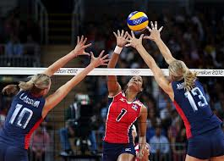
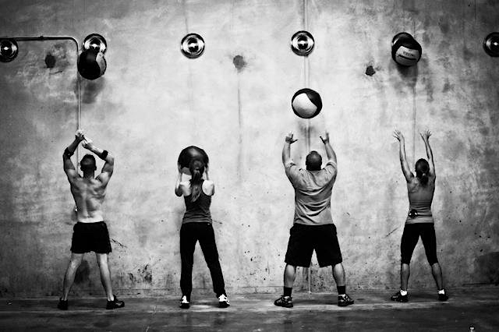
Sports and Activities
Weightlifting (general)
Volleyball
Crossfit
Baseball
Rock Climbing

Slide 13
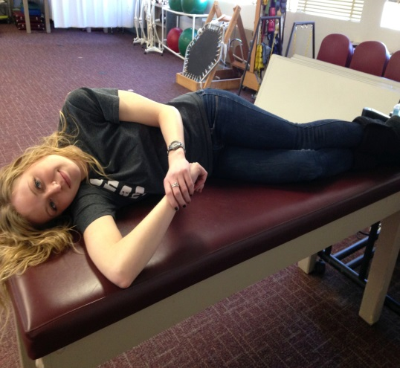
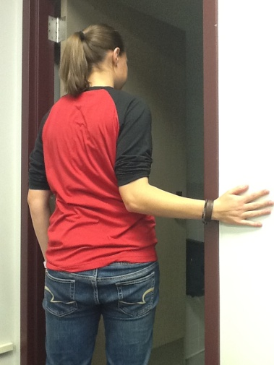
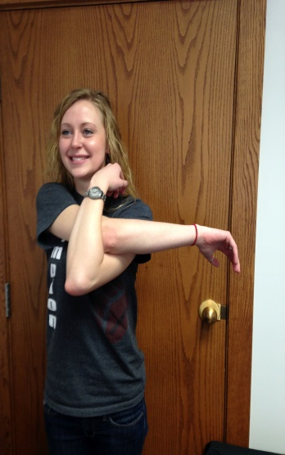
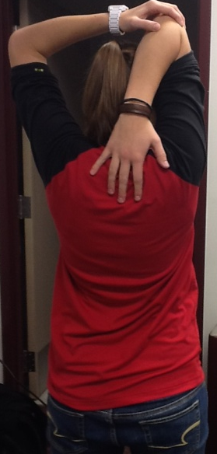
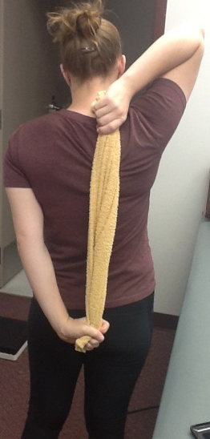
Methods
Static Stretch
4 trials 15 seconds on 15 off
Crossover, Overhead, Towel, Sleeper, Door stretch
(Prentice, 1990; Mcclure et al., 2007; Morrison et al., 1997;
Laudner et al., 2008; Sauers et al, 2007)
Notes:
Include years for studies cited

Slide 14
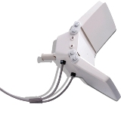
Methods
Pulsed Short Wave Diathermy
Intelect SWD 100 Model 1600 Shortwave Diathermy
Diplode
Heats 3-5 cm deep without heating superficial tissues
Dose IV
800 Hz
Pulse Width: 400 µsec
Avg Output: 48 watts
Notes:
HP-posterior aspect for 20 minutes in prone position
Hydroc temp = 140 to 160
HP holds heat for up to 30 min
Studies show Increase temp 6.5 at 1 cm deep and 1.4 at 3 cm

Slide 15
Methods
4 testing conditions completed over 1 month
Random order of conditions
Control, SS, PSWD, PSWD+SS
ROM measurements completed before and after each testing condition
Posterior Shoulder Tightness, Lateral Scapular Slide, Internal and External Rotation
3 measurements were recorded
Inclinometer reading taken by same researcher (TB)
Order of ROM measurements was also randomized

Slide 16
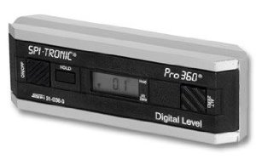
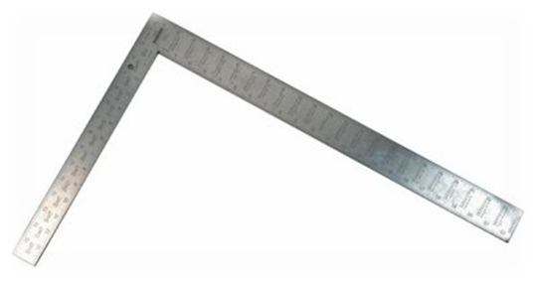
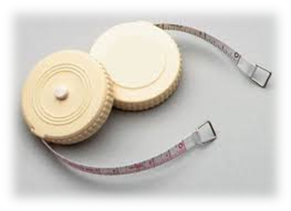
Instrumentation
Digital Inclinometer
Provides a real-time digital
reading of angles
Can be used in either a
horizontal or vertical reference
Is accurate up to 0.1°
Carpenter’s Square
Tape Measure
Notes:
Provides real-time digital readings of angles in horizontal/vertical plane
Accurate within 1 degree
Three measurements of each before and after treatment = intratester reliability

Slide 17
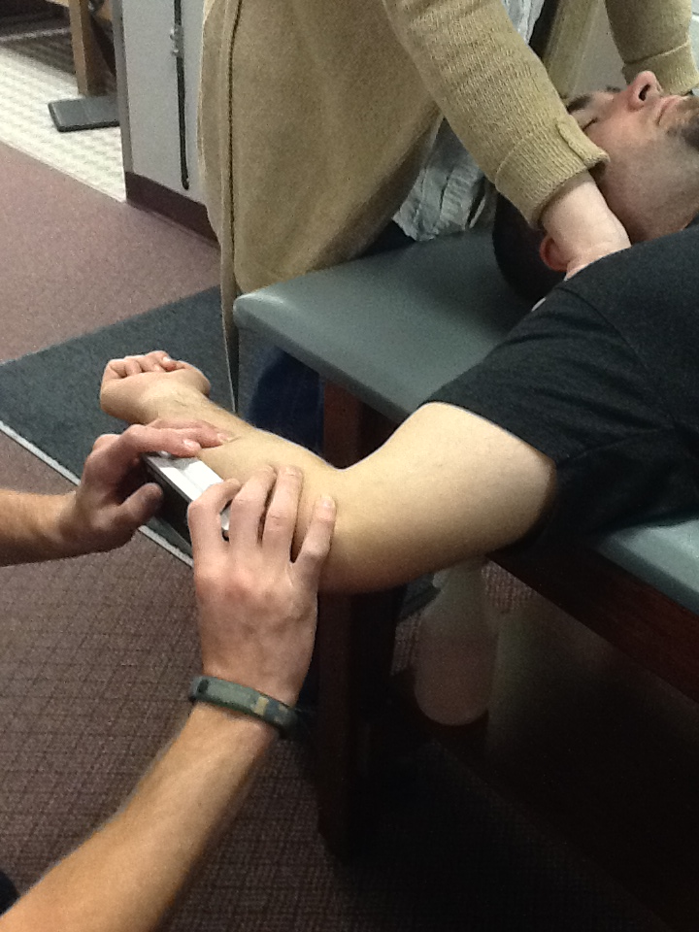
Inclinometer Measurements
Internal and External Rotation (Laudner et al, 2008)
Supine
Shoulder and elbow in 90° of abduction and flexion, respectively
Inclinometer aligned with the ulna
Actively rotate shoulder

Slide 18
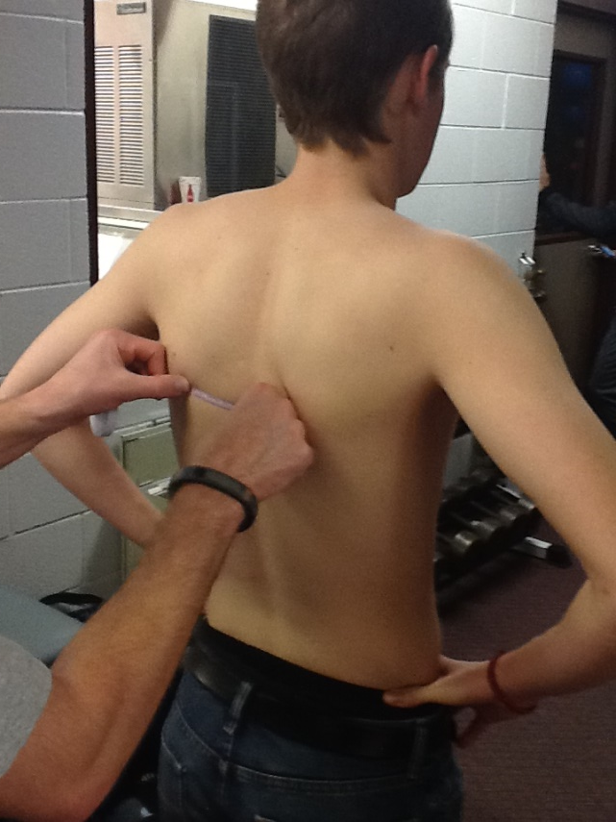
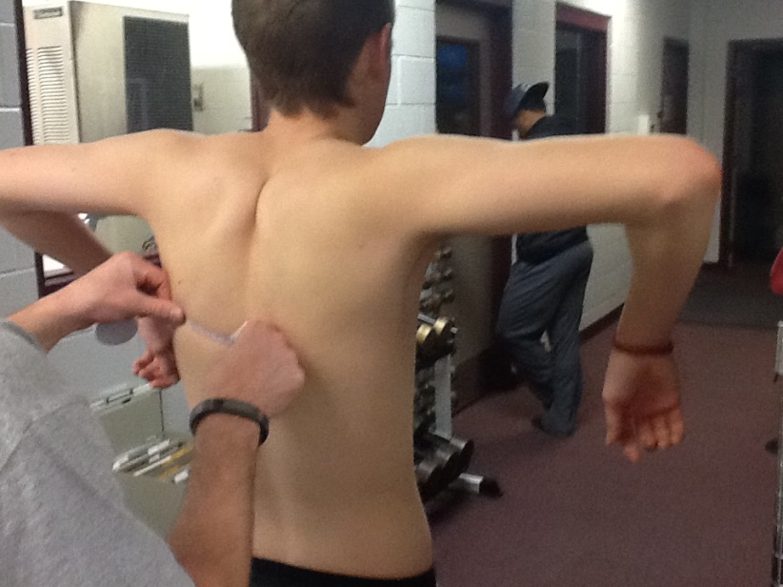
Lateral Scapular Slide Test
Kibler, 1998
Position 1
Position 3
Position 2
Notes:
Kibler
Standing
Step 1: Arms at side and measure distance from spinous process to inferior angle of scapula
Step 2: Hands on hips and measure distance from spinous process to inferior angle of scapula
Step 3: 90 abduction and internally rotate humerus and measure distance from spinous process to inferior angle of scapula

Slide 19
Other Measurements
Posterior Shoulder Tightness
Side lying
Researcher stabilizes scapula while the participant pinches scapulas and passively move into horizontal adduction
Measure distance from table to medial epicondyle
Tyler et al. 1999; Mcclure et al. 2007
Notes:
Provide reference for this technique of measurement
Reliability of .95 and validity of .80

Slide 20
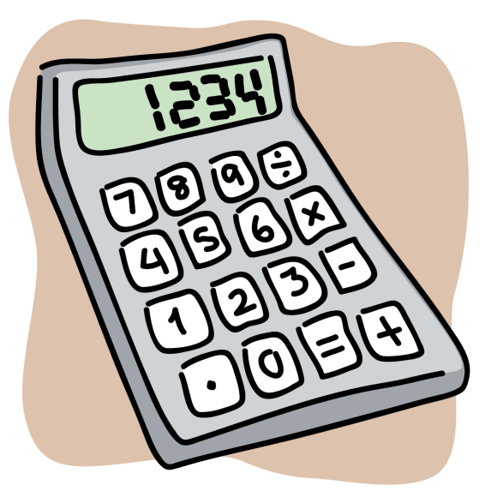
Data Analysis
2 x 4 Repeated Measures ANOVA (time x condition)
Internal rotation
External rotation
Lateral Scapular Slide
Posterior Shoulder Tightness
IBM SPSS version 21
Microsoft Excel 2010

Slide 21
Results
Lateral Scapular Slide
2 x 4 ANOVA not significant (p=.74)
Numbers are stable
Posterior Shoulder Tightness
2 x 4 ANOVA not significant (p=.638)
Main effect for time (p= .08)
Internal Rotation
2 x 4 ANOVA not significant (p = 0.96)
Clinical significance of
2-3 degrees
External Rotation
2 x 4 ANOVA not significant (p = 0.98)

Slide 25
*
* Main effect time p = 0.08
Notes:
Need to indicate main effect for time- however, we should check this graph- control is increasing and the others decreasing- they all should be decreasing???

Slide 26
Discussion
Thermotherapy has often been a choice for warming up tissues and muscles prior to activity
PSWD is effective in decreasing pain and increasing shoulder ROM for conditions like frozen shoulder and rotator cuff tendinopathy. (Rabini et al, 2012; Lueing, Cheing,2008)
Literature of diathermy on lower extremity indicates stretching with diathermy produces more ROM and flexibility gains than stretching alone. (Peres et al. 2002 ; Knight et al. 2001; Draper et al., 2004)
Notes:
Discuss gating mechanism which may have an indirect effect on ROM; same with vasodilation and subsequent decrease in spasm
Lower extremity studies both performed on dorsiflexion ROM
Our results did not show an acute effect on shoulder ROM; however, maybe more treatments were necessary? (not sure if the Peres or Robertson study did multiple treatments or single treatments to achieve their results?
RABINI – the effects of diathermy on disability, shoulder function and pain were equal to subacromial corticosteroid injections
LUENG- deep heating and stretching produced greater increase in pain relief and resulted in better performance of ADL for ROM than superficial heating
Peres- 14 treatments in 3 weeks diathermy and stretch produced greater ROM gains in dorsiflexion than stretching alone
knight– 3 days a week for 6 weeks- deep heat and stretching is more effective than superfical and stretch or stretching alone for ankle dorsiflexion
Draper- 1 treatment a day for 5 days –PSWD with stretching is better than stretching alone or placebo with stretching (did 10 minutes of diathermy, 5 of diathermy with concurrent stretch and 5 minutes of stretching alone)

Slide 27
Discussion
Static stretching is extremely effective in improving in flexibility and range of motion.
(Prentice, 2004)
Cool-down or independent stretches may be better for gains in flexibility without loss of power or strength prior to event
(Frederick, Szymanski, 2001 ; Behm, Chaouachi, 2011 ; Schilling, Stone, 2000)
Our results suggest that there were no differences between PSWD, stretching or a combination of the two on acute gains for shoulder ROM
Notes:
Stretching gains are usually noted in programs conducted over 4-6 weeks; this study specifically looked at acute effects of static stretching; you should bring in the comparison with the Laudner study (Acute effects of sleeper stretch- then you have something to compare to specifically)
Laudner et al- 3 sets of 30 second passive sleeper stretches produced acute gains in posterior shoulder tightness (inclinometer horizontal adduction). Though these gains may be clinically insignificant

Slide 28
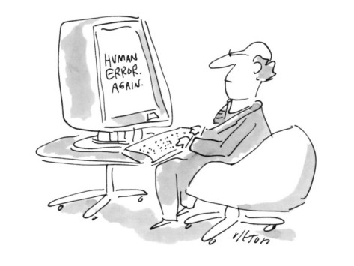
Limitations
Measurement error
Small sample size
Limiting Overhead activity
Fitness levels
Different people stabilizing
Notes:
Digital inclinometer- learning curve
PST is a hard measurement to get – SEE INVITED COMMENTARY OF TYLER ET AL

Slide 29
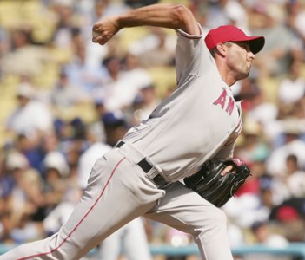
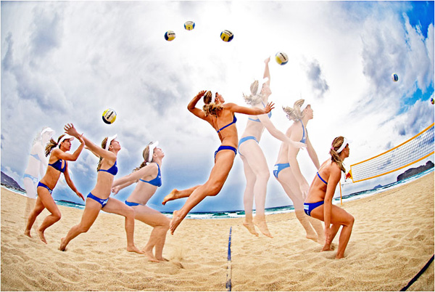
Future Research
Overhead athletic population
Larger sample size
See if multiple treatments improves effect on ROM
Change parameters

Slide 30
Conclusion
Stretching alone is just as effective as stretching combined with diathermy
However in this study neither treatment produced significant acute gains in ROM
Notes:
Need a picture here – maybe a picture of your shirt that was the incentive????

Slide 31
References
Awan R, Smith J, Boon A.J. Measuring Shoulder Internal Rotation Range of Motion: A Comparison of 3 Techniques. Archives of Physical Medicine and Rehabilitation. 2002; Volume 83(9): 1229–1234.
Bacurau, RFP. Monteiro, GA. Ugrinowitsch, C. Tricoli, V. Cabral, LF. Aoki, MS. Acute Effect of a Ballistic and Static Stretching Exercise Bout on Flexibility and Maximal Strength. Journal of Strength and Conditioning Research. 2009; Volume 23(1): 304-308.
Behm, DG. Chaouachi, A. A Review of the Acute Effects of Static and Dynamic Stretching on Performance. European Journal of Applied Physiology. 2011; 111(11): 2633-51.
Borsa, PA. Laudner, KG. Sauers, EL. Mobility and Stability Adaptations in the Shoulder of the Overhead Athlete. Sports Medicine Journal. 2008; 38(1): 17- 36
Clarkson, H.M. Musculoskeletal Assessment: Joint Range of Motion and Manual Muscle Strength. Baltimore, MD: Lippincott Williams & Wilkins; 2000.
Draper, DO. Castro, JL. Feland, B. Schulthies, S. Eggett, D. Shortwave Diathermy and Prolonged Stretching Increase Hamstring Flexibility More than Prolonged Stretching Alone. Journal of Orthopedic Sports Physical Therapy. 2004; Volume 34(1):13-20.
Frederick, GA. Szymanski, DJ. Baseball: Dynamic Flexibility. National Strength and Conditioning Association. 2001; 23(1): 21-30.

Slide 32
References
Garrett, CL. Draper, D.O., Knight, K.L. Heat Distribution in the Lower Leg from Pulsed Short-Wave Diathermy and Ultrasound Treatments. Journal of Athletic Training. 2000; Volume 35(1), 50
Kibler, BW. The Role of the Scapula in Athletic Shoulder Function. The American Journal of Sports Medicine. 1998; 26(2): 325- 336
Knight, K.L., Draper, D.O. Therapeutic Modalities: The Art and Science. Baltimore, MD: Lippencott Williams & Wilkins. 2008; 205.
Knight, C. Rutledge, C. Cox, M. Acosta, M . Hall, S. Effect of Superficial Heat, Deep Heat, and Active Exercise Warm-up on the Extensibility of the Plantar Flexors. Physical Therapy. 2001; Volume 81:1206–1214.
Leung, MSF. Cheing, GLY. Effects of Deep and Superficial Heating in the Management of Frozen Shoulder. Journal of Rehabilitation Medicine . 2008; 40(2): 145.
Laudner, K.G., Sipes, R.C., Wilson, J.T. The Acute Effects of Sleeper Stretches on Shoulder Range of Motion. Journal of Athletic Training. 2008; Volume 40(4), 359-363.
Mcclure, P. Balaicuis, J. Heiland, D. Broersma, ME. Thorndike, CK. Wood, A. A Randomized Control Comparison of Strethching Procedures for Posterior Shoulder Tightness. Journal of Orthopedic and Sports Physical Therapy. 2007; Volume 37(3): 108-114.
Morrison, DS. Frogameni, AD. Woodworth, P. Non-Operative Treatment of Subacromial Impingement Syndrome. Journal of Bone and Joint Surgery. 1997; 79: 732-737.

Slide 33
References
Peres, SE. Draper, DO. Knight, KL. Ricard, MD. Pulsed Shortwave Diathermy and Prolonged Long- Duration Stretching Increase Dorsiflexion Range of Motion More Than Identical Stretching Without Diathermy. Journal of Athletic Training. 2002; Volume 37(1): 43–50.
Prentice, WE. Therapeutic Modalities in Sports Medicine. St. Louis, MO: Times Mirror/ Mosby. 1990; 90-92.
Rabini, A. Giombini, A. Dragoni, S. Agnello, L. Ripani, M. Saraceni, VM. Maffulli, N. Effects of Local Microwave Diathermy on Shoulder Pain and Function in Patients With Rotator Cuff Tendinopathy in Comparison to Subacromial Corticosteroid Injections: A Single-Blind Randomized Trial. The Journal of Orthopedic and Sports Physical Therapy. 2012; 42(4): 363.
Roberts, JM. Wilson, K. Effect of Stretching Duration and Passive ROM in the Lower Extremity. British Journal of Sports Medicine. 1999; Volume 33: 259-263.
Saures, E. August, A. Snyder A. Fauls Stretching Routine Produces Acute Gains in Throwing Shoulder Mobility in Collegiate Baseball Players. Journal of Sports Rehabilitation. 2007; 16(1):28-40.
Schilling, BK. Stone, MH. Stretching: Acute Effects on Strength and Power Performance. Strength and Conditioning Journal. 2000; 22(1): 44-47.
Tyler, TF. Roy, T. Nicholas, SJ. Gleim, GW. Reliability and Validity of a New Method of Measuring Posterior Shoulder Tightness. Journal of Orthopedic and Sports Physical Therapy. 1999; 29(5): 262-274.
Prentice, WE. Rehabilitation Techniques for Sports Medicine and Athletic Training. 4th Edition. New York City, NY: McGraw-Hill Companies Inc. 2004.

Slide 34
Thank You….
Davidson Honors College
Dr. Valerie Moody

Slide 35
Questions?!?!?!?!

