Slide 1
Experimental Evolution of Multicellularity
Jacob Boswell

Slide 2
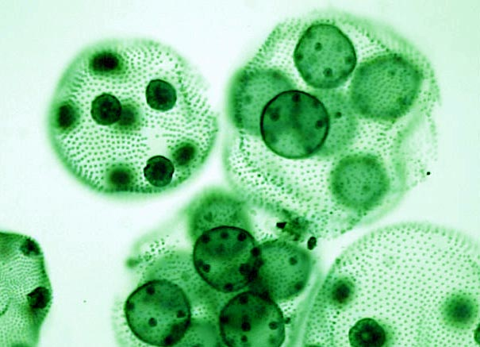
Why Multicellularity?
Stickiness ensures a predictable habitat
Cellular Differentiation
Resistance to Predation

Slide 3
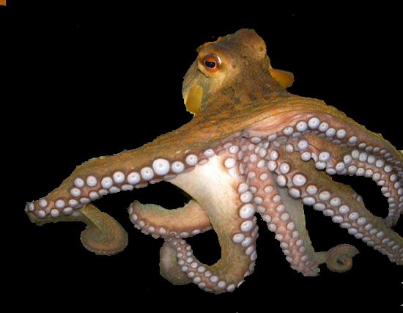
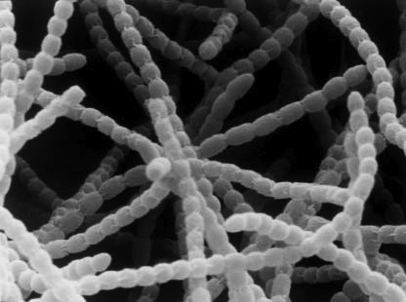
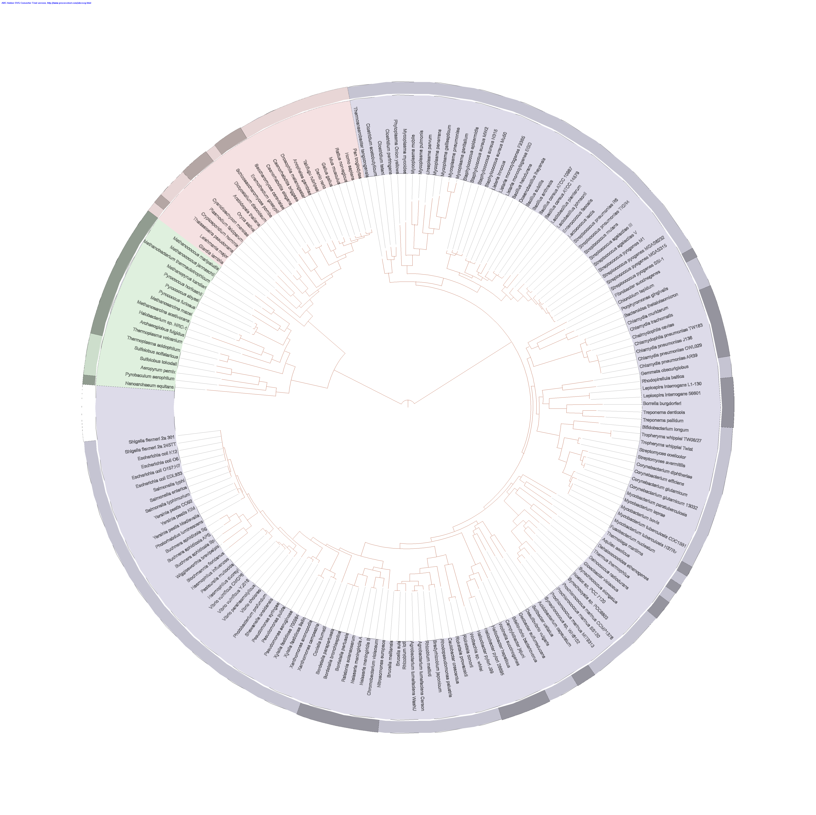
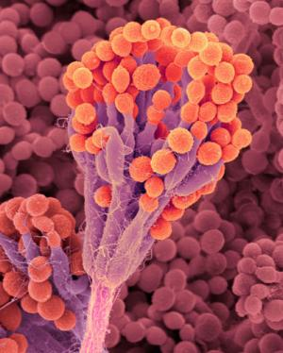
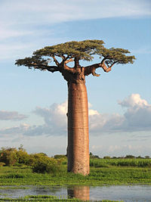
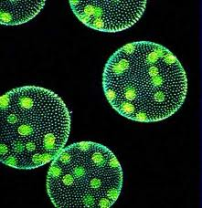
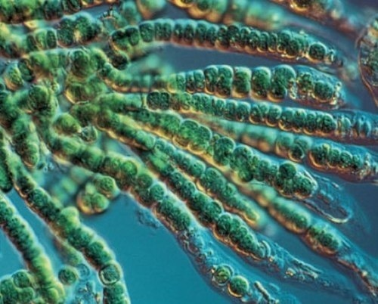
Origins of Multicellularity
You are here
20+ separate origins

Slide 4
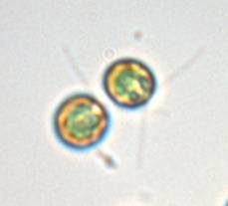
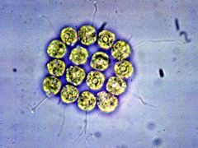
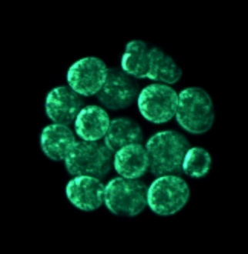
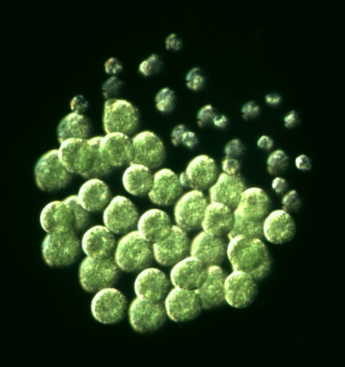
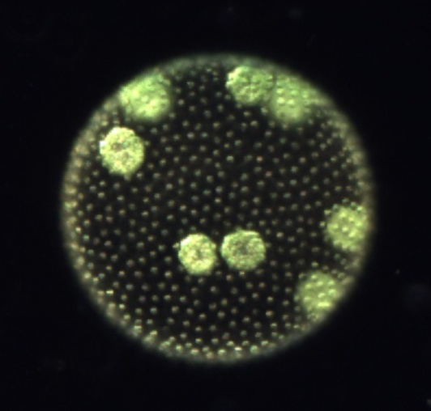
Volvocine algae
Chlamydomonas
Gonium
Eudorina
Pleodorina
Volvox
Figures and Photos : M. Herron (2011)

Slide 5
Experimental Evolution
Multicellularity can evolve in C. reinhardtii due to selection imposed by the predator P. tetraurelia
Hypothesis
Continuous co-culture of Chlamydomonas reinhardtii with Paramecium tetraurelia
Capture phenotypic changes in experimental isolates
Uncover genetic determinants of evolved phenotypes
Notes:
That is to say, multicell can evolve by the incorporation of palmella formation as a permanent strategy, something which could only happen if a heavy predation force was applied over a long period of time

Slide 6
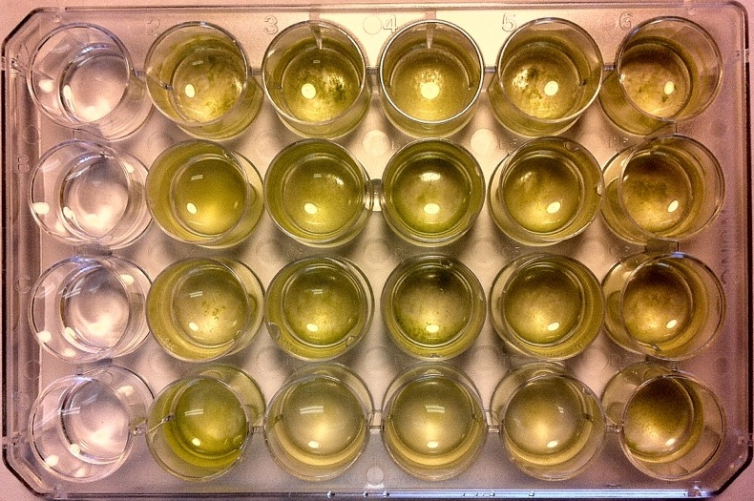
Methods
8 distinct crosses, each with 5 replicates
Transfer to fresh medium weekly
1 2 3 4 5
1 2 3 4 5
A
E
B
F
C
G
D
H

Slide 7
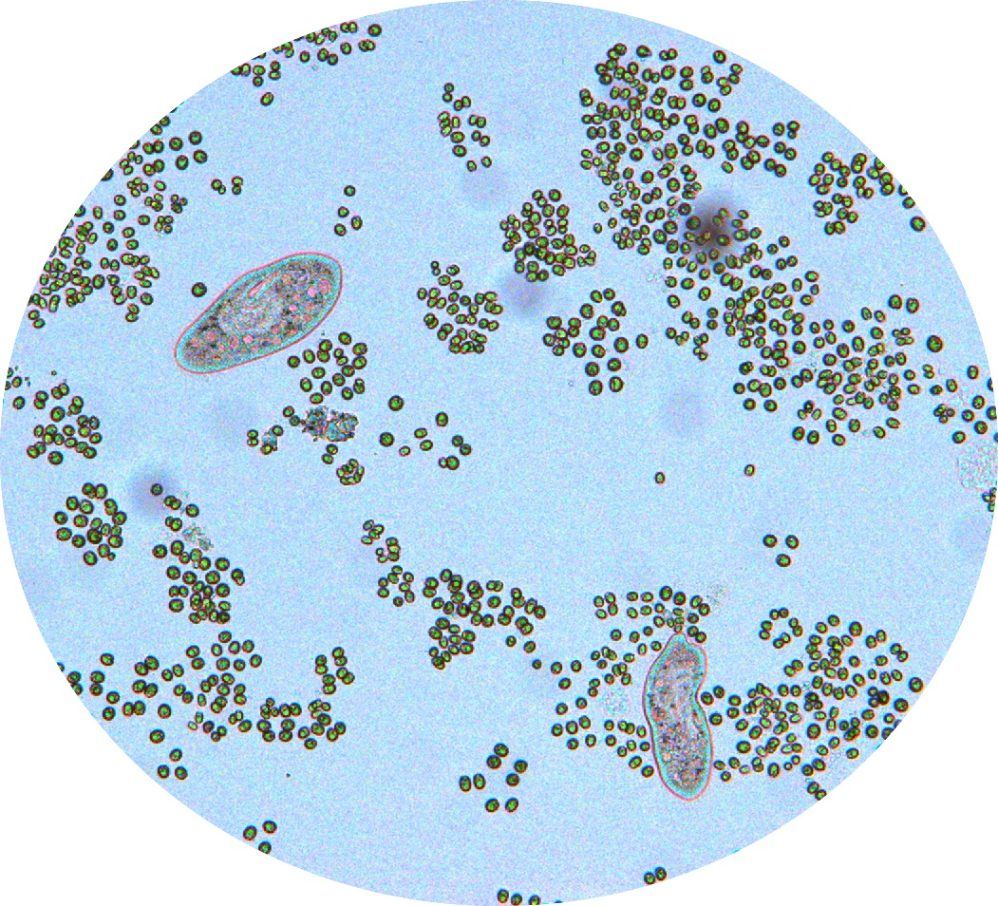
Methods

Slide 8
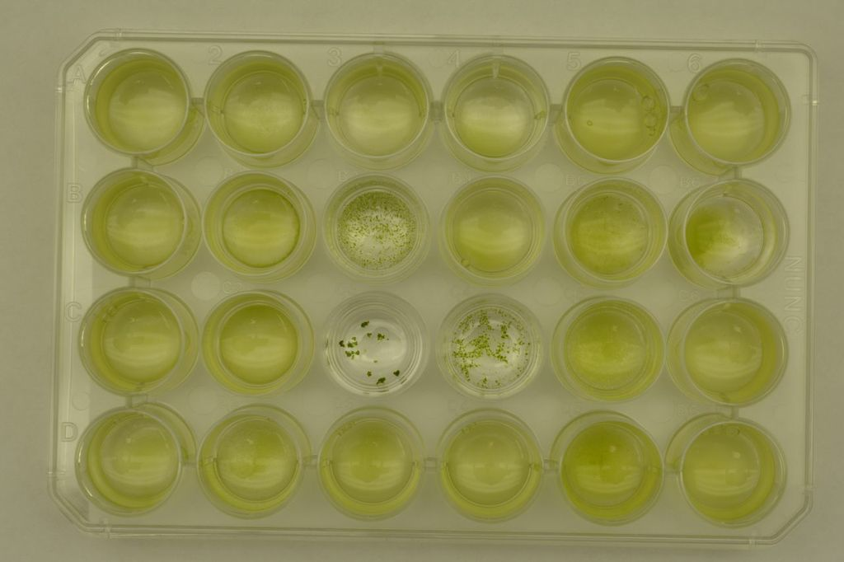
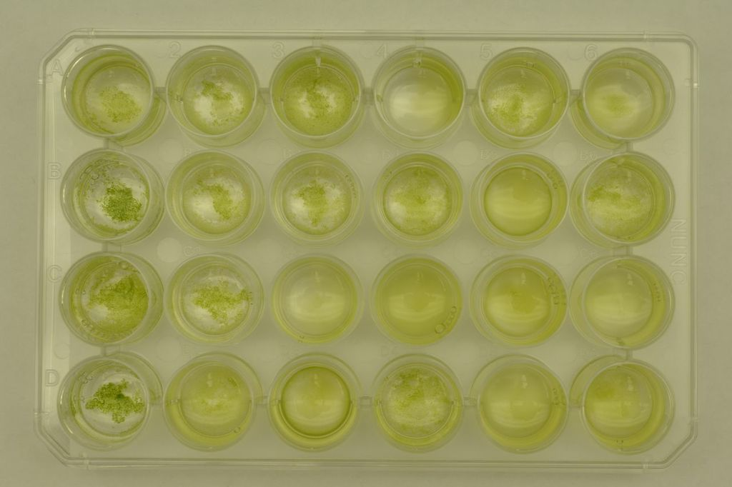
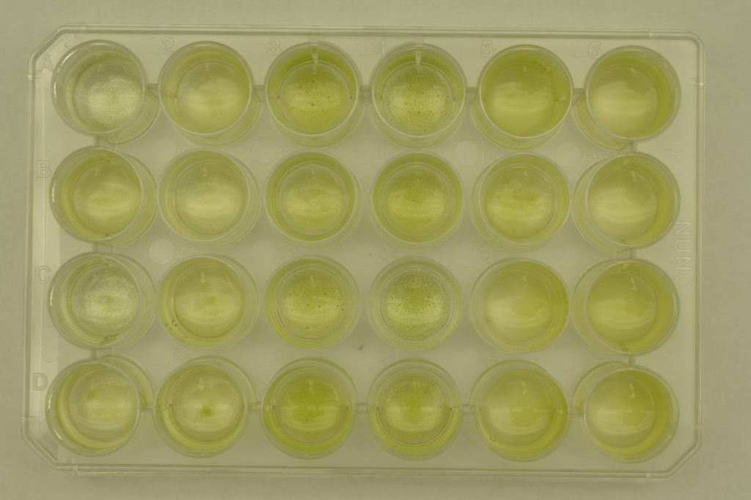
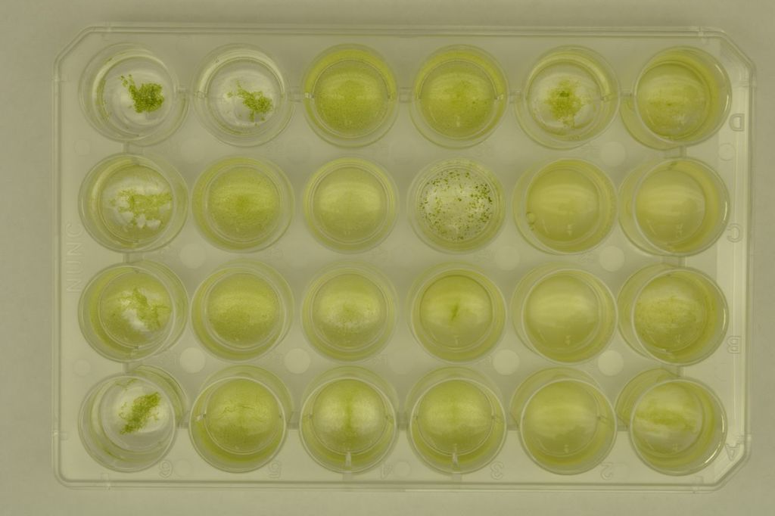
50 weeks later….
~2000 generations

Slide 9
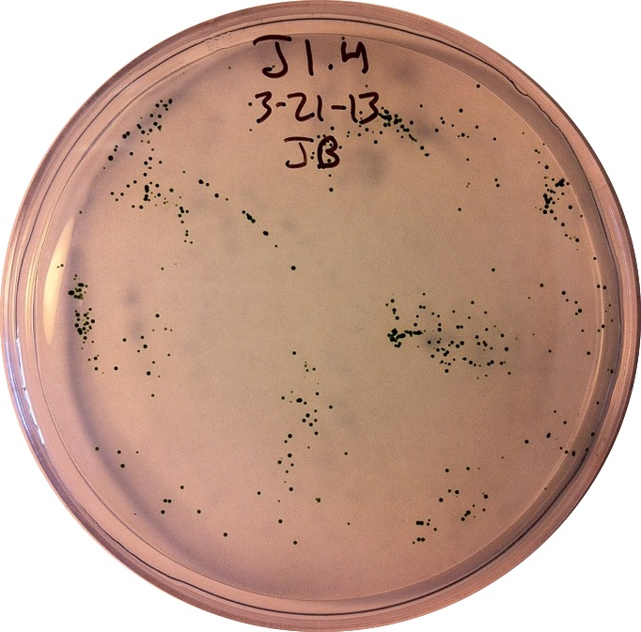
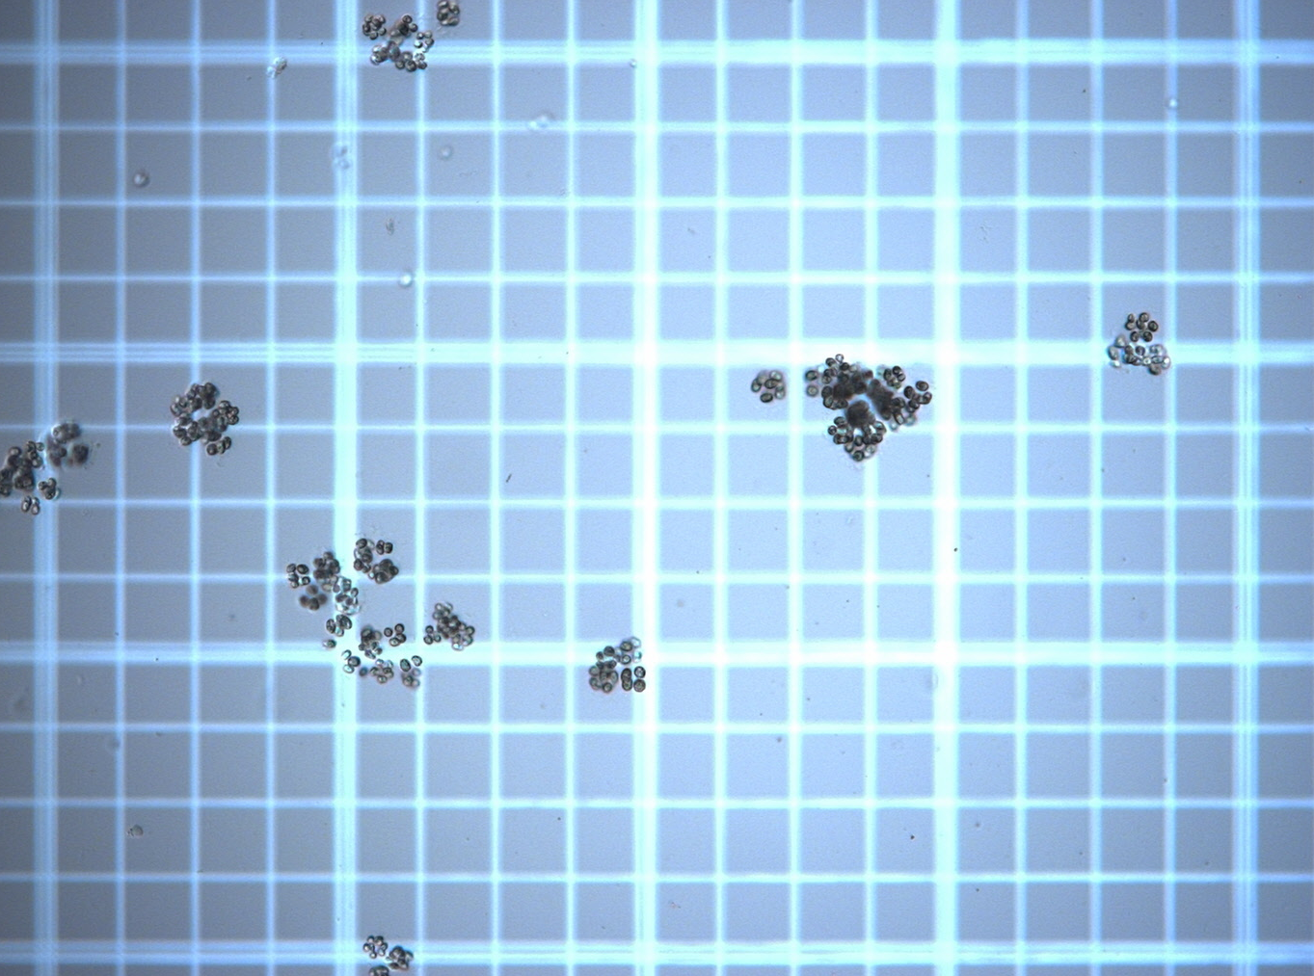
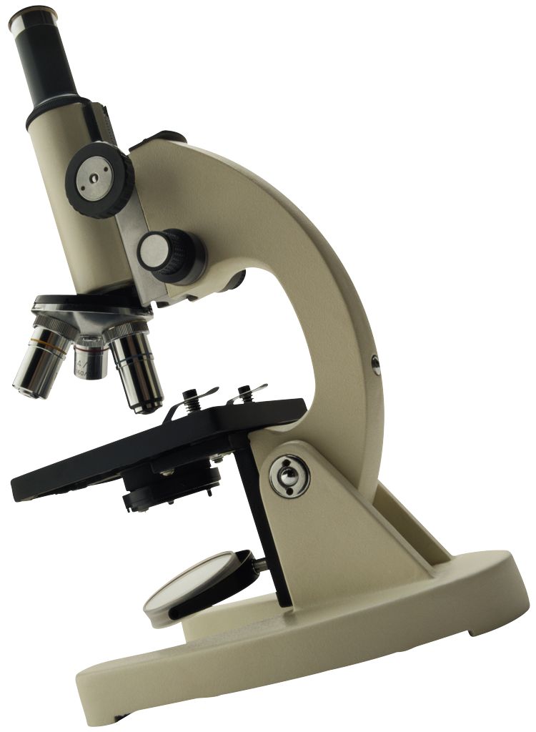
Phenotyping
1 2 3 4 5
ABCD
X8 clones per population
Notes:
First arrow: plate a random sample of each population to isolate genetically distinct individuals, second arrow: repeat plate until axenic, then pick 5 colonies and grow in test tubes, third arrow: mix isolates with 4 concentrations of predator filtrate, fourth arrow: measure palmella: single cell counts for each of 4 treatments X 3 replicates X 5 isolates X 5 replicate populations X 8 crosses = 2400 cell counts per reaction norm

Slide 10
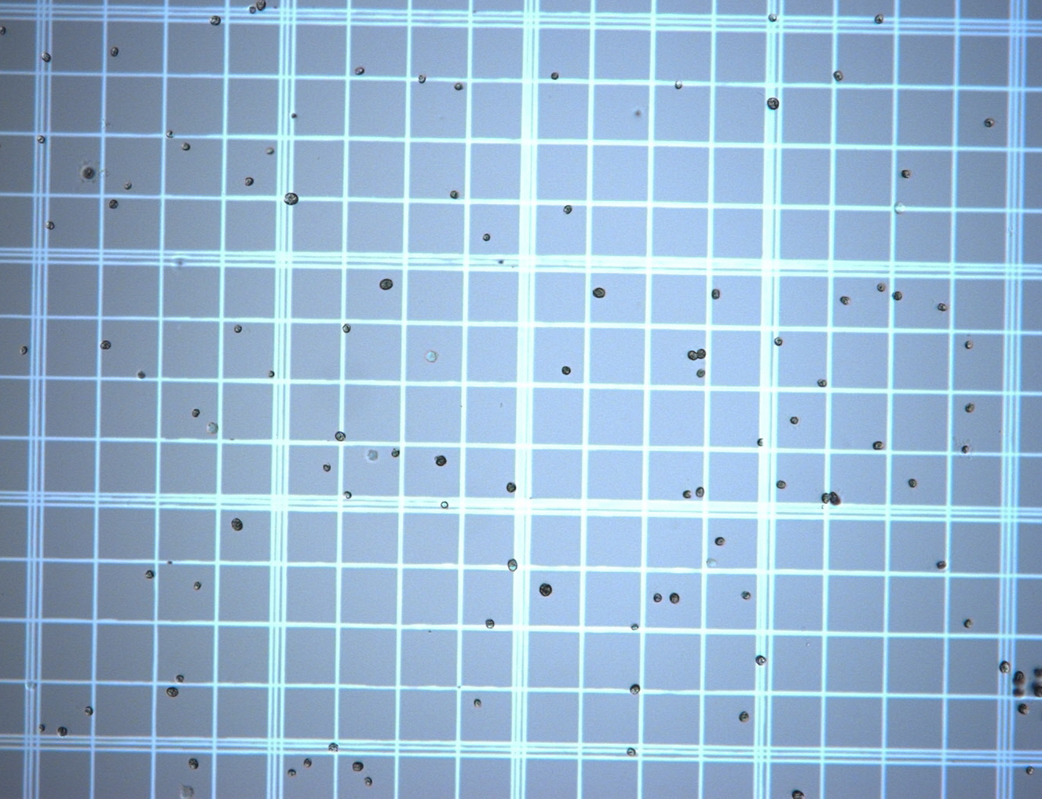
Data Analysis
ImageJ
Produces .csv dataset that assigns each particle an ID number and a size
ImageJ

Slide 11
Results
Based on Raw Particle Counts

Slide 12
Results
Particle-Based Calculations
Raw Multicell Proportion:
.20
Generation 0
Generation 1
Raw Multicell Proportion:
.06

Slide 13
Results
Area-Based Calculations
Area-based Multicell Proportion:
~.5
Generation 0
Generation 1
Area-based Multicell Proportion:
~.5
Serves as a proxy for measuring the proportion of CELLS that are in a multicellular structure

Slide 14
Results
Based on Particle Areas

Slide 15
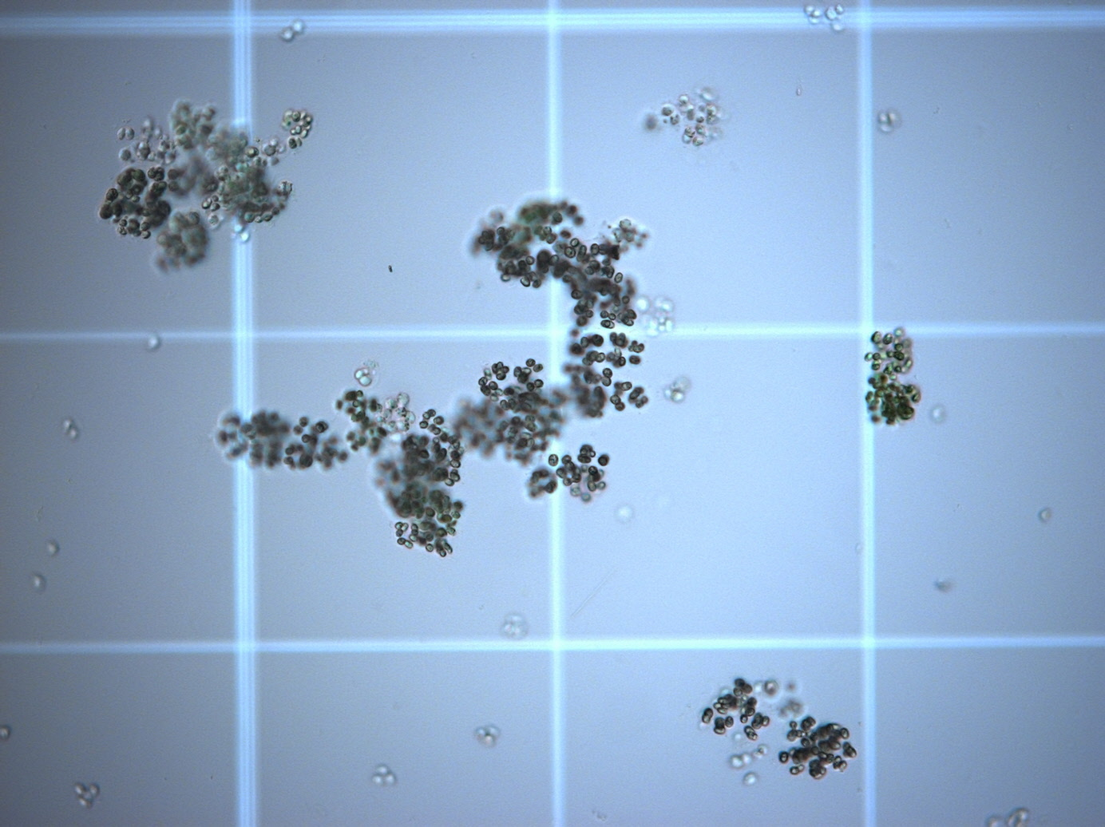
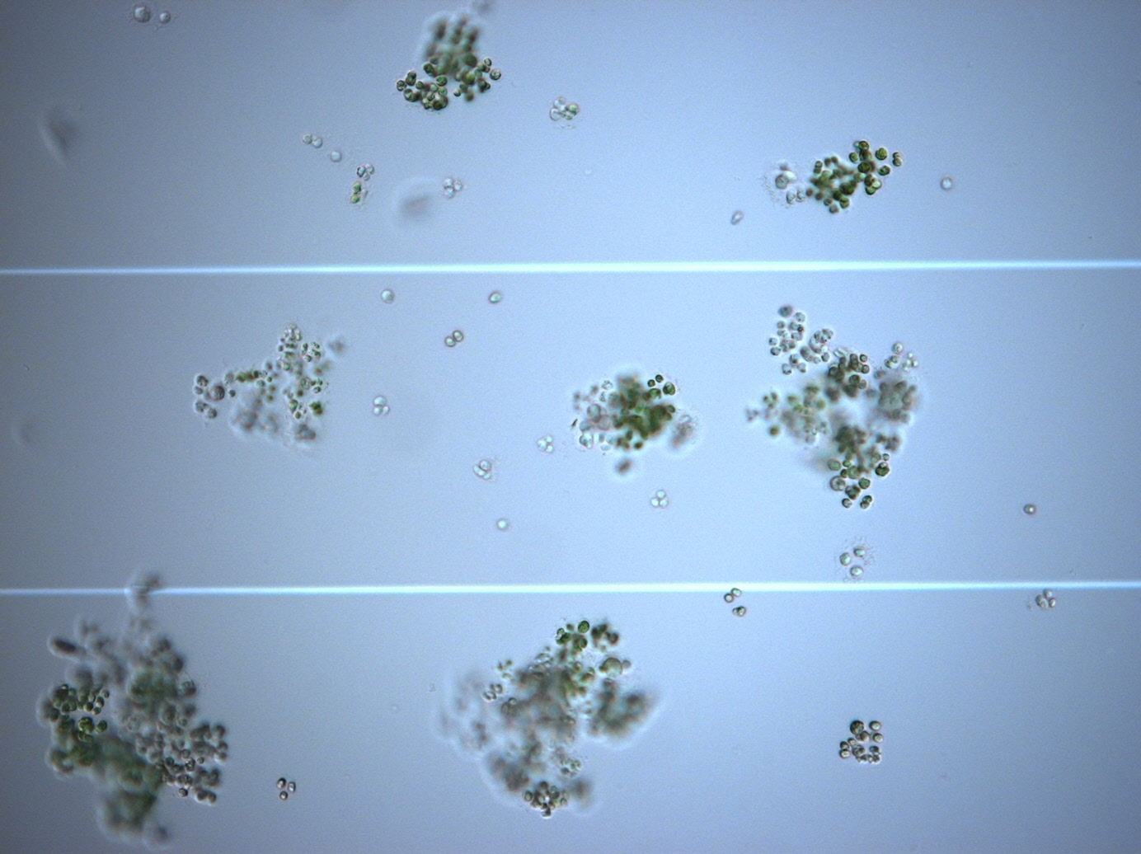
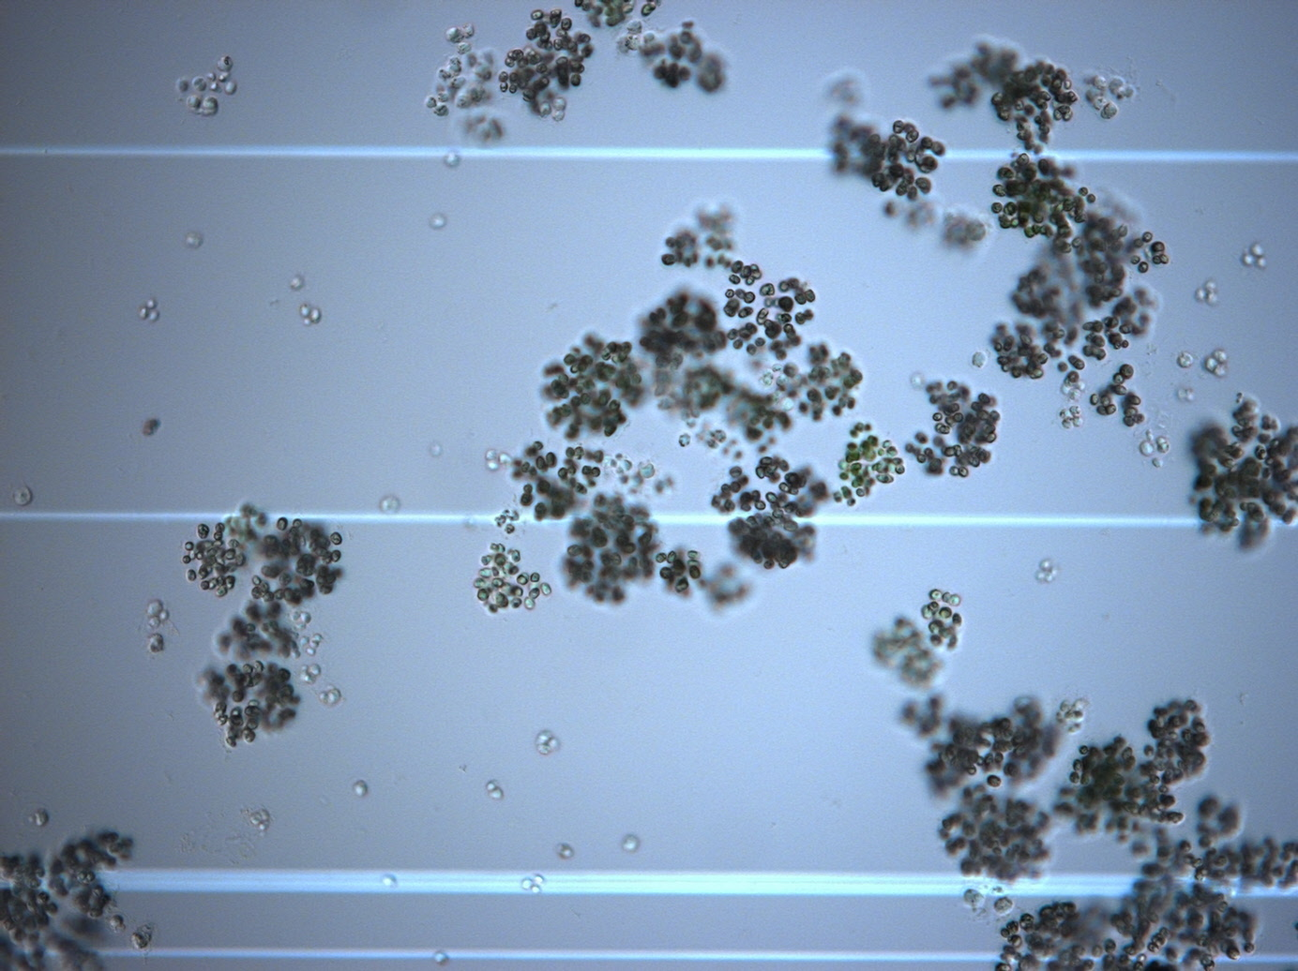
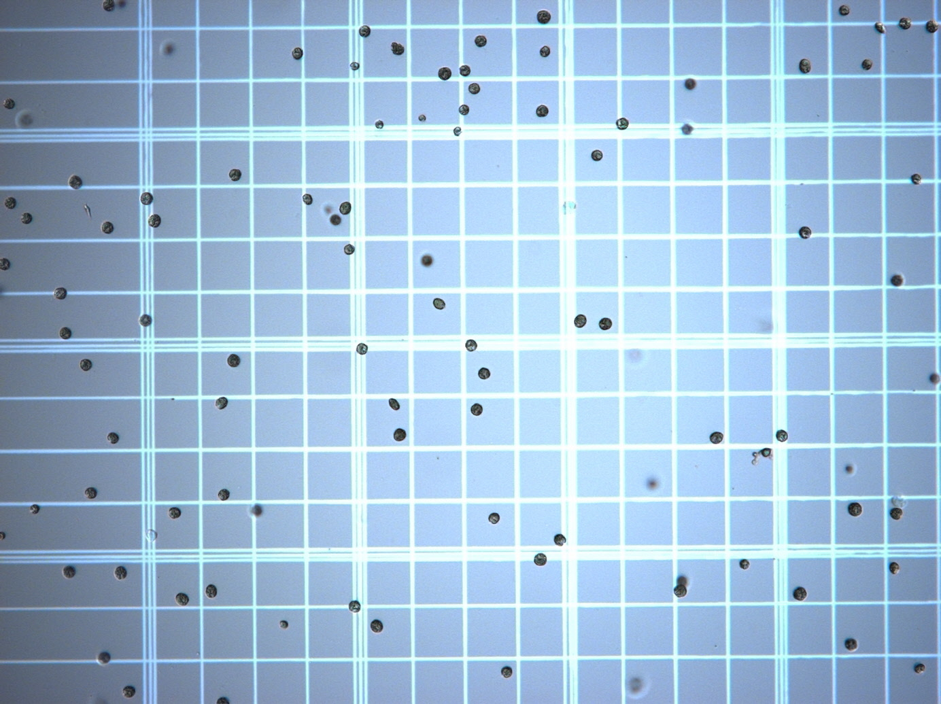
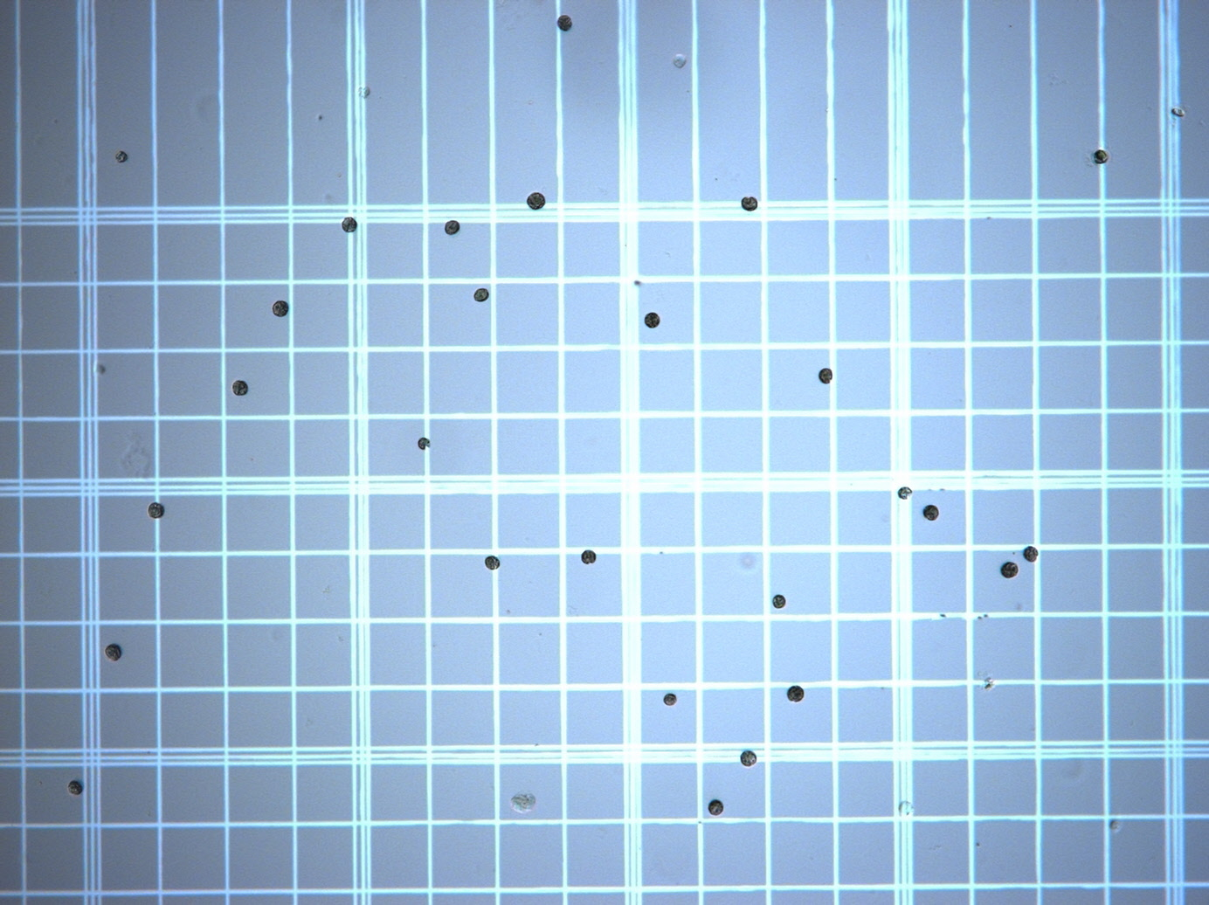
Results
A Closer Look at B2

Slide 16
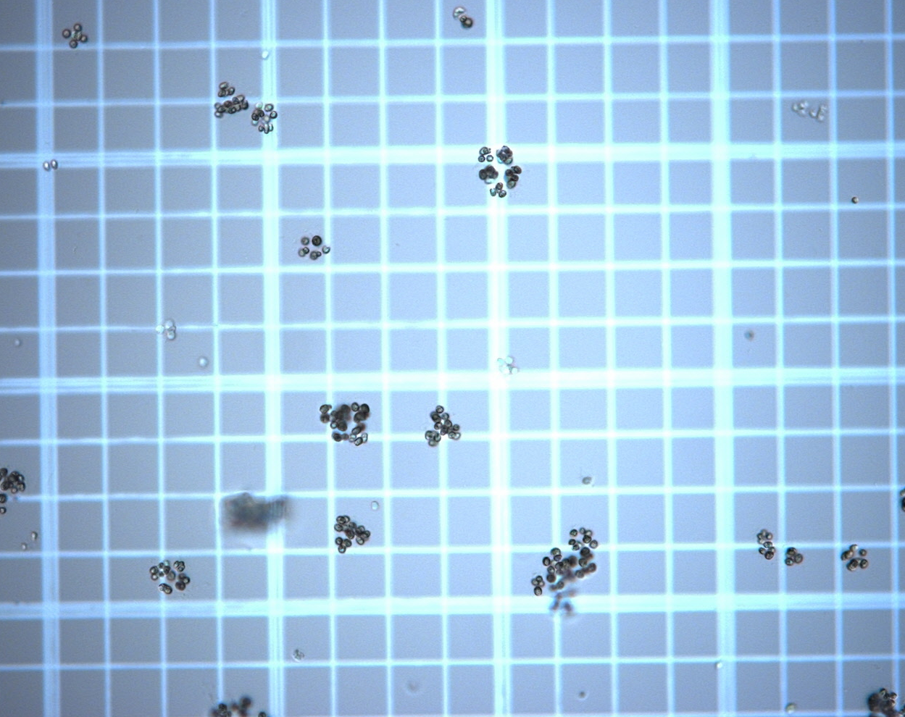
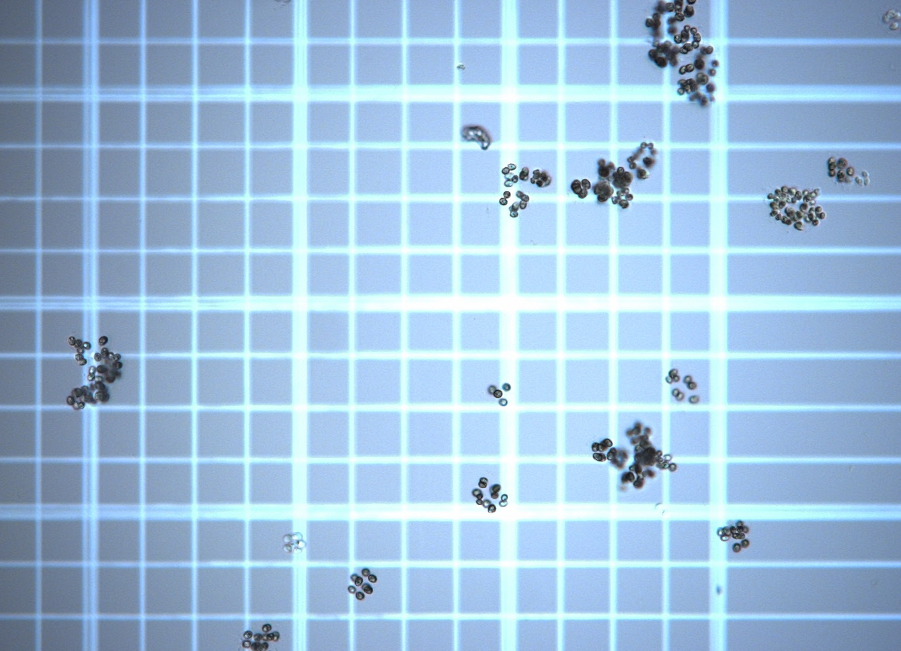
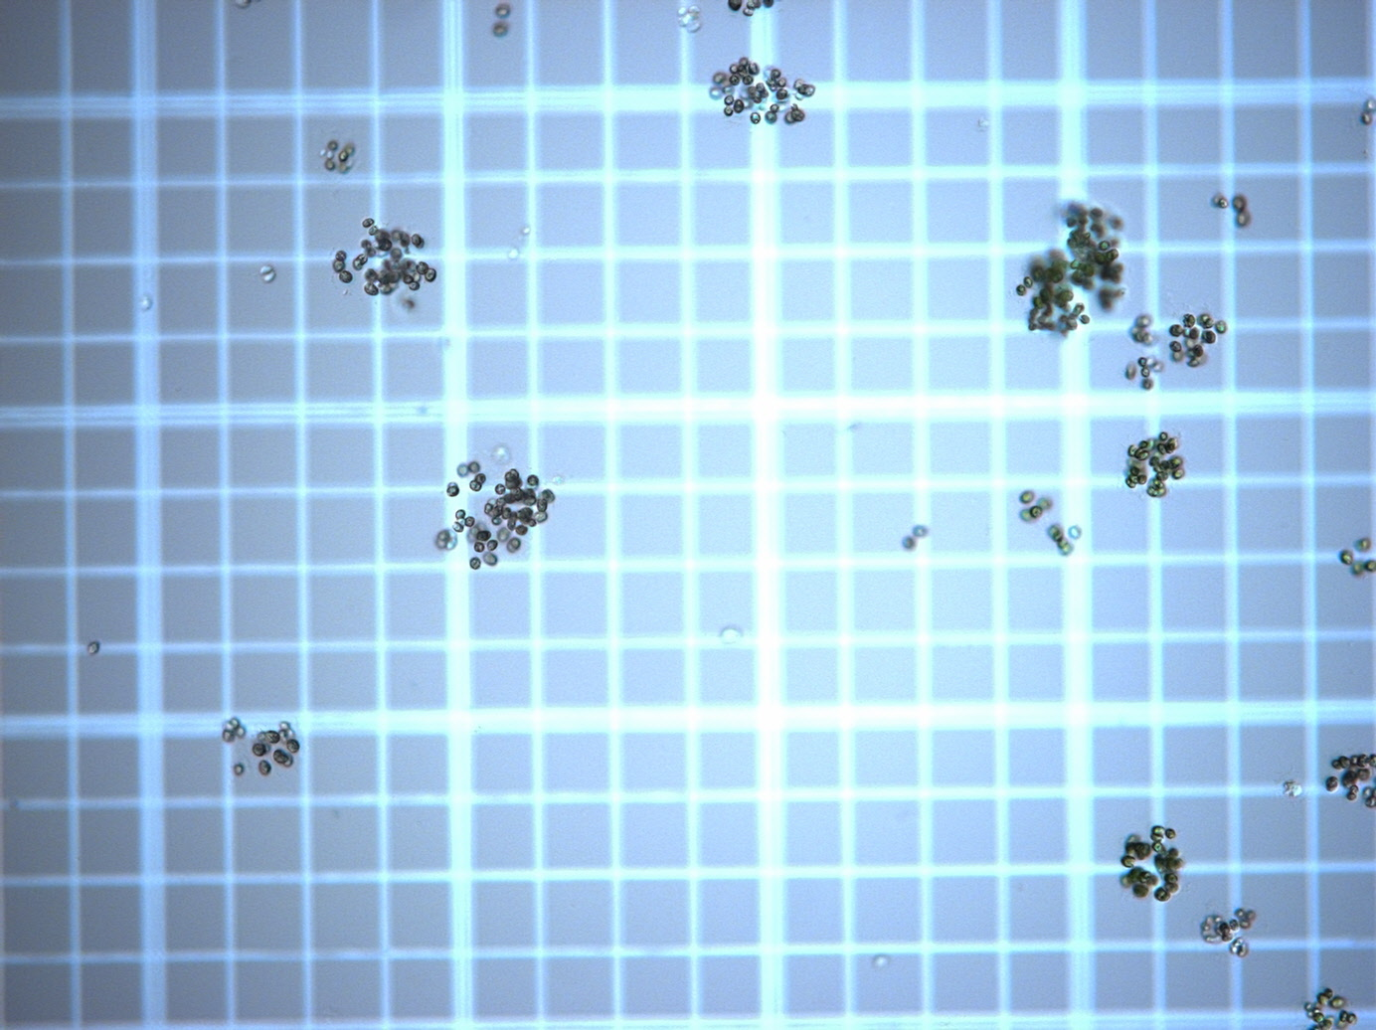
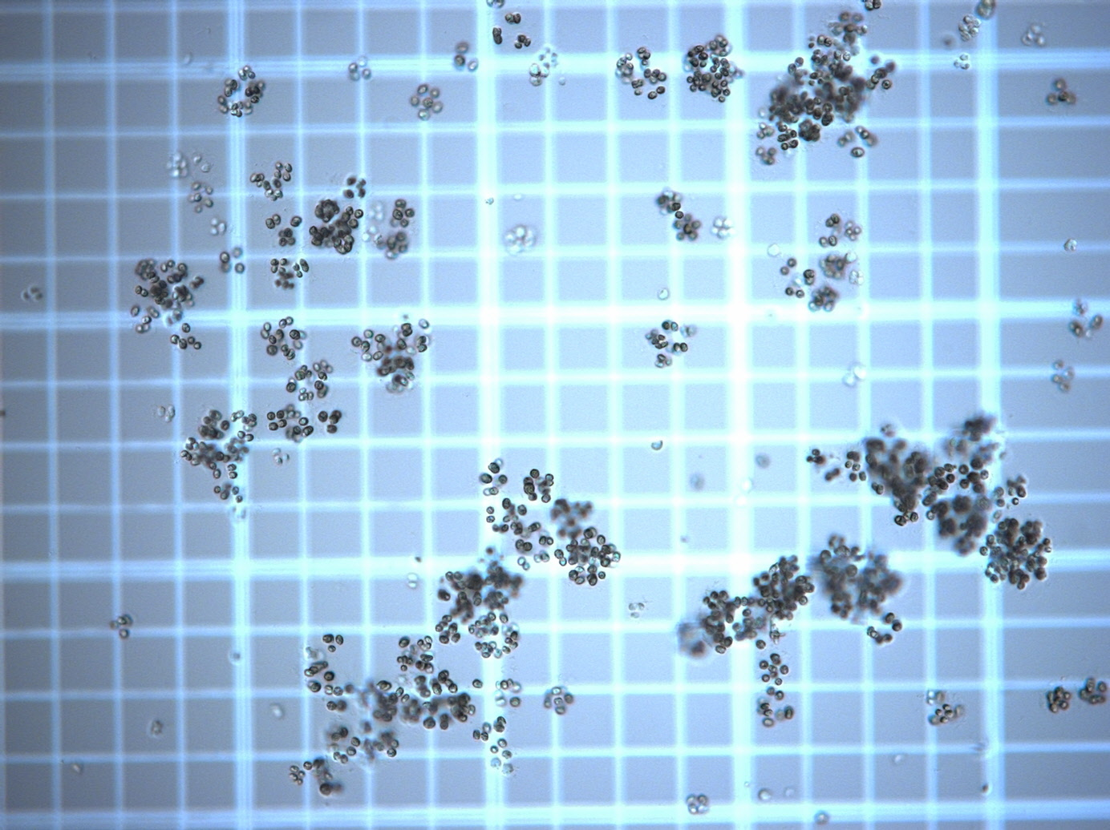
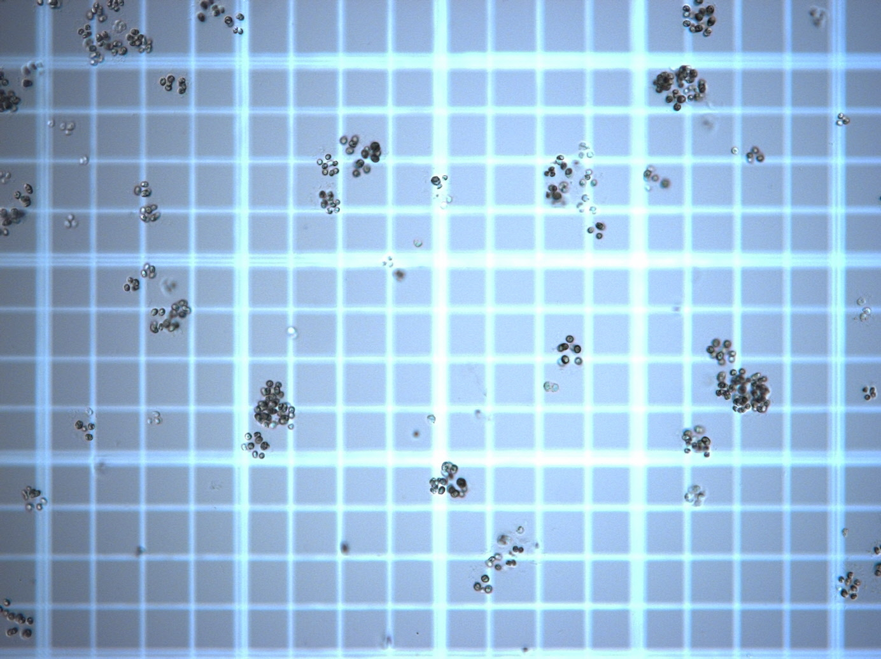
Results
A Closer Look at B5

Slide 17
Future Plans
Repeat ImageJ analysis with more replication
Characterize life-cycle of evolved multicells
Determine genetic basis for phenotypes

Slide 18
Life-Cycle
Future Plans
How are the evolved multicells reproducing?

Slide 19
Genetic Analysis
Future Plans
Bulked Segregant
Ancestral Single Cell
Sequencing Pools
Evolved Multi-cell
Offspring

Slide 20
Genetic Analysis
Future Plans
Prochnik et al (2010)
Compare to other volvocine species
Notes:
Although genomes are very similar (4 loci changes) the diversification of pherophorin proteins and cell cycle proteins is widespread

Slide 21
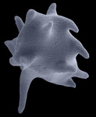
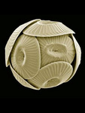
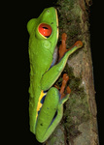
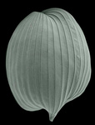
Broader Impact
Tol.org
Notes:
As we progress in this research, we will begin to help answer a number of long-standing questions. Transition from acting in the interest of a single selfish individual to a group of selfish clones, how evolution can work to produce highly integrated forms.

Slide 22
Acknowledgments
Dr. Matthew Herron
Funding
Dr. Frank Rosenzweig
References
Lurling, M., and W. Beekman. 2006. Palmelloids formation in Chlamydomonas reinhardtii: defence against rotifer predators? Annales de Limnologie - International Journal of Limnology 42:65–72.
Ratcliff, W. C., R. F. Denison, M. Borrello, and M. Travisano. 2012. Experimental evolution of multicellularity. PNAS 109:1595–1600.
Bonner, J. T. 1998. The origins of multicellularity. Integrative Biology 1: 27-36.

