Slide 1

Can Personality Traits Predict Substance Use Preference? A Discriminant Functions Analysis of Drug Use in the LGBTQ Population
Adam J. Gott, AA, Nicholas A. Livingston, BS and Bryan Cochran, Ph.D.
University of Montana, Department of Psychology

Slide 2
Personality Traits
  Certain personality Traits linked to heavy alcohol and stimulant use (Brunelle et al, 2004; Kotov et al, 2010)
  Five-Factor model of personality
    Extraversion
    Neuroticism
    Agreeableness
    Conscientiousness
    Openness

Slide 3
CNS Stimulants
  Stimulants of the Central Nervous System (CNS)
    Increase cortical/physiological arousal
    Increase activity of autonomic nervous system
    Increase alertness
  CNS stimulants include:
    Cocaine
    Methamphetamine
    Prescription medications (Aderall, Ritalin, etc.)
    MDMA (Molly/Ecstasy/E, etc.)

Slide 4
CNS Depressants
Depressants of the CNS:
  Decrease cortical/physiological arousal
  Decrease respiration, heart rate, blood pressure, and reflexive reactions
  Decrease alertness
CNS Depressants include:
  Opiates (Heroin, codeine, etc.)
  Painkillers (Vicodin, Percocet, Lortab, etc.)
  Sleeping medication (Ambien, etc.)
  Sedatives (Xanax, Valium, etc.)

Slide 5
Extraversion and Neuroticism
  Extraversion (surgency): Sociable, pleasant affect, sensitive to reward, energetic, dominant, enthusiastic. (Costa & McCrae, 1992 )
    High extraversion linked to increased use of CNS stimulants.
  (Feldman et al, 2007)
  Neuroticism (emotional instability): Nervous, tense, high-strung, moody, worrying. (Costa & McCrae, 1992)
    High neuroticism linked to heavy alcohol (i.e., depressant) consumption.
  (Feldman et al, 2007)

Slide 6
Conscientiousness, Agreeableness, & Openness (to new experience)
Conscientiousness: Self-discipline, control, reliability, achievement orientation (costa &McCrae, 1992; 1995)
  Low conscientiousness linked to Substance Use Disorders (SUD) (Kotov (et al, 2010)
Agreeableness: Pleasant, social, warm, easy to get along with. (Costa & McCrae, 1992; 1995)
Openness (to new experience): Open to cultural and intellectual pursuits, emotionally expressive, curious. (Costa & McCrae, 1992; 1995)
  Not shown to be directly linked to SUD. (Kotov et al, 2010)

Slide 7
Similar, but different
  Impulsivity associated with substance-misuse related outcomes in non-sexual minority samples. (Kotov et al, 2010)
  Impulsivity a multifaceted trait: Urgency and perseverance related to substance use outcomes whereas sensation-seeking and premeditation related to problematic substance use.
    Urgency: Lack of deliberation before engaging in behaviors aimed to combat negative affect
    Premeditation: Quick to act without considering consequences
    Perseverance: Less capable to resist distraction
    Sensation Seeking: Risk taking or thrill seeking
    UPPS; Whiteside & Lyman, 2001

Slide 8
Hypothesis
Differences in personality traits (primarily extraversion and neuroticism) will result in differences of reported primary CNS stimulant and primary CNS depressant use.
We hypothesize that certain traits (extraversion, conscientiousness, and openness) increase the likelihood of using CNS stimulants, whereas, the presence of other traits (neuroticism and agreeableness) increase likelihood of using CNS depressants.

Slide 9
Method & Participants
A subset of participants reporting substance use in the past 30 days (n=33) was taken from a larger sample of LGBTQ individuals.
  recruited nationally
  online survey methodology
Demographics:
  Age: 18-51 (M = 24.63, SD = 8.28)
  Gender: female (57.6%), male (30.3%), transgender (M to F: 3%; F to M: 3%), and other (6.1%).
  Sexual orientation: gay or lesbian (45.5%), bisexual (24.2%), heterosexual (6.1%), pansexual (12.1%), queer (9.1%), and other (3%).
  Ethnicity: African American/Black (3%), Caucasian/White (90.9%), Mixed/Unspecified (6.1%)

Slide 10
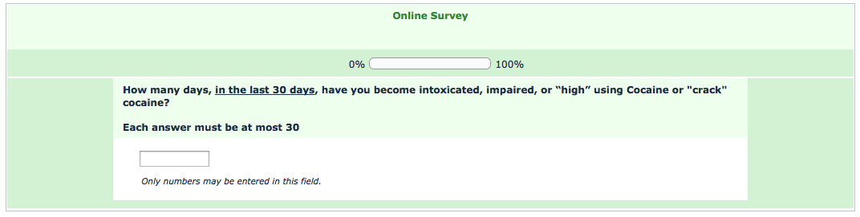
Instrumentation
  Demographics
  Five-Factor Personality Traits (BFI; John & Sravastava, 1999)
  Drug “Preference” was measured by asking how many days, in the last 30 days, participants became intoxicated on a particular substance.

Slide 11
Analyses
To test my hypothesis, I performed a discriminant function analysis
IVs:
  neuroticism
  extroversion
  conscientiousness
  agreeableness
  openness to experience
DV: Group membership (i.e., primary stimulant vs. depressant user)

Slide 12
Results
The overall model was not statistically significant, χ² = 7.913, df = 5, p = .161
However, some interesting trends began to emerge…

Slide 13
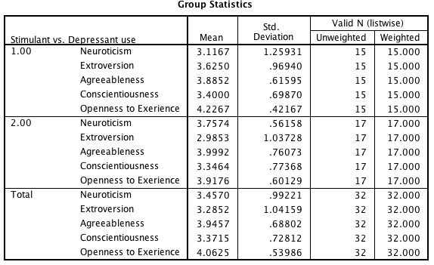
Stimulant Use (1.00) vs. Depressant Use (2.00)

Slide 14
Discussion
Our overall model did not reach statistical significance, therefore, the data did not support our primary hypothesis. However, some of the patterns we observed in the data suggests an effect may be present in a larger sample.
Our null findings may be due to insufficient power. This possibility is likely considering that our sample consisted of only 33 participants.

Slide 15
Limitations to Research
Participants reported number of days using a substance (in the past 30 days); number of substance use events remains unknown.
Reported substance use not always indicative of substance preference.

Slide 16
Directions for Future Research
Development of personalized treatment options based on personality type.
Investigating the relationship between personality traits and drug preference in a larger sample.
Treatment options for the sexual-minority population.

Slide 17
Acknowledgements
I would like to thank the following individuals for their contribution to this project: Nicholas A. Livingston, BA; and Bryan Cochran, PhD

Slide 18
References
Brunelle, C., Assaad, J., Barrett, S. P., Ávila, C., Conrod, P. J., Tremblay, R. E., & Pihl, R. O. (2004). Heightened heart rate response to alcohol intoxication is associated with a reward-seeking personality profile. Alcoholism: Clinical and Experimental Research, 28(3), 394-401.
Costa, P. T., McCrae, R. R. (1992). Normal Personality Assessment in Clinical Practice: The NEO Personality Inventory. Psychological Assessment, 4(1), 5-13.
Costa, P. T., McCrae, R. R. (1995). Domains and Facets: Hierarchical Personality Assessment Using the Revised NEO Personality Inventory. Journal of Personality Assessment, 64(1), 21-50.
Feldman, M., Kumar, V., Angelini, F., Pekala, R., Porter, J. Individual differences in substance preference and substance use. Journal of Addictions & Offender Counseling. April 2007, 27(2): 82-101.

Slide 19
References (cont’d)
John, O. P., Srivastava, S. (1999). The big five trait taxonomy: history, measurement, and theoretical perspectives. In Pervin, L. A., John, O. P. (Eds.), Handbook of Personality: Theory and Research (pp.102-138). New York, NY: Guilford Press.
Kotov, R., Gamez, W., Schmidt, F., Watson, D. (2010). Linking “Big Personality Traits to Anxiety, Depressive, and Substance Use Disorders: A Meta-Analysis. Psychological Bulletin
Whiteside, S. P., Lynam, D. R., (2001). The Five Factor Model and Impulsivity: Using a Structural Model of Personality to Understand Impulsivity. Personality and Individual Differences, 30(4), 669-689.

