Slide 1
Cyberstage
A NEW ERA OF THEATRE PRACTICE
By Hanasara ito

Slide 2
“We need new forms of expression. We need new forms, and if we can’t have them, we had better have nothing.”
-Anton Chekov, The Seagull

Slide 3
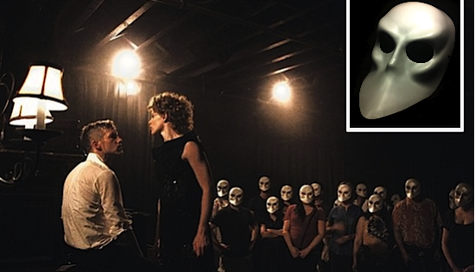
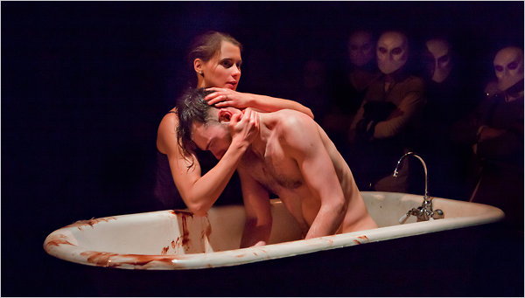
SLEEP
NO
MORE

Slide 4
So what does the internet have to do with this?

Slide 5
Different social media
Facebook vs. Twitter vs. Youtube
Hypothesis: Youtube would be the most useful tool for a theatre education.
  Videographic structure
  Simple User Interface
  Well-known organization

Slide 6
FIndings
After doing several observations and surveys, it seemed that my hypothesis was correct.
  Character and Period Research
  Accessibility to material
Facebook a close second
  Class Discussion

Slide 7
youtube
No income gap– all you need to make a simple youtube video is a camera and an internet connection.
They can bring professional performances into any home in the country.
They offer a resource to show work to the world
Beckett's Play
UM University Players

Slide 8
concerns
How does recorded theatre affect the attendance of live performance?
How do we keep the lines between acting and film, and the benefits and purposes of each?
What are the long-term effects?

Slide 9
Possible solutions
Live Broadcasts
Interactive Workshops
Digital Classes through video conferencing
THINGS WE’VE NEVER EVEN THOUGHT OF!!!

Slide 10
“My art is always in conversation with the culture that is depicted in and sustained through the internet.”

Slide 11
ACKNOWLEDGEMENTS
Many thanks to Laure Pengelly Drake, G. G. Weix, and the Department of Theatre and Dance Students and Faculty for helping me with my discoveries, and always allowing me opportunities to explore the innovations of the art form.

