Slide 1
Balancing Efficiency and Compassion: Researching Best Practices for Homeless Shelter Policy Manuals
Ally Guldborg
Sociology
UM Conference on
Undergraduate Research
April 11, 2014

Slide 2
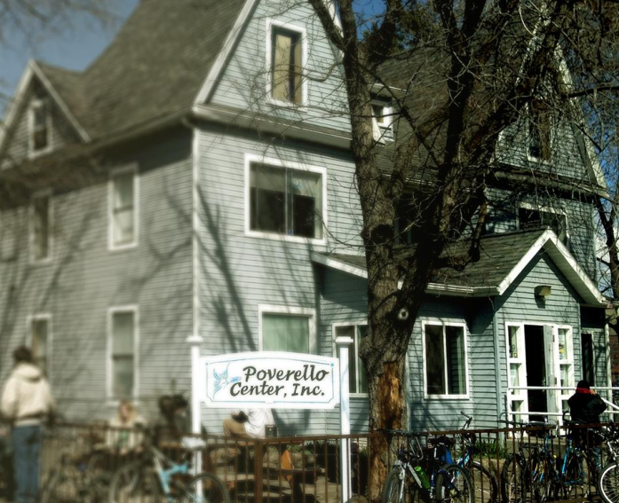
Poverello Center
The Poverello Center is a 45 day emergency shelter for adult men and women.
The Pov recently completed a capital campaign and is moving to a new facility in November 2014.
Notes:
The Poverello Center is a secular nonprofit that provides food and shelter for persons experiencing homelessness in the Missoula area.
It is a 45 day emergency shelter for adult men and women.
The Pov recently completed a capital campaign to build a new facility and expects to move into the new facility in November 2014.
I became interested in this research when I took Daisy Rooks’s Hunger and Homeless class and then was a staff member at the Poverello Center.
I decided to examine homeless shelters from around the western U.S. in order to determine best practices and assist the Pov in revising a policy manual for its new facility.

Slide 3
Literature Review
Shelterization (Stark 1994).
“…the highly organized and disciplined manner of the shelters simply produces a cohort of institutionalized men and women. The constraints forced upon the residents of the shelter remain so rigid that those involved become utterly dependent on the imposing presence of the institution” (Mulder 2004).
Notes:
A review of the literature revealed that emergency shelter policies create a “shelterization” effect that promotes dependence on emergency services.
A “total institution” effect.
Many shelter policies follow a medical model which takes autonomy away from the clients by forcing them to conform to “normal” rather than “diseased” roles.

Slide 4
Methods
Contacted 15 homeless shelters identified as serving similar populations to the Poverello Center.
Criteria for inclusion:
Size
Location
Not a family shelter
47% (7/15) response rate
Notes:
I used homelessshelterdirectory.org to research shelters in the western United States.
I then used each shelter’s website to locate 15 homeless shelters in the western United States, which meant Montana and westward, that served similar populations to the Poverello Center.
The main criteria for inclusion in this study was an overnight shelter that served 70 to 120 clients per night. I chose this criteria because it is the range that the Poverello Center serves per night. I also excluded exclusively family shelters, as the Poverello Center does not extend its services to children.
I contacted the shelters via USPS mail, email, and then by a telephone call and asked for copies of their client policy manuals. I received seven manuals, which was a 47% response rate.
The response rate was low because the criteria I used were very specific.
I then uploaded the manuals into NVivo qualitative data analysis software.

Slide 5
Policies Fit Into Three Categories:
Housekeeping
Behavior Control
Moral Reform

Slide 6
Housekeeping
“Assist in keeping Shelter facility and surrounding grounds clean at all times. You are responsible for doing assigned chores without being asked or reminded and advising staff when your chore is completed. Strip your bed when leaving and not returning or if sheets are soiled. Linens should be exchanged on a weekly basis.” (Homeward Bound)
“It is recommended that you store your personal items inside a bag inside your locker... Lockers will only be opened during locker calls…. See locker call schedule below.” (Poverello Center)
Notes:
I found that most shelter policies fit into three categories: housekeeping, behavior control, which were categories found within my review of the literature, and moral reform, which I discovered within my own study of policy manuals.
The theme found the most in the manuals was housekeeping. This type of policy included chore requirements for clients, hygiene rules, shelter cleanliness rules, personal belongings guidelines, rules about the use of electronics, animal rules, and restricted areas within the premises.
Housekeeping policies exert a small amount of control on clients in order to keep the shelter running smoothly and efficiently. They help to prevent chaos within the shelter itself.
Housekeeping rules exert the smallest amount of control over clients at emergency shelters.

Slide 7
Behavior Control
“Guests/residents are expected to respectfully follow the COMEA guidelines, be respectful to staff, volunteers and other residents at all times. Disrespectful or inappropriate behavior, language or attitude will not be tolerated.” (COMEA House)
“For overnight stays we maintain a ZERO TOLERANCE POLICY TOWARD DRUGS AND ALCOHOL. If staff suspects you are under the influence of alcohol you will be asked to take a breathalyzer test.” (Poverello Center)
Notes:
The second theme I discovered in client policies was behavior control. These policies included rules about drugs and alcohol, respect for others, violence, sexual relations (?), theft, and weapons.
These policies are designed to maintain safety and protect clients and staff from themselves and others and exert a higher amount of control over clients.

Slide 8
Moral Reform
“You are required to attend chapel daily. You may be excused from chapel once a week to attend an outside church, AA, NA, or GA (proof of attendance is required).” (Spokane Union Gospel Mission)
“While staying here, do not Panhandle, solicit, or beg anywhere in the community, if caught you will be suspended for 30 days.” (Great Falls Rescue Mission)
“There is to be no fraternization (hanging out/hooking-up or dating) with guests, visitors, or staff of the opposite sex… This means you cannot visit or sit with the men in Chapel or for meals. You are not to be at the Men's Shelter more than 5 minutes before or after meals.”(Great Falls Rescue Mission)
Notes:
I also discovered a new theme within the manuals. This theme was not mentioned in the review of the literature, but I found it worth noting.
Moral reform policies exert an even higher amount of control on clients in order to push the client to become a “better person.”
These policies included church attendance requirements, bans from panhandling around town, and sexual relations (?).
I found these policies most prevalent in the policy manuals of religious shelters. 43% of the shelters I received manuals from were religious organizations. Approximately 86% of moral reform policies were found in religious shelter manuals.

Slide 9
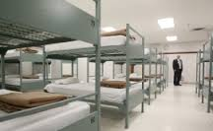
Shelterization or Autonomy?
Housekeeping policies force the client to rely on the shelter staff for basic needs.
Behavior control policies create dependence on shelter staff to facilitate interpersonal interaction.
Moral reform policies require client religiosity in order to obtain services.
Notes:
Do these policies promote shelterization or client autonomy?
Housekeeping policies, such as personal belongings policies, force the client to rely on the shelter staff to meet basic needs. For example, as previously mentioned, locker schedules force clients to rely on shelter staff when they would like to access their belongings.
Behavior control policies, such as respect for others policies and exchange of money policies, treat clients as though they are disordered and cannot interact in a positive way, therefore creating dependence on the shelter to facilitate interaction. It is seen as “rabble management.”
Moral reform policies, such as panhandling policies, create dependence on the shelter by taking away a means of coping with homelessness, thereby making the client depend on the shelter to meet basic needs. Church schedules can also get in the way of work and appointment schedules, thus keeping the person in a state of homelessness. These policies require client religioisity in order to obtain services.
All these policies seem to lead to shelterization.

Slide 10
A Paradox
Policies that help emergency shelters run smoothly and efficiently lead to client dependence on the shelter, keeping clients in homelessness.
Notes:
Policies that help the shelter run efficiently inadvertently lead to client dependence on the shelter, keeping him or her in homelessness. Policies that promote client autonomy seem to be few and far between, but they seem to harm the day-to-day smooth running of the emergency shelter.

Slide 11
Autonomy-Producing Policies
By creating policies that allow rights to clients, emergency shelters can help create client autonomy and assist clients with ending their experience with homelessness.
Notes:
So how do we improve policy manuals to make clients less dependent on the shelter?
Housekeeping and behavior control policies are essential in every shelter in order to maintain efficiency and some sort of consistency within the environment.
Moral reform rules, if the client chooses to follow them, can also be helpful in religious organizations.
By creating policies that allow rights to clients, emergency shelters can help create client autonomy and help clients move out of homelessness.
Many shelters allowed room for grievances if the client felt as though he or she was mistreated.
A few also had confidentiality policies.

Slide 12
Further Research
Larger sample size/ higher response rate
Ethnographic study of clients and staff
Notes:
I used a sample based on similarities between shelters and the Poverello Center. A strict criteria for inclusion greatly narrowed the number of manuals I received.
I would like to have a larger pool of manuals.
Further research could require an ethnographic study to find out the perceived experience of staff and clients regarding each of these policies.

Slide 13
References
Lyon-Callo, Vincent. 2000. “Medicalizing Homelessness: The Production of Self-Blame and Self-Governing within Homeless Shelters.” Medical Anthropology Quarterly 14(3): 328-345.
Marcus, Anthony. 2003. “Shelterization Revisited: Some Methodological Dangers of Institutional Studies of the Homeless.” Human Organization 62(2): 134-142.
Mulder, Mark. 2004. “Faith-Based Homeless Shelters and ‘Hyper-Institutionalization’:A Case Study.” Michigan Sociological Review 18: 136-165.
Stark, Louisa R. 1994. “The Shelter as ‘Total Institution’: An Organizational Barrier to Remedying Homelessness. American Behavioral Scientist 37: 553-562.

Slide 14
 | Amount of control | Purpose | Examples
Housekeeping | Low | Keep shelter running efficiently | Chores, hygiene, personal belongings, restricted areas
Behavior Control | Medium | Protect client and staff from self and others | Drugs & alcohol, respect, violence, sexual relations
Moral Reform | High | Push client to become a better person | Church attendance, panhandling, sexual relations

