Slide 1
Women’s Sphere to Women’s Strength: Eliza Visscher April 11, 2014 umcur
Changing Strategies of Dress Reformers from 1850-1900

Slide 2
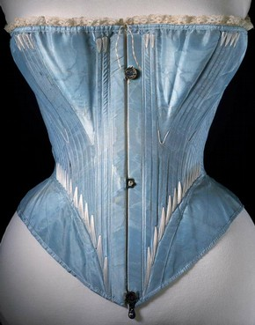
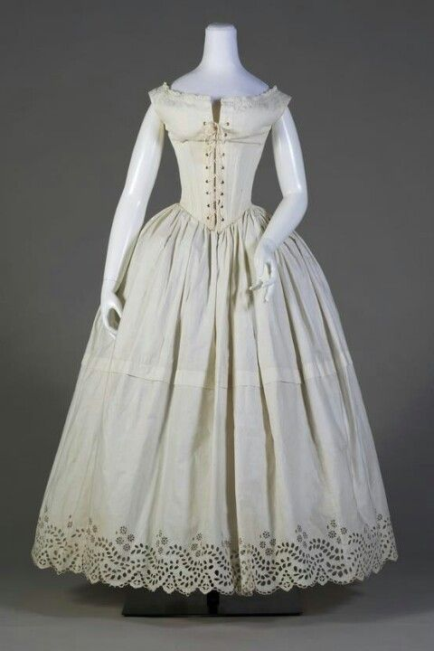
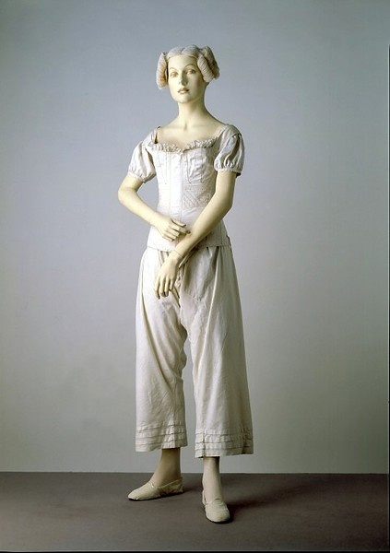
Undergarments

Slide 3
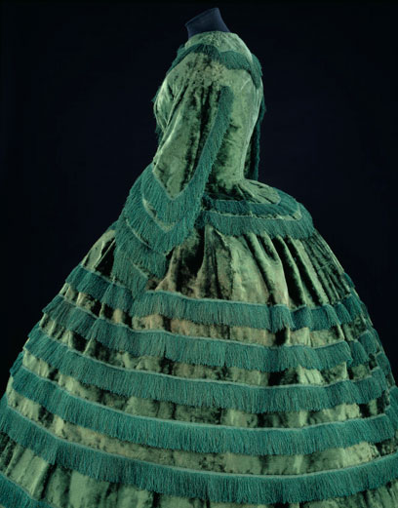
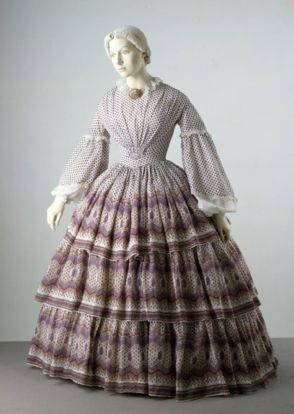
1850

Slide 4
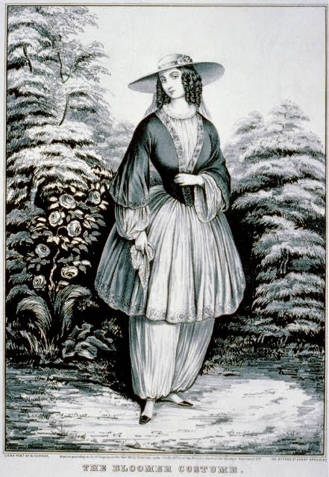
Bloomer Costume

Slide 5
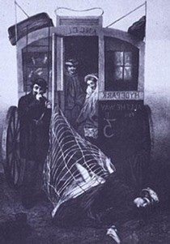
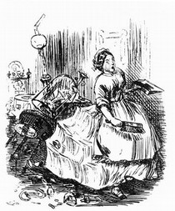
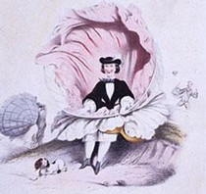
Problems with Dress

Slide 6
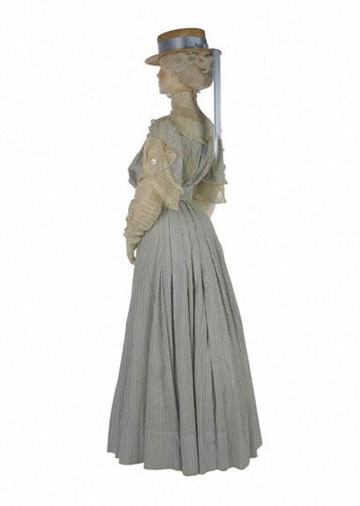
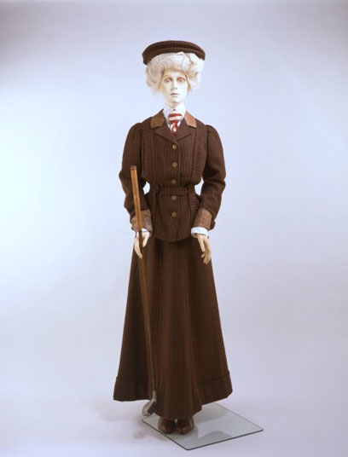
1900

Slide 7
Thank You
Professor Kyle Volk
Images courtesy of Victoria and Albert Museum
Boydston, Jeanne. The Pastoralization of Housework, in Home and Work: Housework, Wages
and the Ideology of Labor in the Early Republic, ed. Linda K. Kerber, Jane Sherron De
Hart, and Cornelia Hughes Dayton. Oxford University Press, 1991.
Circular, May 1852-September 1864.
Cunnington, C. Willet and Phillis. The History of Underclothes. London: Faber and Faber, 1951.
“Dress Reform,” Christian Union, August 29, 1891.
“Dress Reform,” Ohio Farmer, September 16, 1865.
“Dress Reform,” The Ladies Repository, 1875.
Joy, C.A. “Dress Reform,” The Water-Cure Journal, May, 1856.
Merriam, Eve. Growing up Female in America: Ten Lives. New York: Dell Publishing Co., 1915.
“Reform Dress vs. Crinoline,” Herald of Health, August, 1865.
Russell, Frances E. “The Rational Dress Movement,” The Arena, February, 1894.
Safford-Blake, Mary J. and Jackson, Mercy B. Dress-Reform: A Series of Lectures Delivered in
Boston on Dress as it Affects the Health of Women, ed. Abba Gould Woolson. Boston;
Roberts Brothers, 1874.
The Liberator. March 1856-July 1858.
“The Lily,” Accessible Archives, www.accessible-archives.com/collections/the-lily/
The Lily, February 1, 1851- September 1856
Wayne, Tiffany K. Women’s Roles in Nineteenth-Century America. Westport, Connecticut:
Greenwood Press, 1968.
“Woman and Dress,” The Ladies Home Journal, January 1890.

