Slide 1
US Sustainability Reporting: An Evaluation of the SASB Framework
Tess Barker

Slide 2
Overview
Context
My study
Standards analysis
Recommendations

Slide 3
Context
Sustainability as a business imperative
Sustainability reporting
GRI & SASB

Slide 4
This Study
Purpose
Consider the effectiveness of the SASB’s provisional standards in promoting decision-useful sustainability reporting by US public companies
Methods & Scope
SASB Standards
Disclosure guidance
Accounting standards
Conceptual framework
Biotechnology provisional standards

Slide 5
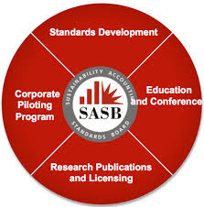
This Study (Cont.)
Evaluation of conformity with:
Materiality
Stakeholder inclusiveness
Context
Completeness & accuracy
Measurability & verifiability
Transparency

Slide 6
Materiality
Brockett & Rezaee
“All relevant performance information that could influence stakeholders’ decision-making process when determining sustainable and enduring performance” (2012)
SASB
Unique materiality thresholds
“Access to medicines”
“Counterfeit drugs”

Slide 7
Materiality (Cont.)
Prioritizes sustainability issues
Risky
88 industry-specific standards
Evidence-based approach to determining materiality

Slide 8
Stakeholder Inclusiveness
Brockett & Rezaee
“Addresses the interest of all stakeholders that affect or are affected by sustainability performance” (2012)
SASB
Investor emphasis
Integrate public opinion

Slide 9
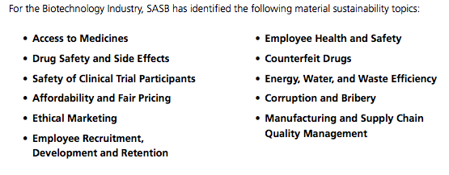
Context
SASB
Materiality
Industries bear burden of discerning materiality
Uniformity
Brockett & Rezaee
All-inclusive & mutually interdependent

Slide 10
Completeness & Accuracy
GRI
“The coverage of material [sustainability topics] and their boundaries, sufficient to reflect significant, environmental and social impacts” (2014, p.17)
SASB
Completeness at metric level
Technical protocols to enhance accuracy

Slide 11
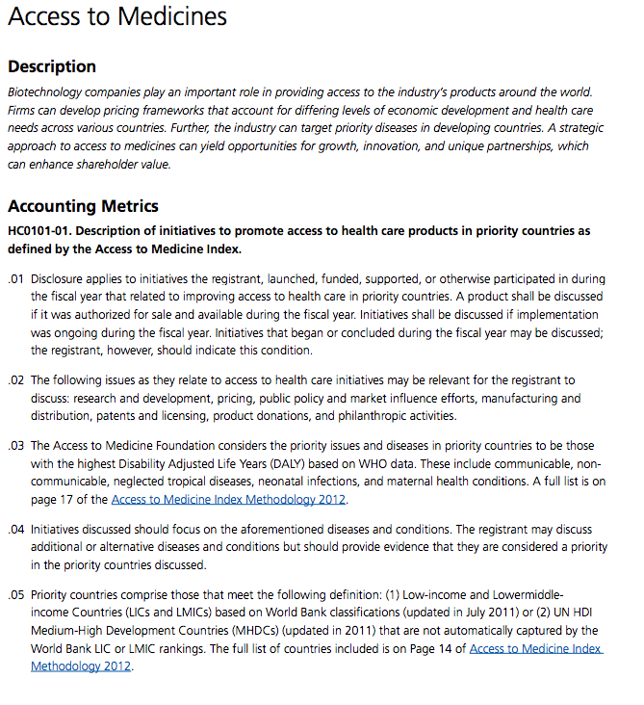
Measurability & Verifiability
Brockett & Rezaee
Ensure that sustainability reports reflect auditable and comparable performance activities
SASB
Technical protocols
Optional narrative descriptions
SASB
Technical protocols
Optional narrative descriptions

Slide 12
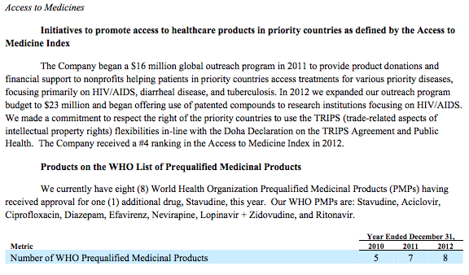
Transparency
Brockett & Rezaee
Honest and open reporting on all dimensions of sustainability performance
SASB
Lack of context for end-users

Slide 13
Summary
Investor focus
Dictates development and structure of SASB standards
Materiality concerns

Slide 14
Special Thanks
Dr. Kent Swift, Associate Professor, Department of Accounting & Finance

Slide 15
Reference
Brockett, A., & Rezaee, Z. (2012). Corporate sustainability: Integrating performance and reporting [Kindle Fire]. Retrieved from Amazon.com
Engleman, R. (2013). Beyond sustainababble. In State of the world 2013: Is sustainability still possible? (pp. 3-16). Washington, DC: IslandPress.
Global Reporting Initiative (GRI). 2011. G3 sustainability reporting guidelines. Retrieved from https://www.globalreporting.org/reporting/latest-guidelines/g3-guidelines/Pages/default.aspx
Global Reporting Initiative (GRI). 2014. G4 sustainability reporting guidelines. Retrieved from https://www.globalreporting.org/resourcelibrary/GRIG4-Part1-Reporting-Principles-and-Standard-Disclosures.pdf
Sustainability Accounting Standards Board (SASB). (2013). Conceptual framework. Retrieved from http://www.sasb.org/approach/conceptual-framework/
Sustainability Accounting Standards Board (SASB). (2013). Biotechnology Accounting Standard. San Francisco, CA: Sustainability Accounting Standards Board.

