Slide 1
Where’s the Kale?
By Amy R. Sisk

Slide 2
Native News Yearly publication of the School of Journalism May 24: Pick up a copy in the Missoulian

Slide 3
Northern Cheyenne Reservation

Slide 4
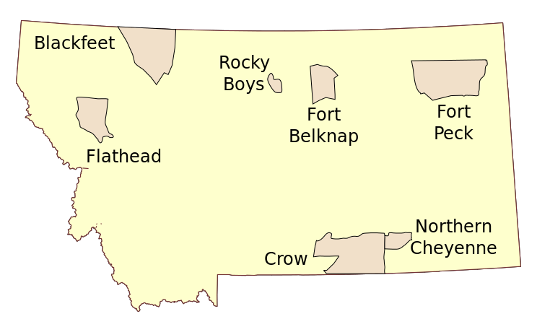
wikimedia.org

Slide 5
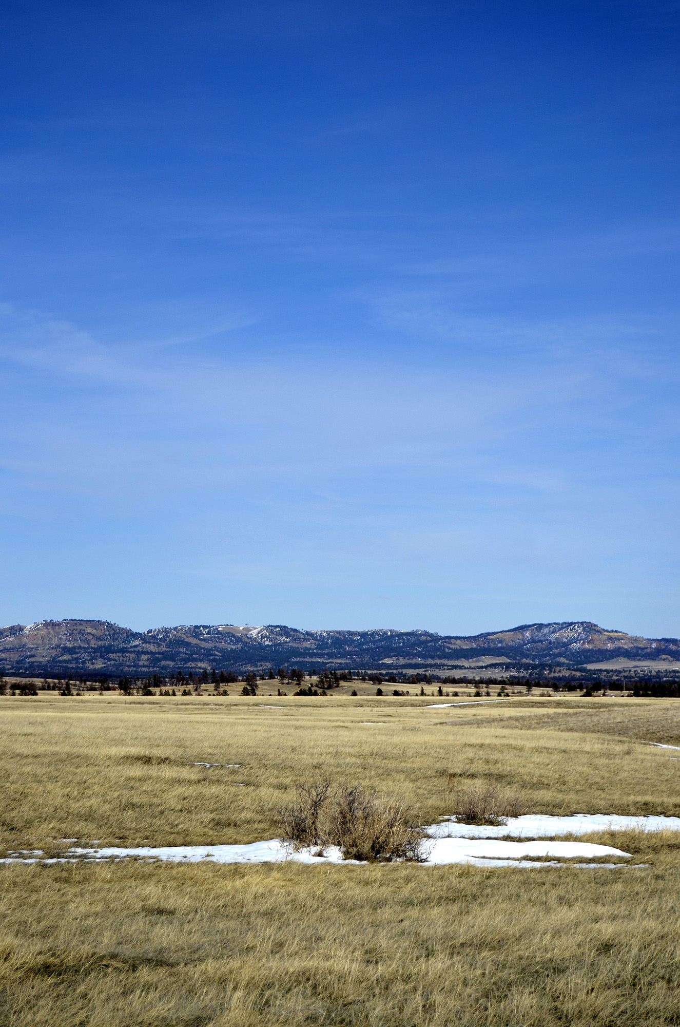

Slide 6
Commodities

Slide 7
SNAP Benefits Food stamp program

Slide 8
Cheyenne Depot Lame Deer convenience store

Slide 9
Lame Deer Trading Post The only grocery store on the Northern Cheyenne Reservation

Slide 10
Wellness Center

Slide 11
Boys & Girls Club

Slide 12
Future

Slide 13
So … where’s the kale?

