Slide 1
Homeless at Home in Missoula:
The Experience of Homelessness for the Mentally Ill
Tyler Cheesman

Slide 2
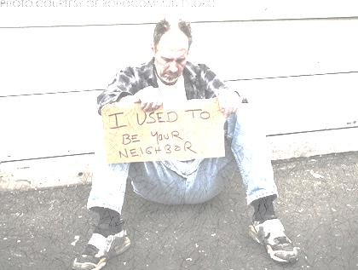
Overview
Research Question
Background
Expectations
Literature Review
Findings
Conclusions

Slide 3
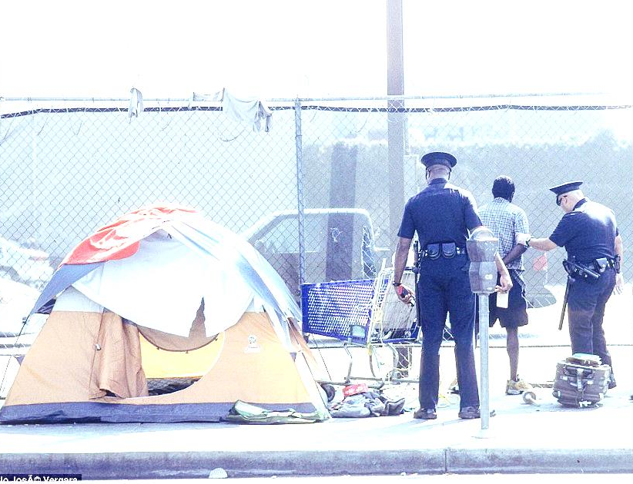
Research Question
What additional obstacles do individuals who are homeless face when they have a mental illness?

Slide 4
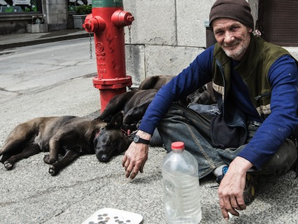
Background
United States
610, 042 homeless individuals
Approximately 26% with a mental illness
Montana
1,878 homeless individuals
Approximately 390 with a mental illness ~ 21%
Approximately a quarter of the homeless population also have a mental illness
Almost a quarter of the homeless population are facing even more obstacles

Slide 5
Expectations
Clients with mental illnesses will face more obstacles than clients without mental illnesses
Based on my service I expected the following obstacles:
Acquiring jobs
Communicating with officials
Proper medical care
Receiving correct medications

Slide 6
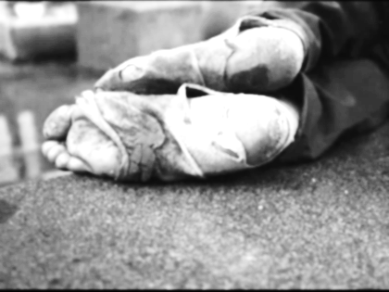
Literature Review
Special obstacles for individuals who have a mental illness and are homeless:
Communication
Maintaining Housing
There’s No Place Like (a) Home: Ontological Security Among Persons With Serious Mental Illness in the United States. Padgett, D.K.
Maintaining Medical Care
Preventing Recurrent Homelessness Among Mentally Ill Men: A “Critical Time” Intervention After Discharge From a Shelter. Susser, E. et. al.

Slide 7
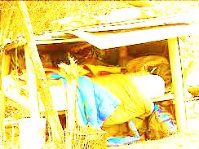
My Research
Qualitative Research
Ethnographic Fieldnotes
I have used pseudonyms for all clients
~40 hours of observation
Volunteered at the Poverello Center front office
Institutional Review Board Approval

Slide 8
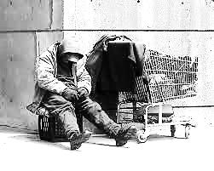
Findings
Obstacles for clients with mental illnesses exceeded the obstacles for clients without mental illnesses
Acquiring Jobs
Correct Medications
Proper Medical Care
Communicating with Officials
Social Interaction
Many of these same obstacles were also found in clients who were medically ill

Slide 9
Case 1: Mur
Mental Illness:
Schizophrenia
Obstacles:
Acquiring Jobs
Evidence:
February 10, 2014
“I travel a lot.” -Mur
“Yeah, if you don’t travel you go crazy.”
-Mur

Slide 10
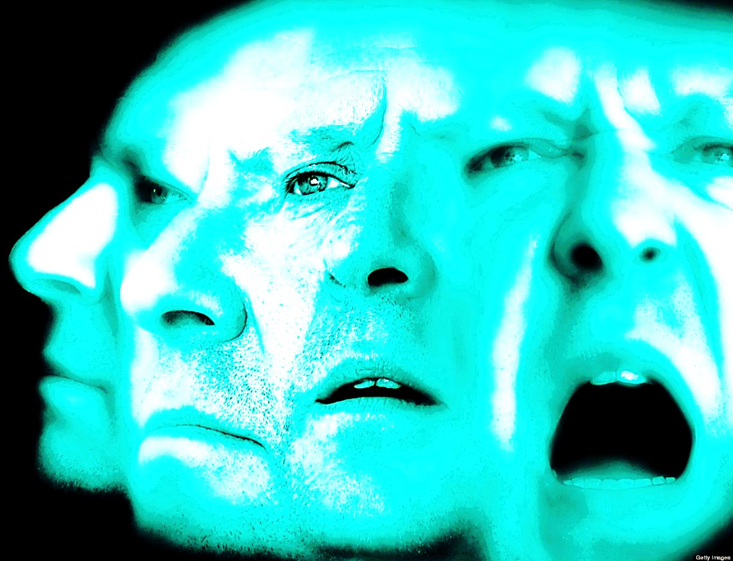
Case 2: Joe
Mental Illness:
Schizophrenia
Obstacles:
Receiving Proper Medications
Communicating with Officials
Evidence:
February 17, 2014
“He spent six days at Providence Health Center and they got his medications all straightened out, he is much more mellow.” -James
“He came in really drunk last week.” -LeAnn
“I would like to apologize for the other night, my meds were mixed up they are good now; but I am really sorry if I scared you.” -Joe

Slide 11
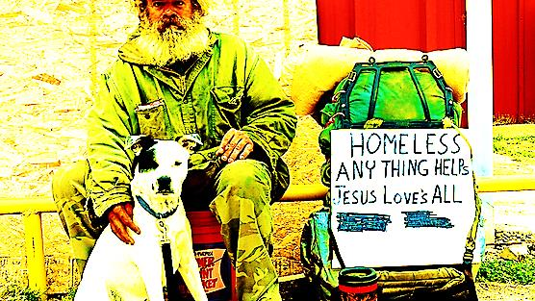
Case 3: Ray
Mental Illness:
Unknown
Obstacles:
Social Interaction
Acquiring Jobs
Evidence
February 24, 2014
“It is giggles dot starchild.” -Ray

Slide 12
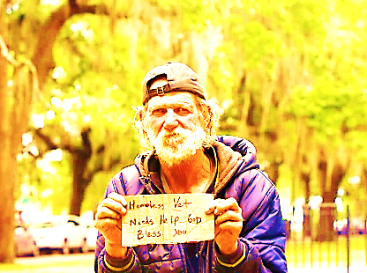
Case 4: Diamond
Mental Illness:
Anxiety Disorder
Obstacles:
Receiving Correct Medications→ Energy Level
Acquiring Jobs
Evidence:
March 17, 2014
“Hi Diamond, how are you doing today?” I sincerely asked with a smile.
Diamond looked at me with a blank face; but then smiled and reciprocated the greeting.

Slide 13
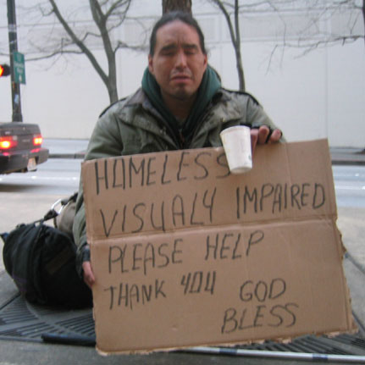
Case 5: Owen
Medical Conditions:
Legally Blind
Disability causing difficulty walking
Obstacles:
Acquiring Jobs
Communicating with Officials
Evidence:
Monday, March 17, 2014
“He was on his way to Billings for a hearing to try to get it (his social security) and possibly some of his back social security money.”
“Jay came out of the office helping Owen make his way to the basement to watch movies or play games.”

Slide 14
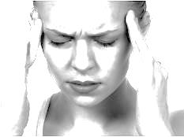
Case 6: Shan
Medical Conditions:
Traumatic Brain Injury
Executive Functioning
Obstacles:
Acquiring Jobs
Proper Medical Care
Communicating with Officials
Social Interactions
Evidence:
Monday, February 10, 2014
“ ‘Would you like Tyler to walk you to the hospital? Bill asked her.’ Shan didn’t answer she just shrugged her shoulders and a few more tears slipped out.”

Slide 15
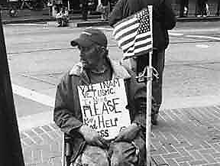
Case 7: Tom
Medical Conditions:
Elderly veteran
Has to be let into medications
Obstacles:
Acquiring Jobs
Evidence:
Monday, February 24, 2014
“Ahh, I just came down to give you ladies hell!” Tom laughed.
Tuesday, March 4, 2014
“Can you let me into Bill’s office as much as I know you hate to?” Tome asked Wane.

Slide 16
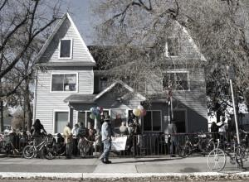
Conclusion
My expectations were correct
These expectations also held true for clients who only had medical illnesses
Support Found in Literature
Proper Medical Care
Communicating with Officials
Acknowledgements
Daisy Rooks
Assistant Professor, Sociology Department
Research Advisor
Cassie Sheets
Volunteer and Outreach Coordinator, Poverello Center
The Poverello Center and Staff

Slide 17
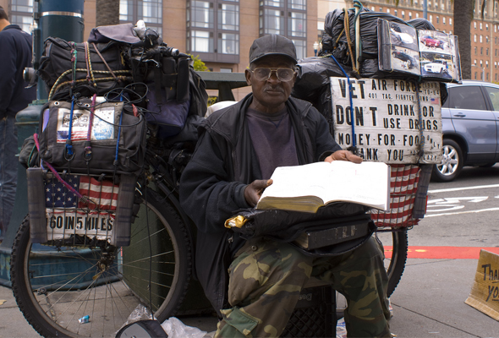
Works Cited
Montana Department of Health and Human Services: 2010 Montana Homeless Survey Analysis Tool
National Coalition for the Homeless: Who is Homeless?
Padgett, D. K. (2007). There's no place like (a) home: Ontological security among persons with serious mental illness in the united states. Social Science and Medicine, 64(9), 1925-1936. Retrieved from http://www.sciencedirect.com/science/article/pii/S0277953607000494
Susser, E. Valencia, E, Conover, S, Felix, A, Tsai, W.Y., and Wyatt, R.J. Preventing recurrent homelessness among mentally ill men: a "critical time" intervention after discharge from a shelter. American Journal of Public Health February 1997: Vol. 87, No. 2, pp. 256-262. doi:10.2105/AJPH.87.2.256. http://ajph.aphapublications.org/doi/abs/10.2105/AJPH.87.2.256
The U.S. Department of Housing and Urban Development, Office of Community Planning and Development: The 2013 Annual Homeless Assessment Report (AHAR) to Congress

