Slide 1
David Edgar
Connection in Political Theatre

Slide 2
“David Edgar’s writings address the most basic questions of how humans
organize and govern themselves in modern societies. This study brings
together the disciplines of political philosophy and theatre studies to
approach the leading British playwright as a political writer and a public
social critic. Edgar uses theatre as a powerful tool of public discourse, an
aesthetic modality for engaging with and thinking/feeling through the
most pressing social issues of the day. In this he is a supreme rationalist:
he deploys character, plot and language to explore ideas, to make certain
kinds of discursive cases and model hypothetical alternatives”
-The Political Theater of David Edgar

Slide 3
The Playwright

Slide 4
February 26, 1948 –
Associated with the Royal Shakespeare Company since 1976 (served as literary assistant 1984-1988)
Founded the University of Birmingham’s MA in Playwriting Studies program
Post-Nicholas Nickleby moved his focus to political writing endeavors
Trilogy focusing on negotiation (between East/West) after collapse of Soviet Union including:
The Shape of the Table (1990)
Pentecost (1994)
The Prisoner’s Dilemma (2001)
Commissioned in 2003 by the Oregon Shakespeare Festival to write Continental Divide, a two part play about American Politics

Slide 5
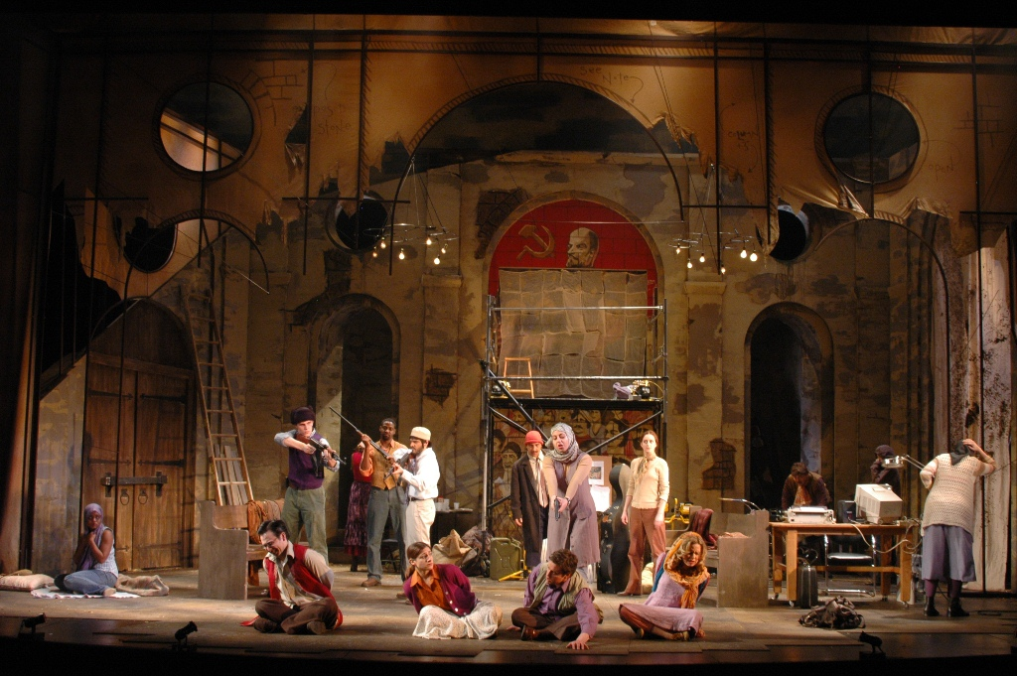
Pentecost

Slide 6
The Play
First produced November 12th, 1994 at The Other Place, a black box theatre owned by the Royal Shakespeare Company
Themes focus mainly on language, cultural identity and East vs. West
Features several different dialiects
Set in a fictional eastern European country
Central “character” is painting

Slide 7
“This provocative premise might be enough subject matter for one playwright, but Mr. Edgar has bigger fish to fry than merely overturning the history of Western art. The culture clash he sets up - between East and West, church and state, restorationists and conservationists and, finally, between a pack of political asylum seekers and their hostages - contains enough material (and languages, including Russian, Polish, Bulgarian, Turkish and Sinhalese) for half a dozen plays.”
-The New York Times Theater Review

Slide 8
Themes
Language
Multiculturalism
Cultural Identity
East vs. West

Slide 9
Through the western lens Leo Katz
Katz as Western World
Varying opinions of art
Redemption
East vs. West
Leo and Gabriella ending

