Slide 1
The Deadliest Road: Analysis of Drunk Driving Fatalities in Montana
By Jessica Lareau

Slide 2
Abstract
This research project examines Driving Under the Influence (DUI) fatalities from the perspective of incarcerated drunk drivers whose crime resulted in the death of another
The data was collected during 2-hour interviews conducted with both male and female inmates from assorted penal institutions across Montana
Inmates were asked a number of questions and their interviews were later analyzed and categorized by the following themes: their relationship to the victim, the stage of grief the inmate displayed, and their own ideas for DUI prevention
The findings from the interviews can aid in the reduction of drunk driving fatalities in Montana

Slide 3
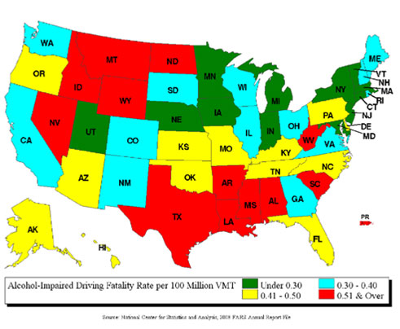
Statistics
National urban fatality rate is ½ the rural fatality rate
+
Montana has most rural vehicle miles traveled
= Montana has highest fatality rate
“In 2008, Montana had the highest alcohol-impaired fatality rate in the nation. This is more than double the national rate.”
-NHTSA’s National Center for Statistics and Analysis, December 2009

Slide 4
Questions Asked
Inmates were asked questions about:
Age
The night/day of the accident
Death of victim
Victim’s family
Alcohol use
Trial and incarceration
Their future
Prevention ideas

Slide 5
Categorization
We categorized inmates based on how they knew their victim:
Friend
Family member
Spouse or boyfriend/girlfriend
No previous relationship (pedestrian or other driver)

Slide 6
Themes
Substance Dependence
Grief & guilt
Childhood trauma
Prior DUI’s
Habitual drunk driving
Relapse- triggered by divorce, death, job loss, military service
Victim Thinking
Narcissistic Personality Disorder, Bipolar Disorder, Post-Traumatic Stress Disorder
Wanting to share their story & help others

Slide 7
One Specific Account
Woman Inmate
Age: 32
Husband died a year & a half prior to accident
Sustained a Traumatic Brain Injury (TBI)
Killed her friend of 15 years
Victim Thinking
Her idea for prevention:
Car with breathalyzer
“they did my Pre-Sentence Investigation & they basically made it appear like I couldn’t function without alcohol”

Slide 8
Feelings During Interviews
My feelings ranged based on the inmates attitude toward their incident. Some common emotions I experienced were:
Empathy- had difficulty remaining objective
Shock- towards certain behaviors or drug use
Anger- towards certain inmates who still do not realize the gravity of their decision
Fear- visiting prison and witnessing the differing attitudes & mannerisms of inmates

Slide 9
Emotions of Inmates
Grief stricken- some inmates found it hard to speak about the incident, began to shut down or cry
Angry- some felt anger towards their behavior and their friends’ decisions
Victim thinking- some feeling that they were not responsible & that they themselves were the victim

Slide 10
Judicial Sentencing
Vary depending on victim’s family:
Victim Impact Statement
Some families want max sentence, others forgive completely
Prison sentences are up to the discretion of the judge, who takes into account the wishes of the victim’s family
Common prison sentences range from 10-30 years, with no less than 10 years

Slide 11
Inmates Beliefs for Prevention
Jail time after 2nd or 3rd DUI instead of 4th
Stricter monitoring for over serving in bars & holding bartenders accountable
Cars with breathalyzers
Accountability to friends- take their keys, do not allow someone to drink & drive
Educating DUI offenders
Some inmates believed nothing can be done

Slide 12
Conclusion
Collected inmates accounts will be used for the preventative use of DUI fatalities
Judicial system needs change
Less sentencing disparity
Jail time after 2nd or 3rd DUI
Pre-trial Supervision vs. Own Recognizance (O.R.)

Slide 13
Bibliography
Fatalities and Fatality Rates in Alcohol-Impaired-Driving Crashes by State, 2007-2008. NHTSA’s National Center for Statistics and Analysis, December 2009
Review of case study audio-interviews by Dr. Conley with all study participants

