Slide 1
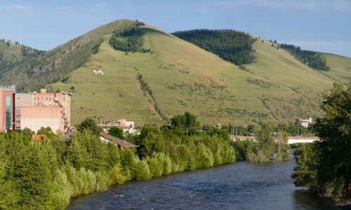
The Effects of Prozac on Aggression in Siamese Fighting Fish
University of Montana
UMCUR April 11, 2014
Andrew Hinkle, Lizzie Catudio-Garrett, Theo Hanson, Schuyler Hollingsworth, & Sarah Olafson | Kathryn Lamp (M.A.), Benjamin
Eisenreich, & Dr. Allen Szalda-Petree (PI) |

Slide 2
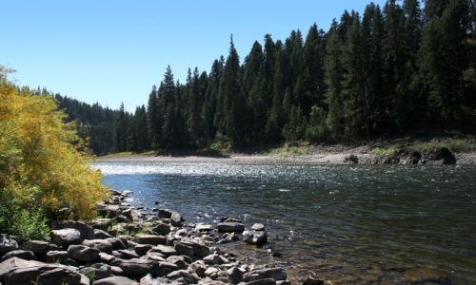
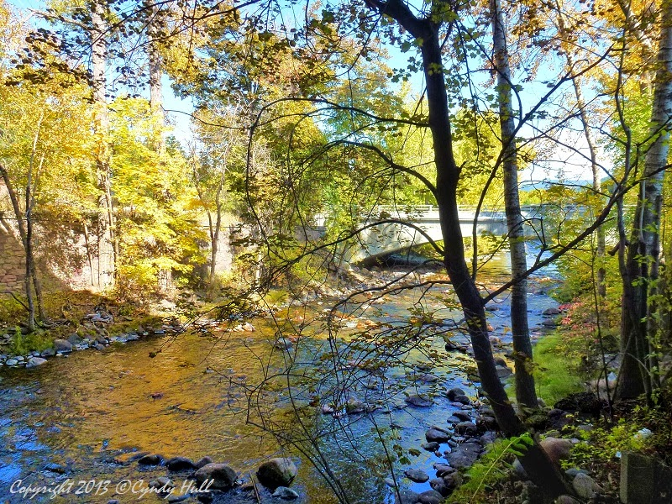
Introduction
Serotonin is a common neurotransmitter found throughout the brain
Serotonin plays direct role with mood, impulsivity, and aggression in a variety of species
Prozac increases levels of serotonin in the brain
Mayrer, 2011 – described Prozac in Missoula’s water supply
Image taken from: http://www.holisticeducator.com/brain.jpg
http://4.bp.blogspot.com/-27h9clDl0G8/Umbq5eySVvI/AAAAAAAADpg/dvWXoacsaaQ/s1600/Fall+Crossing+Creek+Water+Foliage+Trees+Silhouette+Missoula+MT+-+800.jpg

Slide 3
How does Prozac influence aggression?
Prozac is found in Missoula’s water supply. How does consuming this water effect behavior? Especially aggression?
It is hypothesized that Prozac will impact aggression.
Notes:
This is the question that your experiment answers

Slide 4
Importance of Research
Identify environmental/aquatic effect(s) in Missoula’s water supply
Further understanding of pollutants in aquatic systems
Understand serotonin and aggression relationship
Explore behavior affected with Prozac contaminated water supply
Notes:
Summarize your research in three to five points.

Slide 5
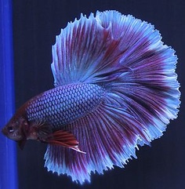
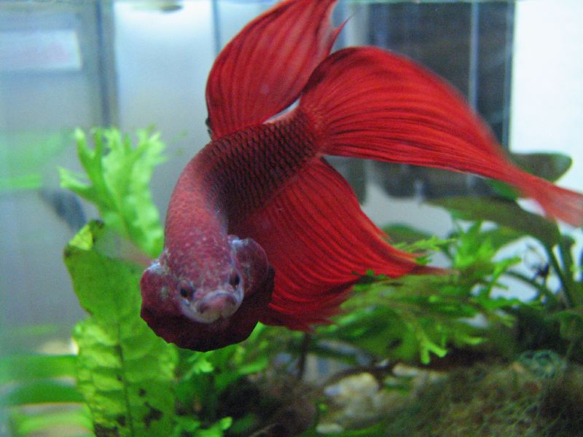
Siamese Fighting Fish (Betta Splendens) Ideal for Aggression Studies
Image taken from: http://1.bp.blogspot.com/_RDBNn7NP2iA/TBdIbe6ajrI/AAAAAAAACDY/RHJJnFlbfv0/s1600/aqua-tropical-fish-betta-basic-sheet.jpg
Betta Fish express their aggression through physiological signals
Aggressive signals are distinct and easy to observe in nature
Includes gill flaring, fin enlargement, and tail beating
Placing a mirror in front of Bettas allows observation of aggressive behavior
Image taken from: http://4.bp.blogspot.com/_TZ60-72xZZk/TOCvROEQjpI/AAAAAAAADsY/vwpCS81bEXE/s1600/betta_flaring.jpg

Slide 6
Variables In Experiment
N=28
Independent variable
Dependent variable
Control: 8
Number of gill flares
Duration of gill flares
At 5, 10, 15, 20 µM
Varying doses of Prozac
5 µM: 5
10 µM: 5
15 µM: 5
20 µM: 5

Slide 7
Example of T-Maze
Home Door
Holding Chamber
Mirror
Holding Chamber
Holding Chamber
Home Chamber

Slide 8
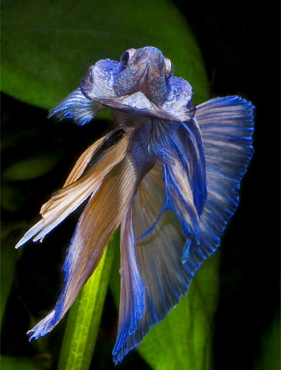
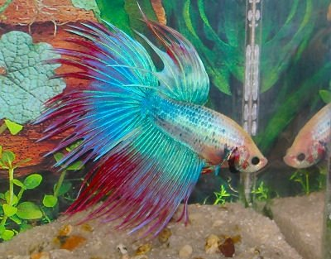
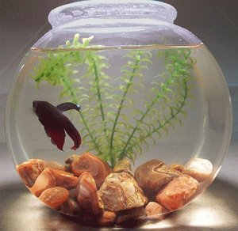
Procedure
Step 1
Bettas were released from holding chamber
Step 2
Bettas recorded for 3 minutes for responses towards mirror
Step 3
Bettas moved back to home chamber
Step 4
Data coded for analysis
Notes:
List all of the steps used in completing your experiment.
Remember to number your steps.
Include photos of your experiment.

Slide 9
Videos
Video of Control Betta
Video of Dosed Betta

Slide 10
Results
0µM : No effect
5µM : Aggression Slightly Increases*
10µM: Aggression Decreases
15µM: Aggression Decreases
20µM: Aggression Eliminated
~39 µM: Lethal concentration*

Slide 11
Prozac decreases aggression in Betta Fish
Previously, it was hypothesized that Prozac would impact aggression and end results support hypothesis.
Notes:
Write hypothesis before you begin the experiment. This should be your best educated guess based on your research.

Slide 12
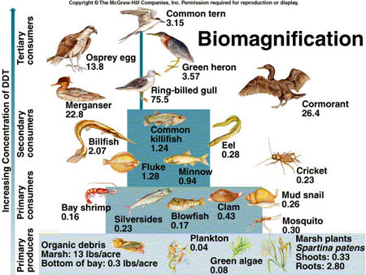
Discussion
Analysis of Greater Impacts
Bio magnification: the increase in concentration of a substance that occurs in a food chain as a consequence of: persistence (Can't be broken down by environmental processes) , food chain energetics or low rate of internal degradation/excretion of the substance
Clinical and environmental implications

Slide 13
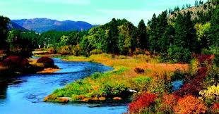
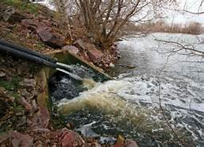
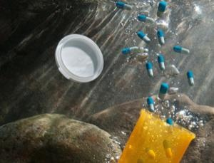
Possible confounds
Shipping stress
Fish age
Researcher error/variance
Time and temperature effects
Further research
Our lab is currently studying the
effects of Prozac on impulsivity
in Bettas

Slide 14
Conclusion
Prozac decreases aggression in Bettas
The dosage levels at which fish were tested are considered safe under EPA guidelines
Prozac has been detected in Missoula’s water system
There is increasing evidence which suggests that this is a widespread phenomenon

Slide 15
Works Cited
Title Slide image taken from: http://cdn.allmissoula.com/images/content/9392_Wrywp_Missoula_Montana_Attractions_Clark_Fork_md.jpg
Procedure Photos:
1.) http://fish-etc.com/wp-content/uploads/2012/03/Betta-warrior1.jpg
2.) http://www.bettainfo.com/wp-content/uploads/betta-fish-mirror.jpg
3.) http://bettafishcaretaker.com/wp-content/uploads/2013/11/betta-bowl.jpg
4.) https://www.google.com/search?q=math+scientists&espv=210&es_sm=93
Discussion Photos
1.) http://www.citruscollege.edu/lc/archive/biology/PublishingImages/0862l.jpg
2.) http://www.epa.ohio.gov/dsw/cso/csoindex.aspx
3.) http://www.cakex.org/case-studies/protecting-local-economy-climate-impacts-clark-fork-river-basin
4.) http://missoulanews.bigskypress.com/missoula/like-water-for-chemicals/Content?oid=1437186
5.) http://www.newscientist.com/article/dn21882-antidepressants-in-drinking-water-may-contribute-to-autism.html#.U0NCI_ldVIE
Conclusion
http://kidsaquariumsquotes.wordpress.com/tag/betta-fish/

Slide 16
Special Thanks To…
Dr. Allen Szalda-Petree
Benjamin Eisenreich
Kathryn Lamp
Everyone who came to our presentation!

Slide 17
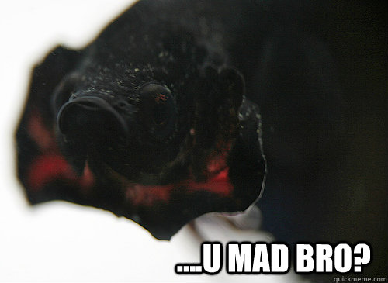
Questions?
Thank you! And Happy Friday!
Image taken from: http://www.quickmeme.com/meme/36j8j3

