Slide 1
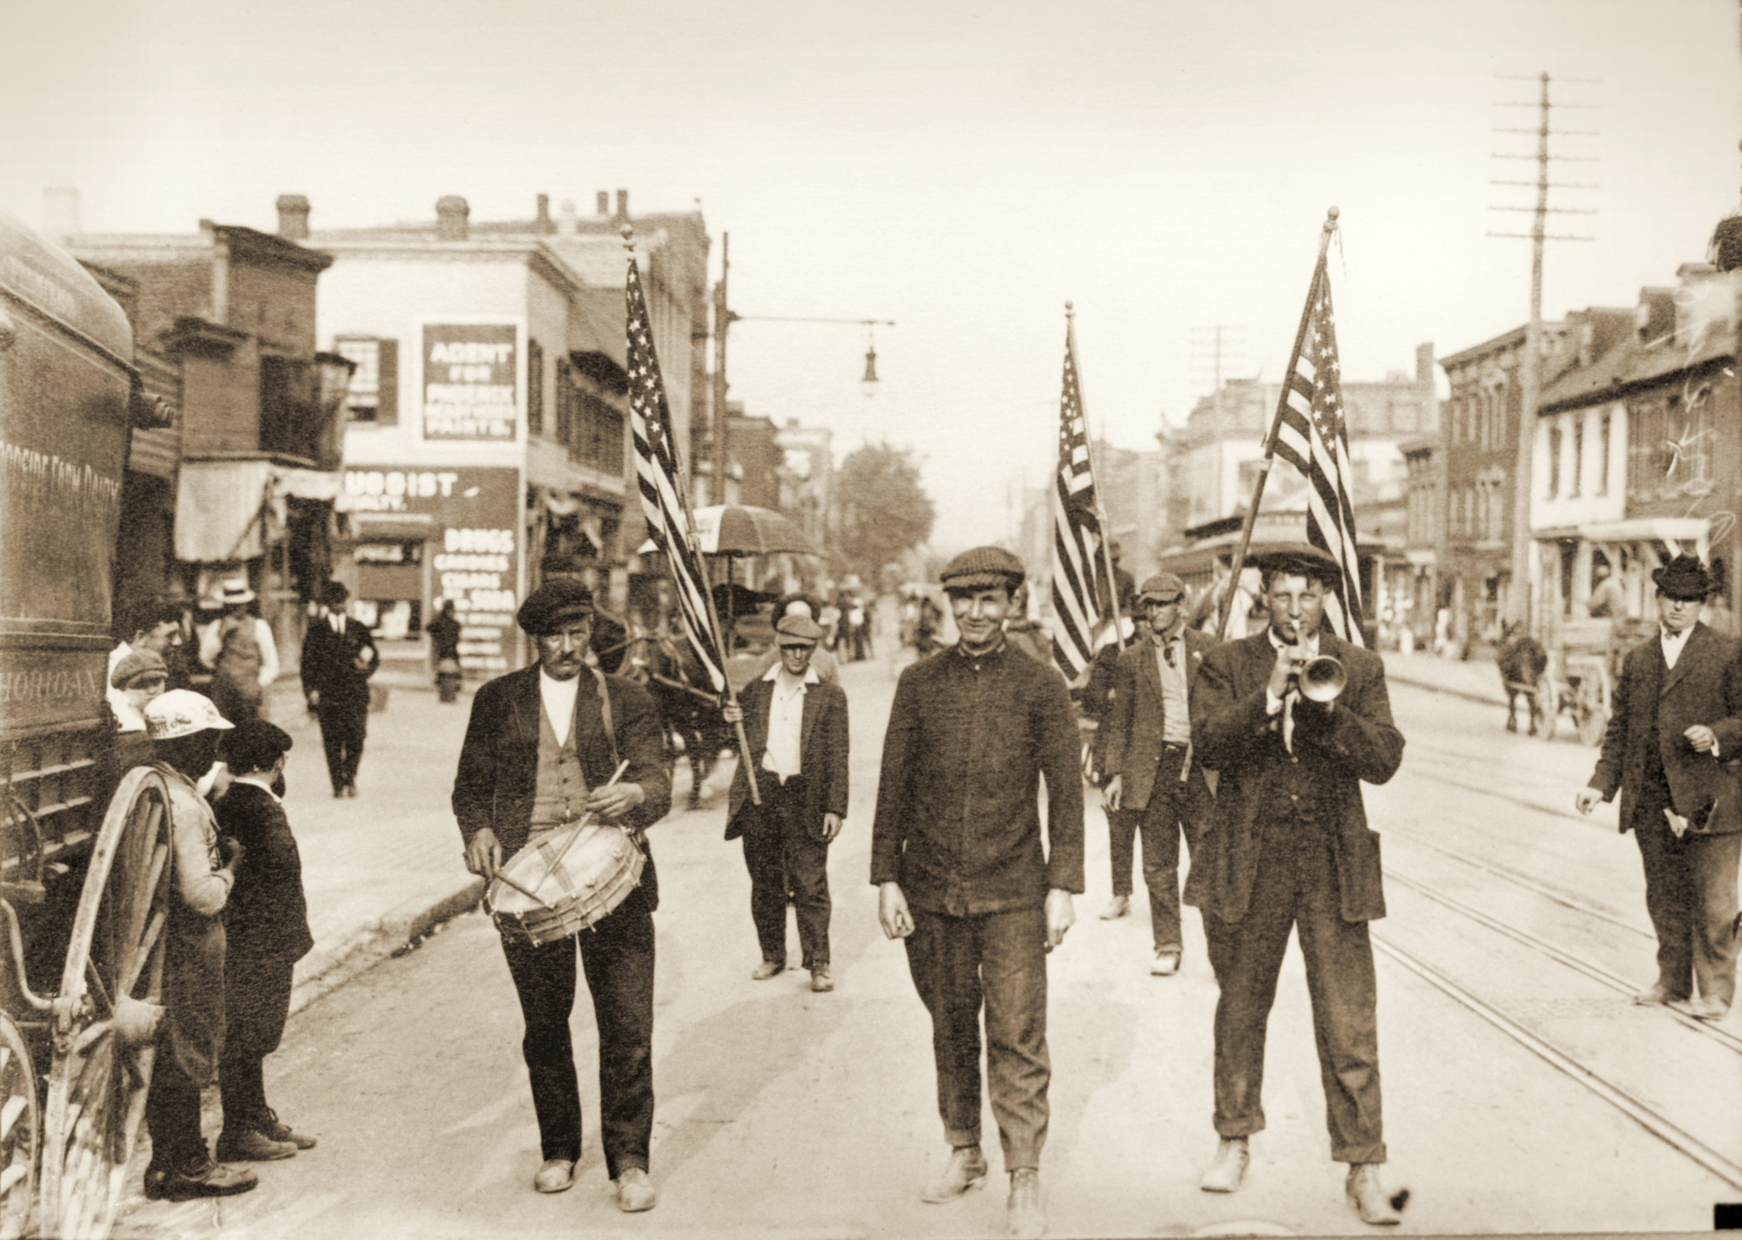
Coxey’s Army, Corporate Interests, and Competing Conceptions of Public Welfare in the Gilded Age: The Evolution of Political Dissent in the 1894 March on Washington
Eamon Ormseth

Slide 2
Questions and Claims
How is the Commonweal defined?
What were acceptable forms of political dissent? Who could participate?
What was the historical legacy of Coxeyism
____________________________________________________
Coxeyism heralded a revolutionary change in tactics of political dissent and challenged the prevailing conception of the public welfare at the time. Through innovative grassroots political action, they demanded the economy be reoriented around the common man—the producers of wealth.

Slide 3
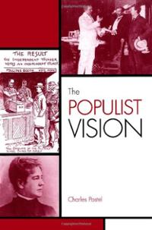
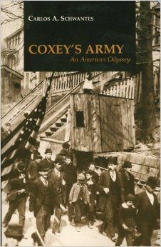
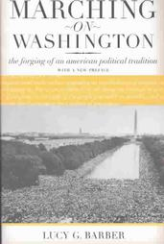
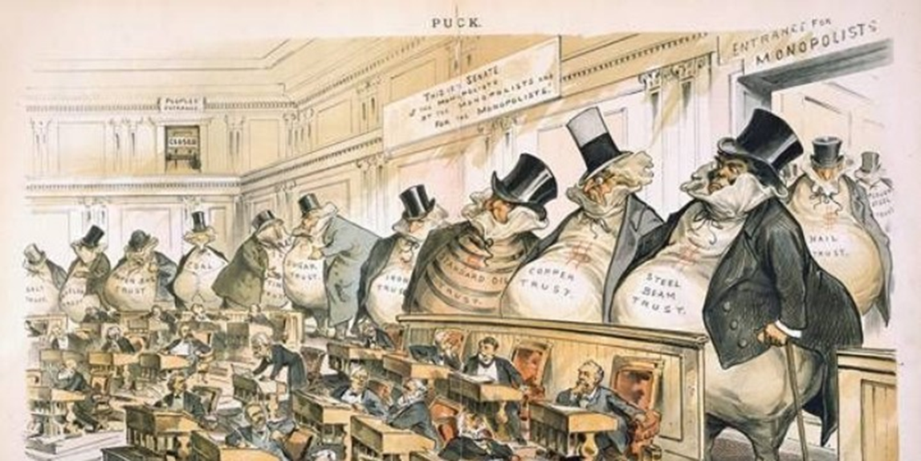
Historiography and Context
“Gilded Age of the Robber Barons”

Slide 4
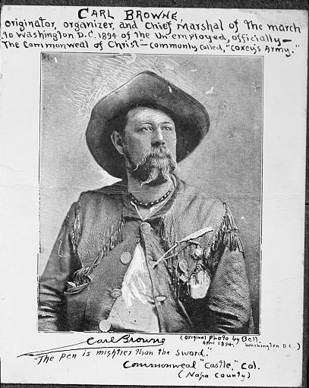
Carl Browne and Jacob Coxey

Slide 5
Coxey’s Proposal
“Five hundred million dollars legal-tender Treasury notes, to be expended under the authority of the Secretary of War at the rate of twenty million dollars per month…Eight hours shall constitute a day’s work, and wages for common labor shall not be less than one dollar and fifty cents per day.”¹
“…This will supply actual money in place of confidence money. This will substitute a cash system for a credit or script system. The business of this country has been done on confidence money. Now that the confidence has vanished, business has also vanished.”²
1. Hall, “An Observer in Coxey’s Camp,” 3.
2. Jacob Coxey quoted in Henry Vincent, The Story of the Commonweal, (Arno Press & The New York Times, 1969), 49.

Slide 6
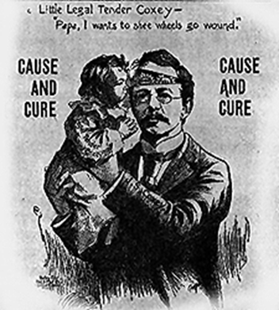
Radical Rhetoric
“What if the unemployed starve in the streets of Washington?” Coxey’s reply: “Then the stench of their ashes will force Congress to give relief.”³
“The remainder of the soul of Christ has been fully reincarnated in thousands of people throughout the United States to-day, and that accounts for the tremendous response to this call of ours, to try to bring about peace and plenty to take the place of panic and poverty.”⁴
3. “PROCLAMATION: District Commissioners Admonish the Invaders,” Western Kansas World, April 28, 1894, 1.
4. Hall, “An Observer in Coxey’s Camp,” 3.
‘The evils of murderous competition; the supplanting of manual labor by machinery…the exploitation, by rent, profit, and interest, of the products of toil—have centralized the wealth of the nation into the hands of the few and placed the masses in a state of hopeless destitution.”

Slide 7
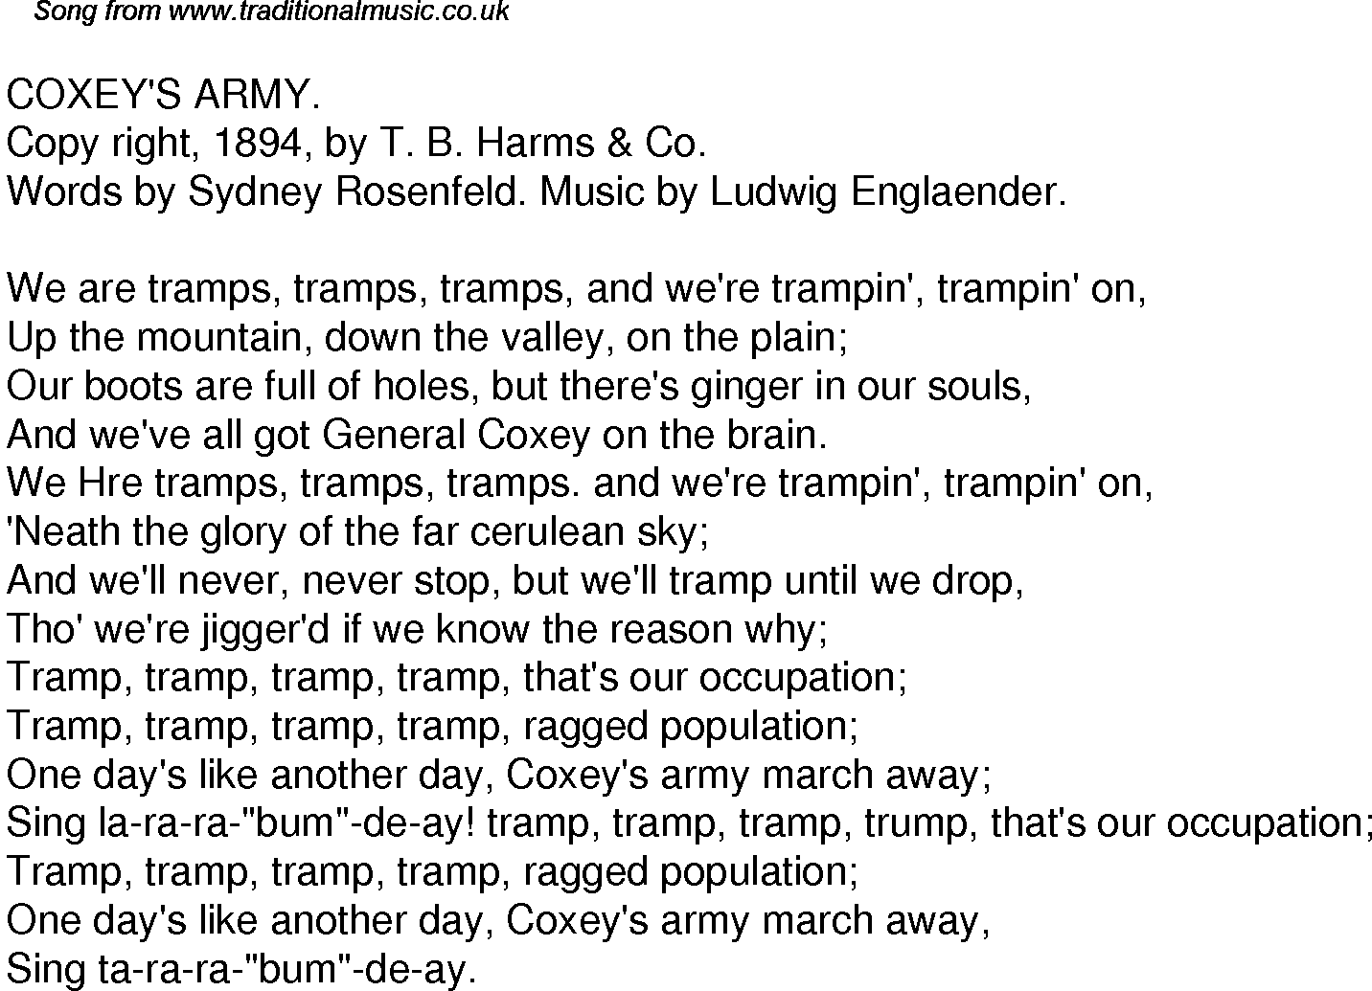
Songs of Armies of the Commonweal
“Marching on! Marching
For work we pray
Both night and day
For Labor’s King we shout and sing!
[…]
We have justice on our side and will not be decried.
A hearing in this land
The “plots” so long denied
And our rights they have decried
So we’re joining Coxey’s Band”
“In the preamble to the constitution [of his contingent Frye] sets forth his followers’ causes for complaint: ‘The evils of murderous competition; the supplanting of manual labor by machinery…the exploitation, by rent, profit, and interest, of the products of toil—have centralized the wealth of the nation into the hands of the few and placed the masses in a state of hopeless destitution.”
“General” Lewis Frye quoted in O. O. Howard, “The Menace of “Coxeyism.”: I.—Significance and Aims of the Movement,” The North American Review 158 (1894), 689.

Slide 8
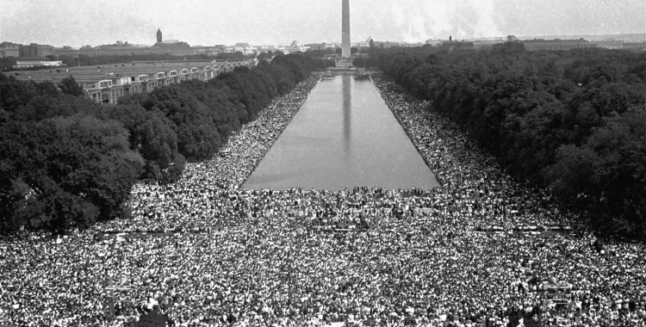
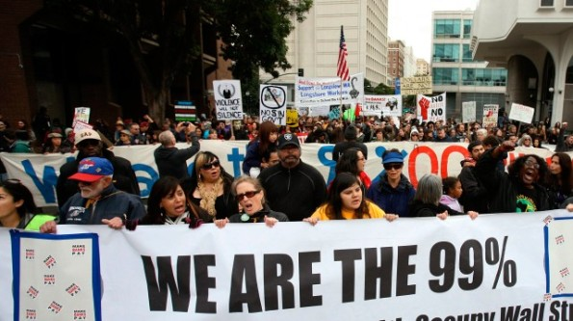
Through the Years
Clockwise from bottom left: Occupy Wall Street; MLK’s 1963 March on Washington; Bonus Army of 1932; Stephen Colbert and Jon Stewart

Slide 9
Acknowledgements
I would like to take this moment to thank:
Dr. Kyle Volk of the History Department for his guidance and criticism.
My classmates in the Upper Division Writing Course for their valuable feedback.
The organizers and presenters of UMCUR
And the University of Montana for providing an environment to pursue scholarship free of constraint.
In solidarity,
Eamon Ormseth

