Slide 1
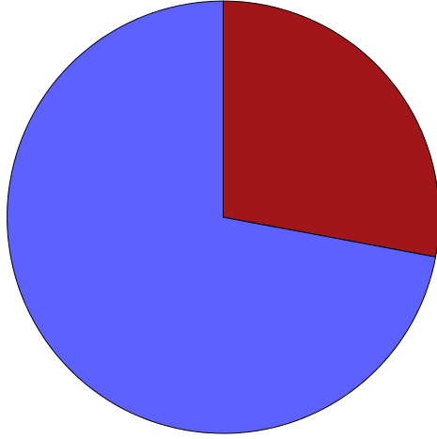
Effects of Pain Interference on Use of Complementary Therapy in Fibromyalgia
Sandra Skogley
Background
Methods
Results
Discussion
Fibromyalgia (FM) is a disorder of chronic widespread pain and tenderness in muscles and joints (National Fibromyalgia Association (NFA), 2012). Pain experiences are amplified due to abnormal sensory processing in the central nervous system (Crofford, L. J., 2012). Physical exertion that comes with normal daily routines exacerbates symptoms. FM affects 10 million people in the US with women representing 75-90% (NFA, 2012).
Treatment focuses on relieving symptoms and improving function for greater quality of life (Crofford, L. J., 2012; NFA, 2012). Recommended complementary or alternative medicine (CAM) includes massage,
acupuncture, chiropractic, yoga, tai chi, and cognitive behavior therapy (Crofford, L. J., 2012; NFA, 2012).
Study Purpose
The purpose of this study is to predict the use of CAM from pain interference and pain intensity of community dwelling people with fibromyalgia.
Sample
Dillman’s Tailored Design for mail-base survey recruitment was used to recruit a random sample of adults aged 18+ from 5 zip codes in the Missoula Valley. We received 521 survey responses for a larger study on pain and participation, leading to a sample of 73 individuals indicating FM as a current health condition.
Demographics
Gender: 61 Females (89.7%)
7 Males (10.3%)
Age: 33-94 years old (Mean 59.76)
Income: $10,000 or less to $30,000 (61.8%)
Measures
Measures included pain interference using a 5 point likert-type scale for the role of pain in limiting each of 9 daily activities, pain intensity using a 10-point anchored scale with 0- “no pain” to 10- “as bad as you can imagine,” and CAM as a single item question “Have you ever used complementary or alternative therapies such as herbs, dietary supplements, acupuncture, meditation, or any similar therapies?”
We used logistic regression analysis to examine the hypothesized relationship between variables. These cross sectional results show that CAM was used by 72.1% of the fibromyalgia participants and that pain interference was a significant predictor of CAM use. The odds ratio adjusted for age, gender and income indicated that for each unit increase in pain interference (range 9-45) there was an 8.7% increase in the likelihood that people used CAM. The model accounted for 36.8% of the variance in the use of CAM.
These findings indicate the likelihood of people with FM using CAM interventions is related to the degree to which pain interferes with their lives. These results would be consistent with the conventional wisdom that CAM may enhance participation, facilitate the ability to pursue valued activities, and improve quality of life for those with FM.
This research is important for researchers, service providers, and policy makers in advancing the understanding of pain interference. Future research using longitudinal data is needed to examine whether or not CAM interventions have a beneficial impact on pain interference for people with FM. This research might include other chronic pain conditions such as Rheumatoid Arthritis.
References
Crofford, L. J. (2012). Fibromyalgia Fact Sheet. American College of Rheumatology, http://www.rheumatology.org/practice/clinical/patients/diseases_and_conditions/fibromyalgia.asp
National Fibromyalgia Association. (2012). http://www.fmaware.org/site/PageServerded3.html?pagename=fibromyalgia
Complementary or
Alternative Medicine Use
72.1%
Use CAM
Pain Interference Measures
In the past 7 days… How much did pain interfere with | Not at all | A little bit | Somewhat | Quite a bit | Very much
Day to day activities? | 4.4% | 10.3% | 29.4% | 35.3% | 20.6
Work around the home? | 4.4% | 8.8% | 27.9% | 33.8% | 25.0%
Ability to participate in social activities? | 10.3% | 8.8% | 19.1% | 27.9% | 33.8%
Enjoyment of life? | 4.4% | 14.7% | 29.4% | 25.0% | 26.5%
Things you usually do for fun? | 4.4% | 11.8% | 27.9% | 25.0% | 30.9%
Enjoyment of social activities? | 10.3% | 10.3% | 25.0% | 17.6% | 36.8%
Household chores? | 5.9% | 11.8% | 23.5% | 29.4% | 29.4%
Family life? | 16.2% | 19.1% | 22.1% | 17.6% | 25.0%
Ability to get a good night’s sleep? | 5.9% | 17.6% | 13.2% | 23.5% | 39.7%
Coefficients for Logistic Regression
 |  |  | 95% Confidence Interval
 | Odds Ratio | Significance | Lower | Upper
Gender | .348 | .214 | .066 | 1.841
Age | 1.028 | .153 | .990 | 1.068
Income | 1.110 | .358 | .888 | 1.388
Pain Interference | 1.087 | .040 | 1.004 | 1.177
Average Pain | .761 | .761 | .535 | 1.083
Special thanks to Dr. Craig Ravesloot, University of Montana Rural Institute, for mentorship on this research project.

