Slide 1
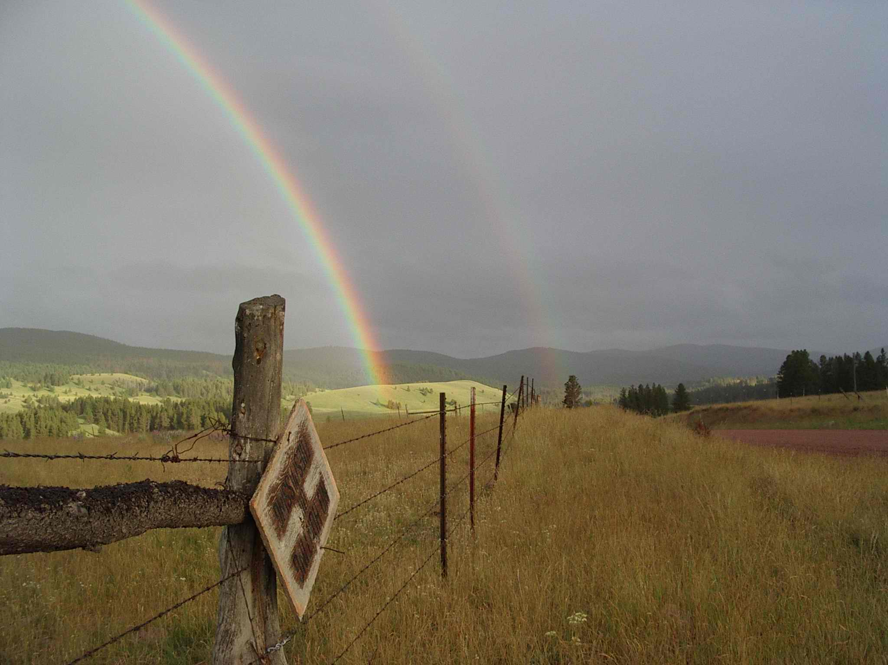
Mitigation and aquifer recharge opportunities in the Clark Fork Basin
Ian Magruder
KirK Engineering &
Natural Resources

Slide 2
The issue: Montana is changing and so are society’s water needs.

Slide 3
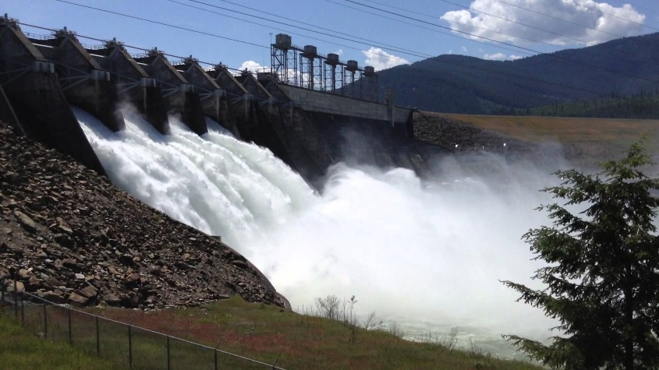
The challenge: In most of the Clark Fork Basin there is essentially no water that is not allocated to existing water rights.

Slide 4
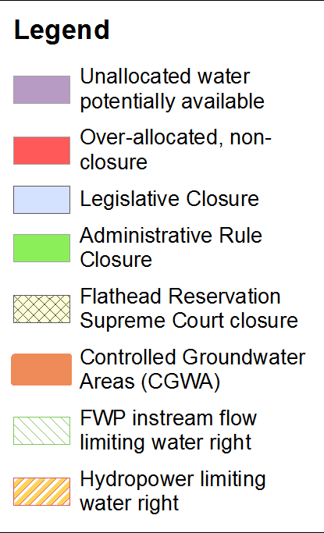
Excerpt from the water availability map in our report

Slide 5
Why is legally available water so limited?
Climate + river flows are less than existing water rights.
Hydropower water rights at dams appropriate the entire flow of a river.
FWP and other State instream flow water rights appropriate the entire flow of a river.
Basin closure by legislature or public petition.

Slide 6
Legally available?... where?

Slide 7
Where water is not legally available what is the process for a new use?
Change existing water right
or purchase mitigation credit
Develop mitigation or aquifer recharge plan
Put your new water to use: residential, municipal, agriculture, industrial.
Apply for permit with DNRC + get approved

Slide 8
Where water is not legally available what is the process for a new use?
Change existing water right
or purchase mitigation credit
Develop mitigation or aquifer recharge plan
Put your new water to use: residential, municipal, agriculture, industrial.
Apply for permit with DNRC + get approved
Sound simple?

Slide 9
A typical challenge is this:
You retire an irrigation water right for mitigation.
You install and pump a new well.
Your well creates a year-round depletion to surface water hydraulically connected to groundwater (all groundwater in Western MT).
Retiring irrigation creates a year-round depletion to surface water from lack of return flow.
You have to mitigate year-round depletions with an irrigation water right which is seasonal.

Slide 10
What’s this? I have to mitigate for the irrigation change too???
Yes, you have to mitigate the “adverse effects” of the new well use and the change in existing irrigation water right.
This applies to changing irrigation to instream flow for fisheries too.

Slide 11
Mitigation opportunities, examples:
Instream mitigation
New storage in a reservoir above ground
Aquifer storage and recovery
Aquifer recharge (infiltration basin, injection well, drainfield, you can be creative)
Retire existing groundwater right
Wastewater/septic return flow

Slide 12
To evaluate mitigation possibilities, we look at 3 hypothetical new water use scenarios.
New municipal well in the Bitterroot.
New subdivision public water supply well in between Missoula and Frenchtown.
Change from irrigation to instream flow in the Deer Lodge Valley.

Slide 13
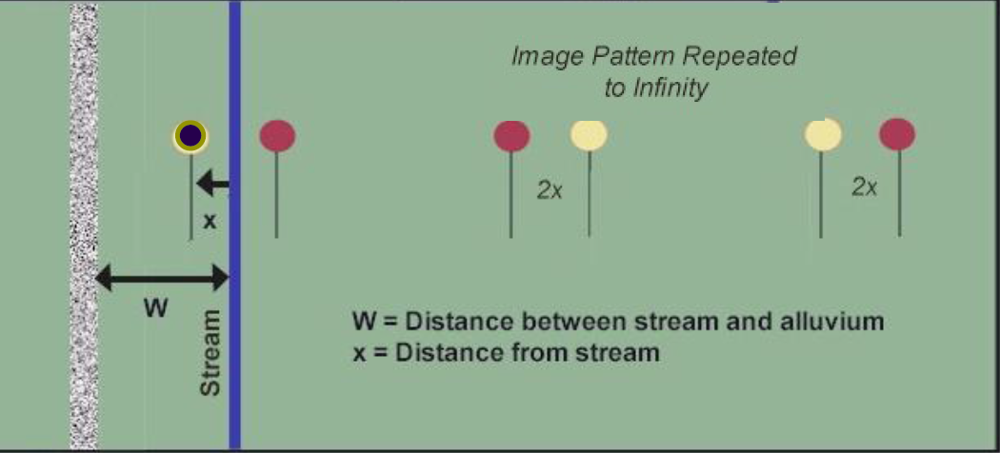
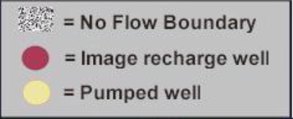
We use a simple analytical model
AWAS – Alluvial Water Accounting System
Developed by the Integrated Decision Support Group at Colorado State University.

Slide 14
We use the model to calculate:
Stream depletion from changing existing water right (reduced return flow from retiring irrigation).
Stream depletion from pumping new well.
Stream accretion from aquifer recharge.

Slide 15
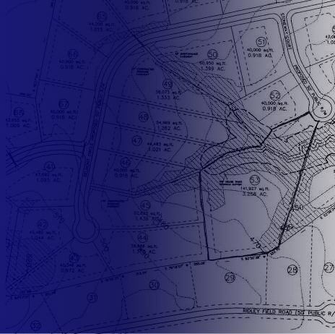
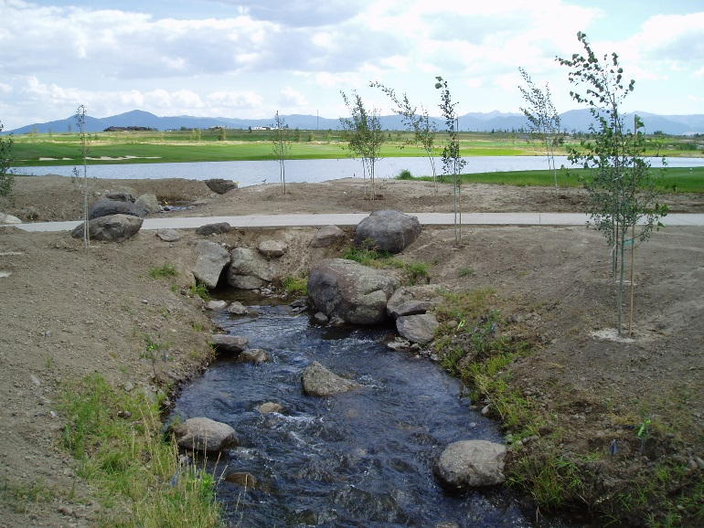
Bitterroot municipal well:
100 single family homes, 1 church, 1 school, 1 store, and 30 acres lawn and garden irrigation.
Distance to river is 1 mile.
Retire 100 acres of wheel line sprinkler at this same location.

Slide 16
Bitterroot mitigation opportunities tested:
Leave irrigation water instream.
Aquifer recharge by infiltrating with a drainfield.
Use irrigation water right for lawn and garden and a new well for indoor use.
Aquifer recharge by infiltrating using a wetland.

Slide 17
Bitterroot River modeled depletion/accretion.
mitigation opportunity #1 leave irrigation water instream.
Month | Depletions from change in return flows (acft) | Depletions from new well (acft)
Jan | -3.31 | -4.85
Feb | -2.88 | -4.3
March | -3.06 | -4.63
April | -2.84 | -4.34
May | -2.82 | -4.34
June | -2.67 | -4.09
July | -2.78 | -4.18
Aug | -2.9 | -4.24
Sept | -3 | -4.27
Oct | -3.29 | -4.63
Nov | -3.29 | -4.65
Dec | -3.4 | -4.88
Annual total | -36.24 | -53.40

Slide 18
Bitterroot River modeled depletion/accretion.
mitigation opportunity #1 leave irrigation water instream.
Month | Depletions from change in return flows (acft) | Depletions from new well (acft) | Accretions from leaving irrigation water instream (acft)
Jan | -3.31 | -4.85
Feb | -2.88 | -4.3
March | -3.06 | -4.63
April | -2.84 | -4.34 | 5.07
May | -2.82 | -4.34 | 24.14
June | -2.67 | -4.09 | 36.22
July | -2.78 | -4.18 | 48.11
Aug | -2.9 | -4.24 | 41.20
Sept | -3 | -4.27 | 22.22
Oct | -3.29 | -4.63 | 4.46
Nov | -3.29 | -4.65
Dec | -3.4 | -4.88
Annual total | -36.24 | -53.40 | 181.43

Slide 19
Bitterroot River modeled depletion/accretion.
mitigation opportunity #1 leave irrigation water instream.
Month | Depletions from change in return flows (acft) | Depletions from new well (acft) | Accretions from leaving irrigation water instream (acft) | Net change to river (acft)
Jan | -3.31 | -4.85 |  | -8.16
Feb | -2.88 | -4.3 |  | -7.18
March | -3.06 | -4.63 |  | -7.69
April | -2.84 | -4.34 | 5.07 | -2.11
May | -2.82 | -4.34 | 24.14 | 16.98
June | -2.67 | -4.09 | 36.22 | 29.46
July | -2.78 | -4.18 | 48.11 | 41.15
Aug | -2.9 | -4.24 | 41.20 | 34.06
Sept | -3 | -4.27 | 22.22 | 14.95
Oct | -3.29 | -4.63 | 4.46 | -3.46
Nov | -3.29 | -4.65 |  | -7.94
Dec | -3.4 | -4.88 |  | -8.28
Annual total | -36.24 | -53.40 | 181.43 | 91.79

Slide 20
Bitterroot well mitigation, what works?
Aquifer recharge using a drainfield.
Month | Depletions from change in return flows (acft) | Depletions from new appropriation (acft) | Aquifer recharge (acft) | Accretions from aquifer recharge (acft) | Net change to river (acft)
Jan | -3.31 | -4.85 |  | 8.35 | 0.19
Feb | -2.88 | -4.3 |  | 7.44 | 0.26
March | -3.06 | -4.63 |  | 8.05 | 0.36
April | -2.84 | -4.34 | 3.22 | 7.58 | 0.4
May | -2.82 | -4.34 | 14.46 | 7.61 | 0.45
June | -2.67 | -4.09 | 17.77 | 7.17 | 0.41
July | -2.78 | -4.18 | 23.54 | 7.32 | 0.36
Aug | -2.9 | -4.24 | 20.19 | 7.39 | 0.25
Sept | -3 | -4.27 | 10.99 | 7.38 | 0.11
Oct | -3.29 | -4.63 | 2.40 | 7.93 | 0.01
Nov | -3.29 | -4.65 |  | 7.95 | 0.01
Dec | -3.4 | -4.88 |  | 8.36 | 0.08
Annual total | -36.24 | -53.40 | 92.58 | 92.53 | 2.89

Slide 21
Bitterroot well mitigation, what works?
Aquifer recharge using a drainfield.
Month | Depletions from change in return flows (acft) | Depletions from new appropriation (acft) | Aquifer recharge (acft) | Accretions from aquifer recharge (acft) | Net change to river (acft)
Jan | -3.31 | -4.85 |  | 8.35 | 0.19
Feb | -2.88 | -4.3 |  | 7.44 | 0.26
March | -3.06 | -4.63 |  | 8.05 | 0.36
April | -2.84 | -4.34 | 3.22 | 7.58 | 0.4
May | -2.82 | -4.34 | 14.46 | 7.61 | 0.45
June | -2.67 | -4.09 | 17.77 | 7.17 | 0.41
July | -2.78 | -4.18 | 23.54 | 7.32 | 0.36
Aug | -2.9 | -4.24 | 20.19 | 7.39 | 0.25
Sept | -3 | -4.27 | 10.99 | 7.38 | 0.11
Oct | -3.29 | -4.63 | 2.40 | 7.93 | 0.01
Nov | -3.29 | -4.65 |  | 7.95 | 0.01
Dec | -3.4 | -4.88 |  | 8.36 | 0.08
Annual total | -36.24 | -53.40 | 92.58 | 92.53 | 2.89

Slide 22
Bitterroot well mitigation, what works?
Aquifer recharge using a drainfield.
Month | Depletions from change in return flows (acft) | Depletions from new appropriation (acft) | Aquifer recharge (acft) | Accretions from aquifer recharge (acft) | Net change to river (acft)
Jan | -3.31 | -4.85 |  | 8.35 | 0.19
Feb | -2.88 | -4.3 |  | 7.44 | 0.26
March | -3.06 | -4.63 |  | 8.05 | 0.36
April | -2.84 | -4.34 | 3.22 | 7.58 | 0.4
May | -2.82 | -4.34 | 14.46 | 7.61 | 0.45
June | -2.67 | -4.09 | 17.77 | 7.17 | 0.41
July | -2.78 | -4.18 | 23.54 | 7.32 | 0.36
Aug | -2.9 | -4.24 | 20.19 | 7.39 | 0.25
Sept | -3 | -4.27 | 10.99 | 7.38 | 0.11
Oct | -3.29 | -4.63 | 2.40 | 7.93 | 0.01
Nov | -3.29 | -4.65 |  | 7.95 | 0.01
Dec | -3.4 | -4.88 |  | 8.36 | 0.08
Annual total | -36.24 | -53.40 | 92.58 | 92.53 | 2.89

Slide 23
Bitterroot well mitigation, what works?
Aquifer recharge using a drainfield.
Recharging 43% of the formerly consumed irrigation water mitigates the new municipal well (0.8 acre drainfield, max flow rate 172 gpm).
Or, recharging 100% of the formerly consumed irrigation water creates extra mitigation marketing water year-round in the amount of ~6 acft per month (1.4 acre drainfield, max flow rate 314 gpm).
In both cases we are also infiltrating formerly non-consumed water (field loss) to mitigate change in return flow.

Slide 24
Bitterroot well mitigation, what works?
Use irrigation water right for lawn and garden and a new well for indoor use.
The new well has an annual diversion of 31.6 acft, so does not qualify for exemption.
Still requires aquifer recharge to mitigate year-round depletions from new well.
Drainfield 0.2 acres in size, max flow rate 50 gpm.

Slide 25
Bitterroot well mitigation, what works?
Aquifer recharge by infiltrating using a wetland.
Wetland is 1.39 acres.
Wetland requires additional water above that used for aquifer recharge to compensate for evaporation and wetland pool filling.
Wetland evaporation requires 3.14 acft of water annually.
Pool filling requires 0.7 acft of water annually.
Wetland generates Section 404 compensatory mitigation credits which can be sold.
Engineering: wetland has to hold water but also leak.

Slide 26
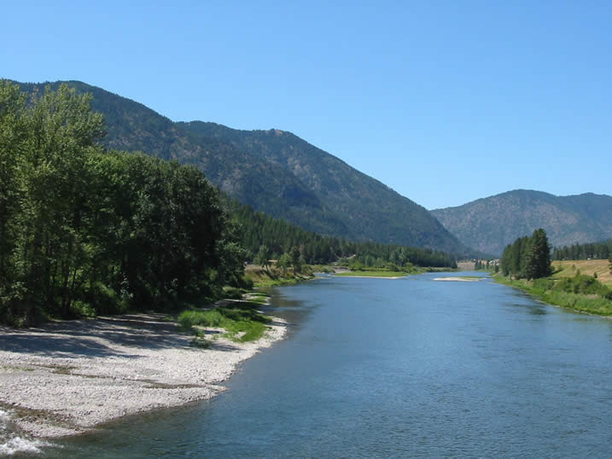
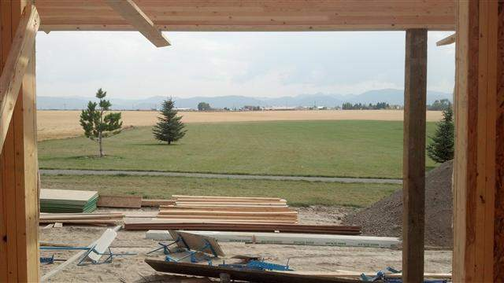
Missoula Valley subdivision well
250.5 acre development, 300 single family homes, 100.5 acres lawn and garden irrigation.
Not on ground formerly irrigated. Will have to purchase an existing water right and change it or purchase mitigation marketing water.
Development is ½ mile from Clark Fork River.

Slide 27
Missoula subdivision mitigation opportunities tested:
Purchase and retire irrigation water right and process a water right change to mitigation.
Purchase mitigation marketing water.
Store spring flow when water is legally available in the Clark Fork River (short window during May-June and flows not high enough every year).

Slide 28
Missoula subdivision well, what works?
New well depletes Clark Fork River year-round, but water is not limited except for Avista hydropower water right which can be mitigated on an annual time-scale.
Mitigate by leaving former irrigation water instream, don’t have to recharge aquifer.
Can retire 155 acres irrigation and process a water right change.
Or can purchase mitigation marketing water.

Slide 29
Missoula subdivision well, what doesn’t work?
Storing spring flows in a lined pond is not feasible. Storing 2-years mitigation supply requires storing 472 acft; 20 acre reservoir would be 23.6 ft deep.
Significant reservoir evaporation.
Still the question of where water would come from when there is a 3+ year drought and water is not legally available to store.

Slide 30
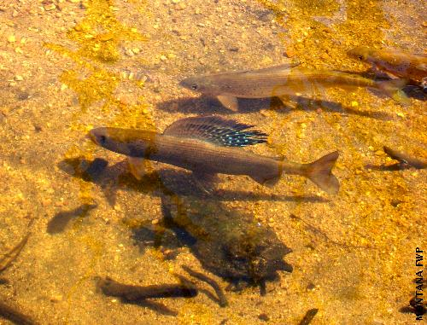
Deer Lodge Valley instream flow change
Portion of a 290 acre field will be taken out of production and the water left instream.
Currently pivot irrigated, historically flood irrigated.
Field is ½ mile from Clark Fork River.

Slide 31
Deer Lodge Valley instream flow change opportunities tested:
Retire 50 acres of the current 290 acres irrigated and leave that water instream.
Retire sufficient acreage to create a minimum of 0.5 cfs of protectable water during August. Offset changes in return flow with instream mitigation.
Retire sufficient acreage to create a minimum of 0.5 cfs of protectable water during August. Offset changes in return flows with aquifer recharge using a drainfield.

Slide 32
Deer Lodge Valley instream flow change, what are the challenges?
Past change from flood to pivot needs to be mitigated if the water right will be changed.
Return flows are already greatly reduced due to the greater efficiency of pivot.
Pivot consumes more water due to greater efficiency. Acreage will have to be reduced to compensate.
Former Milltown Dam hydropower water right, now owned by the State of Montana, appropriates the entire flow of the Clark Fork River at Milltown from August through March.

Slide 33
Deer Lodge Valley instream flow change, what doesn’t work?
50 acres of center pivot irrigated area retired, mitigate by leaving water instream.
River is depleted during October to May from reduced return flow and increased consumptive use of pivot grown alfalfa.
Retire sufficient acreage to create a minimum of 0.5 cfs of protectable water during August, mitigate by leaving water instream.
River is depleted during October to May from reduced return flow.

Slide 34
Deer Lodge Valley instream flow change, what works?
Retire sufficient acreage to create a minimum of 0.5 cfs of protectable water during August. Offset changes in return flows with aquifer recharge using a drainfield.
Reduce alfalfa acreage from 290 to 124 acres.
Creates 0.54 cfs of protectable instream flow during July, 0.5 cfs during August, and 0.39 cfs during September.
Permitting law/rules force you to recreate the historic return flow under flood, even though those return flows haven’t existed for decades, huge recharge requirement.
Drainfield of 1.6 acres in size, max flow rate 359 gpm.

Slide 35
Questions?
Ian Magruder
KirK Engineering &
Natural Resources

