Slide 1
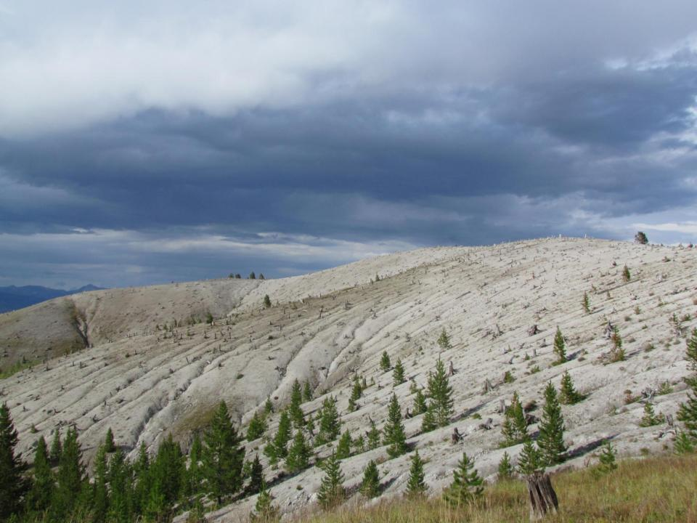
Montana Moonscapes
Steep Slope Remediation and Restoration in the Anaconda Uplands
Pedro Marques
Restoration Ecologist/Project Manager- Watershed Consulting
Notes:
Most of the time we’re talking about river
But huge impact to the uplands
5 years working as the NRDPs Revegetation Contractor for Steep Slopes

Slide 2
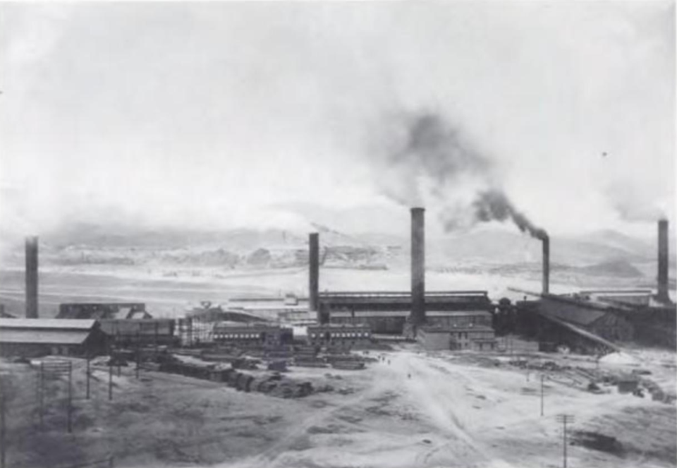
History
‘for a distance of 30 miles the great clouds of smoke that rise from among the mountains indicate the location of Anaconda and the greatest copper smelter in the world’
- Reporter from Minneapolis, 1886
H. Shoebotham, Anaconda: Life of Marcus Daly, The Copper King, Harrisburg, 1956, 77.
Notes:
1885- upper works, 1886 #2
Washoe Smelter in 1901- Old Works across the valley at current Stucky Ridge site. Before big stack.
Washoe smelter Raised from 300’ to 585’ between 1911 to 1918
Logging- 75000 cords of wood per year before coal (1890’s-early1900’s)- 1907 manual by company already uses coal
Estimates suggest that as much as 59 pounds of arsenic and considerable quantities of sulfur dioxide,copper, antimony, lead, and zinc emanated daily from the stacks of the Washoe smelter.
So thick lay the waste that after a few years of operation the company swept the denuded mountainsides immediately adjacent the smelters to retrieve over six million dollars worth of copper from the dust.
MacMillan, Smoke Wars (note10), 87-92

Slide 3
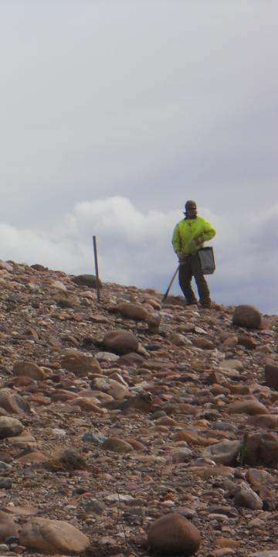
Regulatory Framework
ARCO Remedial Action Work Plan (RAWP) and Final Design Report (FDR)
Stucky Ridge (RDU 1): 2005
Cabbage Gulch (RDU 15): 2007
Steep Slope Remediation (SSR) (> 3:1)
SSR I (planting, broadcast seeding)
SSR II (+ non-mechanized on-slope BMPs)
SSR III (+ mechanized on-slope BMPs)
SSR IV (+ slope re-grade)
NRDP Restoration Objectives (Sediment, Vegetation)
MT FWP Landowner Objectives (Mt. Haggin Wildlife Management Area)
MT Haggin Technical Working Group
Notes:
ROD- 1998, Arco settlement-
RAWP- Stucky Ridge and Cabbage Gulch (112 acres)
- Initial Studies by NRDP, Soil samples for Mt. Haggin
(DEQ, NRDP, FWP, Pioneer Technical, Watershed, KC Harvey- Stuart Jennings.
Report to EPA)

Slide 4
Notes:
Three main areas- as I walk through our approaches we’ll jump between these sites
NRDP Sites- Stucky Ridge, Cabbage Gulch. Stucky is primarily

Slide 5
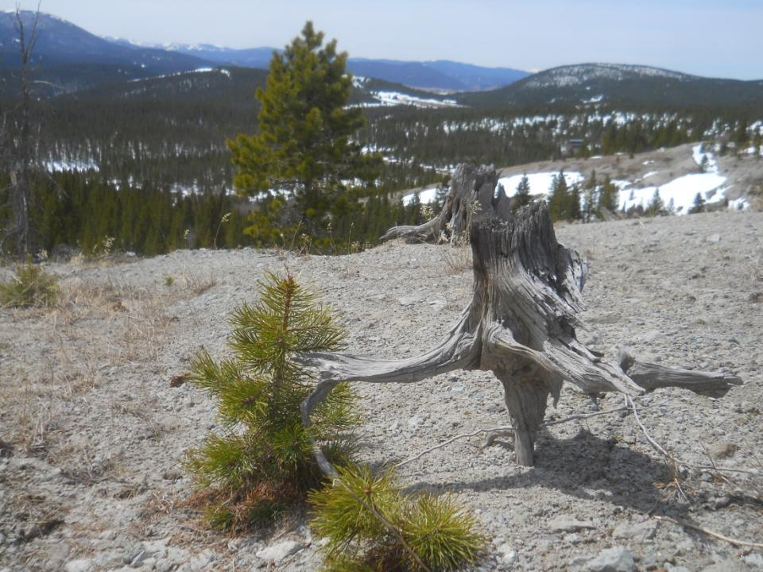
Limiting Factors… What Limiting Factors?
Notes:
Climate- Extreme temps in all seasons. Frozen, Fried and Dessicated.
Worst factor is wind that pulls all moisture off bare slopes

Slide 6
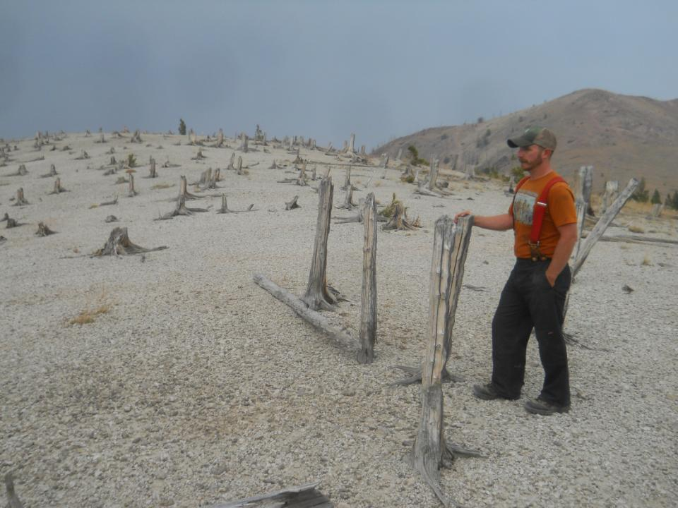
50,000-75,000 cords of wood/year for smelting and building
Loss of 6”-18” of forest soil= all organics and most water holding capacity
Seed sources few and far between (even weeds)

Slide 7
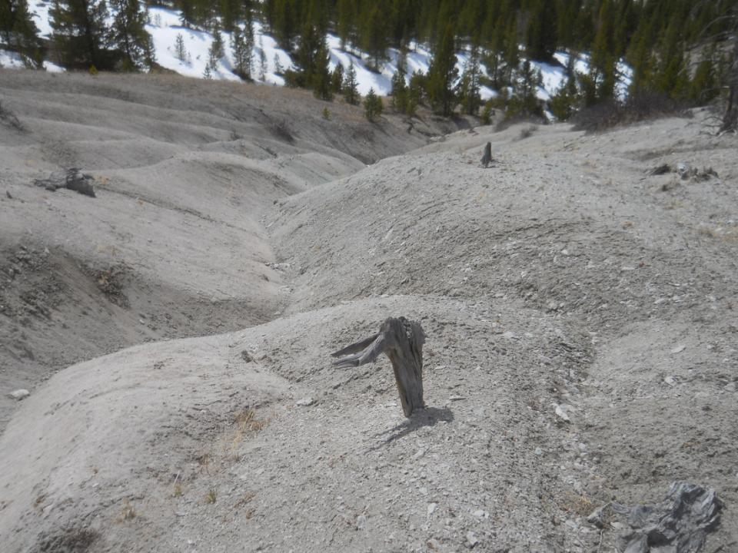
Past the Ecologic
Tipping Point
Moving mineral “soils”
Friable “Bedrock”
Seed predation
Wind erosion

Slide 8
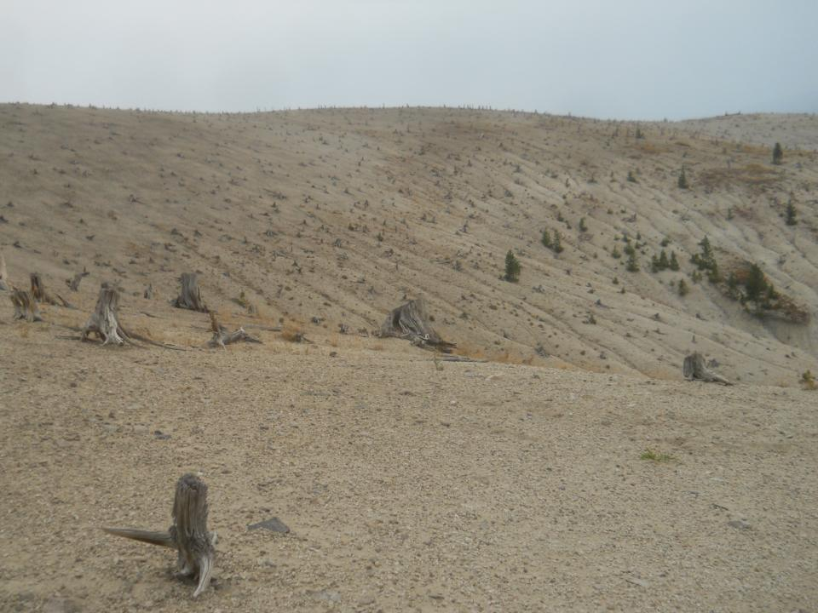

Slide 9
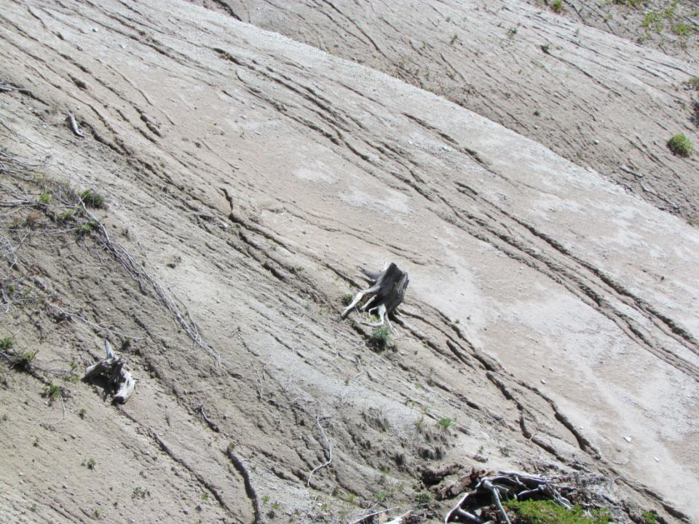
Notes:
Different intensities of rain fill rills, repeat

Slide 10
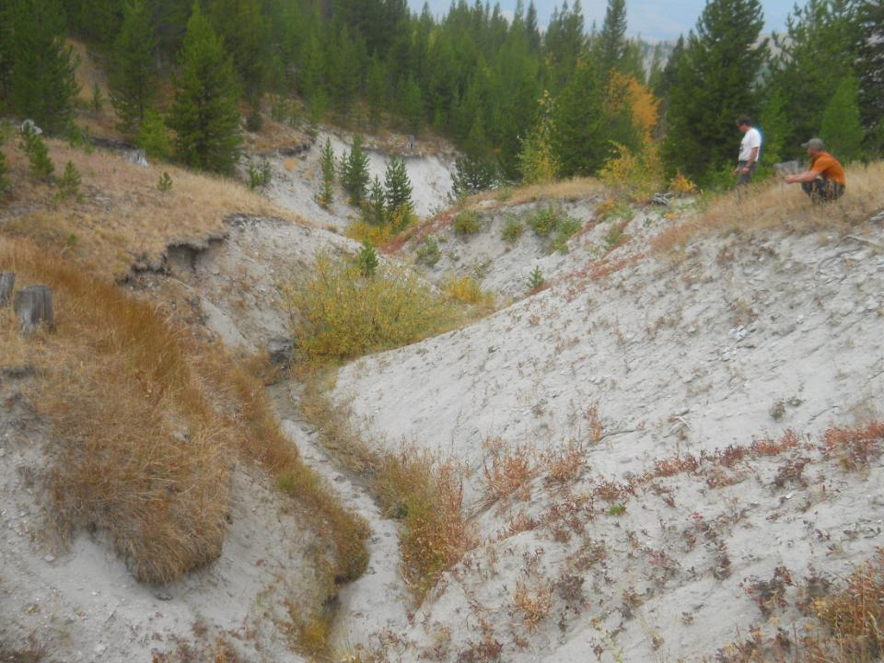
Upper Joiner Creek
Bedrock bottom
Loss of natural grade controls
Notes:
Bedrock- water hits bottom and shoots off the mountain
Riparian is perched on narrow ledge- needs more width

Slide 11
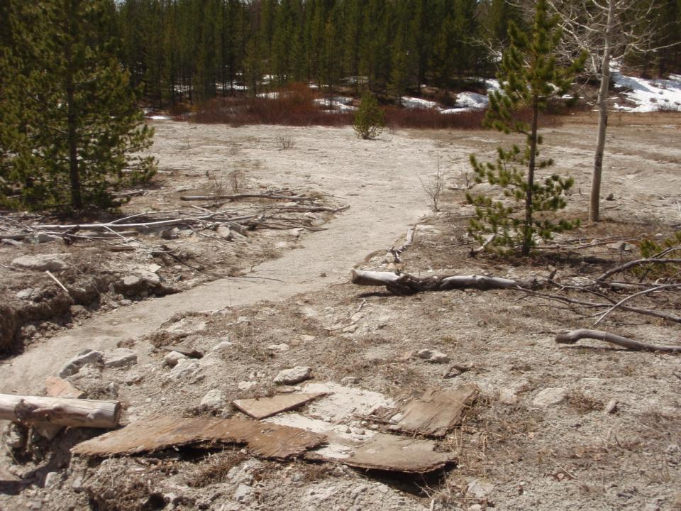
California Creek
Sediment superhighway
Elevated floodplain
Notes:
8 larger sediment plume areas

Slide 12
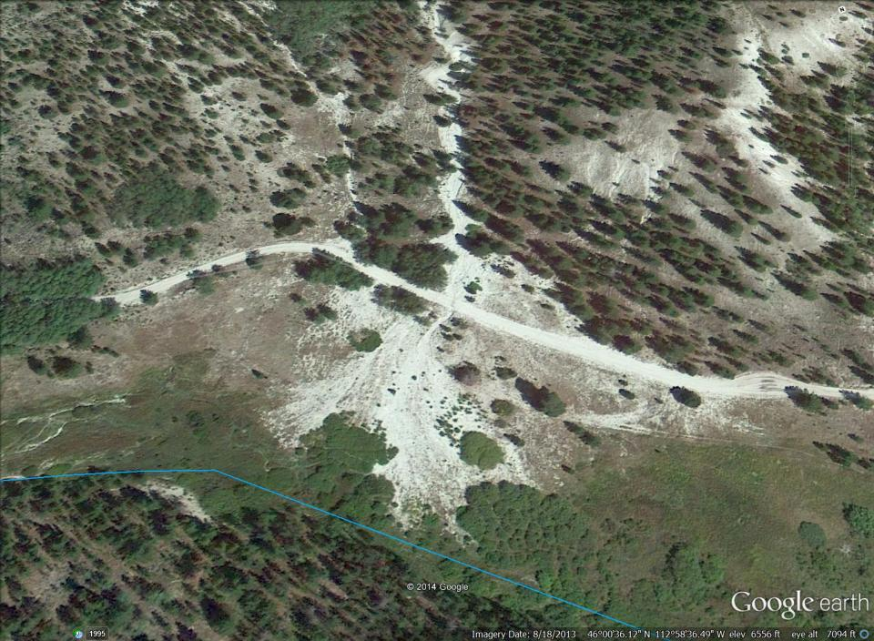
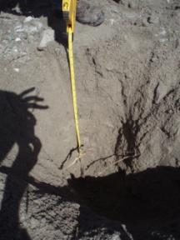
California Creek
26 inches
Notes:
Pushed stream against mountain, turned lush wet bottom into upland vegetation
Grazing doesn’t help
Taking the area immediately visible at 26” down= 8931 tons of sediment. 1% gets to stream every year and we stop this plume, this one area accounts for 16% of the TMDL Upland sediment reduction.

Slide 13
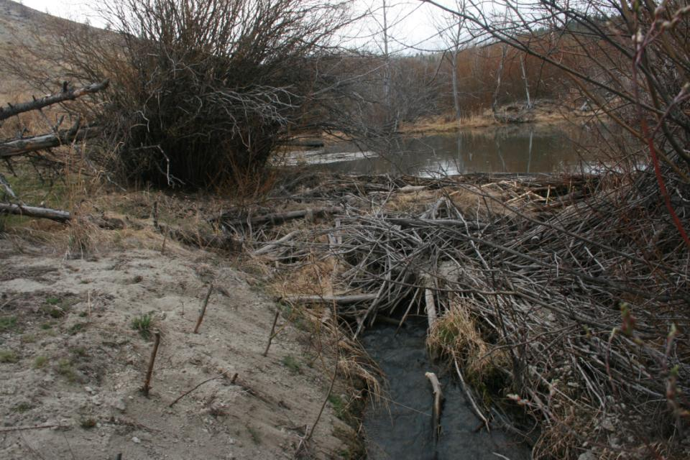
Notes:
What does help is the beaver ponds

Slide 14
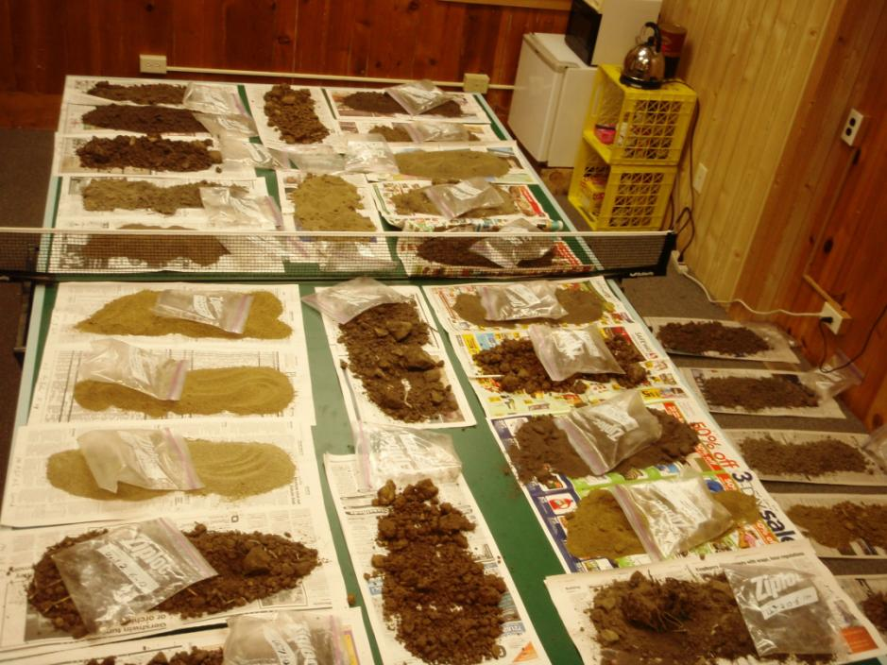
Parent Material
Notes:
Soil is something I’ve learned to live without
Rhyolite, “granitic sand,” volcanic welded tuff.

Slide 15
Sample Location | Sample Depth (inches) | Organic Matter (%) | pH | Cation Exchange Capacity (meq/100g) | Copper (ppm) | Arsenic (mg/kg)
Sediment Plume | 0-2 | 0.1 | 5.9 | 11.3
 | 2-4 | 0.3 | 5.9 | 10.4
 | 0-12 | <.1 | 5.8 | 10.94 | 3.46 | 5.6
 | 12-24 | <.1 | 5.5 | 16.04 | 4.08 | 18.5
Partially Vegetated Floodplain | 0-6 | 2.7 | 6 | 13.7 | 84.76 | 96.9
 | 6-12 | 2.5 | 6 | 14.2 | 35.35 | 53.8
 | 12-24 | 0.67 | 6.2 | 15.57 | 4.08 | 6.1
Partially Vegetated Upland-Mid Slope | 0-2 | 2.5 | 5.2 | 9
 | 2-4 | 1.8 | 5 | 8.5
Bare Upland | 0-2 | 0.5 | 5.5 | 13.4
 | 2-4 | 0.8 | 5.5 | 14.9
 | 0-6 | 0.45 | 5 | 13.2 | 1.29 | 5.3
 | 6-12 | 0.62 | 5.3 | 12.07 | 1.95 | 4.3
Forested Upland | 0-2 | 4.4 | 5 | 7.5
 | 2-4 | 1.8 | 5 | 5.6
 | 0-6” | 2.8 | 4.8 |  | 66.57 | 160.9
 | 6-12” | 1.76 | 4.9 |  | 6.27 | 35.9
Notes:
Volcanic Welded Tuff parent material
Boron and Manganese micronutrients
Copper higher in forested uplands than bare; Higher in upper soil horizon than lower in vegetated areas, opossite in bare ares
Low CEC related to pH
Acidity of forest samples related to pine needles
Bare stuff is clean
ARCO soil sampling- COCs are in finest soil fraction. Dispersed and ubiquitous

Slide 16
Assessments
Notes:
Vegetation types- Aspen and Willow regen from bottom up
field assessment and photo interpretation to GIS

Slide 17
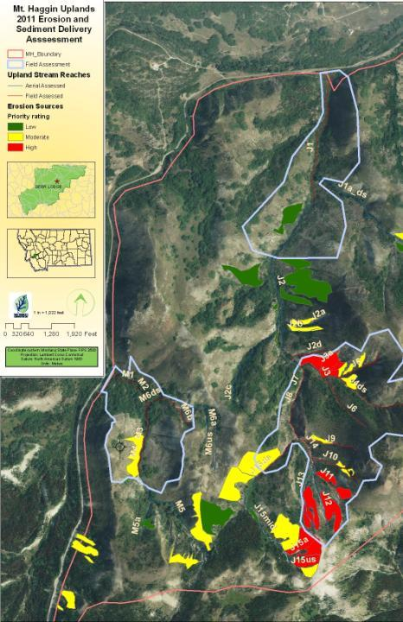
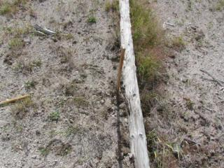
Upland Sediment Source Assessment
Vegetation
Parent Material
Surface Roughness
Slope and Aspect
Paired T- Tests: Browse protection; Container Size; Amendments
Wetland Enhancement Potential
Weed Mapping
Annual Reporting for EPA, NRDP
Notes:
T Tests
Exclosures
Downed wood and micro-sites. A few extra hours of shade a day or one extra week of snow cover can be difference between life and death

Slide 18
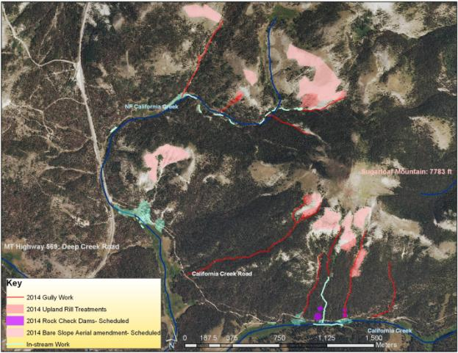
Top-to-bottom Approach
Notes:
Approaches evolved over time. Every location is different
- California Creek
Inherited a large-scale planting effort and 50,000 plants already growing in nurseries.
Adjusted as we went, working with three nurseries growing our own from onsite seed
Seeding: Better bang for the buck
Planting
Seeding
Browse Protection
BMPs- Erosion control
Veg. enhancement- Riparian and Bare Slopes
Fertilization and Amendments

Slide 19
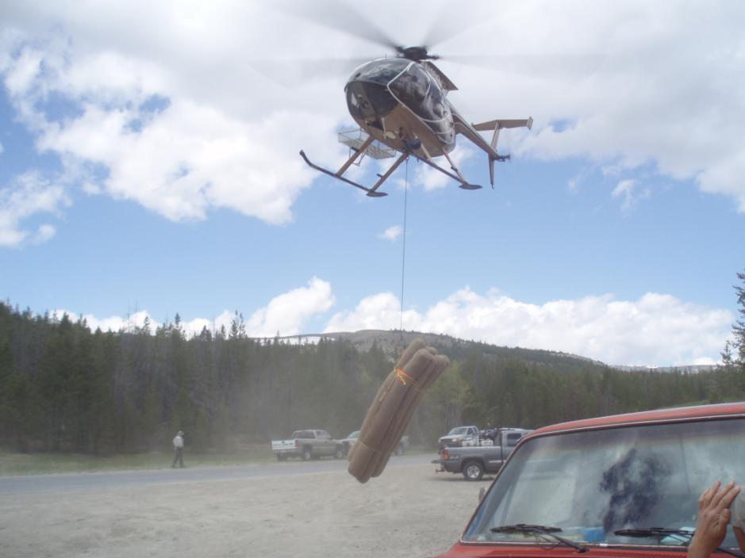
2014 Work Summary
Uplands- NRDP
seeding with amendments
3.5 miles gully controls
Rock checks
Riparian- FWP/DEQ 319
11 exclosures
2200 shrubs and trees
Culvert removal and regrade
50 Beaver Dam Analogues
Road- DEQ 319
2 new culverts and ditch relief
1 headcut treatment
1 road sediment catchment basin

Slide 21
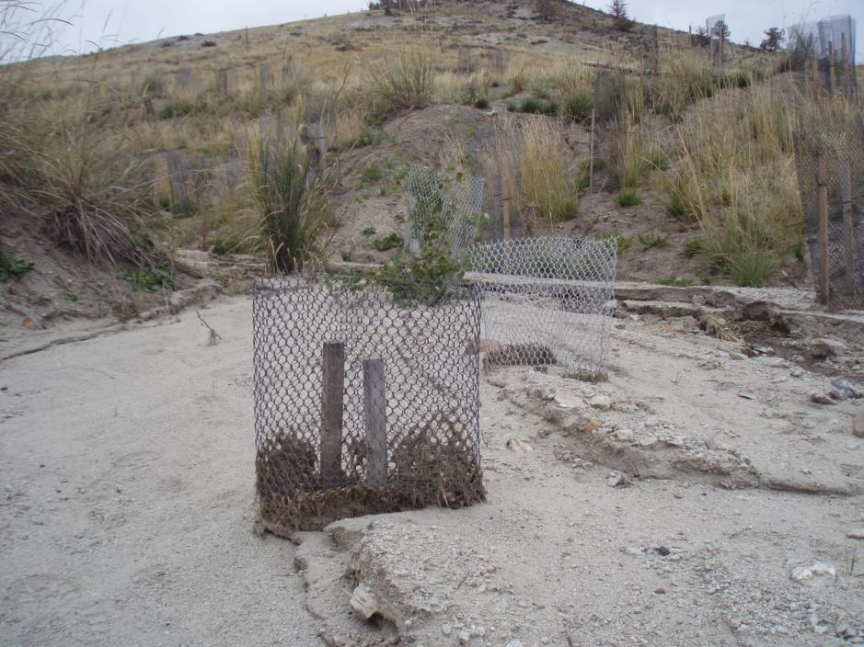
Shrub and Tree Planting

Slide 22
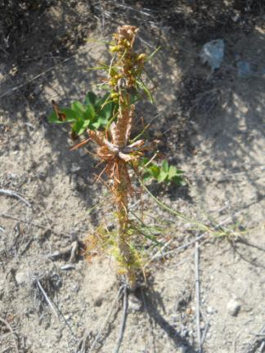
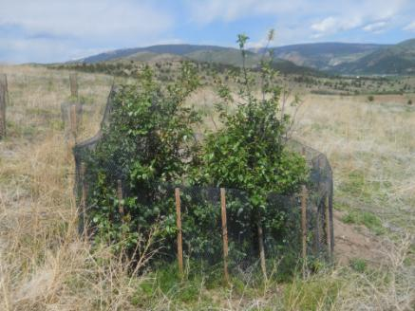
Browse
Notes:
Browse- Lollipop trees; Moose
Sniper – Stucky Ridge
Large fences- Deer Buster nets- zip ties break down within 2 seasons; expensive

Slide 23
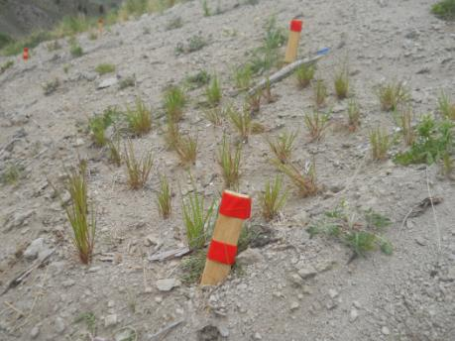
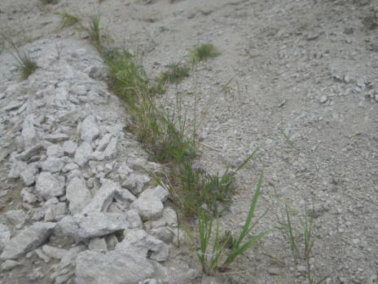
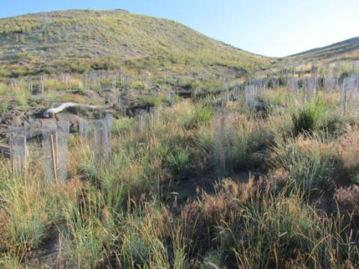
Grass Seeding, Planting and Mechanized Transplanting

Slide 24
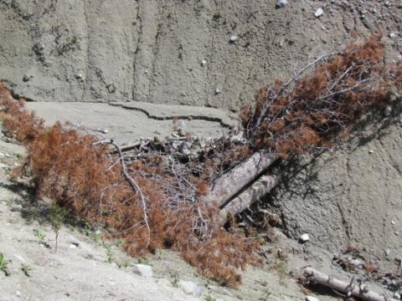
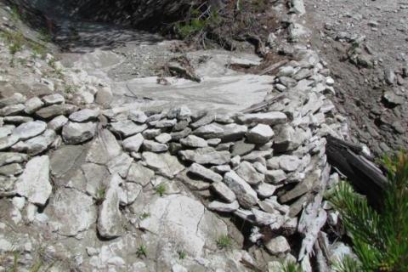
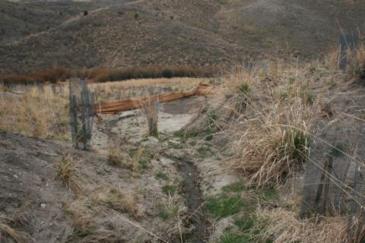
Erosion Control BMPs

Slide 25
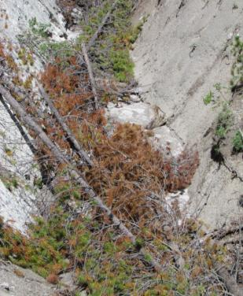
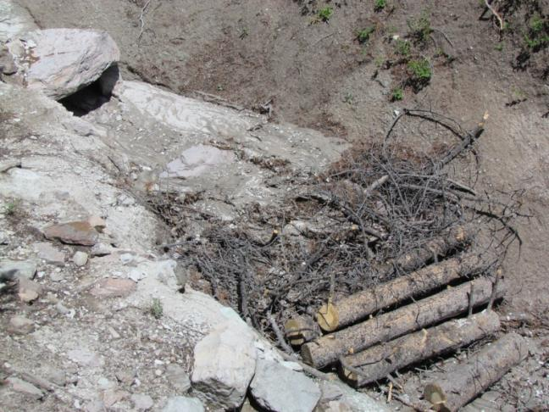
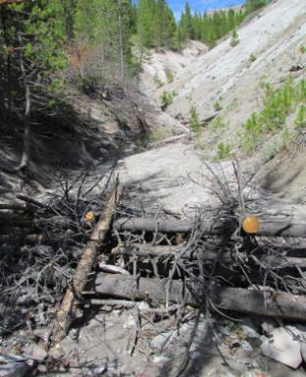
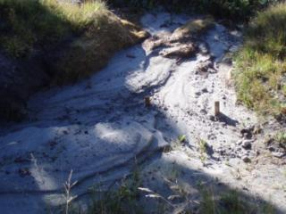
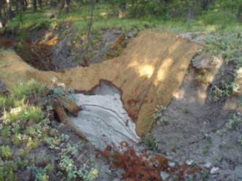

Slide 26
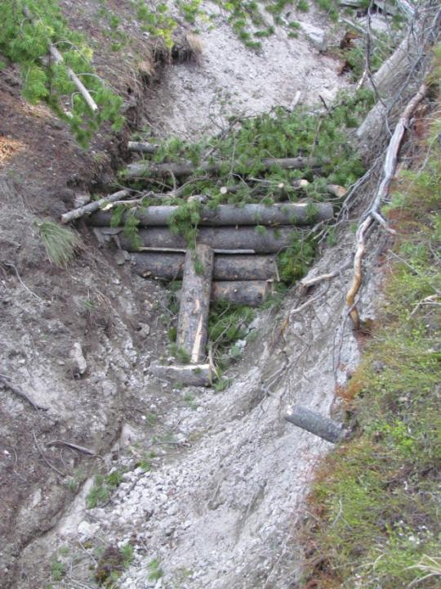
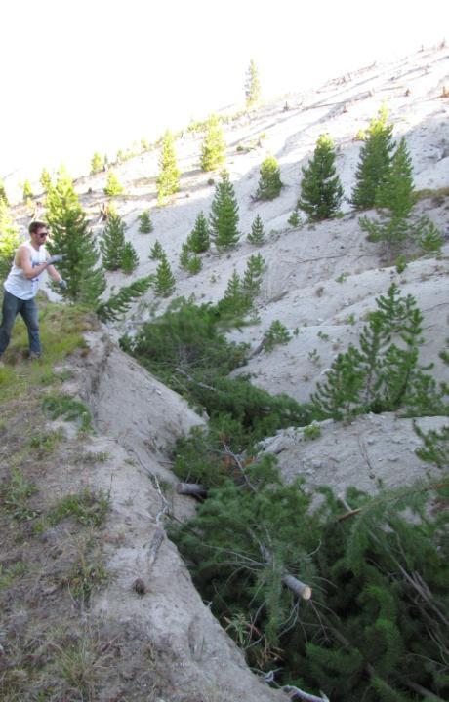

Slide 27
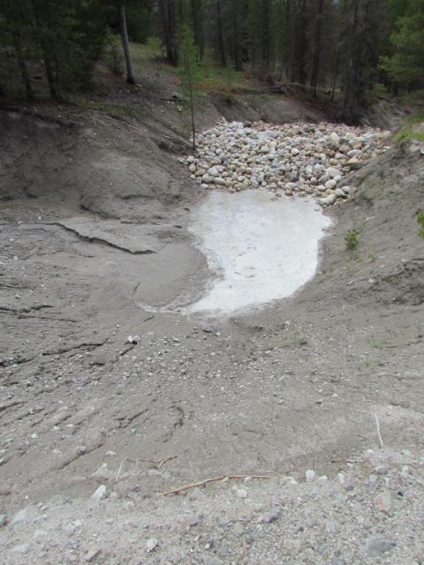
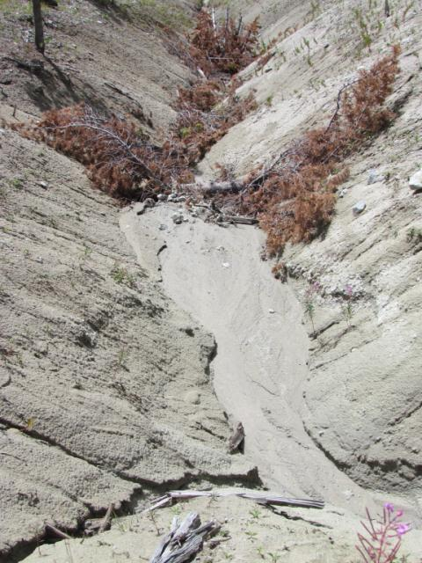
Notes:
Pioneer Technical
Price of 3 checks we did 3.5 miles of gully plugs with MCC

Slide 28
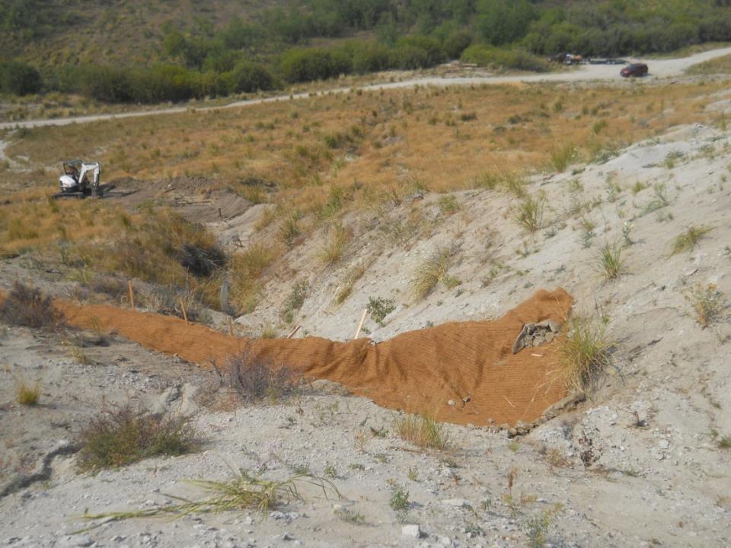

Slide 29
Cut -off gully, 2 years after 1st structure
Notes:
Next slide is looking across 2 years later

Slide 30
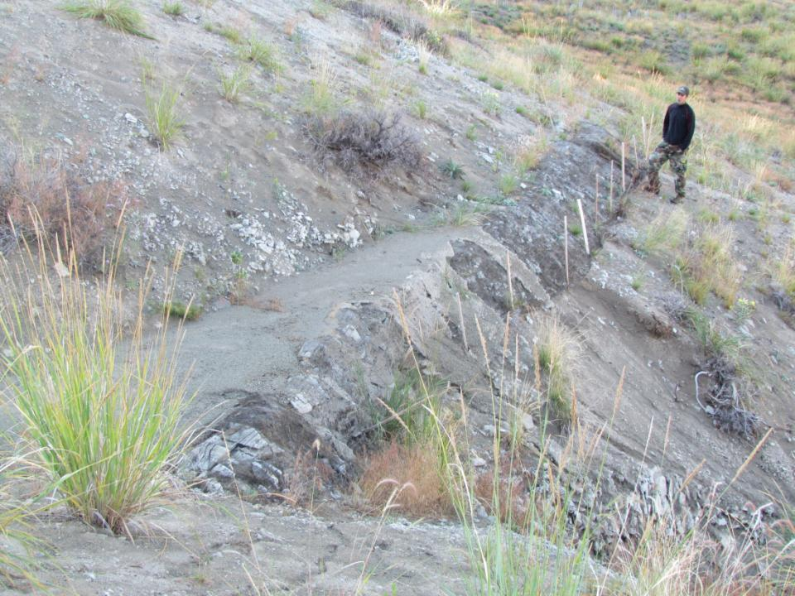
Notes:
Mistake in the execution
Flashy System
Poor execution

Slide 31
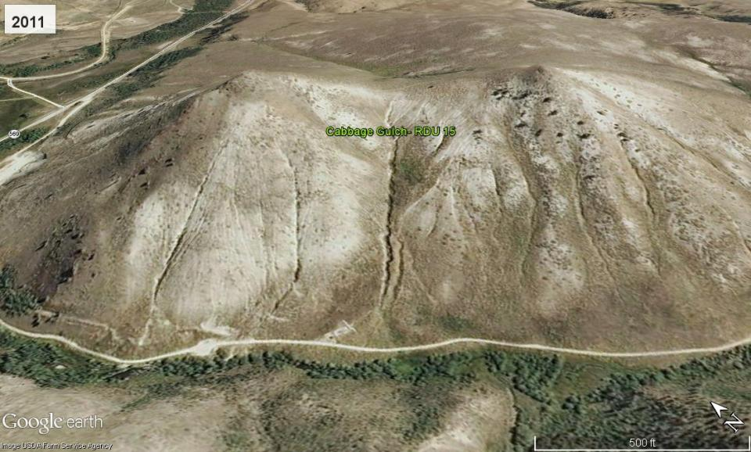

Slide 32
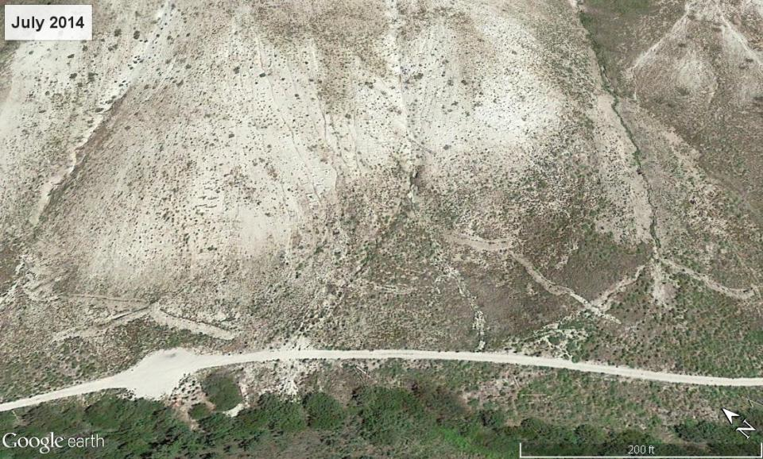

Slide 33
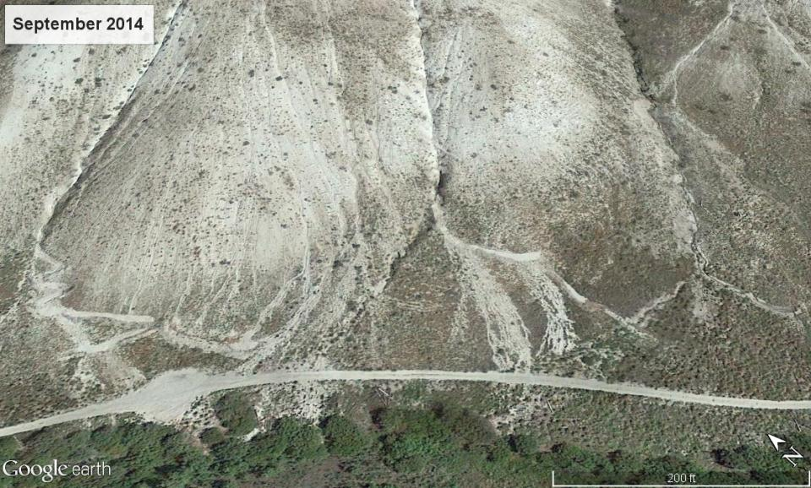

Slide 34
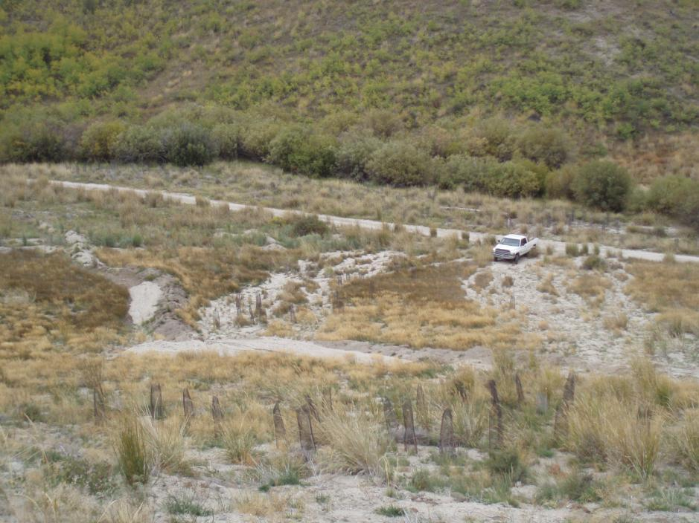

Slide 35
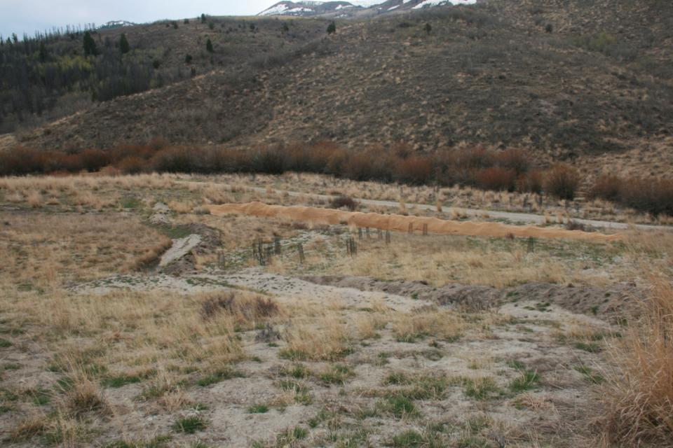

Slide 36
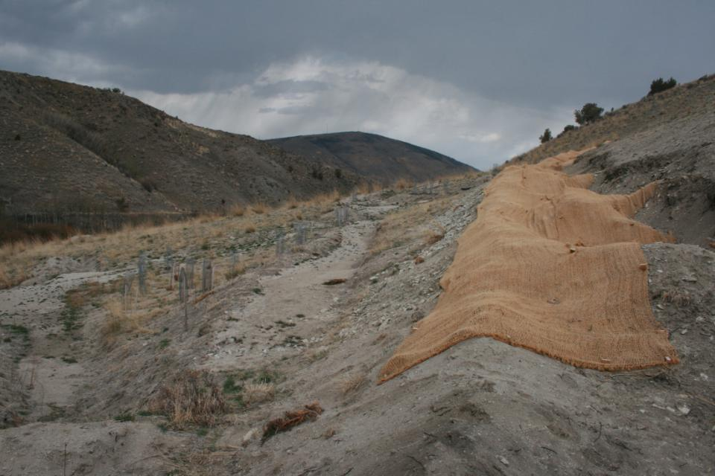

Slide 37
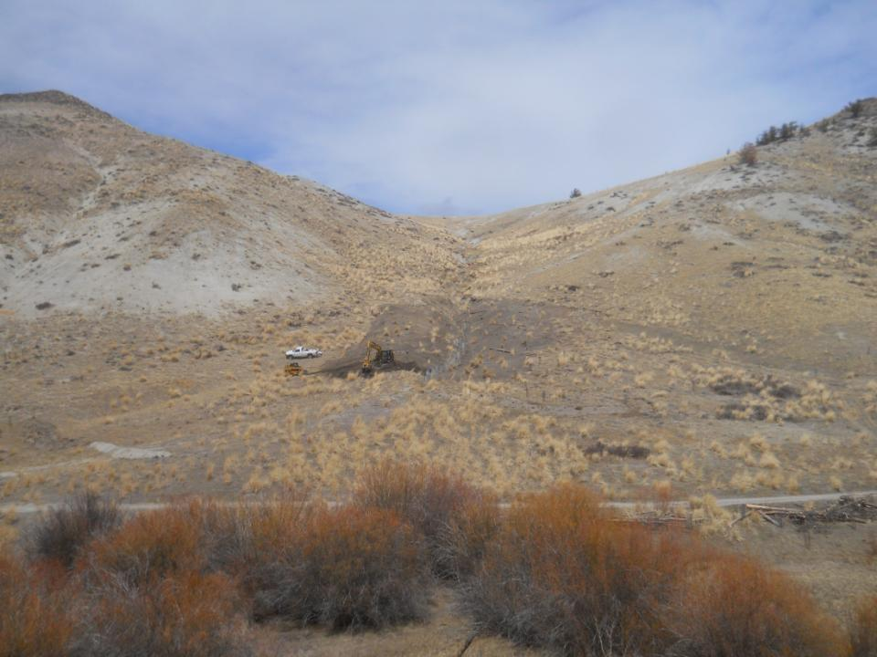
2013

Slide 38
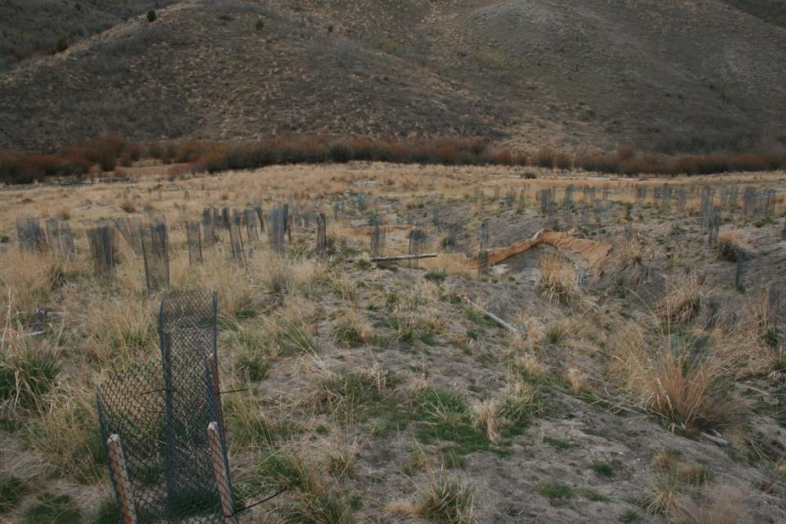
2015

Slide 39
California Creek 2014
Notes:
Lateral groundwater spring above main channel , saturates and mobilizes soil, unzips the mountain

Slide 40
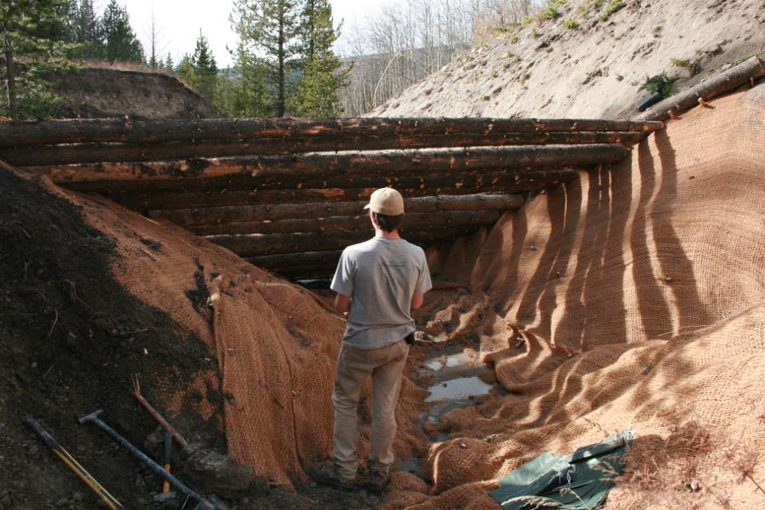

Slide 41
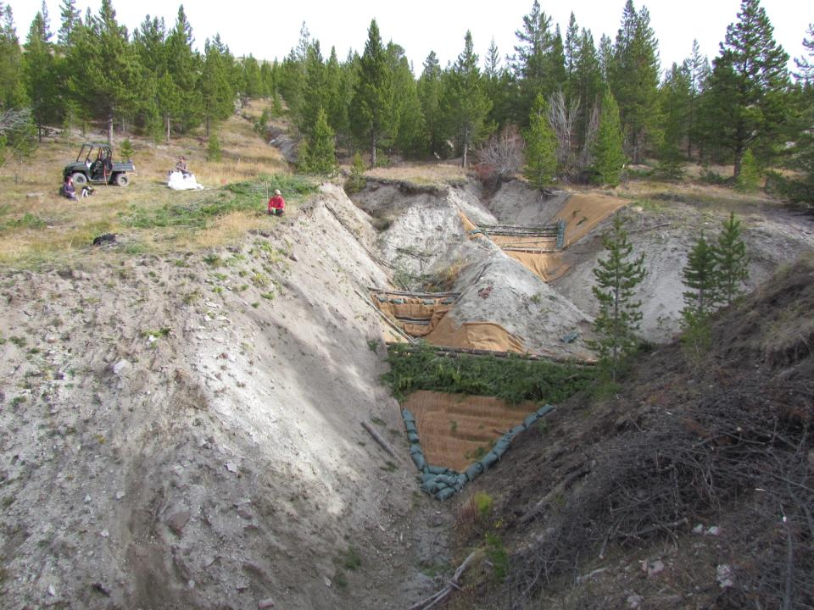

Slide 42
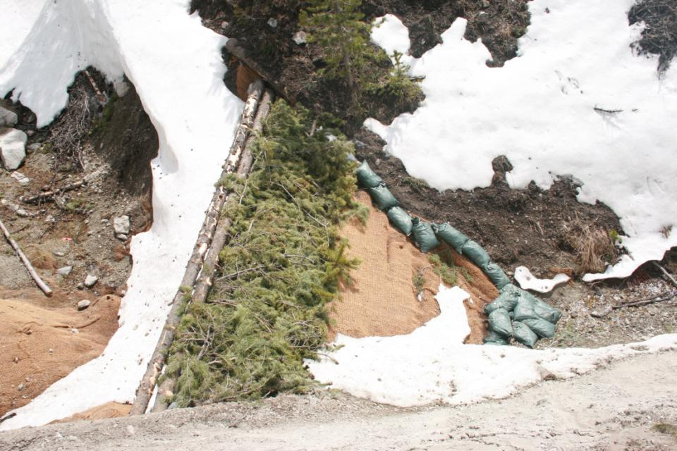

Slide 43
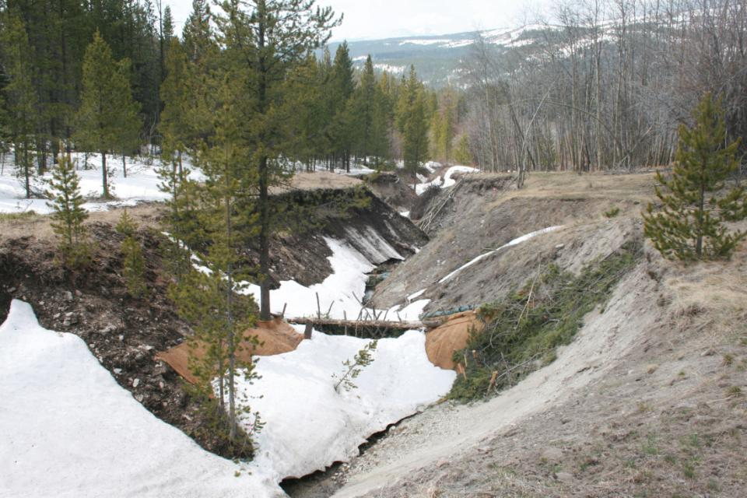
Notes:
Ecologic Tipping Point
Filled structures widen floodplain
Can be built on again (problem of spanning gully width)

Slide 44
Upland Amendment Trials

Slide 46
Monitoring Plots
Fertilization (Aerial and Biosol)
Compost
Seeding
Sedge Transplant
Notes:
15 trenches: 30’ x 12”w x 6-10” deep
Compost, biosol, compost/biosol
Broadcast fertilizer plots
Trenches without coir

Slide 47
Wetland Enhancement
Notes:
Works on the Clark Fork
We’re implementing this on small tributaries- experimenting at 319 project site on Cal. Creek with Big Hole Watershed Group

