Slide 1
Clark Fork River Metals TMDL Development
Eric Sivers
Senior TMDL Planner
esivers@mt.gov

Slide 2
Outline
Relevant criteria and assessment
Current conditons
TMDL process overview
Source assessment
The outlook

Slide 3
Recent Assessment
Metals impairments were assessed for the 2014 Integrated Report’s 303(d) list.
These TMDLs are based on the 2014 303(d) list.

Slide 4
Water Quality Impairments
One or more uses is not supported
Uses depend on classification (B1, C1, etc.)
Relevant criteria depend on use
Notes:
Classifications established in rule: ARM 17.30.606

Slide 5
Waterbody Classifications

Slide 6
Metals Numeric Water Quality Criteria
Chronic aquatic life criteria
Acute aquatic life criteria
Human health standard
LOWEST applicable of these is chosen as the target for TMDLs
Notes:
Hardness dependent metals: cadmium, chromium, copper, lead, nickel, silver, zinc
Zn: hardness dependent, but chronic/acute levels are the same. Ag: acute only; no chronic
Some HHS far lower than ALC (As, Sb); some much higher (Cu, Zn)

Slide 7
Hardness Dependent Criteria
For example, copper:
Higher hardness, higher allowable concentration of copper
Chronic aquatic life criteria at 100 mg/L hardness is 9.33 µg/L
Chronic aquatic life criteria at 50 mg/L hardness is 5.16 µg/L
HHS is fixed: 1,300 µg/L
Notes:
Cu: chronic at 50mgL and 100mgL hardness = 5.16 µg/L and 9.33 µg/L ; acute = 7.29 µg/L and 14.0 µg/L
HHS is fixed at 1,300 µg/L

Slide 8
Importance of Seasonality

Slide 9
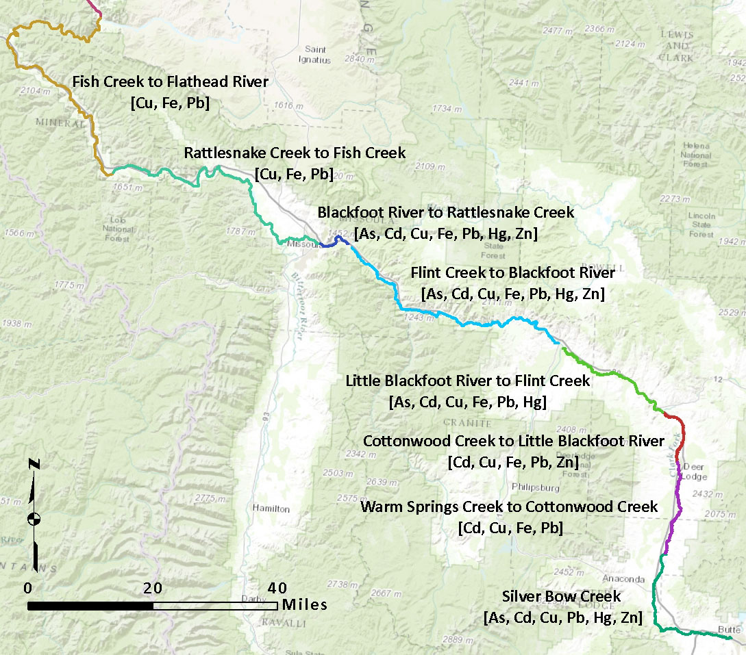
Metals Impairments
Notes:
This project is a subset of the streams in the Clark Fork – Drummond and Middle Clark Fork Tributaries TPAs. Basically it’s all the metals-impaired streams in these planning areas.

Slide 10
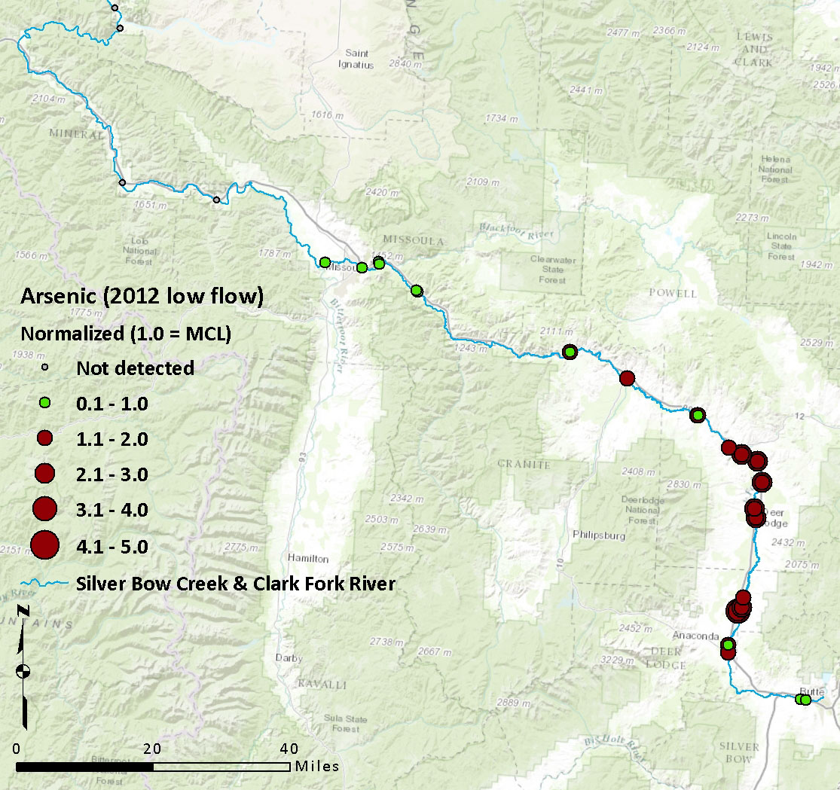
2012 Arsenic Concentrations
High Flow
Low Flow

Slide 11
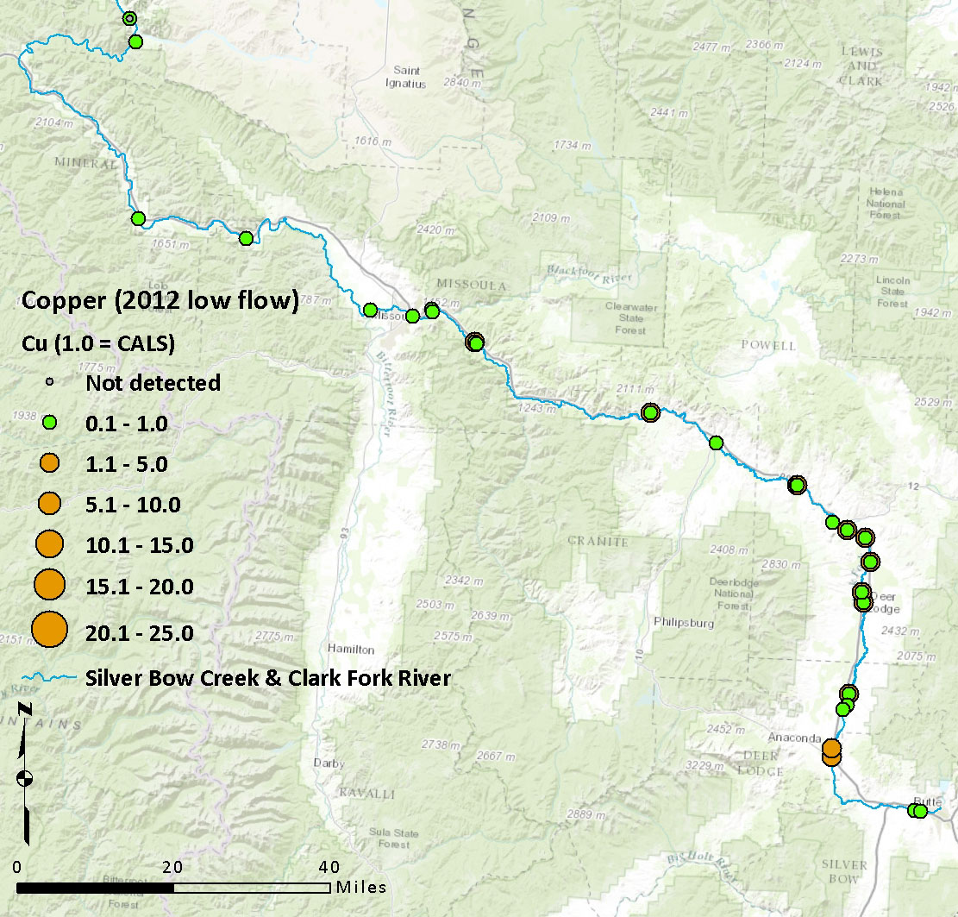
2012 Copper Concentrations
High Flow
Low Flow

Slide 12
Metals vs. Targets

Slide 13
Metals vs. Targets

Slide 14
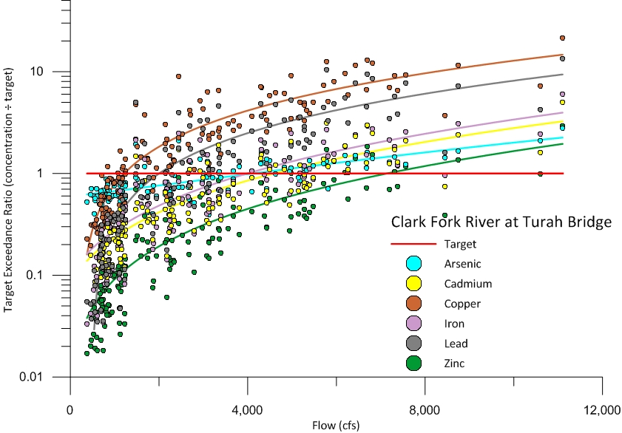
Metals vs. Targets

Slide 15
What is a TMDL?
The amount of a pollutant a stream can
accept and still meet standards.
Think of it as a safe loading rate:
Notes:
How much Yellow #5 and sugar can you consume safely? If there’s a set amount, that’s a numeric standard. If instead it’s: “stop before you turn yellow and slip into a diabetic coma”, that’s a narrative standard.

Slide 16
Calculating the TMDL
A metals TMDL is an equation
TMDLs vary with flow: more water, greater allowable load.
TMDL = target x flow
(x conversion factor)

Slide 17
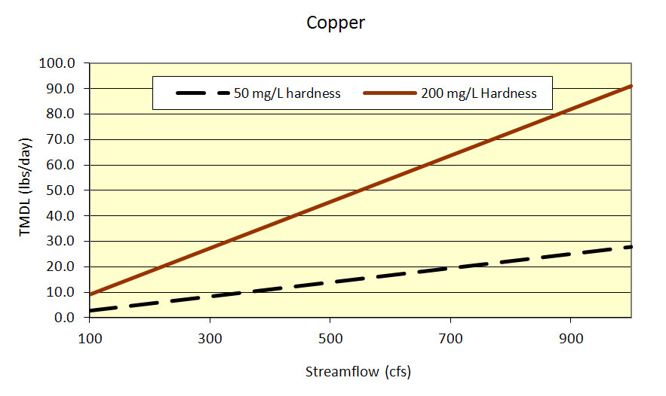
Hardness-Dependent Metals
Notes:
Hardness dependent metals: cadmium, chromium, copper, lead, nickel, silver, zinc
Zn: hardness dependent, but chronic/acute levels are the same. Ag: acute only; no chronic

Slide 18
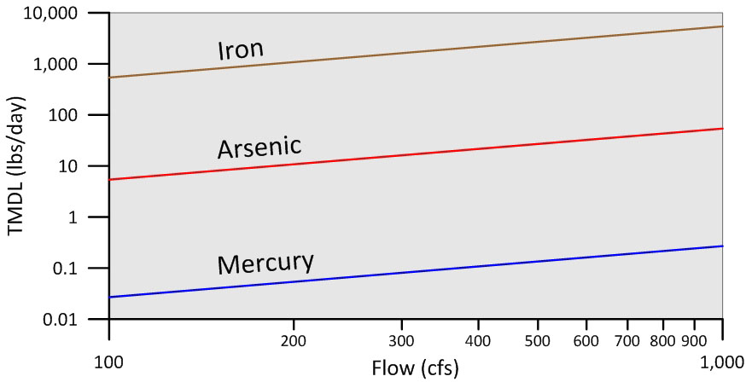
Hardness-Independent Metals
Increasing Load →
Increasing Streamflow →
Notes:
Not shown: aluminum, selenium, antimony

Slide 19
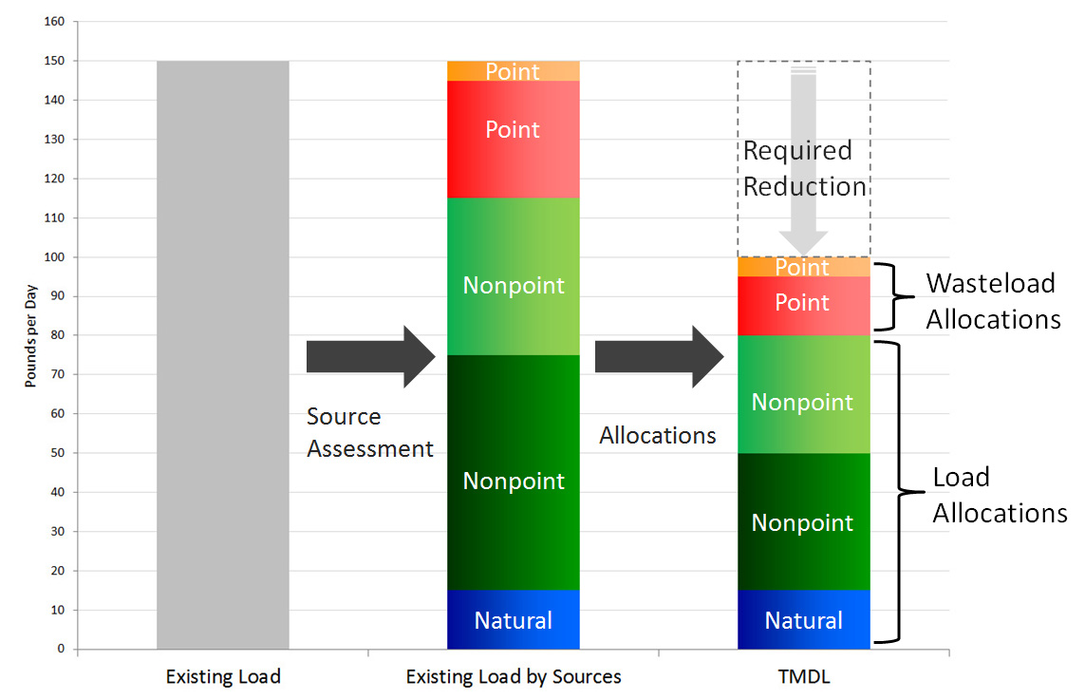
TMDL Model

Slide 20
Allocations
TMDL is the pie; allocations are the pieces of the pie
TMDL = Σ WLAs + Σ LAs
Notes:
AND a margin of safety.

Slide 21
Two Kinds of Allocations:
Load allocations: nonpoint sources –tributaries, background & other diffuse sources
Wasteload allocations: point sources: permitted discharges, Superfund
TMDL = Sum of all allocations

Slide 22
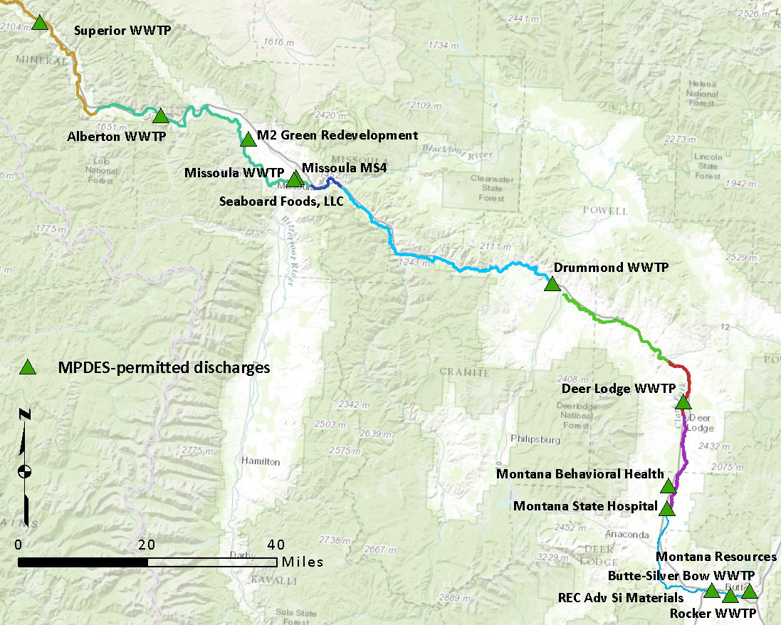
Point Sources

Slide 23
WWTP WLA Approaches
End-of-Pipe
Staged
Continue Existing Operation

Slide 24
‘End-of-Pipe’ WLAs:
Target concentration at discharge
No assimilative capacity due to upstream impairment
Discharging at target concentration does not cause or contribute to impaired conditions
Allows addition of new discharges to a balanced TMDL equation

Slide 25
Staged WLAs:
Usually based on end-of-pipe WLA
Infrastructure improvements
Provide schedule
Case-by-case for each permit

Slide 26
‘Continue Existing’ WLAs:
Discharge concentration may exceed target
Volume of discharge is low
Load contribution of <0.1%
Instream effect not measurable
Notes:
In this document, these situations are associated with anticipated assimilative capacity.

Slide 27
Superfund Mainstem OU WLAs:
Flow-based allowable increase in load over length of the segment
Minus any WLAs or LAs added over the segment
Copper: Target x (Δ flow) – (WLA _{Deer Lodge})

Slide 28
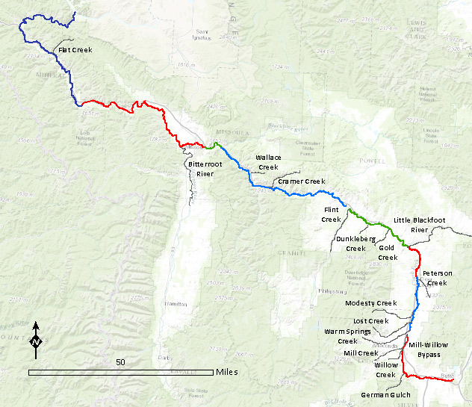
Metals-Impaired Tributaries
Arsenic
Lead
Arsenic
Lead
Mercury
Arsenic
Notes:
German Gulch Arsenic
Mill-Willow Bypass Arsenic, cadmium, copper, lead, zinc
Warm Springs Creek Arsenic, cadmium, copper, iron, lead, zinc
Lost Creek Arsenic, copper, lead
Modesty Creek Arsenic, cadmium, copper, lead
Peterson Creek Iron
Little Blackfoot River Arsenic, lead
Gold Creek Lead, iron
Dunkleberg Creek Arsenic, cadmium, copper, iron, lead, zinc
Flint Creek Arsenic, copper, iron, lead
Cramer Creek Lead
Wallace Creek Copper
Bitterroot River Copper, lead
Flat Creek Arsenic, cadmium, lead, zinc

Slide 29
Clark Fork River
For each segment above the Blackfoot River:
TMDL = WLA _{NPL} + ΣWLA _{WWTPs} + ΣLA _{Tribs}+ LA _{Upstream}

Slide 30
Clark Fork River
For each segment below the Blackfoot River:
TMDL = ΣWLA _{WWTPs} + LA _{Trib} + LA _{Upstream} + LA _{Background}
Notes:
This LA tributary term is for the 1 metals-impaired tributary to each of these AUs. Unimpaired tributary contributions are included in the LA background.

Slide 31
Predicting Assimilative Capacity:
Calculate metals load above TMDL
Compare downstream
e.g. lead: 161 lbs/day above Blackfoot, 80 lbs/day below

Slide 32
Assimilative Capacity
Excess Load
TMDL
Load
Load
Load
Downstream

Slide 33
Assimilative Capacity
Load Reduction
TMDL
Load
Assimilative Capacity
Load
Load
Downstream

Slide 34
Assimilative Capacity Projections

Slide 35
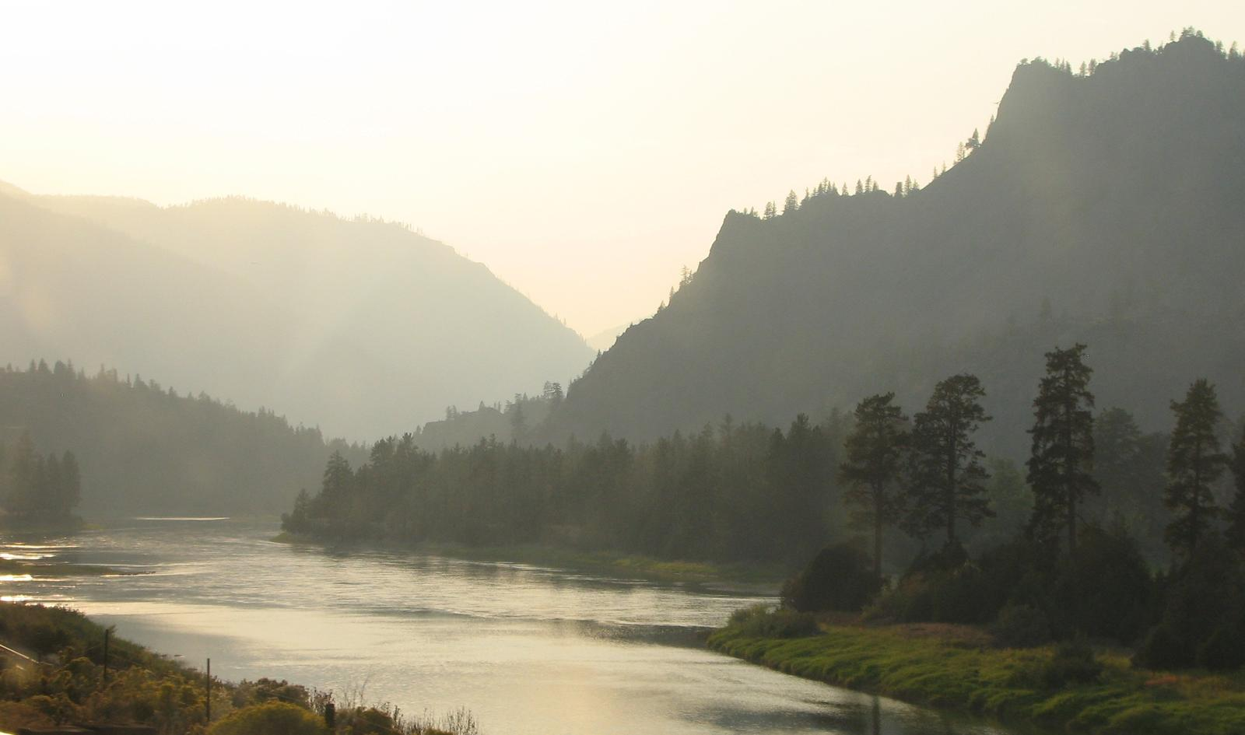
QUESTIONS?

Slide 36
Clark Fork River Metals TMDL Development
Eric Sivers
Senior TMDL Planner
esivers@mt.gov

