Slide 1
Identification of Non-point Sources of Nutrient Loading and Proposed Best Management Practices for Browns Gulch, Silver Bow County, MT
4/24/15
Sarah Hamblock
Raja Nagisetty, Bill Drury, Kumar Ganesan
Environmental Engineering
Master of Science Candidate

Slide 2
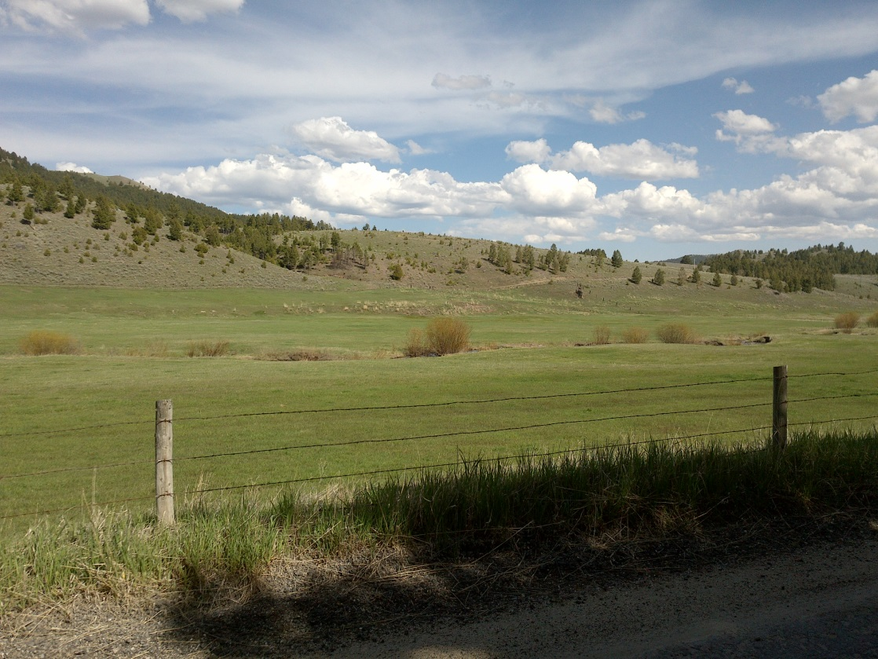
Outline
Background
Objectives and importance
Methodology
Data and Analysis
Conclusions
Future directions

Slide 3
Upper Clark Fork Watershed

Slide 4
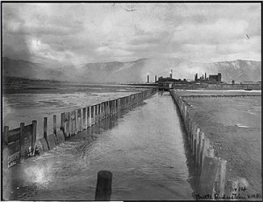
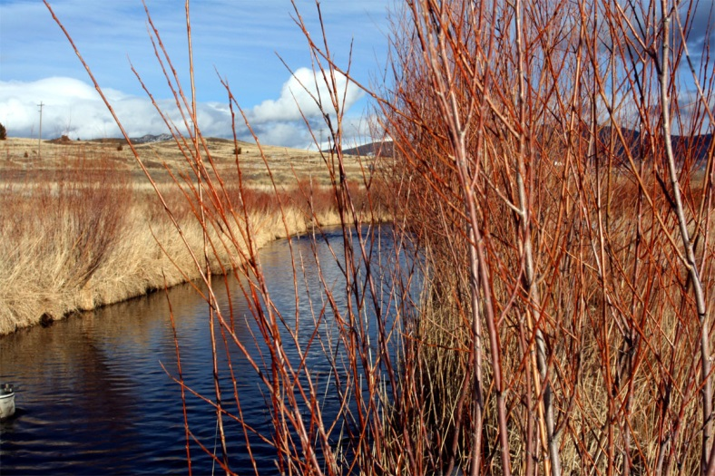
Silver Bow Creek
Use-class I
Montana 303(d) listings:
Arsenic
Cadmium
Copper
Lead
Mercury
Nitrates
Total nitrogen Total phosphorus
Sedimentation/siltation Zinc
Photo credit: Cfwep.org
Photo credit: Butte CTEC
Notes:
Use-class I: Montana also has an I class, which was created for waterbodies of such poor quality that no beneficial uses exist nor are anticipated in the near future. These waters are slated to eventually meet all uses but are not assigned any designated uses.

Slide 5
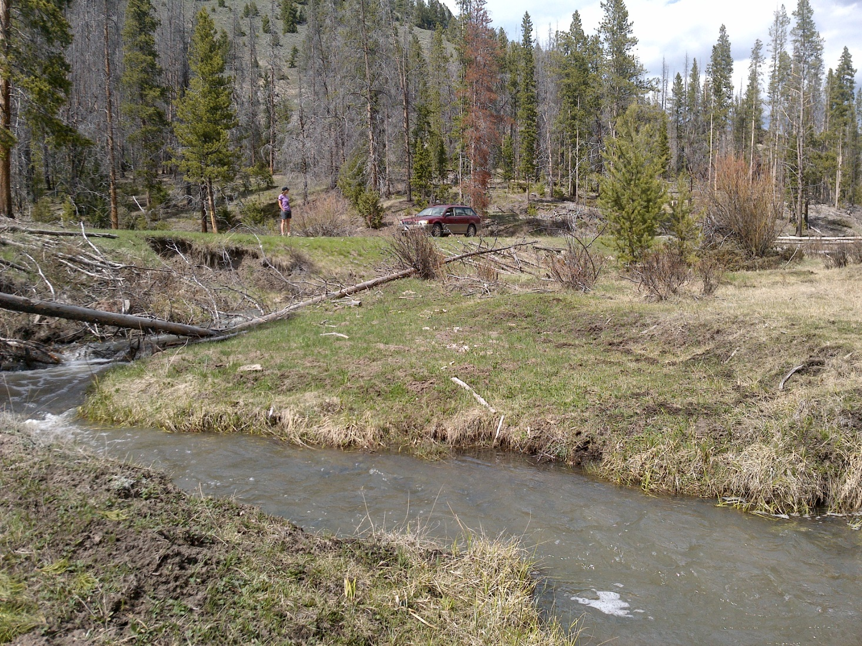

Browns Gulch
Contributes 26% SBC stream flow (MTDEQ, 2003)

Slide 6
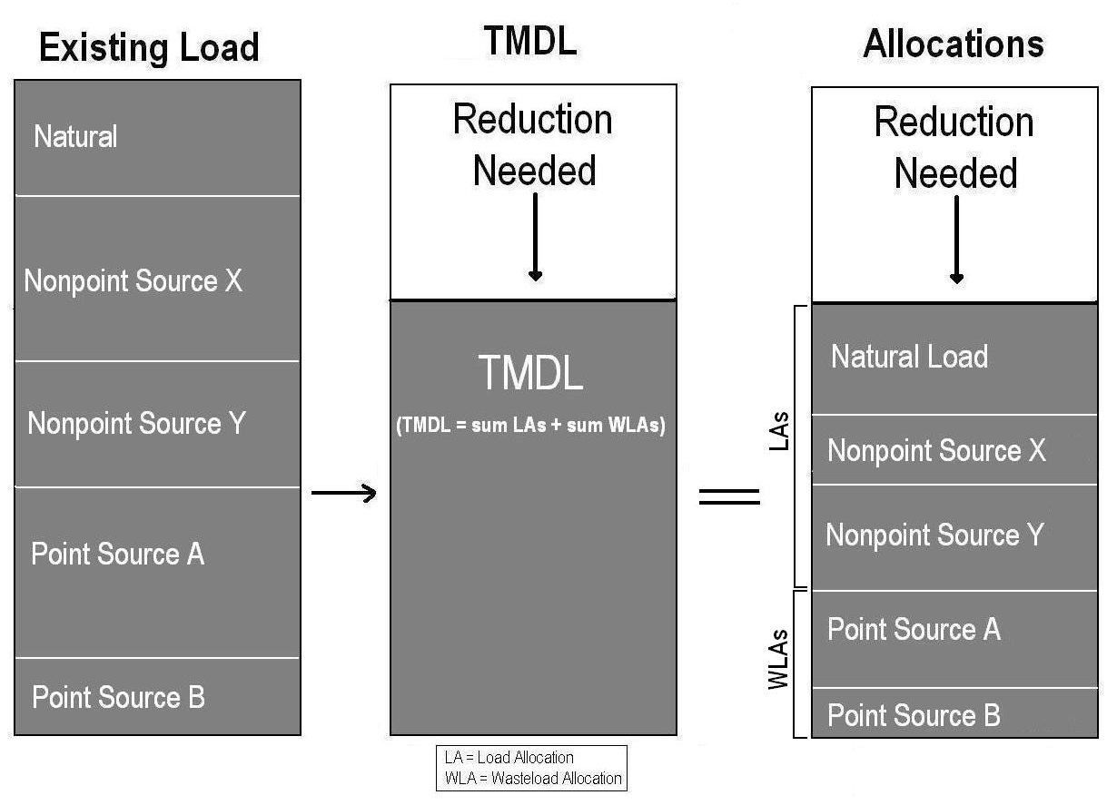
TMDL- total maximum daily load
Load (lbs/day)= concentration*flow
Figure credit: MTDEQ,2014
Browns Gulch: 93% REDUCTION of existing nutrient load to achieve target load
Notes:
TMDL are established ny the MT DEQ as a management strategy to reduce pollutant levels in streams. So, why am I interested in Browns Gulch? Well Browns Gulch is a main tributary to Silver Bow Creek, which is considered and “impaired” for nutrients. Browns Gulch is considered a nonpoint source that contributes to this impairment, and therefore requires a load reduction. Montana DEQ determined that a 93% reduction of existing nutrient load was necessary to achieve the target load.
Load allocation=[(AVG flow)(target)-(AVG flow)(background)]*5.39
Total nitrogen allocation =[(6.35 cfs)(0.3 mg/L) – (6.35cfs)(0.095 mg/L)]*5.39
=7.03 lb/day
Total phosphorous allocation =[(6.35 cfs)(0.03 mg/L) – (6.35cfs)(0.01 mg/L)]*5.39
=0.69 lb/day

Slide 7
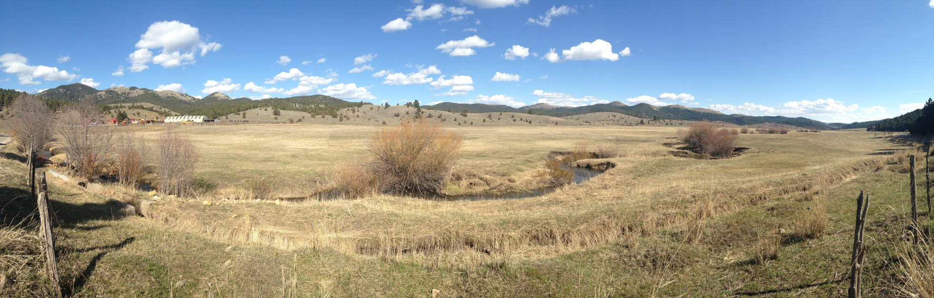
Project Objectives
Quantify loading of nutrients, total nitrogen and total phosphorous, at various flow stages
Determine the general locations of nutrient sources
Recommend “Best Management Practices” for specific locations
Notes:
My project has three main objectives. A note on my second objective, I say general because, as I explained earlier, specific non-point sources are hard to identify. By general locations, I mean areas with similar land use, or large landowners or agricultural producers. I have not yet addressed the third projective objective, so will focus my presentation on the first two. A Best management Practice is an approach to reducing nonpoint source pollution either though land-use changes, installing structures that reduce the amount of pollutants that ebter the stream or treat the water before it enters the stream.that reduce the amount of pollution that reaches the stream.

Slide 8
Importance of study
Total Nitrogen (TN) and Total Phosphorous (TP)
Essential to support stream ecosystems
In excess may lead to growth of algal blooms, excessive aquatic weeds, and alteration of natural aquatic ecosystems
Best Management Practices (BMPs)
Reduce non-point source discharges into streams, often the only pollution control mechanism
Relatively inexpensive alternative to traditional water treatment
Notes:
Thus far, I have referred to nutrients many times. Nutrients are defined as nitrogen and phosphorous. Why is it important to address nutrient concentrations in streams?
Decreased dissolved oxygen levels do not correspond high survival rates of aquatic animals including fish and macroinvertebrates, which need dissolved oxygen to survive.

Slide 9
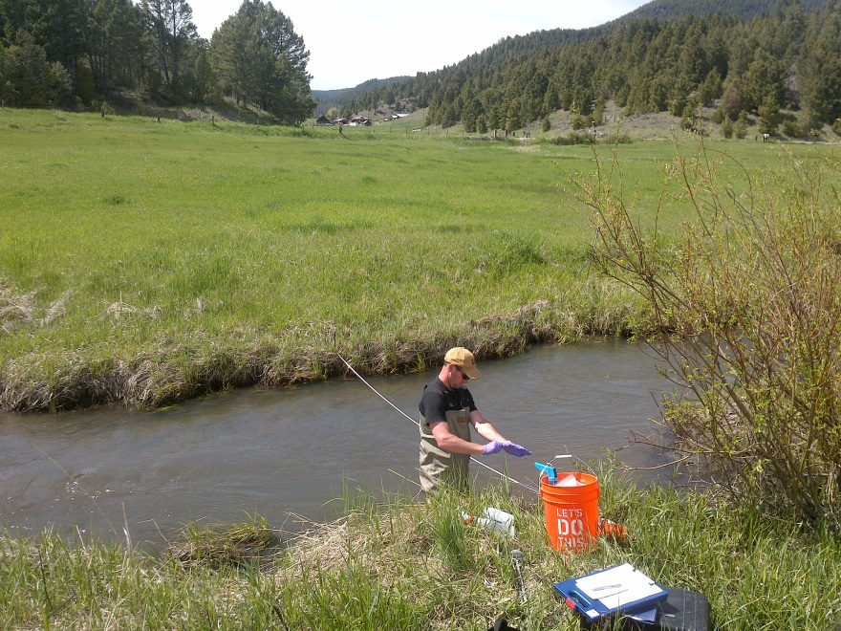
Methodology
1. Quantify N and P loading at multiple flow stages
  Collect surface water samples and analyze for N and P species
  Measure flow rate at sample site
    Load = concentration x flow
  Conduct sampling in spring,
  summer, fall
Notes:
How am I going to accompllish my objectives? To address the first project objective, …. In this photo, Seth Reedy is standing in the stream collecting water samples. As you can see, Browns Gulch is a mixed environment of agriculture and forest.

Slide 10
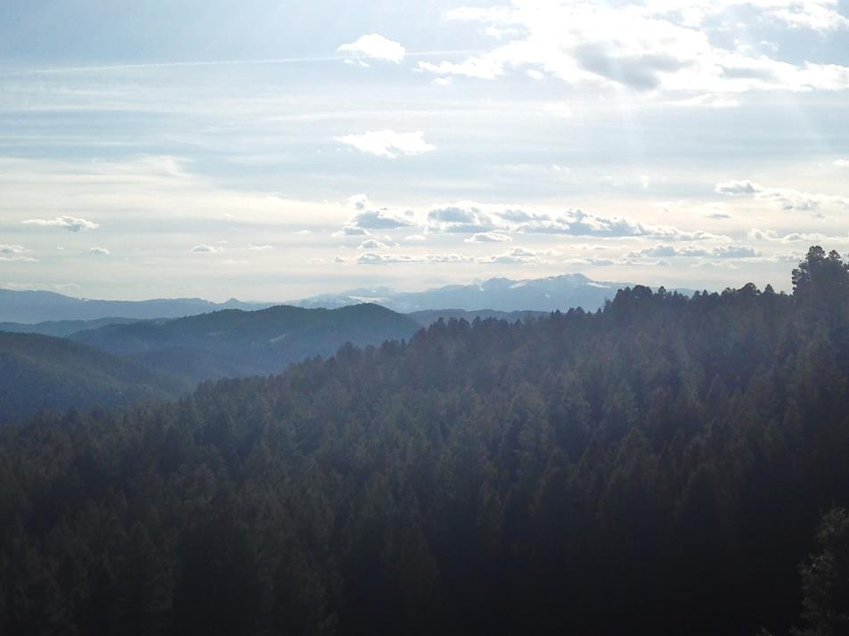
Methodology
2. Determine the locations of nutrient sources
                Determine sampling locations based on land-use, tributary inlets, and land ownership
                Sample for temperature, conductivity, pH, alkalinity, total suspended solids, major anions
                Researched geological and soil data within watershed
                Conduct spatial analysis of land use with ArcGIS
Notes:
Since I am looking at a system with many non-point sources, I have to approach this objective using many different techniques. The first two bullet points are related to sampling, and the last three are related to information from previous studies. The first step to address this was to determine sampling locations. I called landowners to gain permission to sample on property. Once I determine where I could and could not sample on the stream, I chose specific sampling locations. Once at the sample site, I wanted to get as much other information about water quality as possible, so I sampled for:….. The last three points I have started to look into, but will invest much more time in the future.

Slide 11
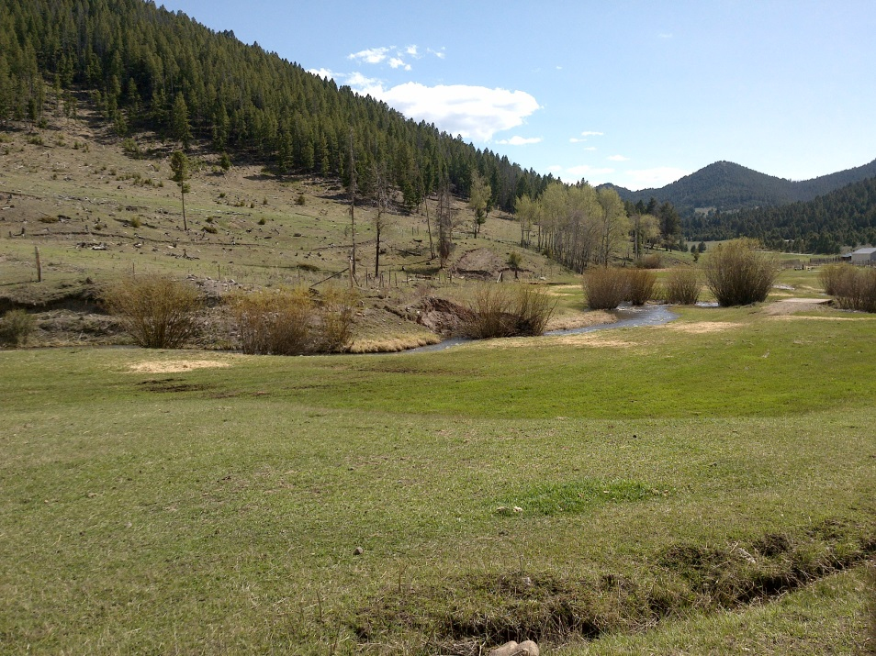
Methodology
3. Recommendation “Best Management Practices” for specific locations
  Conduct a thorough literature
  review of rural and agricultural
  BMPs for nutrient reduction
  Analyze land-cover, slope,
  valley width, and property
  boundaries to determine
  reasonable BMPs for non-point
  sources in Browns Gulch
Notes:
Briefly, to address my last objective, I will need to complete my first two objectives.

Slide 12
Sampling
Stream length: 18.8 miles
12 sampling locations used in May
8 sampling locations used in July and October

Slide 13
Laboratory Analysis
Sampling and Lab Analysis
Data collected
  [TP] , [PO₄⁻³]
  [TN], [TKN], [NO₃⁻ ]/[NO₂⁻],[NH₃]
  Alkalinity
  Total suspended solids
  Specific conductivity
  Flow rate
  [Cl⁻], [Br⁻], [F⁻], [SO₄⁻²]
  Turbidity
  Temperature
  Dissolved oxygen
  BOD (every 4th site)
  Water column chlorophyll (every 4th site)
  Latitude and longitude
  Site photo
All samples, except the BOD and chlorophyll samples, were analyzed in an Environmental Engineering Lab at Montana Tech by Seth Reedy and myself.
The Butte Silver Bow Waste Water Treatment Plant analyzed BOD samples.
The MSE laboratory analyzed chlorophyll samples.
Notes:
Measured concentrations of P, N, major anions, and these standard water quality constituents. For each site I have the Lat/long as well as a site photo for use in future studies.

Slide 14
TN loading
Flow rate decrease
Notes:
This first data addresses my first project objective to determine TN and TP loading at various flow stages. This graphs shows how TN loading changes from upstream to downstream at high and low flow. The red dotted line represents the TMDL load allocation for TN in Browns Gulch. The TMDL establishes an allowable load at the confluence of Browns Gulch and Silver Bow Creek, so we will look at the actual loading occurring at that location. A high flow… at low flow…the load allocation…and the load before agricultural dewatering at the diversion dam. Although the intention of the diversion dam was not to reduce nutrient loads, it is acting as BMP for this purpose.
Browns Gulch TMDL allocation: 7.0 lbs/day
Load at river mile 18.6 in May: 147.7 lbs/day
Load at river mile 18.6 in July: 8.2 lbs/day **
Load at river mile 18.6 in October: 10.3 lbs/day
**before agricultural dewatering, load is : 23.5 lbs/day

Slide 15
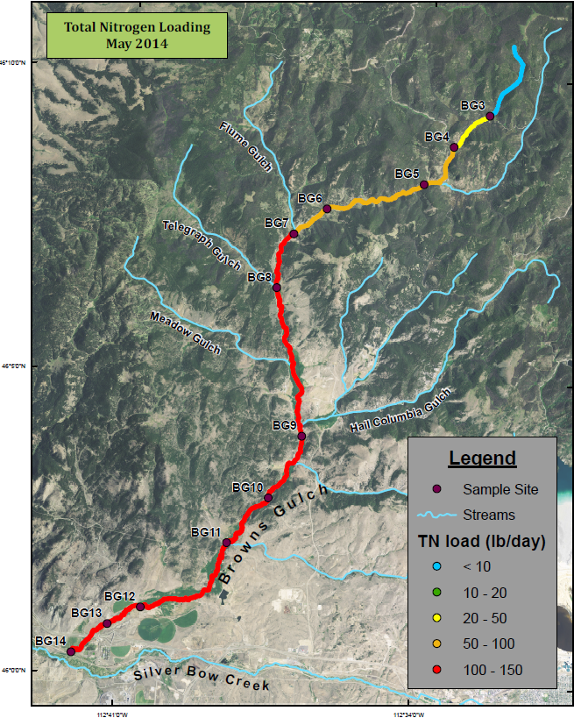
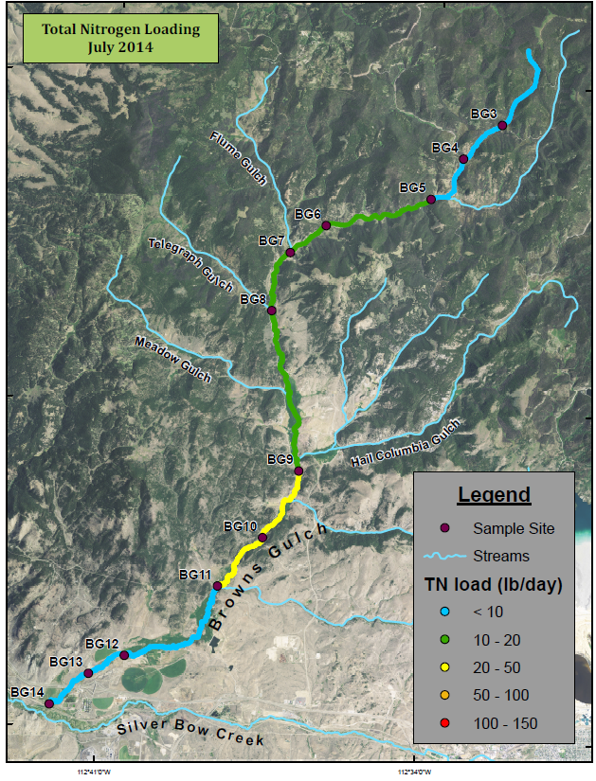
TMDL allocation = 7.0 lbs/day

Slide 16
TN concentration and flow

Slide 17
TP Loading
Notes:
This graph is organized the same way but shows TP data. At high flow, the load at the confluence of BG and SBC is …at low flow…the allocated load is…and the load before agricultural dewatering is…. Now remember that the TMDL called for a 96% reduction in TP. From my data, even at low flow, the load reduction would have to be about 800%.
Browns Gulch TMDL allocation: 0.69 lbs/day
Load at river mile 18.6 in May: 76.6 lbs/day
Load at river mile 18.6 in July: 6.4 lbs/day **
Load at river mile 18.6 in October: 6.7 lbs/day
**before agricultural dewatering, load is: 20.2 lb/day

Slide 18
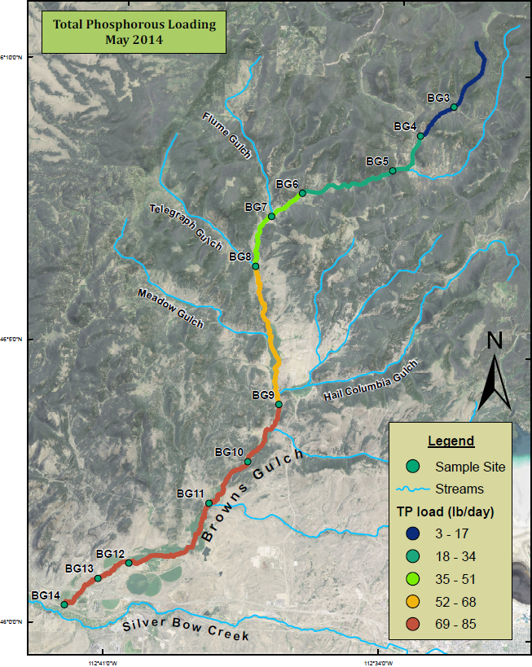
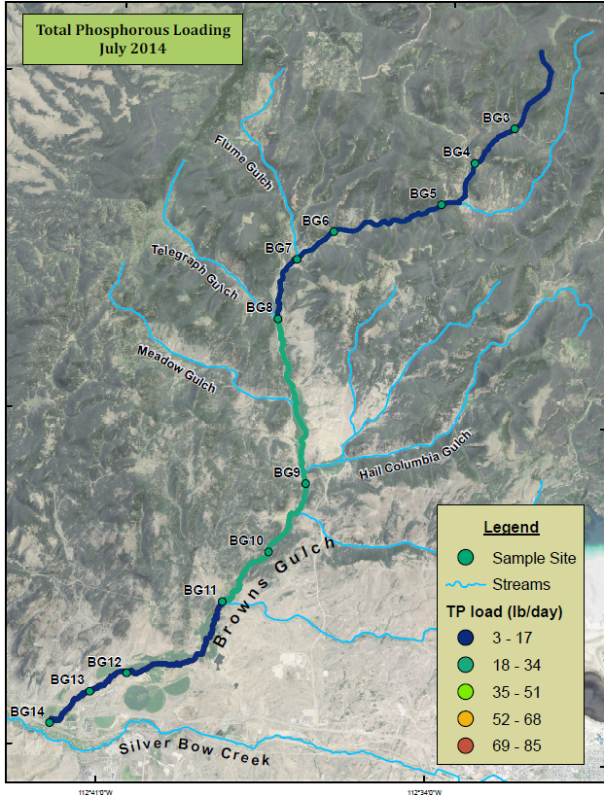
TMDL allocation = 0.7 lbs/day

Slide 19
TP Concentration and flow
Notes:
Regardless of flow rate, the TP concentration does not change significantly. And the TP concentration is significantly greater than the water quality target in the TMDL calculation. Pattern is not followed by Total Nitrogen. I want to point out a very important observation. At the most upstream sampling location, the TP concentration is far above the TMDL water quality target. This is a strong indication that the source of phosphorous is natural rather than anthropogenic. Over the next few slides, I will present data that supports this hypohtesis.

Slide 20
Nitrogen speciation

Slide 21
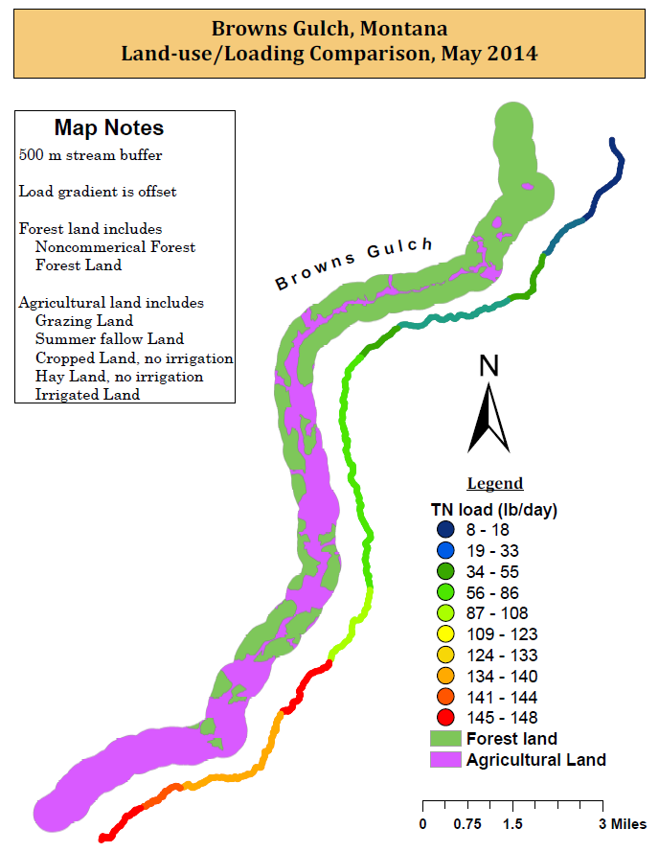
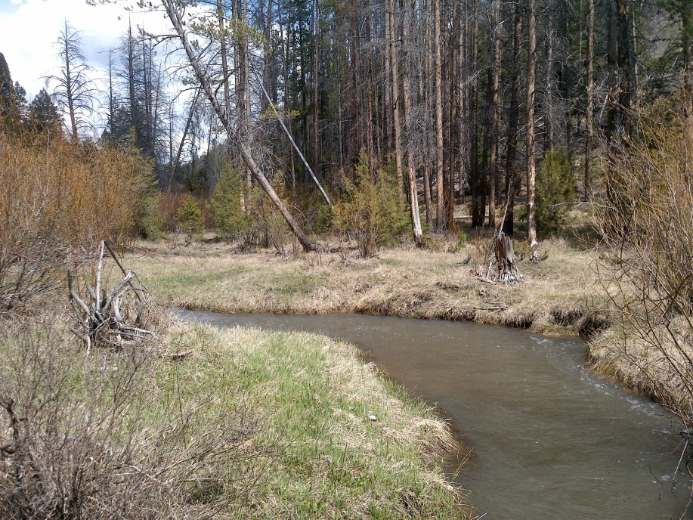
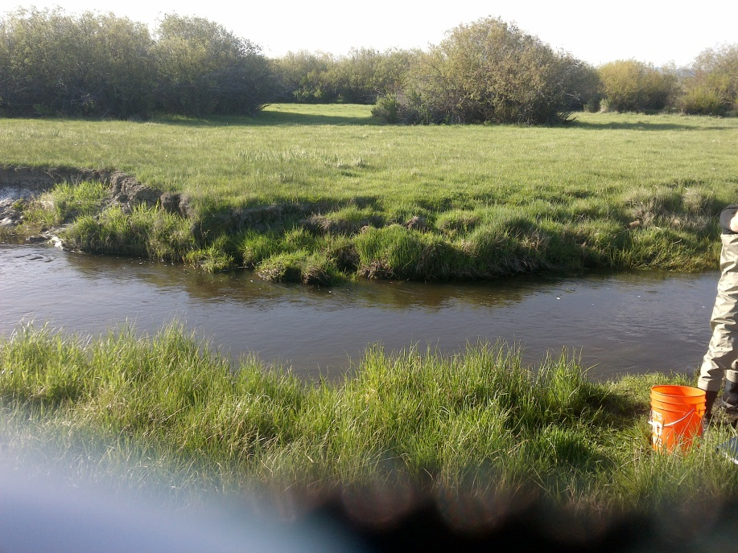

Slide 22
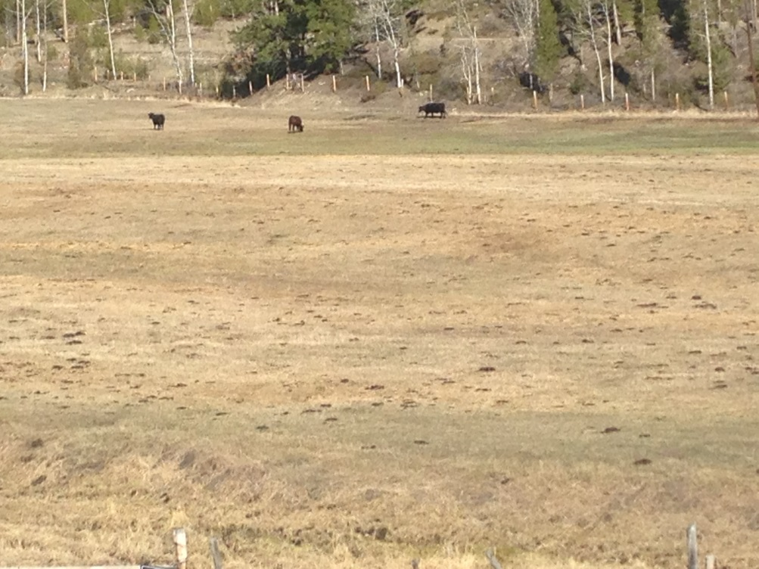

Cattle in riparian areas
ORGANIC NITROGEN
Spring runoff
29 irrigation structures, many are floor irrigation canals (NRCS, 2006)

Slide 23
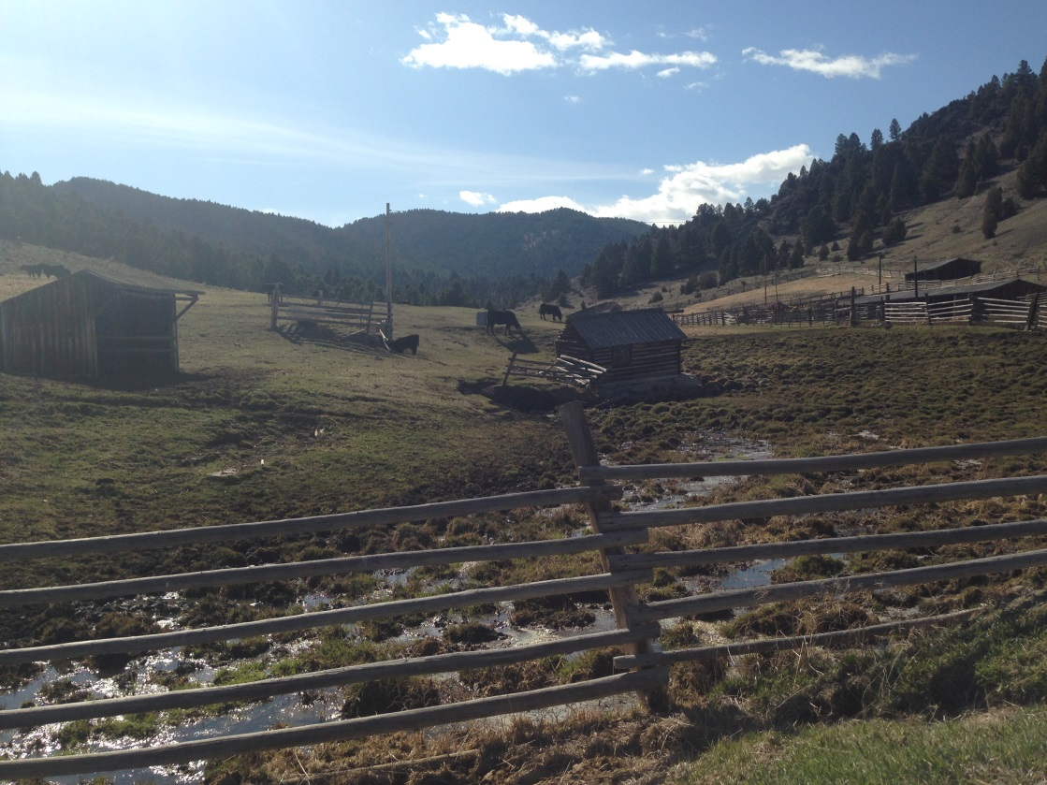
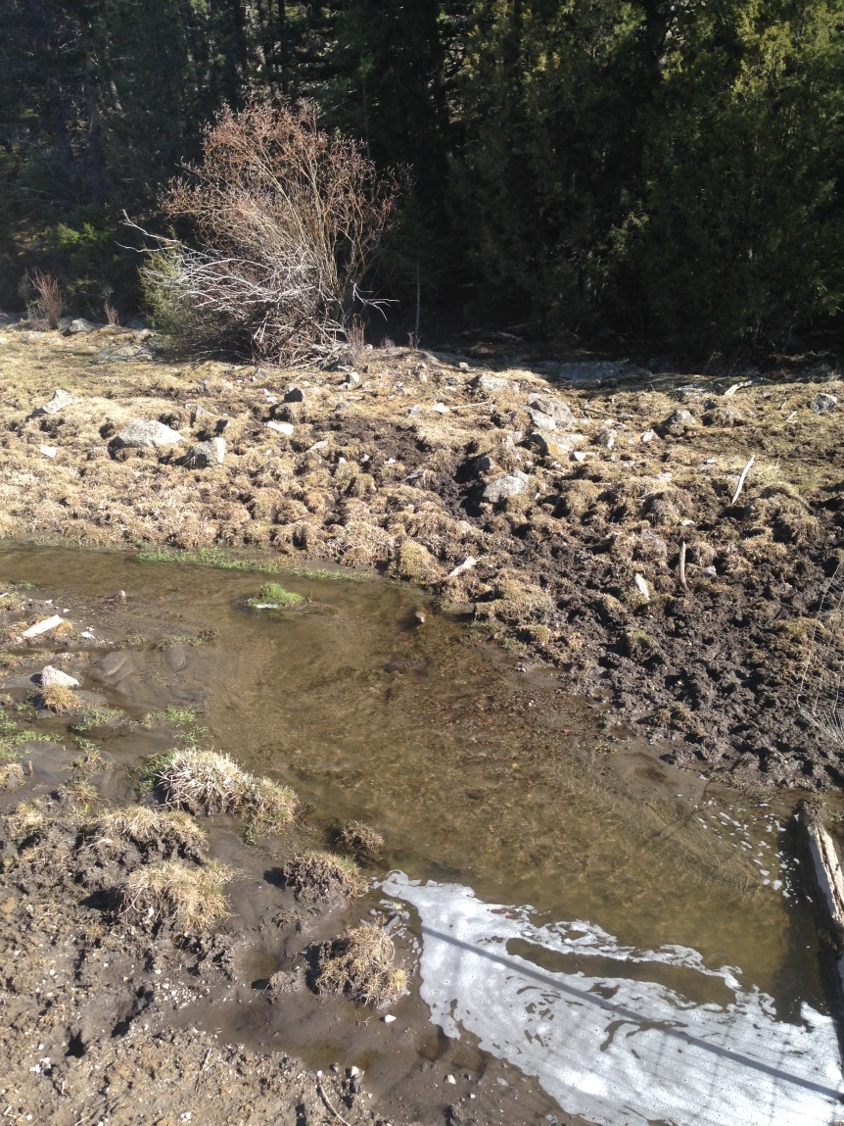
Cattle in riparian areas

Slide 24
Alkalinity, conductivity, and TP
Correlation coefficient and p-value
Sampling Event | TP/Alk | TP/SC
May, n=12 | 0.98, p<0.005 | 0.94, p<0.005
July, n=8 | 0.89, p<0.005 | 0.84, p<0.010
October, n=8 | 0.87, p<0.005 | 0.76, p<0.050
Notes:
Talk about TSS, TP dissimilar relationship
To further investigate the source of the phosphorous, I wanted to see the relationship between TP and alkalinity and specific conductivity. Conductivity is affected primarily by the underlying geology, therefore if the source of phosphorous is also the surrounding geology, I would expect to see a strong relationship. Looking at this set of the data, the correlation is significant at both high and low flow. The difference is reasonable since the subsurface flow or groundwater inputs slow over the summer.

Slide 25
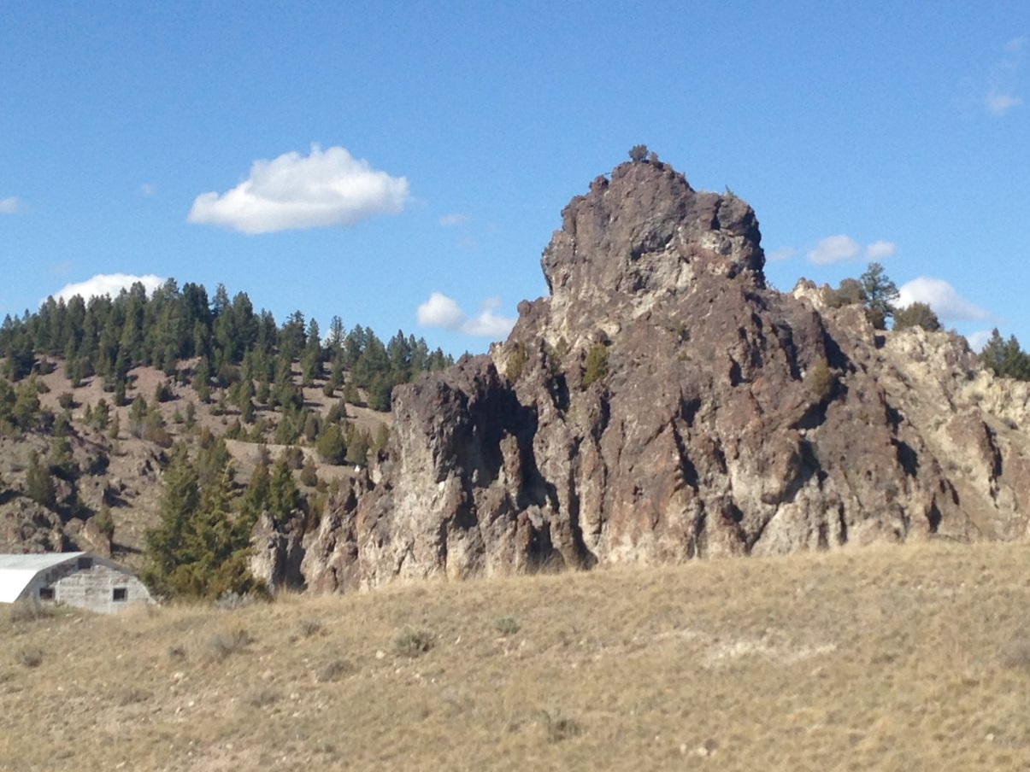
Surficial geology
MT DEQ
Site specific numeric nutrient criteria for Browns Gulch:
0.04 mg/L
(MT DEQ, 2013)
**This was not used in the development of the TMDL load allocation

Slide 26
Surficial geology
Lowland Creek Volcanics
old, weathered, and unconsolidated
MT DEQ:
P content in rock is the strongest predictor of phosphorus stream concentrations
“Tat” unit
rhyolitic air-fall and welded ash-flow tuffs
1140 ppm phosphorus
Notes:
In Hawaiian soils derived from volcanics, phosphorus concentrations average 700 ppm.
A study using a stream-quality model determined that phosphorus content in rock is the strongest predictor of phosphorus stream concentrations, much more so than rock age and weathering rate

Slide 27
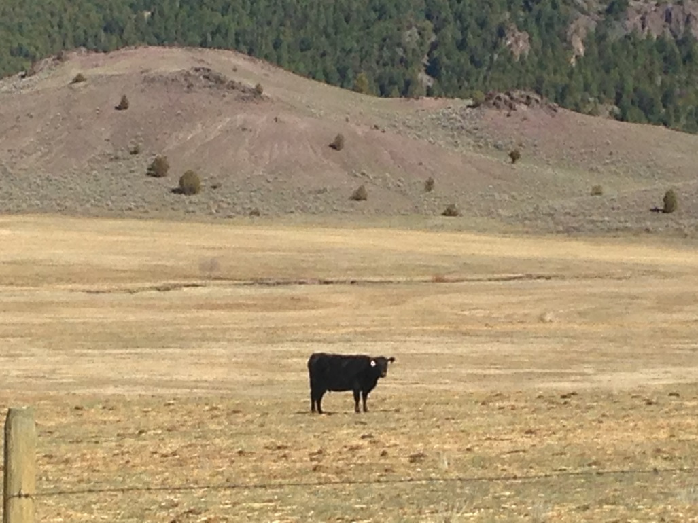
Conclusions about sources
TN loads: primarily from agricultural land uses
TP loads: partially from agricultural land uses, partially from groundwater/surficial geology

Slide 28
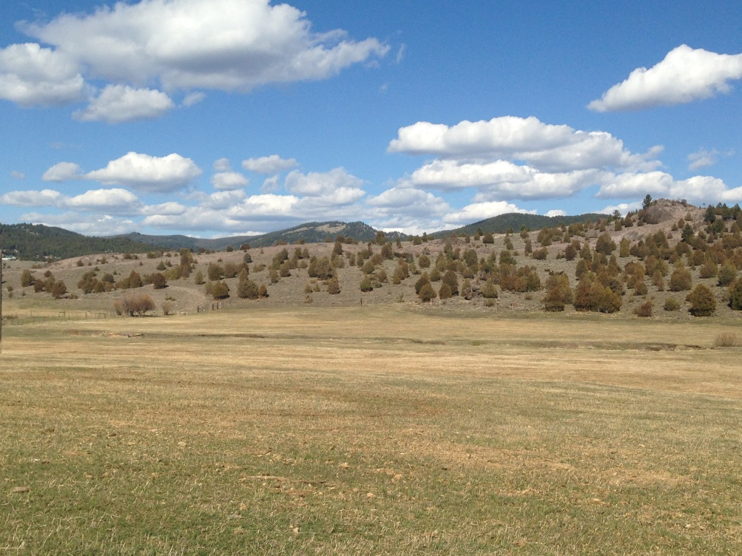
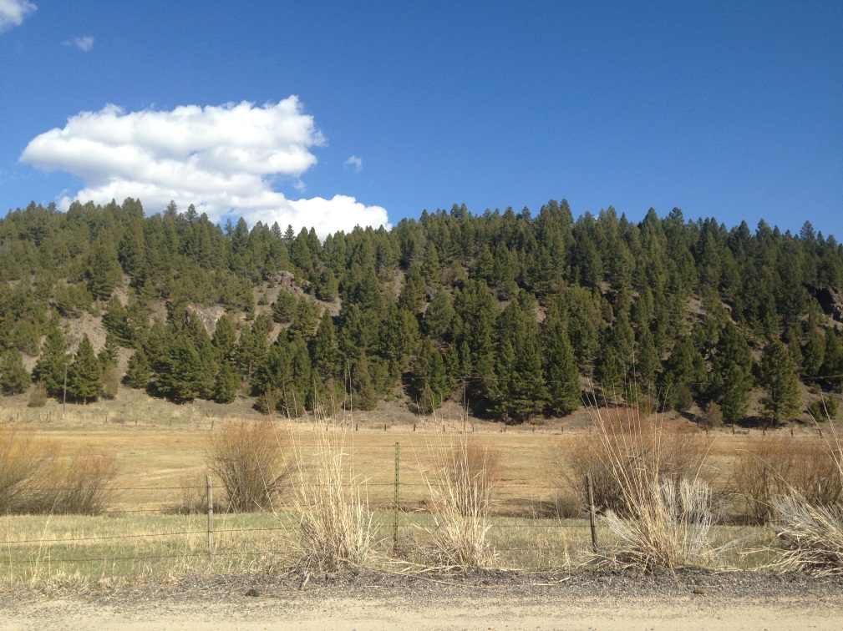
Best management Practices
BMP | Nitrogen reduction (%) | Phosphorus reduction (%)
Vegetated filter strip¹ | >50 | >50
Off-stream water source² | 54 | 81
Exclusion fencing³ | 21-52 | 32-34
Exclusion fencing + woody vegetation⁴ | 55.2* | 78.5
1: EPA, 2005, 2: Sheffield, 1997, 3: Miller, 2010, 4: Line, 2000, *: TKN-N reduction.
Notes:
25-50 m riparian buffer can remove 50% of nitrogen load, grasses compared to forested or wetland vegetation, are the most effective plant for removing http://www.epa.gov/nrmrl/gwerd/eco/pdfs/riparian_buffer.pdf

Slide 29
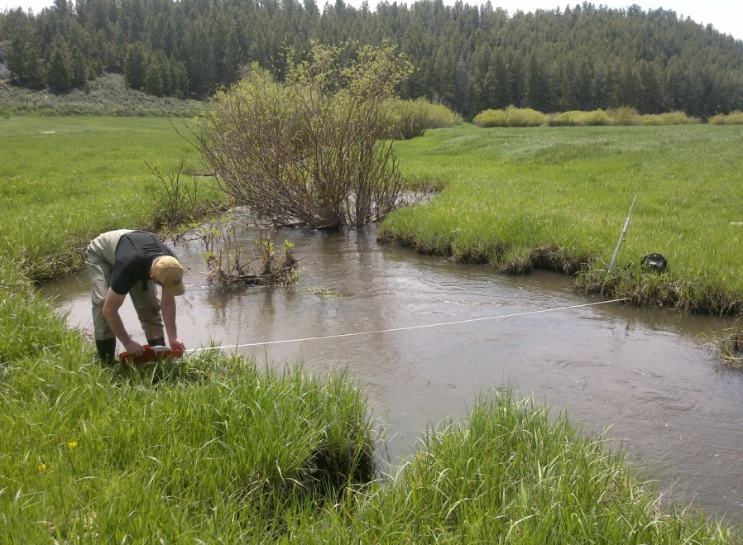

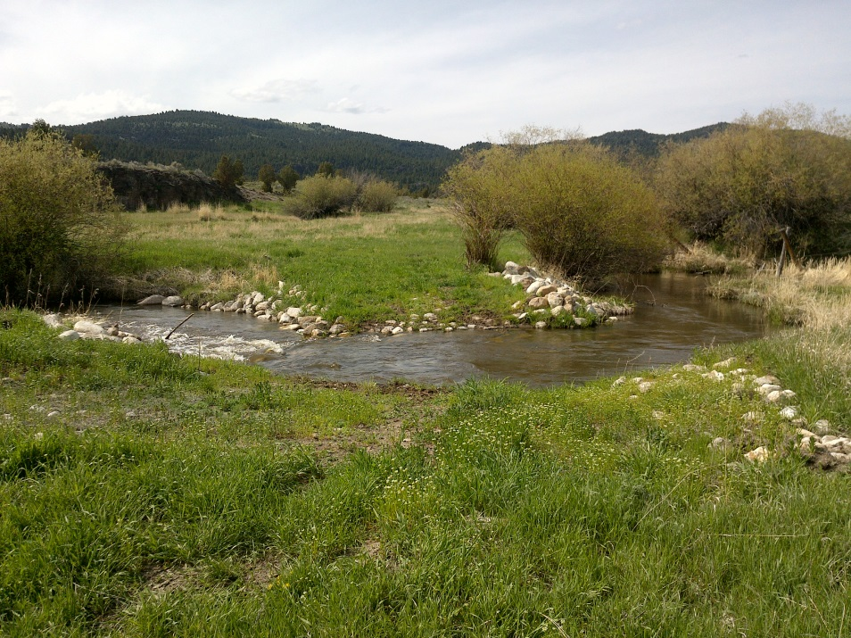
Best management Practices

Slide 30
Best management Practices
Specifics for Browns Gulch:
Implementation of filter strips, exclusion fencing, or off-stream water:
  Reduce the May TN load to SBC: 74 lbs/day
    < TMDL load allocation of 7 lbs/day
  Reduce the July TN load to SBC: 4 lbs/day
    < TMDL load allocation of 7 lbs/day
  Not possible to estimate a quantitative TP reduction
Notes:
This estimate assumes that 100% of the nitrogen load is originating from agricultural sources and that a 50% reduction is achieved. The summer growing season is the target period for TMDL load limitations.
Quantitatively estimating load reductions is not possible because the fraction of phosphorus originating from agricultural sources in unknown.

Slide 31
What next?
Field: flow rates, samples from tributaries
groundwater sampling, GWIC
Lab: flow-injection analyzer
SRP:TP ratios
Data processing: ArcNLET- septic load estimations
BMPs: STEPL- load reduction esimates
Notes:
1-mass balance of nutrients
2- conduct sampling, or more data may become available
3- for lower detection limits
4- nitrate loading estimation tool, developed at Florada State university

Slide 32
References
Montana Dept. of Environmental Quality. (2014). Final - Upper Clark Fork Phase 2 Sediment and Nutrients TMDLs and Framework Water Quality Restoration Plan. Helena, MT: Montana Dept. of Environmental Quality.
Elliott, C.G., and C. McDonald, (2009). Geologic map and geohazard assessment of Silver Bow County, Montana: Montana Bureau of Mines and Geology Open-File Report 585, 88 p., 3 sheets, scale 1:50,000.
Suplee, M. and C. Schmidt. (2013). Derivation of Site-specific Numeric Nutrient Criteria for Selected Streams in the Upper Clark Fork Basin - Addendum A to “Scientific and Technical Basis of the Numeric Nutrient Criteria for Montana’s Wadeable Streams and Rivers: Update 1”. Helena, MT: Montana Dept. of Environmental Quality.
Agouridis, C.T., S.R. Workman, R.C. Warner, G.D. Jennings. (2005). Livestock Grazing Management Impacts on Stream Water Quality: A Review. Journal of the American Water Resources Association. Vol. 41, Iss. 3, pp. 591-606.
Pick, T. and W. Kellogg. (2006). Brown’s Gulch Riparian Assessment Narrative Report. Natural Resource and Conservation Service (NRCS): Submitted to the Watershed Restoration Coalition of the Upper Clark Fork, the Mile High Conservation District, and Kirk Environmental, LLC.

Slide 33
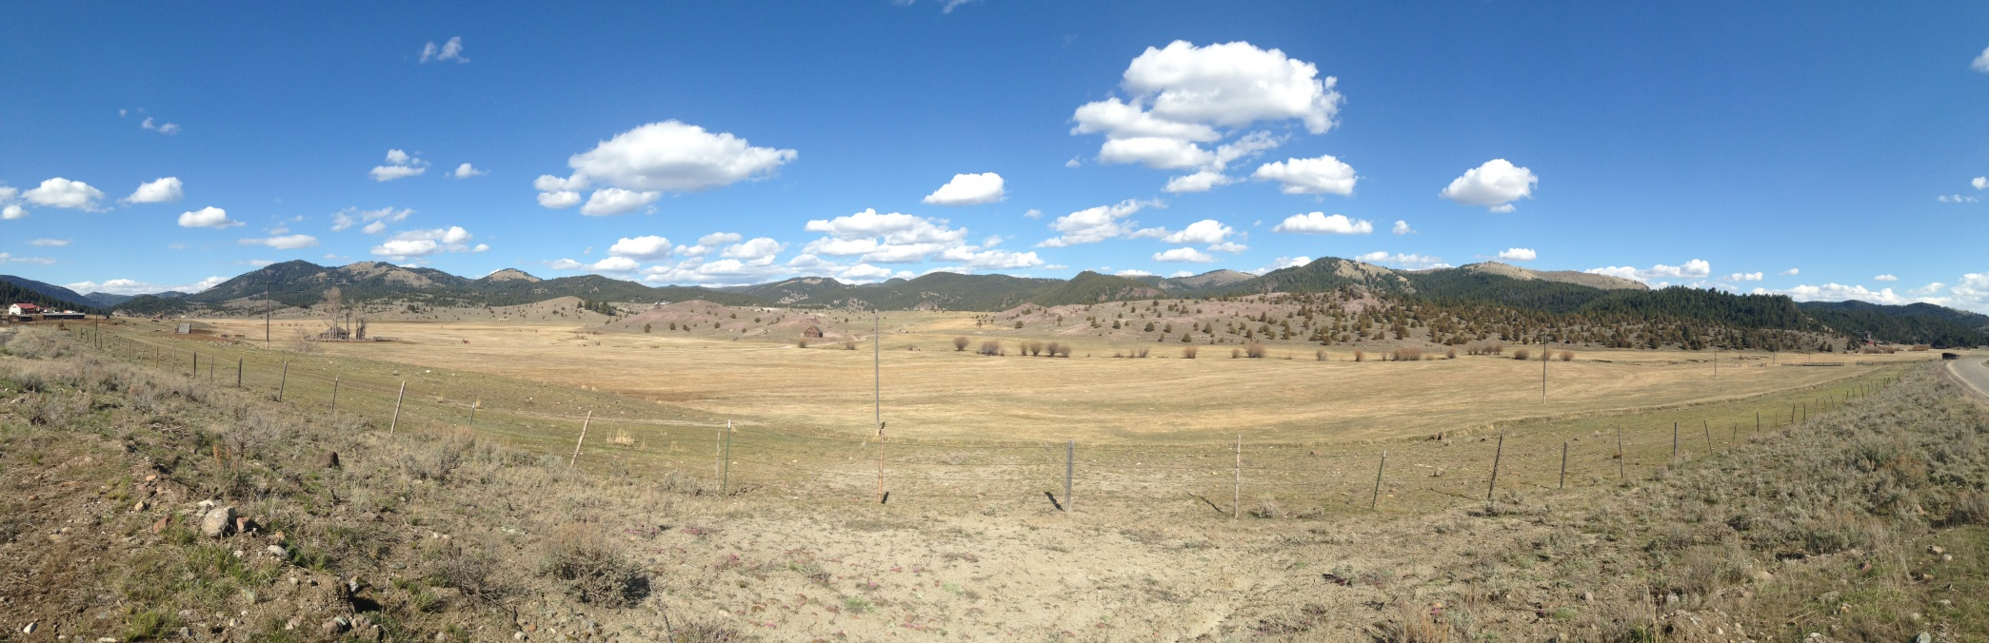
Questions?
Thank You!
Notes:
Prismatic soap bubbles: for some volume in some space, what is the smallest
surface area? In air, a sphere.
For soap bubbles confined between parallel glass plates a few cm apart,
the answer is a prism. The sides of the prisms are flims only a few thousand
molecules think: the surfaces of the films are soap, their insides are water.
Their shape is the one with the smallest surface areal
Visible light passes through most of the films with out interaction. Occasionally
when the thickness of the film and the wavelength of the light are similar, and
when the light strikes at the correct angle, a single color reflects.
The colors define the depths of these microscopic seas, the swirls hint at the currents.
Color of some butterfly wingswhich could be blue, brown or gray, depending
on the viewing angle compared with the illumination angle.

