Slide 1
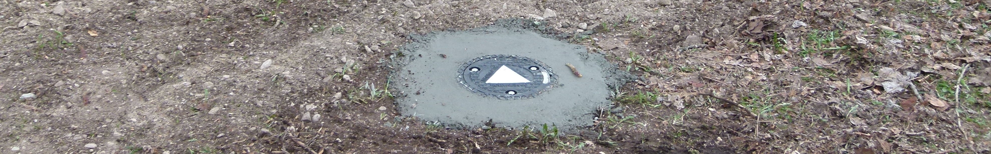
Montana Groundwater Academy
Clark Fork Symposium, University of Montana, Missoula, MT, April 24, 2015
Beth Covitt, spectrUM Discovery Area, University of Montana
Deb Fassnacht, Watershed Education Network
Jessie Herbert, spectrUM Discovery Area, University of Montana
Becca Paquette, Watershed Education Network

Slide 2
Overview
What is Montana Groundwater Academy (MGA)?
Partners
Need
History
Program
Site
Initial Data
Future

Slide 3
What is MGA?
Through engaging in a place-based STEM education program, students will develop increased capacity to make scientifically informed decisions about pressing water issues in western MT.
Ed program led by spectrUM Discovery Area, UM
With many partners
Groundwater education through…
  First-hand investigations
  Learning with regional scale data
Includes field site in Greenough Park
Currently funded by EPA EE grant for high school
Opportunities for further growth & development

Slide 4
MGA Partners
UM
spectrUM Discovery Area
Geosciences
Supporting Partners
Missoula Parks & Recreation
Missoula Valley Water Quality District
Mountain Water Company
Newfields Companies, LLC
Education Partners
Watershed Education Network
Bitter Root RC&D
Clark Fork Coalition
Salish Kootenai College
School Districts
Florence Carlton
Frenchtown
Lincoln
Missoula County (MCPS)
Ronan

Slide 5
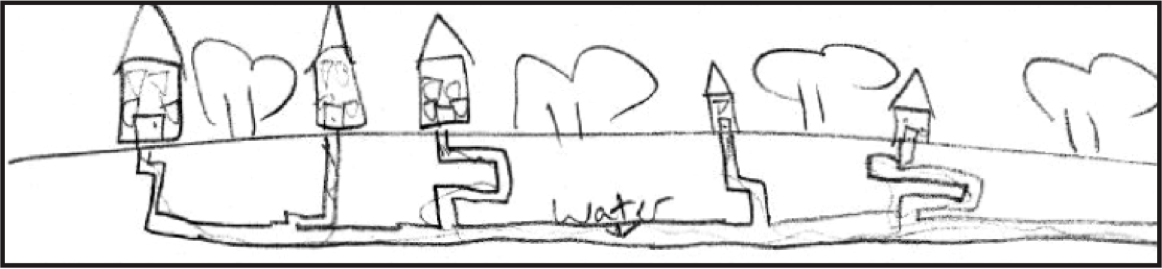
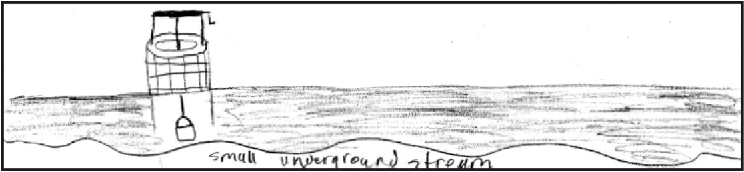
Need
Water science literacy needed for citizenship
Understanding is poor
Current ed opportunities are limited

Slide 6
Need
Common ideas…
Groundwater is a dead-end
GW pollution caused by stuff falling in wells
Contaminants seep through ground w/out need for water transport
Little to no awareness of…
  Driving forces: gravity, pressure
  Constraining factors: permeability, solubility

Slide 7
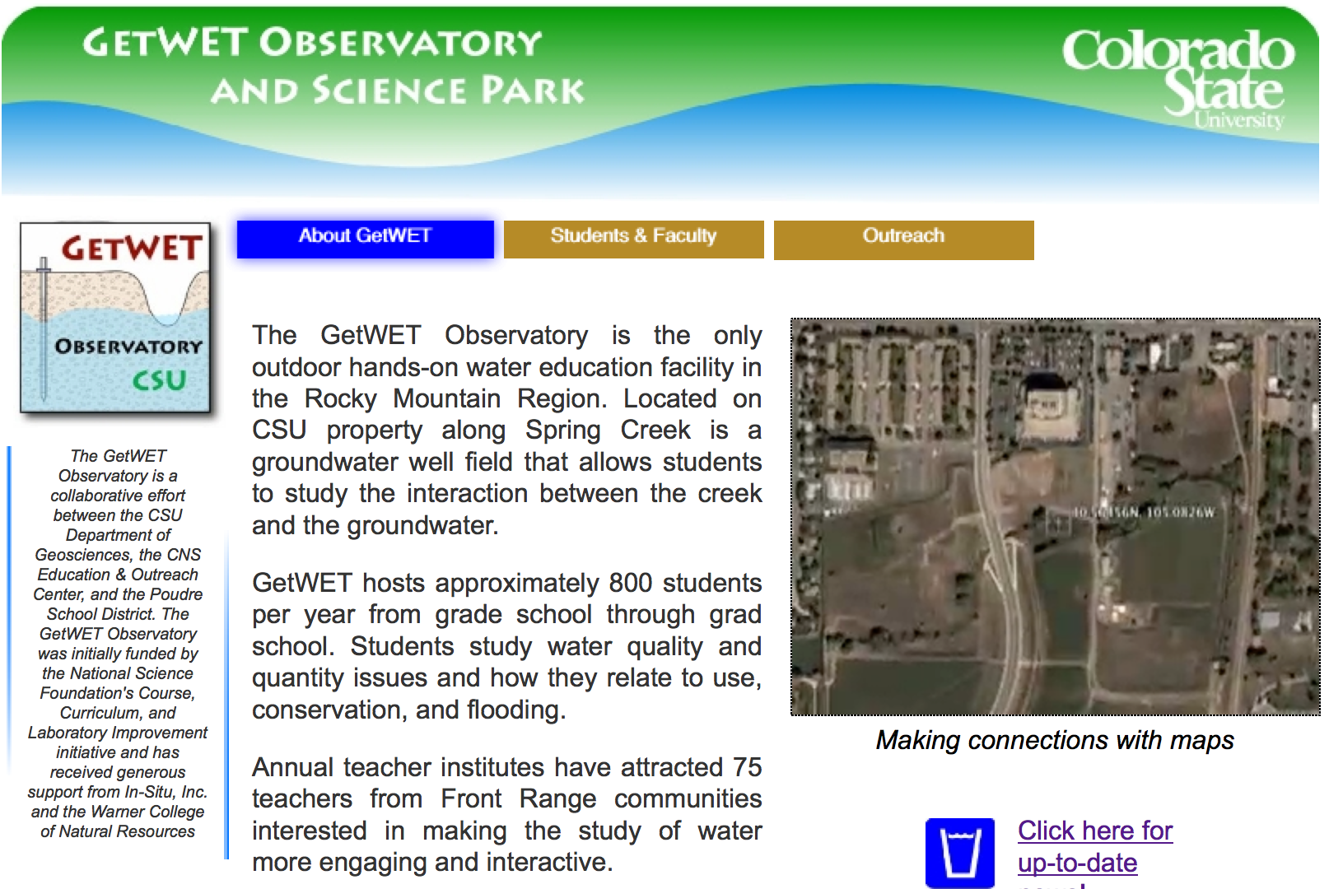
History
Visit to GetWET in Fort Collins in 2011

Slide 8
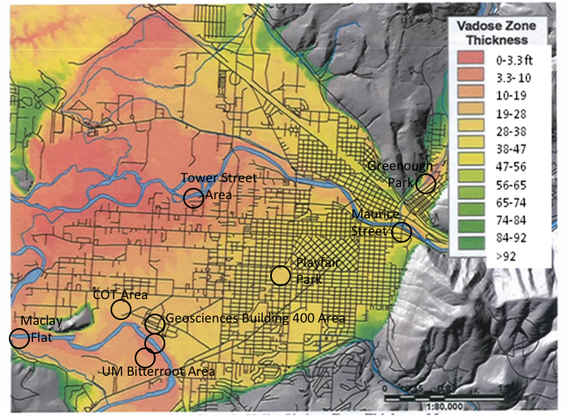
History
Building a team
Scouting sites
Writing grants
  EPA 2012
  Honda 2013
  EPA 2014
Developing community partnerships

Slide 9
Current Program
2 Year EPA EE grant w/matching funds from…
  Mountain Water Company
  Missoula Valley Water Quality District
Additional support from
  Newfields Companies, LLC (managed site installation)
  Missoula Parks and Recreation (approved site for Greenough Park)
Will serve ~800 high school students in western MT

Slide 10
MGA Learning Goals
Align with NGSS
Integrating:
  Core Disciplinary Ideas
  Scientific Practices
  Crosscutting concepts
HS-ESS2-2: Analyze geoscience data to make the claim that one change to Earth’s surface can create feedbacks that cause changes to other Earth systems.
HS-ESS3-1: Construct an explanation based on evidence for how the availability of natural resources, occurrence of natural hazards, and changes in climate have influenced human activity.

Slide 11
MGA Learning Goals
Explain
Where GW is located (vertically & horizontally)
Why GW moves in different directions & at different velocities depending on site conditions
Seasonal & long term patterns & trends
How GW becomes contaminated, & how this can be prevented or remediated
How GW & surface water connect & interact
Investigate GW issues in western MT
Know how to protect, manage & sustain GW resources

Slide 12
3-Day Curriculum
Day 1: GW structure & function w/models
Day 2: Landscape scale GW systems at field site
Day 3: Applications w/regional data sets
Expanding scope design
  Spatial scale
  Temporal scale
  Complexity of systems

Slide 13
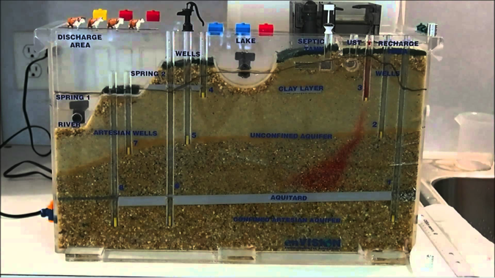
Day 1
If you had to choose a well to provide water for your house, which would you choose & why?
At what relative rate does water move through sand versus clay? Why?
Will pumping water from well X, well Y affect the water in lake? Why?
If a pollutant enters ground at point Z, which wells will be affected? Why?
What forces drive & constrain water movement in an unconfined aquifer?

Slide 14
Day 2
Driving Question: Where is groundwater at this site? Where is it coming from? Where is it going to?
Activity Sequence
  Engage/Elicit: Students use map to indicate/share initial ideas.
  Explore: Students/facilitators discuss how to investigate, develop plan, & collect data. Data are pooled.
  Explain: Students (w/support) use data to create GW elevation contour map, identifying location & direction of GW flow.
  Apply: Students discuss implications of GW flow, considering issues such as movement of contaminants or seasonal and long term fluctuations.

Slide 15
Day 3
Students use graphical representations of data sets to investigate other GW systems & issues, e.g.,…
  How is GW changing in Bitterroot Valley as a result of irrigation?
  How has GW in western MT been impacted by mining activities?
  By other activities (e.g., paperboard mill)?
  Are any impacts of climate change evident in western MT GW data?

Slide 16
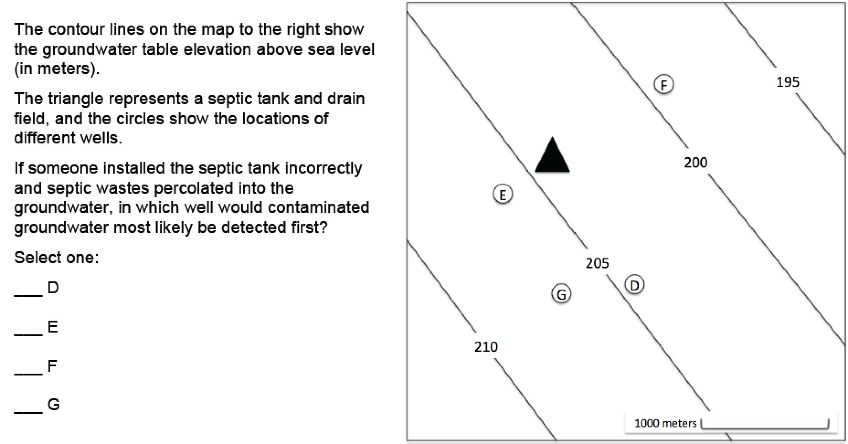
Program Evaluation
Assessing effectiveness of program
  Students
  Teachers
  Education Partners

Slide 17
Program Evaluation
Septic Tank
Pond
Farm Field
Well #2
Well #1
Aquifer 1 (Sand)
Impermeable Layer (Shale)
Aquifer 2 (Gravel)
How does water get into the pond? Explain as many pathways as you can.
Could pumping from well #1 affect the water in the pond?
Could pumping from well #2 affect the water in the pond?
Explain your answers.

Slide 18
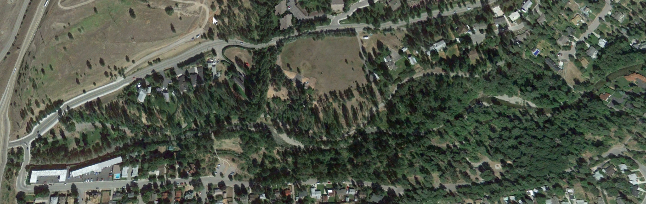
Greenough Park
Final April 2015 Map
12
8
11
10
6
7
2
4
1
5
9
3
2” Geoprobe Monitoring Well
Creek Stage Gauge (4)
Climate Station (1))
Paved Path or Road
Existing Path
Stream stations
Bridge
Stream staff
Stream transducer
1

Slide 19
Site Characteristic Criteria
Necessary
  Accessible to schools
  Access for buses/parking
  Access for students w/low mobility
  Bathrooms
  Shallow groundwater
  Can use shallow wells ($)
  Presence of river/creek
  Novice-comprehensible GW flow & stream interaction
  Safe site
  Location for climate station
Desired
  Electricity
  Paths
  Shelter
  Production well

Slide 20
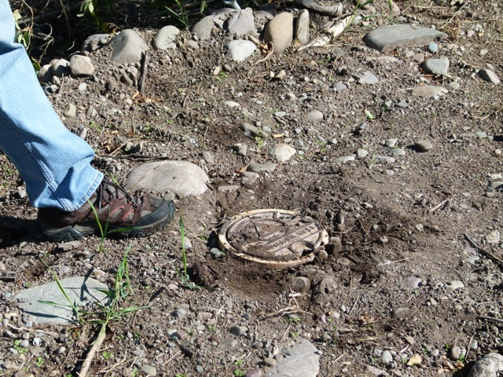
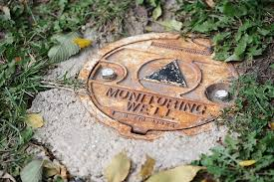
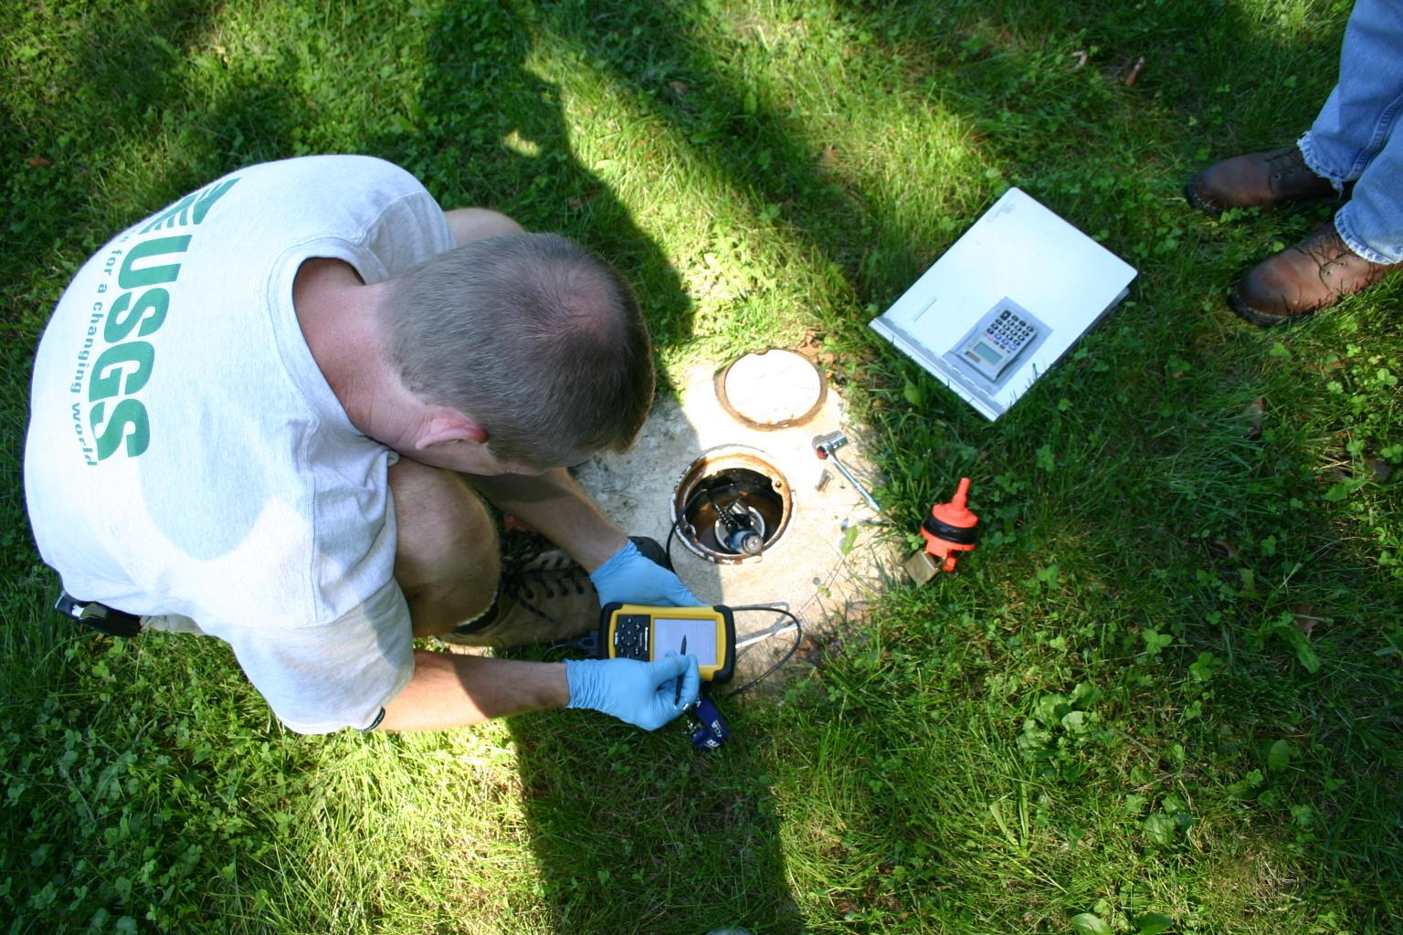
Monitoring Wells At Ground Level

Slide 21
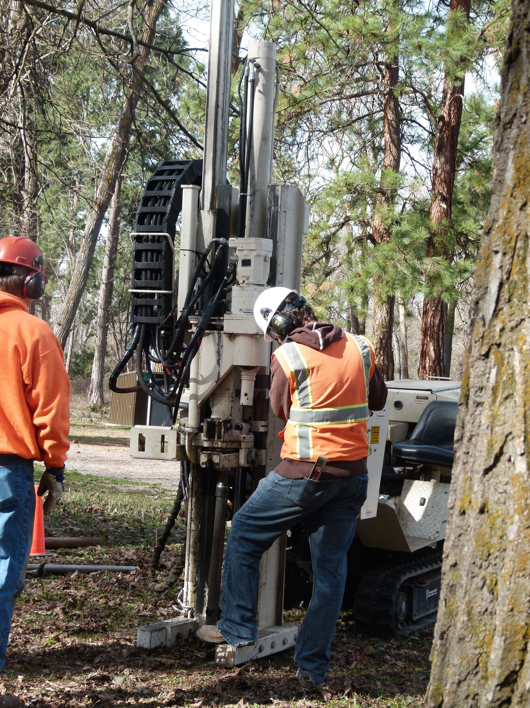
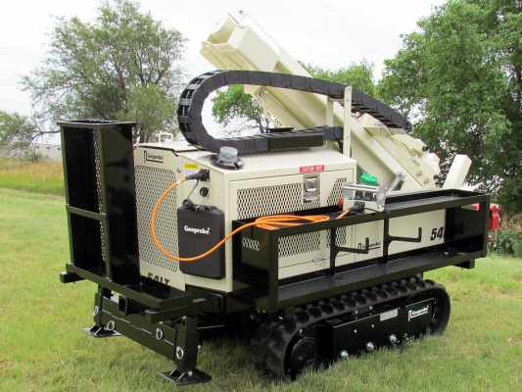
Geoprobe Installation

Slide 22
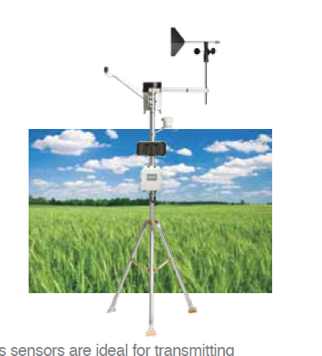
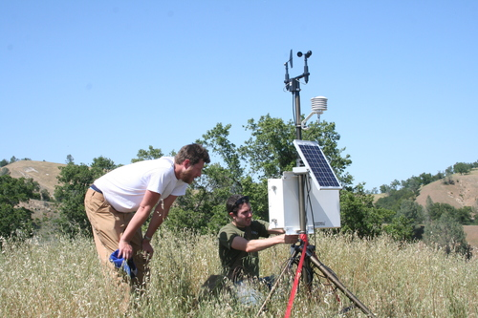
Climate Station
Will be pole mounted in Alvina Park

Slide 23
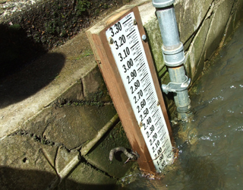
Staff Gauges

Slide 24
Initial Data
Data collected with transducers in several existing wells in Greenough Park starting in June 2014

Slide 25
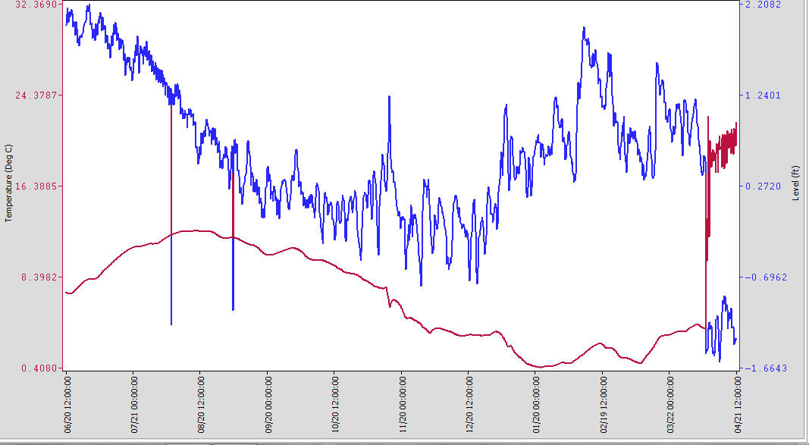
Monitoring Well 2 Greenough Park
5.38 ft
5.5
6.0
6.5
7.0
7.5
TD 8.85 ft BGS
7.44 ft
12.0 C
7.0 C
1.0 C
June 20 2014 12:00
December 20 2014 12:00
April 7 2015 15.42

Slide 26
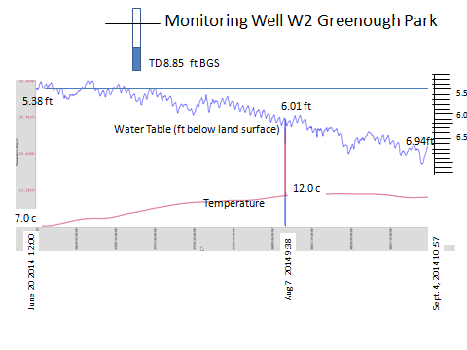

Slide 27
Future Directions
Programming
Sustain high school program
Expand to new audiences
  University
  Middle School
  Public
  Professional
New emphases – e.g., computational thinking & data analysis
Sites
Advanced learning: Maurice Street
Regional satellite sites: Frenchtown, Milltown, Pablo
Research
Opportunities for scientific investigation
Informing Parks concerning maintenance & restoration

Slide 28
Questions / Comments
Contact
Beth Covitt, beth.covitt@umontana.edu
Deb Fassnacht, deb@montanawatershed.org
Jessie Herbert, jessie.herbert@umontana.edu
Becca Paquette, becca_paquette@yahoo.com
This work is supported in part by a grant from the Environmental Protection Agency: Montana Groundwater Academy (96830301). Any opinions, findings, and conclusions or recommendations expressed in this material are those of the authors and do not necessarily reflect the views of the Environmental Protection Agency.

Slide 29
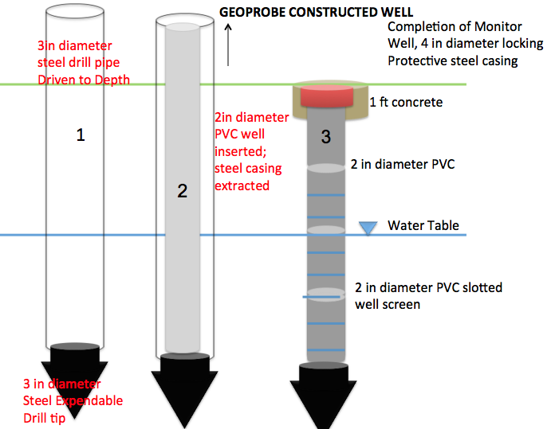
Geoprobe Well Construction

