Slide 1
2015 Clark Fork Symposium
Fostering Watershed Stewardship-
Alternative Mechanisms for Capacity Building
The Whitefish Lake Institute Case Study

Slide 2
Company Background
Founded in 2005 as a 501 (c) 3 non-profit corporation
Three Key Programming Areas
Science, Education, Community Stewardship
Governed by Board of Directors
Two Advisory Committees
Science Advisory Committee
Citizens Advisory Committee
3.5 Staff
Place Based Organization That Reaches Out Geographically

Slide 3
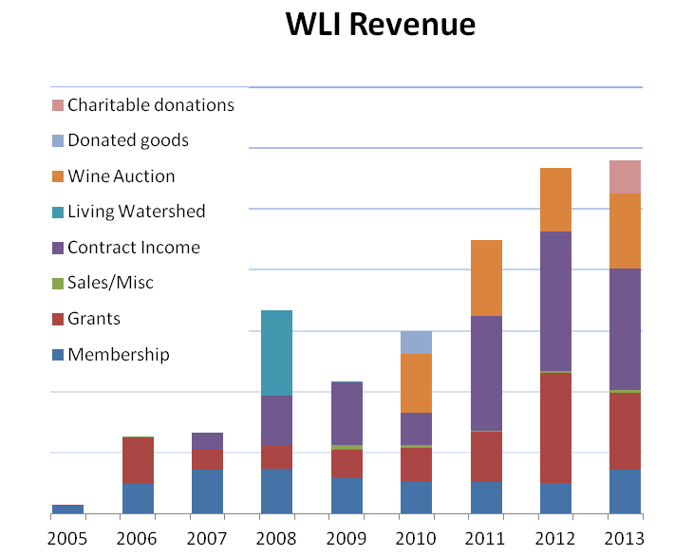
Revenue Source Overview
Membership ($40-$5,000)
Charitable Gifts
Contracts
Grants
City of Whitefish
Whitefish Wine Auction
License Plate & Misc.
Development Agreements
HOA Fees

Slide 4
Organizational Growth vs. Fixed Mindset
Build Relationships
Cross Cultural
Integration
Creative
Partnerships
Adaptive Management
Expect Support
Preach to the Choir
Pigeonholed
-Grants, Other?
Myopic Approach
Notes:
wetlands

Slide 5
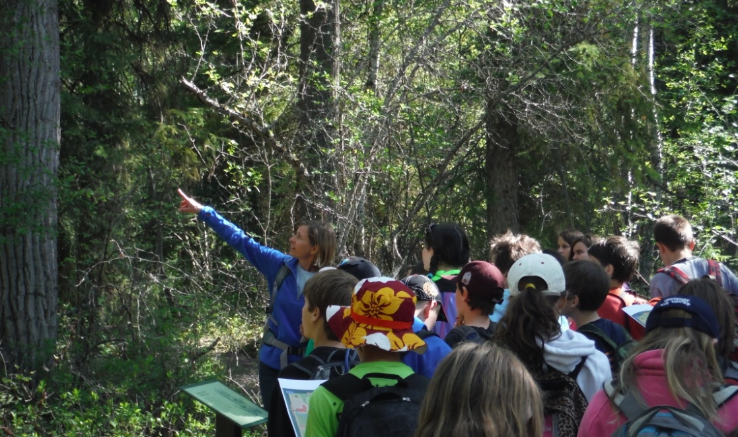
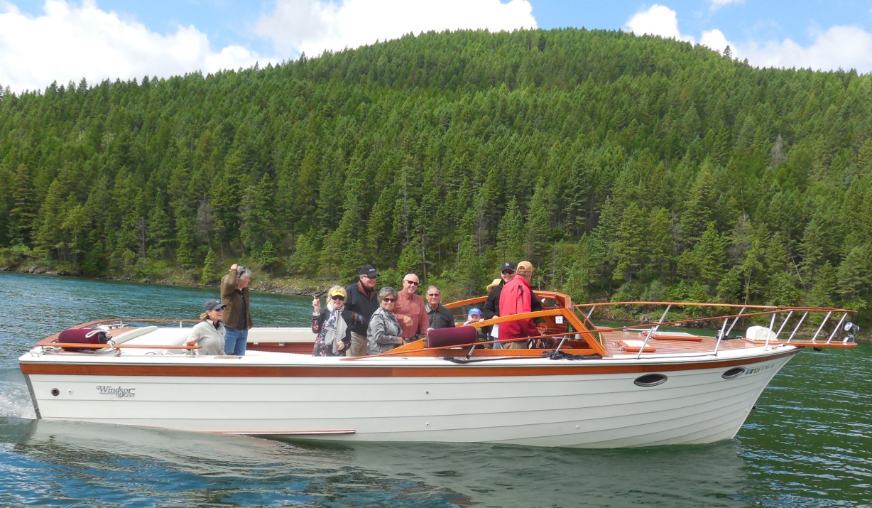
Organization Growth- Build Relationships
All age groups must be reached
Example-
Boat & Wine Tours
for targeted approach

Slide 6
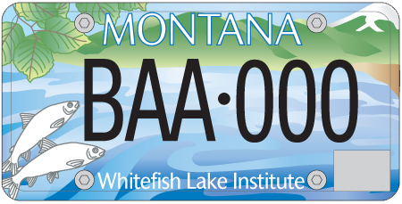
Organizational Growth- Cross Cultural Integration

Slide 7
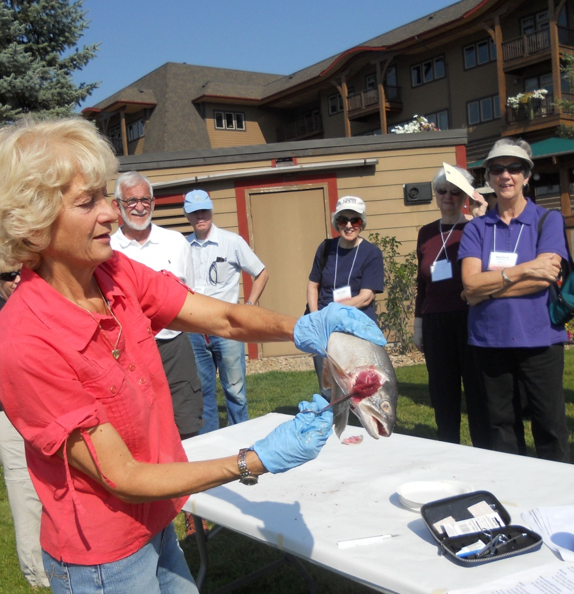
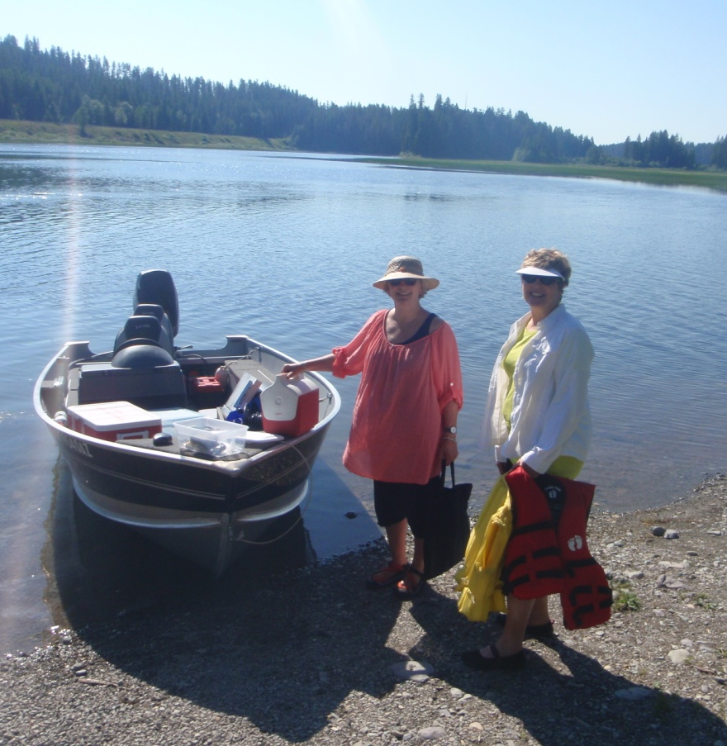
Organizational Growth- Creative Partnerships
Educational Travel Institute of America (Road Scholar)
Northwest Montana Lakes Volunteer Monitoring Network

Slide 8
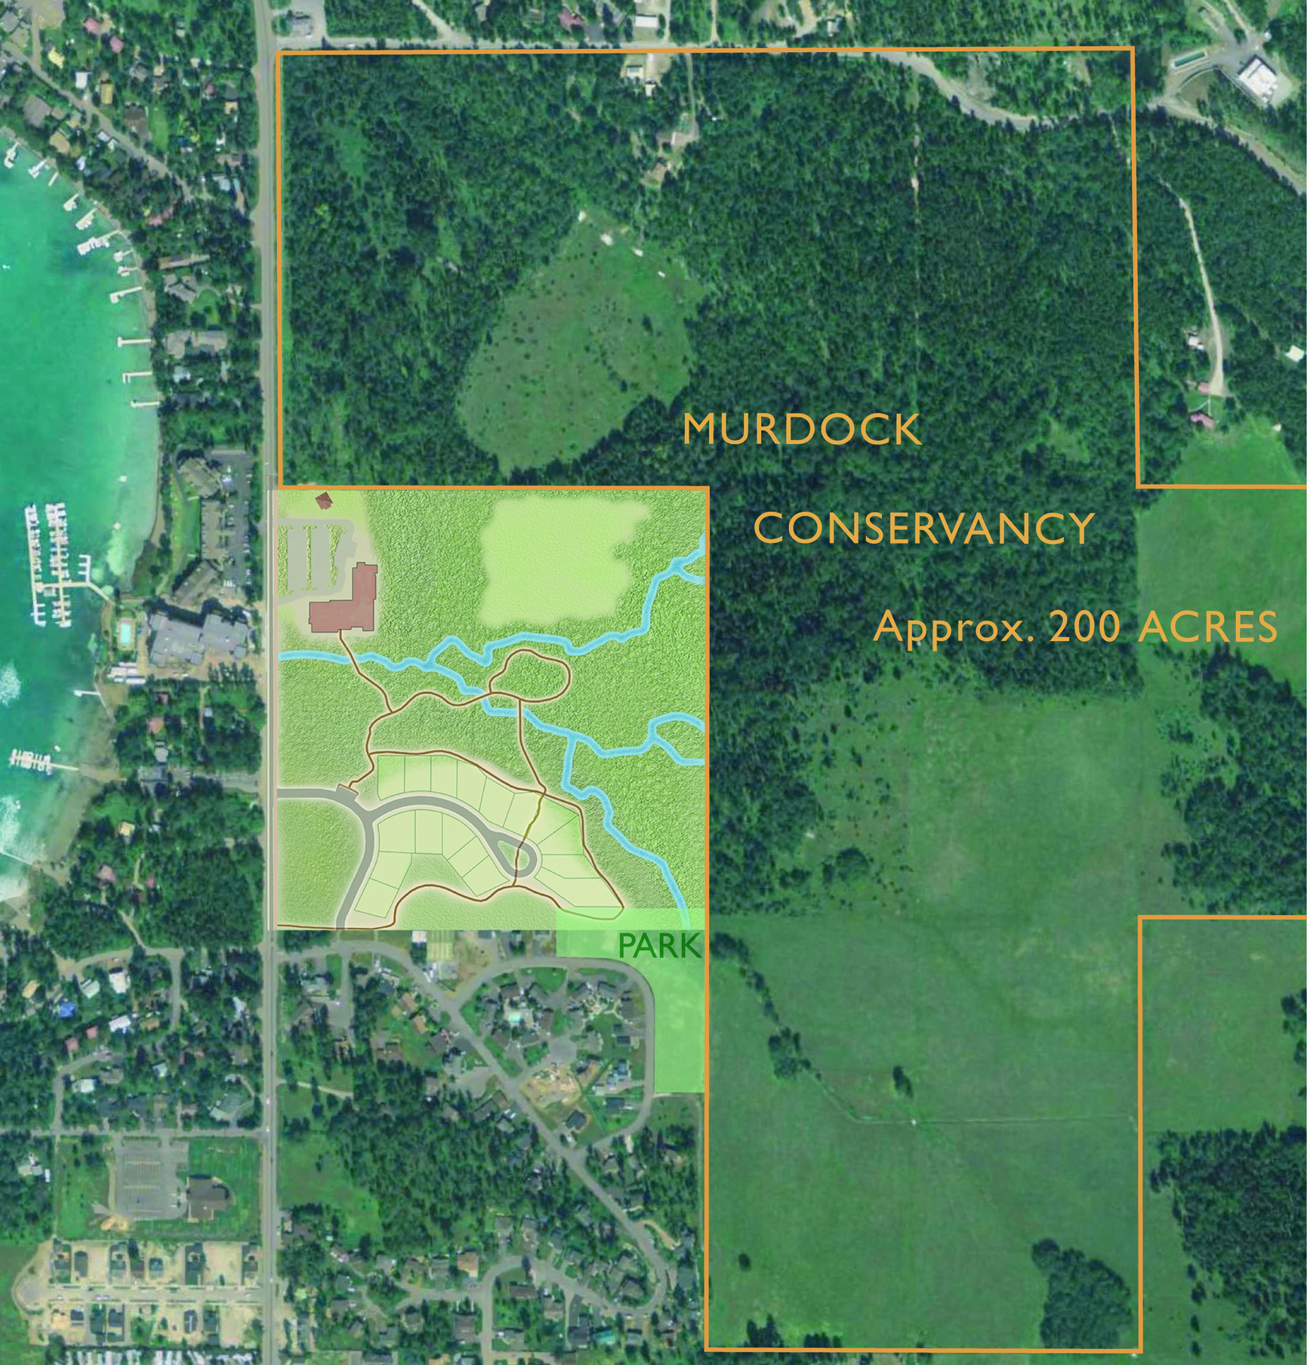
Organizational Growth-
Adaptive Management
The 28.82 acre Averill’s Viking Creek Wetland Preserve is owned and managed by WLI. It is bordered to the north and east by a Nature Conservancy Easement, creating a large contiguous area for water quality protection and wildlife in the urban interface.

Slide 9
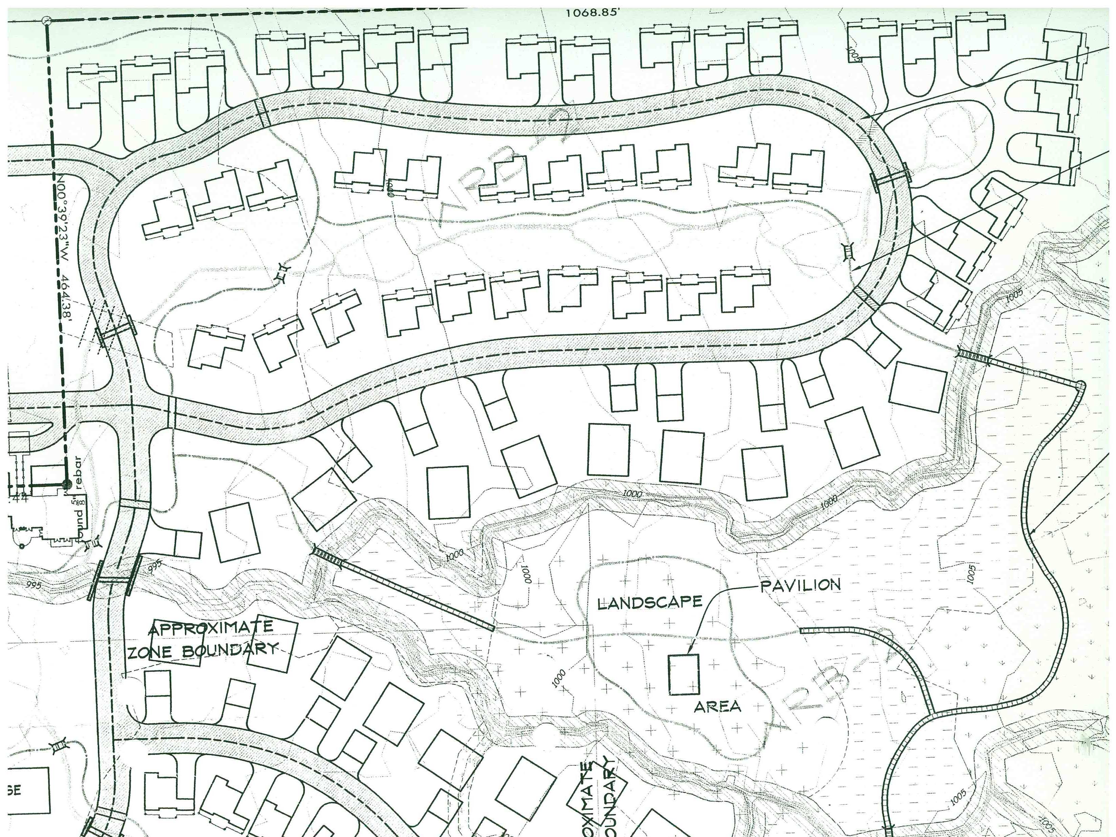
What Could Have Been…

Slide 10
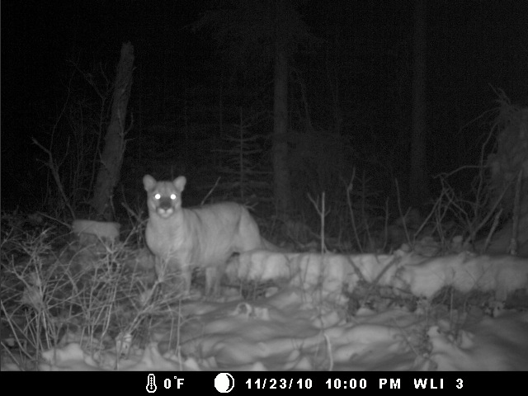
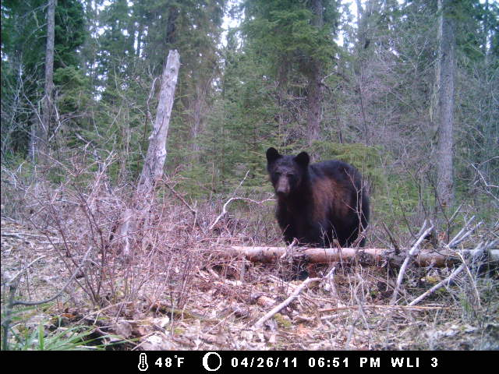
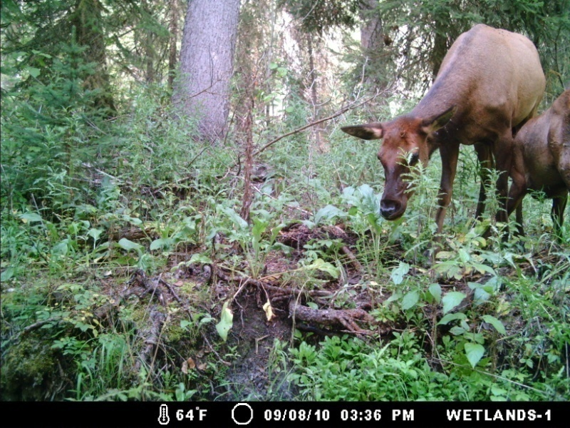
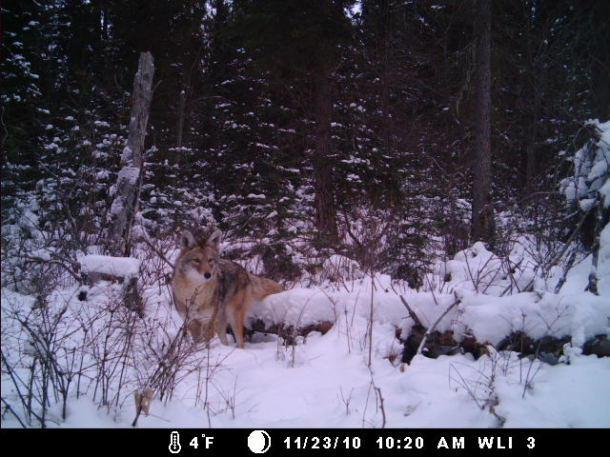
Wildlife of the Wetlands

Slide 11
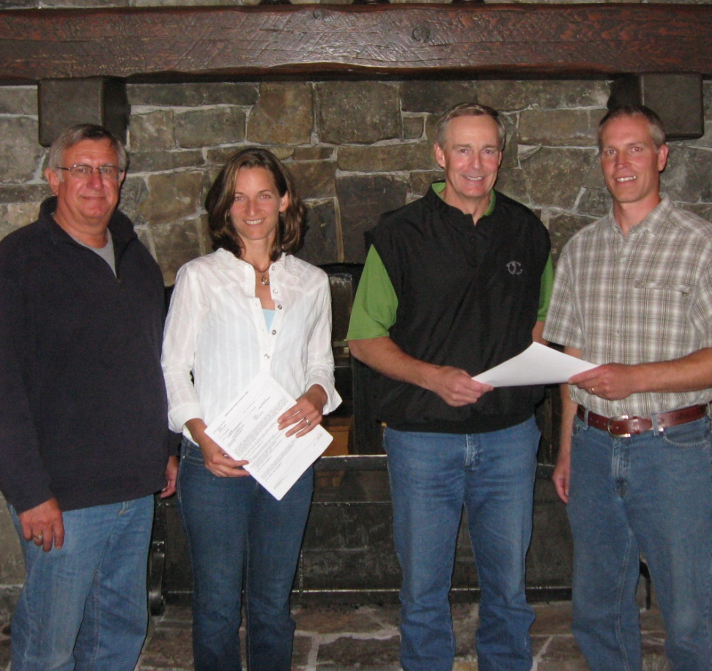
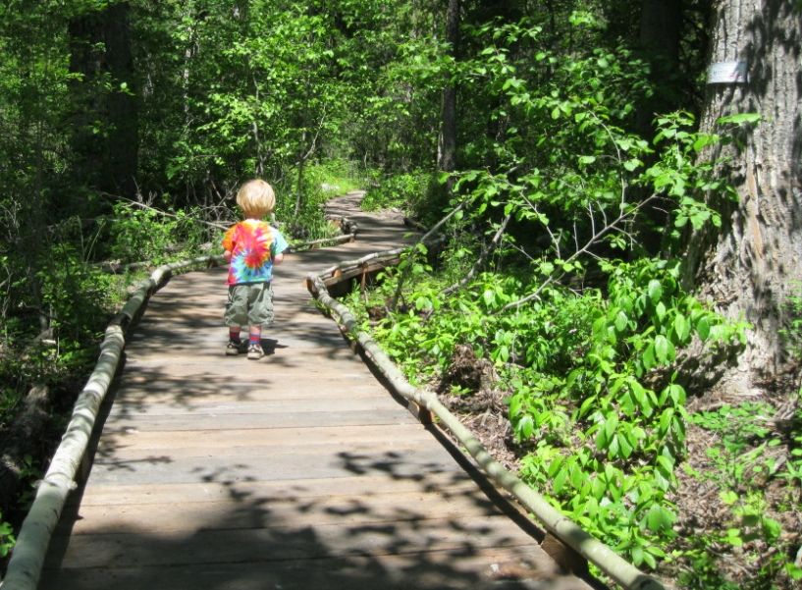
Brokering A Solution
28.82 Acre Property Donation
$110,000 Gift
10:1 Wetland Mitigation Ratio and Financing
Fundraiser Support (Whitefish Wine Auction)
Annual HOA Assessment

Slide 12
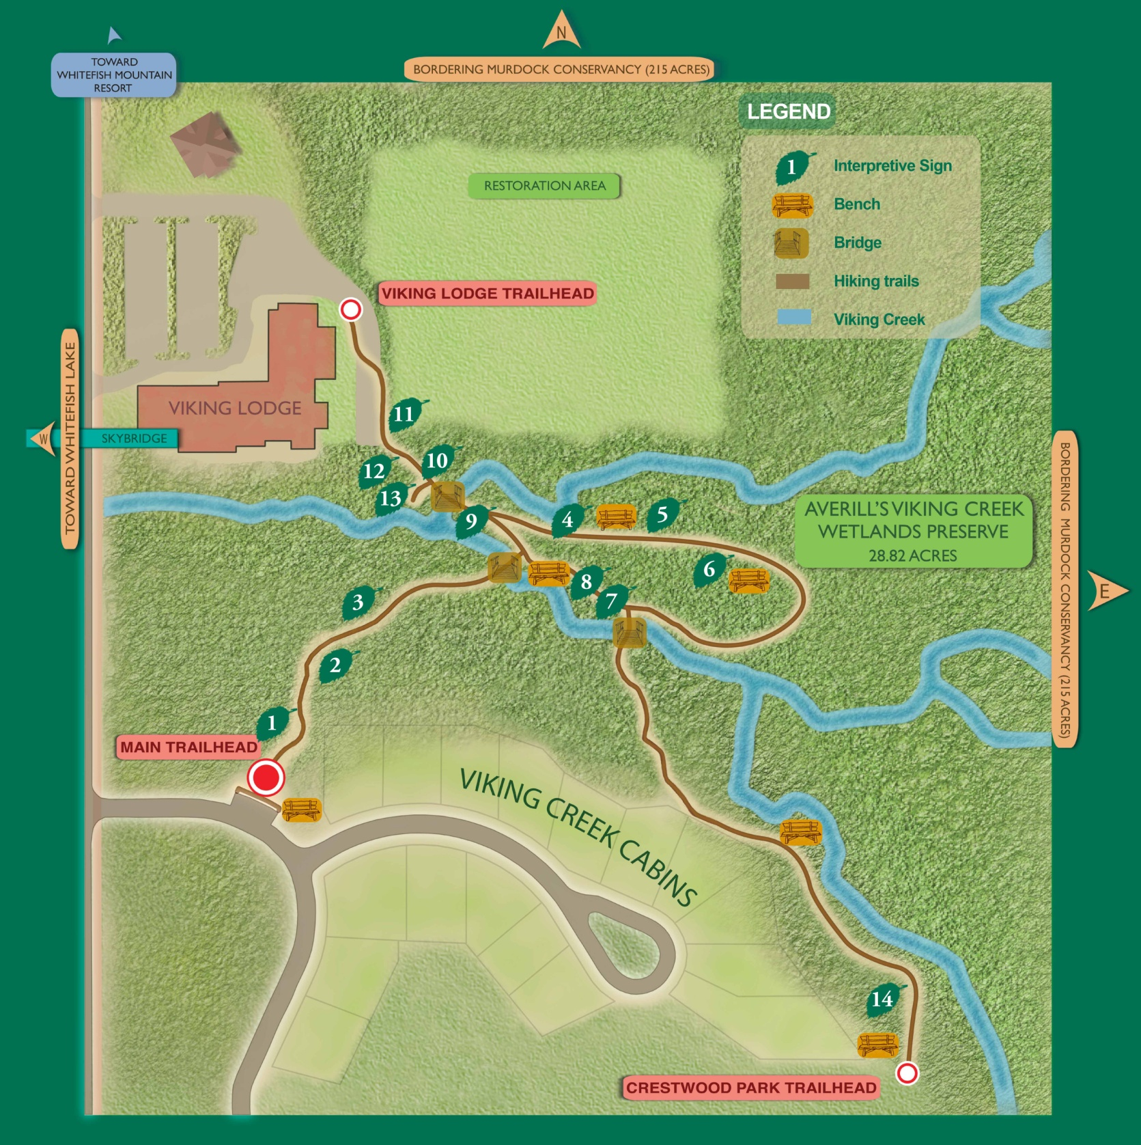
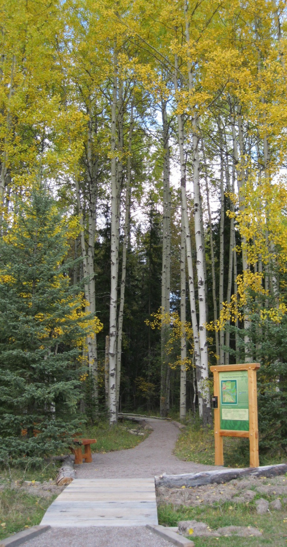

Slide 13
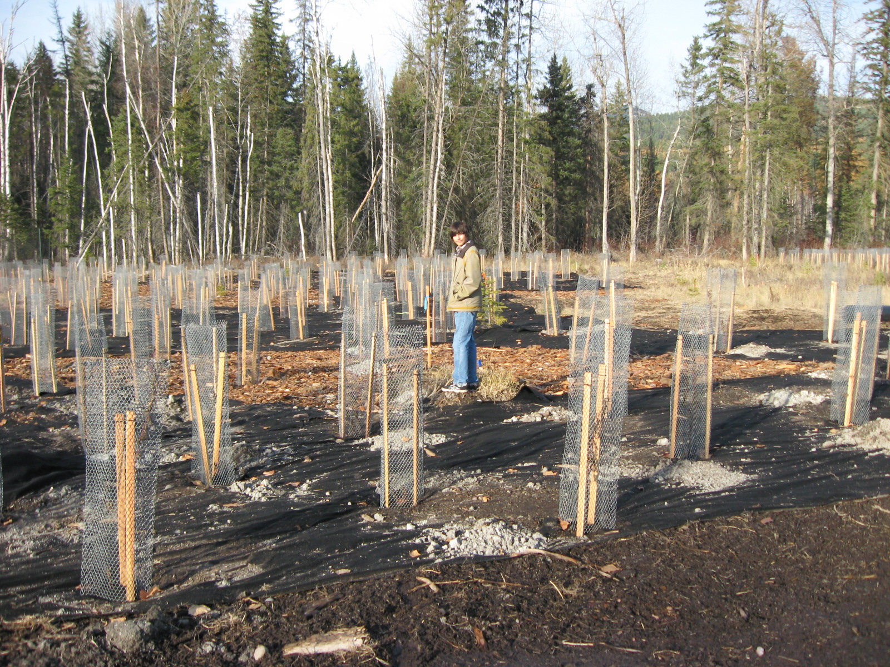
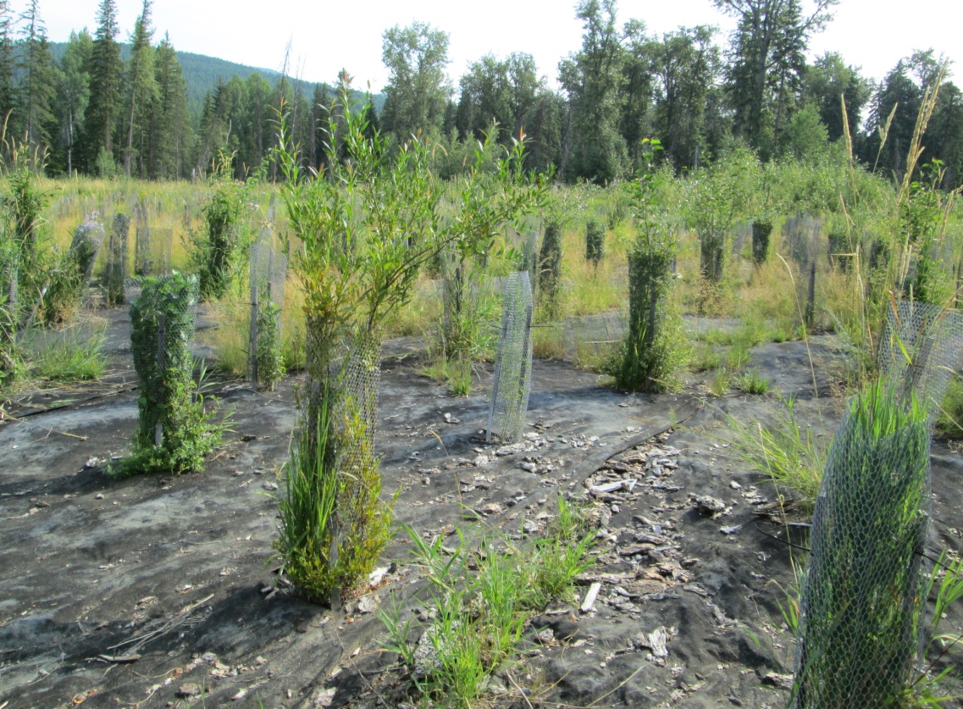
Wetland Restoration

Slide 14
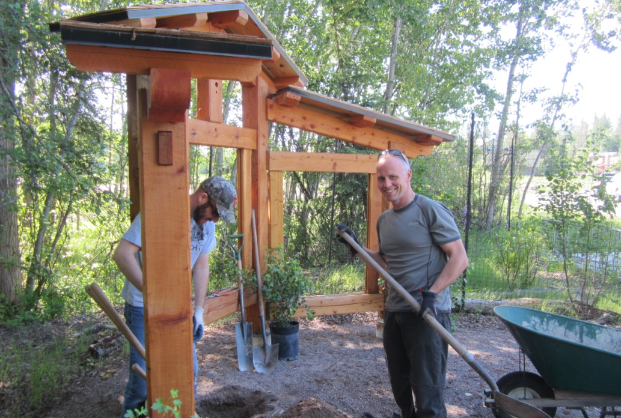
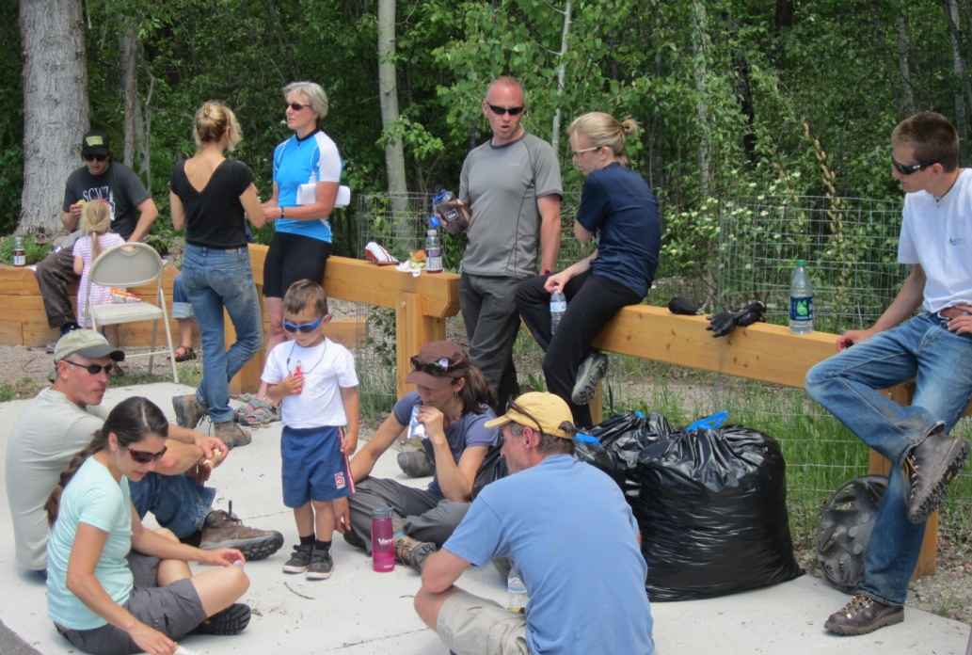
Community Project
Applied Materials
Balancing Axe
Cadeau Foundation
Cinnabar Foundation
City of Whitefish
Dan Averill Family
Forestoration, Inc.
Friends of Wisconsin Avenue Wetlands
Mobile LoGIStics Mapping
Montana Fish, Wildlife & Parks- RTG
Nelson’s Ace Hardware
OTB Designworks
River Design Group, Inc.
Todd Bergett Designs
Watershed Consulting, LLC
Wetland Work Day Volunteers
Whitefish Community Foundation
Whitefish Lake Institute Members

Slide 15
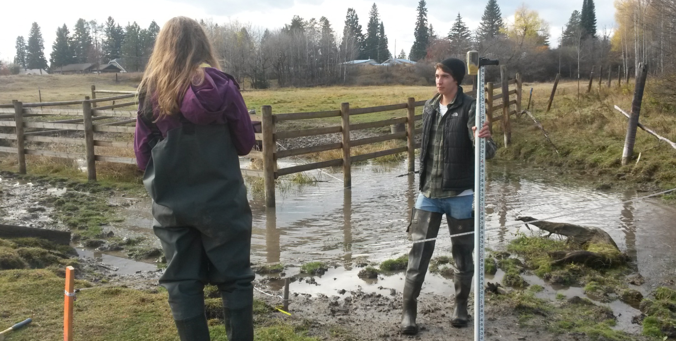
Growth Potential of a Partnership
Finalizing Real Estate Gift - Cow Creek (4 acres)
Cash Gift to Kick-Start Trail Development and Restoration
Annual HOA Assessment
Partner with Whitefish High School FREEFLOW, Flathead Conservation District, Applied Materials, MEEA, COCEEC, Sustainability Fund, Whitefish Rotary, Center for Native Plants, Others

Slide 16
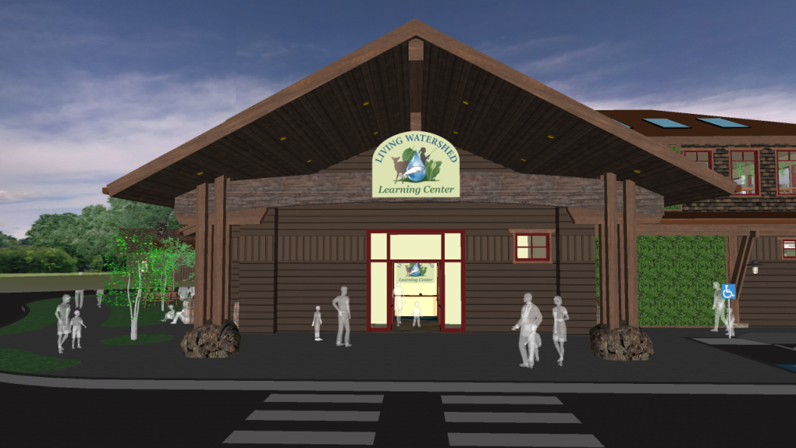
Growth Potential of a Partnership
Proposed Living Watershed Environmental Learning Center
In development- Conservation Fee “Bed Tax” on Lodging for Annual Operating Costs

Slide 17
Mike Koopal, Executive Director
550 East 1st Street #103, Whitefish, MT. 59937
406.862.4327
info@whitefishlake.org
www.whitefishlake.org

