Slide 1
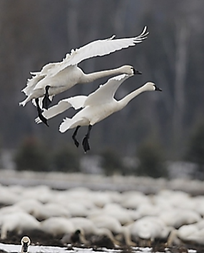
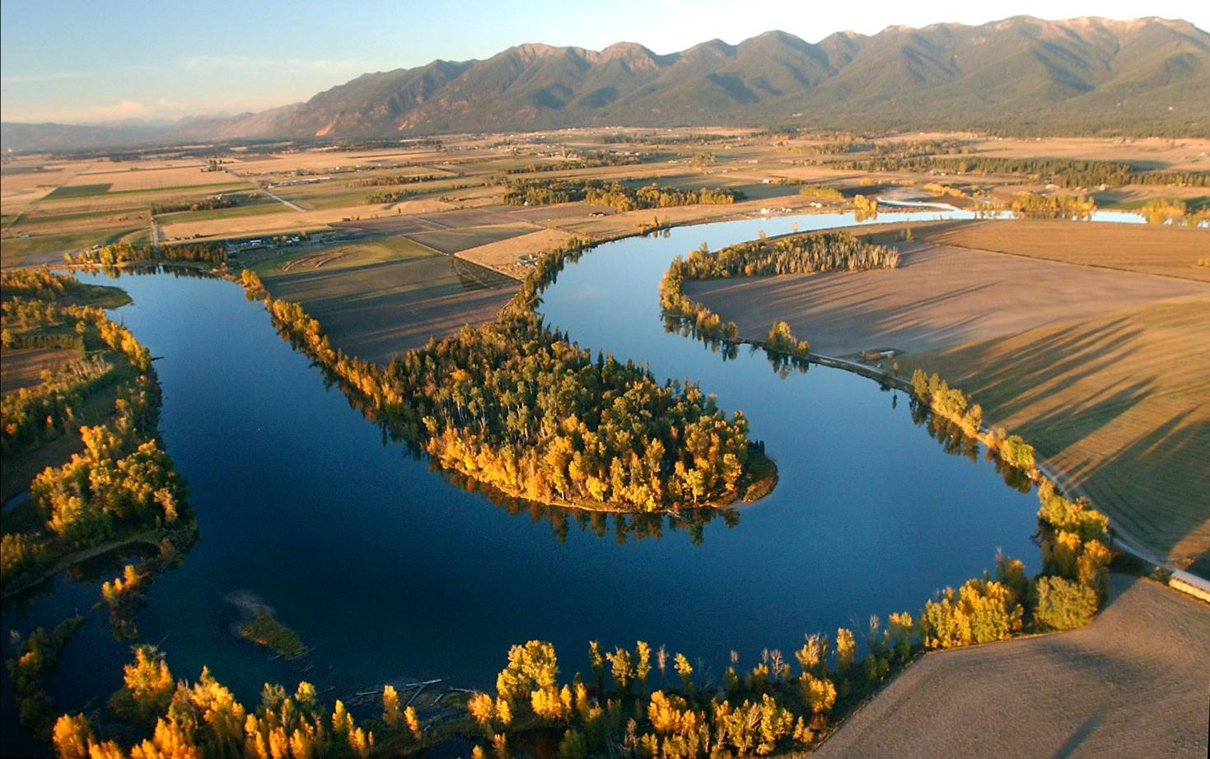
Flathead River to Lake Initiative
Conservation and restoration
through a diverse collaborative effort
Part I – How it began
Part II – Conservation Successes
Part III & IV – Restoration Successes & the Flathead River Steward Program

Slide 2
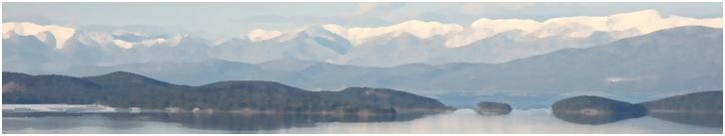

The Flathead Lakers
Working for clean water, healthy ecosystems and lasting quality of life in the Flathead watershed in northwest Montana.
Constanza von der Pahlen
Critical Lands Program Director
Notes:
The Flathead Lakers
The Flathead Lakers is a nonprofit organization working to protect clean water, healthy ecosystems and lasting quality of life in the Flathead Watershed. We are your friends and neighbors, year-round and part-time residents, who care about the future of Flathead Lake and clean water throughout the watershed.

Slide 3
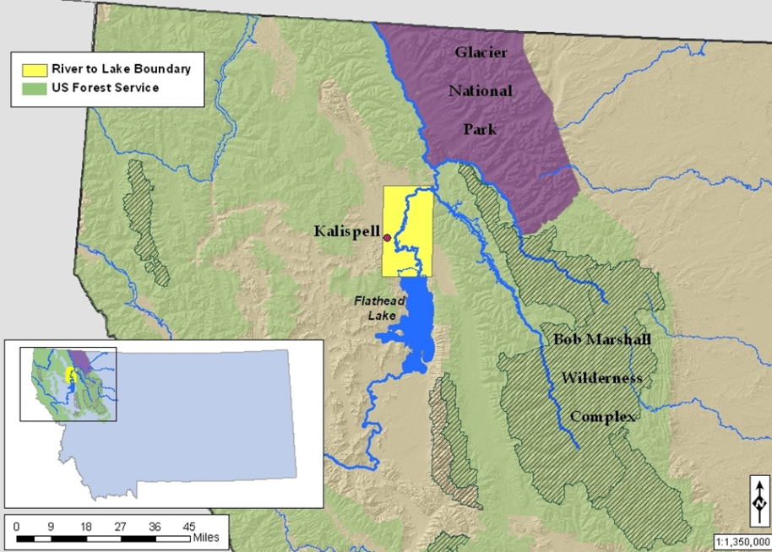
The Flathead Watershed
Nearly 6 million acres of scenic landscapes contribute water to the Flathead Lake
CSKT & MFWP, 2003. Flathead Subbasin Plan: Part I.
Notes:
The Flathead Watershed
The Flathead Watershed includes all the land that drains into Flathead Lake and the Flathead River - a huge area stretching west from the Continental Divide to the Salish Mountains to the west and from across the Canadian border in the north to the Clark Fork River in the south.
The pristine headwaters of the lake start their journey high in the mountains of Glacier National Park, the Bob Marshall Wilderness and other forest lands. The three forks of the Flathead River, the Stillwater, Whitefish and Swan rivers all contribute water to the lake. As they pass through forests, farmland, and cities, the rivers pick up sediments, nutrients and other pollutants which can eventually reach Flathead Lake. Altogether, the Flathead Watershed drains six million acres of scenic landscapes.
The lake and the waters that flow into it are the life blood of this crucial portion of the Crown of the Continent Ecosystem – the most ecologically intact system in the lower 48 states. Its rivers, wetlands and riparian corridors are the most vital areas for maintaining clean water.

Slide 4
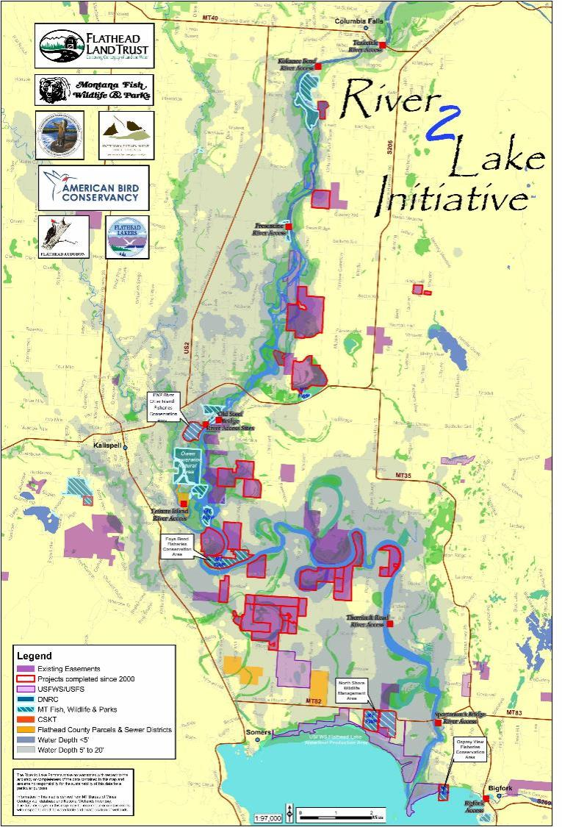
River to Lake Initiative
Focus on protecting critical lands along 44 miles of the Flathead River between Columbia Falls and Flathead Lake and the north shore of Flathead Lake.

Slide 5
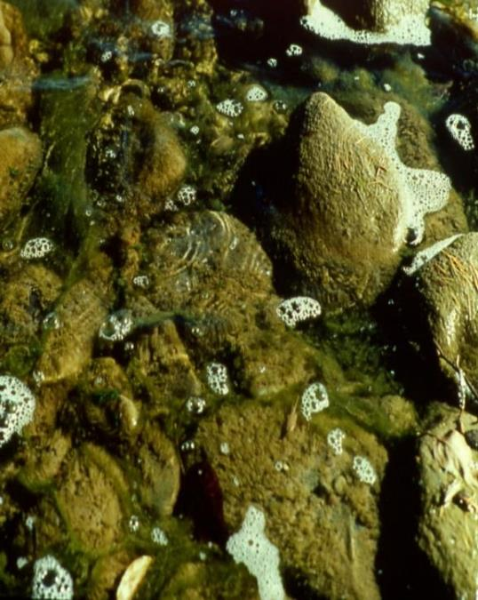
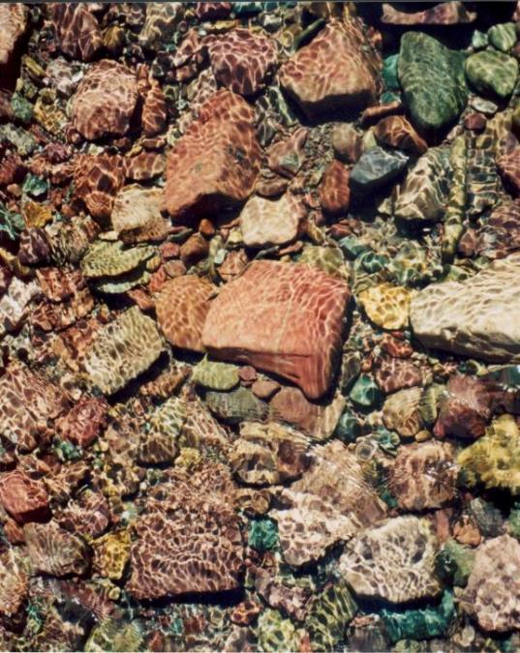
Water quality and nutrient pollution
Montana has declared water quality in Flathead Lake impaired.
Research shows a decline in water quality over the past 30 years.
Non-point source pollution -biggest threat to water quality.
Notes:
Water quality and nutrient pollution
Numerous surveys have shown that the public believes protecting water quality should be a top priority in the Flathead area. But water quality in Flathead Lake has declined and continues to be threatened:
• The state has declared water quality in Flathead Lake impaired (listed on the 303d list of impaired water bodies).
• University of Montana Flathead Lake Biological Station researchers report a decline in water quality over the past 30 years.
• Two major lake-wide pollution algae blooms have occurred, and
• Algae on shoreline rocks has increased.

Slide 6
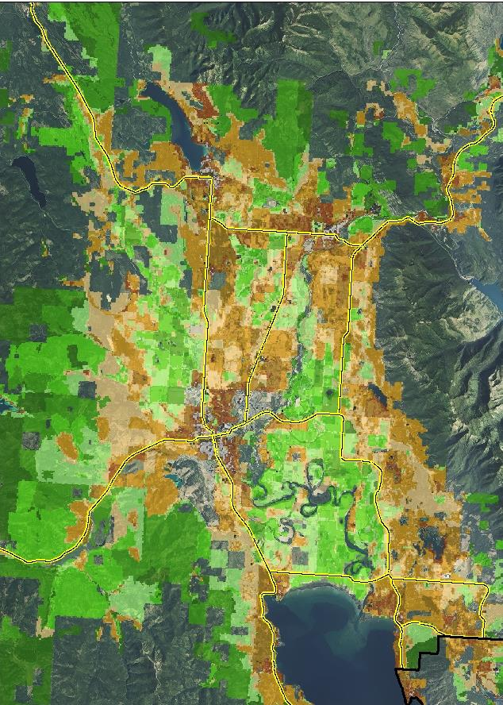
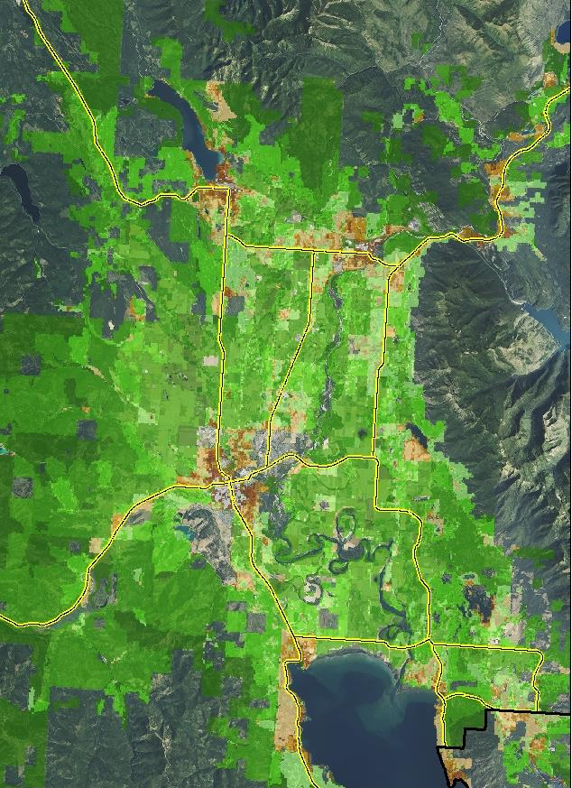
Housing Density in 2010
Housing Density in 1950
Flathead Valley above Flathead Lake contributes the highest nutrient loads to the lake.
Rapid growth and development in critical areas

Slide 7
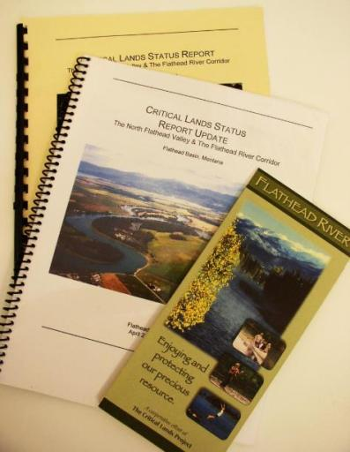
Grass Roots Beginnings
Flathead Lakers’ Critical Lands Project (1999)
Critical Lands workshops:
  agreed on criteria to identify priority areas
  (Ecological function, Cultural, recreational and aesthetic values, Urgency of existing & potential threats Ecological defensibility & durability, Feasibility)
  focus area
  Critical Lands Status Reports (2002, 2004)

Slide 8
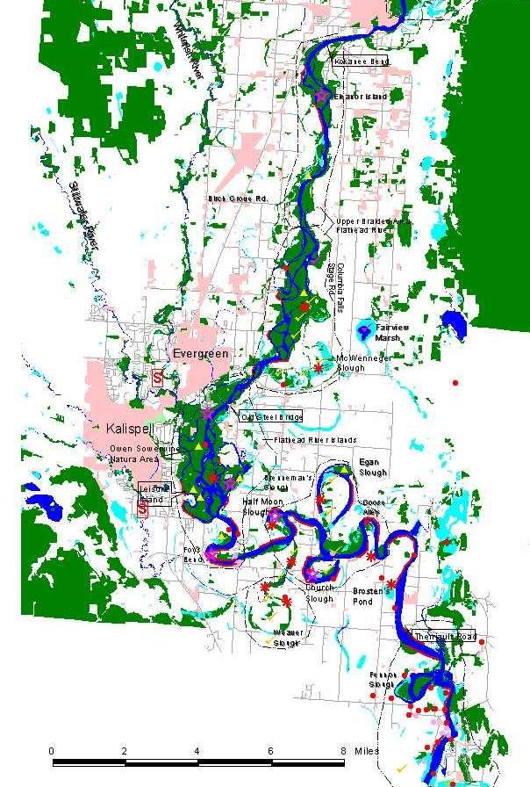
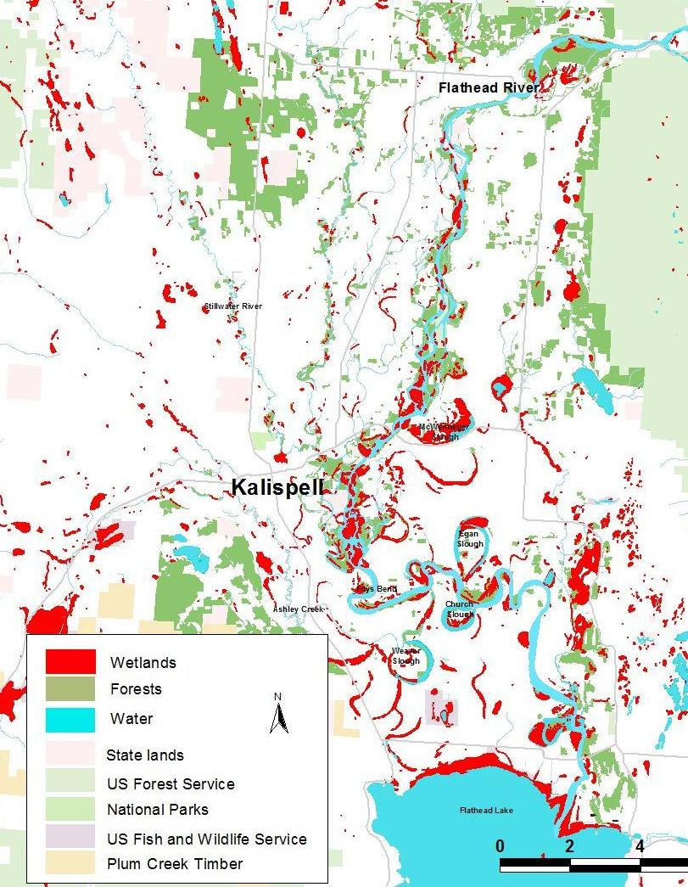
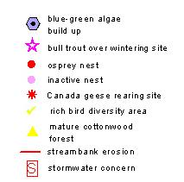
Critical Lands Identification
Status Report (2002)
Wetlands and sloughs
Riparian areas, mature cottonwood forests
Bird hot spots √
Bull trout over-wintering sites
Wildlife: waterfowl, osprey & bald eagle nests
Stormwater S
Notes:
Critical Lands study: We compiled and reviewed various resource studies and reports and interviewed resource managers and scientists. This information was used to identify critical areas, based on the critica lands criteria, where multiple values overlap. These areas include wetlands, riparian areas and floodplains, and the shallow alluvial aquifer connected to the Flathead River. The results of the analysis were summarized in a June, 2002 Critical Lands Status Report for the North Flathead Valley & the Flathead River Corridor. A Critical Lands Status Update was released in April, 2004.

Slide 9
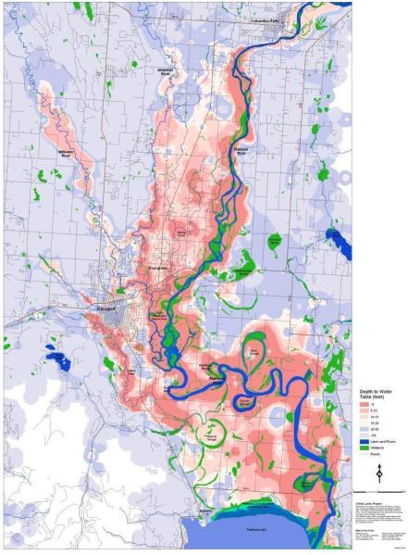
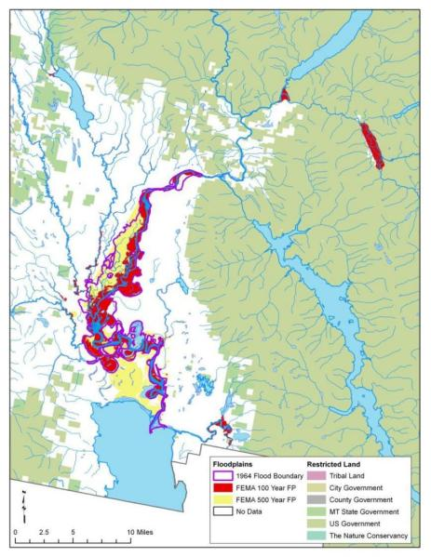
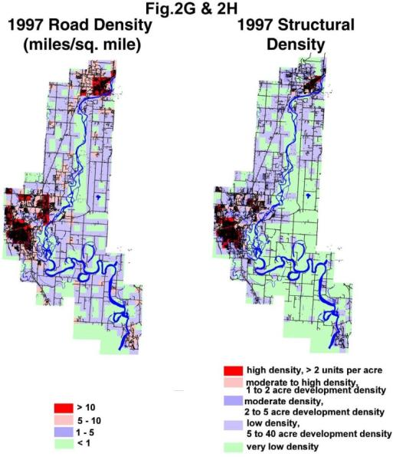
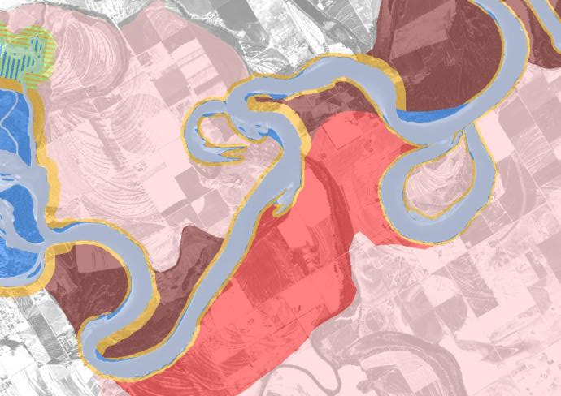
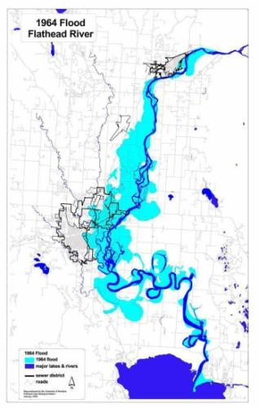
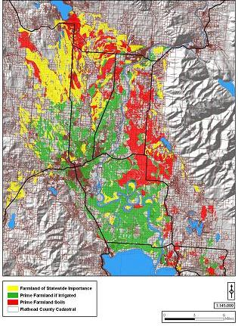
Shallow alluvial aquifer
Flathead R. Floodplains
1964 Flood
Prime Agricultural Soils
Flathead R. Channel Migration
Notes:
The large valleys of the watershed were scoured by recurring glaciers leaving a trail of gravel, sand, silt and clay deposits and glacial till. As the glaciers receded, the meltwater became a river many times larger than the Flathead River of today. The river produced a highly sorted gravel matrix. These gravels are penetrated by groundwater, creating a large and very shallow alluvial aquifer. Water moves rapidly through the gravels connected to the Flathead River.

Slide 10
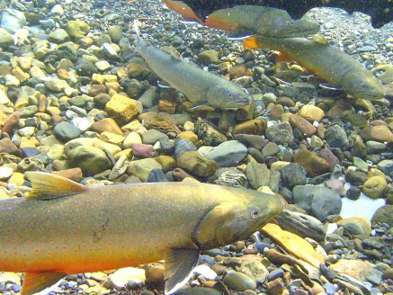
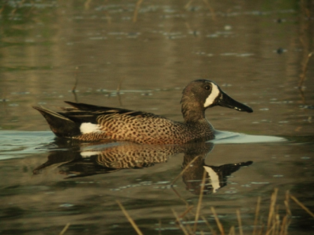
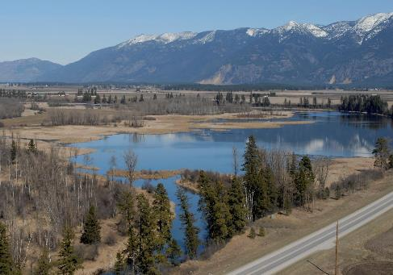
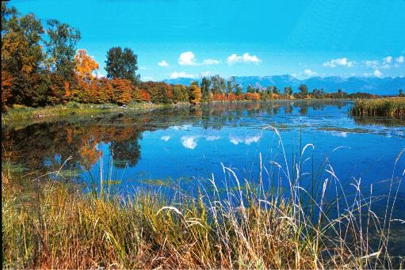
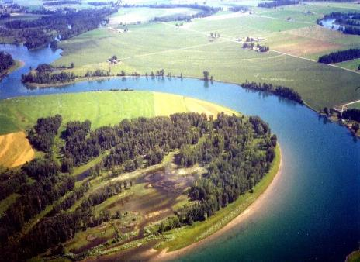
Initial successes
Flathead Land Trust, American Bird Conservancy, MT Fish Wildlife & Parks, Flathead Lakers, and landowners completed significant grant-funded
(BPA, NAWCA, MT Ag Heritage) collaborative projects (~1,000 ac.)
McWenneger Slough
Weaver (Wiley) Slough
Flathead River
Karen Nichols

Slide 11
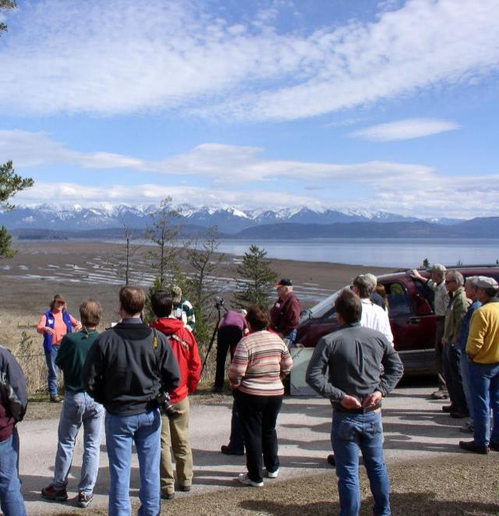
The River to Lake Initiative
is a collaborative effort to
conserve and restore our Flathead River and Lake natural heritage – excellent water quality, outstanding scenic and recreation values, abundant fish and wildlife, and prime farm land
for people to enjoy and benefit from, today and tomorrow
through voluntary conservation, restoration, education and outreach.

Slide 12
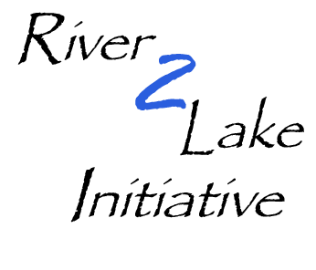

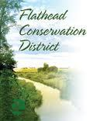
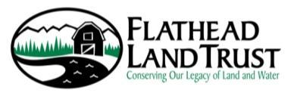
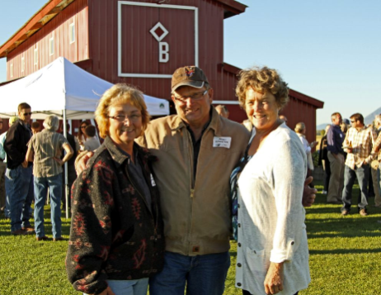

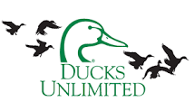

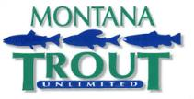

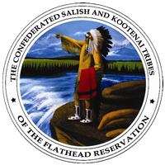

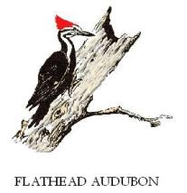
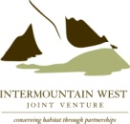

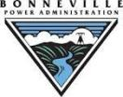

LANDOWNERS
Flathead River Commission

Slide 13
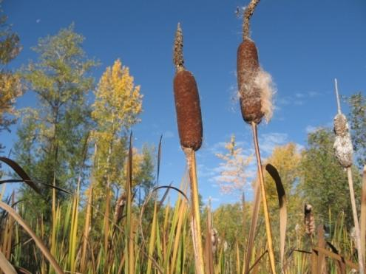
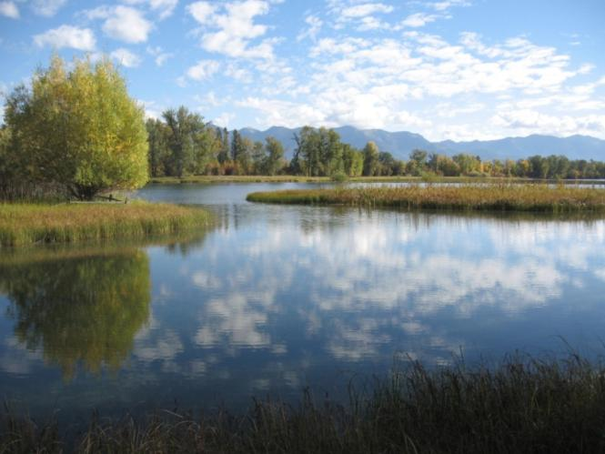
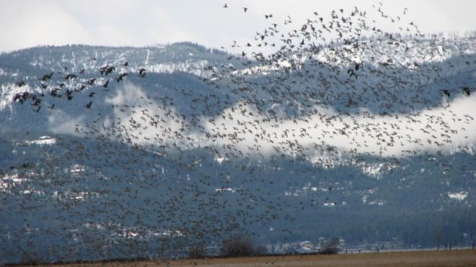
Success of Flathead River to Lake Initiative

Slide 14
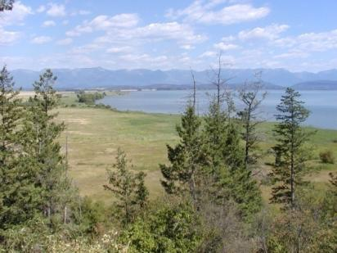
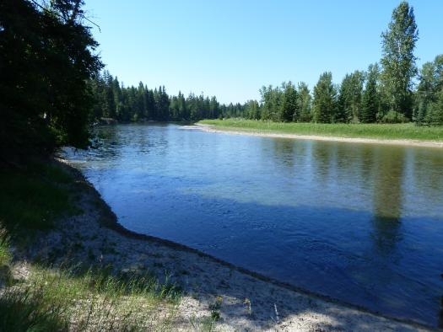
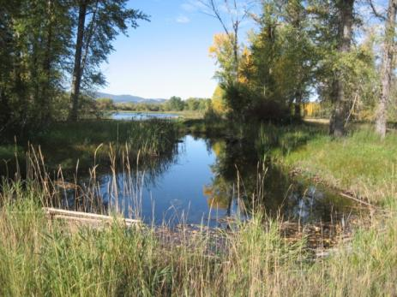
Flathead Land Trust
Non-profit organization implementing land conservation to protect the Flathead Valley’s natural beauty, clean water, and special places that sustain our high quality of life.

Slide 15
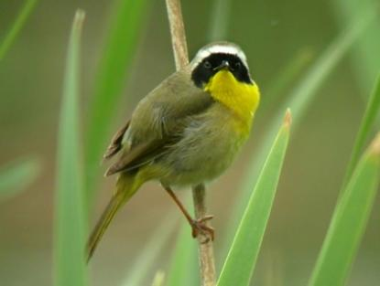
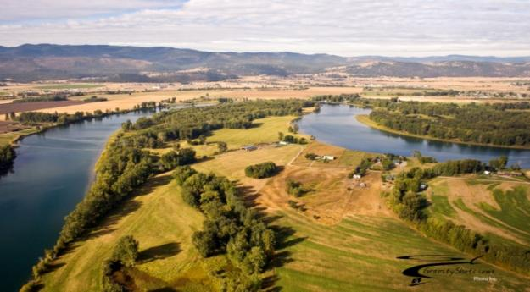
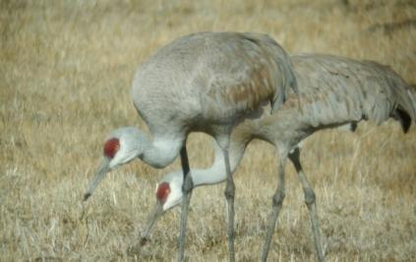
Conservation Success
- Protected over 5,000 acres of critical lands adding to a network totaling over 11,000 acres of protected private and public lands

Slide 16
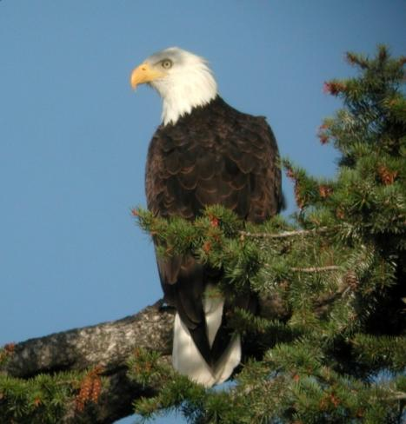

$15 Million in Funding
North American Wetland Conservation Act
State Agricultural Heritage
Bonneville Power Administration Fish Mitigation
NRCS Farm and Ranch Lands Protection Program
MFWP Migratory Bird Stamp

Slide 17
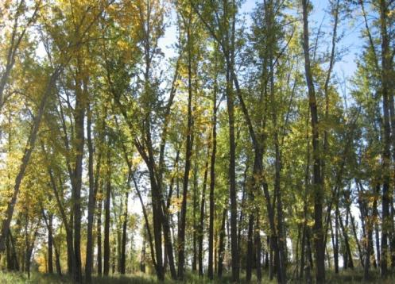
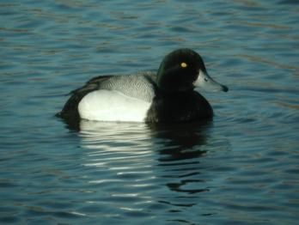
Conservation Metrics
Acres of 100-yr floodplain
Miles bordering Flathead River
Acres of shallow groundwater
Acres of wetland
Acres within ¼ mile buffer of slough
Acres of quality riparian habitat
Acres of important agricultural soils

Slide 18
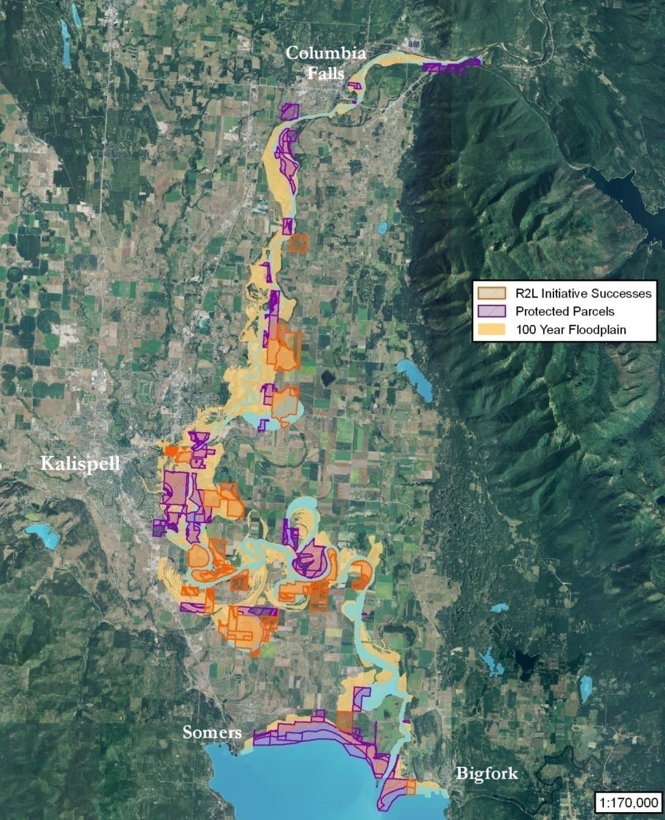
41% of
100-yr.
Floodplain
Protected

Slide 19
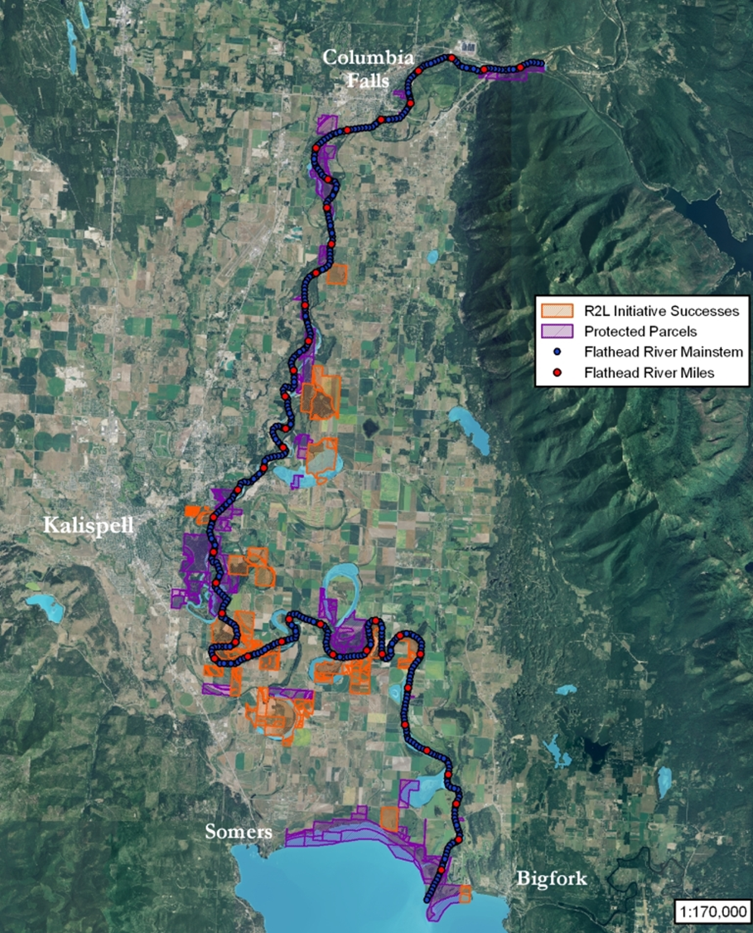
29% of Flathead R. Main Channel Protected

Slide 20
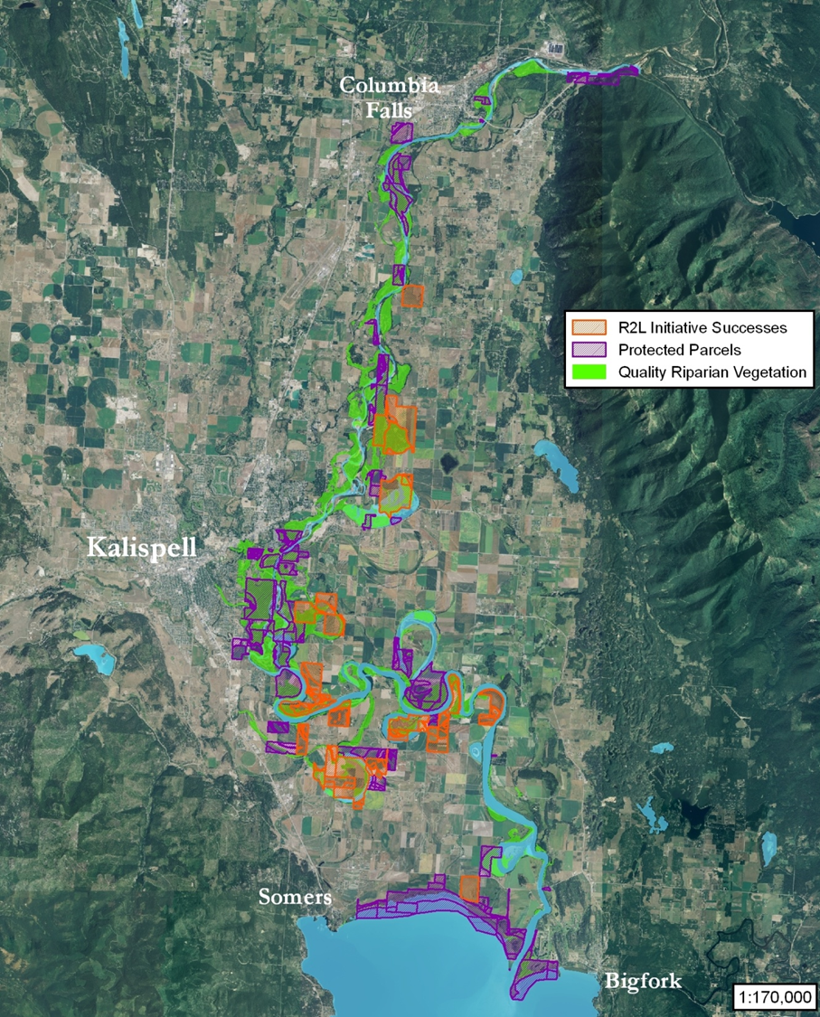
49% of Quality Riparian Area

Slide 21

51% of Wetlands in Focus Area

Slide 22

27% of
Slough
Buffers
Protected

Slide 23

Protection Added to
North Shore Flathead Lake
Flathead Lake

Slide 24



Future Conservation Opportunities

Slide 25



Land Protection Opportunities Identified
Of 135 unprotected parcels,
a) 37 are >160 acres in size
b) 35 contain >80 acres 100-year floodplain
c) 47 border >0.3 miles FR main channel
d) 33 contain >80 acres shallow groundwater
e) 35 contain >30 acres wetlands
f) 32 contain >40 acres slough buffer
g) 30 contain >30 acres quality riparian habitat
h) 30 contain >80 acres important ag. soils

Slide 26



Land Conservation
Continues

Slide 27



Outreach with Events

Slide 28

Hungry Horse Dam and Reservoir

Slide 29
Fisheries Habitat
Mitigation Program
126 km of fish habitat lost within the SF Flathead River and its tributaries
Bonneville Power Administration (BPA) is required under the Northwest Power Act to mitigate these loses to both Montana Fish, Wildlife & Parks and the Confederated Salish and Kootenai Tribes

Slide 30
Montana Fish, Wildlife & Parks (FWP) Mitigation Program
Accomplish habitat mitigation in two ways:
  Fee title acquisitions – FWP owns and manages the land
  Conservation Easements – private landowners continue to own the land, a land trust holds the easement, FWP helps with management of riparian and other wildlife habitat areas
BPA provides yearly O&M funding for all properties – restoration, weed management, etc.

Slide 31
Restoration of Properties
After conservation, restoration becomes the priority
Focused on fisheries habitat (riparian areas), but includes some upland restoration
Funding
  BPA O&M
  NRCS Environmental Quality Incentives Program (EQIP)
  State Wildlife Grants (SWG) Program
  FWP’s Private Land Technical Assistance
  Landowner Contributions

Slide 32
Restoration Approach
Started with consultants – plans developed and implemented by restoration professionals
Overall successful, but expensive
Need for cheaper alternatives and a desire to “take ownership” for restoration activities
  Learn from mistakes – requires consistent monitoring
  Develop site specific plans
  Use volunteer labor and involve the community
  Attempt to become the “experts” when it comes to restoration within the Flathead Valley above Flathead Lake

Slide 33

Restoration Challenge
Lower 22 miles of Flathead River is influenced by Kerr Dam – artificially high all summer long
Leads to massive erosion mainly occurring in the winter

Slide 34


Slide 35

Flathead River Steward Program

Slide 36
Of 37,000 projects in the National River Restoration Science Synthesis database:
20% had no listed goals
54% had project cost information
10% indicated that assessment
or monitoring had occurred
Bernhardt, E. S., Palmer, M., & Allan, J. D (2005). Synthesizing US -river restoration efforts. Science, 305:636-637.
Notes:
Not sure where Kris will leave off…

Slide 37

Created River Steward Program to assist with landowner outreach and follow-up, and to implement, monitor, and maintain restoration projects
  Awarded Big Sky Watershed Corps-members to pilot the program for two years
  2013, 2014 River Steward success
    Partners and landowners report vastly improved outreach and coordination on restoration projects
Notes:
Start talking here, instead? Need this slide?
Introduce the River Steward Program as a way to increase collaboration on complex conservation and restoration projects, and to increase their effectiveness and attractiveness to landowners
Subset of R2L partners involved with creation of River Steward program
Partnered with Big Sky Watershed Corps to staff the program during a pilot period
A lot of landowners have great intentions for their property that often includes conservation and restoration concerns, and only require a little bit of help to get the funding, technical assistance, or labor they need to implement
Follow-up maintenance and monitoring is a HUGE missing piece in many restoration projects (cite Palmer study?)

Slide 38

River Steward Program accomplishments:
  Implemented restoration projects on 5 properties
  Hosted 5 major volunteer events
  Developed 3 new restoration projects for 2015, with several more in early stages
Notes:
Make timeline more clear? What are we working on now…
Mention outreach, tours, landowner interactions, etc.

Slide 39
Restoration Challenges

Slide 40


Restoration Challenges
Physical
  Plant competition
Notes:
Animate text
Be clear about what the solutions intend to resolve

Slide 41


Restoration Challenges
Physical
  Plant competition
  Animals

Slide 42


Notes:
Animate growing season

Slide 43


Slide 44

Restoration Challenges
Physical
  Plant competition
  Animals
  Site conditions, climate

Slide 45


Restoration Challenges
Physical
  Plant competition
  Animals
  Site conditions, climate
Practical
  Can’t set it and forget it
  Every situation is unique
  $$
Notes:
Discuss importance of project maintenance and monitoring well into the life of the project
Bring study to beginning of slide, OR beginning of my talk to discuss the focus of the energy behind our program
Continued care and updates often required in order to achieve maximum success

Slide 46
Restoration Challenges
Physical
  Plant competition
  Animals
  Site conditions, climate
Practical
  Can’t set it and forget it
  Every situation is unique
  $$
Conceptual
  Restoration…to what?
  How to evaluate success
Notes:
There are many challenges facing restoration practices.
Not the least of which is the concept of restoration itself. Determining the end-goal of any practices is the most critical, and most challenging part

Slide 47


Slide 48
Restoration Challenges
Physical
  Plant competition
  Animals
  Site conditions, climate
Practical
  Can’t set it and forget it
  Every situation is unique
  $$
Conceptual
  Restoration…to what?
  How to evaluate success
Stakeholder Success
Aesthetics
Economic benefits
Recreation
Education
Most effective restoration
Ecological Success
Guiding image exists
Ecological improvement
Self-sustaining
No lasting harm done
Assessment completed
Learning Success
Scientific contribution
Management experience
Improve methods
Fig. 1 - Palmer, M. A., Bernhardt, E. S., & Allan, J. D (2005).
Standards for ecologically successful river restoration.
Journal of Applied Ecology, 42:208-217.
Notes:
Create new diagram
Move diagram to beginning of talk?
Could help structure the outset (our goals, etc.)

Slide 49
Contact Information
flatheadrivertolake.org
Constanza von der Pahlen, Flathead Lakers criticallands@flatheadlakers.org; (406) 883-1341
Laura Katzman, Flathead Land Trust
lkatzman@bigsky.net; (406) 752-8293
Kris Tempel, MT Fish, Wildlife and Parks
ktempel@mt.gov; (406) 751-4573
Aaron Clausen, Flathead River Steward
riversteward@outlook.com; (406) 752-4242

