Slide 1
An Assessment of Municipal Water Systems and Water Rights in the Clark Fork River Basin
Jacob Petersen-Perlman
University of Montana
Department of Geography
March 5, 2010

Slide 2
Research Questions
Are the municipal water rights sufficient to meet current and future needs in the Clark Fork River basin?
If the water rights aren’t sufficient, what are some alternatives that municipalities can implement?
What is the level of understanding that water system managers have of water resource policies that could affect the ability of municipalities to expand their water rights in the future?

Slide 3
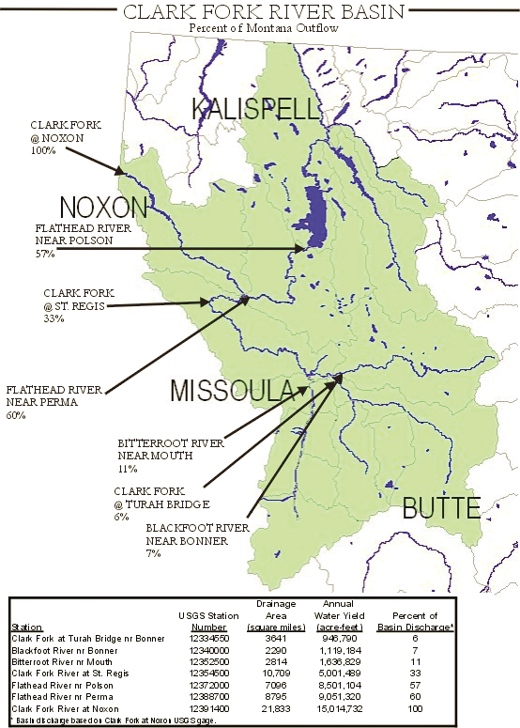
Clark Fork River Basin Background
Headwater tributary basin of the Columbia River
Basin spans majority of western Montana
Three largest reservoirs: Hungry Horse (3.5 million ac-ft), Flathead Lake (1.8 million ac-ft), Noxon Rapids (500,000 ac-ft)
Total drainage area: 21,833 mi²
Source: http://www.dnrc.mt.gov/wrd/water_mgmt/clarkforkbasin_taskforce/images/cf_outflow_map.pdf

Slide 4
Clark Fork River Basin Background
Population
  68% of basin’s population resides in Flathead, Missoula and Ravalli Counties
    The three counties accounted for 92% of the basin’s population growth since 2000
Major communities
  Anaconda
  Butte
  Hamilton
  Kalispell
  Missoula
  Whitefish
YEAR | POPULATION
2000 | 301,888
2006 (est.) | 322,709
2010 (est.) | 342,780
2030 (est.) | 454,820
Source:
Ockert, Susan. “Demographics of the Clark Fork River Basin.” Clark Fork Water Supply & Growth Conference, 2008.

Slide 5
Avista Utilities
Owns and operates Noxon Rapids Dam and Noxon Reservoir
Relatively senior hydropower water rights totaling 50,000 cfs, which are sufficient to use almost all the flows leaving the basin
Clark Fork River’s flows > 50,000 cfs occurred only 6-8% of the time over a 90 year period of record
Avista has never challenged new water rights, with the exception of an application by Thompson River Lumber Company (TRLC)

Slide 6
Avista Utilities
Avista’s Hydro Project Manager Steven A. Fry listed two scenarios where they would most likely not object to future applications:
  Points of diversion are in Flathead R. Basin, upstream of Flathead Reservation
  If downstream, the application meets at least one of the following:
    Water amount de minimus
    Proposed use is largely non-consumptive
    Aquifer recharge or mitigation is developed to offset adverse impacts

Slide 7
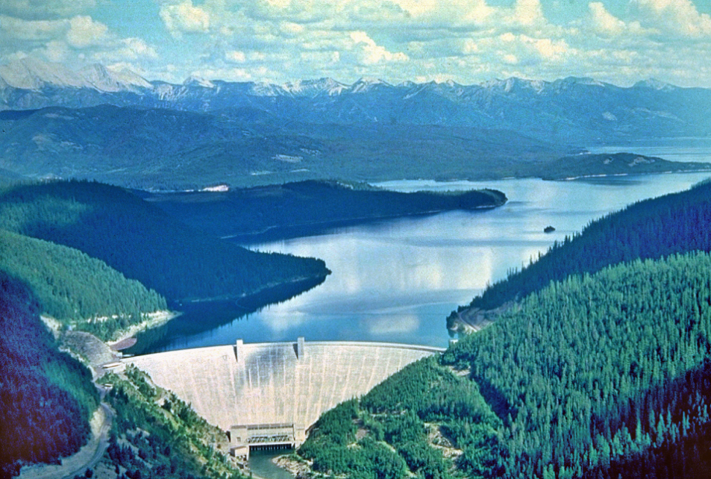
Hungry Horse Reservoir
State of Montana is engaged in discussions with US Bureau of Reclamation (BOR) to lease water due to Clark Fork Task Force idea and recommendation
Water would be used to fulfill Avista’s water rights downstream, freeing up water for municipal and industrial uses
Source: http://www.bpa.gov/corporate/bpanews/library/images/dams/descriptions/hungryhorse.cfm

Slide 8
Water Rights in Closed Basins
Section 85-2-319 MCA legislatively authorizes the closure of basins to certain new appropriations through the adoption of administrative rules & negotiation of reserved water rights compacts
No municipal water rights exception in Upper Clark Fork basin (MCA §85-2-336)
No “Growing Communities Doctrine”
Clark Fork River basin in de facto closure (with the exception of the Upper Flathead)
  Upper Clark Fork River, Bitterroot River basins officially closed

Slide 9
Methods
Data collected for each municipal water right claimed or filed in basin
Interviewed municipal water system operators/managers
Total flow rates and volumes aggregated for each community (Montana DNRC Water Rights Query System)
Demographic data obtained from 1990 and 2000 Censuses when available; 2007 pop. Estimates from Montana’s Census and Economic Information Center (CEIC)
Water use then projected for 2020 and 2030

Slide 10
Communities contacted
Upper Clark Fork
  Anaconda-Deer Lodge City/County
  Butte-Silver Bow
  Deer Lodge
  Philipsburg
  Seeley Lake
Bitterroot
  Darby
  Hamilton
  Lolo
  Pinesdale
  Stevensville
Upper Flathead
  Bigfork
  Columbia Falls
  Coram
  Evergreen
  Hungry Horse
  Lakeside
  Kalispell
  Martin City
  Somers
  Whitefish
  Woods Bay

Slide 11
Communities contacted
Lower Flathead
  Charlo
  Hot Springs
  Pablo
  Ronan
  St. Ignatius
Middle/Lower Clark Fork
  Missoula
  Plains
  Superior
  Thompson Falls

Slide 13
Findings
Upper Clark Fork
  Seeley Lake only community in trouble
Middle & Lower Clark Fork
  Missoula
Flathead
  Upper
    Lack of conservation
    Plenty of water (open basin)
  Lower
    CSKT
    Some towns forecasting future shortages
Bitterroot
  Water quality issues (nitrates, turbidity)
  Hamilton, Stevensville

Slide 14
Findings
Conservation measures to meet shortages
  Most communities have alternating days for lawn watering
  Rates and metering effective conservation measures
Familiarity with policies
  In general, larger communities = higher familiarity
    Also smaller communities with water shortages
Wastewater treatment
  Only a few communities have this issue
Vast majority of communities have enough in water rights for current and future needs
  However, question is being able to change the place of use
How my findings will help with Hungry Horse leasing needs

Slide 15
Questions?

