Slide 1
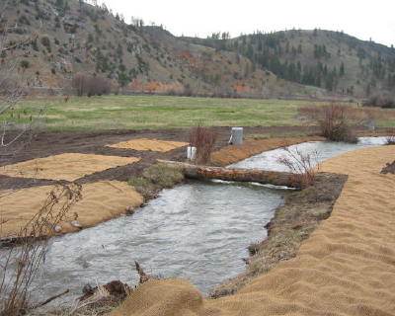
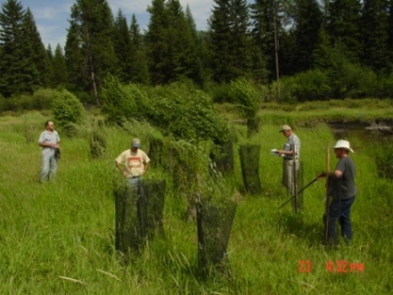
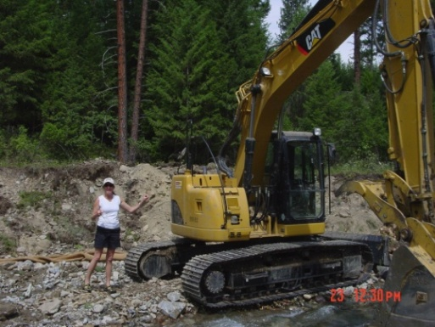
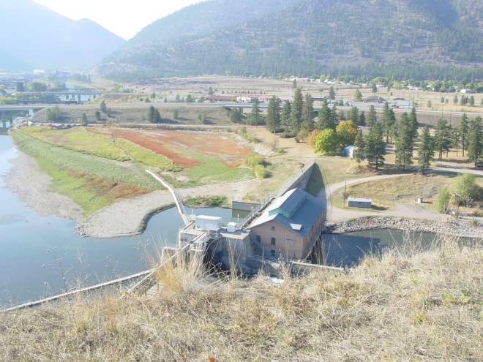
A BRIEF HISTORY of STREAM RESTORATION in MONTANA (and the Clark Fork) Chuck Dalby Hydrologist Montana Department of Natural Resources and Conservation, Water Management Bureau Helena MT March 5, 2010

Slide 2
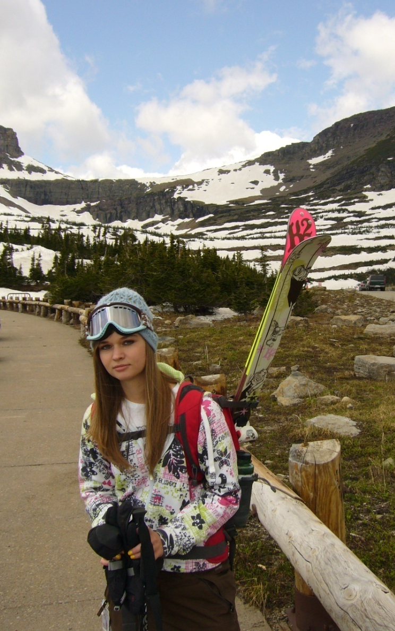

Slide 3
Conclusions of Presentation
♦ Fisheries biologists launched stream restoration in early
1900's -- fish remain driving force;
♦ > 50% of contemporary habitat enhancements developed
by 1940 -- re-invented and marketed in 1980's to present;
♦ Contemporary nation-wide stream restoration enterprise launched in Montana (1982); accelerated by Dave Rosgen;
♦ Criticism of stream restoration in 1930's, 1990's, and 2005 remains legitimate (even in the Clark Fork !) -- but great improvement in science and practice

Slide 4
OVERVIEW 1. Origins of Stream Restoration (1900 to 1950 ) 2. Market Driven Restoration (1983- 1995 or so) ♦ Montana entrepreneurs ♦ Dave Rosgen (1981-Present) 3. Here Come the Academics (1995 to Present) 4. Upper Clark Fork (Doc Watson's Impossible Mission)

Slide 5
What I won't discuss (but would like to)
Semantics of "Restoration"
►Restoration
►Rehabilitation
► Remediation
► Re-naturalization
► Enhancement
Ethics of "Restoration"
Restoration vs. Preservation

Slide 6
1. ORIGINS of STREAM RESTORATION
The Ancients
Manipulation
Native Americans
Sport Fishing:
Conservation/ Enhancement

Slide 7
RIVER PROBLEMS: START of 20th CENTURY
Eastern United States and (Western US)
♦deforestation/woody debris clearing/
log runs
♦commercial fishing
♦ general pollution
sawmills, pulp and paper mills; gas, wood,
alcohol, chemical, glass , dye works, oil
refineries, distilleries, breweries ,smelting
and mining, factories of all sorts,
dead animals, garbage, trash, sewage

Slide 8
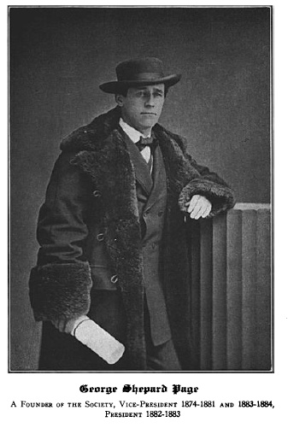
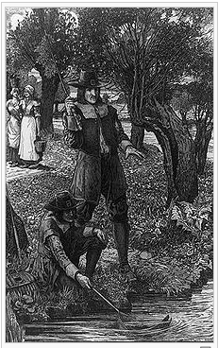
ENTER the
AMERICAN FISHERIES SOCIETY
Founded December 20, 1870
♦commercial fisheries management
♦conservation of sport fisheries
Izaak Walton
(1593-1683)
I.W. League
(1922)

Slide 9
PROBLEMS >>>> BY 1911 U.S. Bureau of Fisheries Had:
Commercial Fisheries Maintenance
♦219,000 persons engaged in fisheries
♦$ 95,000,000 invested in vessels, boats and other property,
♦ generated fish products (hatched fish) worth $60,000,000 annually
Radical Notion that:
" game fishes in connection with recreation and summertime
resort industry...really seem to deserve being ranked
as an industry"
♦ harvest of fresh-water game fishes sent to
market=55,000,000 pounds
(does not include sport anglers catch)

Slide 10
Guiding Principle:
"The primary purpose of all stream improvement is to provide better living
conditions for fish."
"In all stream improvement work it cannot
be too strongly emphasized that the utmost
care should be exercised that the work is
not overdone".
H.S. Davis, Chief,
US Bureau of Fisheries

Slide 11
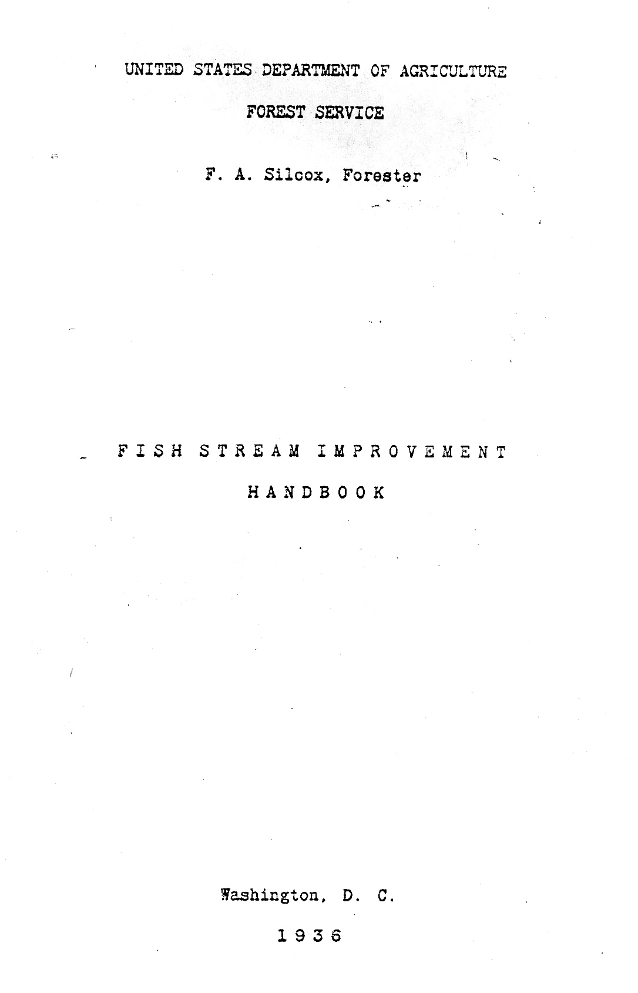
CLASSIC BIBLES

Slide 12
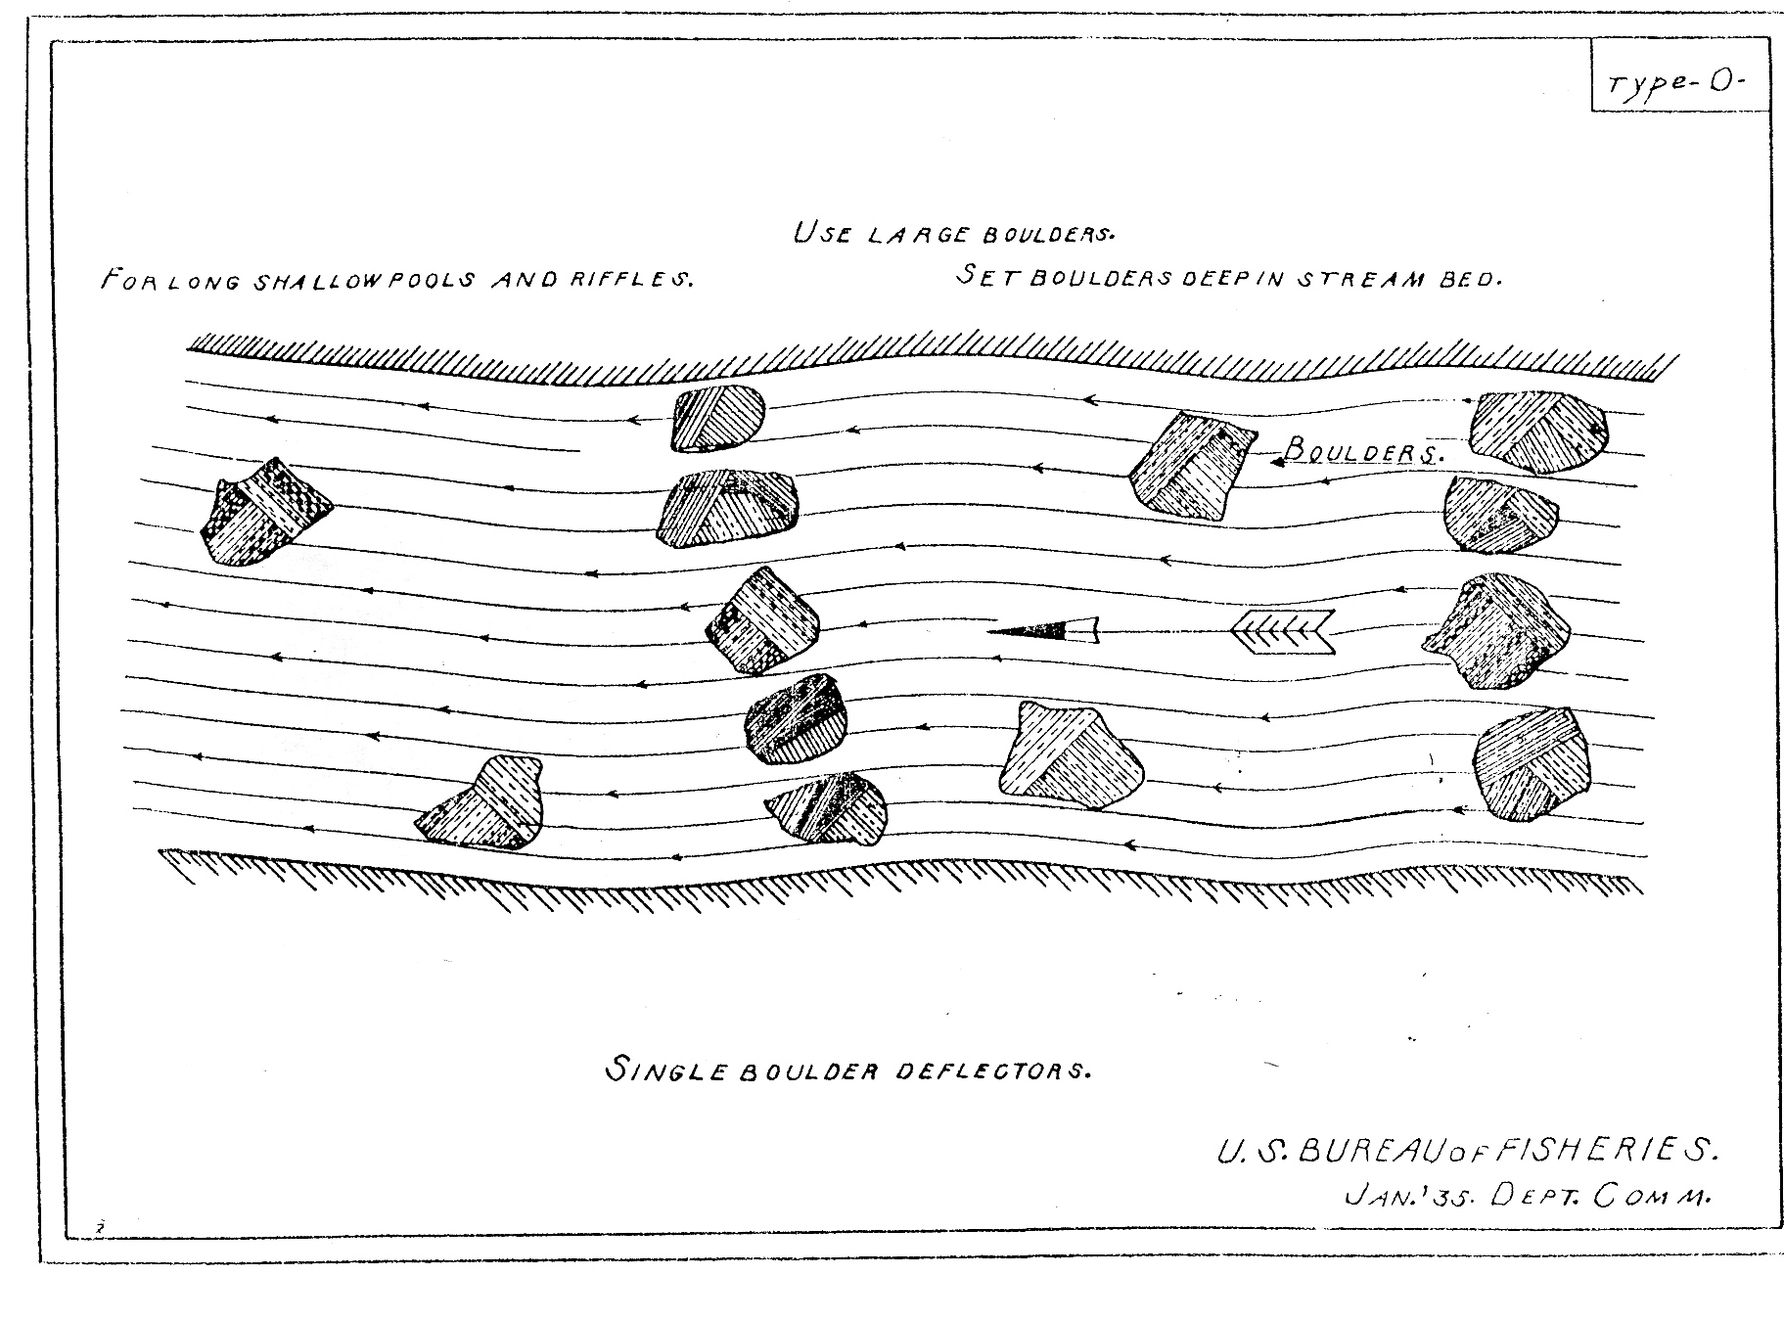
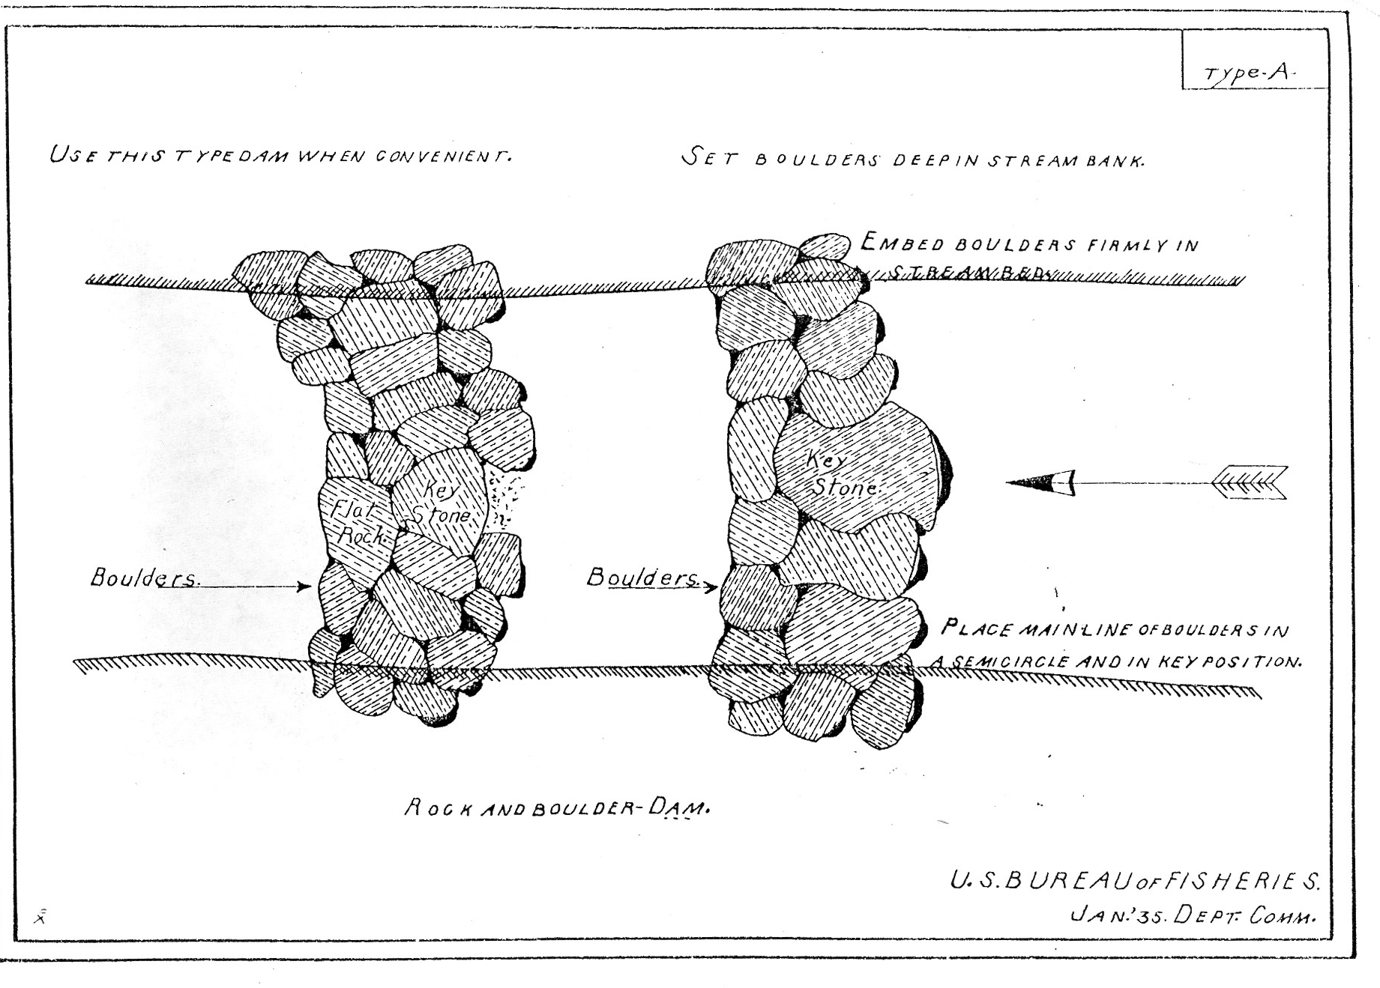
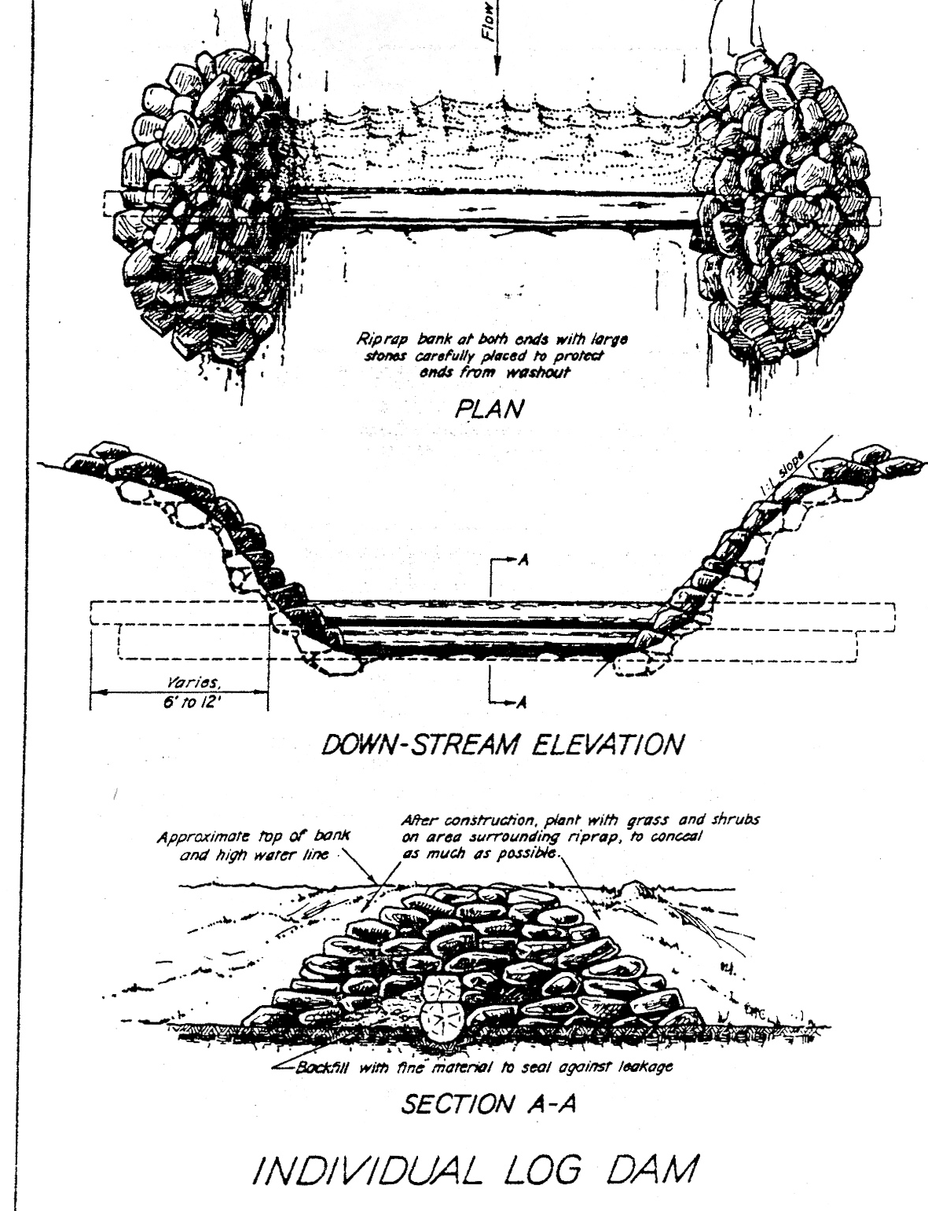
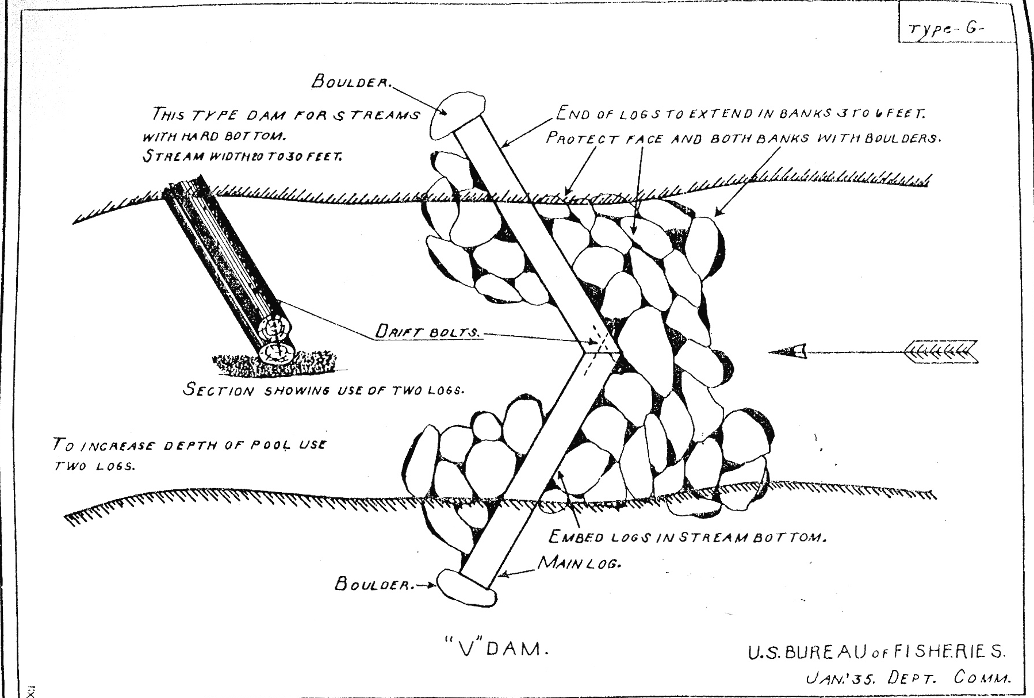
Déjà Vu

Slide 13
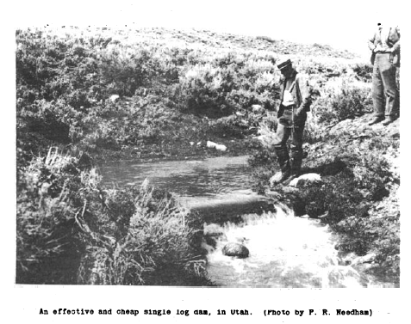
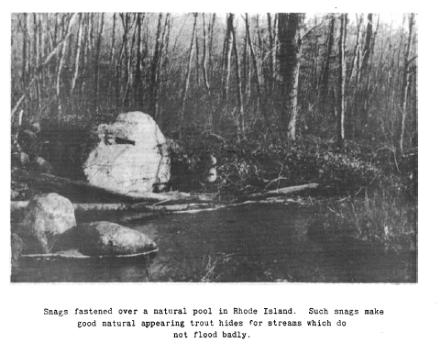
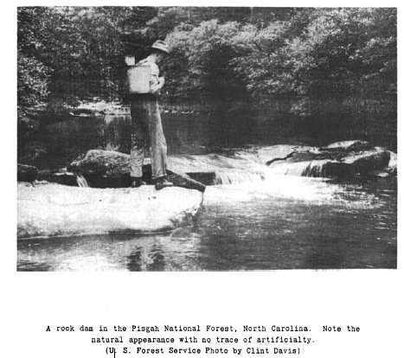
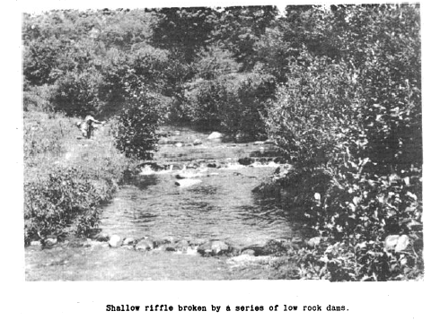

Slide 14
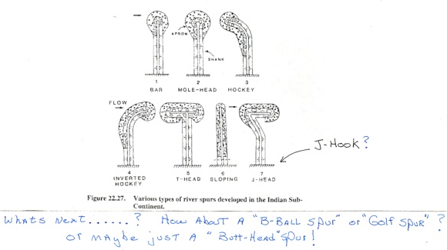
Hydraulic Engineering Manual--circa 1939

Slide 15
1930's and
U.S. BUREAU of FISHERIES
1933 - 1935 Using depression era labor
resources and "conservation
corps", 31,084 in-stream
structures (dams, deflectors,
cover) were constructed on
406 mountain streams

Slide 16
(1930's and U.S. BUREAU of FISHERIES)
"In some instances hardly a foot of stream has been left in its original condition..of what benefit to a stream is it to construct cover for many times the number of fish the stream can support."
H.S. Davis, Chief,
US Bureau of Fisheries

Slide 17
U.S Forest Service 1950--1992
1952, 1985 and 1992 ver. Stream Habitat
Improvement Handbooks
" did not expand on anything learned from
past modes of operation....little understanding
on whether proposed practices...provide
benefits....within the ecologic and geomorphic
context of stream or watershed."
(Beschta, Platts, Kauffman and Hill 1994)

Slide 18
2. Market Driven Stream Restoration
(1983- 1995 or so)
Stream Restoration in Montana--Early Catalysts
♦ Stream Protection Act of 1963
♦ Natural Streambed and Land Protection Act of 1975
to physically alter a stream, one must obtain a permit
that specifies measures required to protect the stream

Slide 19
1982
Stream Restoration
Market Launched in
Montana

Slide 20
Timberline Reclamation, Inc
♦ Wall Street Journal Article, Jan. 25, 1982
"Small Company is Pioneering the Reclamation of Streams"
" A big brown trout flips in the water, 'Whoa, whoa, WHOA,'
shouts Richard McIntyre, bounding towards the creek..
'My God that's a pair of 14 inchers... love it, I love it'. "
"Founded in 1978, Timberline Reclamation has five full-time employees...
In fiscal 1982, Mr. McIntyre expects a revenue of $500,000, nearly double
last year's $260,000. and because he requires customers to pay for all
project-related expenses, he anticipates earnings of $300,000 to $325,000.
'I try to shoot for a profit margin of 70%'. "

Slide 21
1983
♦ Former employees of
Timberline found
Inter-Fleuve, Inc.
♦ A couple of UM Geology grads
form (the first)
Streamworks, Inc.

Slide 22
1984 to present
The Second Coming of Dave Rosgen
♦ good
(Dave made fluvial geomorphology a household word)
♦ bad
(now everyone is an expert on physical channel processes --
well, sort of......)
♦ ugly
(success vs. failure
"The Rosgen Wars")

Slide 23
Current Day Stream Restoration
Diverse Market Driven by :
♦ litigation, mitigation, profit incentive, altruism
Motivated by the Politics, Democracy, and Spiritualism
of "restoring" damaged rivers and ecosystems
Proponents:
♦ state and federal land and water managing agencies
♦ watershed and environmental organizations
♦ universities and professional societies
♦ conservation trusts and landowners
♦ engaged and educated public

Slide 24
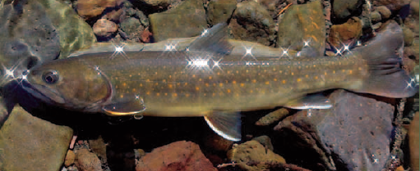
Montana DFWP River and
Fisheries Restoration
1989-- Legislature established River Restoration
Program and funded using license fees
to restore fish and wildlife habitat
1995-- Legislature established Future Fisheries
Improvement Program--expanded funding
and scope to include lakes and reservoirs

Slide 25
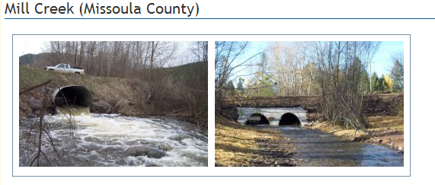
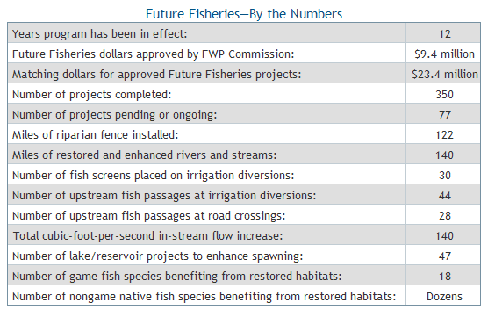
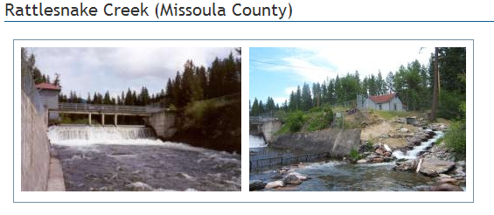
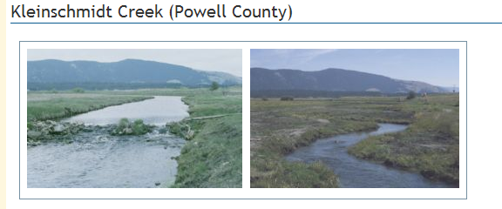
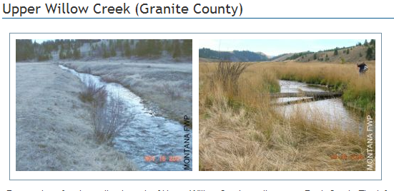
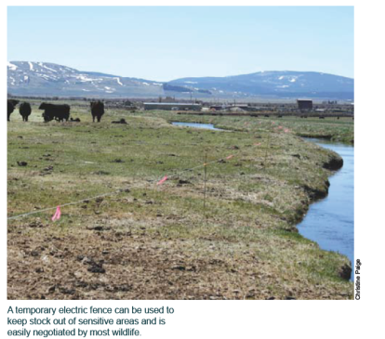
(as of 2008)
Program has effective
review and project
monitoring

Slide 26
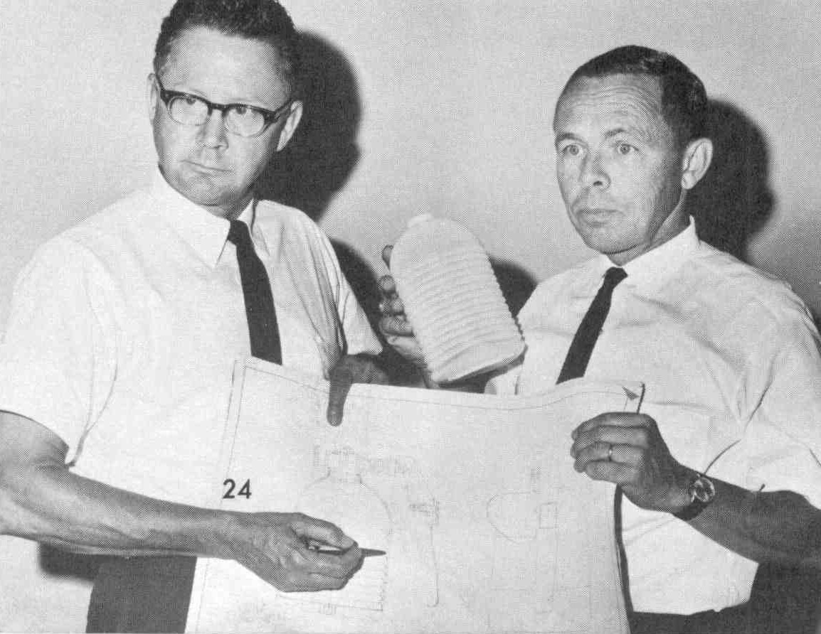
3. HERE COME the ACADEMICS
1994 (~2000) to Present
Where were they ?
and
Why did it take so long ?

Slide 27
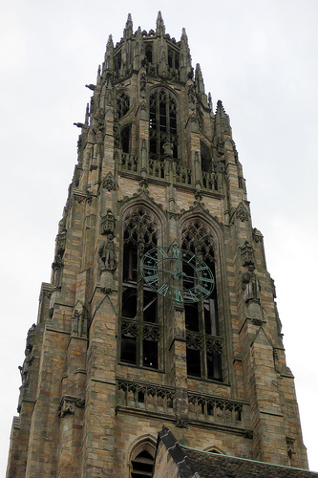
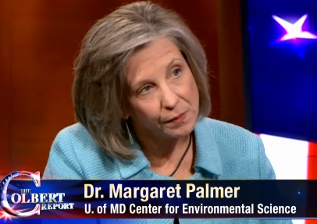
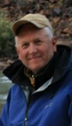
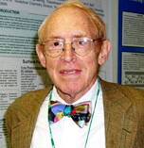
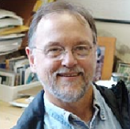
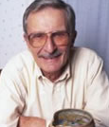
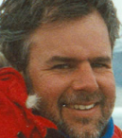
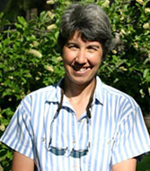
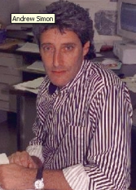
Some were in Towers
Jack Schmidt
Luna Leopold
Matt Kondolf
Emily Bernhardt
"Reds" Wolman
J. Boone Kauffman
Tom Dunne
Gary Parker
Robert Beschta
Peter Wilcock
Ned Andrews
Stan Schumm
Gordon Grant
David Montgomery
Bill Dietrich
Ellen Wohl
Tim Abbe

Slide 28
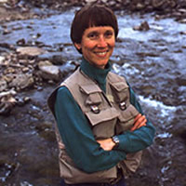
Some were already here and
actively participating !
Some were getting educated !

Slide 29
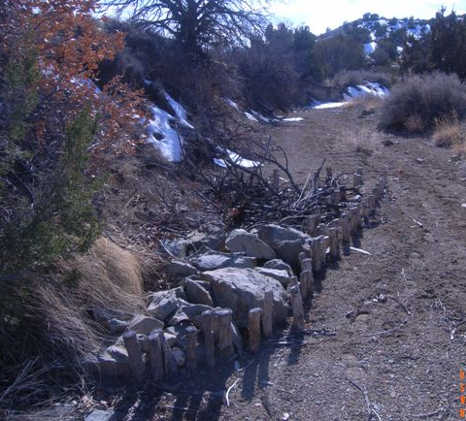
ARTIFICIAL STREAM RESTORATION
Money Well Spent or An Expensive Failure
(Beschta and others 1994)
♦ Science behind efforts ?
♦ Damage caused by naive projects ?
♦ Emphasis on "put-and-take ?
(trout-stocking programs)
♦ Focus on physical habitat ?
(lack of ecosystem perspective)

Slide 30
Academics were doing research and had
little incentive to "dirty" their hands with
river restoration ! WHAT CHANGED ?
♦ River restoration market initiated by Montana consultants
and largely developed by Rosgen had matured ($);
♦ River restoration "failures" and lack of monitoring;
♦ Evolving state-of-the-art of ecosystem science and
fluvial geomorphology (nothing more completely
challenges or integrates the science , than restoration);
♦ Restoration envy.

Slide 31
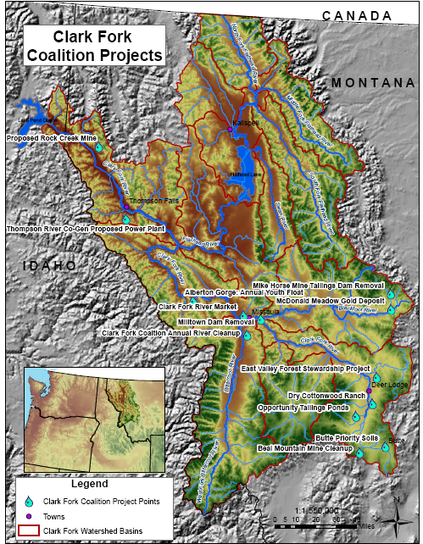
4. Restoration in Clark Fork Basin
Doc Watson's
Impossible Mission:
Assemble cumulative historic
timeline of who performed
restoration in Clark Fork
Basin, what, when, where and
how much it cost to date......
Surely a simple task in today's
GIS-driven information age ?

Slide 32
Well -- Not Exactly...........
♦ Numerous agency- (or entity), specific
tabulations (Excel to relational databases
--most not GIS-based);
♦ Lack of consistent database architecture and QA;
♦ Task of developing and maintaining a
comprehensive state (or basin-wide ?)
database too large for any one entity
BUT SOMEONE SHOULD BE DOING THIS !!!

Slide 33
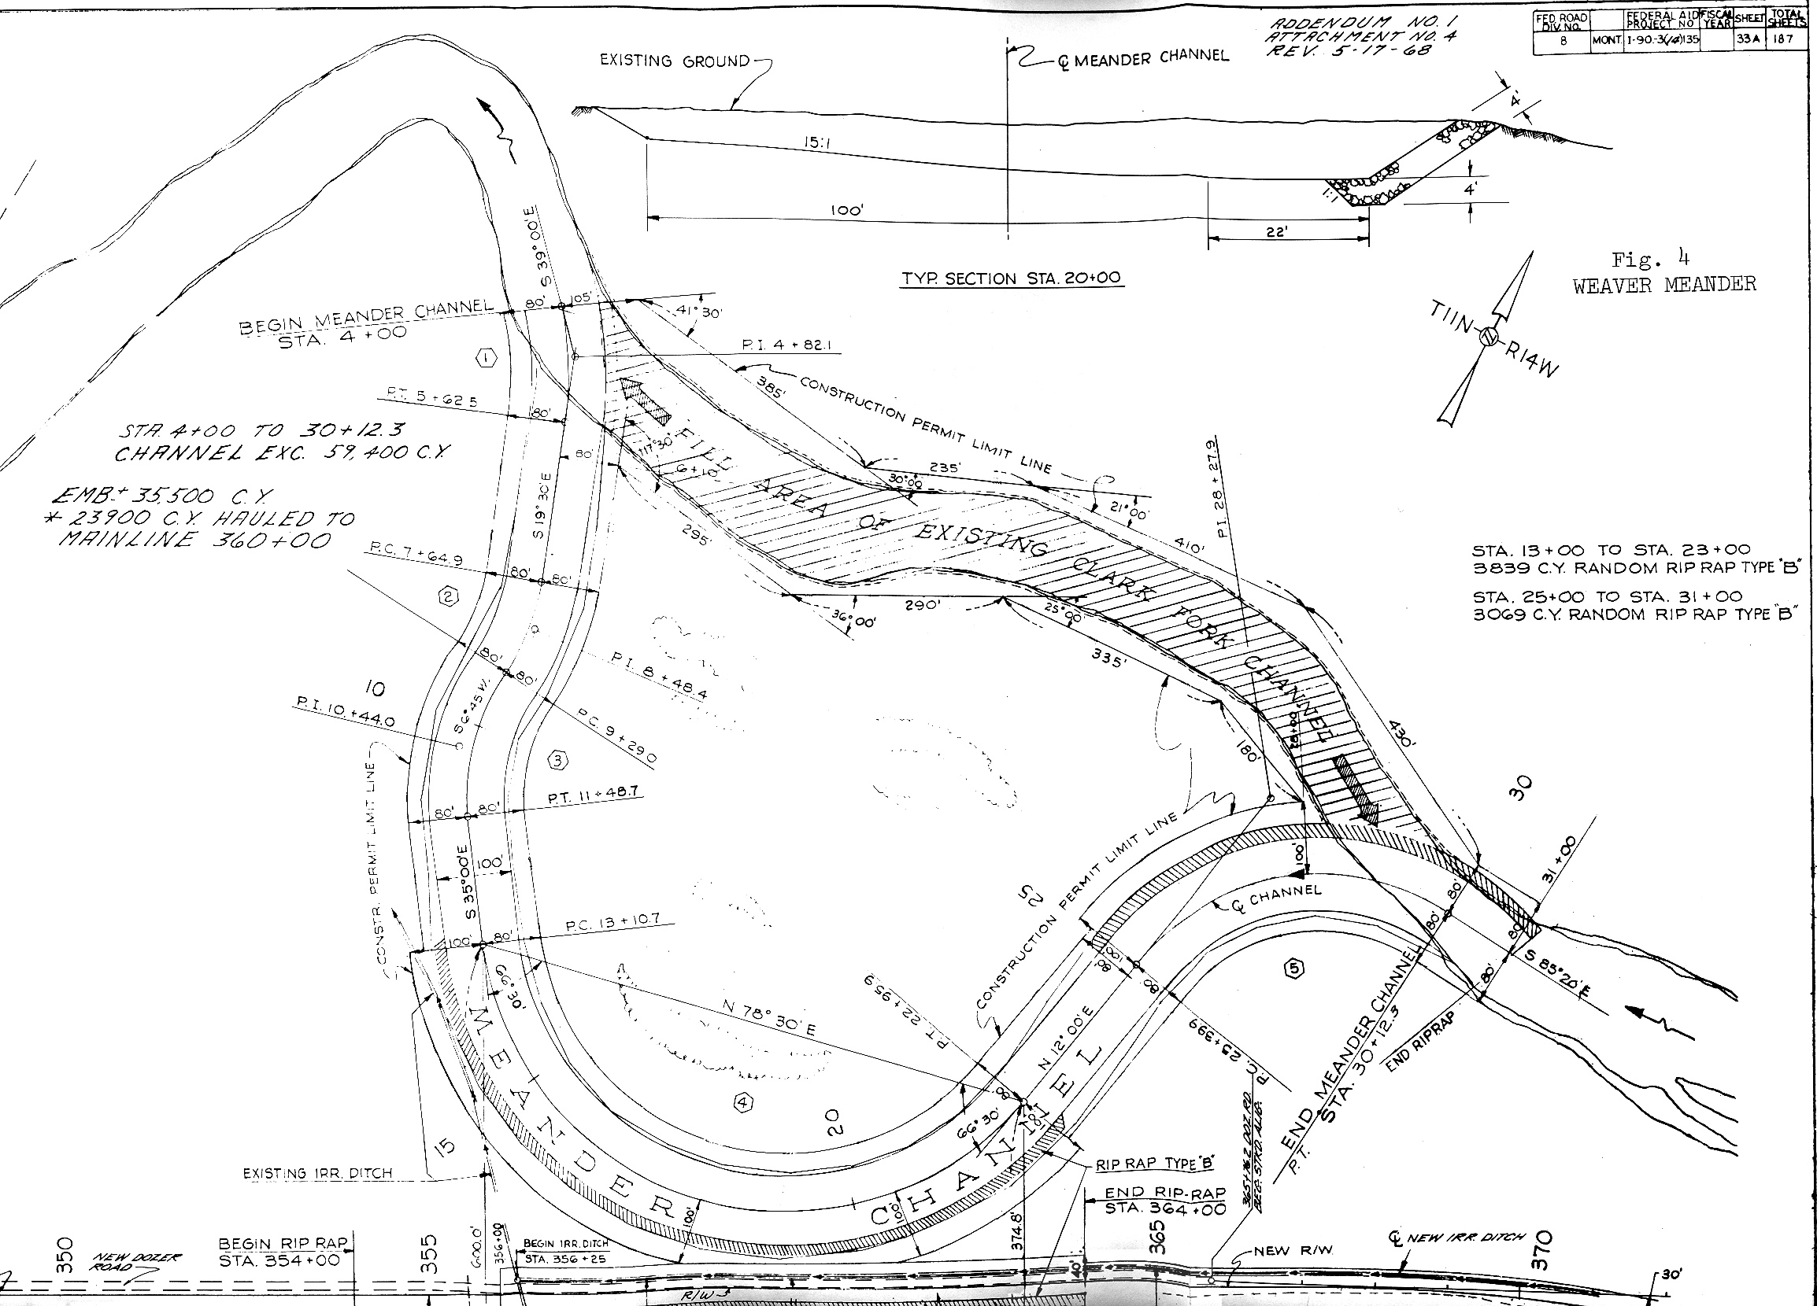
Early (1972) example of "Mitigation/Restoration"
in Clark Fork Basin Downstream of Drummond
♦ Increase channel length to compensate Interstate-90
construction
♦ Montana State Highways, FHA, FWP , and MSU Civil Engineering

Slide 34
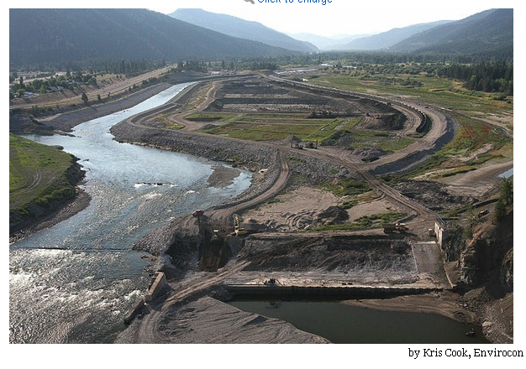
Major Participants in
Clark Fork Basin
Agencies and Corporations:
DFWP Future Fisheries Program DEQ 319 Program
DNRC Loan and Grant Program DNRC Conservation Districts
EPA and DEQ Super fund Programs
USFS, USFWS, NRCS, USBR
Confederated Salish and Kootenai Tribes
Butte, Missoula and Deer Lodge
ARCO, ASARCO, AVISTA, Northwestern
Watershed and Citizen Groups:
Clark Fork Coalition Blackfoot Challenge
Trout Unlimited Nature Conservancy
Montana Wildlife Federation Montana Water Trust
Universities:
UM River Center UM EVST MBMG/Montana Tech
MSU Reclamation Land Res. and Env Sci.
Consultants: All
Photo: Kris Cook, Envirocon

Slide 35
Estimate presented at 2000 Clark Fork Symposium

Slide 36
Estimate of MINIMUM "Restoration" Costs/Commitments in Clark Fork Basin: 1990 to Present (and beyond)
(amounts include expenditures to date and firm commitments)

Slide 37
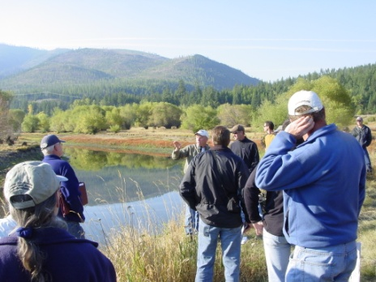
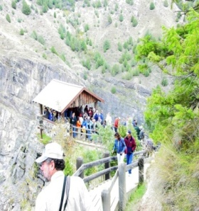
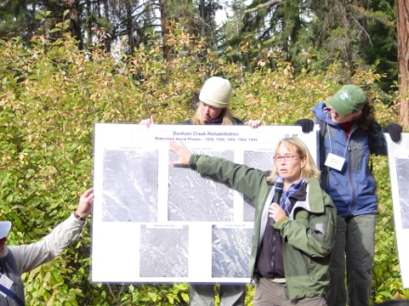
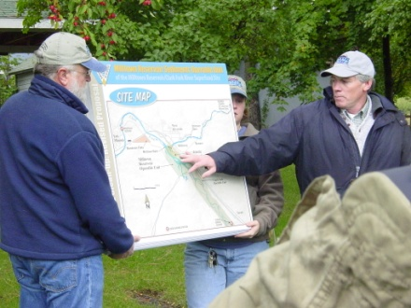
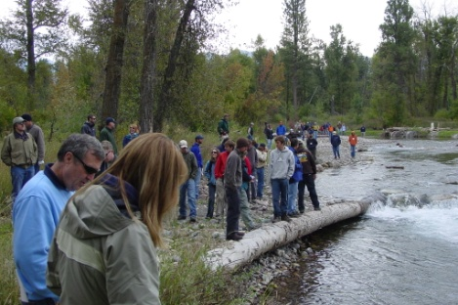
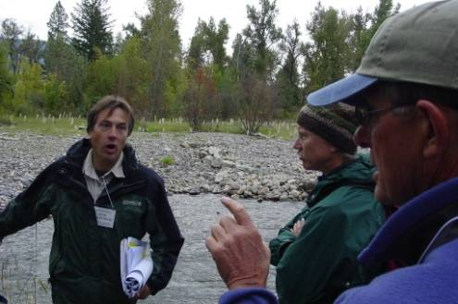
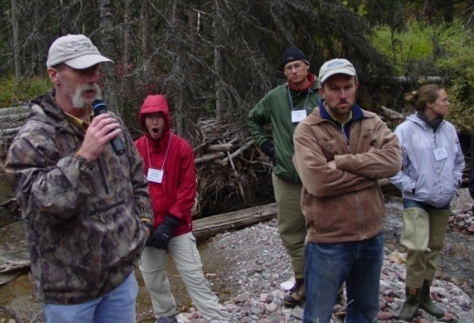
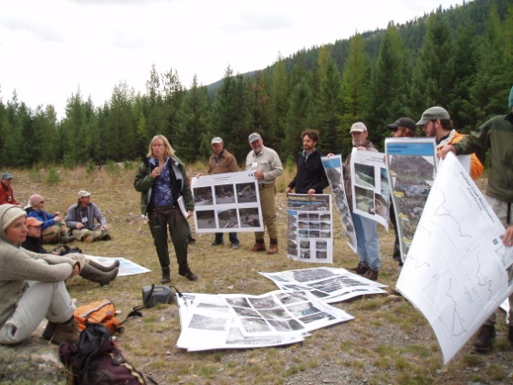
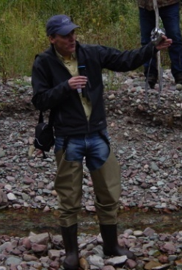
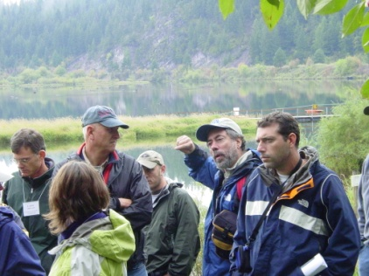
Importance of UM River Center, Clark Fork Coalition,
Task Force, CFRTAC and public participation
The interface between restoration, science, politics and reality is messy
and at times contains the drama and angst of soap operas, but good
outcomes require a democratic approach

Slide 38
So, have Clark Fork "restoration" efforts
been successful ?
Depends--for large complex efforts (Milltown)
it is too early to tell (ask that in 25 to 50 years ?)
More important, is there a framework for measuring
future "success" with any certainty ?
Yes -- but don't get complacent !

Slide 39
