Slide 1
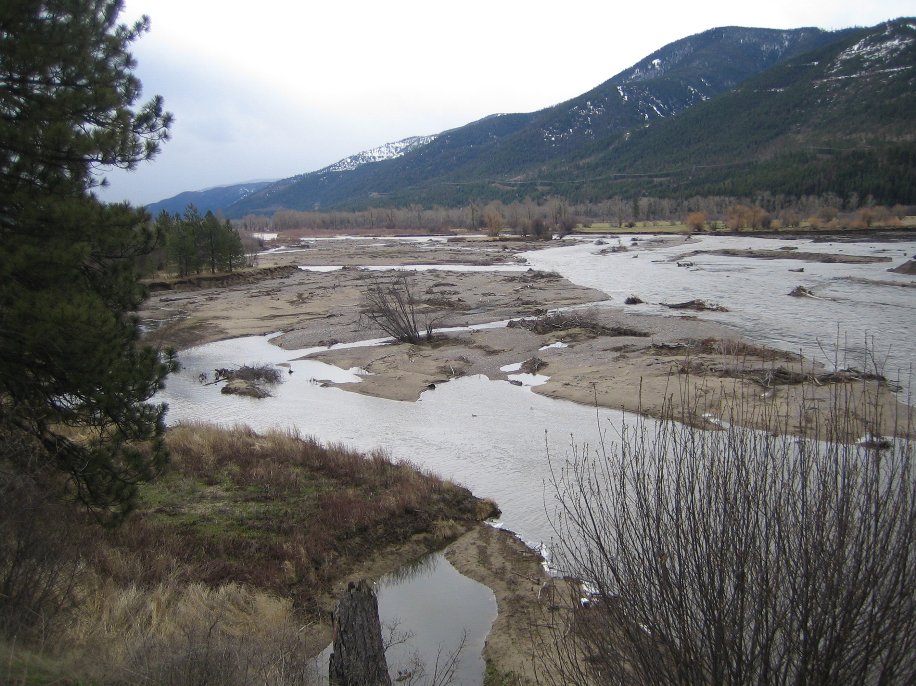
Geomorphic evolution of the Clark Fork River in response to the removal of Milltown Dam
Douglas Brinkerhoff and Andrew C. Wilcox
Dept. of Geosciences, University of Montana
Acknowledgments: Josh Epstein, James Johnsen, Elena Evans, Cleo Woelfle-Erskine, Leonard Sklar

Slide 2
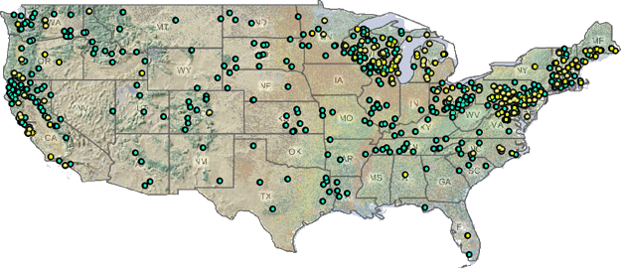
US dam removals
Notes:
Many dam removals, but little data on river response, little knowledge transfer between removals

Slide 3
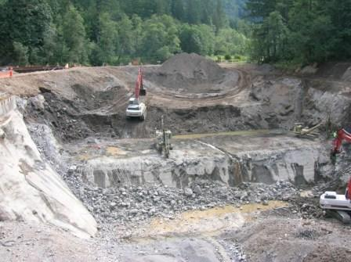
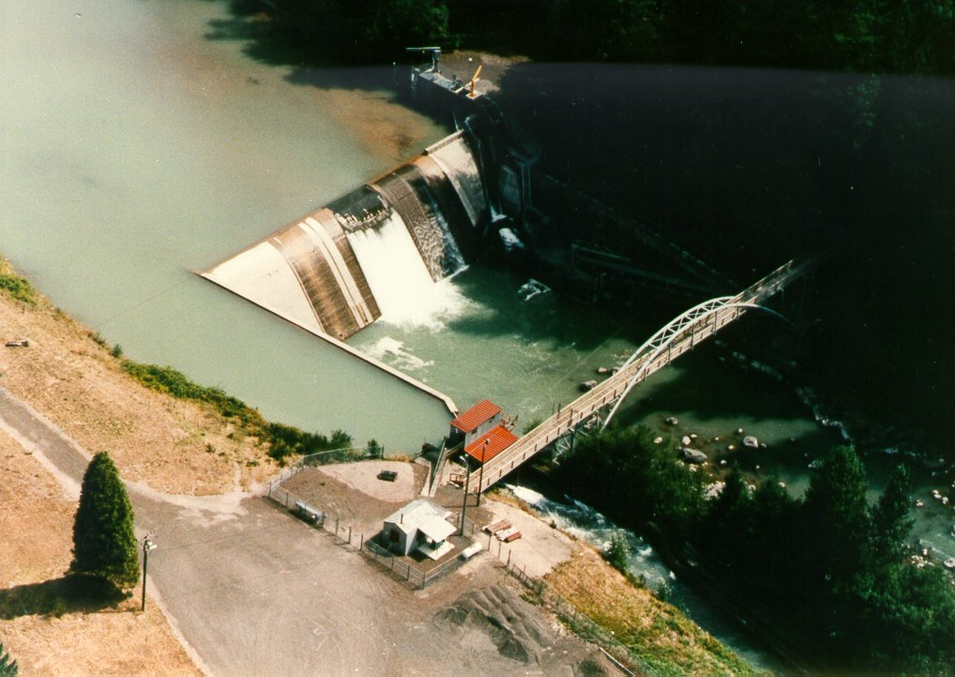
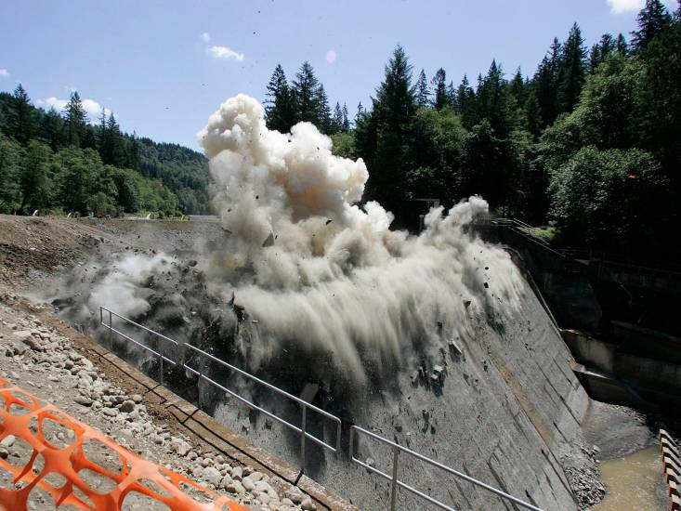
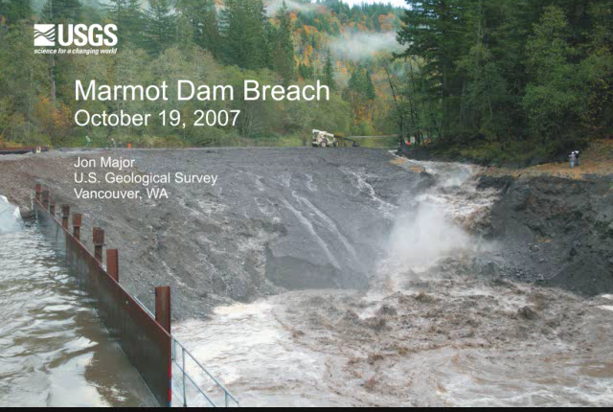
Marmot Dam, Sandy River, OR
after most concrete removed, 8/9/07
Removed in 2007
Notes:
Marmot- an example of a removal with state of the art modeling applied in advance to predict downstream impacts, plus intensive data collection afterward to see what happened, how quickly sediment moved out of reservoir & where it went, comparisons to model predictions

Slide 4
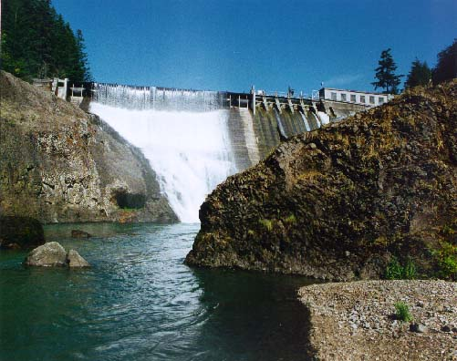
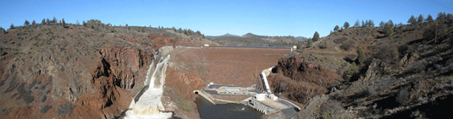
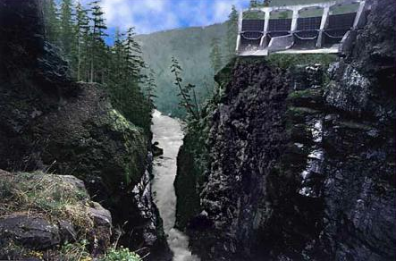
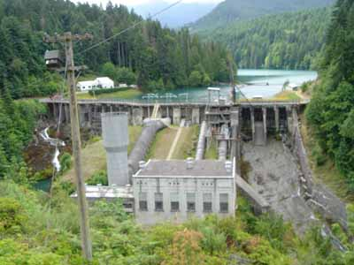
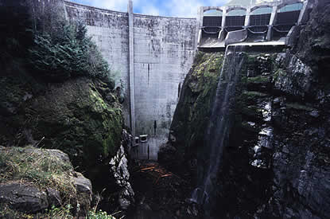
Dam removal
Condit Dam
White Salmon River, WA
2020
Iron Gate Dam, Klamath River
2010?
Elwha Dam, Elwha River
Glines Canyon, Elwha River
Glines Canyon Dam, Elwha River
Post-removal
2011
2011
Notes:
Other significant dam removals planned in Pacific NW
Important geomorphic questions: Sediment routing, channel evolution (reservoir & downstream)
How much $ needs to be spent to mitigate potential sediment impacts?

Slide 5
Questions
Upstream
  How do accumulated sediments erode out of reservoirs?
  Geomorphic response to base-level lowering?
Downstream
  How does a sediment pulse move downstream?
  Where does sediment go?
  How does it change downstream channels & habitat?
  How long do changes last?
Why study this dam removal?
Notes:
Unique aspects of Milltown: Contaminants: problem, tracer, public concern
Sediment removal
Channel reconstruction (“restoration”)
Groundwater remediation

Slide 6
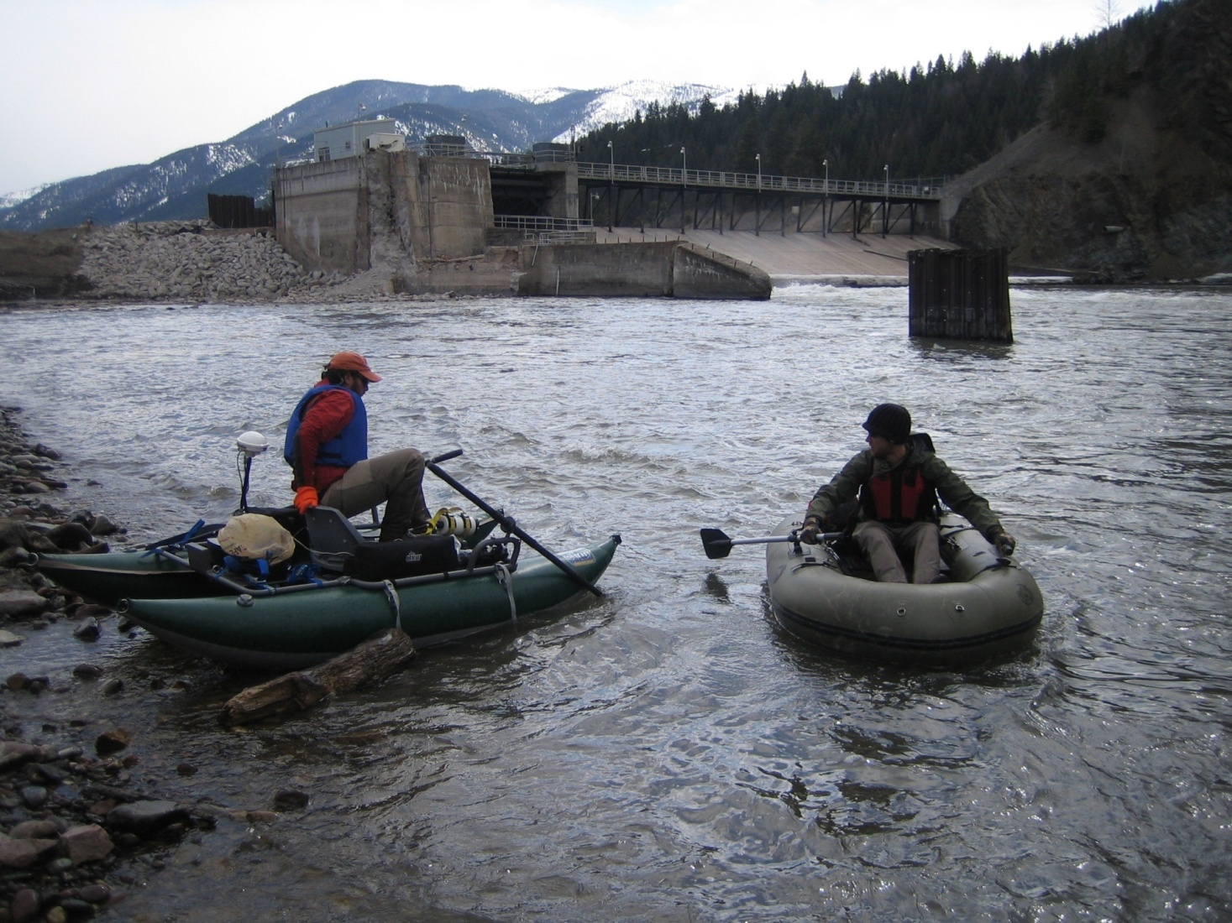

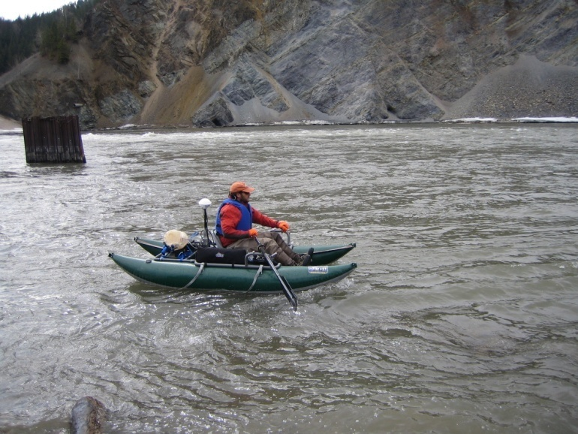
Notes:
Next 3 slides: this research combined efforts of many students applying many methods, 2 undergrad theses, 3 MS theses in my group

Slide 7
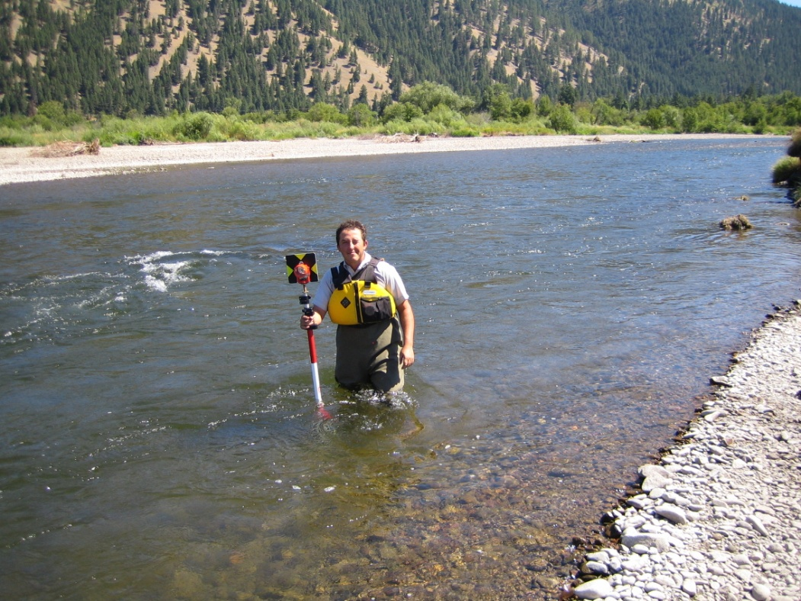
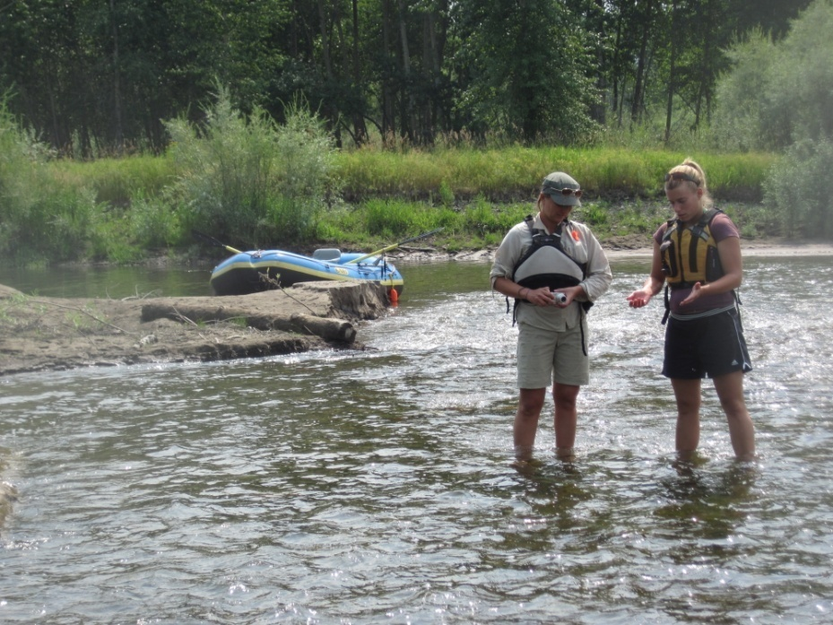
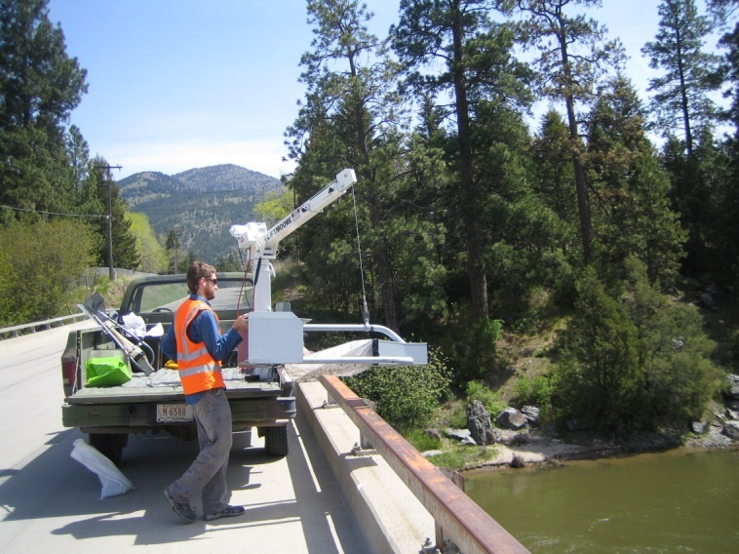
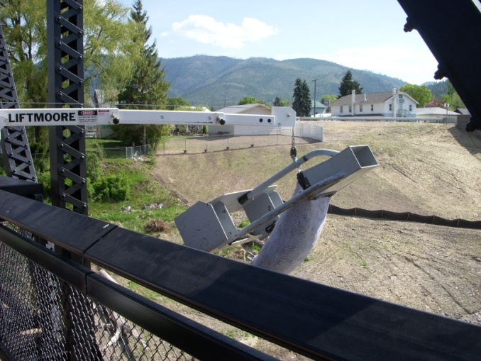

Slide 8
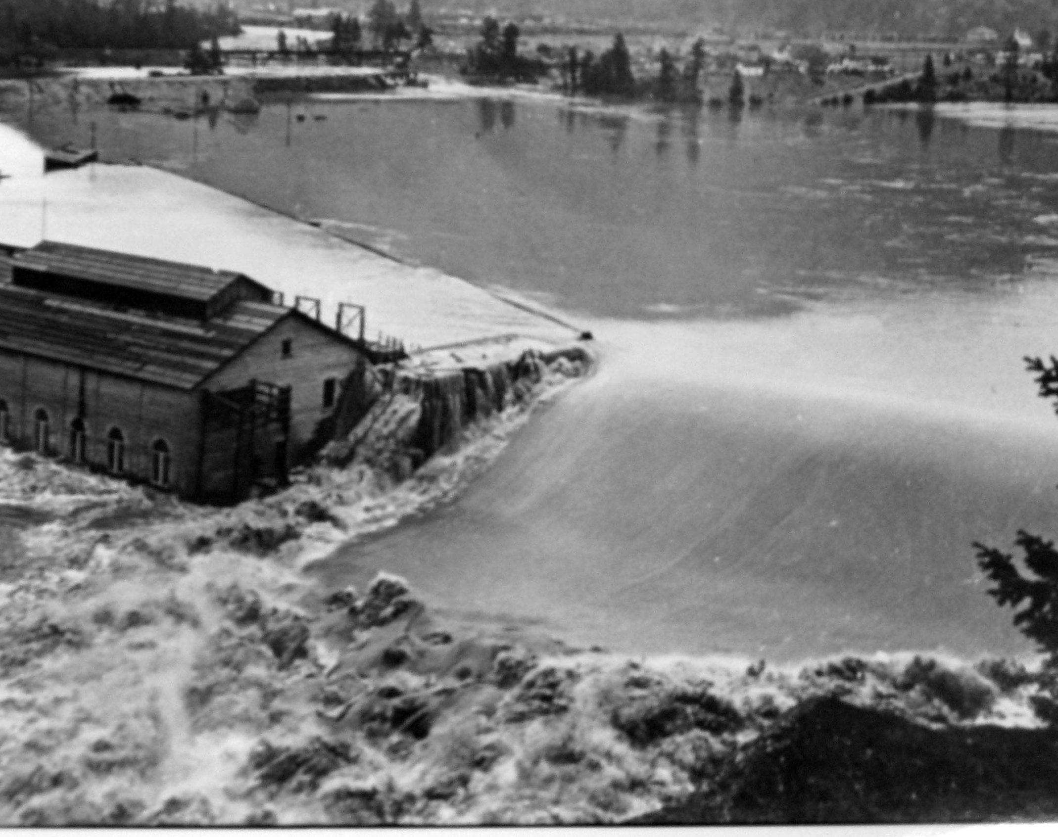
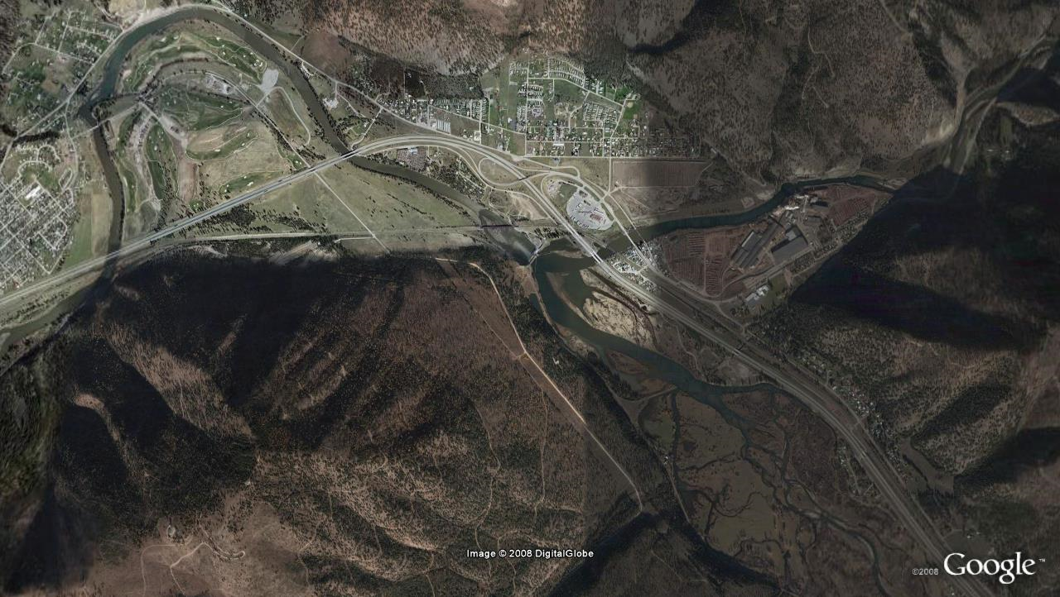
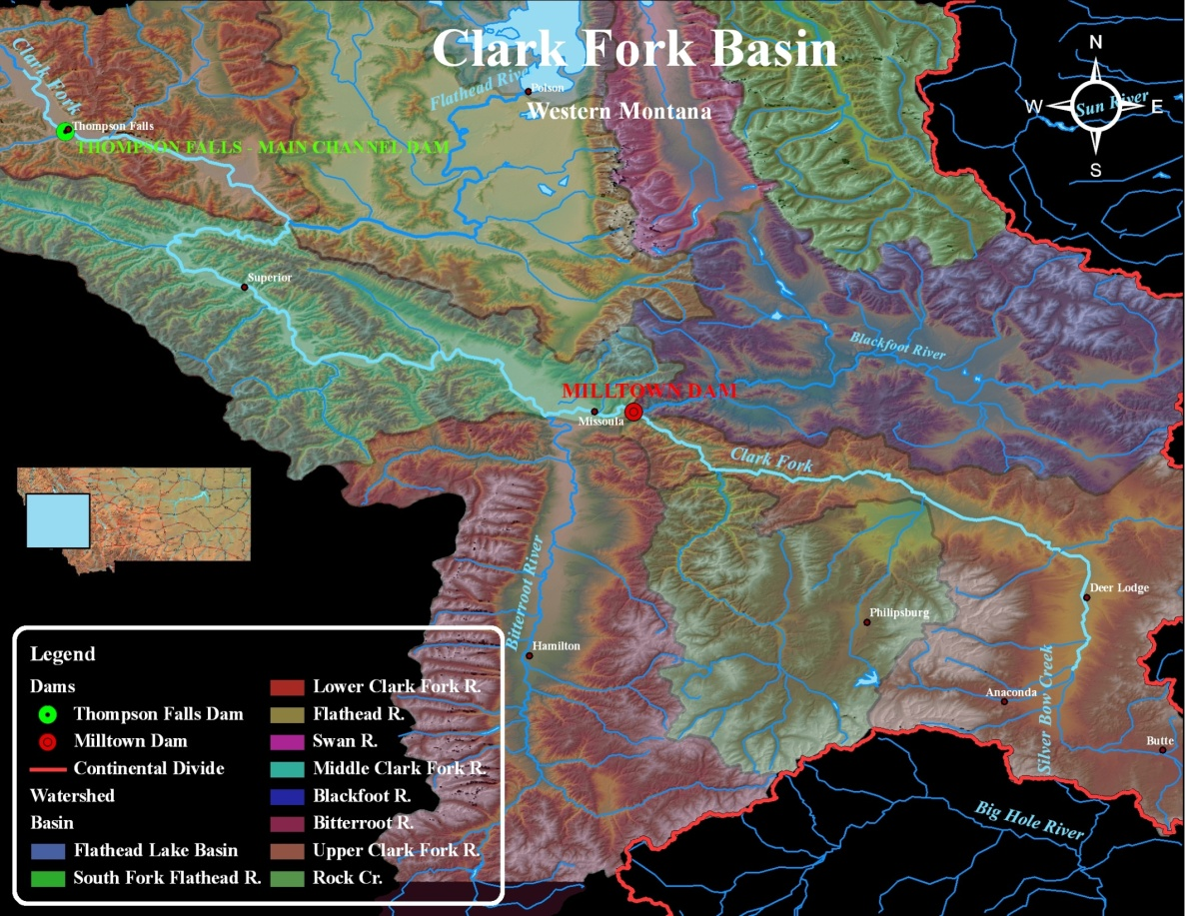
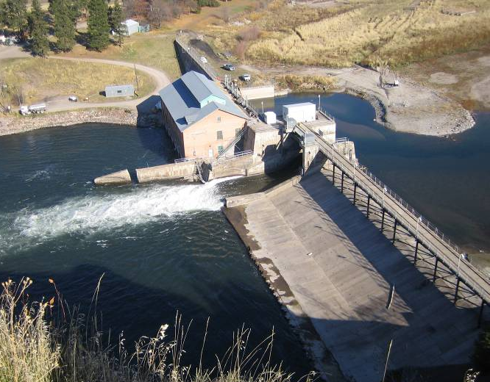
Clark Fork R. (downstream of dam)
1908 flood
Blackfoot River
Missoula 10 km downstream of dam
Milltown Dam
Superfund remediation area
1935
Clark Fork arm of Milltown Reservoir
Notes:
For Clark Fork symposium, probably don’t need to spend much time on history

Slide 9
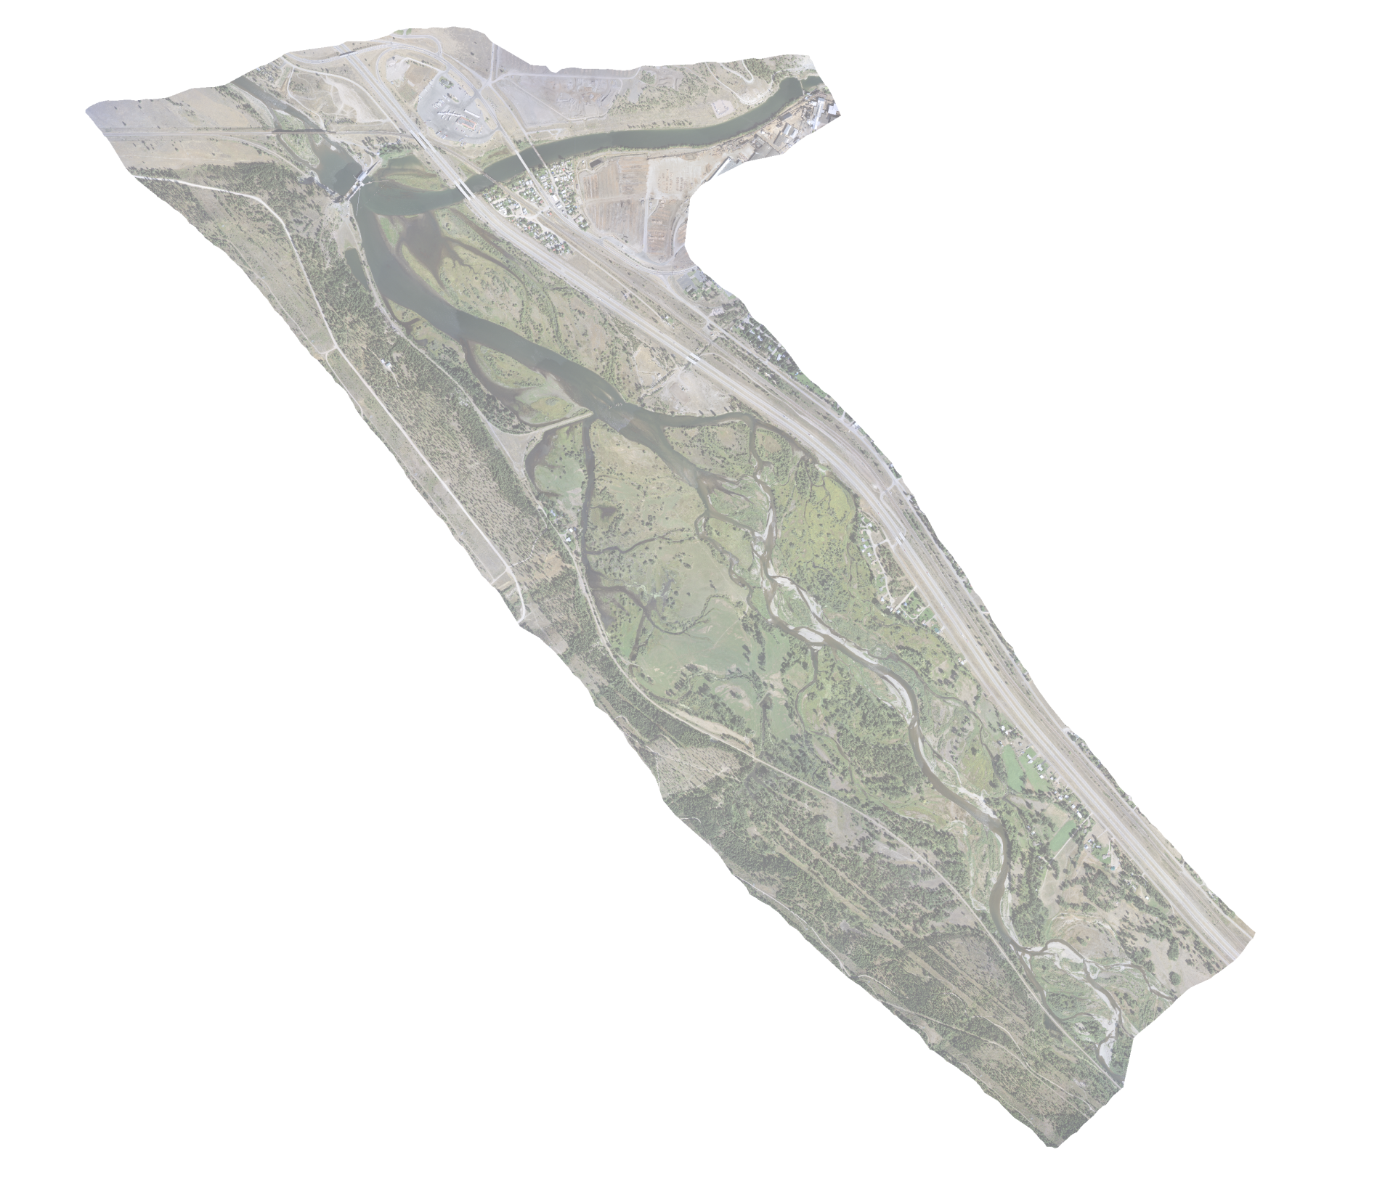
Milltown Reservoir sediment
1. Blackfoot Arm
  (uncontaminated;confined)
2. Lower Clark Fork Arm
  Highly contaminated (As, Cd, Cu, Pb, Zn)
  2 million m³ excavated (Superfund remediation)
Total volume: >5 million m³
3. Upper Clark Fork Arm
  Contaminated
  Subject to river erosion
  Vegetated floodplain
Grain size: silt, fine sand (coarser sand, fine gravel in upstream reaches)
Notes:
3 packages of Milltown reservoir sediment:
Our focus is on erosion of Blackfoot and Upper Clark Fork sediments; lower Clark Fork arm removed by Superfund remediation (some of this sediment likely moved downstream during drawdowns, but unknown how much)
upper reservoir concentrations of arsenic and copper average 125mg/kg and 940mg/kg, respectively (Envirocon, 2004).

Slide 10
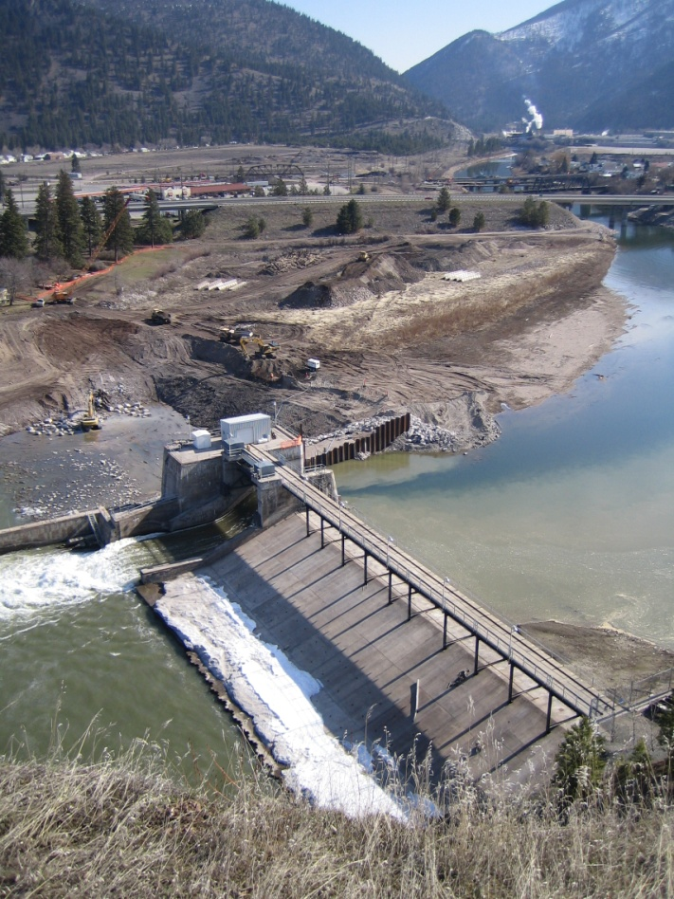
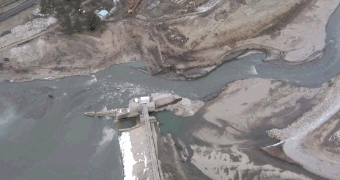
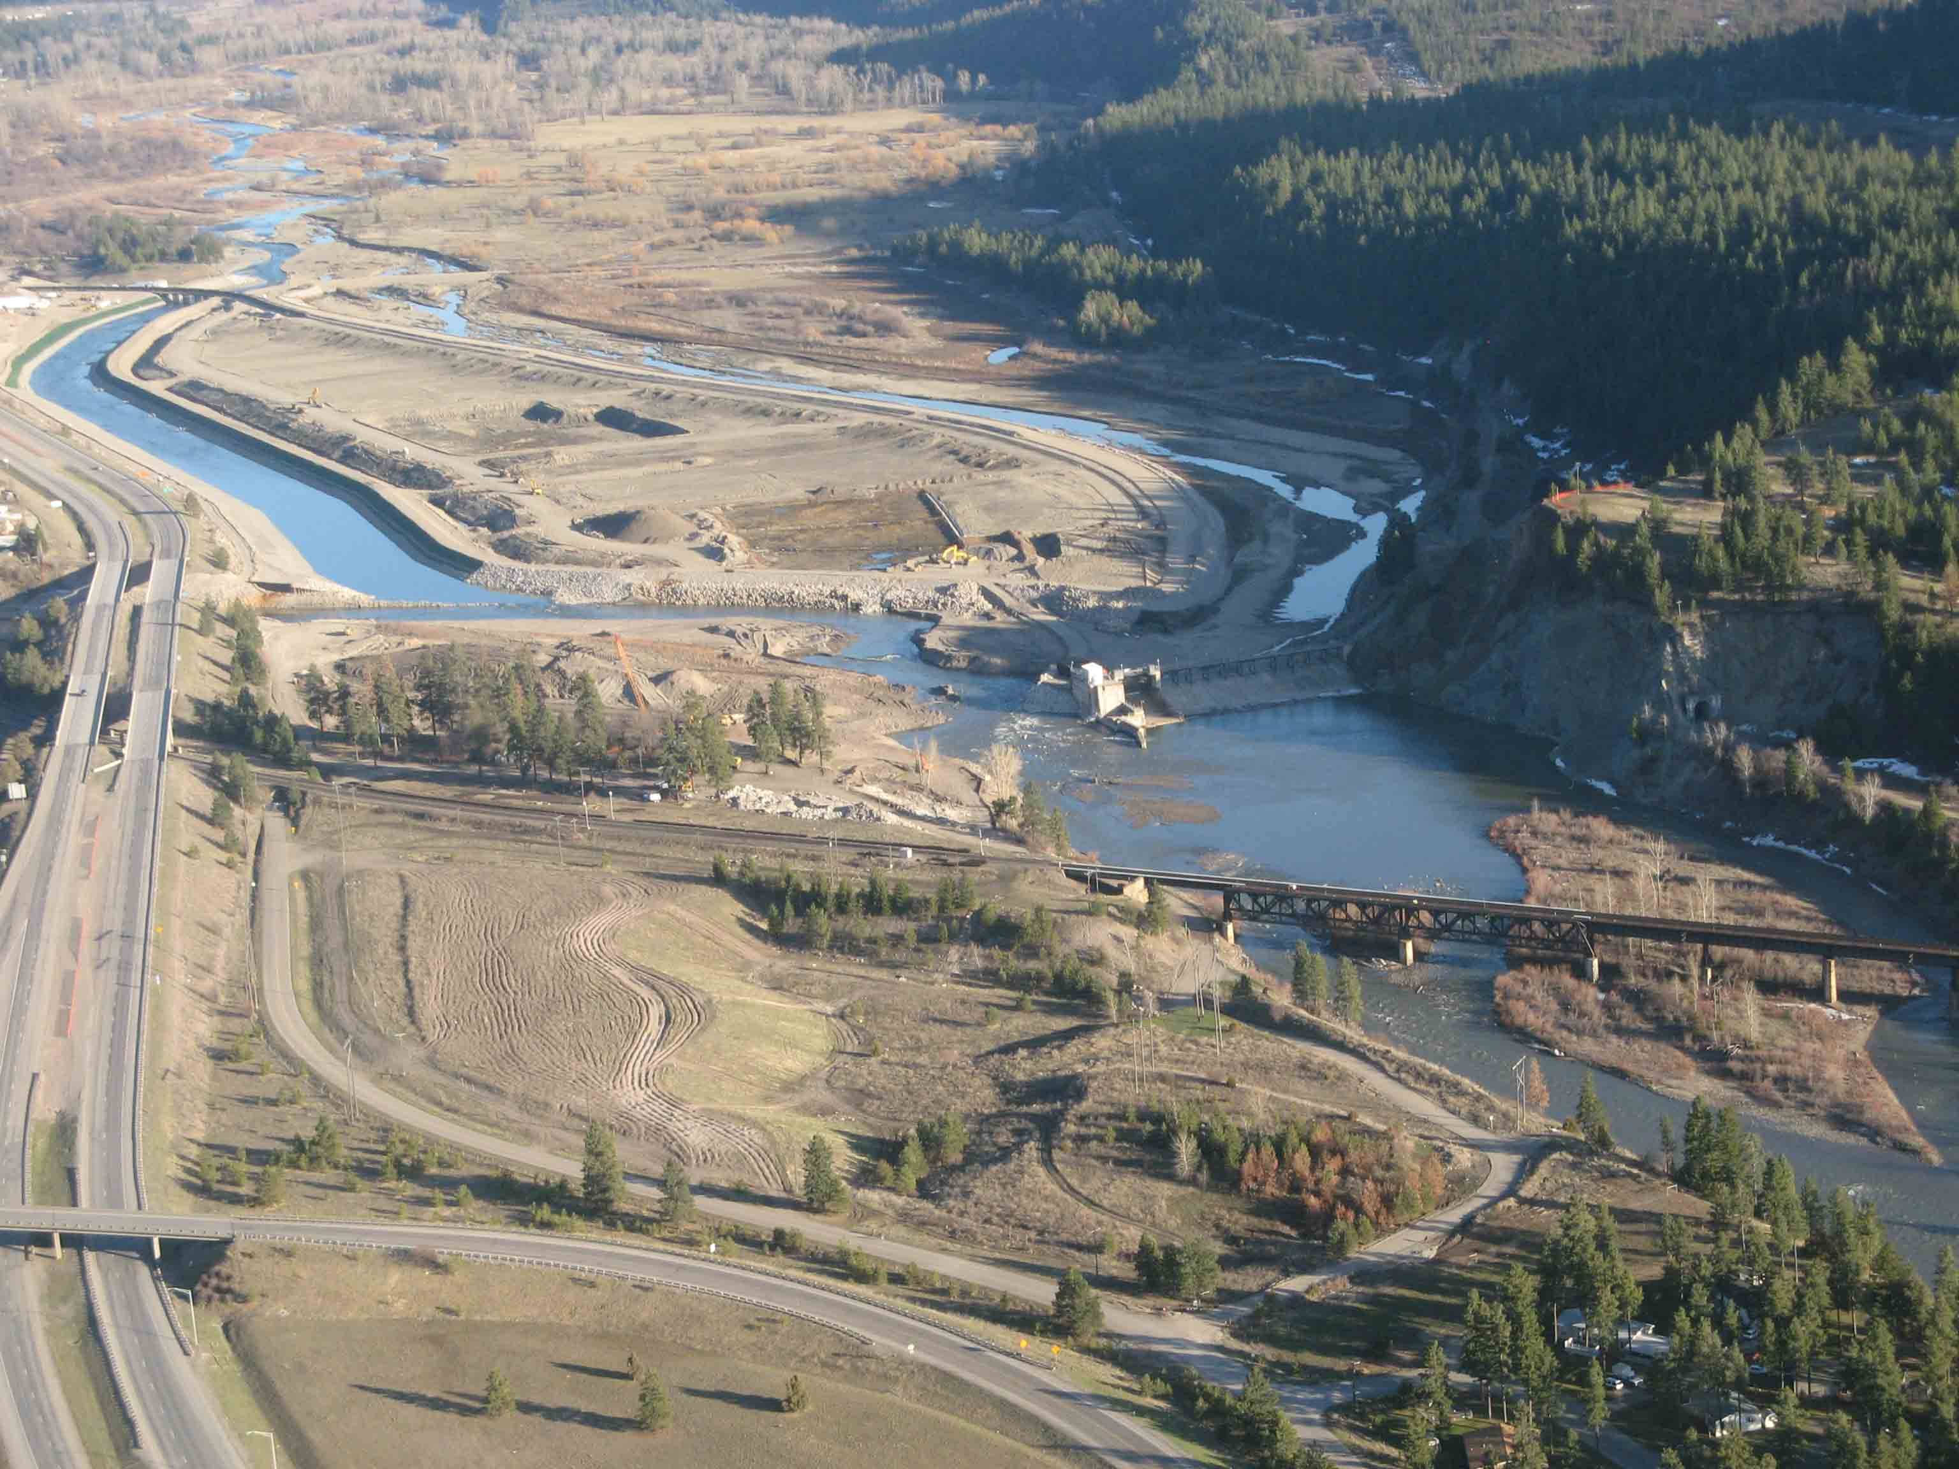
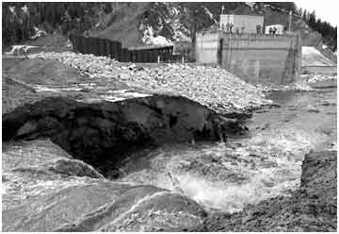
March 2008: cofferdam
March 28, 2008: cofferdam breached
K. Wilson photo
April 2008

Slide 11
USGS Clark Fork R. above Missoula
(4 km downstream of Milltown Dam)
Peak Q RI≈3 yrs
Dam breached
WY 2008
WY 2009
Notes:
2008: 105% of annual average
2009: 121% of annual average
-similar peak magnitudes (RI~3 years); as we’ll see, much larger sediment in transport in 2008, despite similarity of peak magnitudes
-these were above average flows, but unremarkable compared to long-term flow record

Slide 12
Upstream erosional response
Total base level lowering = 9 m
Notes:
Explain concept of base level, through staged drawdowns, cumulative 9 m lowering→ can expect erosion response to propagate upstream as base level drops & river adjusts its slope to attain the new base level

Slide 13
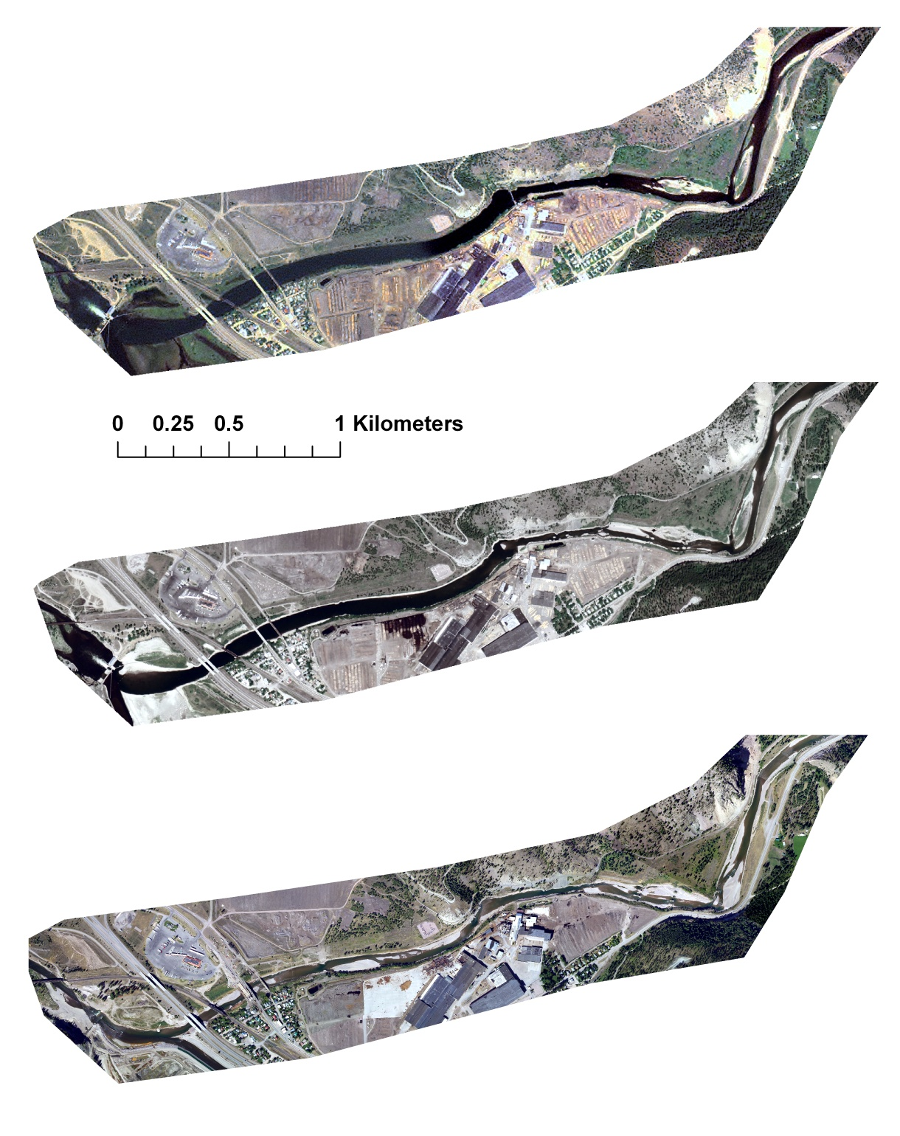
Erosion in Blackfoot arm of Milltown Reservoir
Milltown Dam
2004, pre-drawdown
2004
2006: ~3.5 m drawdown
2006
2008, ~4.5 m drawdown
Milltown Dam breach
2009, ~ 1 m drawdown
2008 (August)
J. Epstein M.S. thesis
Notes:
Erosional response begins in upper reach after 2006, then in lower reach in 2008
-removal of Stimson (aka Bonner) dam after 2006 drawdown
-complex response b/e of multiple drawdowns, Stimson removal, & logs in channel

Slide 14
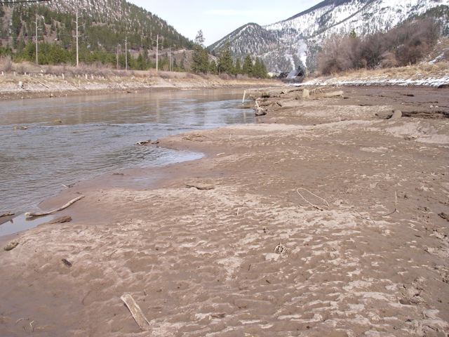
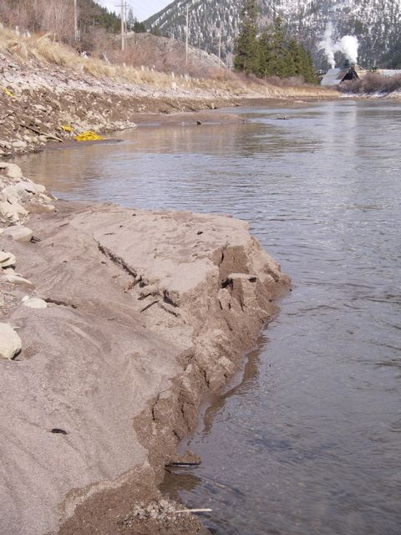
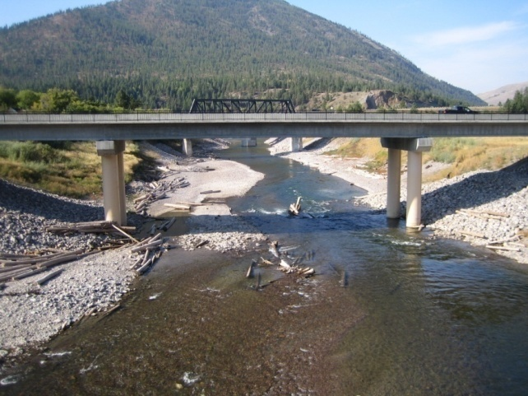
2008
Erosion in Blackfoot River
2009
Notes:
Grain size change (sand-silt to gravel-cobble), development of pool-riffle morphology
Logs

Slide 15
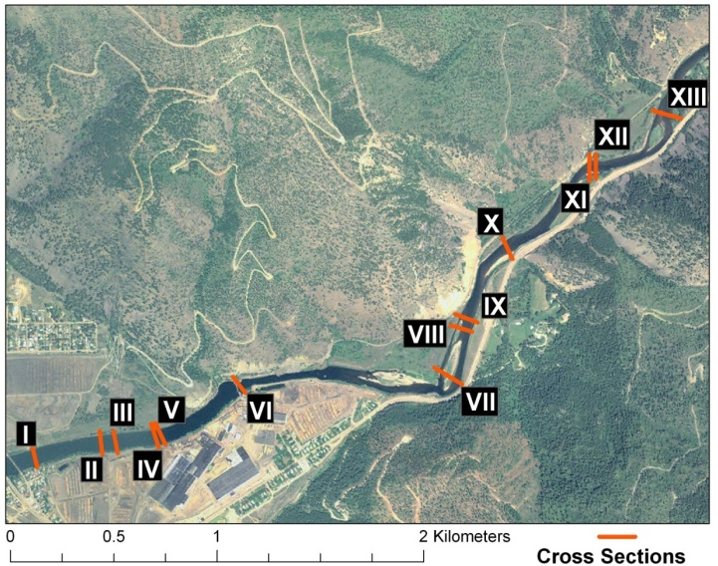
Notes:
Following set of slides moves from downstream to upstream showing pre-breach, then successive post-breach xs’s, upper left photo shows location. Move through these relatively quickly, then repeat- I think when I did this at GSA, it was too fast for audience to digest
-basic story: a couple meters of incision here (which is upstream of pedestrian bridge, we could not survey all the way to confluence b/c of safety / bridge work), progressively (but not evenly) decreasing upstream

Slide 16
XS2

Slide 19
Notes:
This is the cross section in the vicinity of the old Stimson Dam

Slide 20
XS7

Slide 25
Notes:
Here we are up by Marco Flats, and there is no evident response- this is a much further upstream extent of erosion response than predicted

Slide 26

Blackfoot River response
No consistent pattern of widening or narrowing
Erosional response ~4.5 km upstream
Net erosion
2008: 160,000 m³
2009: 80,000 m³
Predicted erosion
(HEC-6):
310,000 m³
(Envirocon 2004)
April 2008
2009
2003
5/20/08
Water surface elevation (m)
6/12/08
7/10/08
9/5/08
Notes:
Note that some erosion likely occurred before we started our work, during initial drawdown, which way be why our estimated erosion is less than predicted.
Overall, numbers are pretty close
Grain size change-sand/silt to gravel

Slide 27
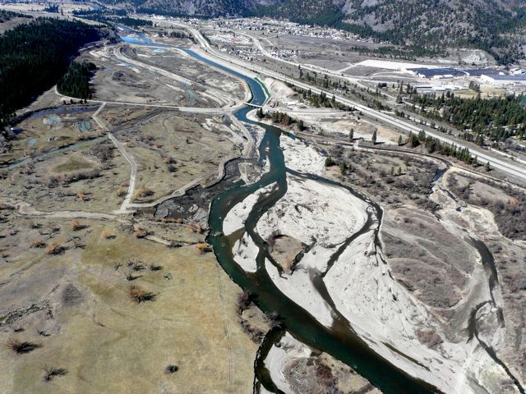
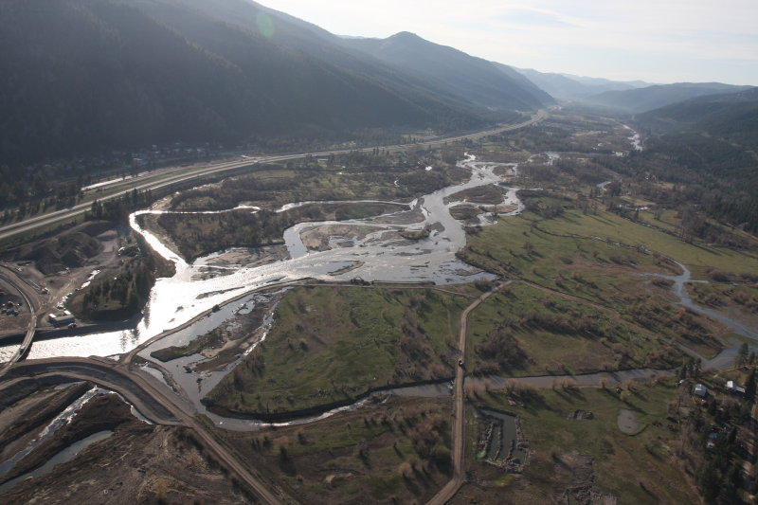
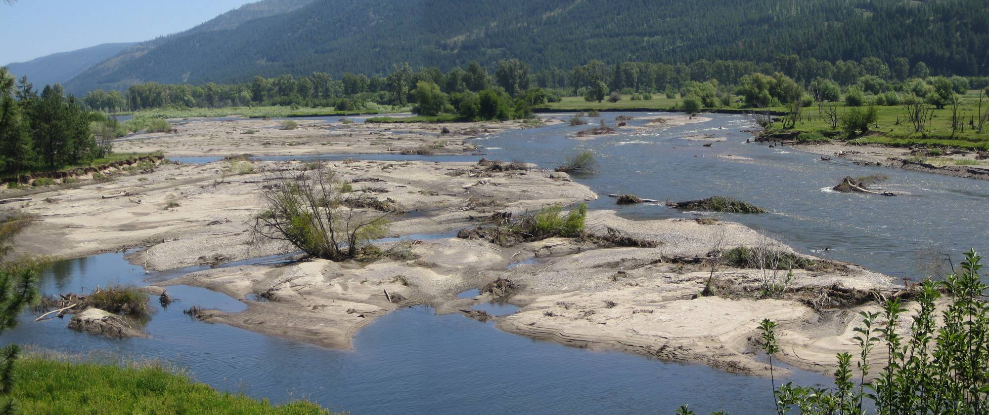
Clark Fork arm of Milltown Reservoir
Lateral erosion ~200 m
Notes:
Much different response in upper CFR arm of reservoir, unconfined
Show long pro, illustrate sediment wedge:
Average widening? Average cross section?
Scour depth

Slide 28
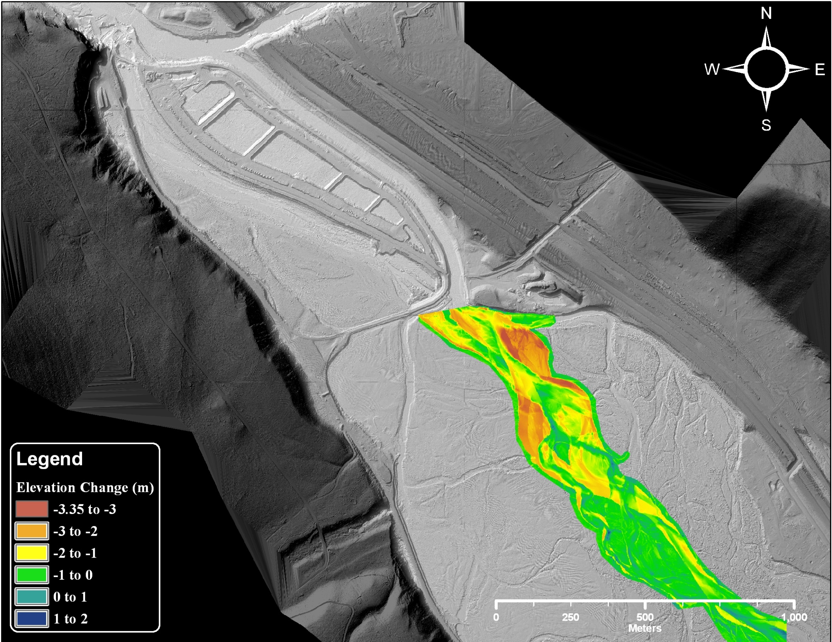
Dam site
Lower Blackfoot (scour not shown)
Scour from CFR upper reservoir
2008 =180,000 m³
Superfund remediation area
Scour estimate from DEM differencing
Predicted (HEC-6):
4,000 m³
(Envirocon 2004)
Notes:
2009 scour 4000 m3, but also areas of aggradation
Observed for 1 year 50x greater than predicted over 4 yrs by model

Slide 29
 | Post-breach scour (m³) | HEC-6 model performance | Erosion mechanism
CFR reservoir | 180,000 | Observed≈50*predicted | widening
BFR reservoir | 240,000 | Observed≈0.75*predicted | incision
Post-breach reservoir erosion (ΔS)=420,000 m³=590,000 t

Slide 30
Measured sediment fluxes
4 km d/s of Milltown Dam
Suspended 2008=450,000 t
2009≈180,000 t
Bedload 2009≈70,000 t
Dam breached
WY2008
WY2009
Notes:
-USGS measured suspended load only
-by measuring bedload and combining our data and theirs, come up with more accurate picture of the amount of sediment transported as a result of the dam removal
-we have limited bedload data from 2008, but not enough to come up with a flux estimate for the hydrograph

Slide 31
2009 bedload transport (J. Johnsen)
Notes:
-describe how we do these measurements
-sampling completed upstream of reservoir on CFR (Turah), within BFR arm of reservoir (pedestrian bridge), and downstream (deer cr bridge)

Slide 32

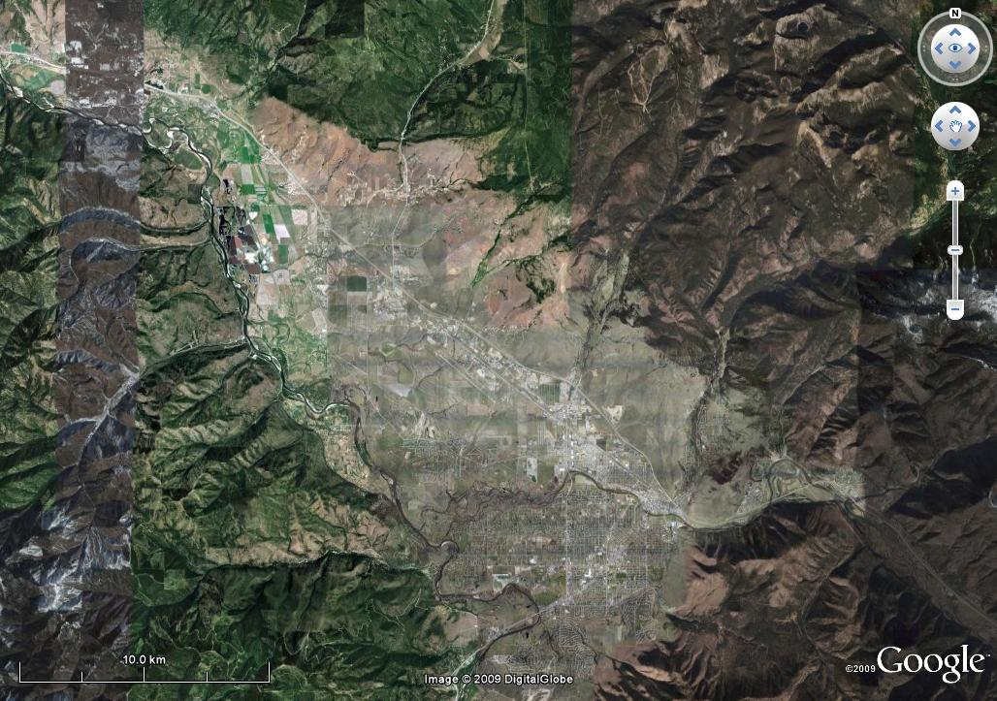
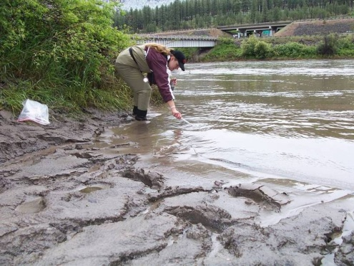
Where did the sediment go?
Milltown Dam
Clark Fork -Bitterroot River confluence
Missoula
Notes:
Cross sections 2-4 km downstream: minimal change
-Tracers show sediment went all the way to Thompson Falls,
-we have not studied morphologic effects downstream of Bitterroot, but we don’t think they were significant

Slide 33
Arsenic concentrations in bed sediment downstream of Milltown Dam, 2008
Thompson Falls Reservoir
(Data from J. Moore)
Notes:
Arsenic and metals in sediment provide tracers, show us that:
-sediment from Milltown quickly reached Thompson Falls
-initial high pulse (May 4) data of contaminants, then declined
-similar patterns observed for other contaminants (Cu, Zn, Pb)
-biological effects unknown, but regardless these data show how contaminants can fingerprint sediment / serve as a useful tracer

Slide 34
Where did the sediment go?
Milltown Dam
Kelly Island
Clark Fork -Bitterroot River confluence
Missoula
Notes:
-Kelly Island- zone of strongest morphologic response
-unconfined, multi thread reach
-striking difference compared to flume-like transport reach through town

Slide 35
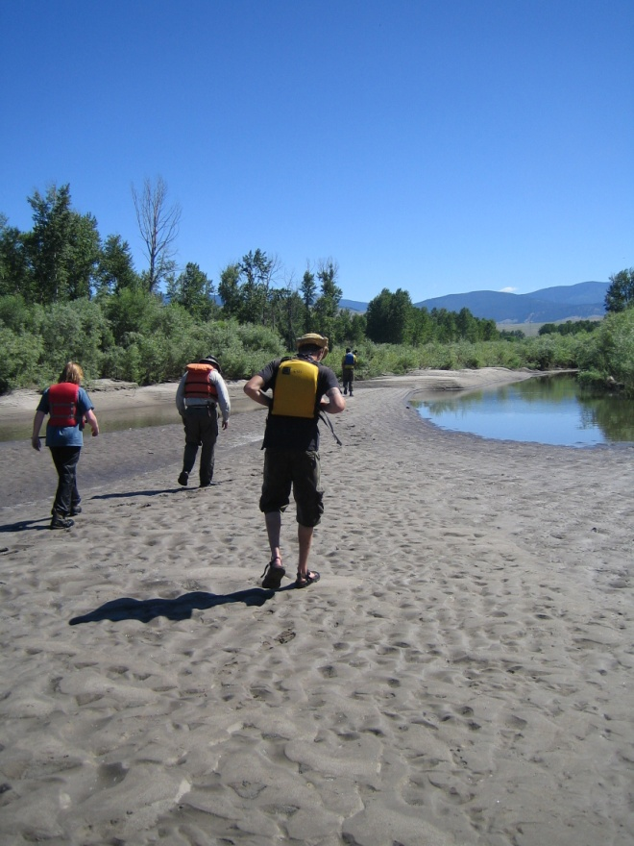

Downstream

Slide 36
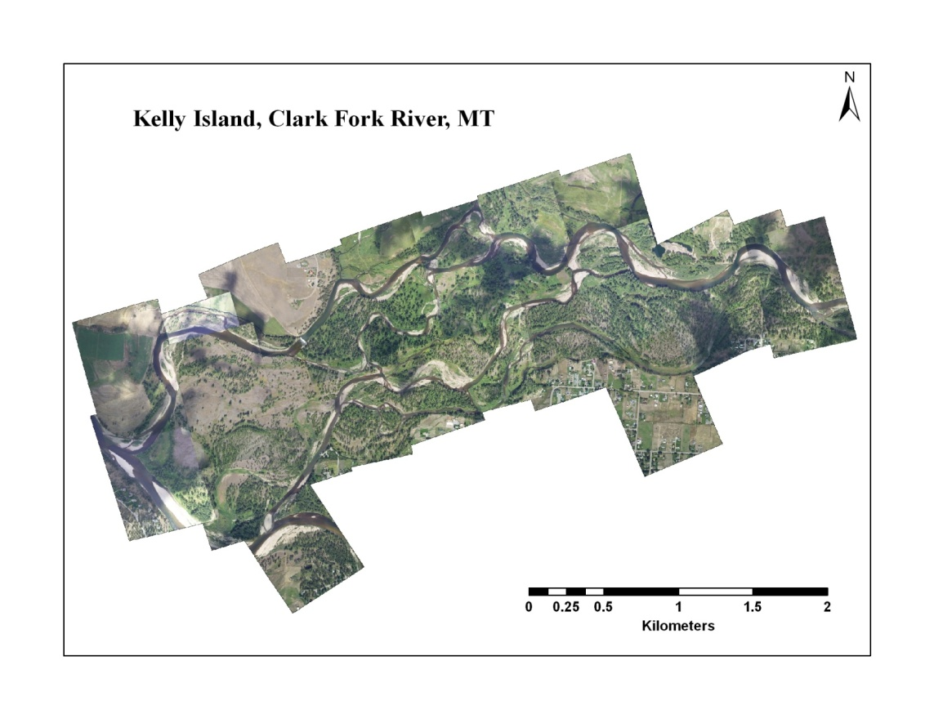
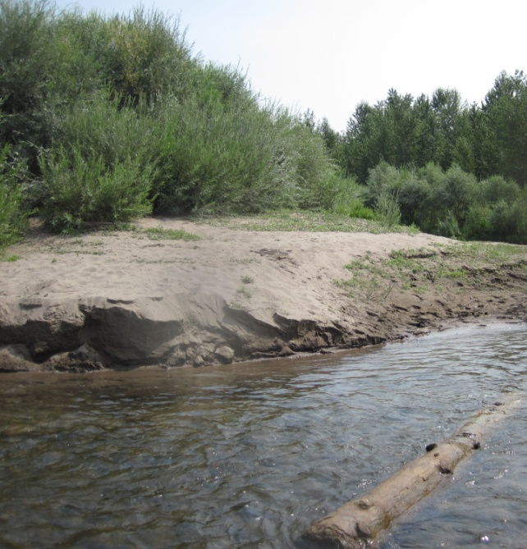
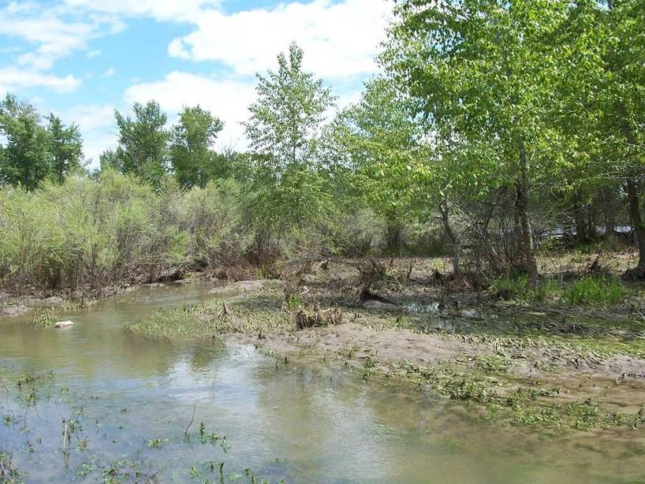
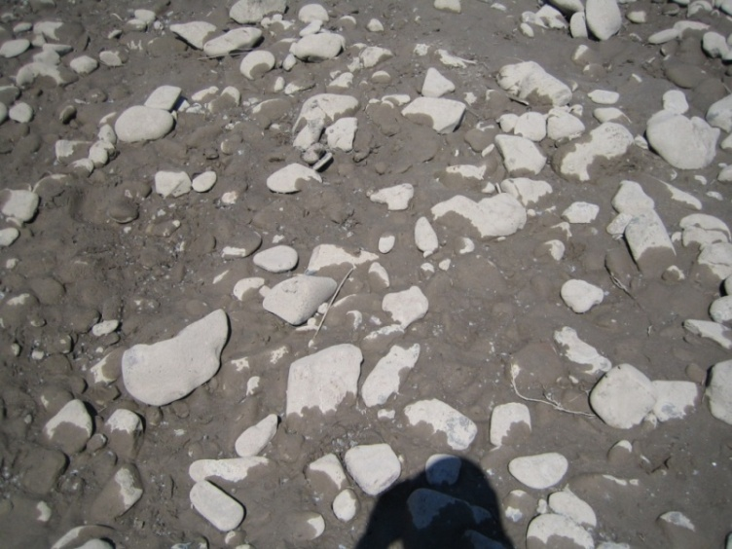
Deposition on bars
Deposition in side channels
Infiltration
Channel migration
Notes:
Primary morphologic responses: deposition on bars (Doug’s work)
-deposition in side channels / on floodplain (Ivan?)
-infiltration (Elena): key questions= persistence, volume, depth, & spatial pattern of infiltration
-effects on channel migration (Doug)

Slide 37
Summary
Upstream:
  Post-breach reservoir erosion=420,000 m³=590,000 t
  Confined vs unconfined reservoir response
Downstream:
  Bedload versus suspended load fluxes
  Infiltration of fines
  Deposition on bars & side channels
Contaminants
Larger river; long & varied downstream reach
Large dam removal ($ and sediment)
Post-removal restoration
Scaling issues

Slide 38
Acknowledgments
Funding:
NSF (EAR-0922296, EAR-0809082), UM University Grant Program, Montana Water Center / U.S. Geological Survey 104(b) Water Resources Research Program
Students:
James Johnsen, Josh Epstein, Elena Evans, Pete Ferranti, Cleo Woelfle-Erskine
Flow and suspended sediment data:
USGS Montana Water Science Center
Geochemistry data:
Johnnie Moore, Heiko Langner, Katy Garcia, Ivan Orsic
Discussions:
L. Sklar, Y. Cui, A. Wygzda

Slide 39
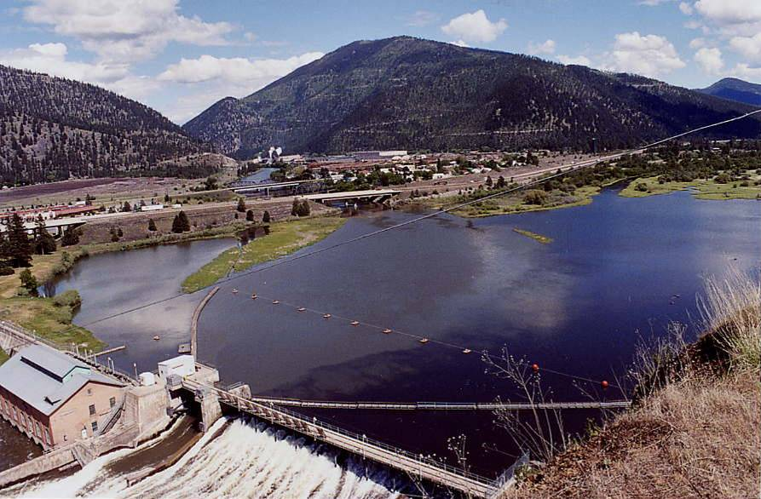
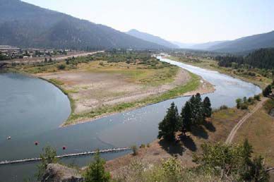
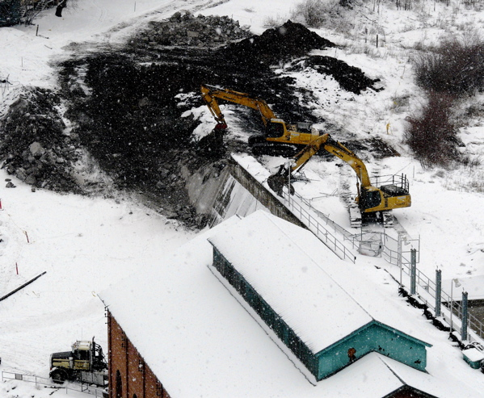
June 2006, full pool (pre-drawdown)
Stage 1 drawdown (3-3.6 m) August 2006
Rail line
Bypass channel
Sediment removal
Jan. 2008: powerhouse removal
November 2007
Notes:
Extra background slide, probably not necessary for CF symposium
Pre removal: reservoir = wetlands, shallow water

