Slide 1
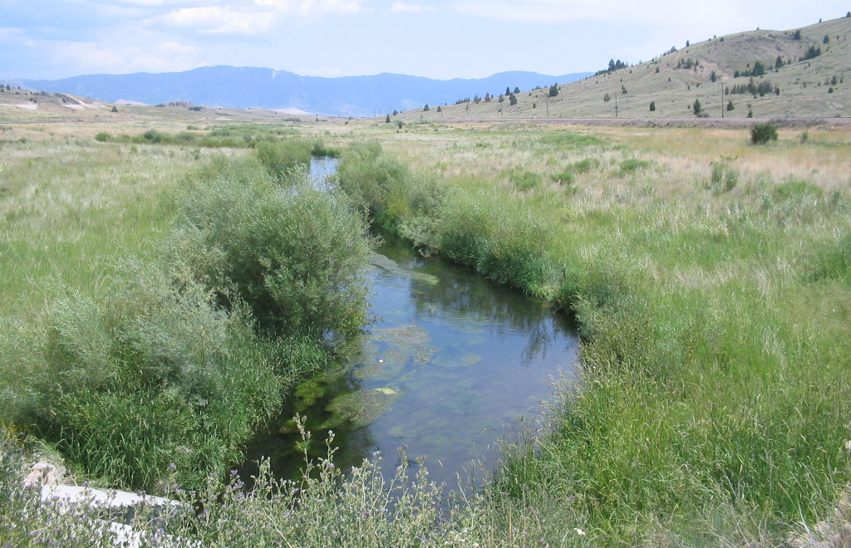
Geochemistry of nutrients in Silver Bow Creek
Chris Gammons, Montana Tech
Dept. of Geological Engineering

Slide 2
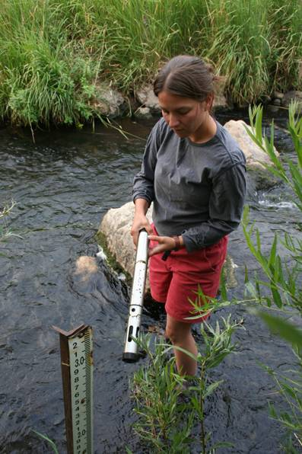
Acknowledgments
Grad students
  Beverly Plumb (M.S. 2009)
  John Babcock (M.S. in progress)
Colleagues
  Steve Parker (MT Tech)
  Simon Poulson (U-Nevada-Reno)
Funding
  USGS & Montana Water Center
Undergrad student Stacey Wilcox

Slide 3
Outline: main points
Silver Bow Creek is severely impacted by nutrient overload
Concentrations of specific nutrients change over very short time and spatial scales
Seasonal effects are also significant
The Warm Springs Ponds act as a huge sink for nitrogen
Stable isotopes may reveal clues to processes of nutrient cycling

Slide 4
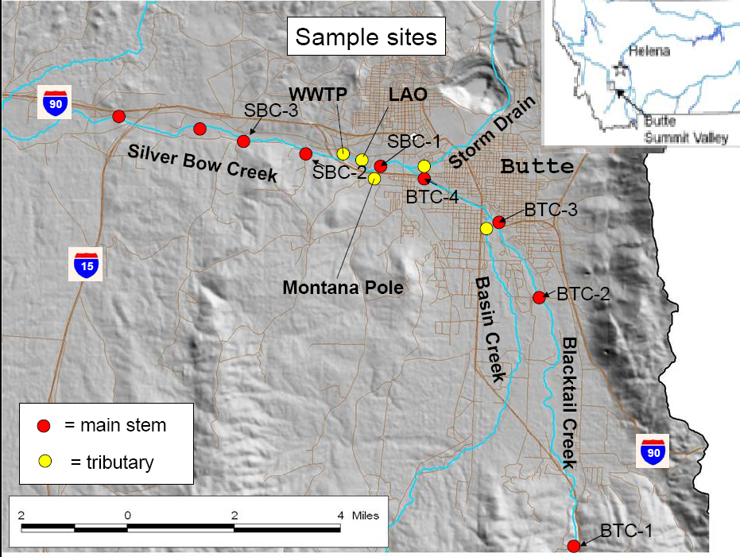

Slide 5
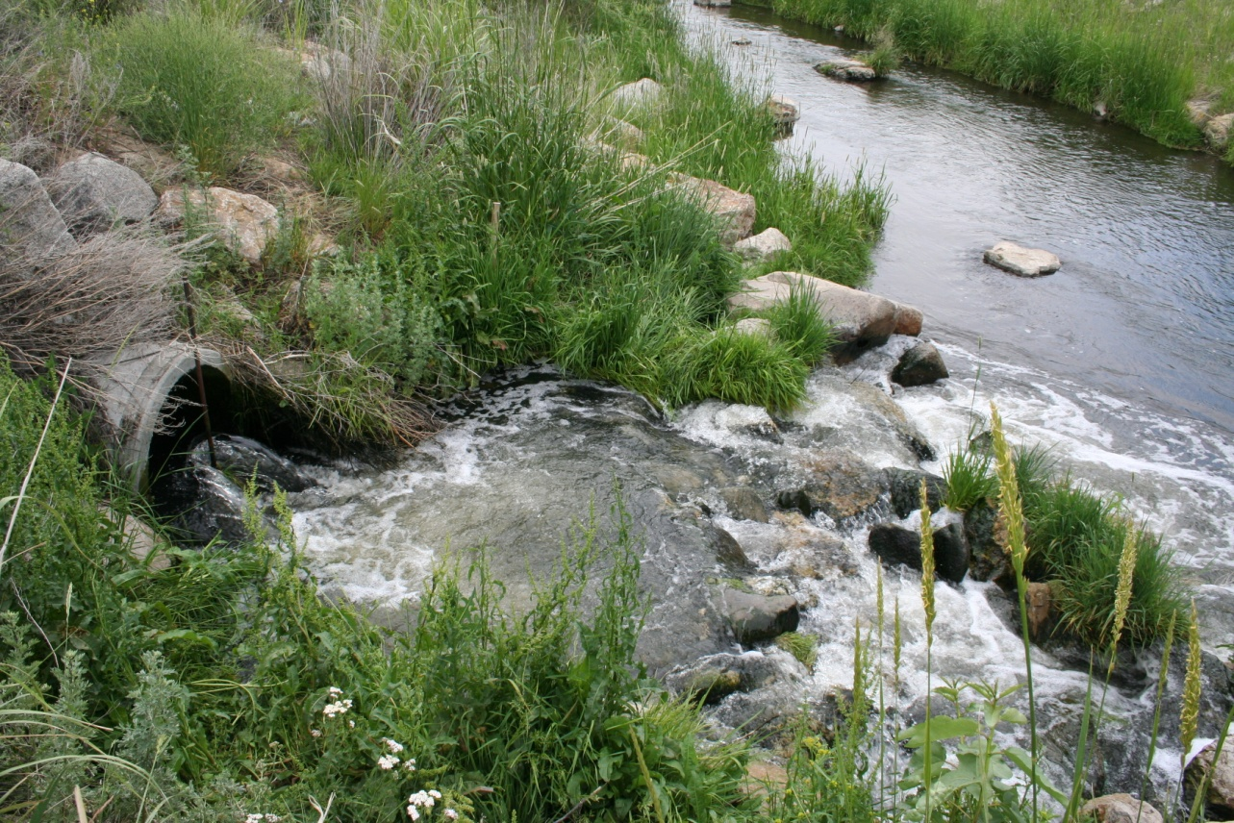
Butte WWTP effluent entering Silver Bow Creek
(3-10 cfs)
Ammonium: NH₄⁺
Phosphate: PO₄³⁻
Nutrients in
WWTP effluent

Slide 6
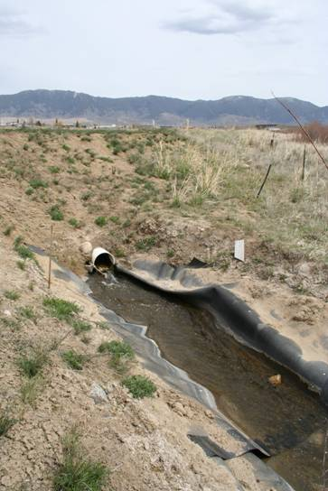
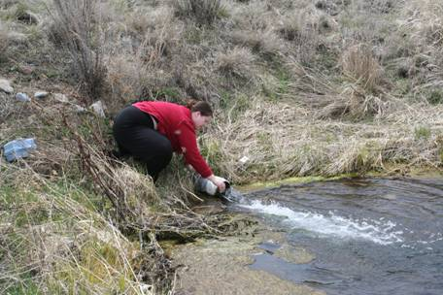
Other point discharges in Butte
Lower Area One (LAO)
Montana Pole (MT Pole)
Grad Student Bev Plumb
1-2 cfs
lime-treated groundwater
~ 1 cfs
Treated PCP plume

Slide 7
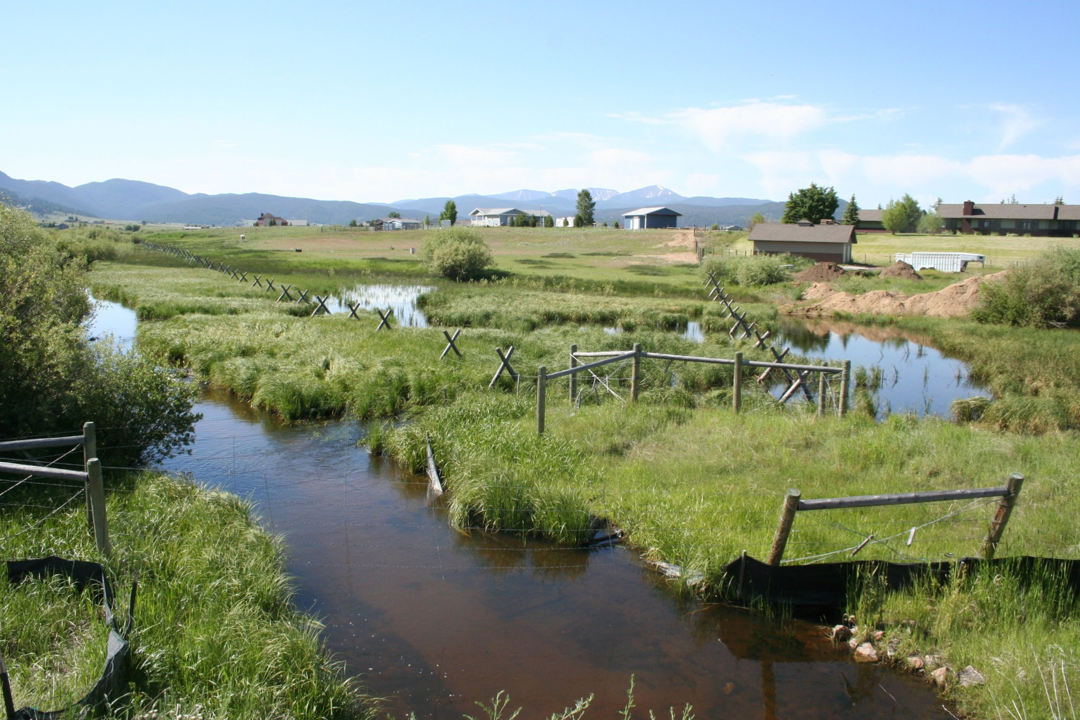
Non-point sources: Butte Valley
Septics
Fertilizers
Animal waste
Blacktail Creek in July

Slide 8
Load comparisons
Total dissolved inorganic N
Soluble reactive P

Slide 9
Comparison of SBC to reference streams
SBC with WWTP
SBC without
WWTP
Trend lines from Smith et al. (2003)

Slide 10
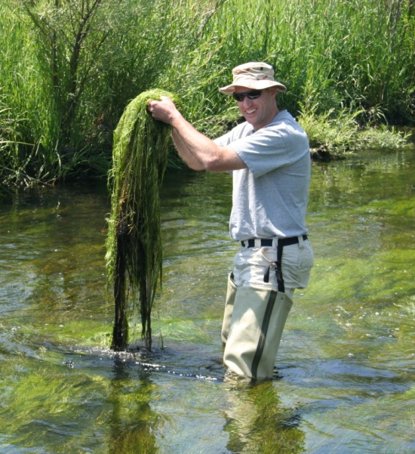
Effects of nutrient overload
Massive growth of algae and plants
Night-time hypoxia
Undergrad student Brian Kuhn

Slide 11
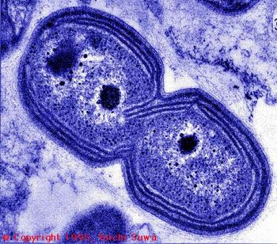
Nitrification (oxidation) of ammonium
Step One:
oxidation of ammonium to
nitrite
NH₄⁺ + 1.5 O₂ → NO₂⁻+ 2H⁺ + H₂O
Step Two:
oxidation of nitrite to nitrate
NO₂⁻ + ½ O₂ → NO₃⁻
N-oxidizing bacterium

Slide 12
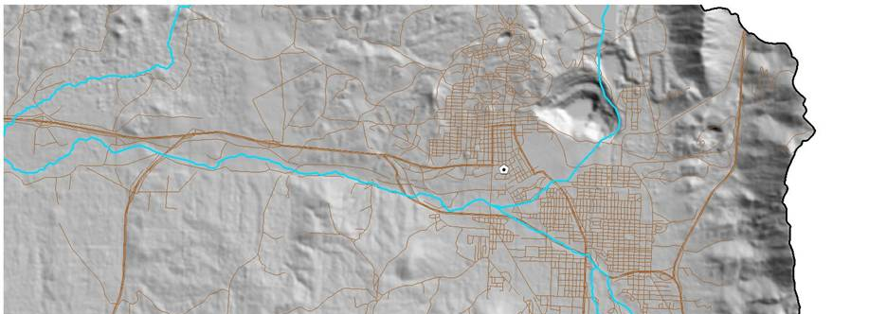
Dissolved Oxygen minimum values (between 4 and 6 AM)
August 2006
Dead Zone
WWTP
Storm Drain
Silver Bow Creek
Butte
5 ppm

Slide 13
Synoptic changes
km below WWTP

Slide 14
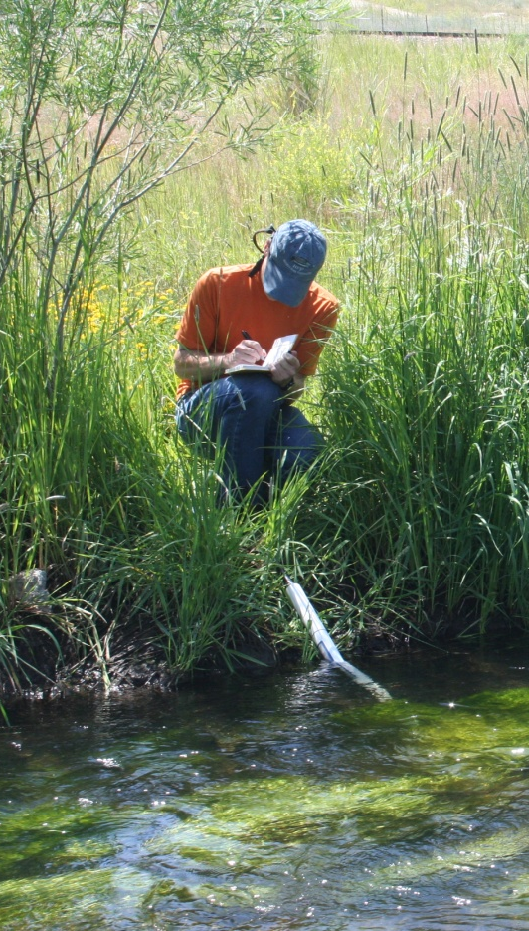
Diurnal changes
SBC-3, July 23-24, 2007
DIN
Nitrate
Ammonium
Nitrite
Grad Student John Babcock

Slide 15
Clark Fork River
Warm Springs
Ponds
Influence of Warm Springs Ponds
SBC-8
0 5 10 km
SBC-7
Pit Lake
SBC-6
north
City of Butte
Silver Bow Creek
BTC-4
detail below
BC-1
BTC-3
BTC-2
Blacktail Creek
BTC-1

Slide 16
Nitrate and Ammonia in WSPOU
Winter months

Slide 17
Dissolved inorganic N and phosphate in WSPOU
Winter months

Slide 18
Phosphate and arsenate in WSPOU

Slide 19

Redox cycling in the ponds
O₂
HAsO₄²⁻, HPO₄²⁻
Fe-oxide(s) + org. C → Fe²⁺
organic C decay
Spring: As and P enter ponds adsorbed onto Fe-oxides
Particles settle to bottom of lake
Summer: Decay of organic C causes Fe-oxides to dissolve
This releases As, P to water column

Slide 20
Nitrate isotopes
Human and animal waste

Slide 21
Synoptic changes in isotopes
km below WWTP

Slide 22
Conclusions
Silver Bow Creek is over-nutrified
  Uncontrolled growth of algae and plants
  Night-time hypoxia = “dead zone”
Butte WWTP is main source of nutrients
  Ammonium
Changes in nutrient concentration and speciation
  Seasonal, diurnal, spatial
Influence of Warm Springs Ponds
Stable Isotopes
  Complicated!
  Reveal in-stream processes more than sources

Slide 23
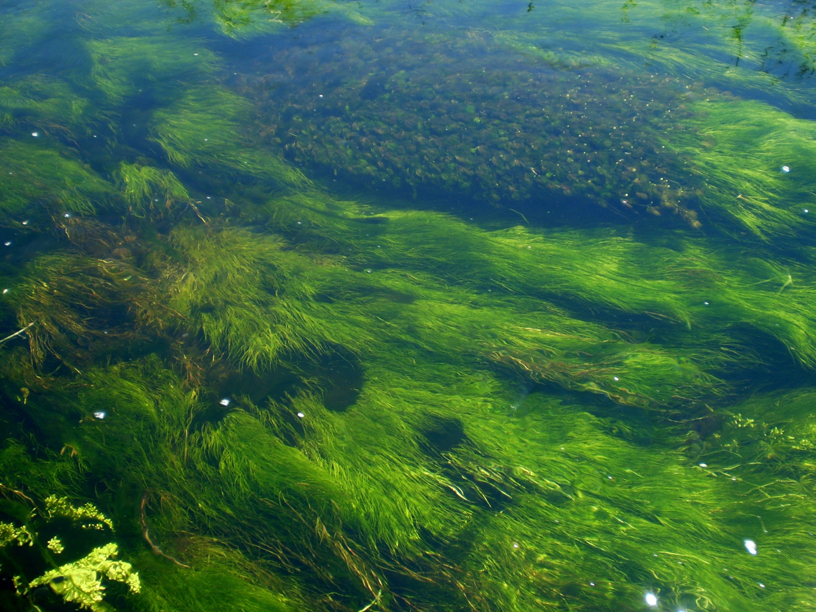
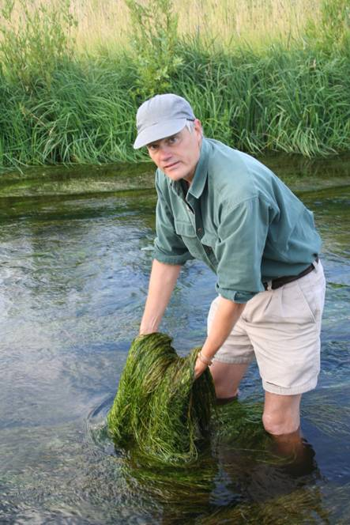
Questions?

