Slide 1


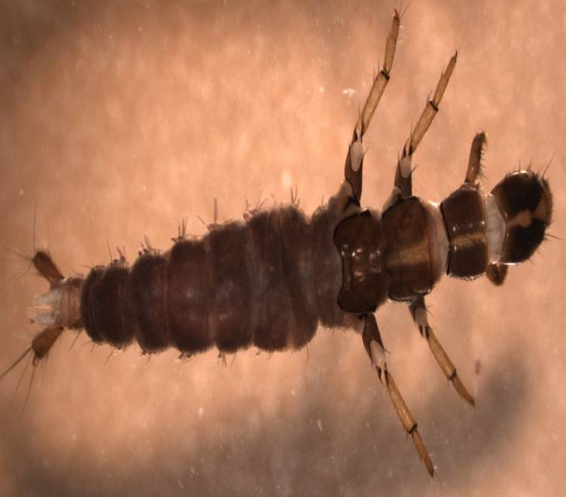
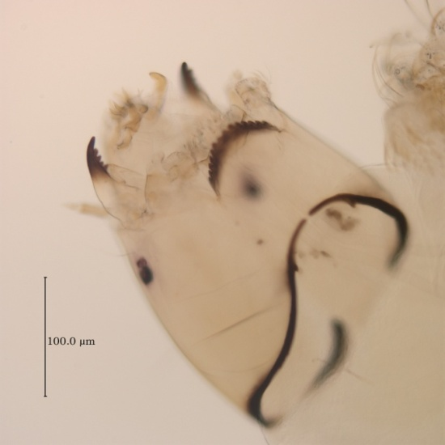
Pre & Post Reclamation Trends in Benthic Invertebrate Communities in Silver Bow Creek, MT
Sean Sullivan
University of Montana
Environmental Studies Program

Slide 2
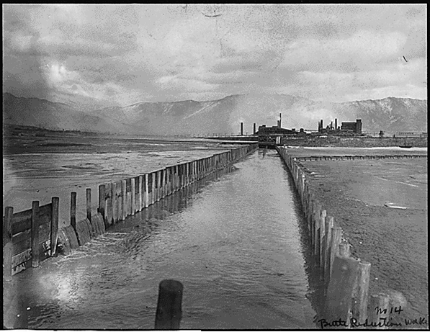
Area History
Silver Bow Creek extends about 21 miles from Butte to the Warm Springs settling ponds.
Historical mining practices used SBC as a conduit for waste.
SBC is part of a large Superfund complex from Butte to Missoula.
http://cfwep.blogspot.com/2009_04_01_archive.html

Slide 3
Remedial actions

Slide 4
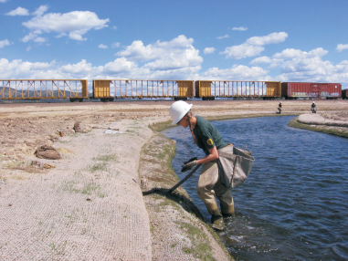
Stream Corridor Restoration
Restoration Goals include the restoration of aquatic habitat, and beneficial uses (NRDP,2004)
Numeric Goal:
  75% of “available indices” (section 9.1.1 NRDP 2009)
Narrative Goal:
  Restoration will reflect a balanced, integrated, and adaptive community of organisms having a species composition, diversity, and functional organization comparable to that of the natural habitat of the region (NRDP 2004, Karr and Dudley 1981).

Slide 5
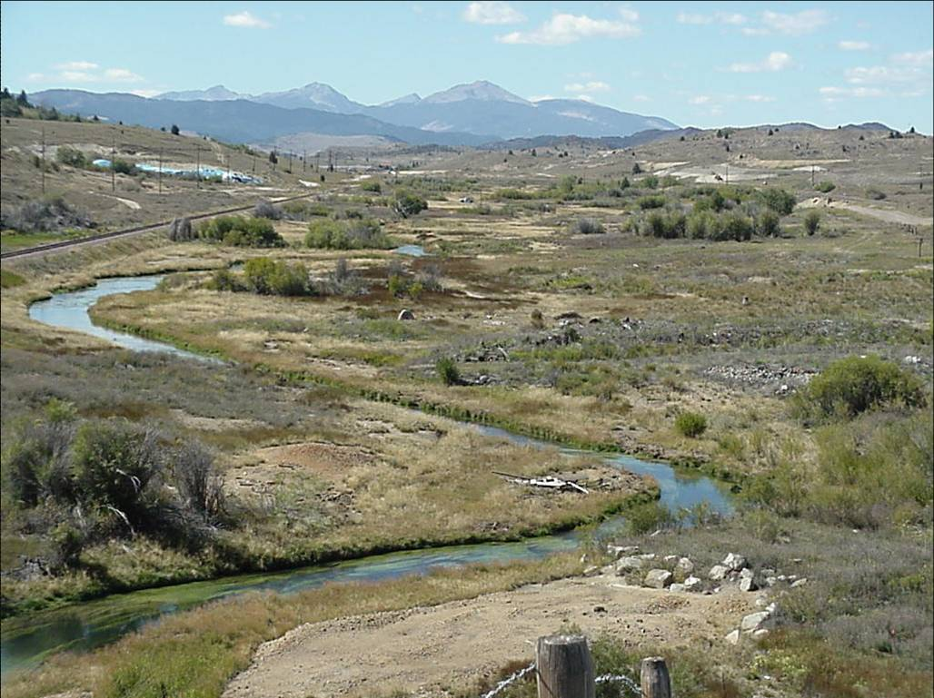
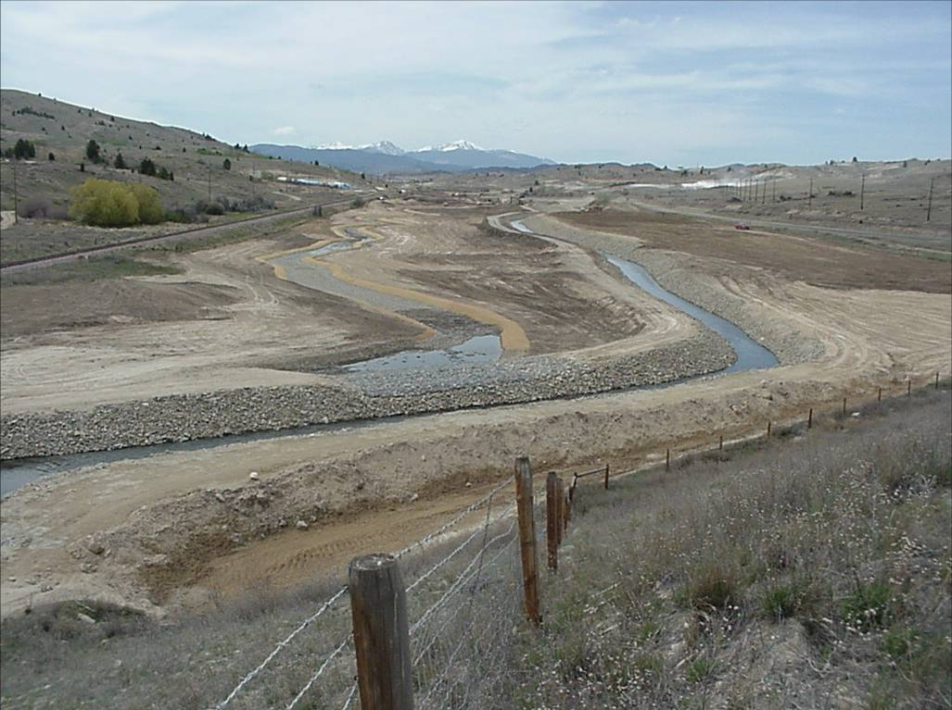
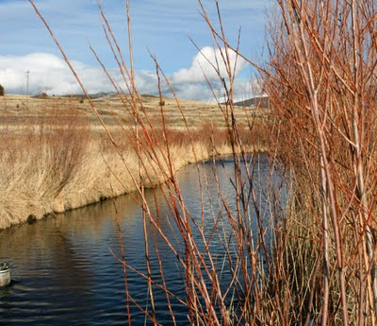
Silver Bow Creek

Slide 6

Annual Monitoring of :
Streamside Tailings Operable Unit
2003-present
Clark Fork River
1986- present
Methods:
  4 Replicate Surber Samples
  Full ID/Enumeration
  Biotic Integrity Index (McGuire 1986)
  Locations: SBC 0,1,2,
  Clark Fork River
    Warm Springs to Below Flathead River confluence
Methods
  Single, Multi-habitat Sweeps
  Fixed Count Sub-Sample
  Variety of Indicies
    Revised Montana Valley/Foothills (Bollman 1998)
    Montana Valleys (Bukantis 1998)
    Montana MMI (Jessup et al. 2006)
    Montana O/E (Hawkins 2006)
  Locations:
    11 sites within SSTOU
    SBC-08 Silver Bow Creek
    at Rocker

Slide 7
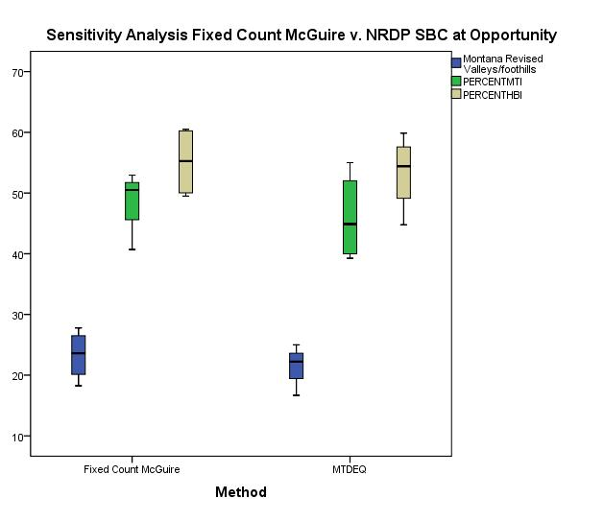
Testing Data Homogenizing Method
Silver Bow Creek at Opportunity
  2004,2006,2007,2008
Classification Strength
  79% based on all taxa
  and all counts
Non-parametric
  Two tailed Ho:
  There is no difference
Data were rarified to a 300 count and statistically compared to see if the effect of rarifaction was significant on index scores.
INDEX | Mann-Whitney U
Montana Revised Valleys/Foothills | 0.357
Metals Tolerance Index | 0.465
Hilsenhoff Biotic Index | 0.273

Slide 8
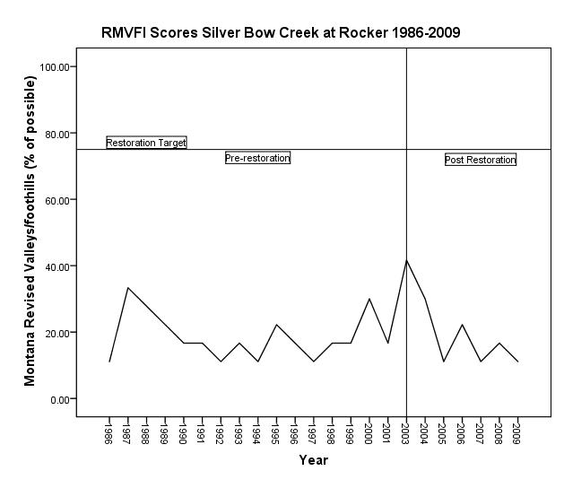
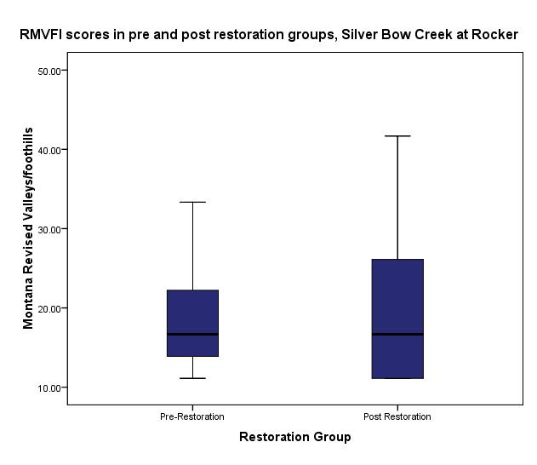
Trend Analysis:
Montana Revised Valleys/Foothills
P=.499

Slide 9
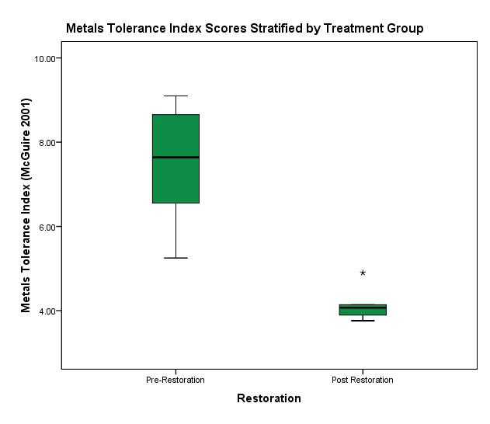
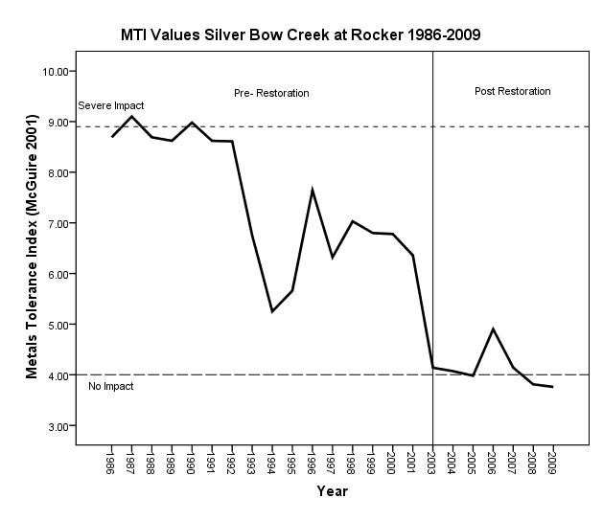
Trend Analysis:
Metals Tolerance Index
Two sample t-test P<.001
P<.001

Slide 10
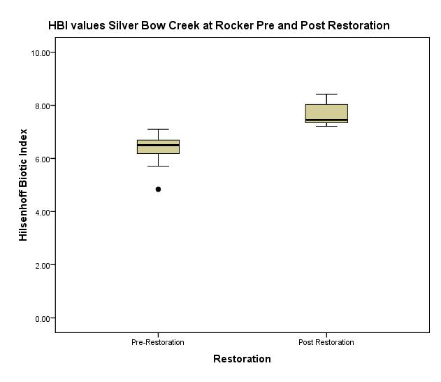
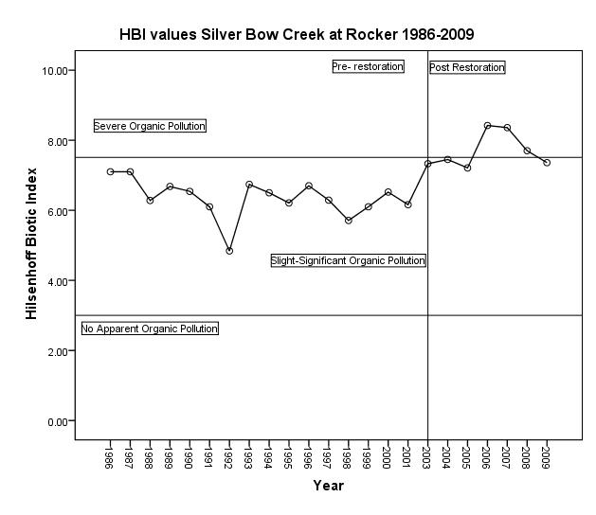
Trend Analysis:
Hilsenhoff Biotic Index
Two sample t-test P<.001
P<.001

Slide 11
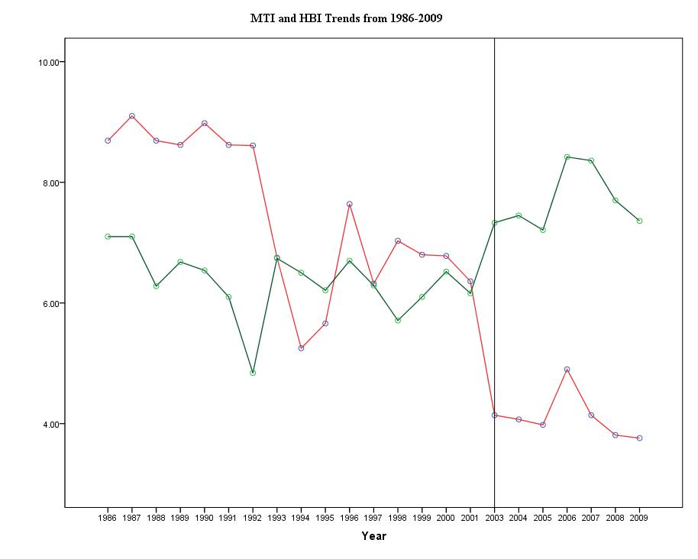
Restoration began in 2003

Slide 12
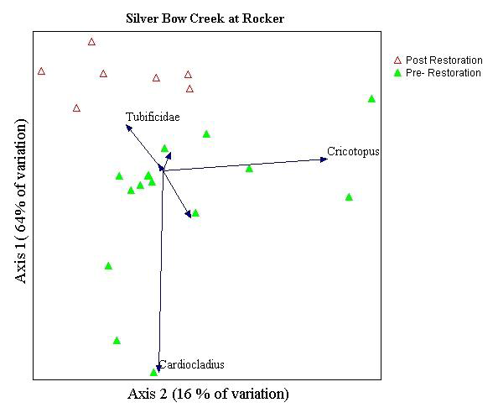
Community Composition
Principal components analysis of Silver Bow Creek data
showing separation between pre and post restoration communities

Slide 13
Indicator Species Analysis
Autecology of the Taxa associated with each restoration group are consistent with conditions present pre and post restoration
(Red: metals tolerant; Green: nutrient tolerant; Orange: early colonizers)

Slide 14
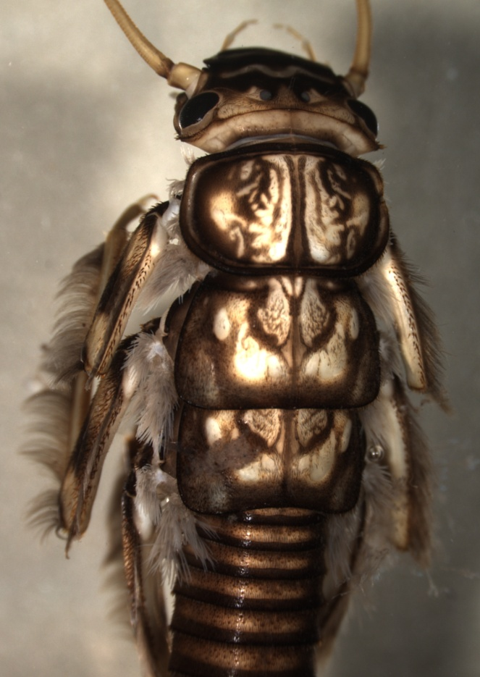
Conclusions
Data Rarefaction Appropriate for these analyses
Trend Analysis
  Montana Revised Valley/Foothill Index (Bollman 1998)
    No Significant Difference between Pre & Post Restoration
  Metals Tolerance Index ( McGuire 2001 )
    Significant Difference Between Pre and Post Restoration
    Positive Response
  Hilsenhoff Biotic Index ( Hilsenhoff 1975)
    Significant Difference Between Pre and Post Restoration
      Suggests increased response to Nutrients and other organic inputs
Community Composition
  Principle Components Analysis indicates:
  6 most common taxa may be driving the taxonomic differences
  Relative Abundances showed:
  shifts in dominant taxa groups and Functional Feeding Groups
  Indicator Species Analysis (ISA) concluded:
  Most significant IS were indicative of conditions suggested in metric analyses
  Note: Most significant IS have strongest indicator values with significant p values

