Slide 1
Redefining Dilution
An Alternative to Traditional Wastewater Treatment
Heath N. Carey, Dr. Cory Cleveland, Dr. Steve Running and Dr. Garon Smith

Slide 2
“According to the EPA, without substantially increasing investment and treatment efficiency, by 2025 U.S. waters will again suffer from sewage-related pollutant loadings that are as high as they were in 1968—the highest in our nation’s history”
(Dorfman, 2004)

Slide 3
“Nationally, wastewater treatment plants rank second [in the top ten major pollution sources to surface water], after agricultural runoff.” (Dorfman, 2004)

Slide 4
A unique situation
How do waste water treatment plants address increasing populations while meeting the ever changing limitations set forth by the EPA?

Slide 5
Additions?

Slide 6
Technological Fixes
Membrane filters
Phosphorus harvesting
Advanced oxidation

Slide 7
Concerns
Unreasonably high pretreatment requirements
Unrealistic lowered throughputs
All of which require an economic input equal to that presented by additional plant construction

Slide 8
The Big Question
How do smaller communities with less financing cross the gap?

Slide 9
Woodburn, Oregon

Slide 10
Will this work in Montana?
3 Main Questions:
Can we establish a tree plantation in this location? Which species?
How will the soils be affected?
How will the groundwater be affected?

Slide 11
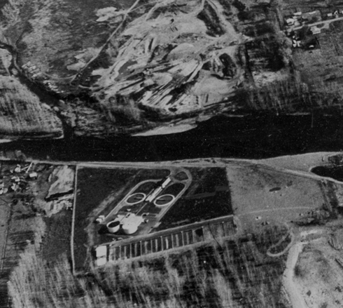
Land History
Historical dump site
1980’s staging area for MWWTP initial upgrade

Slide 12
2003 Staging Area for latest Plant Upgrade

Slide 13
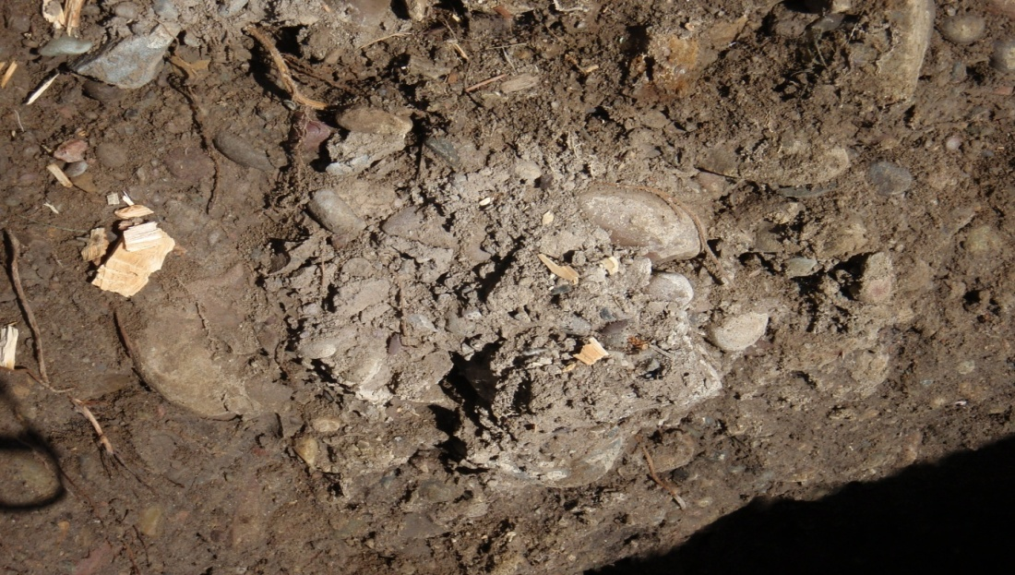
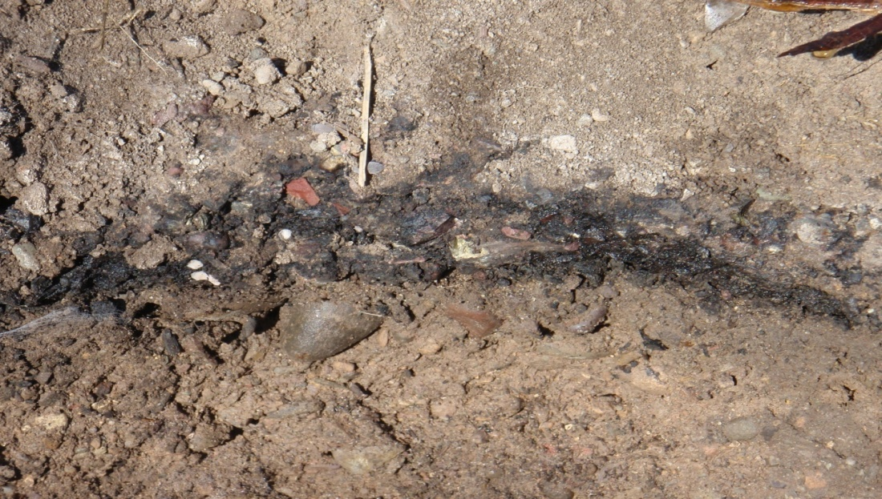
Initial Site Characteristics
High compaction rates
High disturbance (trash)
Low organic material
Low water holding capacity
Low cation exchange capacity

Slide 14
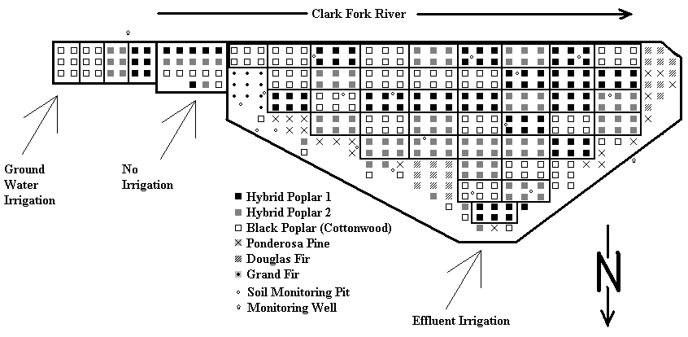

Slide 15
May 9, 2009
May 5, 2009 Planting Begins

Slide 17
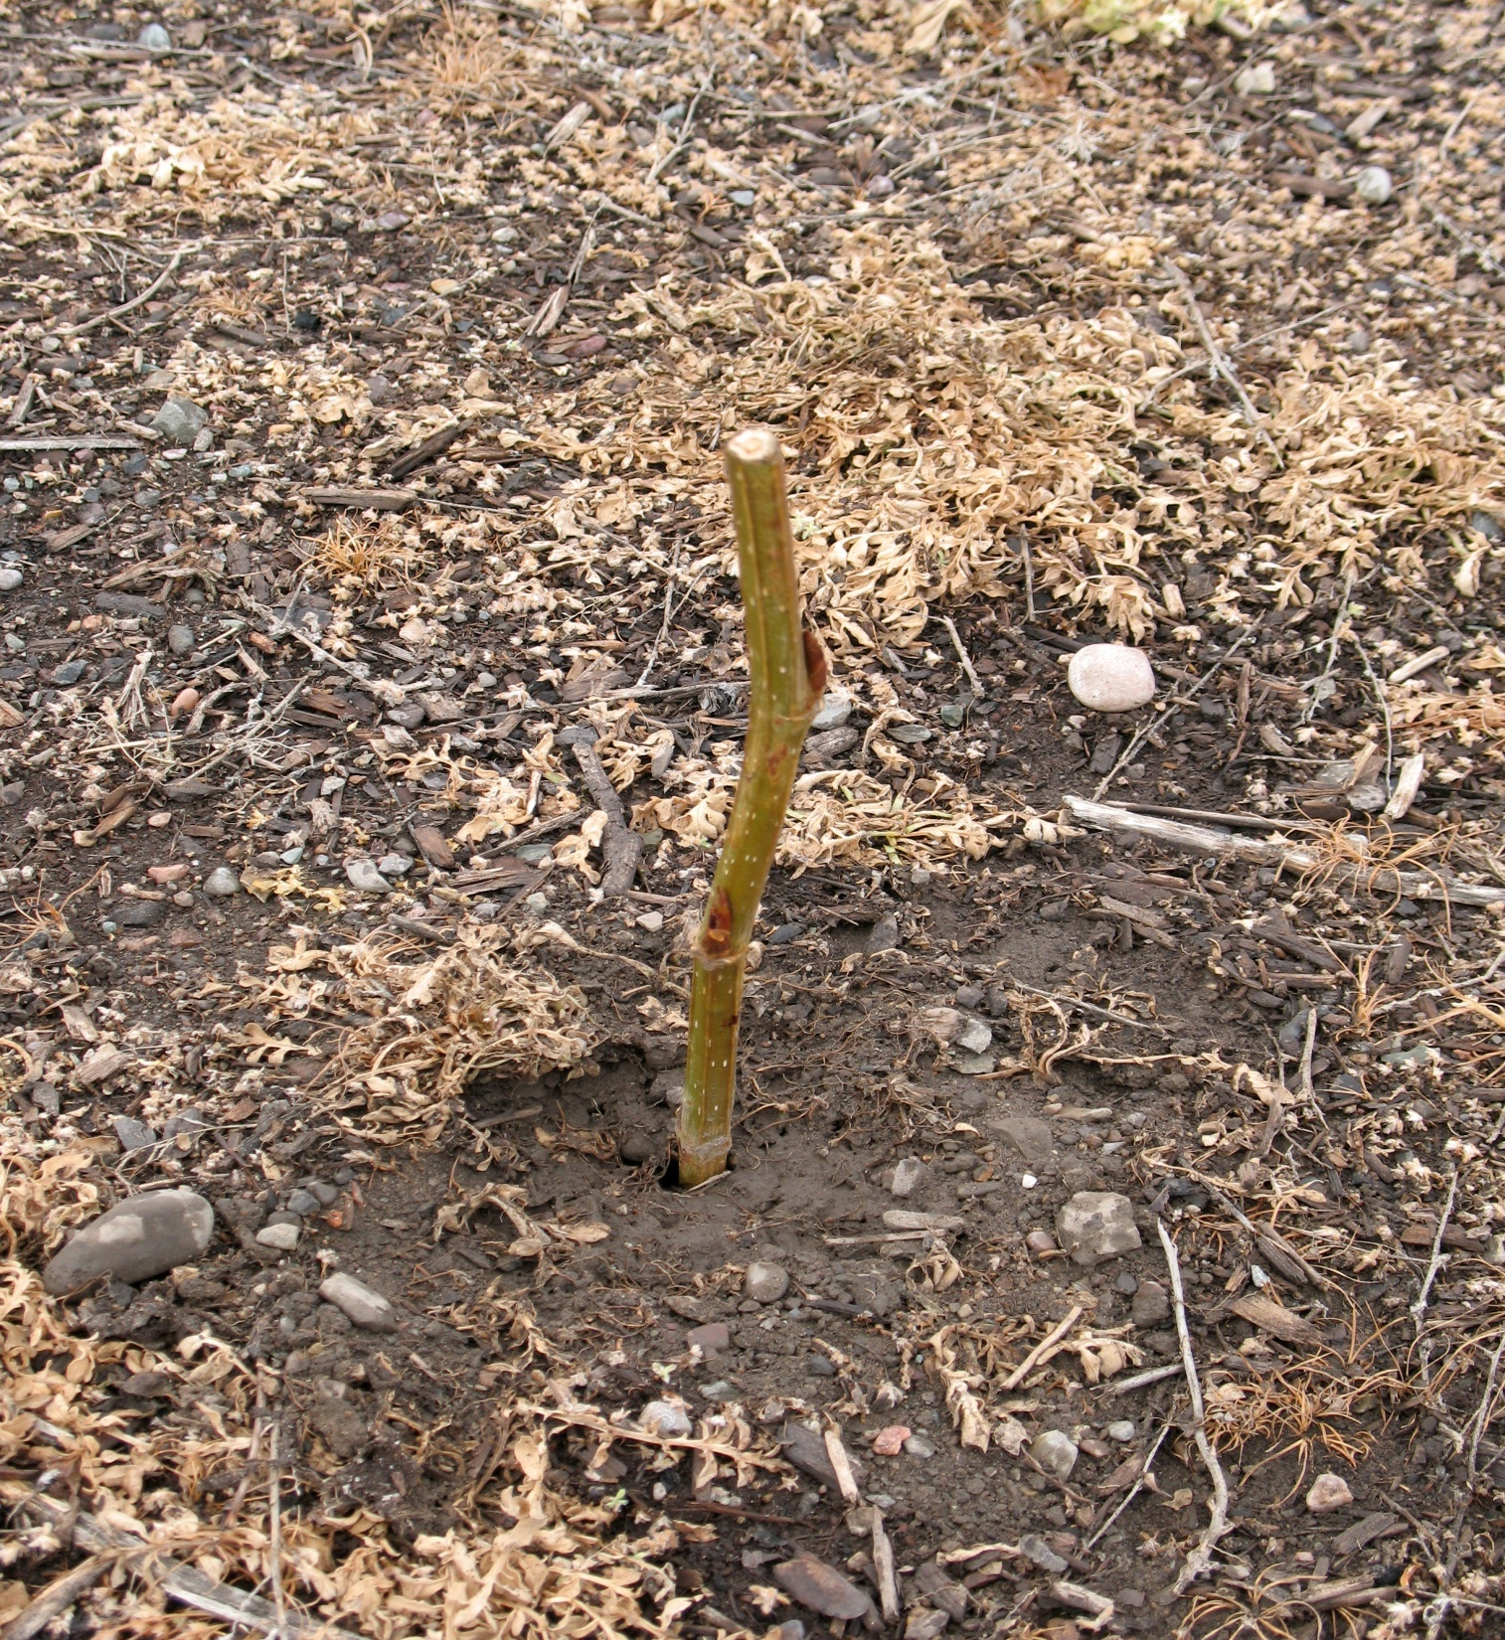

Slide 21
July 4, 2009

Slide 22
July 29, 2009

Slide 23
July 17, 2009

Slide 24
August 23, 2009

Slide 25
Weeding

Slide 33
Side note: The recent early freeze will provide additional survival data

Slide 36
Soil Monitoring

Slide 37
8-Apr-09 3-June-09 8-Sept-09

Slide 38
8-Apr-09 3-June-09 8-Sept-09

Slide 39
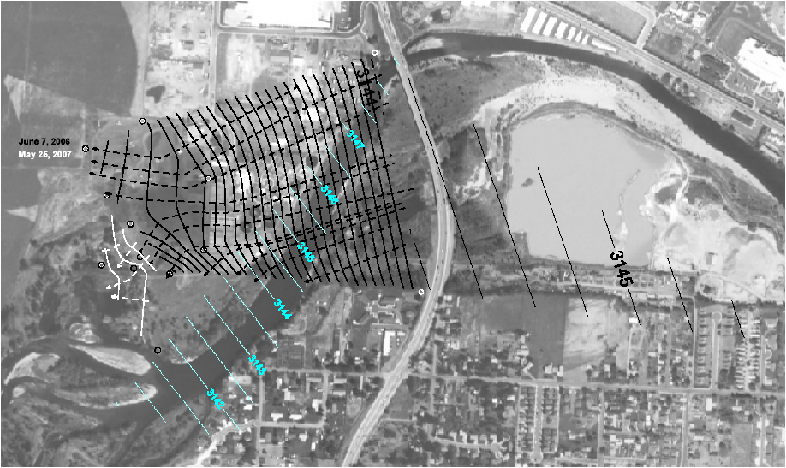
Provided by U.S. Farm Services Agency, National Agricultural Imagery Program (NAIP) and edited by Donna Smith, University of Montana

Slide 42
The Next Step
Continued monitoring
Expansion
Increase density of trees

Slide 43
Richter et. al. (2009) Wood Energy in America

Slide 44
CO2 Sequestering
Gasol et. al. estimates Net Present Value of assimilated biomass power plants to increase by 9 to 190% with the addition of CO2 credit sales; however, these are projected for large plantations (4,700+ ha).

Slide 45
Collaboration
Collaborative efforts offer the possibility of a permanent solution:
- Increased biomass production
~ 100% methane capture and reuse
~ 100% nutrient removal

Slide 46
Questions
Acknowledgments: The City of Missoula; Mayor John Engen; Starr Sullivan; Jim Cook, Able Tree Service; Tom McCamant; Jon Leff; Sasha Reed; Arlin Bird; Kat Kaufman; Aaron Mihelish; Allissa Corrow; Dylan Goldey; Aaron Flesch; Evan Guzik; Laurel Aroner; Maria Garcia; Erica Hefty; Angela Meyer; Cassie Hemphill; Gary Longsine; Rachel Jennings; Ian Jennings; Peter Orr; Adam Kenmir; Chris Carlson; Heidi Davidson; Matt Young; Dr. Heiko Langner … and many others.

