Slide 1
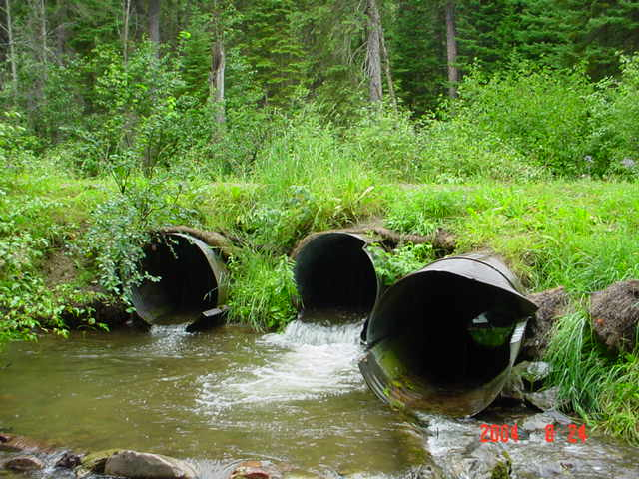
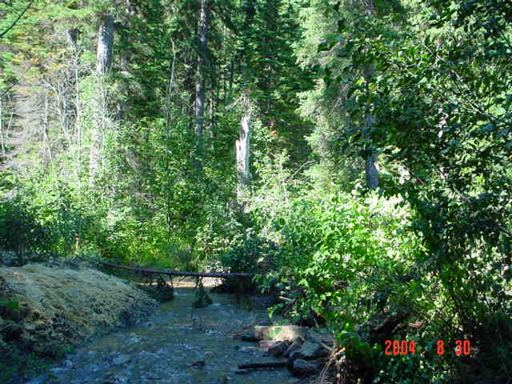

Watershed Restoration on the Lolo NF
Benefits for the Clark Fork Watershed
Taylor Greenup, Hydrologist, Lolo National Forest
Jennifer Mickelson, Fisheries Biologist, Lolo National Forest
Swartz Creek
Missoula RD

Slide 2
Overview
Lolo NF within the Clark Fork watershed
Forest Restoration Objectives and Priorities
Project Planning, Implementation, and Tracking
Highlight Project:
Upper Lolo Creek Road Reclamation

Slide 3
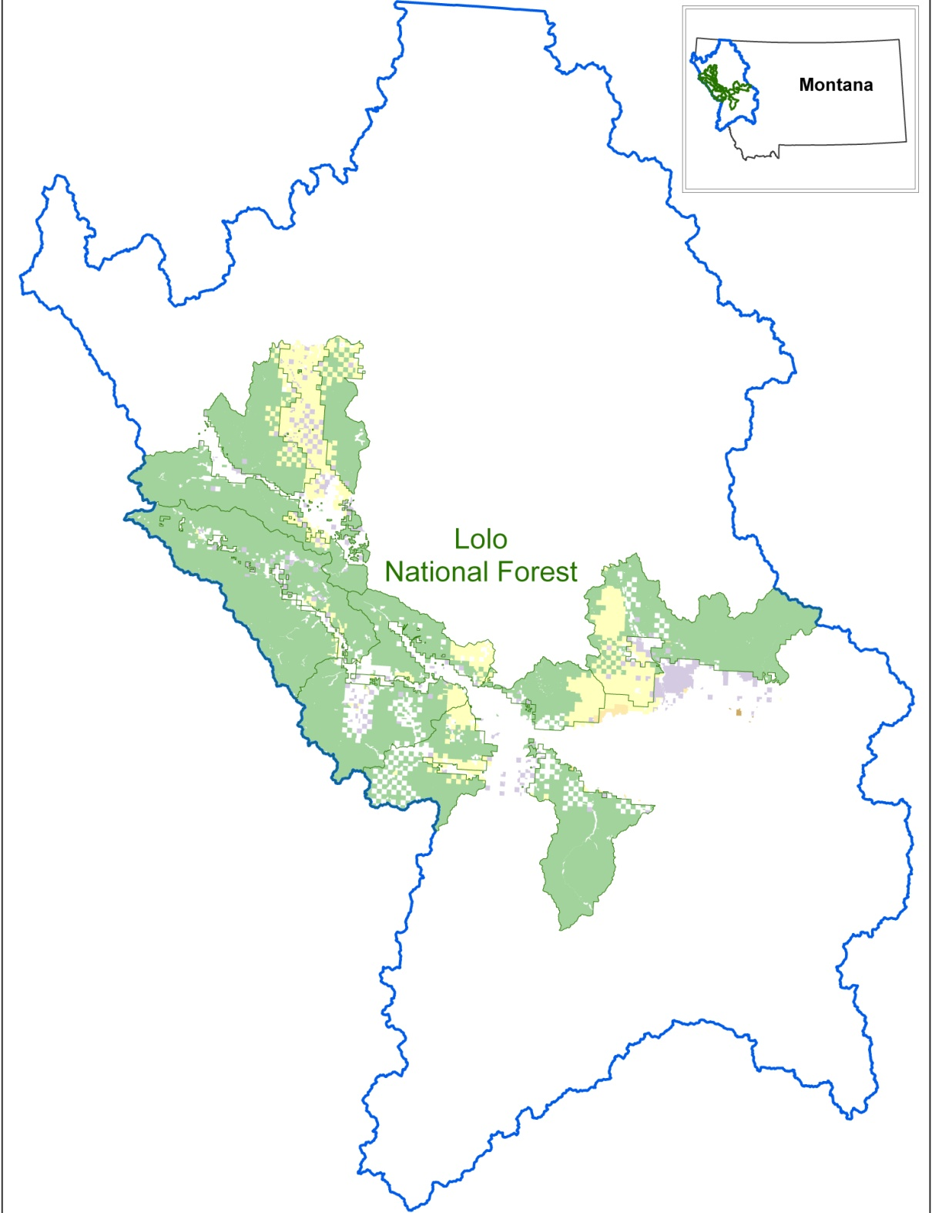
Lolo NF
Watershed Facts
2 million acres
4 million acre-feet/yr est. mean annual contribution to water supply (Brown and Froemke, 2009)
Headwaters
Blackfoot River
Bitterroot River
Middle Clark Fork
St. Regis River
Thompson River

Slide 4
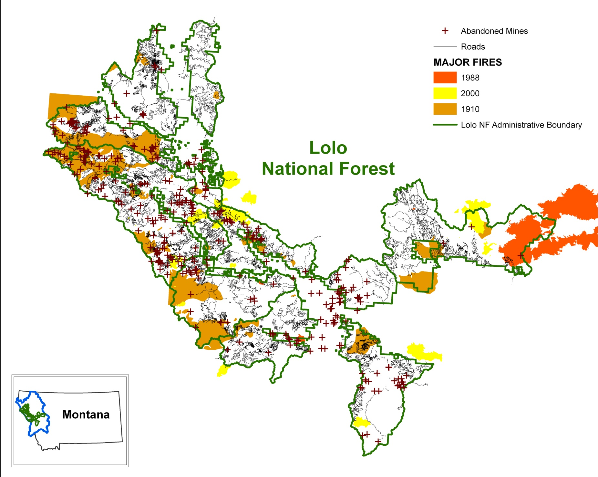
Forest Watershed Impacts

Slide 5
Watershed Restoration
Returning an undesirable existing condition to a desired future condition at a defined scale.
  i.e. Sediment levels, road density, stream crossing, instream channel parameters (width, depth, bank stability), fish populations, etc.
  Mitigation – to lessen in force or intensity; make less severe (Webster 1995)

Slide 6
Restoration on the Forest
Multiple sources for direction:
  Lolo National Forest Plan and INFISH
  Northern Region Restoration and Protection Strategy “Restoration and maintenance of high value watersheds in a properly functioning condition.”
  Montana State Water Quality Plans
  Threatened and Endangered Species Conservation

Slide 7
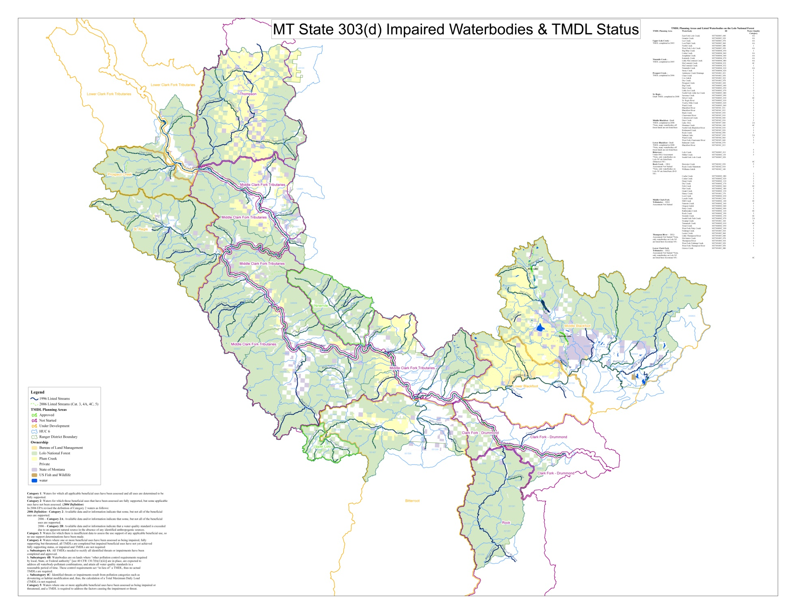
Restoration Prioritization

Slide 8
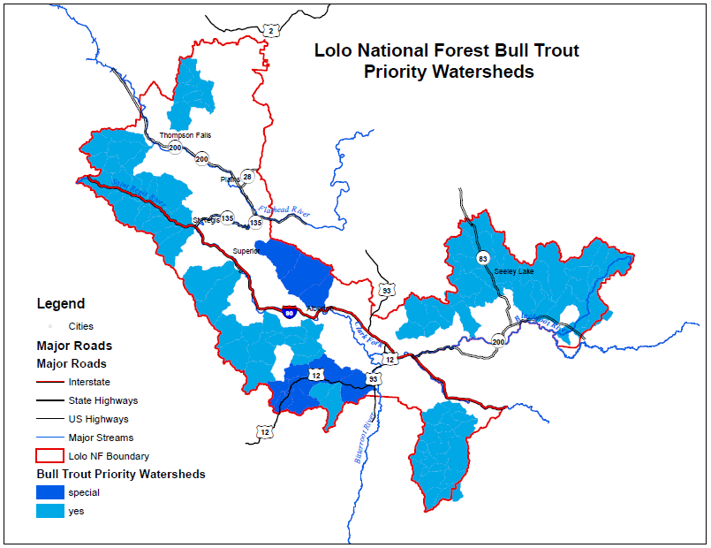
Restoration Prioritization

Slide 9
Forest Project Planning and Implementation
NEPA:
  5 Year Planning Process
    Typically integrated, large-scale projects
    Reviewed annually
  Small projects
    Tend to be resource specific
    Often involve partners for watershed restoration
Funding
Contracting

Slide 10
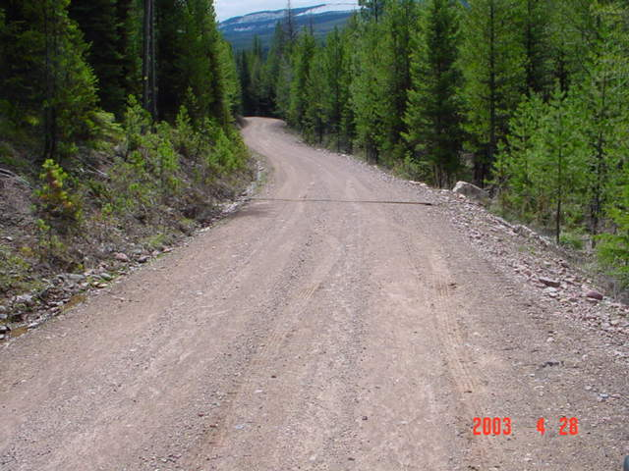
Road Maintenance
Cost Range:
Blading - $300/mi
Rolling - $100 - 180/mi
Brushing - $335 to 780/mi
Rip Rap - $500 to 1,000/struct.

Slide 11
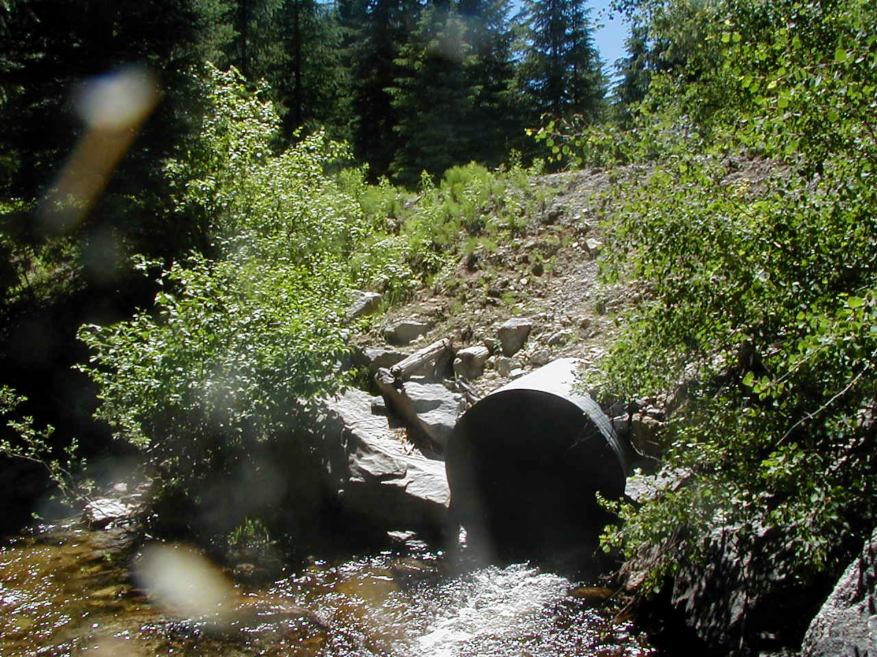
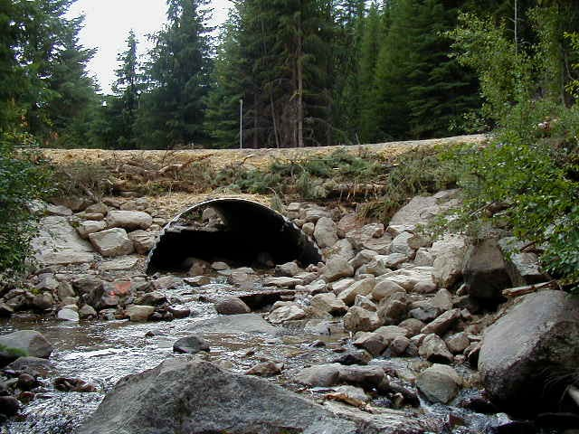
Aquatic Passage
Cost range from $25,000 – 125,000

Slide 12
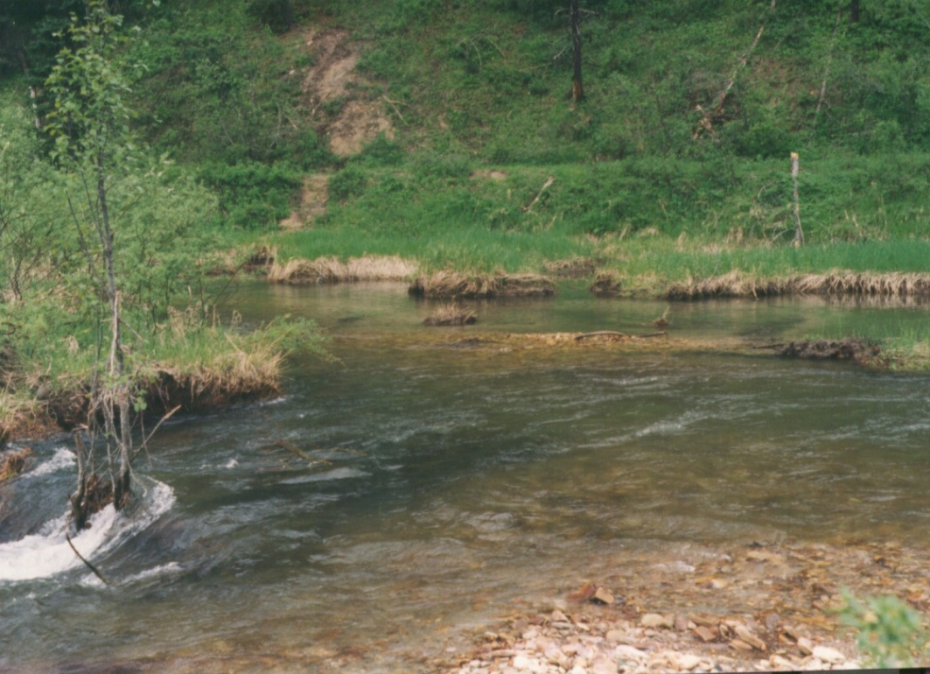
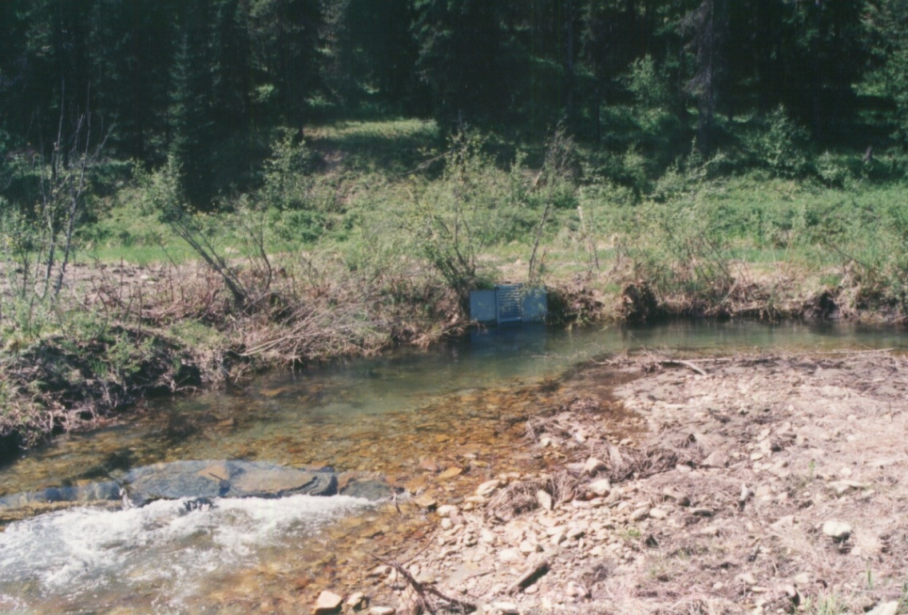
Stream Restoration
  Cost range from $264,000 - $528,000/mi

Slide 13
Lolo National Forest
Watershed Improvement Tracking
Forest Activities Tracked:
Stored, Decommissioned and Re-located Roads and Trails
Stored and Decommissioned Road-Stream Crossings
Upgraded Road-Stream Crossings for AOP & Q100
Stream Restoration Sites
Abandoned Mine Reclamation Sites
Fish Screen Locations
Other: land/stream acquisition, etc.
Costs and Funding Source

Slide 14
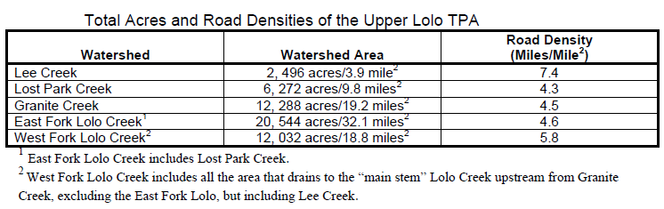
Highlight Project:
Upper Lolo Watershed Restoration
Coordinated assessments for the Upper Lolo TMDL (2003)

Slide 15
Upper Lolo Watershed Restoration
Goal: “to improve water quality and aquatic habitat by reducing the amount of non-natural sediment delivered to streams by forest roads”
NEPA completed and Decision Notice signed in 2005. Commitment:
  Remove or replace 22 culverts
  Decommission 58 miles of roads
  BMP upgrades to 35 miles of major roads

Slide 16
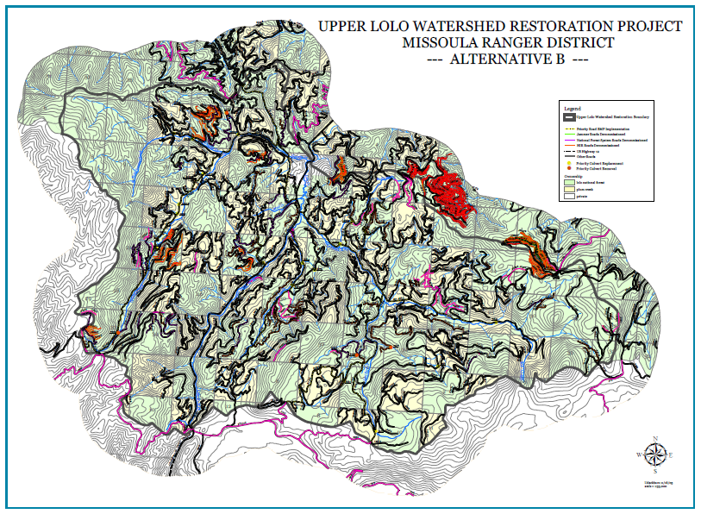

Slide 17
Upper Lolo Watershed Restoration
Partnerships:
Montana Trout Conservancy
Westslope Chapter of Trout Unlimited
Work to Date:
    2007:
    Level 3 Decommissioning: 5.78 miles
    Level 3N Decommissioning: 11.08 miles
    Level 4 Decommissioning: 0.45 miles
    Level 5 Decommissioning: 0.79 miles
    Total Number of Culverts Removed - 13
    Miles of Upstream Habitat Made Accessible - 2.18 Miles
    Total Cost - $171,000 (11,000 NFWF and 161,000 NFVW)

Slide 18
Upper Lolo Watershed Restoration
Work to Date, continued:
    2008:
    Level 3 Decommissioning: 36.64 miles
    Level 3N Decommissioning: 18.39 miles
    Level 4 Decommissioning: 5.79 miles
    Level 5 Decommissioning: 4.07 miles
    Total Number of Culverts Removed - 37
    Miles of Upstream Habitat Made Accessible - 10.24
    Total Cost - $168,993 all NFVW

Slide 19
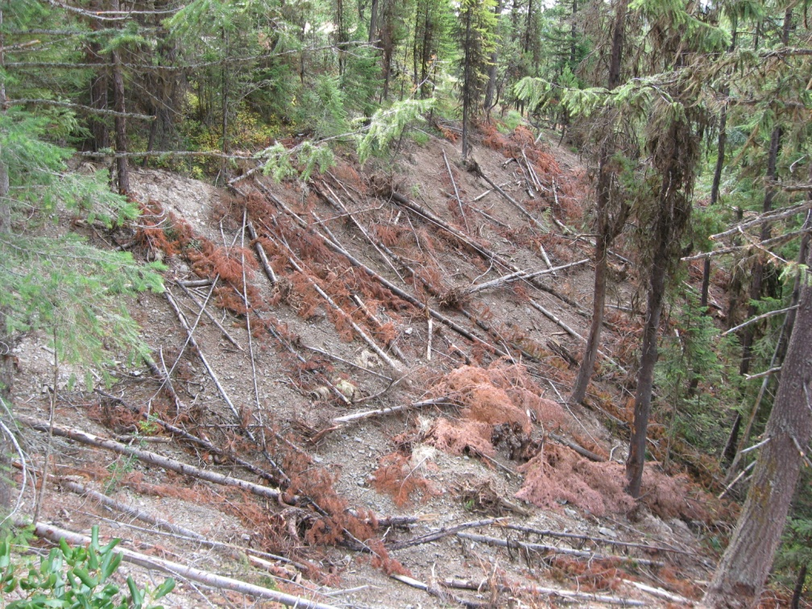
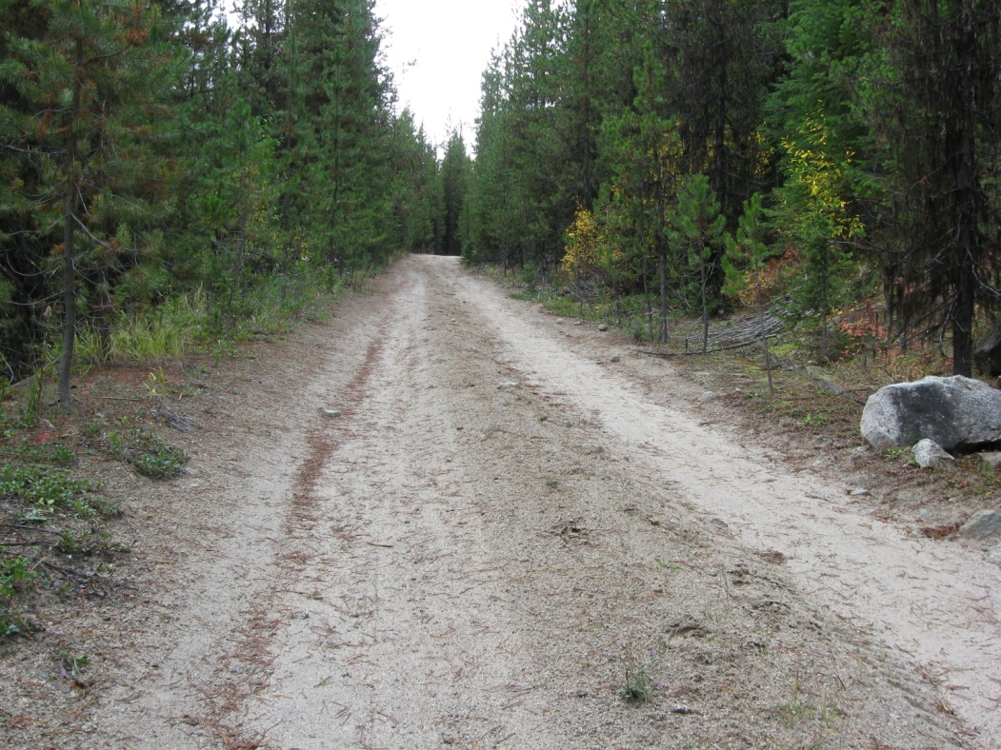
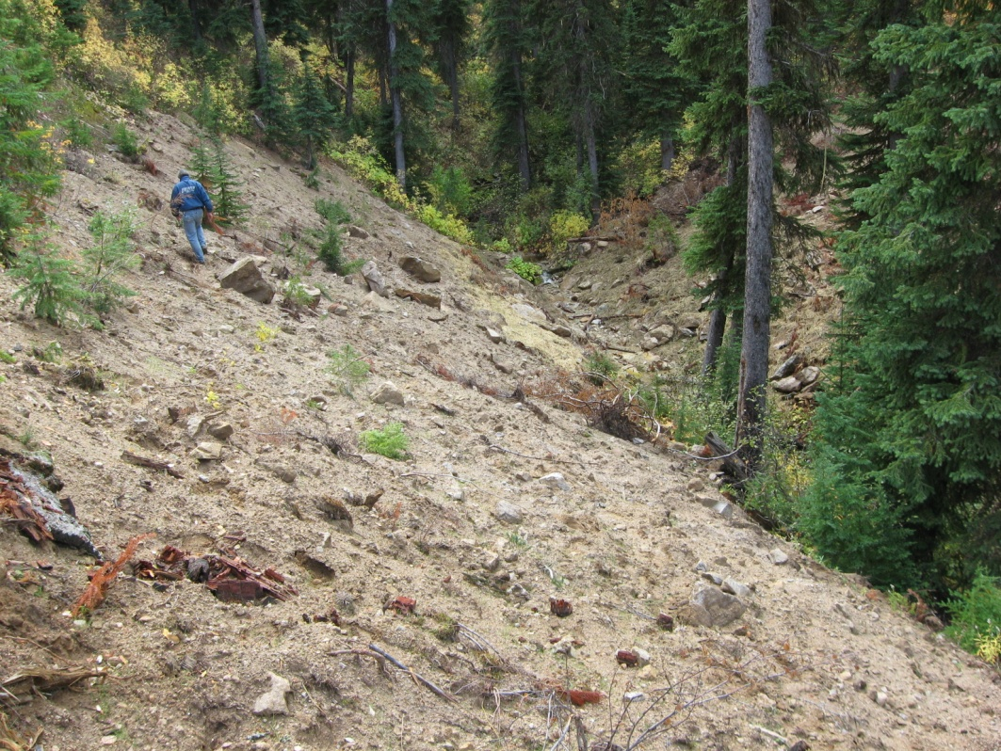
Upper Lolo Watershed Restoration
Road Decommissioning

Slide 20
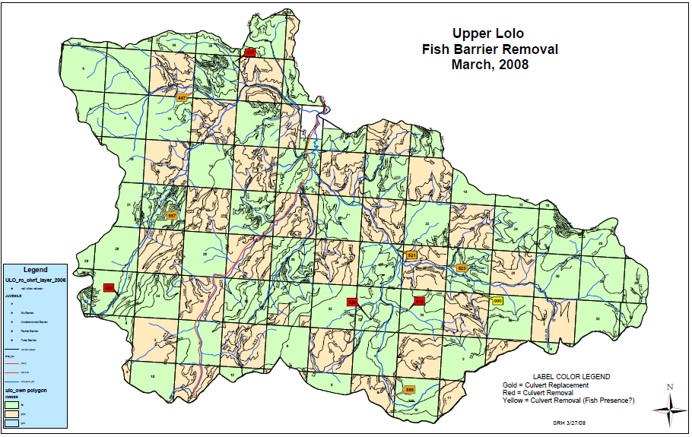

Slide 21
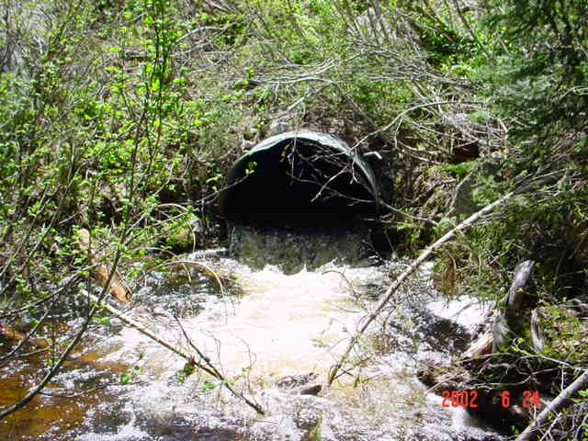
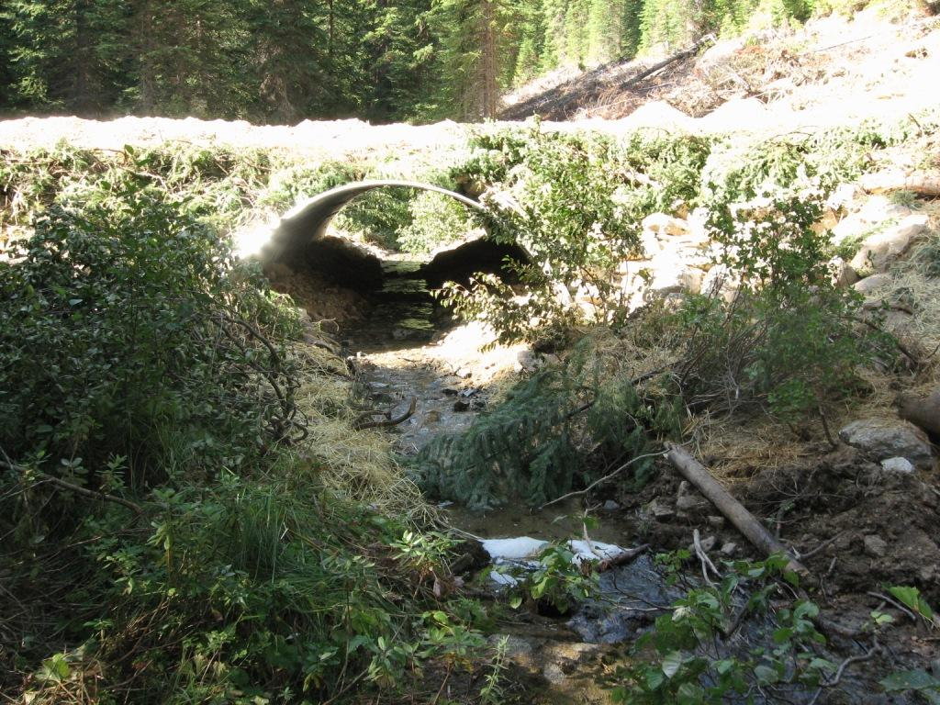
Upper Lolo Watershed Restoration
Culvert Upgrades
Aquatic Organism Passage
Q100 flows
Unnamed Tributary to Lost Park Creek

Slide 22
Upper Lolo Watershed Restoration
What remains:
    Complete remaining culvert removals/upgrades
      11 culverts to open ~12 miles of fish habitat
    Implement remaining road BMP upgrades
Future Needs in the Upper Lolo:
    Assessment and probable restoration of former Plum Creek lands

Slide 23
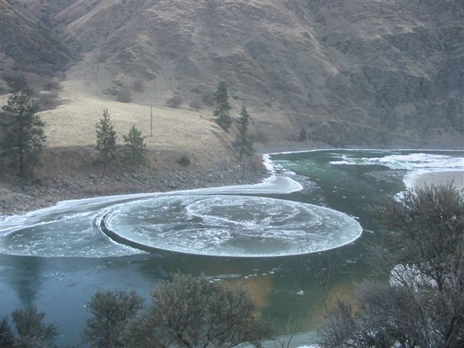
Questions?
Taylor Greenup, Hydrologist
Lolo National Forest
406-329-3949
tgreenup@fs.fed.us
Jennifer Mickelson, Fisheries Biologist
Lolo National Forest
406-826-4350
jmickelson@fs.fed.us

