Slide 1
20 Years of Water Quality Status and Trends in the Clark Fork-Pend Oreille Watershed 1984-2004
John Babcock, Bruce Anderson, and Gary Ingman,
Land & Water Consulting/PBSJ
and
Vicki Watson, UM Watershed Health Clinic

Slide 2
Tri-State Water Quality Council History & Mission
• Formed in 1993 to address interstate water quality issues in the three-state watershed
• Primary interstate issue is nutrients & eutrophication
• Secondary issue is heavy metals toxicity
• Mission: …”Citizens, business, industry, government and environmental groups are united”…”to improve water water quality”… ”through mutual respect, collaboration, science and education.”

Slide 3
Tri-State Water Quality Council Management Goals
• Control nuisance algae in the Clark Fork by reducing nutrient concentrations
• Protect Pend Oreille Lake by maintaining or reducing nutrient loading from the Clark Fork R.
• Reduce near-shore eutrophication in Pend Oreille Lake by reducing non-point nutrient loading
• Improve Pend Oreille River water quality through aquatic weed management and tributary non-point source controls

Slide 4
Tri-State Water Quality Council Management Plan Elements
• Basin-wide nutrient management plan
• Clark Fork voluntary nutrient reduction plan (VNRP)
• MT-ID Pend Oreille Lake nutrient loading agreement
• Pend Oreille Lake management plan (TMDL)
• Public involvement & education
• Basin-wide monitoring plan

Slide 5
The Clark Fork-Pend Oreille Watershed
• 26,000 mi.² drainage area
• includes Clark Fork of the Columbia River, Pend Oreille Lake, Pend Oreille River
• includes 2 EPA Regions, 3 states, 14 counties, several Indian reservations

Slide 7
Monitoring Program Goals
Clark Fork River –
• Nutrients - evaluate time trends and spatial variation
• Periphyton - evaluate time trends
• Mid-summer Targets - evaluate compliance with nutrient concentration targets

Slide 8
Monitoring Program Goals
Pend Oreille Lake –
• Nutrient Loads - estimate annual nutrient loads via Clark Fork River
• Periphyton - evaluate time trends for near-shore algae
• Secchi Disc - evaluate time trends for Secchi transparency
Pend Oreille River –
• Nutrients - evaluate time trends

Slide 9
Water Quality Trends Analysis
• 20-year data set available from Tri-State Council and former MT DEQ monitoring programs
• evaluation scheduled to coincide with 10-year anniversary of tri-state management plan
• results will be used to evaluate progress &
adjust management plan

Slide 10
Monitoring Locations
Clark Fork River – 32 total stations
5 headwater stations (above Warm Springs)
15 mainstem stations
12 tributaries
7 monitored for algae
5 monitored for summer nutrient targets
Pend Oreille River – 2 stations

Slide 12
Monitoring Parameters
Nutrients
Total Phosphorus (TP)
Total Nitrogen (TN) (TKN + NO₂+NO₃)
Soluble Reactive Phosphorus (SRP)
Total Soluble Inorganic Nitrogen (TSIN) (NO₂+NO₃ + NH₄)
Metals
Total Recoverable Copper (Cu)
Total Recoverable Zinc (Zn)
Algae
Chlorophyll A (chla)
Ash Free Dry Weight (AFDW)
Flow (CFS)

Slide 13
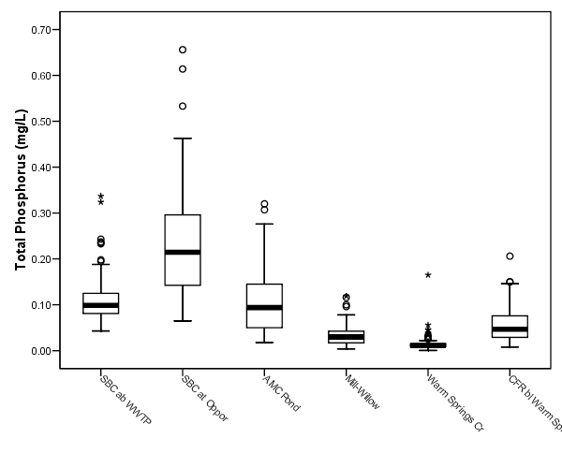
Total Phosphorus – Upper Watershed

Slide 14
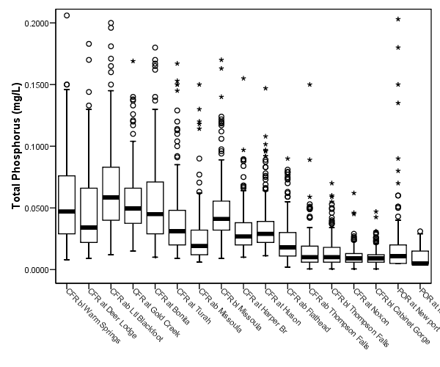
Total Phosphorus – Clark Fork Mainstem

Slide 15
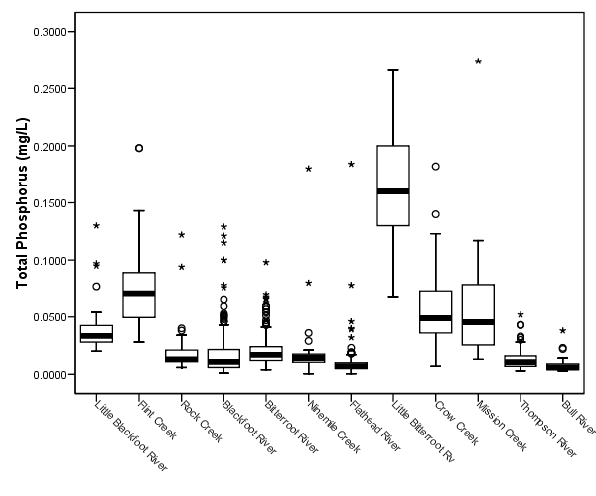
Total Phosphorus – Tributaries

Slide 16
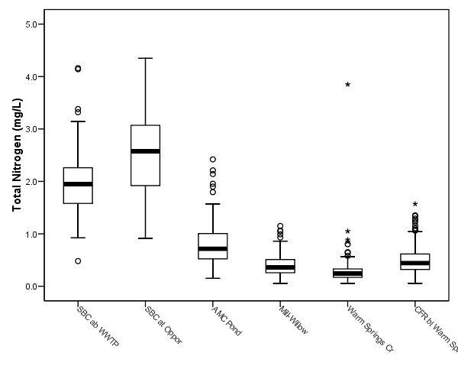
Total Nitrogen – Upper Watershed

Slide 17
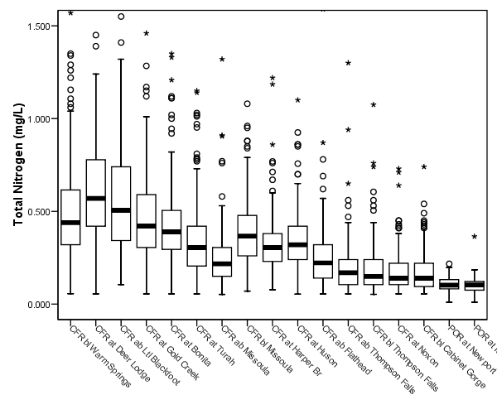
Total Nitrogen – Clark Fork Mainstem

Slide 18
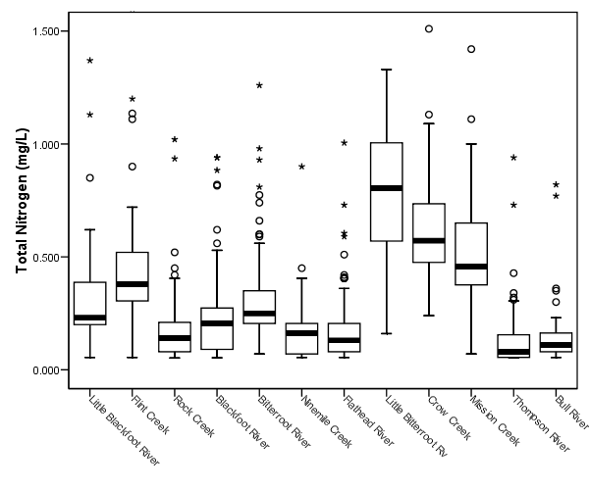
Total Nitrogen – Tributaries

Slide 19
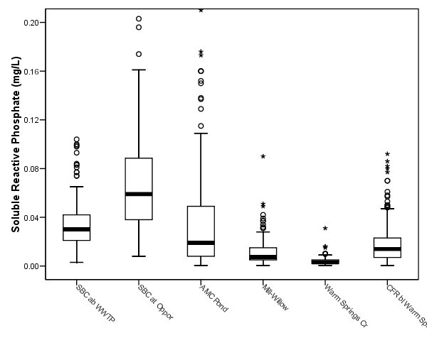
Soluble Reactive Phosphorus – Upper Watershed

Slide 20
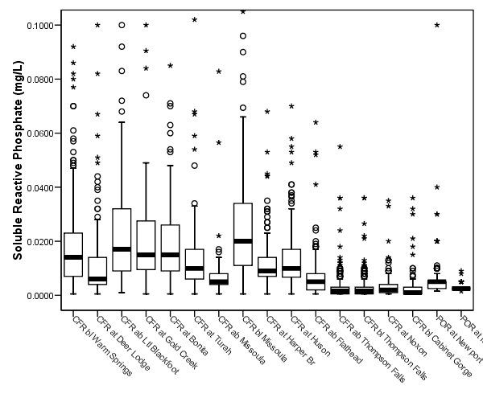
Soluble Reactive Phosphorus – Clark Fork Mainstem

Slide 21
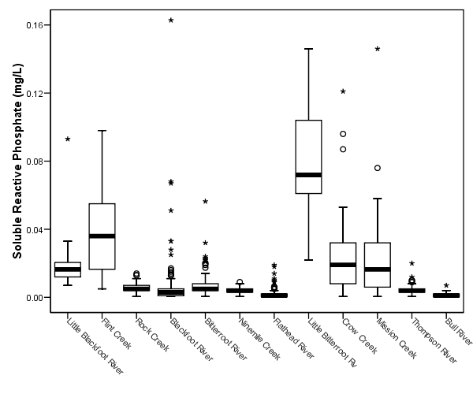
Soluble Reactive Phosphorus – Tributaries

Slide 22
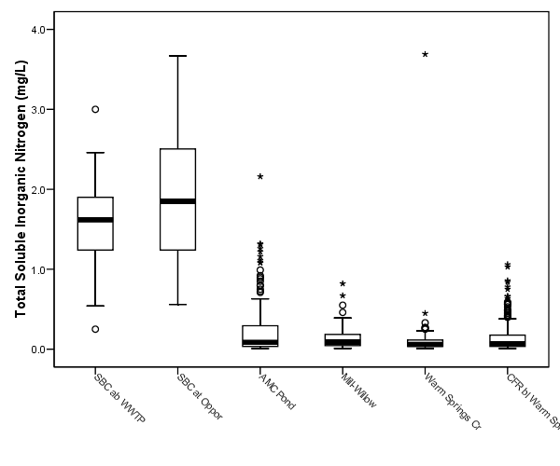
Total Soluble Inorganic Nitrogen – Upper Watershed

Slide 23
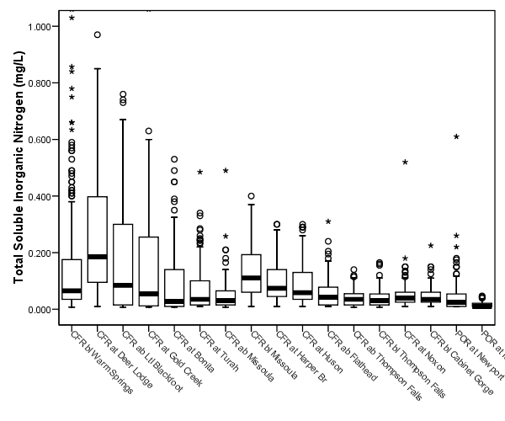
Total Soluble Inorganic Nitrogen – Clark Fork Mainstem

Slide 24
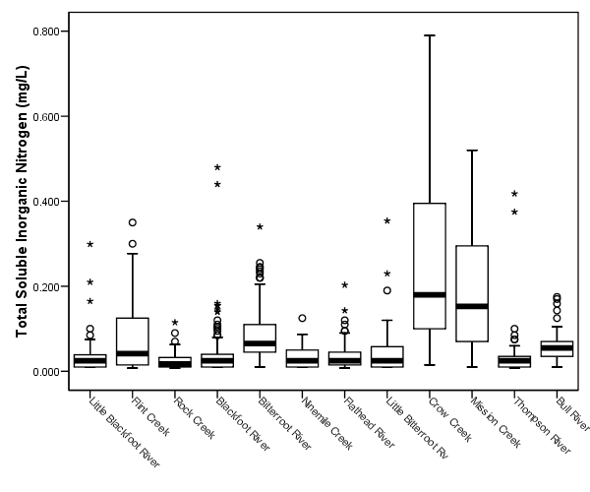
Total Soluble Inorganic Nitrogen – Tributaries

Slide 25
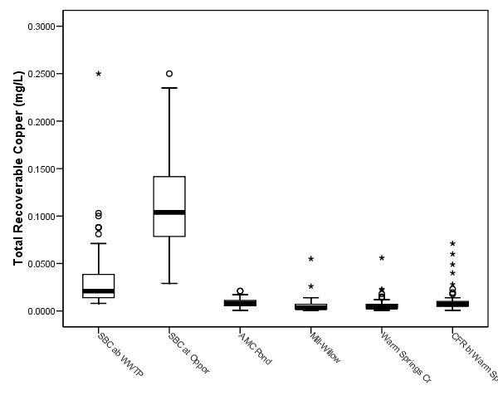
Total Recoverable Copper – Upper Watershed

Slide 26
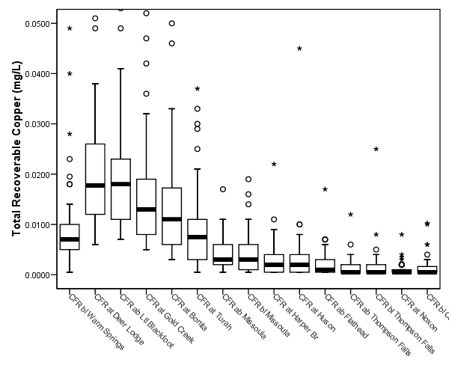
Total Recoverable Copper – Clark Fork Mainstem

Slide 27
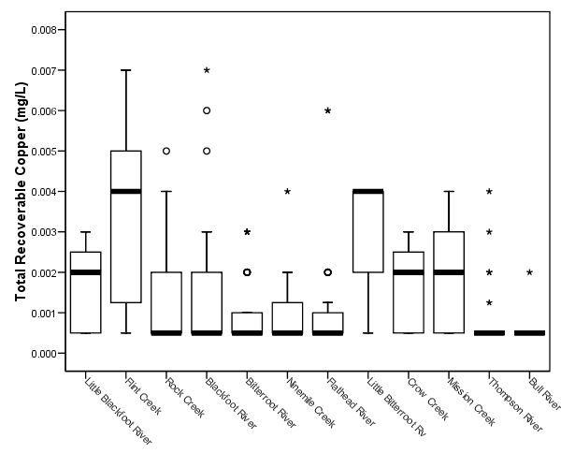
Total Recoverable Copper – Tributaries

Slide 28
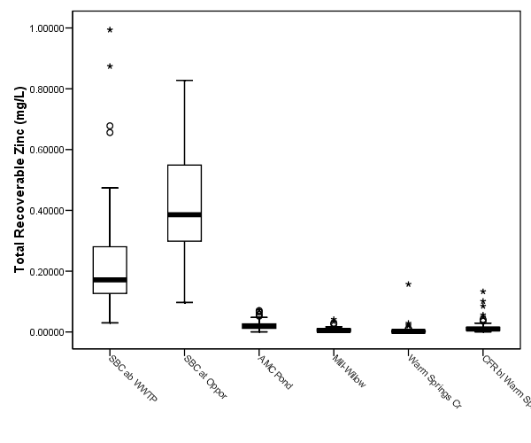
Total Recoverable Zinc – Upper Watershed

Slide 29
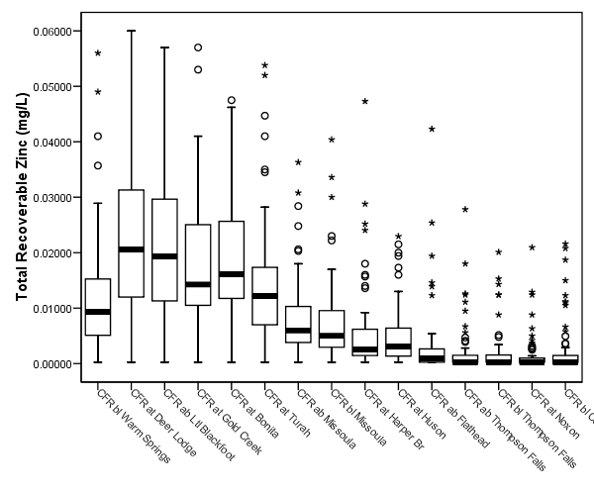
Total Recoverable Zinc – Clark Fork Mainstem

Slide 30
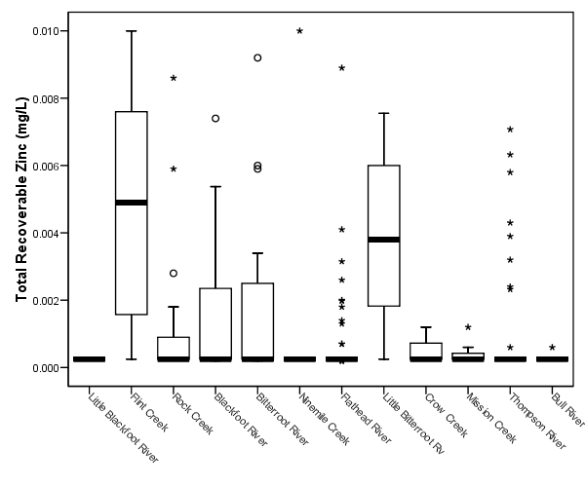
Total Recoverable Zinc – Tributaries

Slide 31
Clark Fork River Nutrient Trend Detection
Management Goal: | Improve water quality
Monitoring Goal: | Detect significant trends in nutrient concentrations
Water Quality Parameters: | Total phosphorus, total nitrogen, soluble reactive phosphorus, total soluble inorganic nitrogen
Statistical Methodology: | Seasonal Kendall with Sen slope estimate
Statistical Hypothesis: | Ho: No trend exists Ha: Trend exists
Data Analysis Result: | Conclusions regarding presence of trends; Provide estimate of trend magnitude
Information Product: | Management goal met when no trend exists, or indicates improvement

Slide 32
Number of Statistically Significant Parameter/Flow Correlations
 | Positive (+) | Negative (-) | % Significant
Total Phosphorus | 21 | 0 | 63%
Total Nitrogen | 13 | 4 | 52%
Soluble Nitrogen | 3 | 11 | 42%
Soluble Phosphorus | 14 | 2 | 48%
Total Copper | 20 | 0 | 61%
Total Zinc | 14 | 0 | 42%
Flow | 3 | 9 | 36%

Slide 33
Statistically Significant Trends
 | Positive (+) | Negative (-) | % Total
Total Phosphorus | 2 | 13 | 44%
Total Nitrogen | 0 | 15 | 44%
Soluble Nitrogen | 14 | 2 | 47%
Soluble Phosphorus | 2 | 17 | 56%
Total Copper | 2 | 4 | 18%
Total Zinc | 1 | 6 | 21%

Slide 34
Statistically Significant Trends Upper River
Station | TP | TN | SRP | TSIN | CU | ZN
Silver Bow Cr ab Butte WWTP | + |  | + |  | - | -
Silver Bow Cr at Opportunity | + |  | + |  | - | -
AMC Pond 2 Discharge | - |  | - |  |  | -
Mill-Willow Bypass | - | - | -
Warm Springs Cr near mouth |  | -

Slide 35
Statistically Significant Trends Clark Fork Mainstem
Station | TP | TN | SRP | TSIN | CU | ZN
below Warm Springs | - | - | - | - |  | -
above Deer Lodge |  | - | - |  | - | -
below Deer Lodge | - | - | - |  |  | -
Gold Creek | - | - | - |  | -
Bonita |  |  | -
Turah |  | - | -
above Missoula |  | -
below Missoula | - |  | - | +
Harper Br. | - |  | - | +
Huson | - | - | - | +
above Flathead | - | - | - | +
above Thompson Falls |  | - | - | +
below Thompson Falls |  |  | - | +
Noxon | - |  |  | +
Cabinet Gorge |  | - |  | +
POR at Newport | - | - | - | -
POR at Metaline Falls

Slide 36
Statistically Significant Trends Tributaries
Station | TP | TN | SRP | TSIN | CU | ZN
Little Blackfoot River |  |  |  |  | +
Flint Creek
Rock Creek |  | -
Blackfoot River |  |  |  | + |  | +
Bitterroot River |  |  | - | +
Ninemile Creek |  |  |  | +
Flathead River |  |  |  | +
Little Bitterroot River |  |  | - | +
Crow Creek
Mission Creek |  |  |  |  | +
Thompson River | - | -
Bull River |  |  |  | +

Slide 37
Total Phosphorus – below Deer Lodge

Slide 38
Total Nitrogen – below Deer Lodge

Slide 39
Soluble Reactive Phosphorus – below Deer Lodge

Slide 40
Total Soluble Inorganic Nitrogen – below Missoula

Slide 41
Total Recoverable Copper – Silver Bow Creek above Butte WWTP

Slide 42
Total Recoverable Zinc – Silver Bow Creek above Butte WWTP

Slide 43
Periphyton Monitoring

Slide 45
Clark Fork River Nuisance Algae
Management Goal: | Control Nuisance Algae
Monitoring Goal: | Detect significant trends in attached algae
Definition of Water Quality: | Chlorophyll a (mg/m2)/Ash Free Dry Weight (g/m2)
Statistical Methodology: | Kendall with Sen slope estimate
Statistical Hypothesis: | Ho: No trend exists Ha: Trend exists
Data Analysis Result: | Conclusions regarding presence of trends; Provide estimate of trend magnitude
Information Product: | Management goal met when slope indicates improvement

Slide 46
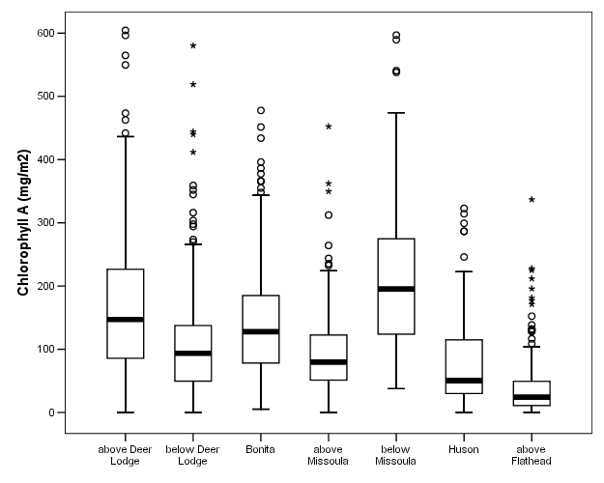
Clark Fork Periphyton – spatial trends

Slide 47
Statistically Significant Trends - Chlorophyll A and AFDW
Site | Chlorophyll a | Ash Free Dry Weight
Above Deer Lodge
Below Deer Lodge |  | -
Bonita | + | +
Above Missoula | + | +
Below Missoula | + | +
Huson | +
Above Flathead |  | -

Slide 48
Periphyton Target Attainment
Station | % Sample Events below Target Mean (100 mg/m2) | % Sample Events below Target Maximum (150 mg/m2)
Above Deer Lodge | 30 | 30
Below Deer Lodge | 60 | 80
Bonita | 50 | 60
Above Missoula | 70 | 90
Below Missoula | 40 | 50
Huson | 80 | 90
Above Flathead | 90 | 100

Slide 49
Summer Nutrient Targets
Primary Targets
Total Nitrogen: All Stations = 300 μg/L
Total Phosphorous: Upstream of Missoula = 20 μg/L
Total Phosphorous: Downstream of Missoula = 39μg/L
Secondary Targets
Total Soluble Inorganic Nitrogen = 30 μg/L
Soluble Reactive Phosphate = 6 μg/L

Slide 51
Summer Nutrients 1998-2002 - Number of Years below Target
Station | TP | TN | SRP | TSIN
Silver Bow Creek ab WWTP | 0 | 0 | 0 | 0
Clark Fork bl Warm Springs | 0 | 0 | 0 | 0
Clark Fork ab Ltl Blackfoot | 0 | 1 | 0 | 2
Clark Fork bl Missoula | 1 | 0 | 0 | 0
Clark Fork at Huson | 3 | 0 | 0 | 0

Slide 52
Summer Nutrients 1998-2002 - Percent of Samples below Target
Station | TP | TN | SRP | TSIN
Silver Bow Creek ab WWTP | 0% | 0% | 0% | 0%
Clark Fork bl Warm Springs | 6% | 61% | 6% | 55%
Clark Fork ab Ltl Blackfoot | 4% | 50% | 9% | 70%
Clark Fork bl Missoula | 65% | 37% | 17% | 4%
Clark Fork at Huson | 90% | 70% | 54% | 19%

Slide 53
Statistically Significant Trends Based on Summer Data
Station | TN | TP | SRP | TSIN
Silver Bow at Opportunity
Clark Fork bl Warm Springs | - | - | - | -
Clark Fork ab Ltl Blackfoot | - | - | -
Clark Fork bl Missoula |  | - | - | -
Clark Fork at Huson |  | - | - | -

Slide 54
Conclusions – Clark Fork River
Nutrient and metal concentrations are generally high in the upper watershed, and decrease downstream
Approx. ½ of stations show significant trends for nutrients, less for metals
TP, TN, and SRP are decreasing throughout the watershed in response to management activities
TSIN is increasing in localized areas in response to development activities
Metals are decreasing in the upper watershed

Slide 55
Conclusions – Clark Fork River
Summer nutrient concentrations are approaching targets but are not yet in compliance at most stations
Trend slopes suggest targets will be attained at most stations within a few years
Attainment of periphyton standing crop targets has been highly variable by year and location
Periphyton standing crops have shown an increasing trend at some locations
Prevailing drought conditions have likely contributed to this pattern

Slide 56
Connecting the Feedback Loop
• Results will be used to fine-tune VNRP assumptions & management actions
• Documentation of emerging problems will be focal point for future planning
• Results will support MT DEQ’s basin-wide TMDL allocation process
• Results will be used to fine-tune & optimize future monitoring

Slide 57
Lessons Learned
• consistent, long-term data sets are invaluable!
• good data helps build trust among stakeholders & depoliticizes water quality issues
• documentation of successes encourages participation, facilitates sponsorship, & provides basis for giving credit to partners
• early detection of emerging problems – “an ounce of prevention”
• despite the best monitoring design efforts, the answers won’t always be cut & dried – fine-tuning through an active feedback loop will always be needed

Slide 58
www.tristatecouncil.org

