Slide 1
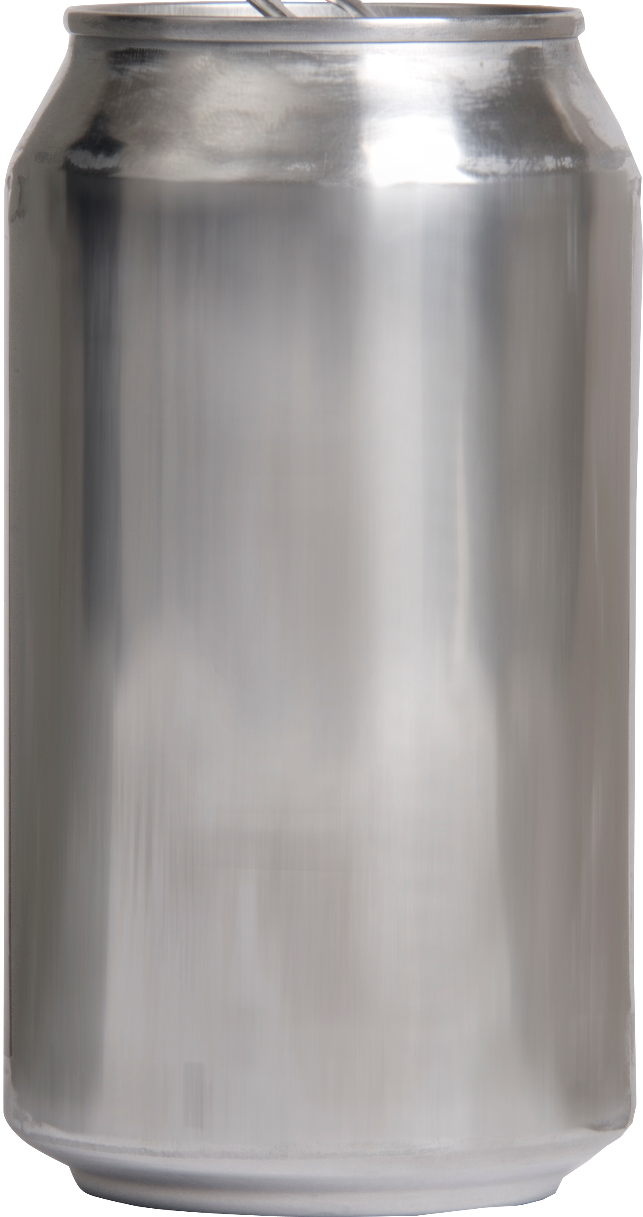

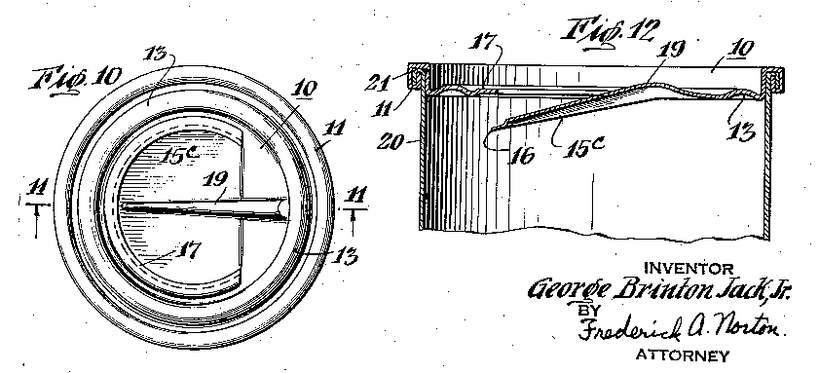

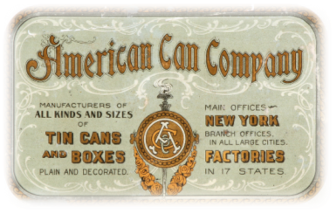





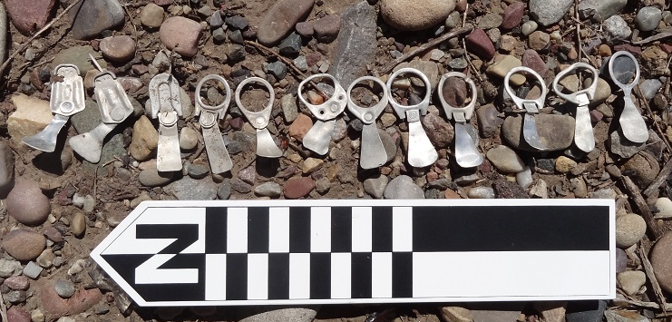
A Clino-cladistic Look at
Pull & Push Tab Patents
ca.1950-1980
William D. Schroeder, M.S., R.P.A., PhD candidate—University of Montana; Cultural Heritage and Applied Anthropology
Abstract
Pull tabs revolutionized the way beverage cans and food containers were opened and their contents removed. Ermal Fraze is credited with this, yet he was not alone in the invention nor was he technically the first. Until recently, pull tabs were not considered diagnostic in Historical Archaeology because they had not yet met the 50-year-old threshold. As of 2015, ring pull tabs entered the historic era, yet relatively little is known about these artifacts. In order to place these artifacts in terminus ante and post quem timeframes for historical archaeologists who have located and will more frequently encounter these items of disposable material culture, a database with hyperlinks has been built to provide an archival reference. There are hundreds of patented variations and manufacturing methods in the United States Patent and Trademark Office filed and accepted between ca.1950 and 1980 yet really only two geni—pull and push, and four species—"snap top," ring pull, stay-tab, and push button. Taking a cue from biology, the inventions were arranged by family based on the first instance of a morphological characteristic (clade) and by progenitors (inventors) then put in numerical/chronological order based on their patent or design filing and/or acceptance dates (cline) thereby generating a genealogy or family tree thereby charting their evolution. Not all patents or designs saw nationwide production or distribution; some never saw production. Not all patents, designs, or innovations are represented here. And, one should keep in mind the “time lag” between a patent’s filing, patent pending production, and its official acceptance. Products also had a use life and disposal period that often extended past its manufactured date range. Functional ease, compatibility with can manufacturing machinery, reduction of harm, and externalities also influenced the food and beverage container industry to “build a better mousetrap.” Then there’s “Sister Frange”….
195O
Key-wound tear strips were first used to provide a convenient means of opening sealed tin-plated steel food canisters in 1866. Over 100 tin manufacturers incorporated as the American Can Co. (ACCO) in 1901. Edwin Norton—a canner since 1868—renamed the Norton Tin Can and Plate Company and founded Continental Can Co. in 1904, the second largest can manufacturer in the US¹. National Can Co., founded in 1929, became the third largest. The US Government sued the American Can Co. in 1913 stating the “Tin Can Trust” restrained trade and arbitrarily fixed prices and so should be dissolved². All three restructured, renamed, and re-branded several times. All three devised means of opening can ends more reliably, easier, and safer.
Push Family
Pull Family
“Frange” Family
George B. Jack, Jr. filed US patent 2,261,117 in June, 1939 and was accepted in Nov., 1941. His closure member included “integral tabs or tongues adapted to be manually or digitally depressed …to permit access to the contents,” and was assigned to US Can
Corp. though never saw production.
Julius Edward Selliken (1907-1991) may have only produced this one patent in 1939 (US 2,153,344). Army Infantry Corporal Selliken was captured by Nazis and sent to Stalag 3C near Alt Drewitz, Prussia during WW II. Selliken lived to a ripe old age of 109. Selliken should be credited with being the progenitor of the pull tab; Ermal Fraze referenced this patent in 1963.
Ayers Houghtelling is better known for his allegorical paintings, architecture, and NASA illustrations than his beverage can opening patent. In 1959, US patent 2,870,935 was assigned to actress Suzanne Kaaren Blackmer who was noted for being an original Rockette and having acted with Bela Lugosi and The 3 Stooges.
Ermal “Ernie” Cleon Fraze founded the Dayton Reliable Tool and Manufacturing Co. in 1949. Legend has it that Fraze invented the pull tab out of frustration and necessity while on a camping trip in 1959. There had to be an easier way to open a beverage can than with a church-key opener.
Over 75% of US beer producers adopted Fraze's can by 1965. John S. Bozek and John Henchert of the Continental Can Co., William E. Taylor of the American Can Co., and Daniel Cudzik of Reynolds Aluminum Co. improved on Fraze’s patents and were his strongest competitors in opening means and designs. An exemplar from the first six-pack of Iron City Beer produced in 1963 featuring the new “Easy-open can” manufactured by the Aluminum Company of America (Alcoa, Inc.) is held in the Wright State University archives along with bench drawings and other Ermal Fraze memorabilia³.
Pull solid
1955
Austin L. Morrill and John P. Kelly of Raytheon Manufacturing Co. felt in 1955 that “some type of tab must be attached to [a] strip or formed integral with it so that the key can be fitted over the tab and turned to tear out the tear strip as the key is rotated about is own axis and moved along the can’s surface,” and “it is evident that such a waste can be substantial,” and “is particularly useful for vacuum packed coffee cans where a vacuum tight seal is desired until the can is opened for the first time and then a replaceable top is desired.”
(US patent 2,806,628; accepted 1957)
John E. Walsh produced several inventions and designs for the United Shoe Machinery Corp. (USMC) along with his son, John E. Walsh II, and grandson, John E. Walsh III. The USMC fought repeated court cases involving the purchase of foreign-made equipment and then claiming new ideas based on them. The USMC was also subject to Sherman Anti-Trust Act violations as a shoe industry monopoly. This design from 1963 had a rhombus-shaped tear strip and
a ring pull (US 3,084,835).
¹https://www.britannica.com/biography/Edwin-Norton.
²New York Times. November 30, 1913. Retrieved on February 24, 2017.
This design was assigned to Louis Fried and was based on the previously filed US patent 2,790,577 and Australian patent AU 19,570,2674, a container top and opener, in 1953. James J. Walsh, Jr. was a General Manager of Sales at Bethlehem Steel during his lengthy career. It is not known if Ralph D’Andrea and Louis Fried also worked there and created inventions with Walsh.
l96O
³www.libraries.wright.edu/special/collectionguides/files/ms447.pdf
Pull solid
Pull ring
USD 199596 S
USD 199597 S
In 1965, Ermal Fraze responded to public concern and comment that his original invention was too sharp; discarded pull tabs had cut feet and hands. Fraze redesigned his tear strip to have softer edges and the can top featured raised beads “…to serve a desirable degree a guard means for contact with the user’s lips in the event that the user elects to drink the liquid directly out of the can.” Note similarity to Bozek’s designs for the U-tab.
Ermal Fraze designed an “ornamental” closure with a tear strip opener in 1963
(USD 195,604 S) with a term of 14 years which revolutionized beverage cans. Carl A. Huth of ACCO patented an almost identical tab to Fraze’s in 1965 (US 3,225,957), yet the tab is angled. William E. Taylor also invented “the same” angled tab tear strip for ACCO and published it as US 3,244,315 in 1966. Fraze responded with another very similar tab design featuring an elliptical rivet and a bulb opening (US 3,237,744) in 1966.
USD 199822 S
USD 200883 S
USD 201647 S
Responding to safety concerns, Fraze’s Dayton Reliable Tool & Manufacturing Co. designed a better beverage can opening device in 1965 which resembles Selliken’s and John E. Walsh’s patents except that the ring pull is attached to a bung as opposed to being a solid metal ring or being soldered in place. Little is known about Omar L. Brown except he stayed in Dayton, OH until his death in 1999 at the age of 98. Brown provided Fraze’s company with numerous designs
and patents which were mesne assigned to Ermal Fraze including the “Pull Tab for a
Tear Strip Opener” (USD 203,080 S).
l965
John S. Bozek invented and designed several can openers and closures for Continental Can Co. Design 199,596 was based on the shape of a garter supporter. Other designs featuring a solid riveted tab were called U-tabs because of their vernacular “U” shape. Bozek and Fraze competed neck and neck through the early 1960s for more efficient and utilitarian designs for beverage can opening devices.
Push Stay-tab
1970
Omar L. Brown should be given credit for having devised the first non-removable tab filed on October 13, 1967 (US 3,446,389). The idea underwent several refinements before it became a reliable opening means. Note the inward-folding triangular push panel of this patent. Later designs would feature round or oblong openings. Non-removable tabs and tear strips became a necessity for retaining valuable Aluminum.
Daniel F. Cudzik is credited for inventing the Easy-open Wall in 1972 (US 3,836,038). Cudzik referenced Fraze and Smith et al. in his patent. Cudzik designed for Reynolds Metals Co. and they became a competitor in the can market with the new apparatus in 1974. Cudzik donated a can to the Museum of Modern Art under Architecture and Design with Alcoa as the maker.
Charles S. Nissen and Robert P. Gatton of Rome City, IN filed patent design 206,500 for a Combined Can End and Tear Strip Opener accepted on Dec. 20, 1966. The new design featured a teardrop-shaped opening with a “softer” tear strip without sharp “pointed” edges. The teardrop shape would dominate the market until ca. 1975 when the Stay-tab was widely produced. Variations on the teardrop shape included
bowling-pin-shaped, propeller-like, “dog
bone,” and narrow rectangular tear strips
ca. 1968.
Omar L. Brown improved the beverage can opening experience as well as means with US patent 4,024,981; Ermal Fraze was assigned it in 1977. The new lift tab assembly was called an Easy-open Ecology End, more commonly referred to as a Non-detachable or Stay-tab.
Push button
1975
Ronald Pearce and Thomas Herrmann applied for US patent 3,886,881—method of making a press tab container end from a metallic shell—in late 1973. Only one shell of metal needed deformation to accommodate content release. Pearce and Herrmann’s coining process stretched and scored the aluminum making the tabs easy to manually depress—a little too easy in transport, and fingers sometimes were cut or got stuck. Nevertheless it was patented in 1975 and was quite memorable.
Alan G. Dalli, Michael Debenhaum, and Ralph E. Schackleford of the Broken Hill Proprietary Co., Ltd. of Melbourne, AUS received a US reissue patent 28,910 for Push-in Easy-opening Closures in 1976. American Can Co. produced its own version of the push tab type in the US and Canada concurrently. Plastic push tab lids were more widely manufactured than beverage can tops. Coors products were unpasteurized, kept cold, and not transported east of the Mississippi River until 1977 and popularized in the film Smokey and the Bandit.
In the summer of 2016, I was selected as the Summer Resources Intern at the Grand Teton National Park.
My assignment was to locate trace evidence of turn of the century Mormon and non-Mormon homesteads and settlements near the historic towns of Mormon Row and Kelly, WY within the park’s boundaries. I was also
tasked with locating previously unidentified irrigation network features that served the historic communities.
While attempting to locate an irrigation ditch, I happened upon an area near Kelly, WY which was used for generations as the “town dump.” Historic-era refuse before the Gros Ventre Slide of 1925 and Flood event
of 1927 was washed away from the landscape. Large scour marks from the flood created pockets
where refuse was later deposited until the 1990s when Park clean-up events took place.
The resultant archaeological concentrations chronicle a small community’s disposable
material culture from ca.1930 to 1990 and contains numerous food and beverage cans,
bottles, and other artifacts close to the surface. Having already devised a “key card” for
handy field reference of beverage can pull tab types, I was delighted to find a nearly
complete series of the most commonly and widely produced “snap top”
and ring-pull tab types.
The problem became apparent: How can one distinguish one type from another and how can they be chronologically ordered so that their historic or non-historic (or not yet historic) status can be discerned?
The only reliable form of information on this can be found in the United States Patent and Trademark Office (USPTO) records. There, the inventor(s), assignee(s), date of filing, date of acceptance, and any referenced, competing, or international patents and designs are all listed as well as full descriptions of the invention, innovation, or production method. The next task was to build a database of this information with images so that an artifact such as a pull tab or container end opener can be correctly identified and a date range ascribed. By searching the USPTO and Google Patents, I was able to locate predecessors and precursors that better elucidate the evolution of these innovations and inventions of material culture. Unfortunately,
few obituaries or biographies were written about the inventors and designers; only Ermal Fraze,
the purported inventor of the Snap Top and a prototype aluminum can donated to
the Museum of Modern Art by Daniel Cudzik stand out as testaments to the progenitors of
pop-tops. Often more is known about the factory or company than the employees
who made them successful.
1980
In evolutionary biological terms, there are two family lines based on morphological characteristics, i.e. clades: Pull and Push. There are four “species”: Pull solid, Pull ring, Push button and Push Stay-tab. (And then there’s “Frange.”) Their changes over time or historical trajectories might be said to constitute clines. I have arranged the evolution of beverage can opening means as if a genealogical family tree. There are hundreds of “patent children” that are not represented here; only the first patent (parent) for a particular “species” of opening type.

