Slide 1
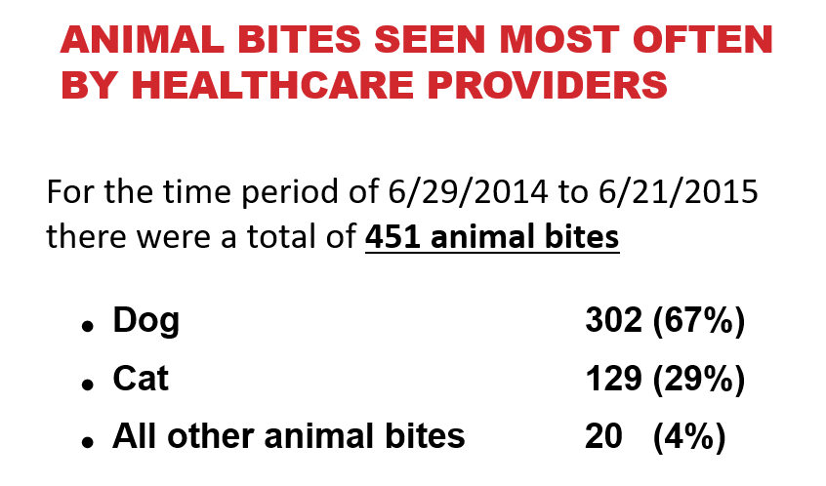
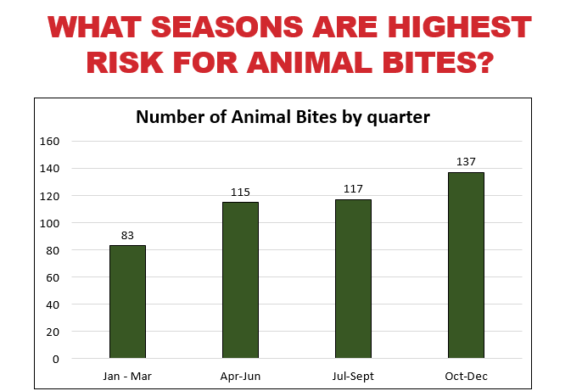
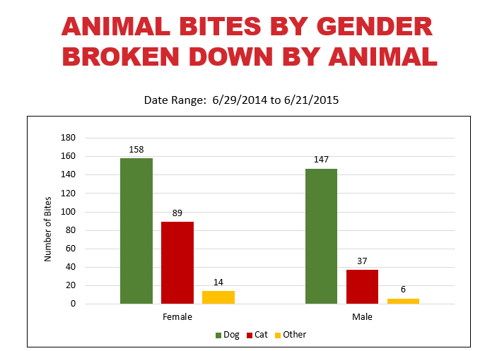
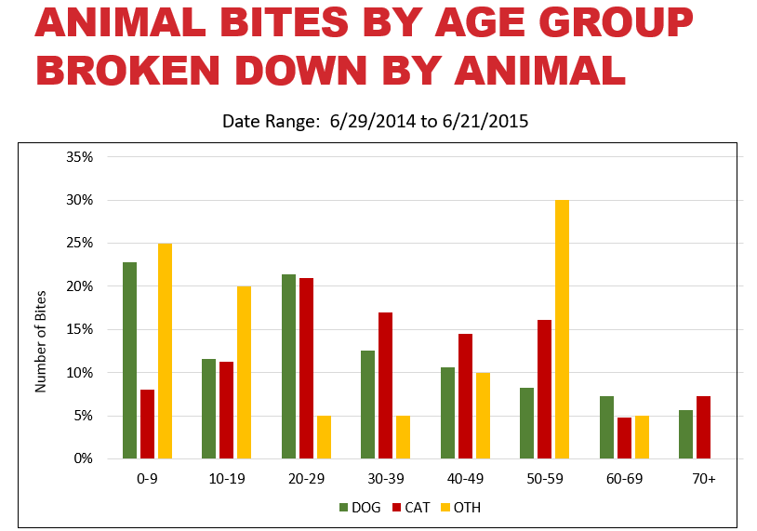
Taking a Bite out of Unwanted Data in the Animal Bite Syndrome
Erika R. Baldry¹, Jill K. Baber, MPH², and Tracy K. Miller, PhD²
School of Public and Community Health Sciences
University of Montana
Introduction
Epidemiology Profile
Summary
Purpose: To describe the data obtained from the pre-defined BioSense 2.0 “animal bites” syndrome and develop an improved syndrome for animal bite surveillance in North Dakota.
Methods:
Line list for “animal bite” visits from July 2014-June 2015 was created from BioSense 2.0 data.
Each entry was reviewed and coded as animal bite, not animal bite, or unknown. Animal bite types consisted of dog, cat or other.
Words that contributed to correct or incorrect data were noted and applied to a new syndrome definition.
The BioSense Animal Bite syndrome data included 1516 unique visits, representing 953 ED visits and 563 outpatient visits. Of all visits, 513 (34%) were identified as animal bites. Other visits included 604 insect bites, 33 human bites, 334 visits related to animal contact but unrelated to bites, and 32 unknown visits that referenced “bites” alone.
Although the BioSense 2.0 syndrome definition for animal bites excludes the term “insect” from chief complaint, 40% of our animal bite syndrome data was related to insect bites. For 95% of insect bites, a specific diagnosis code (E906.4) or diagnosis terms for insect bites was triggering the inclusion, with the remaining 5% of visits including the name of the insect (spider, mosquito, tick, wasp, bed bug, etc.).
Removing the E906.4 code and adding specific insects to the exclusion criteria, resulted in an 81% reduction in misclassification, while leaving the known animal bites (n=513) the same. This clean data was used to develop the Epi Profile.
Animal bites requiring most healthcare visits resulted from domestic dogs and cats. While dogs and cats are typically vaccinated against rabies, some are not or their vaccine history is unknown. It is important to monitor for these bites in order to determine a possible seasonality or increase in risk to gender or age.
Our hypothesis was that spring and summer months, when people are outdoors and are in possible contact with animals, are when more bites would occur. However, when looking at the data, one can see that most bites occurred from domestic pets during fall and winter months.
Syndrome Definitions
z
BioSense 2.0 Definition
Diagnosis: E906
Diagnosis Text: bite+animal, bite+snake, cat,
dog, rat bite
Chief Complaint Text: aldilla, animal, ara?a, bite-frost, cat, dog, gato, jelly fish sting, mangota, moridid, pica, picadura, rabies, raccoon, snake; exclude: insect
Revised BioSense 2.0 Definition
Diagnosis: E9060, E9061, E9062, E9063, E9065; exclude K09, E9068
Diagnosis Text: dog, rat, snake, lizard, bite+animal; exclude: dental
Chief Complaint: adilla, animal, cat, dog, jelly fish sting, rabies, raccoon, snake; exclude: insect, wasp, yellow jacket, hornet, tick, spider, mosquito, bug, fly, fall, fell, trip, scan, tongue, food, service, itch, allerg
Discussion
Animal bite data was analyzed by the gender of the people showing up at the emergency rooms as well as by the type of animal that caused the bite. As seen in the graph, dog bites made up the largest number of animal bites for both genders. Additionally, more females than males were bitten across all animal categories.
As with the previous graph looking at gender, we investigated the animal bite data and how it affected the different ages of people seeking care. As the graph shows, dog bites occurred more often among those under the age of 10 (23%), most cat bites occurred among those aged 20-29 (21%) and other bites occurred most often among those 50-59 (30%).
Several issues came to light during this evaluation:
When analyzing the animal bite data, insect bites were often found, further emphasizing the importance of an accurate syndrome.
Due to the lack of ranch animals in the original BioSense 2.0 definition, the need for regional syndromes need to be considered. In 2014/2015, relative to cats and dogs, there were more rabid cows and horses reported to the ND Dept of Health. The need for ongoing evaluation of this syndrome will be important to assess risk.
Institutions: 1. University of Montana, Missoula, MT, United States. 2. North Dakota Department of Health, Bismarck ND, United States.

